Slide 1
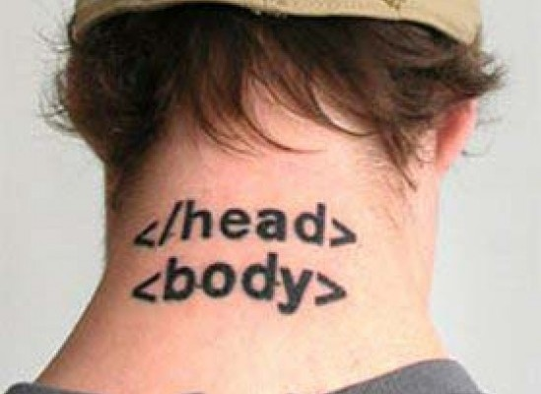
CSE 154
Lecture 2: More HTML and CSS

Slide 2
Block and inline elements
block elements contain an entire large region of content
examples: paragraphs, lists, table cells
the browser places a margin of whitespace between block elements for separation
inline elements affect a small amount of content
examples: bold text, code fragments, images
the browser allows many inline elements to appear on the same line
must be nested inside a block element

Slide 3
Line break: <br>
forces a line break in the middle of a block element (inline)
<p>
The woods are lovely, dark and deep, <br /> But I have promises to
keep, <br /> And miles to go before I sleep, <br /> And miles to go
before I sleep.
</p>
The woods are lovely, dark and deep,
But I have promises to keep,
And miles to go before I sleep,
And miles to go before I sleep.
Warning: Don't over-use br (guideline: >= 2 in a row is bad)

Slide 4
Links: <a>
links, or "anchors", to other pages (inline)
<p>
Search
<a href="http://www.google.com/">Google</a> or our
<a href="lectures.html">Lecture Notes</a>.
</p>
Search Google or our Lecture Notes.
uses the href attribute to specify the destination URL
can be absolute (to another web site) or relative (to another page on this site)
anchors are inline elements; must be placed in a block element such as p or h1

Slide 5
Phrase elements : <em>, <strong>
em: emphasized text (usually rendered in italic)
strong: strongly emphasized text (usually rendered in bold)
<p>
HTML is <em>really</em>,
<strong>REALLY</strong> fun!
</p>
HTML is really, REALLY fun!
as usual, the tags must be properly nested for a valid page

Slide 6
Images: <img>
inserts a graphical image into the page (inline)
<img src="images/koalafications.jpg" alt="Koalified koala" />
the src attribute specifies the image URL
HTML5 also requires an alt attribute describing the image

Slide 7
Comments: <!-- ... -->
comments to document your HTML file or "comment out" text
<!-- My web page, by Suzy Student
CSE 190 D, Spring 2048 -->
<p>CSE courses are <!-- NOT --> a lot of fun!</p>
CSE courses are a lot of fun!
many web pages are not thoroughly commented (or at all)
still useful at top of page and for disabling code
comments cannot be nested and cannot contain a --

Slide 8
Quotations <blockquote>
a lengthy quotation (block)
<p>As Lincoln said in his famous Gettysburg Address:</p>
<blockquote>
<p>Fourscore and seven years ago, our fathers brought forth
on this continent a new nation, conceived in liberty, and
dedicated to the proposition that all men are created equal.</p>
</blockquote> HTML
As Lincoln said in his famous Gettysburg Address:
Fourscore and seven years ago, our fathers brought forth on this continent a new nation, conceived in liberty, and dedicated to the proposition that all men are created equal. output

Slide 9
Inline quotations <q>
a short quotation (inline)
<p>Quoth the Raven, <q>Nevermore.</q></p> HTML
Quoth the Raven, “Nevermore.” output
Why not just write the following?
<p>Quoth the Raven, "Nevermore."</p>

Slide 10
Computer code <code>
a short section of computer code (usually shown in a fixed-width font)
<p>
The <code>ul</code> and <code>ol</code>
tags make lists.
</p> HTML
The ul and ol tags make lists. output

Slide 11
Preformatted text <pre>
a large section of pre-formatted text (block)
<pre>
Bill Gates speaks
You will be assimilated
Microsoft fans delirious
</pre> HTML
Bill Gates speaks
You will be assimilated
Microsoft fans delirious output
Displayed with exactly the whitespace / line breaks given in the text
Shown in a fixed-width font by default

Slide 12
Deletions and insertions: <del>, <ins>
content that should be considered deleted or added to the document (inline)
<p>
<del>Final Exam</del> <ins>Midterm</ins> is on <del>Aug 29</del> <ins>Apr 17</ins>.
</p> HTML
Final Exam Midterm is on Aug 29 Apr 17. output

Slide 13
Abbreviations: <abbr>
an abbreviation, acronym, or slang term (inline)
<p>
Safe divers always remember to check their
<abbr title="Self-Contained Underwater Breathing Apparatus">SCUBA</abbr> gear.
</p> HTML
Safe divers always remember to check their SCUBA gear. output
The title will appear when the abbreviated word is hovered over
In some browsers the abbreviated word will have a dashed underline

Slide 14
The Internet
Wikipedia: http://en.wikipedia.org/wiki/Internet
a connection of computer networks using the Internet Protocol (IP)
layers of communication protocols: IP → TCP/UDP → HTTP/FTP/POP/SMTP/SSH...

Slide 15
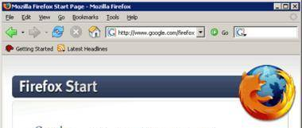
Web servers and browsers
web server: software that listens for web page requests
Apache
Microsoft Internet Information Server (IIS) (part of Windows)
web browser: fetches/displays documents from web servers
Mozilla Firefox
Microsoft Internet Explorer (IE)
Apple Safari
Google Chrome
Opera

Slide 16
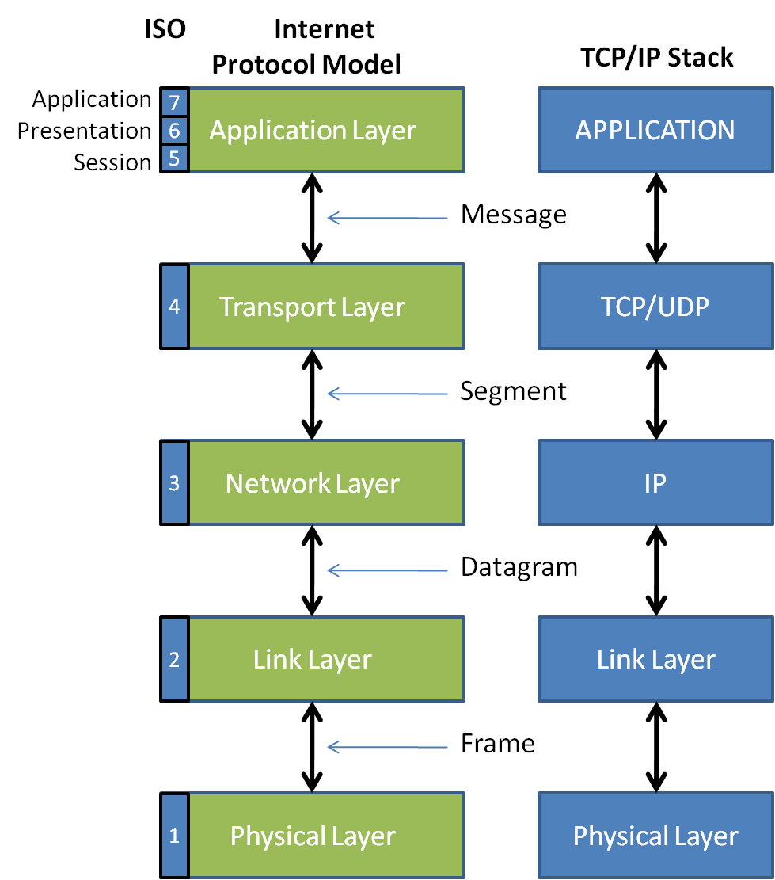
Layers of protocol
Protocol:
a set of rules governing the format of data sent
IP address:

Slide 17
How do web addresses work?
DNS:
a set of servers that map written names to IP addresses
Example: www.cs.washington.edu → 128.208.3.88
many systems maintain a local cache called a hosts file
URL:
a basic URL:http://www.aw-bc.com/info/regesstepp/index.html
~~~~ ~~~~~~~~~~~~~ ~~~~~~~~~~~~~~~~~~~~~~~~~~
protocol host path

Slide 18
Who "runs" the internet?
Internet Engineering Task Force (IETF): internet protocol standards
Internet Corporation for Assigned Names and Numbers (ICANN):
decides top-level domain names
World Wide Web Consortium (W3C): web standards

Slide 19
Brief History
began as a US Department of Defense network called ARPANET (1960s-70s)
initial services: electronic mail, file transfer
opened to commercial interests in late 80s
WWW created in 1989-91 by Tim Berners-Lee
popular web browsers released: Netscape 1994, IE 1995
Amazon.com opens in 1995; Google January 1996
Hamster Dance web page created in 1999

Slide 20
Content vs. presentation
HTML is for content; what is on the page (heading; list; code; etc.)
CSS is for presentation; how to display the page (bold; centered; 20px margin; etc.)
keeping content separate from presentation is a very important web design principle
If the HTML contains no styles, its entire appearance can be changed by swapping .css files
see also: CSS Zen Garden

Slide 21
Cascading Style Sheets (CSS): <link>
<head>
...
<link href="filename" type="text/css" rel="stylesheet" />
...
</head>
CSS describes the appearance and layout of information on a web page (as opposed to HTML, which describes the content of the page)
can be embedded in HTML or placed into separate .css file (preferred)

Slide 22
Basic CSS rule syntax
selector {
property: value;
property: value;
...
property: value;
}
p {
font-family: sans-serif;
color: red;
}
a CSS file consists of one or more rules
a rule's selector specifies HTML element(s) and applies style properties
a selector of * selects all elements

Slide 23
CSS properties for colors
p {
color: red;
background-color: yellow;
}
This paragraph uses the style above.
Property | Description
color | color of an element’s text
background-color | color that will appear behind the element

Slide 24
Specifying colors
p { color: red; }
h2 { color: rgb(128, 0, 196); }
h4 { color: #FF8800; }
This paragraph uses the first style above.
This h2 uses the second style above.
This h4 uses the third style above.
color names: aqua, black, blue, fuchsia, gray, green, lime, maroon, navy, olive, purple, red, silver, teal, white (white), yellow
RGB codes: red, green, and blue values from 0 (none) to 255 (full)
hex codes: RGB values in base-16 from 00 (0, none) to FF (255, full)

Slide 25
CSS properties for fonts
property | description
font-family | which font will be used
font-size | how large the letters will be drawn
font-style | used to enable/disable italic style
font-weight | used to enable/disable bold style
Complete list of font properties

Slide 26
font-size
p {
font-size: 14pt;
}
This paragraph uses the style above.
units: pixels (px) vs. point (pt) vs. m-size (em)
16px, 16pt, 1.16em
vague font sizes: xx-small, x-small, small, medium, large, x-large, xx-large, smaller, larger
percentage font sizes, e.g.: 90%, 120%

Slide 27
font-family
p {
font-family: Georgia;
}
h2 {
font-family: "Courier New";
}
This paragraph uses the first style above.
This h2 uses the second style above.
enclose multi-word font names in quotes

Slide 28
More about font-family
p {
font-family: Garamond, "Times New Roman", serif;
}
This paragraph uses the above style.
can specify multiple fonts from highest to lowest priority
generic font names:
serif, sans-serif, cursive, fantasy, monospace

Slide 29
font-weight, font-style
p {
font-weight: bold;
font-style: italic;
}
This paragraph uses the style above.
either of the above can be set to normal to turn them off (e.g. headings)

Slide 30
CSS properties for text
property | description
text-align | alignment of text within its element
text-decoration | decorations such as underlining
line-height, word-spacing, letter-spacing | gaps between the various portions of the text
text-indent | indents the first letter of each paragraph
Complete list of text properties (http://www.w3schools.com/css/css_reference.asp#text)

Slide 31
text-align
blockquote { text-align: justify; }
h2 { text-align: center; } CSS
The Emperor's Quote
[TO LUKE SKYWALKER] The alliance... will die. As will your friends. Good, I can feel your anger. I am unarmed. Take your weapon. Strike me down with all of your hatred and your journey towards the dark side will be complete. output
can be left, right, center, or justify (which widens all full lines of the element so that they occupy its entire width)

Slide 32
Text-decoration
p {
text-decoration: underline;
} CSS
This paragraph uses the style above.
output
can also be overline, line-through, blink, or none
effects can be combined:
text-decoration: overline underline;

Slide 33
text-shadow
p {
font-weight: bold;
text-shadow: 2px 2px gray;
} CSS
This paragraph uses the style above. output
shadow is specified as an X-offset, a Y-offset, and an optional color

Slide 34
CSS properties for backgrounds
property | description
background-color | color to fill background
background-image | image to place in background
background-position | placement of bg image within element
background-repeat | whether/how bg image should be repeated
background-attachment | whether bg image scrolls with page
background | shorthand to set all background properties

Slide 35
background-image
body {
background-image: url("images/draft.jpg");
}
CSS
background image/color fills the element's content area

Slide 36
background-repeat
body {
background-image: url("images/draft.jpg");
background-repeat: repeat-x;
} CSS
can be repeat (default), repeat-x, repeat-y, or no-repeat

Slide 37
background-position
body {
background-image: url("images/draft.jpg");
background-repeat: no-repeat;
background-position: 370px 20px;
} CSS
value consists of two tokens, each of which can be top, left, right, bottom, center, a percentage, or a length value in px, pt, etc.
value can be negative to shift left/up by a given amount

