Slide 1
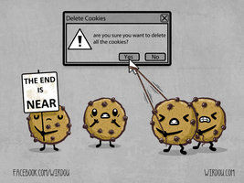
CSE 154
Lecture 21: Sessions

Slide 2
Expiration / persistent cookies
setcookie("name", "value", expiration); PHP
$expireTime = time() + 60*60*24*7; # 1 week from now
setcookie("CouponNumber", "389752", $expireTime);
setcookie("CouponValue", "100.00", $expireTime); PHP
to set a persistent cookie, pass a third parameter for when it should expire
indicated as an integer representing a number of seconds, often relative to current timestamp
if no expiration passed, cookie is a session cookie; expires when browser is closed
time function returns the current time in seconds
date function can convert a time in seconds to a readable date

Slide 3
Deleting a cookie
setcookie("name", FALSE); PHP
setcookie("CouponNumber", FALSE); PHP
setting the cookie to FALSE erases it
you can also set the cookie but with an expiration that is before the present time:
setcookie("count", 42, time() - 1); PHP
remember that the cookie will also be deleted automatically when it expires, or can be deleted manually by the user by clearing their browser cookies

Slide 4
How long does a cookie exist?
session cookie : the default type; a temporary cookie that is stored only in the browser's memory
when the browser is closed, temporary cookies will be erased
can not be used for tracking long-term information
safer, because no programs other than the browser can access them
persistent cookie : one that is stored in a file on the browser's computer
can track long-term information
potentially less secure, because users (or programs they run) can open cookie files, see/change the cookie values, etc.

Slide 5
What is a session?
session: an abstract concept to represent a series of HTTP requests and responses between a specific Web browser and server
HTTP doesn't support the notion of a session, but PHP does
sessions vs. cookies:
a cookie is data stored on the client
a session's data is stored on the server (only 1 session per client)
sessions are often built on top of cookies:
the only data the client stores is a cookie holding a unique session ID
on each page request, the client sends its session ID cookie, and the server uses this to find and retrieve the client's session data

Slide 6
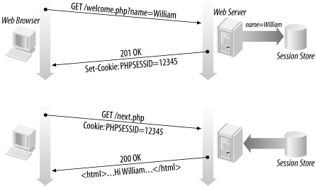
How sessions are established
client's browser makes an initial request to the server
server notes client's IP address/browser, stores some local session data, and sends a session ID back to client (as a cookie)
client sends that same session ID (cookie) back to server on future requests
server uses session ID cookie to retrieve its data for the client's session later (like a ticket given at a coat-check room)

Slide 7
Cookies vs. sessions
duration: sessions live on until the user logs out or closes the browser; cookies can live that long, or until a given fixed timeout (persistent)
data storage location: sessions store data on the server (other than a session ID cookie); cookies store data on the user's browser
security: sessions are hard for malicious users to tamper with or remove; cookies are easy
privacy: sessions protect private information from being seen by other users of your computer; cookies do not

Slide 8
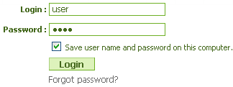
Implementing user logins
many sites have the ability to create accounts and log in users
most apps have a database of user accounts
when you try to log in, your name/pw are compared to those in the database

Slide 9
Sessions in PHP: session_start
session_start(); PHP
session_start signifies your script wants a session with the user
must be called at the top of your script, before any HTML output is produced
when you call session_start:
if the server hasn't seen this user before, a new session is created
otherwise, existing session data is loaded into $_SESSION associative array
you can store data in $_SESSION and retrieve it on future pages
complete list of PHP session functions

Slide 10
Accessing session data
$_SESSION["name"] = value; # store session data
$variable = $_SESSION["name"]; # read session data
if (isset($_SESSION["name"])) { # check for session data PHP
if (isset($_SESSION["points"])) {
$points = $_SESSION["points"];
print("You've earned $points points.\n");
} else {
$_SESSION["points"] = 0; # default
} PHP
the $_SESSION associative array reads/stores all session data
use isset function to see whether a given value is in the session

Slide 11
Common session bugs
session_start doesn't just begin a session; it also reloads any existing session for this user. So it must be called in every page that uses your session data:
# the user has a session from a previous page
print $_SESSION["name"]; # undefined
session_start();
print $_SESSION["name"]; # joe PHP
previous sessions will linger unless you destroy them and regenerate the user's session ID:
session_destroy();
session_regenerate_id(TRUE);
session_start(); PHP

Slide 12
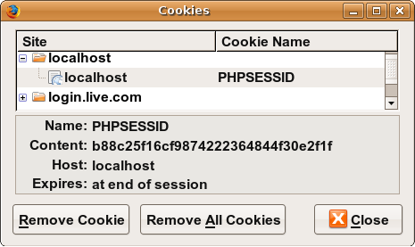
Where is session data stored?
on the client, the session ID is stored as a cookie with the name PHPSESSID
on the server, session data are stored as temporary files such as /tmp/sess_fcc17f071...
you can find out (or change) the folder where session data is saved using the session_save_path function
for very large applications, session data can be stored into a SQL database (or other destination) instead using thesession_set_save_handler function

Slide 13
Ending a session
session_destroy(); PHP
session_destroy ends your current session
potential problem: if you call session_start again later, it sometimes reuses the same session ID/data you used before
if you may want to start a completely new empty session later, it is best to flush out the old one:
session_destroy();
session_regenerate_id(TRUE); # flushes out session
#ID number
session_start(); PHP

Slide 14
Session timeout
because HTTP is stateless, it is hard for the server to know when a user has finished a session
ideally, user explicitly logs out, but many users don't
client deletes session cookies when browser closes
server automatically cleans up old sessions after a period of time
old session data consumes resources and may present a security risk
adjustable in PHP server settings or with session_cache_expire function
you can explicitly delete a session by calling session_destroy

