Slide 1
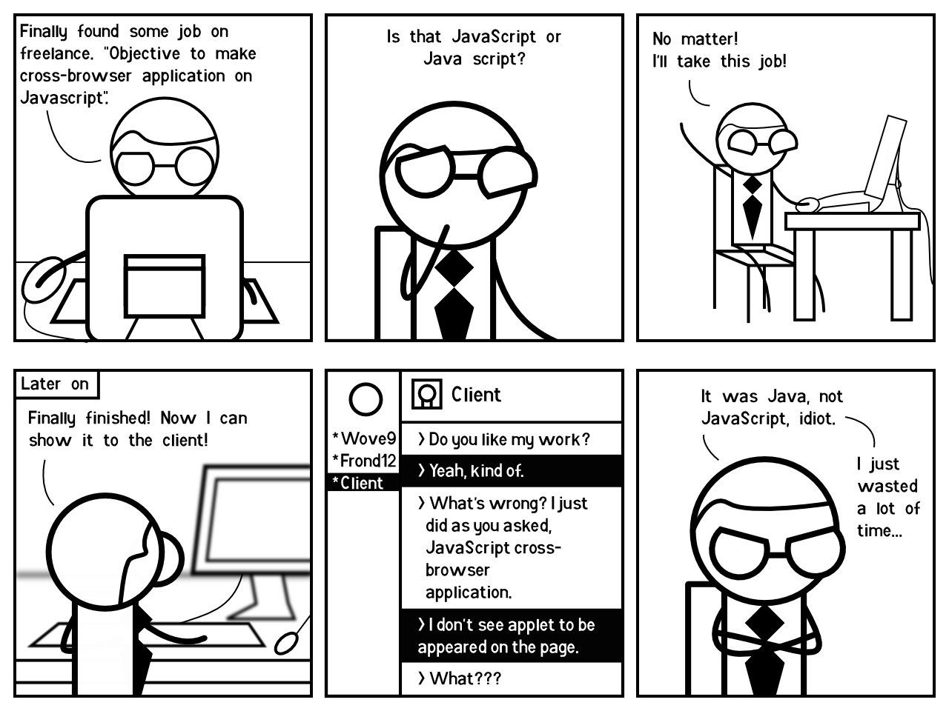
CSE 154
Lecture 6: Javascript

Slide 2
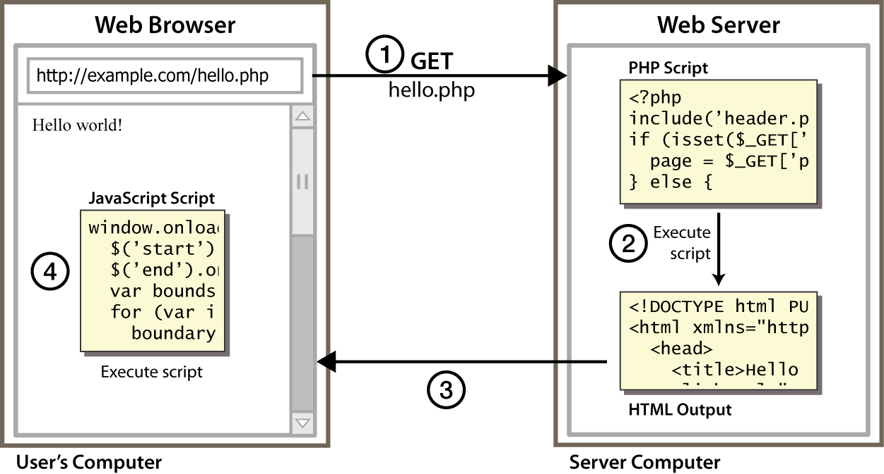
Client-side scripting
client-side script: code runs in browser after page is sent back from server often this code manipulates the page or responds to user actions

Slide 3
What is JavaScript?
a lightweight programming language ("scripting language")
used to make web pages interactive
insert dynamic text into HTML (ex: user name)
react to events (ex: page load user click)
get information about a user's computer (ex: browser type)
perform calculations on user's computer (ex: form validation)
a web standard (but not supported identically by all browsers)
NOT related to Java other than by name and some syntactic similarities

Slide 4
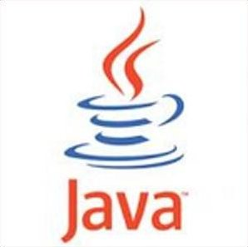
JavaScript vs. Java
interpreted, not compiled
more relaxed syntax and rules
fewer and "looser" data types
variables don't need to be declared
errors often silent (few exceptions)
key construct is the function rather than the class
"first-class" functions are used in many situations
contained within a web page and integrates with its HTML/CSS content
+
= JavaScript

Slide 5
Linking to a JavaScript file: script
<script src="filename" type="text/javascript"></script> HTML
<script src="example.js" type="text/javascript"></script> HTML
script tag should be placed in HTML page's head
script code is stored in a separate .js file
JS code can be placed directly in the HTML file's body or head (like CSS)
but this is bad style (should separate content, presentation, and behavior)

Slide 6
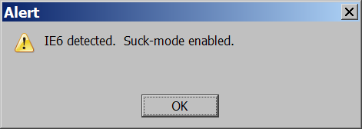
A JavaScript statement: alert
alert("message"); JS
alert("IE6 detected. Suck-mode enabled."); JS
output
a JS command that pops up a dialog box with a message

Slide 7
Variables and types
var name = expression; JS
var age = 32;
var weight = 127.4;
var clientName = "Connie Client"; JS
variables are declared with the var keyword (case sensitive)
types are not specified, but JS does have types ("loosely typed")
Number, Boolean, String, Array, Object, Function, Null, Undefined
can find out a variable's type by calling typeof

Slide 8
Number type
var enrollment = 99;
var medianGrade = 2.8;
var credits = 5 + 4 + (2 * 3); JS
integers and real numbers are the same type (no int vs. double)
same operators: + - * / % ++ -- = += -= *= /= %=
similar precedence to Java
many operators auto-convert types: "2" * 3 is 6

Slide 9
String type
var s = "Connie Client";
var fName = s.substring(0, s.indexOf(" ")); // "Connie"
var len = s.length; // 13
var s2 = 'Melvin Merchant'; // can use "" or ' '
methods: charAt, charCodeAt, fromCharCode, indexOf, lastIndexOf, replace, split, substring, toLowerCase, toUpperCase
charAt returns a one-letter String (there is no char type)
length property (not a method as in Java)
concatenation with + : 1 + 1 is 2, but "1" + 1 is "11"

Slide 10
More about String
escape sequences behave as in Java: \' \" \& \n \t \\
to convert between numbers and Strings:
var count = 10;
var s1 = "" + count; // "10"
var s2 = count + " bananas, ah ah!"; // "10 bananas, ah ah!"
var n1 = parseInt("42 is the answer"); // 42
var n2 = parseFloat("booyah"); // NaN
to access characters of a String, use [index] or charAt:
var firstLetter = s[0];
var firstLetter = s.charAt(0);
var lastLetter = s.charAt(s.length - 1);

Slide 11
Comments (same as Java)
// single-line comment
/* multi-line comment */ JS
identical to Java's comment syntax
recall: 4 comment syntaxes
HTML:<!-- comment -->
CSS/JS:/* comment */
Java/JS:// comment

Slide 12
for loop (same as Java)
for (initialization; condition; update) {
statements;
} JS
var sum = 0;
for (var i = 0; i < 100; i++) {
sum = sum + i;
} JS
var s1 = "hello";
var s2 = "";
for (var i = 0; i < s.length; i++) {
s2 += s1[i] + s1[i];
}
// s2 stores "hheelllloo“ JS

Slide 13
Math object
var rand1to10 = Math.floor(Math.random() * 10 + 1);
var three = Math.floor(Math.PI); JS
methods: abs, ceil, cos, floor, log, max, min, pow, random, round, sin, sqrt, tan
properties: E, PI

Slide 14
Logical operators
Relational: > < >= <=
Logical: && || !
Equality: == != === !==
most logical operators automatically convert types. These are all true:
5 < "7"
42 == 42.0
"5.0" == 5
The === and !== are strict equality tests; checks both type and value:
"5.0" === 5 is false

Slide 15
Boolean type
var iLikeJS = true;
var ieIsGood = "IE6" > 0; // false
if ("web dev is great") { /* true */ }
if (0) { /* false */ } JS
any value can be used as a Boolean
"falsey" values: 0, 0.0, NaN, "", null, and undefined
"truthy" values: anything else
converting a value into a Boolean explicitly:
var boolValue = Boolean(otherValue);
var boolValue = !!(otherValue);

Slide 16
Special values: null and undefined
var ned = null;
var benson = 9;
var caroline;
// at this point in the code,
// ned is null
// benson's 9
// caroline is undefined JS
undefined : has not been declared, does not exist
null : exists, but was specifically assigned an empty or null value
Why does JavaScript have both of these?

Slide 17
if/else statement (same as Java)
if (condition) {
statements;
} else if (condition) {
statements;
} else {
statements;
} JS
identical structure to Java's if/else statement
JavaScript allows almost anything as a condition

Slide 18
while loops (same as Java)
while (condition) {
statements;
} JS
do {
statements;
} while (condition); JS
break and continue keywords also behave as in Java but do not use them in this class!

Slide 19
Arrays
var name = []; // empty array
var name = [value, value, ..., value]; // pre-filled
name[index] = value; // store element PHP
var ducks = ["Huey", "Dewey", "Louie"];
var stooges = []; // stooges.length is 0
stooges[0] = "Larry"; // stooges.length is 1
stooges[1] = "Moe"; // stooges.length is 2
stooges[4] = "Curly"; // stooges.length is 5
stooges[4] = "Shemp"; // stooges.length is 5 PHP
two ways to initialize an array
length property (grows as needed when elements are added)

Slide 20
Array methods
var a = ["Stef", "Jason"]; // Stef, Jason
a.push("Brian"); // Stef, Jason, Brian
a.unshift("Kelly"); // Kelly, Stef, Jason, Brian
a.pop(); // Kelly, Stef, Jason
a.shift(); // Stef, Jason
a.sort(); // Jason, Stef JS
array serves as many data structures: list, queue, stack, ...
methods: concat, join, pop, push, reverse, shift, slice, sort, splice, toString, unshift
push and pop add / remove from back
unshift and shift add / remove from front
shift and pop return the element that is removed

Slide 21
Splitting strings: split and join
var s = "the quick brown fox";
var a = s.split(" "); // ["the", "quick", "brown", "fox"]
a.reverse(); // ["fox", "brown", "quick", "the"]
s = a.join("!"); // "fox!brown!quick!the“ JS
split breaks apart a string into an array using a delimiter
can also be used with regular expressions surrounded by /:
var a = s.split(/[ \t]+/);
join merges an array into a single string, placing a delimiter between them

Slide 22
Defining functions
function name() {
statement ;
statement ;
...
statement ;
} JS
function myFunction() {
alert("Hello!");
alert("How are you?");
} JS
the above could be the contents of example.js linked to our HTML page
statements placed into functions can be evaluated in response to user events

Slide 23
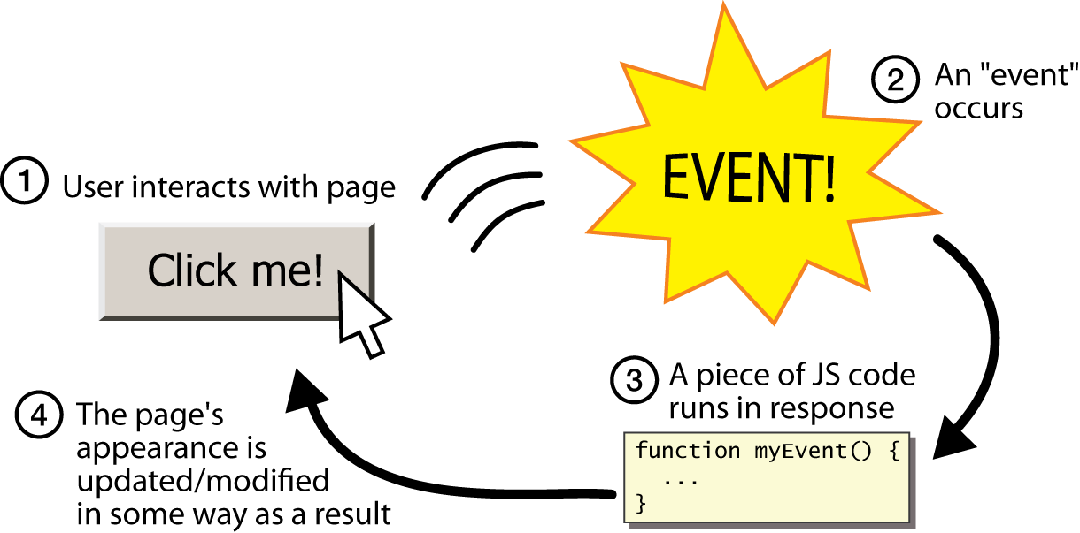
Event-driven programming
JS programs have no main; they respond to user actions called events
event-driven programming: writing programs driven by user events

Slide 24
Event handlers
<element attributes onclick="function();">... HTML
<div onclick="myFunction();">Click me!</div> HTML
Click me! HTML
JavaScript functions can be set as event handlers
when you interact with the element, the function will execute
onclick is just one of many event HTML attributes we'll use

Slide 25
Buttons: <button>
the canonical clickable UI control (inline)
<button onclick="myFunction();">Click me!</button> HTML
output
button's text appears inside tag; can also contain images
To make a responsive button or other UI control:
choose the control (e.g. button) and event (e.g. mouse click) of interest
write a JavaScript function to run when the event occurs
attach the function to the event on the control

Slide 26
Accessing an element: document.getElementById
var name = document.getElementById("id"); JS
<img id="icon01" src="images/octopus.jpg" alt="an animal" />
<button onclick="changeImage();">Click me!</button> HTML
function changeImage() {
var octopusImage = document.getElementById("icon01");
octopusImage.src = "images/kitty.gif";
} JS
output
document.getElementById returns the DOM object for an element with a given id

Slide 27
<input>
<!-- 'q' happens to be the name of Google's required parameter -->
<input type="text" name="q" value="Colbert Report" />
<input type="submit" value="Booyah!" /> HTML
output
input element is used to create many UI controls
an inline element that MUST be self-closed
name attribute specifies name of query parameter to pass to server
type can be button, checkbox, file, hidden, password, radio, reset, submit, text, ...
value attribute specifies control's initial text

Slide 28
Text fields: <input>
<input type="text" size="10" maxlength="8" /> NetID <br />
<input type="password" size="16" /> Password
<input type="submit" value="Log In" /> HTML
output
input attributes: disabled, maxlength, readonly, size, value
size attribute controls onscreen width of text field
maxlength limits how many characters user is able to type into field

Slide 29
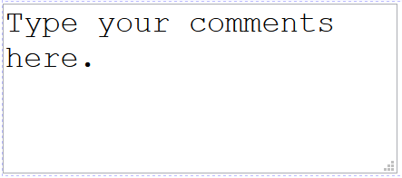
Text boxes: <textarea>
a multi-line text input area (inline)
<textarea rows="4" cols="20">
Type your comments here.
</textarea> HTML
output
initial text is placed inside textarea tag (optional)
required rows and cols attributes specify height/width in characters
optional readonly attribute means text cannot be modified

