Slide 1
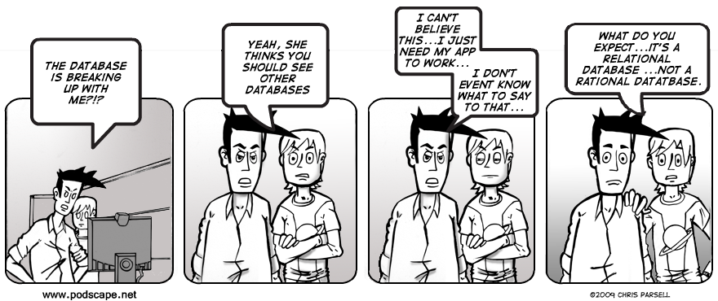
CSE 154
Lecture 25: SQL and HTML tables

Slide 2
Practice queries
What are the names of all teachers Bart has had?
SELECT DISTINCT t.name
FROM teachers t
JOIN courses c ON c.teacher_id = t.id
JOIN grades g ON g.course_id = c.id
JOIN students s ON s.id = g.student_id
WHERE s.name = 'Bart'; SQL
How many total students has Ms. Krabappel taught, and what are their names?
SELECT DISTINCT s.name
FROM students s
JOIN grades g ON s.id = g.student_id
JOIN courses c ON g.course_id = c.id
JOIN teachers t ON t.id = c.teacher_id
WHERE t.name = 'Krabappel'; SQL

Slide 3
HTML tables: <table>, <tr>, <td>
A 2D table of rows and columns of data (block element)
<table>
<tr><td>1,1</td><td>1,2 okay</td></tr>
<tr><td>2,1 real wide</td><td>2,2</td></tr>
</table> HTML
output
1,1 | 1,2 okay
2,1 real wide | 2,2
table defines the overall table, tr each row, and td each cell's data
tables are useful for displaying large row/column data sets
NOTE: tables are sometimes used by novices for web page layout, but this is not proper semantic HTML and should be avoided

Slide 4
Table headers, captions: <th>, <caption>
<table>
<caption>My important data</caption>
<tr><th>Column 1</th><th>Column 2</th></tr>
<tr><td>1,1</td><td>1,2 okay</td></tr>
<tr><td>2,1 real wide</td><td>2,2</td></tr>
</table> HTML
output
My important data
Column 1 | Column 2
1,1 | 1,2 okay
2,1 real wide | 2,2
th cells in a row are considered headers; by default, they appear bold
a caption at the start of the table labels its meaning

Slide 5
Styling tables
table { border: 2px solid black; caption-side: bottom; }
tr { font-style: italic; }
td { background-color: yellow; text-align: center; width: 30%; }
output
Column 1 | Column 2
1,1 | 1,2 okay
2,1 real wide | 2,2
My important data
all standard CSS styles can be applied to a table, row, or cell
table specific CSS properties:
border-collapse, border-spacing, caption-side, empty-cells, table-layout

Slide 6
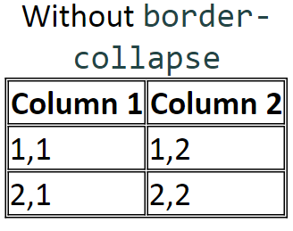
The border-collapse property
table, td, th { border: 2px solid black; }
table { border-collapse: collapse; } CSS
With border-collapse
Column 1 | Column 2
1,1 | 1,2
2,1 | 2,2
by default, the overall table has a separate border from each cell inside
the border-collapse property merges these borders into one

Slide 7
The rowspan and colspan attributes
<table>
<tr><th>Column 1</th><th>Column 2</th><th>Column 3</th></tr>
<tr><td colspan="2">1,1-1,2</td>
<td rowspan="3">1,3-3,3</td></tr>
<tr><td>2,1</td><td>2,2</td></tr>
<tr><td>3,1</td><td>3,2</td></tr>
</table> HTML
HTML
Column 1 | Column 2 | Column 3
1,1-1,2 |  | 1,3-3,3
2,1 | 2,2
3,1 | 3,2
colspan makes a cell occupy multiple columns; rowspan multiple rows
text-align and vertical-align control where the text appears within a cell

Slide 8
Column styles: <col>, <colgroup>
<table>
<col class="urgent" />
<colgroup class="highlight" span="2"></colgroup>
<tr><th>Column 1</th><th>Column 2</th><th>Column 3</th></tr>
<tr><td>1,1</td><td>1,2</td><td>1,3</td></tr>
<tr><td>2,1</td><td>2,2</td><td>2,3</td></tr>
</table> HTML
output
Column 1 | Column 2 | Column 3
1,1 | 1,2 | 1,3
2,1 | 2,2 | 2,3
col tag can be used to define styles that apply to an entire column (self-closing)
colgroup tag applies a style to a group of columns (NOT self-closing

Slide 9
Don't use tables for layout!
(borderless) tables appear to be an easy way to achieve grid-like page layouts
many "newbie" web pages do this (including many UW CSE web pages...)
but, a table has semantics; it should be used only to represent an actual table of data
instead of tables, use divs, widths/margins, floats, etc. to perform layout
tables should not be used for layout!
tables should not be used for layout!!
TABLES SHOULD NOT BE USED FOR LAYOUT!!!
TABLES SHOULD NOT BE USED FOR LAYOUT!!!!

Slide 10
Designing a query
Figure out the proper SQL queries in the following way:
Which table(s) contain the critical data? (FROM)
Which columns do I need in the result set? (SELECT)
How are tables connected (JOIN) and values filtered (WHERE)?
Test on a small data set (imdb_small).
Confirm on the real data set (imdb).
Try out the queries first in the MySQL console.
Write the PHP code to run those same queries.
Make sure to check for SQL errors at every step!!

