Slide 1
CSE 154
Lecture 24: Multi-table SQL Queries (Joins)

Slide 2
Exceptions for errors
$db = new PDO("mysql:dbname=imdb_small", "jessica", "guinness");
$db->setAttribute(PDO::ATTR_ERRMODE, PDO::ERRMODE_EXCEPTION);
$rows = $db->query("SEEELECT * FROM movies WHERE year = 2000");
# kaboom! PHP
using setAttribute, you can tell PDO to throw (generate) a PDOException when an error occurs
the exceptions will appear as error messages on the page output
you can catch the exception to gracefully handle the error

Slide 3
Related tables and keys
id | name | email
123 | Bart | bart@fox.com
456 | Milhouse | milhouse@fox.com
888 | Lisa | lisa@fox.com
404 | Ralph | ralph@fox.com
id | name
1234 | Krabappel
5678 | Hoover
9012 | Obourn
id | name | teacher_id
10001 | Computer Science 142 | 1234
10002 | Computer Science 143 | 5678
10003 | Computer Science 154 | 9012
10004 | Informatics 100 | 1234
student_id | course_id | grade
123 | 10001 | B-
123 | 10002 | C
456 | 10001 | B+
888 | 10002 | A+
888 | 10003 | A+
404 | 10004 | D+
teachers
students
courses
grades
primary key: a column guaranteed to be unique for each record (e.g. Lisa Simpson's ID 888)
foreign key: a column in table A storing a primary key value from table B
(e.g. records in grades with student_id of 888 are Lisa's grades)
normalizing: splitting tables to improve structure / redundancy (linked by unique IDs)

Slide 4
Giving names to tables
SELECT s.name, g.*
FROM students s
JOIN grades g ON s.id = g.student_id
WHERE g.grade <= 'C'; SQL
name | student_id | course_id | grade
Bart | 123 | 10001 | B-
Bart | 123 | 10002 | C
Milhouse | 456 | 10001 | B+
Lisa | 888 | 10002 | A+
Lisa | 888 | 10003 | A+
can give names to tables, like a variable name in Java
to specify all columns from a table, write table.*
(grade column sorts alphabetically, so grades C or better are ones <= it)

Slide 5
Querying multi-table databases
When we have larger datasets spread across multiple tables, we need queries that can answer high-level questions such as:
What courses has Bart taken and gotten a B- or better?
What courses have been taken by both Bart and Lisa?
Who are all the teachers Bart has had?
How many total students has Ms. Krabappel taught, and what are their names?
To do this, we'll have to join data from several tables in our SQL queries.

Slide 6
Joining with ON clauses
SELECT column(s)
FROM table1
JOIN table2 ON condition(s)
...
JOIN tableN ON condition(s); SQL
SELECT *
FROM students
JOIN grades ON id = student_id; SQL
join: combines records from two or more tables if they satisfy certain conditions
the ON clause specifies which records from each table are matched
the rows are often linked by their key columns (id)

Slide 7
Join example
SELECT *
FROM students
JOIN grades ON id = student_id; SQL
id | name | email | student_id | course_id | grade
123 | Bart | bart@fox.com | 123 | 10001 | B-
123 | Bart | bart@fox.com | 123 | 10002 | C
404 | Ralph | ralph@fox.com | 404 | 10004 | D+
456 | Milhouse | milhouse@fox.com | 456 | 10001 | B+
888 | Lisa | lisa@fox.com | 888 | 10002 | A+
888 | Lisa | lisa@fox.com | 888 | 10003 | A+
table.column can be used to disambiguate column names:
SELECT *
FROM students
JOIN grades ON students.id = grades.student_id; SQL

Slide 8
Filtering columns in a join
SELECT name, course_id, grade
FROM students
JOIN grades ON id = student_id; SQL
name | course_id | grade
Bart | 10001 | B-
Bart | 10002 | C
Ralph | 10004 | D+
Milhouse | 10001 | B+
Lisa | 10002 | A+
Lisa | 10003 | A+

Slide 9
Filtered join (JOIN with WHERE)
SELECT name, course_id, grade
FROM students
JOIN grades ON id = student_id
WHERE name = 'Bart'; SQL
name | course_id | grade
Bart | 10001 | B-
Bart | 10002 | C
FROM / JOIN glue the proper tables together, and WHERE filters the results
what goes in the ON clause, and what goes in WHERE?
ON directly links columns of the joined tables
WHERE sets additional constraints such as particular values (123, 'Bart')

Slide 10
What's wrong with this?
SELECT name, id, course_id, grade
FROM students
JOIN grades ON id = 123
WHERE id = student_id; SQL
name | id | course_id | grade
Bart | 123 | 10001 | B-
Bart | 123 | 10002 | C
The above query produces the same rows as the previous one, but it is poor style. Why?
The JOIN ON clause is poorly chosen. It doesn't really say what connects a grades record to a students record.
They are related when they are for a student with the same id.
Filtering out by a specific ID or name should be done in the WHERE clause, not JOIN ON.

Slide 11
Multi-way join
SELECT c.name
FROM courses c
JOIN grades g ON g.course_id = c.id
JOIN students bart ON g.student_id = bart.id
WHERE bart.name = 'Bart' AND g.grade <= 'B-'; SQL
name
Computer Science 142
More than 2 tables can be joined, as shown above
What does the above query represent?
The names of all courses in which Bart has gotten a B- or better.

Slide 12
A suboptimal query
Exercise: What courses have been taken by both Bart and Lisa?
SELECT bart.course_id
FROM grades bart
JOIN grades lisa ON lisa.course_id = bart.course_id
WHERE bart.student_id = 123
AND lisa.student_id = 888; SQL
problem: requires us to know Bart/Lisa's Student IDs, and only spits back course IDs, not names.
Write a version of this query that gets us the course names, and only requires us to know Bart/Lisa's names, not their IDs.

Slide 13
Improved query
What courses have been taken by both Bart and Lisa?
SELECT DISTINCT c.name
FROM courses c
JOIN grades g1 ON g1.course_id = c.id
JOIN students bart ON g1.student_id = bart.id
JOIN grades g2 ON g2.course_id = c.id
JOIN students lisa ON g2.student_id = lisa.id
WHERE bart.name = 'Bart'
AND lisa.name = 'Lisa'; SQL

Slide 14
Practice queries
What are the names of all teachers Bart has had?
SELECT DISTINCT t.name
FROM teachers t
JOIN courses c ON c.teacher_id = t.id
JOIN grades g ON g.course_id = c.id
JOIN students s ON s.id = g.student_id
WHERE s.name = 'Bart'; SQL
How many total students has Ms. Krabappel taught, and what are their names?
SELECT DISTINCT s.name
FROM students s
JOIN grades g ON s.id = g.student_id
JOIN courses c ON g.course_id = c.id
JOIN teachers t ON t.id = c.teacher_id
WHERE t.name = 'Krabappel'; SQL

Slide 15
Designing a query
Figure out the proper SQL queries in the following way:
Which table(s) contain the critical data? (FROM)
Which columns do I need in the result set? (SELECT)
How are tables connected (JOIN) and values filtered (WHERE)?
Test on a small data set (imdb_small).
Confirm on the real data set (imdb).
Try out the queries first in the query tool.
Write the PHP code to run those same queries.
Make sure to check for SQL errors at every step!!

Slide 16
Example imdb database
id | first_name | last_name | gender
433259 | William | Shatner | M
797926 | Britney | Spears | F
831289 | Sigourney | Weaver | F
...
id | name | year | rank
112290 | Fight Club | 1999 | 8.5
209658 | Meet the Parents | 2000 | 7
210511 | Memento | 2000 | 8.7
...
actor_id | movie_id | role
433259 | 313398 | Capt. James T. Kirk
433259 | 407323 | Sgt. T.J. Hooker
797926 | 342189 | Herself
...
actors
movies
roles
movie_id | genre
209658 | Comedy
313398 | Action
313398 | Sci-Fi
...
id | first_name | last_name
24758 | David | Fincher
66965 | Jay | Roach
72723 | William | Shatner
...
director_id | movie_id
24758 | 112290
66965 | 209658
72723 | 313398
...
also available, imdb_small with fewer records (for testing queries)
movies_genres
directors
movies_directors

Slide 17
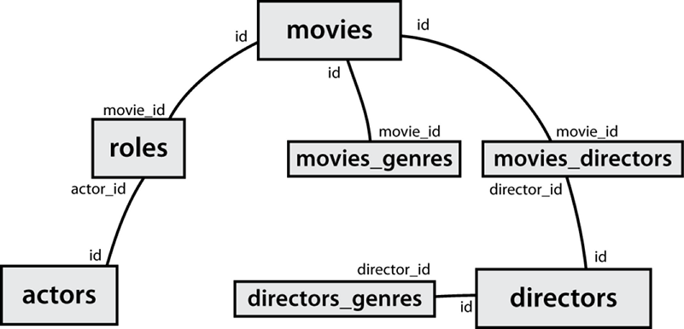
IMDb table relationships / ids

Slide 18
IMDb practice queries
What are the names of all movies released in 1995?
How many people played a part in the movie "Lost in Translation"?
What are the names of all the people who played a part in the movie "Lost in Translation"?
Who directed the movie "Fight Club"?
How many movies has Clint Eastwood directed?
What are the names of all movies Clint Eastwood has directed?
What are the names of all directors who have directed at least one horror film?
What are the names of every actor who has appeared in a movie directed by Christopher Nolan?

