Slide 1
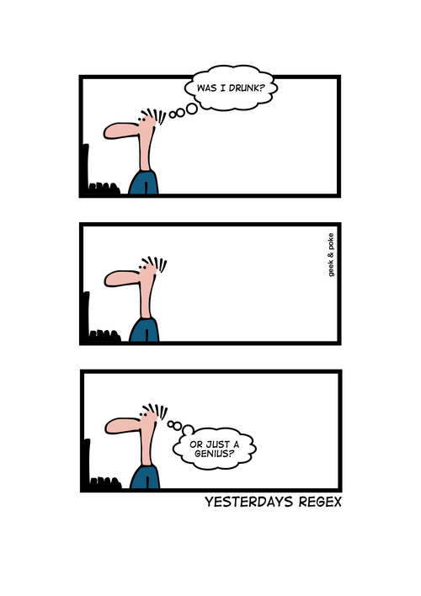
CSE 154
Lecture 21: Cookies

Slide 2
Regular expressions in PHP (PDF)
regex syntax: strings that begin and end with /, such as "/[AEIOU]+/"
function | description
preg_match(regex, string) | returns TRUE if string matches regex
preg_replace(regex, replacement, string) | returns a new string with all substrings that match regex replaced by replacement
preg_split(regex, string) | returns an array of strings from given string broken apart using given regex as delimiter (like explode but more powerful)

Slide 3
PHP form validation w/ regexes
$state = $_POST["state"];
if (!preg_match("/^[A-Z]{2}$/", $state)) {
print "Error, invalid state submitted.";
} PHP
preg_match and regexes help you to validate parameters
sites often don't want to give a descriptive error message here (why?)

Slide 4
Regular expression PHP example
# replace vowels with stars
$str = "the quick brown fox";
$str = preg_replace("/[aeiou]/", "*", $str);
# "th* q**ck br*wn f*x"
# break apart into words
$words = preg_split("/[ ]+/", $str);
# ("th*", "q**ck", "br*wn", "f*x")
# capitalize words that had 2+ consecutive vowels
for ($i = 0; $i < count($words); $i++) {
if (preg_match("/\\*{2,}/", $words[$i])) {
$words[$i] = strtoupper($words[$i]);
}
} # ("th*", "Q**CK", "br*wn", "f*x") PHP

Slide 5
The die function
die("error message text"); PHP
PHP's die function prints a message and then completely stops code execution
it is sometimes useful to have your page "die" on invalid input
problem: poor user experience (a partial, invalid page is sent back)

Slide 6
The header function
header("HTTP header text"); # in general
header("Location: url"); # for browser redirection PHP
PHP's header function can be used for several common HTTP messages
sending back HTTP error codes (404 not found, 403 forbidden, etc.)
redirecting from one page to another
indicating content types, languages, caching policies, server info, ...
you can use a Location header to tell the browser to redirect itself to another page
useful to redirect if the user makes a validation error
must appear before any other HTML output generated by the script

Slide 7
Using header to redirect between pages
header("Location: url"); PHP
$city = $_POST["city"];
$state = $_POST["state"];
$zip = $_POST["zip"];
if (!$city || strlen($state) != 2 || strlen($zip) != 5) {
header("Location: start-page.php"); # invalid input; redirect
} PHP
one problem: User is redirected back to original form without any clear error message or understanding of why the redirect occurred.

Slide 8
Including files: include
include("filename"); PHP
include("header.html");
include("shared-code.php"); PHP
inserts the entire contents of the given file into the PHP script's output page
encourages modularity
useful for defining reused functions needed by multiple pages
related: include_once, require, require_once

Slide 9
Including a common HTML file
<!DOCTYPE html>
<!-- this is top.html -->
<html><head><title>This is some common code</title>
... HTML
include("top.html"); # this PHP file re-uses top.html's HTML content
Including a .html file injects that HTML output into your PHP page at that point
useful if you have shared regions of pure HTML tags that don't contain any PHP content

Slide 10
Including a common PHP file
<?php
# this is common.php
function useful($x) { return $x * $x; }
function top() {
?>
<!DOCTYPE html>
<html><head><title>This is some common code</title>
...
<?php
} PHP
include("common.php"); # this PHP file re-uses common.php's PHP code
$y = useful(42); # call a shared function
top(); # produce HTML output
...
including a .php file injects that PHP code into your PHP file at that point
if the included PHP file contains functions, you can call them

Slide 11
Stateful client/server interaction
Sites like amazon.com seem to "know who I am." How do they do this? How does a client uniquely identify itself to a server, and how does the server provide specific content to each client?
HTTP is a stateless protocol; it simply allows a browser to request a single document from a web server
today we'll learn about pieces of data called cookies used to work around this problem, which are used as the basis of higher-level sessions between clients and servers

Slide 12
What is a cookie?
cookie: a small amount of information sent by a server to a browser, and then sent back by the browser on future page requests
cookies have many uses:
authentication
user tracking
maintaining user preferences, shopping carts, etc.
a cookie's data consists of a single name/value pair, sent in the header of the client's HTTP GET or POST request

Slide 13
How cookies are sent
when the browser requests a page, the server may send back a cookie(s) with it
if your server has previously sent any cookies to the browser, the browser will send them back on subsequent requests
alternate model: client-side JavaScript code can set/get cookies

Slide 14
Myths about cookies
Myths:
Cookies are like worms/viruses and can erase data from the user's hard disk.
Cookies are a form of spyware and can steal your personal information.
Cookies generate popups and spam.
Cookies are only used for advertising.
Facts:
Cookies are only data, not program code.
Cookies cannot erase or read information from the user's computer.
Cookies are usually anonymous (do not contain personal information).
Cookies CAN be used to track your viewing habits on a particular site.

Slide 15
A "tracking cookie"
an advertising company can put a cookie on your machine when you visit one site, and see it when you visit another site that also uses that advertising company
therefore they can tell that the same person (you) visited both sites
can be thwarted by telling your browser not to accept "third-party cookies"

Slide 16
Where are the cookies on my computer?
IE: HomeDirectory\Cookies
e.g. C:\Documents and Settings\jsmith\Cookies
each is stored as a .txt file similar to the site's domain name
Chrome:
C:\Users\username\AppData\Local\Google\Chrome\User Data\Default
Firefox: HomeDirectory\.mozilla\firefox\???.default\cookies.txt
view cookies in Firefox preferences: Privacy, Show Cookies...

Slide 17
How long does a cookie exist?
session cookie : the default type; a temporary cookie that is stored only in the browser's memory
when the browser is closed, temporary cookies will be erased
can not be used for tracking long-term information
safer, because no programs other than the browser can access them
persistent cookie : one that is stored in a file on the browser's computer
can track long-term information
potentially less secure, because users (or programs they run) can open cookie files, see/change the cookie values, etc.

Slide 18
Setting a cookie in PHP
setcookie("name", "value"); PHP
setcookie("username", “allllison");
setcookie("age", 19); PHP
setcookie causes your script to send a cookie to the user's browser
setcookie must be called before any output statements (HTML blocks, print, or echo)
you can set multiple cookies (20-50) per user, each up to 3-4K bytes
by default, the cookie expires when browser is closed (a "session cookie")

Slide 19
Retrieving information from a cookie
$variable = $_COOKIE["name"]; # retrieve value of the cookie
if (isset($_COOKIE["username"])) {
$username = $_COOKIE["username"];
print("Welcome back, $username.\n");
} else {
print("Never heard of you.\n");
}
print("All cookies received:\n");
print_r($_COOKIE); PHP
any cookies sent by client are stored in $_COOKIES associative array
use isset function to see whether a given cookie name exists

Slide 20
What cookies have been set?
Chrome: F12 → Resources → Cookies; Firefox: F12 → Cookies

Slide 21
Expiration / persistent cookies
setcookie("name", "value", expiration); PHP
$expireTime = time() + 60*60*24*7; # 1 week from now
setcookie("CouponNumber", "389752", $expireTime);
setcookie("CouponValue", "100.00", $expireTime); PHP
to set a persistent cookie, pass a third parameter for when it should expire
indicated as an integer representing a number of seconds, often relative to current timestamp
if no expiration passed, cookie is a session cookie; expires when browser is closed
time function returns the current time in seconds
date function can convert a time in seconds to a readable date

Slide 22
Deleting a cookie
setcookie("name", FALSE); PHP
setcookie("CouponNumber", FALSE); PHP
setting the cookie to FALSE erases it
you can also set the cookie but with an expiration that is before the present time:
setcookie("count", 42, time() - 1); PHP
remember that the cookie will also be deleted automatically when it expires, or can be deleted manually by the user by clearing their browser cookies

Slide 23
Clearing cookies in your browser
Chrome: Wrench → History → Clear all browsing data...
Firefox: Firefox menu → Options → Privacy → Show Cookies... → Remove (All) Cookies

Slide 24
Cookie scope and attributes
setcookie("name", "value", expire, "path", "domain", secure, httponly);
a given cookie is associated only with one particular domain (e.g. www.example.com)
you can also specify a path URL to indicate that the cookie should only be sent on certain subsets of pages within that site (e.g. /users/accounts/ will bind towww.example.com/users/accounts)
a cookie can be specified as Secure to indicate that it should only be sent when using HTTPS secure requests
a cookie can be specified as HTTP Only to indicate that it should be sent by HTTP/HTTPS requests only (not JavaScript, Ajax, etc.; seen later); this is to help avoid JavaScript security attacks

Slide 25
Common cookie bugs
When you call setcookie, the cookie will be available in $_COOKIE on the next page load, but not the current one. If you need the value during the current page request, also store it in a variable:
setcookie("name", "joe");
print $_COOKIE["name"]; # undefined PHP
$name = "joe";
setcookie("name", $name);
print $name; # joe PHP
setcookie must be called before your code prints any output or HTML content:
<!DOCTYPE html><html>
<?php
setcookie("name", "joe"); # should precede HTML content!

