Slide 1
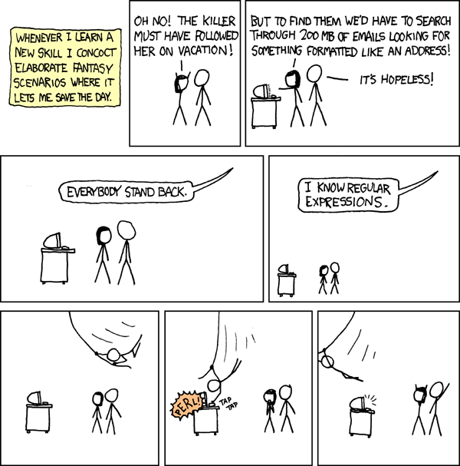
CSE 154
Lecture 20: Regular Expressions

Slide 2
What is form validation?
validation: ensuring that form's values are correct
some types of validation:
preventing blank values (email address)
ensuring the type of values
integer, real number, currency, phone number, Social Security number, postal address, email address, date, credit card number, ...
ensuring the format and range of values (ZIP code must be a 5-digit integer)
ensuring that values fit together (user types email twice, and the two must match)

Slide 3
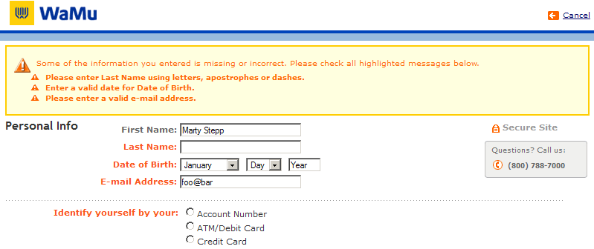
A real form that uses validation

Slide 4
Client vs. server-side validation
Validation can be performed:
client-side (before the form is submitted)
can lead to a better user experience, but not secure (why not?)
server-side (in PHP code, after the form is submitted)
needed for truly secure validation, but slower
both
best mix of convenience and security, but requires most effort to program

Slide 5
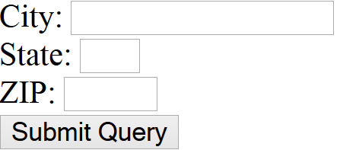
An example form to be validated
<form action="http://foo.com/foo.php" method="get">
<div>
City: <input name="city" /> <br />
State: <input name="state" size="2" maxlength="2" /> <br />
ZIP: <input name="zip" size="5" maxlength="5" /> <br />
<input type="submit" />
</div>
</form> HTML
output
Let's validate this form's data on the server...

Slide 6
Basic server-side validation
$city = $_POST["city"];
$state = $_POST["state"];
$zip = $_POST["zip"];
if (!$city || strlen($state) != 2 || strlen($zip) != 5) {
print "Error, invalid city/state/zip submitted.";
} PHP
basic idea: examine parameter values, and if they are bad, show an error message and abort. But:
How do you test for integers vs. real numbers vs. strings?
How do you test for a valid credit card number?
How do you test that a person's name has a middle initial?
(How do you test whether a given string matches a particular complex format?)

Slide 7
Regular expressions
/^[a-zA-Z_\-]+@(([a-zA-Z_\-])+\.)+[a-zA-Z]{2,4}$/
regular expression ("regex"): a description of a pattern of text
can test whether a string matches the expression's pattern
can use a regex to search/replace characters in a string
regular expressions are extremely powerful but tough to read (the above regular expression matches email addresses)
regular expressions occur in many places:
Java: Scanner, String's split method (CSE 143 sentence generator)
supported by PHP, JavaScript, and other languages
many text editors (TextPad) allow regexes in search/replace
The site Rubular is useful for testing a regex.

Slide 8
Regular expressions
This picture best describes regex.

Slide 9
Basic regular expressions
/abc/
in PHP, regexes are strings that begin and end with /
the simplest regexes simply match a particular substring
the above regular expression matches any string containing "abc":
YES: "abc", "abcdef", "defabc", ".=.abc.=.", ...
NO: "fedcba", "ab c", "PHP", ...

Slide 10
Wildcards: .
A dot . matches any character except a \n line break
/.oo.y/ matches "Doocy", "goofy", "LooNy", ...
A trailing i at the end of a regex (after the closing /) signifies a case-insensitive match
/all/i matches “Allison Obourn", “small", “JANE GOODALL", ...

Slide 11
Special characters: |, (), \
| means OR
/abc|def|g/ matches "abc", "def", or "g"
There's no AND symbol. Why not?
() are for grouping
/(Homer|Marge) Simpson/ matches "Homer Simpson" or "Marge Simpson"
\ starts an escape sequence
many characters must be escaped to match them literally: / \ $ . [ ] ( ) ^ * + ?
/<br \/>/ matches lines containing <br /> tags

Slide 12
Quantifiers: *, +, ?
* means 0 or more occurrences
/abc*/ matches "ab", "abc", "abcc", "abccc", ...
/a(bc)*/ matches "a", "abc", "abcbc", "abcbcbc", ...
/a.*a/ matches "aa", "aba", "a8qa", "a!?xyz__9a", ...
+ means 1 or more occurrences
/Hi!+ there/ matches "Hi! there", "Hi!!! there", ...
/a(bc)+/ matches "abc", "abcbc", "abcbcbc", ...
? means 0 or 1 occurrences
/a(bc)?/ matches "a" or "abc"

Slide 13
More quantifiers: {min,max}
{min,max} means between min and max occurrences (inclusive)
/a(bc){2,4}/ matches "abcbc", "abcbcbc", or "abcbcbcbc"
min or max may be omitted to specify any number
{2,} means 2 or more
{,6} means up to 6
{3} means exactly 3

Slide 14
Practice exercise
When you search Google, it shows the number of pages of results as "o"s in the word "Google". What regex matches strings like "Google", "Gooogle", "Goooogle", ...? (try it) (data)
Answer: /Goo+gle/ (or /Go{2,}gle/)

Slide 15
Anchors: ^ and $
^ represents the beginning of the string or line; $ represents the end
/Jess/ matches all strings that contain Jess; /^Jess/ matches all strings that start with Jess; /Jess$/ matches all strings that end with Jess; /^Jess$/ matches the exact string "Jess" only
/^Alli.*Obourn$/ matches “AlliObourn", “Allie Obourn", “Allison E Obourn", ... but NOT “Allison Obourn stinks" or "I H8 Allison Obourn"
(on the other slides, when we say, /PATTERN/ matches "text", we really mean that it matches any string that contains that text)

Slide 16
Character sets: []
[] group characters into a character set; will match any single character from the set
/[bcd]art/ matches strings containing "bart", "cart", and "dart"
equivalent to /(b|c|d)art/ but shorter
inside [], many of the modifier keys act as normal characters
/what[!*?]*/ matches "what", "what!", "what?**!", "what??!", ...
What regular expression matches DNA (strings of A, C, G, or T)?
/[ACGT]+/

Slide 17
Character ranges: [start-end]
inside a character set, specify a range of characters with -
/[a-z]/ matches any lowercase letter
/[a-zA-Z0-9]/ matches any lower- or uppercase letter or digit
an initial ^ inside a character set negates it
/[^abcd]/ matches any character other than a, b, c, or d
inside a character set, - must be escaped to be matched
/[+\-]?[0-9]+/ matches an optional + or -, followed by at least one digit

Slide 18
Practice Exercises
What regular expression matches letter grades such as A, B+, or D- ? (try it) (data)
What regular expression would match UW Student ID numbers? (try it) (data)
What regular expression would match a sequence of only consonants, assuming that the string consists only of lowercase letters? (try it) (data)

Slide 19
Escape sequences
special escape sequence character sets:
\d matches any digit (same as [0-9]); \D any non-digit ([^0-9])
\w matches any word character (same as [a-zA-Z_0-9]); \W any non-word char
\s matches any whitespace character ( , \t, \n, etc.); \S any non-whitespace
What regular expression matches names in a "Last, First M." format with any number of spaces?
/\w+,\s+\w+\s+\w\./

Slide 20
Regular expressions in PHP (PDF)
regex syntax: strings that begin and end with /, such as "/[AEIOU]+/"
function | description
preg_match(regex, string) | returns TRUE if string matches regex
preg_replace(regex, replacement, string) | returns a new string with all substrings that match regex replaced by replacement
preg_split(regex, string) | returns an array of strings from given string broken apart using given regex as delimiter (like explode but more powerful)

Slide 21
PHP form validation w/ regexes
$state = $_POST["state"];
if (!preg_match("/^[A-Z]{2}$/", $state)) {
print "Error, invalid state submitted.";
} PHP
preg_match and regexes help you to validate parameters
sites often don't want to give a descriptive error message here (why?)

Slide 22
Regular expression PHP example
# replace vowels with stars
$str = "the quick brown fox";
$str = preg_replace("/[aeiou]/", "*", $str);
# "th* q**ck br*wn f*x"
# break apart into words
$words = preg_split("/[ ]+/", $str);
# ("th*", "q**ck", "br*wn", "f*x")
# capitalize words that had 2+ consecutive vowels
for ($i = 0; $i < count($words); $i++) {
if (preg_match("/\\*{2,}/", $words[$i])) {
$words[$i] = strtoupper($words[$i]);
}
} # ("th*", "Q**CK", "br*wn", "f*x") PHP

Slide 23
The die function
die("error message text"); PHP
PHP's die function prints a message and then completely stops code execution
it is sometimes useful to have your page "die" on invalid input
problem: poor user experience (a partial, invalid page is sent back)

Slide 24
The header function
header("HTTP header text"); # in general
header("Location: url"); # for browser redirection PHP
PHP's header function can be used for several common HTTP messages
sending back HTTP error codes (404 not found, 403 forbidden, etc.)
redirecting from one page to another
indicating content types, languages, caching policies, server info, ...
you can use a Location header to tell the browser to redirect itself to another page
useful to redirect if the user makes a validation error
must appear before any other HTML output generated by the script

Slide 25
Using header to redirect between pages
header("Location: url"); PHP
$city = $_POST["city"];
$state = $_POST["state"];
$zip = $_POST["zip"];
if (!$city || strlen($state) != 2 || strlen($zip) != 5) {
header("Location: start-page.php"); # invalid input; redirect
} PHP
one problem: User is redirected back to original form without any clear error message or understanding of why the redirect occurred. (We can improve this later.)

Slide 26
Practice exercise
Use regular expressions to add validation to the turnin form shown in previous lectures.
The student name must not be blank and must contain a first and last name (two words).
The student ID must be a seven-digit integer.
The assignment must be a string such as "hw1" or "hw6".
The section must be a two-letter uppercase string representing a valid section such as AF or BK.
The email address must follow a valid general format such as user@example.com.
The course must be one of "142", "143", or "154" exactly.

Slide 27
Handling invalid data
function check_valid($regex, $param) {
if (preg_match($regex, $_POST[$param])) {
return $_POST[$param];
} else {
# code to run if the parameter is invalid
die("Bad $param");
}
}
...
$sid = check_valid("/^[0-9]{7}$/", "studentid");
$section = check_valid("/^[AB][A-C]$/i", "section"); PHP
Having a common helper function to check parameters is useful.
If your page needs to show a particular HTML output on errors, the die function may not be appropriate.

Slide 28
Regular expressions in HTML forms
How old are you?
<input type="text" name="age" size="2" pattern="[0-9]+" title="an integer" />
<input type="submit" /> HTML
output
HTML5 adds a new pattern attribute to input elements
the browser will refuse to submit the form unless the value matches the regex

