Slide 1
CSE 154
Lecture 15: Intro to PHP

Slide 2
URLs and web servers
http://server/path/file
usually when you type a URL in your browser:
your computer looks up the server's IP address using DNS
your browser connects to that IP address and requests the given file
the web server software (e.g. Apache) grabs that file from the server's local file system, and sends back its contents to you
some URLs actually specify programs that the web server should run, and then send their output back to you as the result: https://webster.cs.washington.edu/cse190m/quote.php
the above URL tells the server webster.cs.washington.edu to run the program quote2.php and send back its output

Slide 3
Server-Side web programming
server-side pages are programs written using one of many web programming languages/frameworks
examples: PHP, Java/JSP, Ruby on Rails, ASP.NET, Python, Perl
the web server contains software that allows it to run those programs and send back their output
each language/framework has its pros and cons
we will use PHP for server-side programming

Slide 4
Why PHP?
There are many other options for server-side languages: Ruby on Rails, JSP, ASP.NET, etc. Why choose PHP?
free and open source: anyone can run a PHP-enabled server free of charge
compatible: supported by most popular web servers
simple: lots of built-in functionality; familiar syntax
available: installed on UW's servers (Dante, Webster) and most commercial web hosts
well-documented: type php.net/functionName in browser Address bar to get docs for any function

Slide 5
What is PHP?
PHP stands for "PHP Hypertext Preprocessor"
a server-side scripting language
used to make web pages dynamic:
provide different content depending on context
interface with other services: database, e-mail, etc
authenticate users
process form information
PHP code can be embedded in HTML code

Slide 6
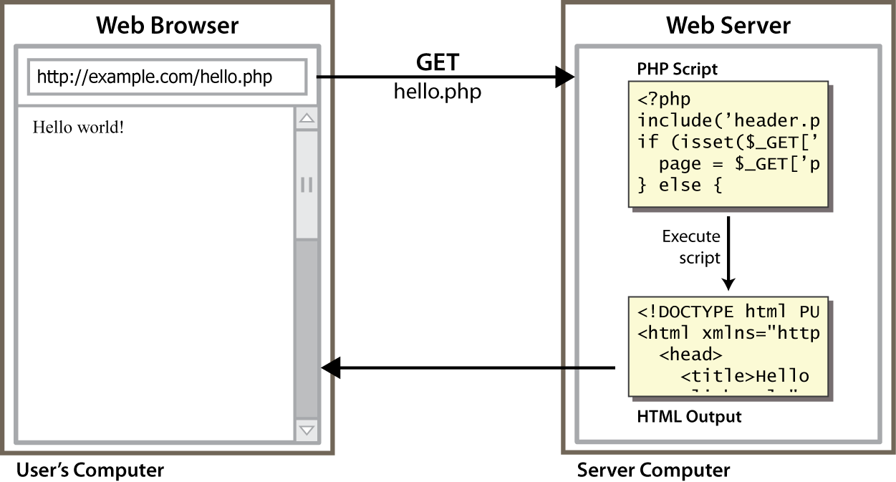
Lifecycle of a PHP web request
browser requests a .html file (static content): server just sends that file
browser requests a .php file (dynamic content): server reads it, runs any script code inside it, then

Slide 7
Hello, World!
The following contents could go into a file hello.php:
<?php
print "Hello, world!";
?> PHP
Hello, world! output
a block or file of PHP code begins with <?php and ends with ?>
PHP statements, function declarations, etc. appear between these endpoints

Slide 8
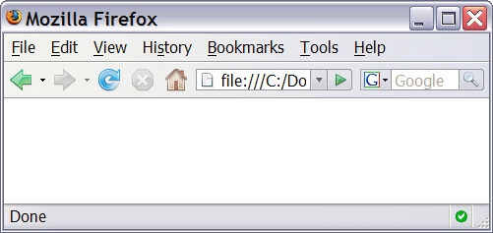
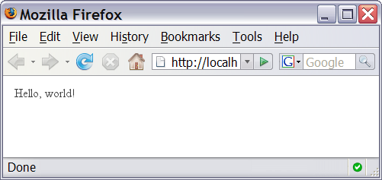
Viewing PHP output
you can't view your .php page on your local hard drive; you'll either see nothing or see the PHP source code
if you upload the file to a PHP-enabled web server, requesting the .php file will run the program and send you back its output

Slide 9
Console output: print
print "text"; PHP
print "Hello, World!\n";
print "Escape \"chars\" are the SAME as in Java!\n";
print "You can have
line breaks in a string.";
print 'A string can use "single-quotes". It\'s cool!'; PHP
Hello, World! Escape "chars" are the SAME as in Java! You can have line breaks in a string. A string can use "single-quotes". It's cool! output
some PHP programmers use the equivalent echo instead of print

Slide 10
Arithmetic Operations
+ - * / % . ++ -- = += -= *= /= %= .=
many operators auto-convert types: 5 + "7" is 12

Slide 11
Variables
$name = expression; PHP
$user_name = "PinkHeartLuvr78";
$age = 16;
$drinking_age = $age + 5;
$this_class_rocks = TRUE; PHP
names are case sensitive; separate multiple words with _
names always begin with $, on both declaration and usage
implicitly declared by assignment (type is not written; a "loosely typed" language)

Slide 12
Types
basic types: int, float, boolean, string, array, object, NULL
test what type a variable is with is_type functions, e.g. is_string
gettype function returns a variable's type as a string (not often needed)
PHP converts between types automatically in many cases:
string → int auto-conversion on + ("1" + 1 == 2)
int → float auto-conversion on / (3 / 2 == 1.5)
type-cast with (type):
$age = (int) "21";

Slide 13
String type
$favorite_food = "Ethiopian";
print $favorite_food[2]; # h PHP
zero-based indexing using bracket notation
string concatenation operator is . (period), not +
5 + "2 turtle doves" produces 7
5 . "2 turtle doves" produces "52 turtle doves“
can be specified with "" or ' '

Slide 14
String functions
# index 0123456789012345
$name = “Austin Weale";
$length = strlen($name); # 16
$cmp = strcmp($name, “Linda Guo"); # > 0
$index = strpos($name, “s"); # 2
$first = substr($name, 7, 4); # “Weal"
$name = strtoupper($name); # “AUSTIN WEALE“ PHP
Name | Java Equivalent
strlen | length
strpos | indexOf
substr | substring
strtolower, strtoupper | toLowerCase, toUpperCase
trim | trim
explode, implode | split, join

Slide 15
Interpreted strings
$age = 16;
print "You are " . $age . " years old.\n";
print "You are $age years old.\n"; # You are 16 years old. PHP
strings inside " " are interpreted
variables that appear inside them will have their values inserted into the string
strings inside ' ' are not interpreted:
print 'You are $age years old.\n'; # You are $age years old.\n PHP
if necessary to avoid ambiguity, can enclose variable in {}:
print "Today is your $ageth birthday.\n"; # $ageth not found
print "Today is your {$age}th birthday.\n"; PHP

Slide 16
bool (Boolean) type
$feels_like_summer = FALSE;
$php_is_rad = TRUE;
$student_count = 217;
$nonzero = (bool) $student_count; # TRUE PHP
the following values are considered to be FALSE (all others are TRUE):
0 and 0.0
"", "0", and NULL (includes unset variables)
arrays with 0 elements
can cast to boolean using (bool)
FALSE prints as an empty string (no output); TRUE prints as a 1

Slide 17
for loop
for (initialization; condition; update) {
statements;
} PHP
for ($i = 0; $i < 10; $i++) {
print "$i squared is " . $i * $i . ".\n";
} PHP

Slide 18
if/else statement
if (condition) {
statements;
} else if (condition) {
statements;
} else {
statements;
} PHP
can also say elseif instead of else if

Slide 19
while loop (same as Java)
while (condition) {
statements;
} PHP
do {
statements;
} while (condition); PHP
break and continue keywords also behave as in Java

Slide 20
Comments
# single-line comment
// single-line comment
/*
multi-line comment
*/ PHP
like Java, but # is also allowed
a lot of PHP code uses # comments instead of //
we recommend # and will use it in our examples

