Slide 1
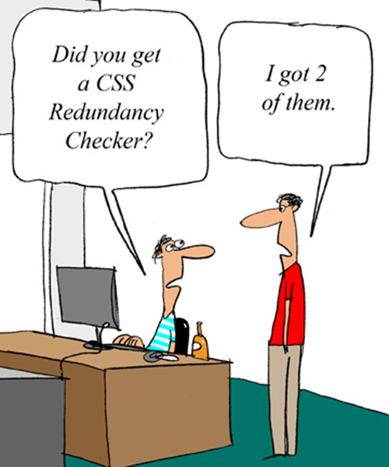
CSE 154
Lecture 3: more CSS

Slide 2
Cascading Style Sheets (CSS): <link>
<head>
...
<link href="filename" type="text/css" rel="stylesheet" />
...
</head> HTML
CSS describes the appearance and layout of information on a web page (as opposed to HTML, which describes the content of the page)
can be embedded in HTML or placed into separate .css file (preferred)

Slide 3
Basic CSS rule syntax
selector {
property: value;
property: value;
...
property: value;
}
p {
font-family: sans-serif;
color: red;
}
a CSS file consists of one or more rules
a rule's selector specifies HTML element(s) and applies style properties
a selector of * selects all elements

Slide 4
Inline styles: the style attribute (BAD!)
<p style="font-family: sans-serif; color: red;">
This is a paragraph</p>
HTML
This is a paragraph
output
higher precedence than embedded or linked styles
used for one-time overrides and styling a particular element
this is bad style; DO NOT DO THIS (why?)

Slide 5
Embedding style sheets: <style> (BAD!)
<head>
<style type="text/css">
p { font-family: sans-serif; color: red; }
h2 { background-color: yellow; }
</style>
</head>
HTML
CSS code can be embedded within the head of an HTML page
this is bad style; DO NOT DO THIS (why?)

Slide 6
Content vs. presentation
HTML is for content; what is on the page (heading; list; code; etc.)
CSS is for presentation; how to display the page (bold; centered; 20px margin; etc.)
keeping content separate from presentation is a very important web design principle
If the HTML contains no styles, its entire appearance can be changed by swapping .css files
see also: CSS Zen Garden

Slide 7
CSS comments: /* ... */
/* This is a comment.
It can span many lines in the CSS file. */
p {
color: red;
background-color: aqua;
} CSS
CSS (like HTML) is usually not commented as much as code such as Java
the // single-line comment style is NOT supported in CSS
the <!-- ... --> HTML comment style is also NOT supported in CSS

Slide 8
W3C CSS Validator
<p>
<a href="http://jigsaw.w3.org/css-validator/check/referer">
<img src="http://jigsaw.w3.org/css-validator/images/vcss"
alt="Valid CSS!" /></a>
</p> HTML
output
jigsaw.w3.org/css-validator/
checks your CSS to make sure it meets the official CSS specifications
more picky than the web browser, which may render malformed CSS correctly

Slide 9
CSS properties for fonts
property | description
font-family | which font will be used
font-size | how large the letters will be drawn
font-style | used to enable/disable italic style
font-weight | used to enable/disable bold style
Complete list of font properties

Slide 10
font-size
p {
font-size: 14pt;
}
This paragraph uses the style above.
units: pixels (px) vs. point (pt) vs. m-size (em)
16px, 16pt, 1.16em
vague font sizes: xx-small, x-small, small, medium, large, x-large, xx-large, smaller, larger
percentage font sizes, e.g.: 90%, 120%

Slide 11
font-family
p {
font-family: Georgia;
}
h2 {
font-family: "Courier New";
}
This paragraph uses the first style above.
This h2 uses the second style above.
enclose multi-word font names in quotes

Slide 12
More about font-family
p {
font-family: Garamond, "Times New Roman", serif;
}
This paragraph uses the above style.
can specify multiple fonts from highest to lowest priority
generic font names:
serif, sans-serif, cursive, fantasy, monospace

Slide 13
font-weight, font-style
p {
font-weight: bold;
font-style: italic;
}
This paragraph uses the style above.
either of the above can be set to normal to turn them off (e.g. headings)

Slide 14
Grouping styles
p, h1, h2 {
color: green;
}
h2 {
background-color: yellow;
} CSS
This paragraph uses the above style.
output
This h2 uses the above styles.
A style can select multiple elements separated by commas
The individual elements can also have their own styles

Slide 15
CSS properties for text
property | description
text-align | alignment of text within its element
text-decoration | decorations such as underlining
line-height, word-spacing, letter-spacing | gaps between the various portions of the text
text-indent | indents the first letter of each paragraph
Complete list of text properties (http://www.w3schools.com/css/css_reference.asp#text)

Slide 16
text-align
blockquote { text-align: justify; }
h2 { text-align: center; } CSS
The Emperor's Quote
[TO LUKE SKYWALKER] The alliance... will die. As will your friends. Good, I can feel your anger. I am unarmed. Take your weapon. Strike me down with all of your hatred and your journey towards the dark side will be complete. output
can be left, right, center, or justify (which widens all full lines of the element so that they occupy its entire width)

Slide 17
Text-decoration
p {
text-decoration: underline;
} CSS
This paragraph uses the style above.
output
can also be overline, line-through, blink, or none
effects can be combined:
text-decoration: overline underline;

Slide 18
text-shadow
p {
font-weight: bold;
text-shadow: 2px 2px gray;
} CSS
This paragraph uses the style above. output
shadow is specified as an X-offset, a Y-offset, and an optional color

Slide 19
The list-style-type property
ol { list-style-type: lower-roman; } CSS
Possible values:
i. none : No marker
ii. disc (default), circle, square
iii. Decimal: 1, 2, 3, etc.
iv. decimal-leading-zero: 01, 02, 03, etc.
v. lower-roman: i, ii, iii, iv, v, etc.
vi. upper-roman: I, II, III, IV, V, etc.
vii. lower-alpha: a, b, c, d, e, etc.
viii. upper-alpha: A, B, C, D, E, etc.
x. lower-greek: alpha, beta, gamma, etc.
others: hebrew, armenian, georgian, cjk-ideographic, hiragana…

Slide 20
CSS properties for backgrounds
property | description
background-color | color to fill background
background-image | image to place in background
background-position | placement of bg image within element
background-repeat | whether/how bg image should be repeated
background-attachment | whether bg image scrolls with page
background | shorthand to set all background properties

Slide 21
background-image
body {
background-image: url("images/draft.jpg");
}
CSS
background image/color fills the element's content area

Slide 22
background-repeat
body {
background-image: url("images/draft.jpg");
background-repeat: repeat-x;
} CSS
can be repeat (default), repeat-x, repeat-y, or no-repeat

Slide 23
background-position
body {
background-image: url("images/draft.jpg");
background-repeat: no-repeat;
background-position: 370px 20px;
} CSS
value consists of two tokens, each of which can be top, left, right, bottom, center, a percentage, or a length value in px, pt, etc.
value can be negative to shift left/up by a given amount

Slide 24
The visibility property
p.secret {
visibility: hidden;
} CSS
output
property | description
visibility | sets whether an element should be shown onscreen; can be visible (default) or hidden
hidden elements will still take up space onscreen, but will not be shown
to make it not take up any space, set display to none instead
can be used to show/hide dynamic HTML content on the page in response to events

Slide 25
The opacity property
body { background-image: url("images/marty-mcfly.jpg");
background-repeat: repeat; }
p { background-color: yellow;}
p.mcfly1 { opacity: 0.75; }
p.mcfly2 { opacity: 0.50; }
p.mcfly3 { opacity: 0.25; } CSS
property | description
opacity | how not-transparent the element is; value ranges from 1.0 (opaque) to 0.0 (transparent)

Slide 26
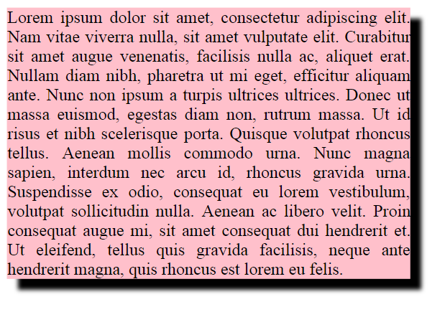
box-shadow
box-shadow: h-shadow v-shadow blur; CSS
box-shadow: 10px 10px 5px; CSS

Slide 27
Styles that conflict
p, h1, h2 { color: blue; font-style: italic; }
h2 { color: red; background-color: yellow; } CSS
This paragraph uses the first style above.
output
This heading uses both styles above.
when two styles set conflicting values for the same property, the latter style takes precedence

Slide 28
Cascading style sheets
It's called Cascading Style Sheets because the properties of an element cascade together in this order:
browser's default styles (reference)
external style sheet files (in a <link> tag)
internal style sheets (in a <style> tag in the page header)
inline style (the style attribute of an HTML element)

Slide 29
Inheriting styles (explanation)
body { font-family: sans-serif; background-color: yellow; }
p { color: red; background-color: aqua; }
a { text-decoration: underline; }
h2 { font-weight: bold; text-align: center; } CSS
This is a heading
A bulleted list output
A styled paragraph. Previous slides are available on the website.
when multiple styles apply to an element, they are inherited
a more tightly matching rule can override a more general inherited rule
not all properties are inherited (notice link's color above)

