Slide 1
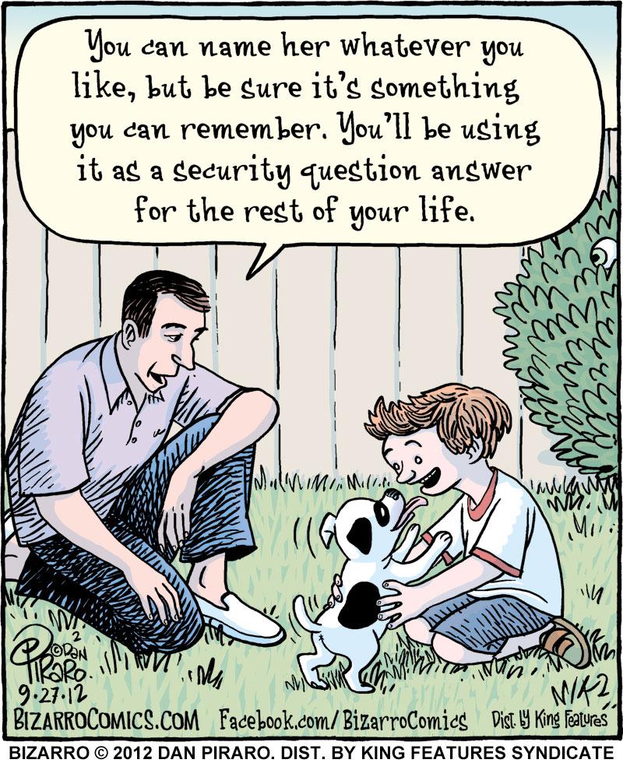
CSE 154
Lecture 11: More Events

Slide 2
Problems with reading/changing styles
<button id="clickme">Click Me</button> HTML
window.onload = function() {
document.getElementById("clickme").onclick = biggerFont;
};
function biggerFont() {
var button = document.getElementById("clickme");
var size = parseInt(button.style.fontSize);
button.style.fontSize = (size + 4) + "pt";
} JS
output
style property lets you set any CSS style for an element
problem: you cannot read existing styles with it (you can read ones you set using the DOM .style, but not ones that are set in the CSS file)

Slide 3
Accessing elements' existing styles
window.getComputedStyle(element).propertyName JS
function biggerFont() {
// turn text yellow and make it bigger
var clickMe = document.getElementById("clickme");
var size = parseInt(window.getComputedStyle(clickMe).fontSize);
clickMe.style.fontSize = (size + 4) + "pt";
} JS
output
getComputedStyle method of global window object accesses existing styles

Slide 4
Common bug: incorrect usage of existing styles
the following example computes e.g. "200px" + 100 + "px" , which would evaluate to "200px100px"
var main = document.getElementById("main");
main.style.top = window.getComputedStyle(main).top + 100 + "px“;
// bad! JS
a corrected version:
main.style.top = parseInt(window.getComputedStyle(main).top) +
100 + "px"; // correct JS

Slide 5
Removing a node from the page
function slideClick() {
var bullet = document.getElementById("removeme");
bullet.parentNode.removeChild(bullet);
} JS
odd idiom: obj.parentNode.remove(obj);

Slide 6
The keyword this
this.fieldName // access field
this.fieldName = value; // modify field
this.methodName(parameters); // call method JS
all JavaScript code actually runs inside of an object
by default, code runs in the global window object (so this === window)
all global variables and functions you declare become part of window
the this keyword refers to the current object

Slide 7
Event handler binding
window.onload = function() {
document.getElementById("textbox").onmouseout = booyah;
document.getElementById("submit").onclick = booyah;
// bound to submit button here
};
function booyah() { // booyah knows what object it was called on
this.value = "booyah";
} JS
output
event handlers attached unobtrusively are bound to the element
inside the handler, that element becomes this

Slide 8
Fixing redundant code with this
<input id="huey" type="radio" name="ducks" value="Huey" /> Huey
<input id="dewey" type="radio" name="ducks" value="Dewey" /> Dewey
<input id="louie" type="radio" name="ducks" value="Louie" /> Louie HTML
function processDucks() {
if (document.getElementById("huey").checked) {
alert("Huey is checked!");
} else if (document.getElementById("dewey").checked) {
alert("Dewey is checked!");
} else {
alert("Louie is checked!");
}
alert(this.value + " is checked!");
} JS
output
if the same function is assigned to multiple elements, each gets its own bound copy

Slide 9
JavaScript events
abort | blur | change | click | dblclick | error | focus
keydown | keypress | keyup | load | mousedown | mousemove | mouseout
mouseover | mouseup | reset | resize | select | submit | unload
the click event (onclick) is just one of many events that can be handled

Slide 10
The event object
function name(event) {
// an event handler function ...
} JS
Event handlers can accept an optional parameter to represent the event that is occurring. Event objects have the following properties / methods:
property name | description
type | what kind of event, such as "click" or "mousedown"
target | the element on which the event occurred
timeStamp | when the event occurred

Slide 11
Mouse events
click | user presses/releases mouse button on the element
dblclick | user presses/releases mouse button twice on the element
mousedown | user presses down mouse button on the element
mouseup | user releases mouse button on the element
clicking
mouseover | mouse cursor enters the element's box
mouseout | mouse cursor exits the element's box
mousemove | mouse cursor moves around within the element's box
movement

Slide 12
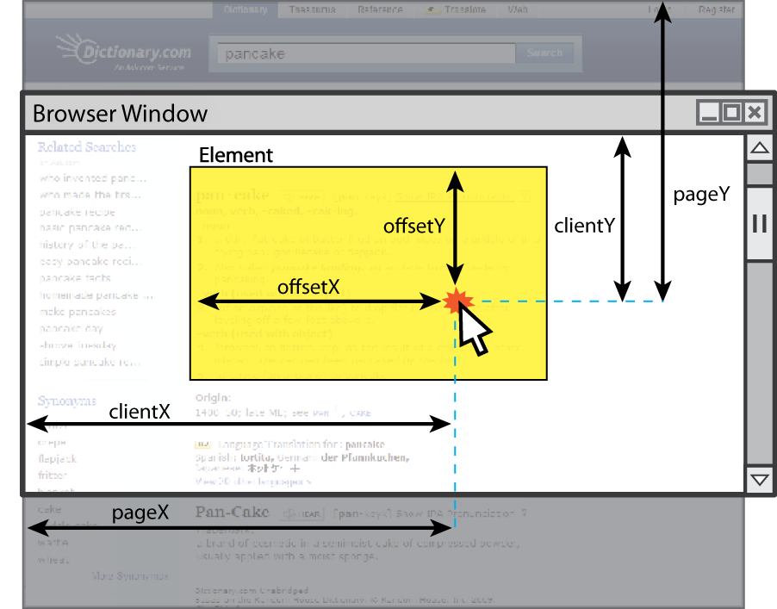
Mouse event objects
The event passed to a mouse handler has these properties:
property/method | description
clientX clientY | coordinates in browser window
screenX screenY | coordinates in screen
offsetX offsetY | coordinates in element (non-standard)
button | integer representing which button was pressed (0=Left, 1=Middle, 2=Right)

Slide 13
Mouse event example
<pre id="target">Move the mouse over me!</pre> HTML
window.onload = function() {
var target = document.getElementById("target");
target.onmousemove = target.onmousedown = showCoords;
};
function showCoords(event) {
document.getElementById("target").innerHTML =
+ "screen : (" + event.screenX + ", " + event.screenY + ")\n"
+ "client : (" + event.clientX + ", " + event.clientY + ")\n"
+ "button : " + event.button;
} JS
screen : (333, 782)
client : (222, 460)
button : 0 output

Slide 14
Keyboard/text events
name | description
focus | this element gains keyboard focus (attention of user's keyboard)
blur | this element loses keyboard focus
keydown | user presses a key while this element has keyboard focus
keyup | user releases a key while this element has keyboard focus
keypress | user presses and releases a key while this element has keyboard focus
select | this element's text is selected or deselected

Slide 15
Key event objects
property name | description
keyCode | ASCII integer value of key that was pressed (convert to char with String.fromCharCode)
altKey, ctrlKey, shiftKey | true if Alt/Ctrl/Shift key is being held
issue: if the event you attach your listener to doesn't have the focus, you won't hear the event
possible solution: attach key listener to entire page body, document, an outer element, etc.

Slide 16
Key event example
document.getElementById("textbox").onkeydown = textKeyDown;
...
function textKeyDown(event) {
var key = String.fromCharCode(event.keyCode);
if (key == 's' && event.altKey) {
alert("Save the document!");
this.value = this.value.split("").join("-");
}
} JS
each time you push down any key, even a modifier such as Alt or Ctrl, the keydown event fires
if you hold down the key, the keydown event fires repeatedly
keypress event is a bit flakier and inconsistent across browsers

Slide 17
Some useful key codes
keyboard key | event keyCode
Backspace | 8
Tab | 9
Enter | 13
Escape | 27
Page Up, Page Down, End, Home | 33, 34, 35, 36
Left, Up, Right, Down | 37, 38, 39, 40
Insert, Delete | 45, 46
Windows/Command | 91
F1 - F12 | 112 - 123

Slide 18
Page/window events
name | description
contextmenu | the user right-clicks to pop up a context menu
error | an error occurs when loading a document or an image
load, unload | the browser loads the page
resize | the browser window is resized
scroll | the user scrolls the viewable part of the page up/down/left/right
unload | the browser exits/leaves the page
The above can be handled on the window object

Slide 19
Multiple listeners to the same event
element.addEventListener("event", function); JS
var button = document.getElementById("mybutton");
button.addEventListener("click", func1);
// button.onclick = func1;
button.addEventListener("click", func2);
// button.onclick = func2; JS
if you assign onclick twice, the second one replaces the first
addEventListener allows multiple listeners to be called for the same event
(note that you do not include "on" in the event name!)

Slide 20
Multiple window.onload listeners
window.onload = function;
window.addEventListener("load", function); JS
it is considered bad form to directly assign to window.onload
multiple .js files could be linked to the same page, and if they all need to run code when the page loads, their window.onload statements will override each other
by calling window.addEventListener instead, all of them can run their code when the page is loaded

Slide 21
Form events
event name | description
submit | form is being submitted
reset | form is being reset
change | the text or state of a form control has changed

Slide 22
Stopping an event
event method name | description
preventDefault | stops the browser from doing its normal action on an event; for example, stops the browser from following a link when <a> tag is clicked, or stops browser from submitting a form when submit button is clicked
stopPropagation | stops the browser from showing this event to any other objects that may be listening for it
you can also return false; from your event handler to stop an event

Slide 23
Stopping an event, example
<form id="exampleform" action="http://foo.com/foo.php">...</form>
window.onload = function() {
var form = document.getElementById("exampleform");
form.onsubmit = checkData;
};
function checkData(event) {
if (document.getElementById("state").length != 2) {
alert("Error, invalid city/state."); // show error message
event.preventDefault();
return false; // stop form submission
}
} JS

