Slide 1
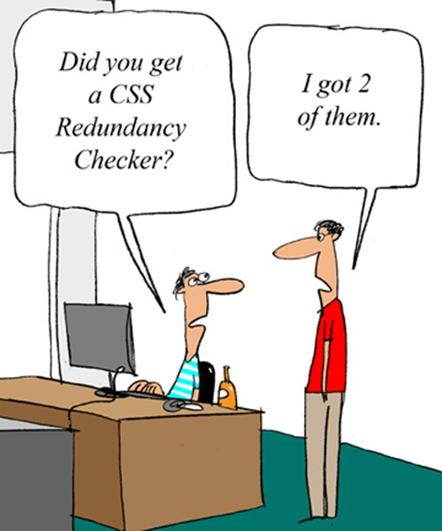
CSE 154
Lecture 3: Yet more HTML AND CSS

Slide 2
HTML Character Entities
a way of representing any Unicode character within a web page
character(s) | entity
< > | &lt; &gt;
é è ñ | &eacute; &egrave; &ntilde;
™ © | &trade; &copy;
π δ Δ | &pi; &delta; &Delta;
И | &#1048;
" & | &quot; &amp;
Complete list of HTML entities

Slide 3
Nesting tags
<p>
HTML is <em>really,
<strong>REALLY</em> lots of</strong> fun!
</p>
tags must be correctly nested
(a closing tag must match the most recently opened tag)
the browser may render it correctly anyway, but it is invalid HTML
(how would we get the above effect in a valid way?)

Slide 4
Unordered list: <ul>, <li>
<ul>
<li>No shoes</li>
<li>No shirt</li>
<li>No problem!</li>
</ul> HTML
No shoes
No shirt
No problem! output
ul represents a bulleted list of items (block)
li represents a single item within the list (block)

Slide 5
More about unordered lists
<ul>
<li>Harry Potter characters:
<ul>
<li>Harry Potter</li>
<li>Hermione</li>
<li>Ron</li>
</ul>
</li>
<li>LOTR characters:
<ul>
<li>Frodo</li>
<li>Bilbo</li>
<li>Sam</li>
</ul>
</li>
</ul> HTML
Harry Potter characters:
Harry Potter
Hermione
Ron
LOTR characters:
Frodo
Bilbo
Sam
output

Slide 6
Ordered list <ol>
<p>Apple business model:</p>
<ol>
<li>Beat Microsoft</li>
<li>Beat Google</li>
<li>Conquer the world!</li>
</ol> HTML
Apple business model:
Beat Microsoft
Beat Google
Conquer the world output
ol represents a numbered list of items
we can make lists with letters or Roman numerals using CSS (later)

Slide 7
Definition list <dl>, <dt>, <dd>
<dl>
<dt>newbie</dt> <dd>one who does not have mad skills</dd>
<dt>own</dt> <dd>to soundly defeat (e.g. I owned that newbie!)</dd>
<dt>frag</dt> <dd>a kill in a shooting game</dd>
</dl> HTML
newbie
one who does not have mad skills
own
to soundly defeat (e.g. I owned that newbie!)
frag
a kill in a shooting game output
dl represents a list of definitions of terms
dt represents each term, and dd its definition

Slide 8
Web page metadata: <meta>
information about your page (for a browser, search engine, etc.)
<meta charset="utf-8" />
<meta name="description“ content="Authors' web site for Building Java Programs." />
<meta name="keywords" content="java, textbook" /> HTML
placed in the head section of your HTML page
meta tags often have both the name and content attributes
some meta tags use the http-equiv attribute instead of name
the meta tag with charset attribute indicates language/character encodings
using a meta tag Content-Type stops validator "tentatively valid" warnings

Slide 9
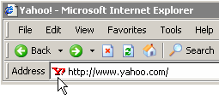
Favorites icon ("favicon")
<link href="filename" type="MIME type" rel="shortcut icon" /> HTML
<link href="yahoo.gif" type="image/gif" rel="shortcut icon" /> HTML
output
the link tag, placed in the head section, attaches another file to the page
in this case, an icon to be placed in the browser title bar and bookmarks
IE6: Doesn't work; must put a file favicon.ico in the root of the web server

Slide 10
Web Standards
It is important to write proper HTML code and follow proper syntax.
Why use valid HTML and web standards?
more rigid and structured language
more interoperable across different web browsers
more likely that our pages will display correctly in the future
can be interchanged with other XML data: SVG (graphics), MathML, MusicML, etc.

Slide 11
W3C HTML Validator
<p>
<a href="http://validator.w3.org/check/referer">
<img src="http://webster.cs.washington.edu/w3c-html.png" alt="Validate" />
</a>
</p>
validator.w3.org
checks your HTML code to make sure it follows the official HTML syntax
more picky than the browser, which may render bad HTML correctly

Slide 12
The bad way to produce styles
<p>
<font face="Arial">Welcome to Greasy Joe's.</font>
You will <b>never</b>, <i>ever</i>, <u>EVER</u> beat
<font size="+4" color="red">OUR</font> prices!
</p>
Welcome to Greasy Joe's. You will never, ever, EVER beat OUR prices!

Slide 13
Embedding style sheets: <style> (BAD!)
<head>
<style type="text/css">
p { font-family: sans-serif; color: red; }
h2 { background-color: yellow; }
</style>
</head>
HTML
CSS code can be embedded within the head of an HTML page
this is bad style; DO NOT DO THIS (why?)

Slide 14
Inline styles: the style attribute (BAD!)
<p style="font-family: sans-serif; color: red;">
This is a paragraph</p>
HTML
This is a paragraph
output
higher precedence than embedded or linked styles
used for one-time overrides and styling a particular element
this is bad style; DO NOT DO THIS (why?)

Slide 15
Cascading Style Sheets (CSS): <link>
<head>
...
<link href="filename" type="text/css" rel="stylesheet" />
...
</head> HTML
CSS describes the appearance and layout of information on a web page (as opposed to HTML, which describes the content of the page)
can be embedded in HTML or placed into separate .css file (preferred)

Slide 16
Basic CSS rule syntax
selector {
property: value;
property: value;
...
property: value;
}
p {
font-family: sans-serif;
color: red;
}
a CSS file consists of one or more rules
a rule's selector specifies HTML element(s) and applies style properties
a selector of * selects all elements

Slide 17
CSS comments: /* ... */
/* This is a comment.
It can span many lines in the CSS file. */
p {
color: red;
background-color: aqua;
} CSS
CSS (like HTML) is usually not commented as much as code such as Java
the // single-line comment style is NOT supported in CSS
the <!-- ... --> HTML comment style is also NOT supported in CSS

Slide 18
W3C CSS Validator
<p>
<a href="http://jigsaw.w3.org/css-validator/check/referer">
<img src="http://jigsaw.w3.org/css-validator/images/vcss"
alt="Valid CSS!" /></a>
</p> HTML
output
jigsaw.w3.org/css-validator/
checks your CSS to make sure it meets the official CSS specifications
more picky than the web browser, which may render malformed CSS correctly

Slide 19
CSS properties for fonts
property | description
font-family | which font will be used
font-size | how large the letters will be drawn
font-style | used to enable/disable italic style
font-weight | used to enable/disable bold style
Complete list of font properties

Slide 20
font-size
p {
font-size: 14pt;
}
This paragraph uses the style above.
units: pixels (px) vs. point (pt) vs. m-size (em)
16px, 16pt, 1.16em
vague font sizes: xx-small, x-small, small, medium, large, x-large, xx-large, smaller, larger
percentage font sizes, e.g.: 90%, 120%

Slide 21
font-family
p {
font-family: Georgia;
}
h2 {
font-family: "Courier New";
}
This paragraph uses the first style above.
This h2 uses the second style above.
enclose multi-word font names in quotes

Slide 22
More about font-family
p {
font-family: Garamond, "Times New Roman", serif;
}
This paragraph uses the above style.
can specify multiple fonts from highest to lowest priority
generic font names:
serif, sans-serif, cursive, fantasy, monospace

Slide 23
font-weight, font-style
p {
font-weight: bold;
font-style: italic;
}
This paragraph uses the style above.
either of the above can be set to normal to turn them off (e.g. headings)

Slide 24
Grouping styles
p, h1, h2 {
color: green;
}
h2 {
background-color: yellow;
} CSS
This paragraph uses the above style.
output
This h2 uses the above styles.
A style can select multiple elements separated by commas
The individual elements can also have their own styles

Slide 25
The list-style-type property
ol { list-style-type: lower-roman; } CSS
Possible values:
i. none : No marker
ii. disc (default), circle, square
iii. Decimal: 1, 2, 3, etc.
iv. decimal-leading-zero: 01, 02, 03, etc.
v. lower-roman: i, ii, iii, iv, v, etc.
vi. upper-roman: I, II, III, IV, V, etc.
vii. lower-alpha: a, b, c, d, e, etc.
viii. upper-alpha: A, B, C, D, E, etc.
x. lower-greek: alpha, beta, gamma, etc.
others: hebrew, armenian, georgian, cjk-ideographic, hiragana…

Slide 26
The visibility property
p.secret {
visibility: hidden;
} CSS
output
property | description
visibility | sets whether an element should be shown onscreen; can be visible (default) or hidden
hidden elements will still take up space onscreen, but will not be shown
to make it not take up any space, set display to none instead
can be used to show/hide dynamic HTML content on the page in response to events

Slide 27
The opacity property
body { background-image: url("images/marty-mcfly.jpg");
background-repeat: repeat; }
p { background-color: yellow;}
p.mcfly1 { opacity: 0.75; }
p.mcfly2 { opacity: 0.50; }
p.mcfly3 { opacity: 0.25; } CSS
property | description
opacity | how not-transparent the element is; value ranges from 1.0 (opaque) to 0.0 (transparent)

Slide 28
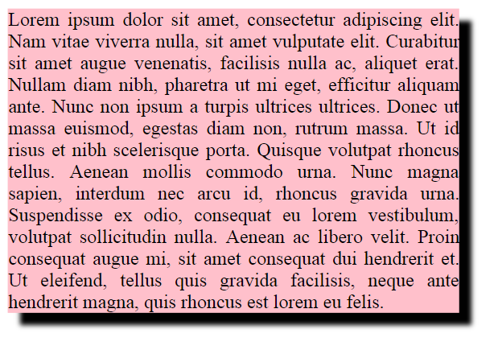
box-shadow
box-shadow: h-shadow v-shadow blur; CSS
box-shadow: 10px 10px 5px; CSS

Slide 29
Styles that conflict
p, h1, h2 { color: blue; font-style: italic; }
h2 { color: red; background-color: yellow; } CSS
This paragraph uses the first style above.
output
This heading uses both styles above.
when two styles set conflicting values for the same property, the latter style takes precedence

Slide 30
Inheriting styles (explanation)
body { font-family: sans-serif; background-color: yellow; }
p { color: red; background-color: aqua; }
a { text-decoration: underline; }
h2 { font-weight: bold; text-align: center; } CSS
This is a heading
A bulleted list output
A styled paragraph. Previous slides are available on the website.
when multiple styles apply to an element, they are inherited
a more tightly matching rule can override a more general inherited rule
not all properties are inherited (notice link's color above)

