Slide 1
CSE 154
Lecture 20: The DoM tree

Slide 2
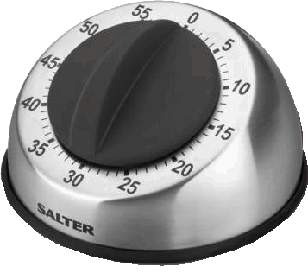
Setting a timer
method | description
setTimeout(function, delayMS); | arranges to call given function after given delay in ms
setInterval(function, delayMS); | arranges to call function repeatedly every delayMS ms
clearTimeout(timerID); clearInterval(timerID); | stops the given timer
both setTimeout and setInterval return an ID representing the timer
this ID can be passed to clearTimeout/Interval later to stop the timer

Slide 3
Passing parameters to timers
function delayedMultiply() {
// 6 and 7 are passed to multiply when timer goes off
setTimeout(multiply, 2000, 6, 7);
}
function multiply(a, b) {
alert(a * b);
} JS
output
any parameters after the delay are eventually passed to the timer function
doesn't work in IE; must create an intermediate function to pass the parameters
why not just write this?
setTimeout(multiply(6 * 7), 2000); JS

Slide 4
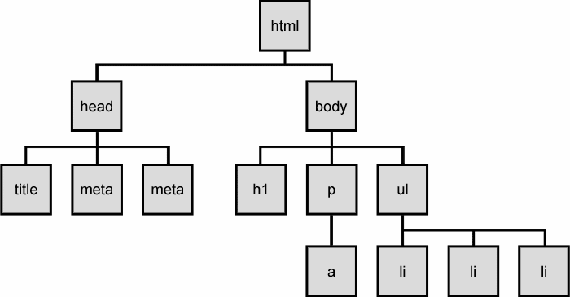
The DOM tree
The elements of a page are nested into a tree-like structure of objects the DOM has properties and methods for traversing this tree

Slide 5
DOM versus innerHTML hacking
Why not just code the previous example this way?
function slideClick() {
document.getElementById("main").innerHTML += "<p>A paragraph!</p>";
} JS
Imagine that the new node is more complex:
ugly: bad style on many levels (e.g. JS code embedded within HTML)
error-prone: must carefully distinguish " and '
can only add at beginning or end, not in middle of child list
function slideClick() {
document.getElementById("main").innerHTML += "<p style='color: red; " +
"margin-left: 50px;' " + "onclick='myOnClick();'>" +
"A paragraph!</p>";
} JS

Slide 6
Creating new nodes
name | description
document.createElement("tag") | creates and returns a new empty DOM node representing an element of that type
document.createTextNode("text") | creates and returns a text node containing given text
// create a new <h2> node
var newHeading = document.createElement("h2");
newHeading.innerHTML = "This is a heading";
newHeading.style.color = "green"; JS
merely creating a element does not add it to the page
you must add the new element as a child of an existing element on the page...

Slide 7
Modifying the DOM tree
Every DOM element object has these methods:
name | description
appendChild(node) | places given node at end of this node's child list
insertBefore(new, old) | places the given new node in this node's child list just before old child
removeChild(node) | removes given node from this node's child list
replaceChild(new, old) | replaces given child with new node
var p = document.createElement("p");
p.innerHTML = "A paragraph!";
document.getElementById("main").appendChild(p); JS
A paragraph!

Slide 8
Complex DOM manipulation problems
How would we do each of the following in JavaScript code? Each involves modifying each one of a group of elements ...
When the Go button is clicked, reposition all the divs of class puzzle to random x/y locations.
When the user hovers over the maze boundary, turn all maze walls red.
Change every other item in the ul list with id of TAs to have a gray background.

Slide 9
Selecting groups of DOM objects
methods in document and other DOM objects (* = HTML5):
name | description
getElementsByTagName | returns array of descendents with the given tag, such as "div"
getElementsByName | returns array of descendents with the given name attribute (mostly useful for accessing form controls)
querySelector * | returns the first element that would be matched by the given CSS selector string
querySelectorAll * | returns an array of all elements that would be matched by the given CSS selector string

Slide 10
Getting all elements of a certain type
highlight all paragraphs in the document:
var allParas = document.querySelectorAll("p");
for (var i = 0; i < allParas.length; i++) {
allParas[i].style.backgroundColor = "yellow";
} JS
<body>
<p>This is the first paragraph</p>
<p>This is the second paragraph</p>
<p>You get the idea...</p>
</body> HTML

Slide 11
Complex selectors
highlight all paragraphs inside of the section with ID "address":
// document.getElementById("address").getElementsByTagName("p")
var addrParas = document.querySelectorAll("#address p");
for (var i = 0; i < addrParas.length; i++) {
addrParas[i].style.backgroundColor = "yellow";
} JS
<p>This won't be returned!</p>
<div id="address">
<p>1234 Street</p>
<p>Atlanta, GA</p>
</div> HTML

Slide 12
Common querySelectorAll issues
many students forget to write . or # in front of a class or id
// get all buttons with a class of "control"
var gameButtons = document.querySelectorAll("control");
var gameButtons = document.querySelectorAll(".control"); JS
querySelectorAll returns an array, not a single element; must loop over the results (document.querySelector returns just the first element that matches, if that's what you want)
// set all buttons with a class of "control" to have red text
document.querySelectorAll(".gamebutton").style.color = "red";
var gameButtons = document.querySelector(".gamebutton");
for (var i = 0; i < gameButtons.length; i++) {
gameButtons[i].style.color = "red";
}
Q: Can I still select a group of elements using querySelectorAll even if my CSS file doesn't have any style rule for that same group? (A: Yes!)

Slide 13
Removing a node from the page
function slideClick() {
var bullet = document.getElementById("removeme");
bullet.parentNode.removeChild(bullet);
} JS
odd idiom: obj.parentNode.remove(obj);

Slide 14
The keyword this
this.fieldName // access field
this.fieldName = value; // modify field
this.methodName(parameters); // call method JS
all JavaScript code actually runs inside of an object
by default, code runs in the global window object (so this === window)
all global variables and functions you declare become part of window
the this keyword refers to the current object

Slide 15
Event handler binding
window.onload = function() {
document.getElementById("textbox").onmouseout = booyah;
document.getElementById("submit").onclick = booyah;
}; // bound to submit button here
function booyah() { // booyah knows what object it was called on
this.value = "booyah";
} JS
output
event handlers attached unobtrusively are bound to the element
inside the handler, that element becomes this

Slide 16
Problems with reading/changing styles
<button id="clickme">Click Me</button> HTML
window.onload = function() {
document.getElementById("clickme").onclick = biggerFont;
};
function biggerFont() {
var button = document.getElementById("clickme");
var size = parseInt(button.style.fontSize);
button.style.fontSize = (size + 4) + "pt";
} JS
output
style property lets you set any CSS style for an element
problem: you cannot read existing styles with it (you can read ones you set using the DOM .style, but not ones that are set in the CSS file)

Slide 17
Accessing elements' existing styles
window.getComputedStyle(element).propertyName JS
function biggerFont() {
// turn text yellow and make it bigger
var clickMe = document.getElementById("clickme");
var size = parseInt(window.getComputedStyle(clickMe).fontSize);
clickMe.style.fontSize = (size + 4) + "pt";
} JS
output
getComputedStyle method of global window object accesses existing styles

Slide 18
Common bug: incorrect usage of existing styles
the following example computes e.g. "200px" + 100 + "px" , which would evaluate to "200px100px"
var main = document.getElementById("main");
main.style.top = window.getComputedStyle(main).top + 100 + "px“;
// bad! JS
a corrected version:
main.style.top = parseInt(window.getComputedStyle(main).top) +
100 + "px"; // correct JS

Slide 19
Getting/setting CSS classes
function highlightField() {
// turn text yellow and make it bigger
var text = document.getElementById("text");
if (!text.className) {
text.className = "highlight";
} else if (text.className.indexOf("invalid") < 0) {
text.className += " highlight"; // awkward
}
} JS
JS DOM's className property corresponds to HTML class attribute
somewhat clunky when dealing with multiple space-separated classes as one big string

Slide 20
Getting/setting CSS classes with classList
function highlightField() {
// turn text yellow and make it bigger
var text = document.getElementById("text");
if (!text.classList.contains("invalid")) {
text.classList.add("highlight");
}
} JS
classList collection has methods add, remove, contains, toggle to manipulate CSS classes
similar to existing className DOM property, but don't have to manually split by spaces

Slide 21
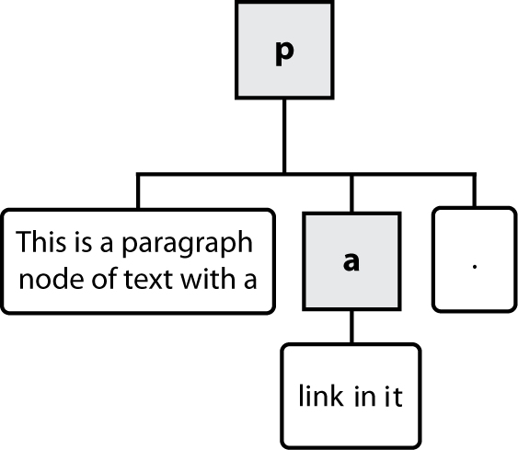
Types of DOM nodes
<p>
This is a paragraph of text with a
<a href="/path/page.html">link in it</a>.
</p> HTML
element nodes (HTML tag)
can have children and/or attributes
text nodes (text in a block element)
attribute nodes (attribute/value pair)
text/attributes are children in an element node
cannot have children or attributes
not usually shown when drawing the DOM tree

Slide 22
Traversing the DOM tree manually
every node's DOM object has the following properties:
name(s) | description
firstChild, lastChild | start/end of this node's list of children
childNodes | array of all this node's children
nextSibling, previousSibling | neighboring nodes with the same parent
parentNode | the element that contains this node
complete list of DOM node properties
browser incompatiblity information (IE6 sucks)

Slide 23
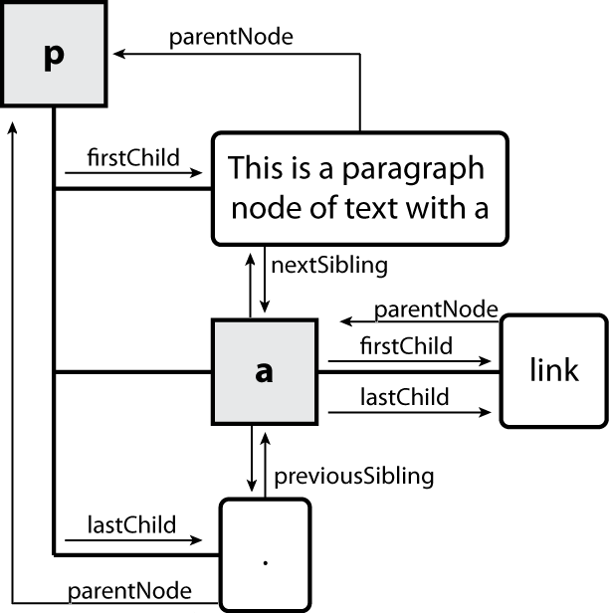
DOM tree traversal example
<p id="foo">This is a paragraph of text with a
<a href="/path/to/another/page.html">link</a>.</p> HTML

Slide 24
Element vs. text nodes
<div>
<p>
This is a paragraph of text with a
<a href="page.html">link</a>.
</p>
</div> HTML
Q: How many children does the div above have?
A: 3
an element node representing the <p>
two text nodes representing "\n\t" (before/after the paragraph)
Q: How many children does the paragraph have? The a tag?

