Slide 1
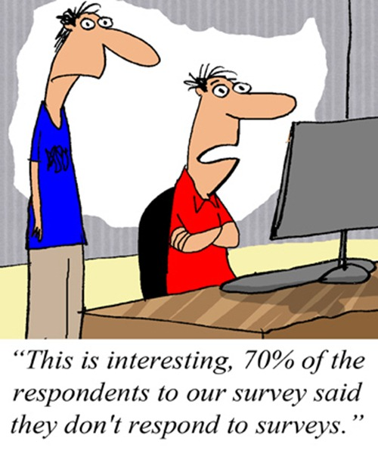
CSE 154
Lecture 9: FOrms

Slide 2
Web data
most interesting web pages revolve around data
examples: Google, IMDB, Digg, Facebook, YouTube, Rotten Tomatoes
can take many formats: text, HTML, XML, multimedia
many of them allow us to access their data
some even allow us to submit our own new data
most server-side web programs accept parameters that guide their execution

Slide 3
Query strings and parameters
URL?name=value&name=value...
http://www.google.com/search?q=Romney
http://example.com/student_login.php?username=obourn&id=1234567
query string: a set of parameters passed from a browser to a web server
often passed by placing name/value pairs at the end of a URL
above, parameter username has value obourn, and sid has value 1234567
PHP code on the server can examine and utilize the value of parameters
a way for PHP code to produce different output based on values passed by the user

Slide 4
Query parameters: $_GET, $_POST
$user_name = $_GET["username"];
$id_number = (int) $_GET["id"];
$eats_meat = FALSE;
if (isset($_GET["meat"])) {
$eats_meat = TRUE;
} PHP
$_GET["parameter name"] or $_POST["parameter name"] returns a GET/POST parameter's value as a string
parameters specified as http://....?name=value&name=value are GET parameters
test whether a given parameter was passed with isset

Slide 5
Example: Exponents
$base = $_GET["base"];
$exp = $_GET["exponent"];
$result = pow($base, $exp);
print "$base ^ $exp = $result"; PHP
exponent.php?base=3&exponent=4
3 ^ 4 = 81 output

Slide 6
Example: Print all parameters
<?php foreach ($_GET as $param => $value) { ?>
<p>Parameter <?= $param ?> has value <?= $value ?></p>
<?php } ?> PHP
print_params.php?name=Allison+Obourn&sid=1234567
Parameter name has value Allison Obourn
Parameter sid has value 1234567 output
or call print_r or var_dump on $_GET for debugging

Slide 7
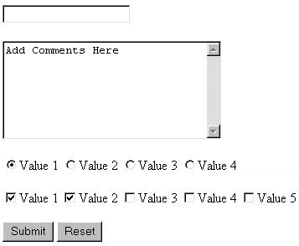
HTML forms
form: a group of UI controls that accepts information from the user and sends the information to a web server
the information is sent to the server as a query string
JavaScript can be used to create interactive controls (seen later)

Slide 8
HTML form: <form>
<form action="destination URL">
form controls
</form> HTML
required action attribute gives the URL of the page that will process this form's data
when form has been filled out and submitted, its data will be sent to the action's URL
one page may contain many forms if so desired

Slide 9
Form example
<form action="http://www.google.com/search">
<div>
Let's search Google:
<input name="q" />
<input type="submit" />
</div>
</form> HTML
Let's search Google: output
must wrap the form's controls in a block element such as div

Slide 10
Form controls: <input>
<!-- 'q' happens to be the name of Google's required parameter -->
<input type="text" name="q" value="Colbert Report" />
<input type="submit" value="Booyah!" /> HTML
output
input element is used to create many UI controls
an inline element that MUST be self-closed
name attribute specifies name of query parameter to pass to server
type can be button, checkbox, file, hidden, password, radio, reset, submit, text, ...
value attribute specifies control's initial text

Slide 11
Text fields: <input>
<input type="text" size="10" maxlength="8" /> NetID <br />
<input type="password" size="16" /> Password
<input type="submit" value="Log In" /> HTML
output
input attributes: disabled, maxlength, readonly, size, value
size attribute controls onscreen width of text field
maxlength limits how many characters user is able to type into field

Slide 12
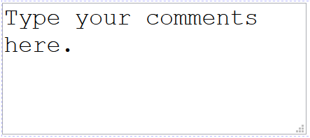
Text boxes: <textarea>
a multi-line text input area (inline)
<textarea rows="4" cols="20">
Type your comments here.
</textarea> HTML
output
initial text is placed inside textarea tag (optional)
required rows and cols attributes specify height/width in characters
optional readonly attribute means text cannot be modified

Slide 13
Checkboxes: <input>
yes/no choices that can be checked and unchecked (inline)
<input type="checkbox" name="lettuce" /> Lettuce
<input type="checkbox" name="tomato" checked="checked" /> Tomato
<input type="checkbox" name="pickles" checked="checked" /> Pickles HTML
output
none, 1, or many checkboxes can be checked at same time
when sent to server, any checked boxes will be sent with value on:
http://webster.cs.washington.edu/params.php?tomato=on&pickles=on
use checked="checked" attribute in HTML to initially check the box

Slide 14
Radio buttons: <input>
sets of mutually exclusive choices (inline)
<input type="radio" name="cc" value="visa" checked="checked" /> Visa
<input type="radio" name="cc" value="mastercard" /> MasterCard
<input type="radio" name="cc" value="amex" /> American Express HTML
output
grouped by name attribute (only one can be checked at a time)
must specify a value for each one or else it will be sent as value on

Slide 15
Text labels: <label>
<label><input type="radio" name="cc" value="visa" checked="checked" /> Visa</label>
<label><input type="radio" name="cc" value="mastercard" /> MasterCard</label>
<label><input type="radio" name="cc" value="amex" /> American Express</label> HTML
output
associates nearby text with control, so you can click text to activate control
can be used with checkboxes or radio buttons
label element can be targeted by CSS style rules

Slide 16
Drop-down list: <select>, <option>
menus of choices that collapse and expand (inline)
<select name="favoritecharacter">
<option>Jerry</option>
<option>George</option>
<option selected="selected">Kramer</option>
<option>Elaine</option>
</select> HTML
output
option element represents each choice
select optional attributes: disabled, multiple, size
optional selected attribute sets which one is initially chosen

Slide 17
Using <select> for lists
<select name="favoritecharacter[]" size="3" multiple="multiple">
<option>Jerry</option>
<option>George</option>
<option>Kramer</option>
<option>Elaine</option>
<option selected="selected">Newman</option>
</select> HTML
output
optional multiple attribute allows selecting multiple items with shift- or ctrl-click
must declare parameter's name with [] if you allow multiple selections
option tags can be set to be initially selected

Slide 18
Option groups: <optgroup>
<select name="favoritecharacter">
<optgroup label="Major Characters">
<option>Jerry</option>
<option>George</option>
<option>Kramer</option>
<option>Elaine</option>
</optgroup>
<optgroup label="Minor Characters">
<option>Newman</option>
<option>Susan</option>
</optgroup>
</select> HTML
output
What should we do if we don't like the bold appearance of the optgroups?

Slide 19
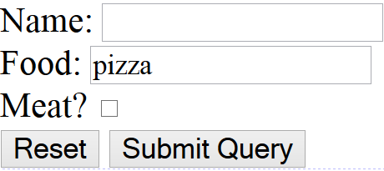
Reset buttons
Name: <input type="text" name="name" /> <br />
Food: <input type="text" name="meal" value="pizza" /> <br />
<label>Meat? <input type="checkbox" name="meat" /></label> <br />
<input type="reset" /> HTML
output
when clicked, returns all form controls to their initial values
specify custom text on the button by setting its value attribute

Slide 20
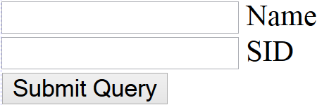
Hidden input parameters
<input type="text" name="username" /> Name <br />
<input type="text" name="sid" /> SID <br />
<input type="hidden" name="school" value="UW" />
<input type="hidden" name="year" value="2048" /> HTML
output
an invisible parameter that is still passed to the server when form is submitted
useful for passing on additional state that isn't modified by the user

Slide 21
Grouping input: <fieldset>, <legend>
groups of input fields with optional caption (block)
<fieldset>
<legend>Credit cards:</legend>
<input type="radio" name="cc" value="visa" checked="checked" /> Visa
<input type="radio" name="cc" value="mastercard" /> MasterCard
<input type="radio" name="cc" value="amex" /> American Express
</fieldset> HTML
output
fieldset groups related input fields, adds a border; legend supplies a caption

Slide 22
Styling form controls
element[attribute="value"] {
property : value;
property : value;
...
property : value;
} CSS
input[type="text"] {
background-color: yellow;
font-weight: bold;
} CSS
output
attribute selector: matches only elements that have a particular attribute value
useful for controls because many share the same element (input)

Slide 23
Problems with submitting data
<label><input type="radio" name="cc" /> Visa</label>
<label><input type="radio" name="cc" /> MasterCard</label> <br />
Favorite Star Trek captain:
<select name="startrek">
<option>James T. Kirk</option>
<option>Jean-Luc Picard</option>
</select> <br /> HTML
HTML
this form submits to our handy params.php tester page
the form may look correct, but when you submit it...
[cc] => on, [startrek] => Jean-Luc Picard

Slide 24
The value attribute
<label><input type="radio" name="cc" value="visa" /> Visa</label>
<label><input type="radio" name="cc" value="mastercard" /> MasterCard</label> <br />
Favorite Star Trek captain:
<select name="startrek">
<option value="kirk">James T. Kirk</option>
<option value="picard">Jean-Luc Picard</option>
</select> <br /> HTML
HTML
value attribute sets what will be submitted if a control is selected
[cc] => visa, [startrek] => picard

