Slide 1
CSE 154
Lecture 1: Basic HTML and CSS

Slide 2
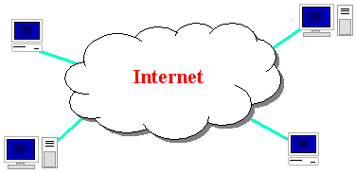
The Internet
Wikipedia: http://en.wikipedia.org/wiki/Internet
a connection of computer networks using the Internet Protocol (IP)
layers of communication protocols: IP → TCP/UDP → HTTP/FTP/POP/SMTP/SSH...

Slide 3
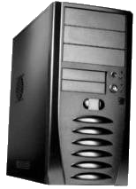
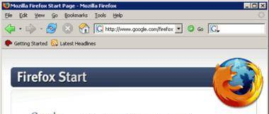
Web servers and browsers
web server: software that listens for web page requests
Apache
Microsoft Internet Information Server (IIS) (part of Windows)
web browser: fetches/displays documents from web servers
Mozilla Firefox
Microsoft Internet Explorer (IE)
Apple Safari
Google Chrome
Opera

Slide 4
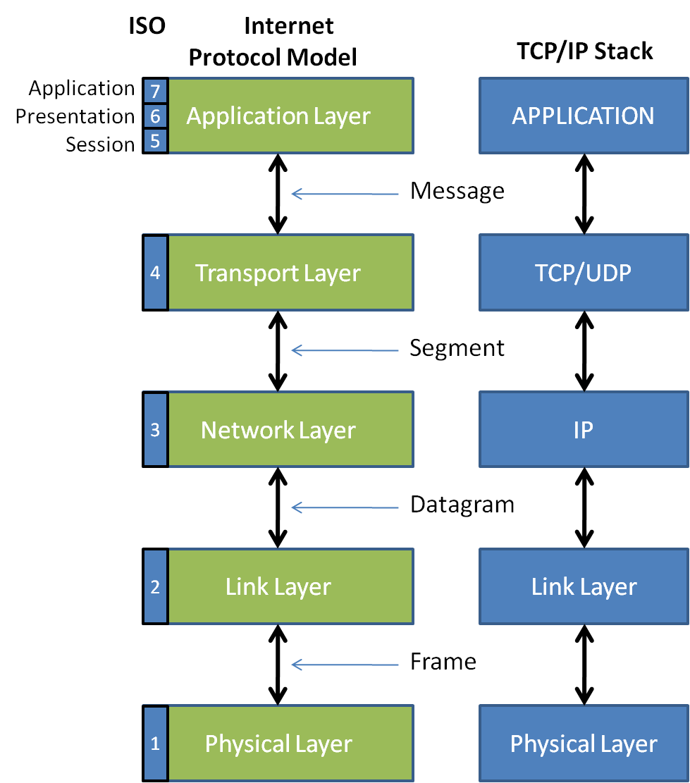
Layers of protocol
Protocol:
a set of rules governing the format of data sent
IP address:

Slide 5
Internet Protocol (IP)
a simple protocol for attempting to send data between two computers
each device has a 32-bit IP address written as four 8-bit numbers (0-255)
find out your internet IP address: whatismyip.com
find out your local IP address:
in a terminal, type: ipconfig (Windows) or ifconfig (Mac/Linux)

Slide 6
Transmission Control Protocol (TCP)
adds multiplexing, guaranteed message delivery on top of IP
multiplexing: multiple programs using the same IP address
port: a number given to each program or service
port 80: web browser (port 443 for secure browsing)
port 25: email
port 22: ssh
port 5190: AOL Instant Messenger
more common ports
some programs (games, streaming media programs) use simpler UDP protocol instead of TCP

Slide 7
How do web addresses work?
DNS:
a set of servers that map written names to IP addresses
Example: www.cs.washington.edu → 128.208.3.88
many systems maintain a local cache called a hosts file
URL:
a basic URL:http://www.aw-bc.com/info/regesstepp/index.html
~~~~ ~~~~~~~~~~~~~ ~~~~~~~~~~~~~~~~~~~~~~~~~~
protocol host path

Slide 8
Domain Name System (DNS)
a set of servers that map written names to IP addresses
Example: www.cs.washington.edu → 128.208.3.88
many systems maintain a local cache called a hosts file
Windows: C:\Windows\system32\drivers\etc\hosts
Mac: /private/etc/hosts
Linux: /etc/hosts

Slide 9
Uniform Resource Locator (URL)
an identifier for the location of a document on a web site
a basic URL:http://www.aw-bc.com/info/regesstepp/index.html
~~~~ ~~~~~~~~~~~~~ ~~~~~~~~~~~~~~~~~~~~~~~~~~
protocol host path
upon entering this URL into the browser, it would:
ask the DNS server for the IP address of www.aw-bc.com
connect to that IP address at port 80
ask the server to GET /info/regesstepp/index.html
display the resulting page on the screen

Slide 10
Hypertext Transport Protocol (HTTP)
the set of commands understood by a web server and sent from a browser
some HTTP commands (your browser sends these internally):
GET filename : download
POST filename : send a web form response
PUT filename : upload
simulating a browser with a terminal window:
$ telnet www.cs.washington.edu 80
Trying 128.208.3.88...
Connected to 128.208.3.88 (128.208.3.88).
Escape character is '^]'.
GET /index.html
<!DOCTYPE HTML PUBLIC "-//W3C//DTD HTML 4.0 ...">
<html>
...

Slide 11
Who "runs" the internet?
Internet Engineering Task Force (IETF): internet protocol standards
Internet Corporation for Assigned Names and Numbers (ICANN):
decides top-level domain names
World Wide Web Consortium (W3C): web standards

Slide 12
Brief History
began as a US Department of Defense network called ARPANET (1960s-70s)
initial services: electronic mail, file transfer
opened to commercial interests in late 80s
WWW created in 1989-91 by Tim Berners-Lee
popular web browsers released: Netscape 1994, IE 1995
Amazon.com opens in 1995; Google January 1996
Hamster Dance web page created in 1999

Slide 13
Web languages / technologies
Hypertext Markup Language (HTML): used for writing web pages
Cascading Style Sheets (CSS): stylistic info for web pages
PHP Hypertext Processor (PHP): dynamically create pages on a web server
JavaScript: interactive and programmable web pages
Asynchronous JavaScript and XML (Ajax): accessing data for web applications
eXtensible Markup Language (XML): metalanguage for organizing data
Structured Query Language (SQL): interaction with databases

Slide 14
Hypertext Markup Language (HTML)
describes the content and structure of information on a web page
not the same as the presentation (appearance on screen)
surrounds text content with opening and closing tags
each tag's name is called an element
syntax: <element> content </element>
example: <p>This is a paragraph</p>
most whitespace is insignificant in HTML (ignored or collapsed to a single space)
we will use a newer version called HTML5

Slide 15
Structure of an HTML page
<!DOCTYPE html>
<html>
<head>
information about the page
</head>
<body>
page contents
</body>
</html>

Slide 16
Page title: <title>
describes the title of the web page
<title>Chapter 2: HTML Basics</title>
placed within the head of the page
displayed in the web browser's title bar and when bookmarking the page

Slide 17
Paragraph: <p>
paragraphs of text (block)
<p>You're not your job.
You're not how much money you have in the bank.
You're not the car you drive. You're not the contents
of your wallet. You're not your khakis. You're
the all-singing, all-dancing crap of the world.</p>
You're not your job. You're not how much money you have in the bank. You're not the car you drive. You're not the contents of your wallet. You're not your khakis. You're the all-singing, all-dancing crap of the world.
placed within the body of the page
more paragraph examples

Slide 18
Headings: <h1>, <h2>, ..., <h6>
headings to separate major areas of the page (block)
<h1>University of Whoville</h1>
<h2>Department of Computer Science</h2>
<h3>Sponsored by Micro$oft</h3>
University of Whoville
Department of Computer Science
Sponsored by Micro$oft
More heading examples

