Slide 1
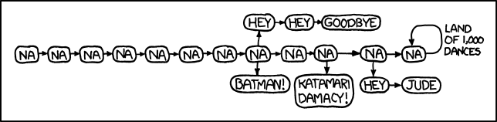
Goodbye, world!

Slide 2
Major themes
Abstraction
  Leverage existing components without understanding details
  Create components that can be used as black boxes
Design tradeoffs
  Algorithm analysis - scalability and growth
  Keeping code easy to read for maintainability
Recursion
  Reason about problems in terms of self-similarity
  Write very short code to achieve complex behaviors
Art – "A programmer who subconsciously views himself as an artist will enjoy what he does and will do it better." (Knuth)

Slide 3
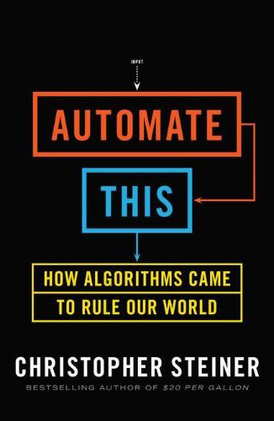
Automate all the things
Foreign policy: outcome prediction
Law: evidence summary
Medicine: smart diagnostics
Music: hit identification
Sports: superstar discovery
Wall Street: high frequency trading

Slide 4



Explore Big Ideas
Historical context
Key algorithms
Privacy

Slide 5
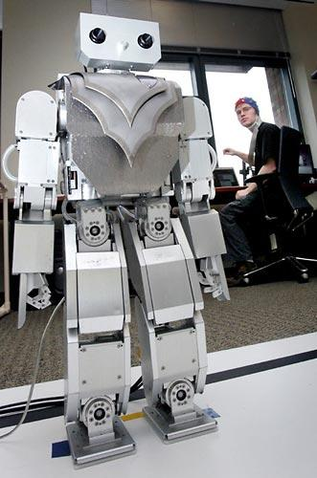
Beyond programming
Mind-controlled robots
  http://www.youtube.com/watch?v=TQ7EOpPNQyw
Muscle-controlled interfaces
  http://www.youtube.com/watch?v=pktVSTwC8qo
3D models from pictures
  http://www.youtube.com/watch?v=25Yifq70elY
Face aging
  http://www.youtube.com/watch?v=fLQtssJDMMc
Animation
  http://www.youtube.com/watch?v=b4kkPlLdMvI
Security
  http://www.pbs.org/wgbh/nova/tech/tadayoshi-kohno.html

Slide 6
What project?
Little text-processing applications
  identify lines above 100
  remove line-breaks
Add a GUI to the random sentence generator
Automate chemistry, physics, calculus problems, etc
Find quotes by keyword in books
What are you currently doing that a computer could do?

Slide 7
What language?
Expanding your Java knowledge with a project is valuable
Pick a project, see what language is most appropriate
  iOS: Objective-C
  Android: Java
  Client-side web: Javascript
  Beautiful visuals: Processing
  Quick data processing: Python
  Embedded systems: C/C++
Learn a new paradigm
  Functional languages: Racket, Haskell (now, Java 8, too!)

Slide 8
Leveraging existing code
Processing language
  http://nlp.stanford.edu/software/
Building games
  http://lwjgl.org/
Building games with physics
  http://jbox2d.org/
Processing biological data
  http://biojava.org/wiki/Main_Page
Accessing Facebook data
  http://restfb.com/

Slide 9
Using the restFB API
Add the restfb jar to your build path
  In Eclipse, right click on your project > properties
  In Java Build Path, Add JARs...
Get an access token from the Facebook Graph API Explorer

Slide 10
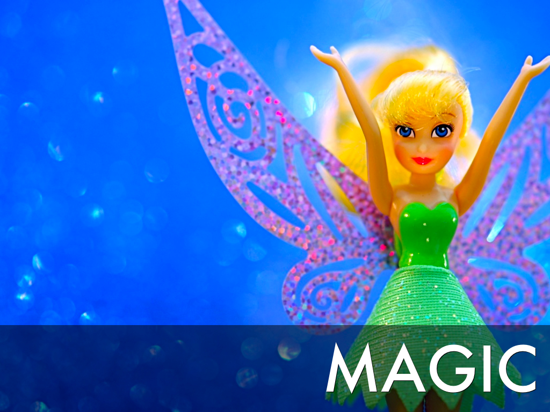

Slide 11
Courses?
CSE non-majors
  CSE 154: Web Programming
  CSE 373: Data Structures and Algorithms
  CSE 374: Programming Concepts and Tools (C/C++, Linux, ...)
  CSE 131: Digital Photography
  CSE 460: Animation Capstone (open to all majors)
  INFO, AMATH, DXARTS, ...
CSE majors
  CSE 311: (Mathematical) Foundations of Computing
  CSE 332: Data Abstractions (Data Structures and Algorithms)
  CSE 331: Software Design and Implementation
  CSE 341: Programming Languages
  CSE 344: Intro to Data Management (and databases)
  CSE 351: Hardware/Software Interface

Slide 12
Weekly meetings
Change – technologies for low-income regions
  http://change.washington.edu/
Dub – human-computer interaction and design
  http://dub.washington.edu/

Slide 13
