Slide 1
Recursive Backtracking Practice
11/12/2021

Slide 2
Administrivia
Wrapping up our simulated midterm week!
A6 (AnagramSolver) released

Slide 3
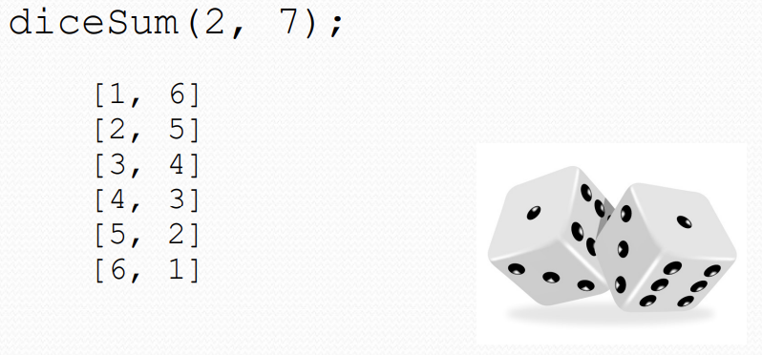
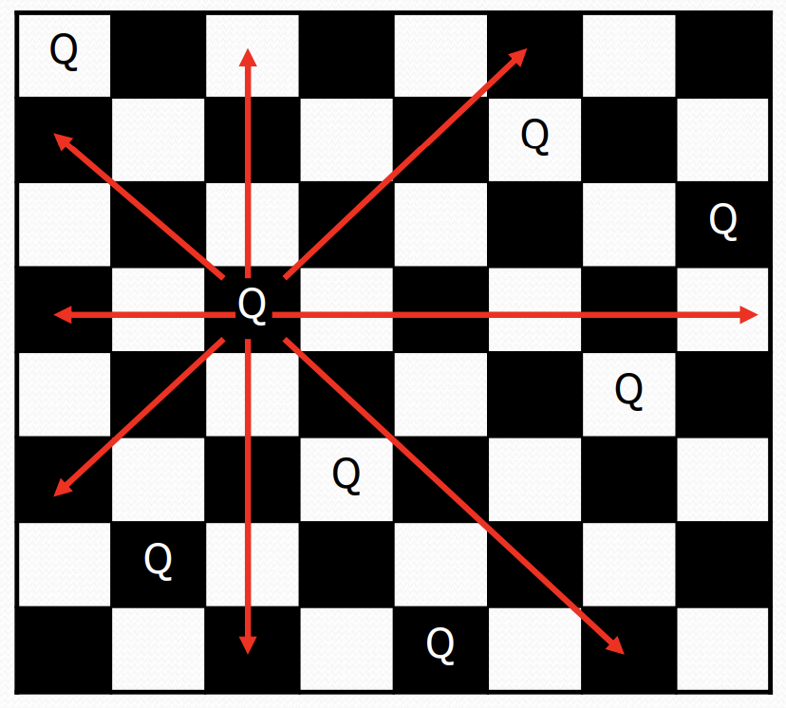
On Wednesday
8 Queens

Slide 4
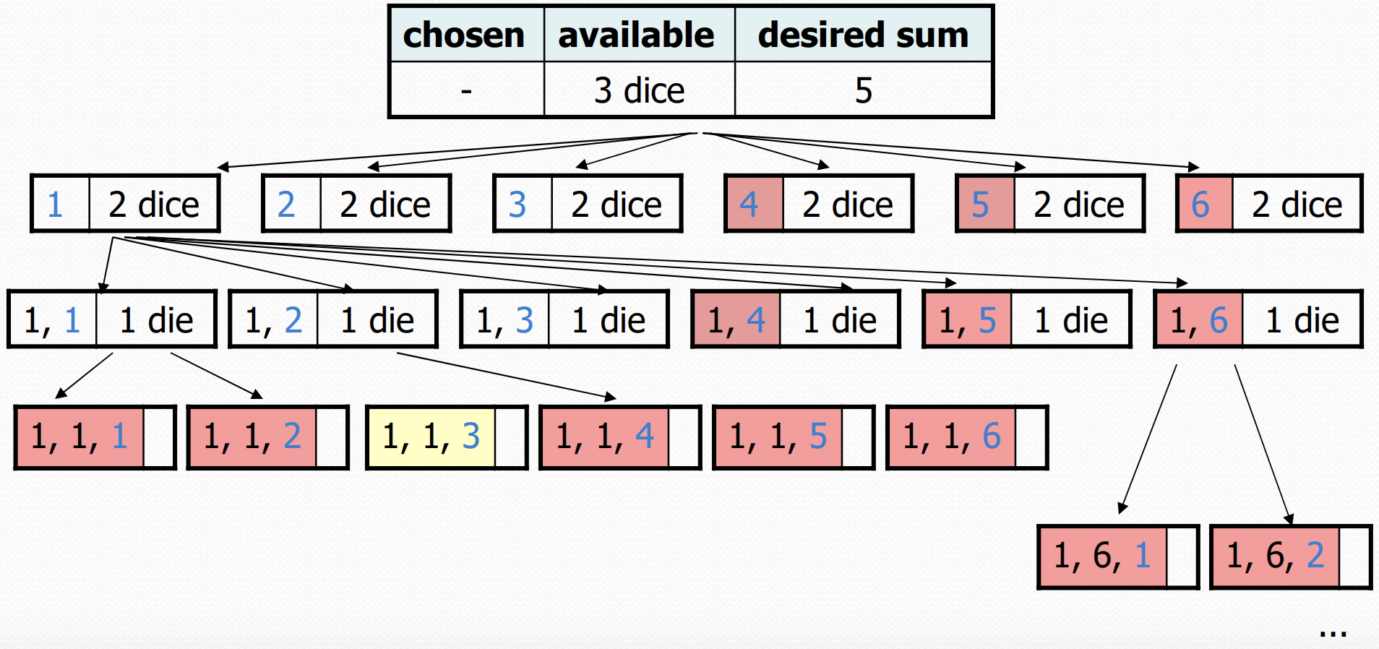
Decision Trees

Slide 5

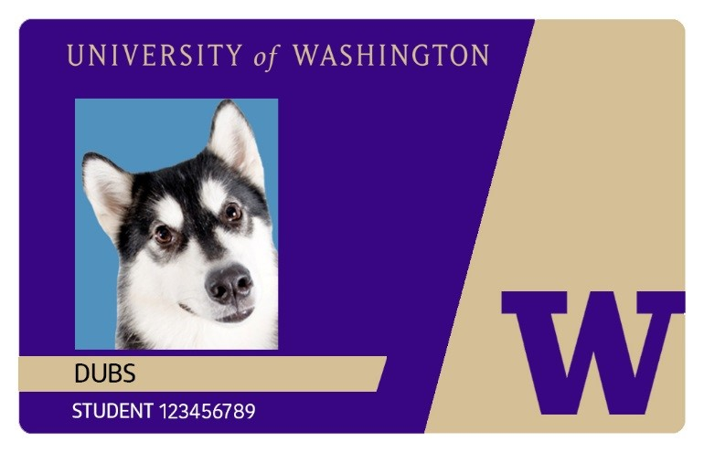



Spend all your Husky card money!
$1
$2
Balance: $3
$3
$5

Slide 6
chosen: 📞
dollarsLeft: 3
Output:
chosen
Phone Number: 425-123-4567

Slide 7
chosen: 📞
dollarsLeft: 3
$1
Output:
1
chosen
Phone Number: 425-123-4567

Slide 8
chosen: 📞
dollarsLeft: 3
$1
chosen: 📞
dollarsLeft: 2
Output:
1
chosen
Phone Number: 425-123-4567

Slide 9
chosen: 📞
dollarsLeft: 3
$1
chosen: 📞
dollarsLeft: 2
Output:
$1
1 1
chosen
Phone Number: 425-123-4567

Slide 10
chosen: 📞
dollarsLeft: 3
$1
chosen: 📞
dollarsLeft: 2
Output:
$1
chosen: 📞
dollarsLeft: 1
1 1
chosen
Phone Number: 425-123-4567

Slide 11
chosen: 📞
dollarsLeft: 3
$1
chosen: 📞
dollarsLeft: 2
Output:
$1
chosen: 📞
dollarsLeft: 1
$1
1 1 1
chosen
Phone Number: 425-123-4567

Slide 12
chosen: 📞
dollarsLeft: 3
$1
chosen: 📞
dollarsLeft: 2
Output:
$1
chosen: 📞
dollarsLeft: 1
$1
1 1 1
chosen: 📞
dollarsLeft: 0
chosen
Phone Number: 425-123-4567

Slide 13
chosen: 📞
dollarsLeft: 3
$1
chosen: 📞
dollarsLeft: 2
Output:
$1
chosen: 📞
dollarsLeft: 1
$1
1 1 1
chosen: 📞
dollarsLeft: 0
chosen
Phone Number: 425-123-4567

Slide 14
chosen: 📞
dollarsLeft: 3
$1
chosen: 📞
dollarsLeft: 2
Output:
[1, 1, 1]
$1
chosen: 📞
dollarsLeft: 1
$1
1 1 1
chosen: 📞
dollarsLeft: 0
chosen
Phone Number: 425-123-4567

Slide 15
chosen: 📞
dollarsLeft: 3
$1
chosen: 📞
dollarsLeft: 2
Output:
[1, 1, 1]
$1
chosen: 📞
dollarsLeft: 1
1 1 1
chosen
Phone Number: 425-123-4567

Slide 16
chosen: 📞
dollarsLeft: 3
$1
chosen: 📞
dollarsLeft: 2
Output:
[1, 1, 1]
$1
chosen: 📞
dollarsLeft: 1
1 1
chosen
Phone Number: 425-123-4567

Slide 17
chosen: 📞
dollarsLeft: 3
$1
chosen: 📞
dollarsLeft: 2
Output:
[1, 1, 1]
$1
chosen: 📞
dollarsLeft: 1
$2
1 1 2
chosen: 📞
dollarsLeft: -1
chosen
Phone Number: 425-123-4567

Slide 18
chosen: 📞
dollarsLeft: 3
$1
chosen: 📞
dollarsLeft: 2
Output:
[1, 1, 1]
$1
chosen: 📞
dollarsLeft: 1
$2
1 1 2
chosen: 📞
dollarsLeft: -1
chosen
Phone Number: 425-123-4567

Slide 19
chosen: 📞
dollarsLeft: 3
$1
chosen: 📞
dollarsLeft: 2
Output:
[1, 1, 1]
$1
chosen: 📞
dollarsLeft: 1
1 1 2
chosen
Phone Number: 425-123-4567

Slide 20
chosen: 📞
dollarsLeft: 3
$1
chosen: 📞
dollarsLeft: 2
Output:
[1, 1, 1]
$1
chosen: 📞
dollarsLeft: 1
1 1
chosen
Phone Number: 425-123-4567

Slide 21
chosen: 📞
dollarsLeft: 3
$1
chosen: 📞
dollarsLeft: 2
Output:
[1, 1, 1]
$1
chosen: 📞
dollarsLeft: 1
$3
1 1 3
chosen: 📞
dollarsLeft: -2
chosen
Phone Number: 425-123-4567

Slide 22
chosen: 📞
dollarsLeft: 3
$1
chosen: 📞
dollarsLeft: 2
Output:
[1, 1, 1]
$1
chosen: 📞
dollarsLeft: 1
$3
1 1 3
chosen: 📞
dollarsLeft: -2
chosen
Phone Number: 425-123-4567

Slide 23
chosen: 📞
dollarsLeft: 3
$1
chosen: 📞
dollarsLeft: 2
Output:
[1, 1, 1]
$1
chosen: 📞
dollarsLeft: 1
1 1
chosen
Phone Number: 425-123-4567

Slide 24
chosen: 📞
dollarsLeft: 3
$1
chosen: 📞
dollarsLeft: 2
Output:
[1, 1, 1]
$1
chosen: 📞
dollarsLeft: 1
$5
1 1 5
chosen: 📞
dollarsLeft: -4
chosen
Phone Number: 425-123-4567

Slide 25
chosen: 📞
dollarsLeft: 3
$1
chosen: 📞
dollarsLeft: 2
Output:
[1, 1, 1]
$1
chosen: 📞
dollarsLeft: 1
$5
1 1 5
chosen: 📞
dollarsLeft: -4
chosen
Phone Number: 425-123-4567

Slide 26
chosen: 📞
dollarsLeft: 3
$1
chosen: 📞
dollarsLeft: 2
Output:
[1, 1, 1]
$1
chosen: 📞
dollarsLeft: 1
1 1
chosen
Phone Number: 425-123-4567

Slide 27
chosen: 📞
dollarsLeft: 3
$1
chosen: 📞
dollarsLeft: 2
Output:
[1, 1, 1]
1
chosen
Phone Number: 425-123-4567

Slide 28
chosen: 📞
dollarsLeft: 3
$1
chosen: 📞
dollarsLeft: 2
Output:
[1, 1, 1]
$2
chosen: 📞
dollarsLeft: 0
1 2
chosen
Phone Number: 425-123-4567

Slide 29
chosen: 📞
dollarsLeft: 3
$1
chosen: 📞
dollarsLeft: 2
Output:
[1, 1, 1]
[1, 2]
$2
chosen: 📞
dollarsLeft: 0
1 2
chosen
Phone Number: 425-123-4567

Slide 30
chosen: 📞
dollarsLeft: 3
$1
$5
$2
$3
chosen: 📞
dollarsLeft: 2
chosen: 📞
dollarsLeft: 1
chosen: 📞
dollarsLeft: 0
chosen: 📞
dollarsLeft: -2
$1
$2
$3
$5
$1
$2
$3
$5
chosen: 📞
dollarsLeft: 1
chosen: 📞
dollarsLeft: 0
chosen: 📞
dollarsLeft: -1
chosen: 📞
dollarsLeft: -3
chosen: 📞
dollarsLeft: 0
chosen: 📞
dollarsLeft: -1
chosen: 📞
dollarsLeft: -2
chosen: 📞
dollarsLeft: -4
$1
chosen: 📞
dollarsLeft: 0

Slide 31
chosen: 📞
dollarsLeft: 3
$1
$5
$2
$3
chosen: 📞
dollarsLeft: 2
chosen: 📞
dollarsLeft: 1
chosen: 📞
dollarsLeft: 0
chosen: 📞
dollarsLeft: -2
$1
$2
$3
$5
$1
$2
$3
$5
chosen: 📞
dollarsLeft: 1
chosen: 📞
dollarsLeft: 0
chosen: 📞
dollarsLeft: -1
chosen: 📞
dollarsLeft: -3
chosen: 📞
dollarsLeft: 0
chosen: 📞
dollarsLeft: -1
chosen: 📞
dollarsLeft: -2
chosen: 📞
dollarsLeft: -4
$1
chosen: 📞
dollarsLeft: 0

Slide 32
What order should I do my homework in?
CSE 143, MATH 125, PSYCH 101

