Slide 1
Building Java Programs
Chapter 13
Sorting
reading: 13.3, 13.4

Slide 3
Collections class
Method name | Description
binarySearch(list, value) | returns the index of the given value in a sorted list (< 0 if not found)
copy(listTo, listFrom) | copies listFrom's elements to listTo
emptyList(), emptyMap(), emptySet() | returns a read-only collection of the given type that has no elements
fill(list, value) | sets every element in the list to have the given value
max(collection), min(collection) | returns largest/smallest element
replaceAll(list, old, new) | replaces an element value with another
reverse(list) | reverses the order of a list's elements
shuffle(list) | arranges elements into a random order
sort(list) | arranges elements into ascending order

Slide 4
Sorting
sorting: Rearranging the values in an array or collection into a specific order (usually into their "natural ordering").
one of the fundamental problems in computer science
can be solved in many ways:
there are many sorting algorithms
some are faster/slower than others
some use more/less memory than others
some work better with specific kinds of data
some can utilize multiple computers / processors, ...
comparison-based sorting : determining order by comparing pairs of elements:
<, >, compareTo, …

Slide 5
Sorting methods in Java
The Arrays and Collections classes in java.util have a static method sort that sorts the elements of an array/list
String[] words = {"foo", "bar", "baz", "ball"};
Arrays.sort(words);
System.out.println(Arrays.toString(words));
// [ball, bar, baz, foo]
List<String> words2 = new ArrayList<String>();
for (String word : words) {
words2.add(word);
}
Collections.sort(words2);
System.out.println(words2);
// [ball, bar, baz, foo]

Slide 6
Sorting algorithms
bogo sort: shuffle and pray
bubble sort: swap adjacent pairs that are out of order
selection sort: look for the smallest element, move to front
insertion sort: build an increasingly large sorted front portion
merge sort: recursively divide the array in half and sort it
heap sort: place the values into a sorted tree structure
quick sort: recursively partition array based on a middle value
other specialized sorting algorithms:
bucket sort: cluster elements into smaller groups, sort them
radix sort: sort integers by last digit, then 2nd to last, then ...
...

Slide 7
Selection sort
selection sort: Orders a list of values by repeatedly putting the smallest or largest unplaced value into its final position.
The algorithm:
Look through the list to find the smallest value.
Swap it so that it is at index 0.
Look through the list to find the second-smallest value.
Swap it so that it is at index 1.
...
Repeat until all values are in their proper places.

Slide 8
Selection sort example
Initial array:
After 1st, 2nd, and 3rd passes:
index | 0 | 1 | 2 | 3 | 4 | 5 | 6 | 7 | 8 | 9 | 10 | 11 | 12 | 13 | 14 | 15 | 16
value | 22 | 18 | 12 | -4 | 27 | 30 | 36 | 50 | 7 | 68 | 91 | 56 | 2 | 85 | 42 | 98 | 25
index | 0 | 1 | 2 | 3 | 4 | 5 | 6 | 7 | 8 | 9 | 10 | 11 | 12 | 13 | 14 | 15 | 16
value | -4 | 18 | 12 | 22 | 27 | 30 | 36 | 50 | 7 | 68 | 91 | 56 | 2 | 85 | 42 | 98 | 25
index | 0 | 1 | 2 | 3 | 4 | 5 | 6 | 7 | 8 | 9 | 10 | 11 | 12 | 13 | 14 | 15 | 16
value | -4 | 2 | 12 | 22 | 27 | 30 | 36 | 50 | 7 | 68 | 91 | 56 | 18 | 85 | 42 | 98 | 25
index | 0 | 1 | 2 | 3 | 4 | 5 | 6 | 7 | 8 | 9 | 10 | 11 | 12 | 13 | 14 | 15 | 16
value | -4 | 2 | 7 | 22 | 27 | 30 | 36 | 50 | 12 | 68 | 91 | 56 | 18 | 85 | 42 | 98 | 25

Slide 9
Selection sort code
// Rearranges the elements of a into sorted order using
// the selection sort algorithm.
public static void selectionSort(int[] a) {
for (int i = 0; i < a.length - 1; i++) {
// find index of smallest remaining value
int min = i;
for (int j = i + 1; j < a.length; j++) {
if (a[j] < a[min]) {
min = j;
}
}
// swap smallest value its proper place, a[i]
swap(a, i, min);
}
}

Slide 10
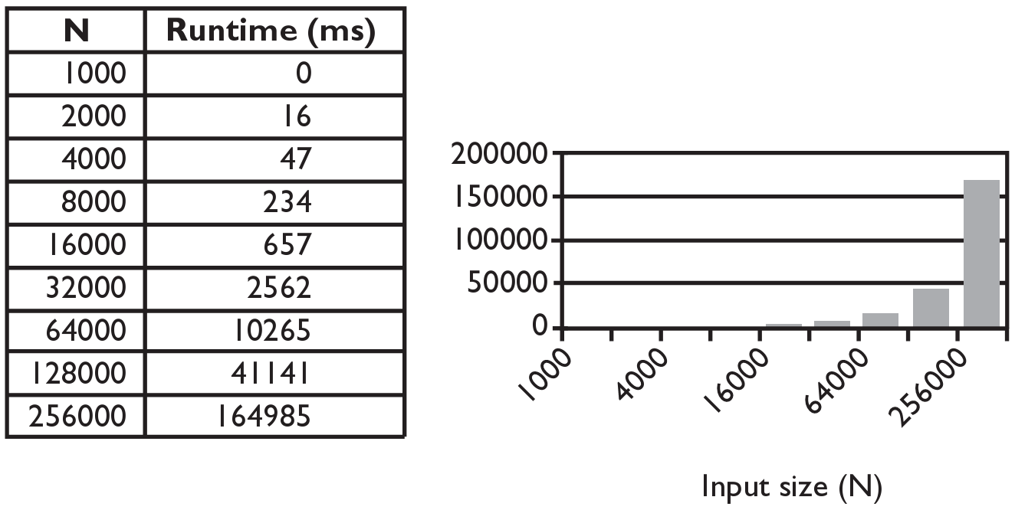
Selection sort runtime (Fig. 13.6)
What is the complexity class (Big-Oh) of selection sort?

Slide 11
Bogo sort
bogo sort: Orders a list of values by repetitively shuffling them and checking if they are sorted.
name comes from the word "bogus"
The algorithm:
Scan the list, seeing if it is sorted. If so, stop.
Else, shuffle the values in the list and repeat.
This sorting algorithm (obviously) has terrible performance!
What is its runtime?

Slide 12
Bogo sort code
// Places the elements of a into sorted order.
public static void bogoSort(int[] a) {
while (!isSorted(a)) {
shuffle(a);
}
}
// Returns true if a's elements are in sorted order.
public static boolean isSorted(int[] a) {
for (int i = 0; i < a.length - 1; i++) {
if (a[i] > a[i + 1]) {
return false;
}
}
return true;
}

Slide 13
Bogo sort code, cont'd.
// Shuffles an array of ints by randomly swapping each
// element with an element ahead of it in the array.
public static void shuffle(int[] a) {
for (int i = 0; i < a.length - 1; i++) {
// pick a random index in [i+1, a.length-1]
int range = a.length - 1 - (i + 1) + 1;
int j = (int) (Math.random() * range + (i + 1));
swap(a, i, j);
}
}
// Swaps a[i] with a[j].
public static void swap(int[] a, int i, int j) {
if (i != j) {
int temp = a[i];
a[i] = a[j];
a[j] = temp;
}
}

Slide 14
Similar algorithms
index | 0 | 1 | 2 | 3 | 4 | 5 | 6 | 7 | 8 | 9 | 10 | 11 | 12 | 13 | 14 | 15 | 16
value | 22 | 18 | 12 | -4 | 27 | 30 | 36 | 50 | 7 | 68 | 91 | 56 | 2 | 85 | 42 | 98 | 25
bubble sort: Make repeated passes, swapping adjacent values
slower than selection sort (has to do more swaps)
insertion sort: Shift each element into a sorted sub-array
faster than selection sort (examines fewer values)
index | 0 | 1 | 2 | 3 | 4 | 5 | 6 | 7 | 8 | 9 | 10 | 11 | 12 | 13 | 14 | 15 | 16
value | 18 | 12 | -4 | 22 | 27 | 30 | 36 | 7 | 50 | 68 | 56 | 2 | 85 | 42 | 91 | 25 | 98
22
50
91
98
index | 0 | 1 | 2 | 3 | 4 | 5 | 6 | 7 | 8 | 9 | 10 | 11 | 12 | 13 | 14 | 15 | 16
value | -4 | 12 | 18 | 22 | 27 | 30 | 36 | 50 | 7 | 68 | 91 | 56 | 2 | 85 | 42 | 98 | 25
sorted sub-array (indexes 0-7)
7

Slide 15
Merge sort
merge sort: Repeatedly divides the data in half, sorts each half, and combines the sorted halves into a sorted whole.
The algorithm:
Divide the list into two roughly equal halves.
Sort the left half.
Sort the right half.
Merge the two sorted halves into one sorted list.
An example of a "divide and conquer" algorithm.
Invented by John von Neumann in 1945

Slide 16
Merge sort example
index | 0 | 1 | 2 | 3 | 4 | 5 | 6 | 7
value | 22 | 18 | 12 | -4 | 58 | 7 | 31 | 42
split
22 | 18 | 12 | -4
58 | 7 | 31 | 42
split
split
22 | 18
12 | -4
58 | 7
31 | 42
split
split
split
split
22
18
12
-4
58
7
31
42
merge
merge
merge
merge
18 | 22
-4 | 12
7 | 58
31 | 42
merge
merge
-4 | 12 | 18 | 22
7 | 31 | 42 | 58
merge
-4 | 7 | 12 | 18 | 22 | 31 | 42 | 58

Slide 17
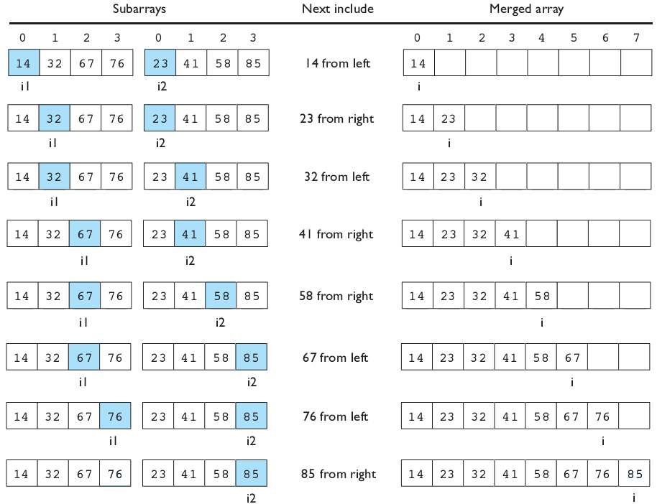
Merging sorted halves

Slide 18
Merge sort
merge sort: Repeatedly divides the data in half, sorts each half, and combines the sorted halves into a sorted whole.
The algorithm:
Divide the list into two roughly equal halves.
Sort the left half.
Sort the right half.
Merge the two sorted halves into one sorted list.
An example of a "divide and conquer" algorithm.
Invented by John von Neumann in 1945

Slide 19
Merge halves code
// Merges the left/right elements into a sorted result.
// Precondition: left/right are sorted
public static void merge(int[] result, int[] left,
int[] right) {
int i1 = 0; // index into left array
int i2 = 0; // index into right array
for (int i = 0; i < result.length; i++) {
if (i2 >= right.length ||
(i1 < left.length && left[i1] <= right[i2])) {
result[i] = left[i1]; // take from left
i1++;
} else {
result[i] = right[i2]; // take from right
i2++;
}
}
}

Slide 20
Merge sort code
// Rearranges the elements of a into sorted order using
// the merge sort algorithm.
public static void mergeSort(int[] a) {
// split array into two halves
int[] left = Arrays.copyOfRange(a, 0, a.length/2);
int[] right = Arrays.copyOfRange(a, a.length/2, a.length);
// sort the two halves
...
// merge the sorted halves into a sorted whole
merge(a, left, right);
}

Slide 21
Merge sort code 2
// Rearranges the elements of a into sorted order using
// the merge sort algorithm (recursive).
public static void mergeSort(int[] a) {
if (a.length >= 2) {
// split array into two halves
int[] left = Arrays.copyOfRange(a, 0, a.length/2);
int[] right = Arrays.copyOfRange(a, a.length/2, a.length);
// sort the two halves
mergeSort(left);
mergeSort(right);
// merge the sorted halves into a sorted whole
merge(a, left, right);
}
}

Slide 22
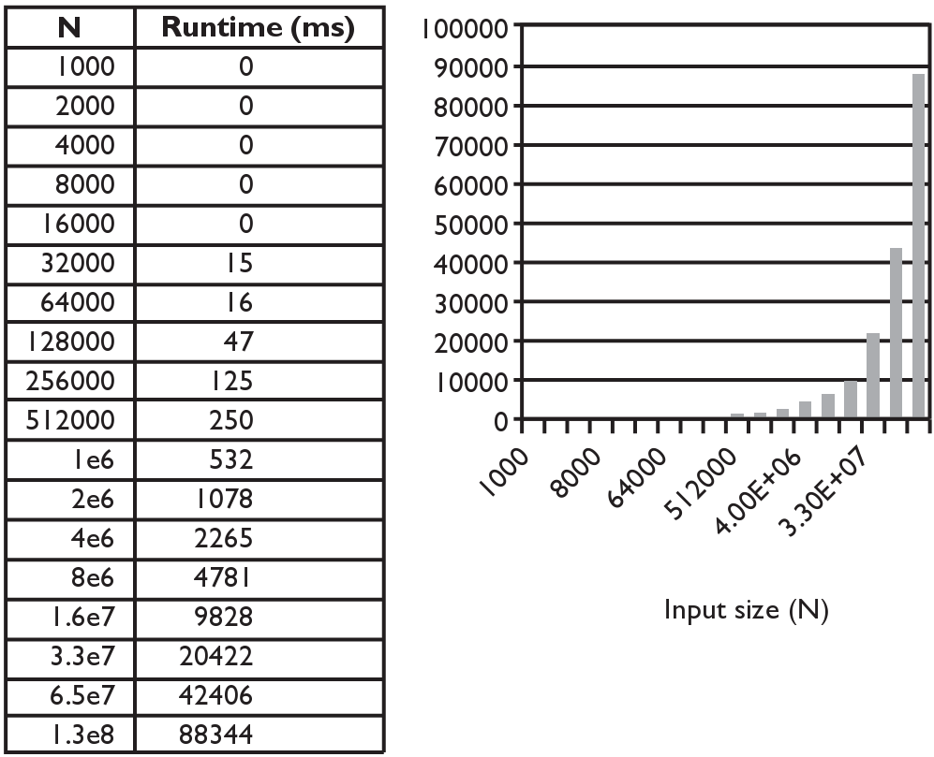
Merge sort runtime
What is the complexity class (Big-Oh) of merge sort?

