Slide 1
Building Java Programs
Chapter 11
Sets and Maps
reading: 11.2 - 11.3

Slide 2
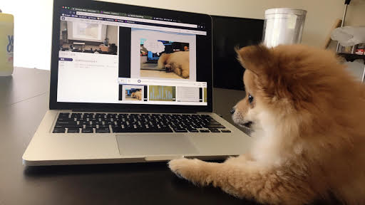

Slide 3
Plan for Lecture
Review code
Fix style and add indentation to output
Grammars and Regular Expressions

Slide 4
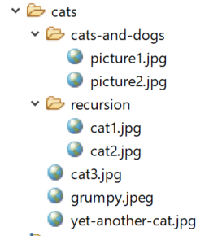
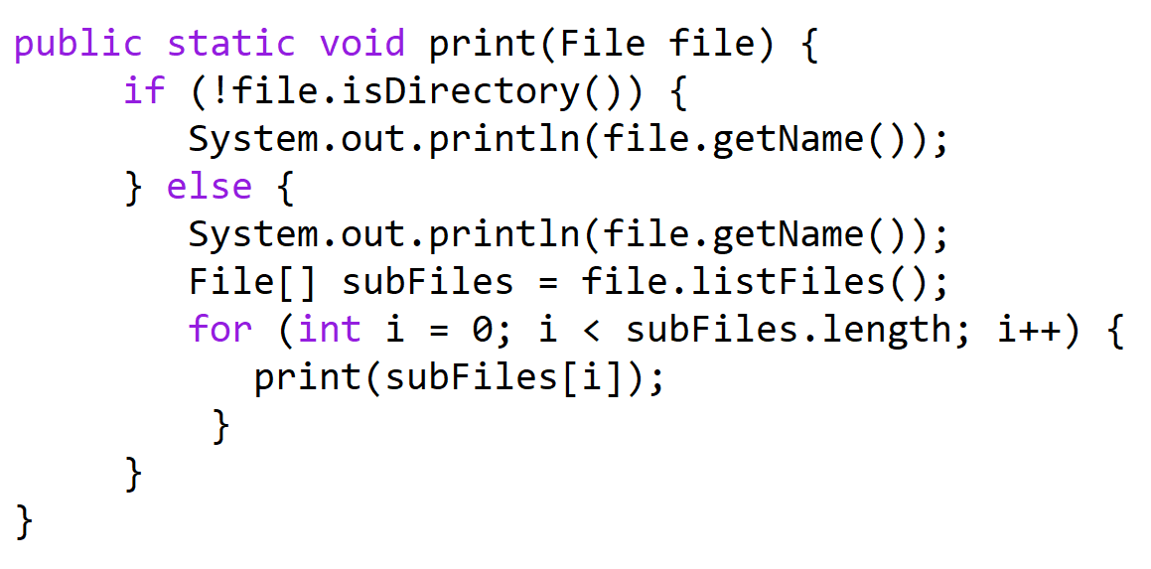
print
file = cats
subFiles = [cats-and-dogs, recursion, cat3.jpg, …]
i = 0
file = cats
subFiles = [cats-and-dogs, recursion, cat3.jpg, …]
i = 0 1
file = recursion
…
file = cats-and-dgs
subFiles = [picture1.jpg, picture2.jpg]
i = 0
cats
cats-and-dogs
picture1.jpg
picture2.jpg
recursion
…
file = cats-and-dgs
subFiles = [picture1.jpg, picture2.jpg]
i = 0 1
file = picture2.jpg
file = picture1.jpg

Slide 5
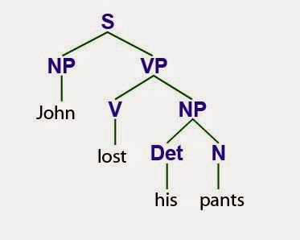

Slide 6
Languages and grammars
(formal) language: A set of words or symbols.
grammar: A description of a language that describes which sequences of symbols are allowed in that language.
describes language syntax (rules) but not semantics (meaning)
can be used to generate strings from a language, or to determine whether a given string belongs to a given language

Slide 7
Backus-Naur (BNF)
Backus-Naur Form (BNF): A syntax for describing language grammars in terms of transformation rules, of the form:
<symbol> ::= <expression> | <expression> ... | <expression>
terminal: A fundamental symbol of the language.
non-terminal: A high-level symbol describing language syntax, which can be transformed into other non-terminal or terminal symbol(s) based on the rules of the grammar.
developed by two Turing-award-winning computer scientists in 1960 to describe their new ALGOL programming language

Slide 8
An example BNF grammar
<s>::=<n> <v>
<n>::=Marty | Victoria | Stuart | Jessica
<v>::=cried | slept | belched
Some sentences that could be generated from this grammar:
Marty slept
Jessica belched
Stuart cried

Slide 9
BNF grammar version 2
<s>::=<np> <v>
<np>::=<pn> | <dp> <n>
<pn>::=Marty | Victoria | Stuart | Jessica
<dp>::=a | the
<n>::=ball | hamster | carrot | computer
<v>::=cried | slept | belched
Some sentences that could be generated from this grammar:
the carrot cried
Jessica belched
a computer slept

Slide 10
BNF grammar version 3
<s>::=<np> <v>
<np>::=<pn> | <dp> <adj> <n>
<pn>::=Marty | Victoria | Stuart | Jessica
<dp>::=a | the
<adj>::=silly | invisible | loud | romantic
<n>::=ball | hamster | carrot | computer
<v>::=cried | slept | belched
Some sentences that could be generated from this grammar:
the invisible carrot cried
Jessica belched
a computer slept
a romantic ball belched

Slide 11
Grammars and recursion
<s>::=<np> <v>
<np>::=<pn> | <dp> <adjp> <n>
<pn>::=Marty | Victoria | Stuart | Jessica
<dp>::=a | the
<adjp>::=<adj> <adjp> | <adj>
<adj>::=silly | invisible | loud | romantic
<n>::=ball | hamster | carrot | computer
<v>::=cried | slept | belched
Grammar rules can be defined recursively, so that the expansion of a symbol can contain that same symbol.
There must also be expressions that expand the symbol into something non-recursive, so that the recursion eventually ends.

Slide 12
Grammar, final version
<s>::=<np> <vp>
<np>::=<dp> <adjp> <n>|<pn>
<dp>::=the|a
<adjp>::=<adj>|<adj> <adjp>
<adj>::=big|fat|green|wonderful|faulty|subliminal
<n>::=dog|cat|man|university|father|mother|child
<pn>::=John|Jane|Sally|Spot|Fred|Elmo
<vp>::=<tv> <np>|<iv>
<tv>::=hit|honored|kissed|helped
<iv>::=died|collapsed|laughed|wept
Could this grammar generate the following sentences?
Fred honored the green wonderful child
big Jane wept the fat man fat
Generate a random sentence using this grammar.

Slide 13
Sentence generation
<s>
<n>
<vp>
<pn>
<tv>
<np>
<dp>
<adjp>
<n>
<adj>
<adjp>
<adj>
Fred
honored
the
green
wonderful
child

