Slide 1
Building Java Programs
Chapter 15
ArrayIntList
reading: 15.1

Slide 2
Welcome to CSE 143!

Slide 3
Context for CSE 143
CSE 142
Control: loops, if/else, methods, parameters, returns
I/O: Scanners, user input, files
Data: primitive types (int, double, etc.), arrays, classes
CSE 143
Control: recursion
Data
Java collections
Classes + Object Oriented Programming
Best of CS

Slide 4
Recall: Arrays (7.1)
array: object that stores many values of the same type.
element: One value in an array.
index: 0-based integer to access an element from an array.
length: Number of elements in the array.
index | 0 | 1 | 2 | 3 | 4 | 5 | 6 | 7 | 8 | 9
value | 12 | 49 | -2 | 26 | 5 | 17 | -6 | 84 | 72 | 3
element 0
element 4
element 9
length = 10

Slide 5
Array Limitations
Fixed-size
Adding or removing from middle is hard
Not much built-in functionality (need Arrays class)

Slide 6
Collections
collection: an object that stores data; a.k.a. "data structure"
the objects stored are called elements
some collections maintain an ordering; some allow duplicates
typical operations: add, remove, clear, contains (search), size
examples found in the Java class libraries: (covered in this course!)
ArrayList, LinkedList, HashMap, TreeSet, PriorityQueue
all collections are in the java.util package
import java.util.*;

Slide 7
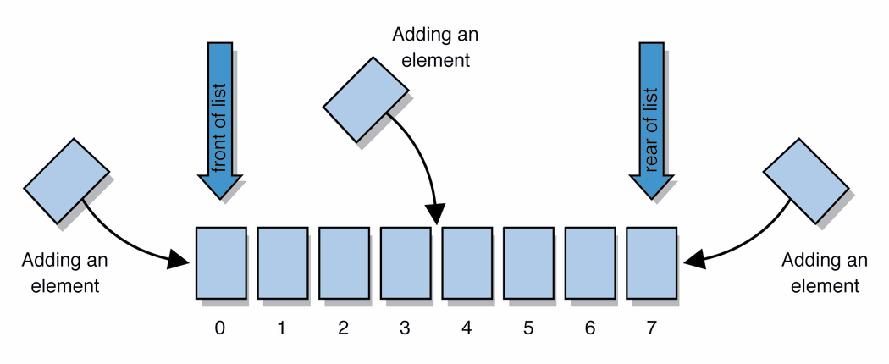
Lists
list: a collection of elements with 0-based indexes
elements can be added to the front, back, or elsewhere
a list has a size (number of elements that have been added)
This is just a high level idea, haven’t said how to do it in Java

Slide 8
List Abstraction
Like an array that resizes to fit its contents.
When a list is created, it is initially empty.
[]
Use add methods to add to different locations in list
[hello, ABC, goodbye, okay]
The list object keeps track of the element values that have been added to it, their order, indexes, and its total size.
You can add, remove, get, set, ... any index at any time.

Slide 9
Type parameters (generics)
ArrayList<Type> name = new ArrayList<Type>();
When constructing an ArrayList, you must specify the type of its elements in < >
This is called a type parameter ; ArrayList is a generic class.
Allows the ArrayList class to store lists of different types.
Arrays use a similar idea with Type[]
ArrayList<String> names = new ArrayList<String>();
names.add("Marty Stepp");
names.add("Stuart Reges");

Slide 10
ArrayList methods (10.1)*
add(value) | appends value at end of list
add(index, value) | inserts given value just before the given index, shifting subsequent values to the right
clear() | removes all elements of the list
indexOf(value) | returns first index where given value is found in list (-1 if not found)
get(index) | returns the value at given index
remove(index) | removes/returns value at given index, shifting subsequent values to the left
set(index, value) | replaces value at given index with given value
size() | returns the number of elements in list
toString() | returns a string representation of the list such as "[3, 42, -7, 15]"

Slide 11
ArrayList vs. array
construction
String[] names = new String[5];
ArrayList<String> list = new ArrayList<String>();
storing a value
names[0] = "Jessica";
list.add("Jessica");
retrieving a value
String s = names[0];
String s = list.get(0);

Slide 12
ArrayList vs. array
String[] names = new String[5]; // construct
names[0] = "Jessica"; // store
String s = names[0]; // retrieve
for (int i = 0; i < names.length; i++) {
if (names[i].startsWith("B")) { ... }
} // iterate
ArrayList<String> list = new ArrayList<String>();
list.add("Jessica"); // store
String s = list.get(0); // retrieve
for (int i = 0; i < list.size(); i++) {
if (list.get(i).startsWith("B")) { ... }
} // iterate

Slide 13
ArrayList as param/return
public static void name(ArrayList<Type> name) {// param
public static ArrayList<Type> name(params) // return
Example:
// Returns count of plural words in the given list.
public static int countPlural(ArrayList<String> list) {
int count = 0;
for (int i = 0; i < list.size(); i++) {
String str = list.get(i);
if (str.endsWith("s")) {
count++;
}
}
return count;
}

Slide 14
Client - Radio

Slide 15
Implementer - Radio

Slide 16
Client – ArrayList
ArrayList<String> list:
[“a”, “b”, “c”]

Slide 17
Implementer - ArrayList
String[] elementData:
[“a”, “b”, “c”, null, null, null, null, null, null]
int size:
3

Slide 18
Recall: classes and objects
class: A program entity that represents:
A complete program or module, or
A template for a type of objects.
(ArrayList is a class that defines a type.)
object: An entity that combines state and behavior.
object-oriented programming (OOP): Programs that perform their behavior as interactions between objects.
abstraction: Separation between concepts and details. Objects provide abstraction in programming.

Slide 19
Elements of a class
public class BankAccount {
private String name; // fields:
private int id; // data encapsulated
private double balance; // inside each object
public BankAccount(String name, int id) {
this.name = name; // constructor:
this.id = id; // initializes
this.balance = 0.0; // new objects
}
public void deposit(double amount) {
this.balance += amount; // instance method:
} // each object's
... // behavior
}
"implicit parameter": object on which a method was called

Slide 20
ArrayList implementation
What is an ArrayList's behavior?
add, remove, indexOf, etc
What is an ArrayList's state?
Many elements of the same type
For example, unfilled array
index | 0 | 1 | 2 | 3 | 4 | 5 | 6 | ... | 98 | 99
value | 17 | 93208 | 2053278 | 10 | 3 | 0 | 0 | ... | 0 | 0
size | 5

Slide 21
ArrayIntList implementation
Simpler than ArrayList<E>
No generics (only stores ints)
Fewer methods: add(value), add(index, value), get(index), set(index, value), size(), isEmpty(), remove(index), indexOf(value), contains(value), toString(),
Fields?
int[]
int to keep track of the number of elements added
The default capacity (array length) will be 10

Slide 22
Implementing add
How do we add to the end of a list?
public void add(int value) { // just put the element
list[size] = value; // in the last slot,
size++; // and increase the size
}
list.add(42);
index | 0 | 1 | 2 | 3 | 4 | 5 | 6 | 7 | 8 | 9
value | 3 | 8 | 9 | 7 | 5 | 12 | 0 | 0 | 0 | 0
size | 6
index | 0 | 1 | 2 | 3 | 4 | 5 | 6 | 7 | 8 | 9
value | 3 | 8 | 9 | 7 | 5 | 12 | 42 | 0 | 0 | 0
size | 7

Slide 23
Printing an ArrayIntList
Let's add a method that allows clients to print a list's elements.
You may be tempted to write a print method:
// client code
ArrayIntList list = new ArrayIntList();
...
list.print();
Why is this a bad idea? What would be better?

Slide 24
The toString method
Tells Java how to convert an object into a String
ArrayIntList list = new ArrayIntList();
System.out.println("list is " + list);
// ("list is " + list.toString());
Syntax:
public String toString() {
code that returns a suitable String;
}
Every class has a toString, even if it isn't in your code.
The default is the class's name and a hex (base-16) number:
ArrayIntList@9e8c34

Slide 25
toString solution
// Returns a String representation of the list.
public String toString() {
if (size == 0) {
return "[]";
} else {
String result = "[" + elementData[0];
for (int i = 1; i < size; i++) {
result += ", " + elementData[i];
}
result += "]";
return result;
}
}

