Slide 1
Building Java Programs
Chapter 10 & 11
Lists and Sets
reading: 10.1, 11.2

Slide 3
Collections
collection: an object that stores data; a.k.a. "data structure"
the objects stored are called elements
some collections maintain an ordering; some allow duplicates
typical operations: add, remove, clear, contains (search), size
examples found in the Java class libraries: (covered in this course!)
ArrayList, LinkedList, HashMap, TreeSet, PriorityQueue
all collections are in the java.util package
import java.util.*;

Slide 4
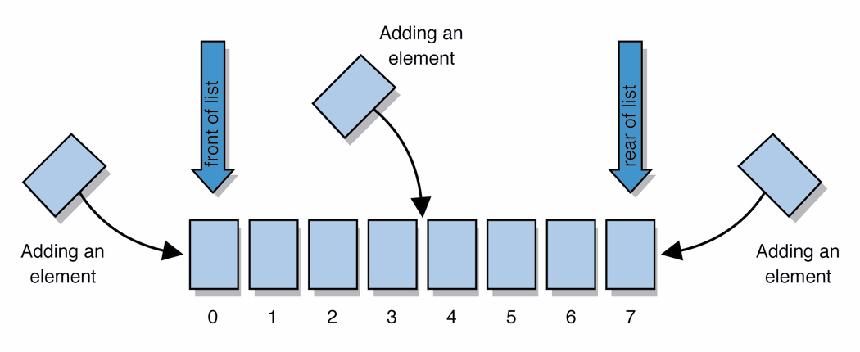
Lists
list: a collection of elements with 0-based indexes
elements can be added to the front, back, or elsewhere
a list has a size (number of elements that have been added)

Slide 5
List methods
List<String> list = new ArrayList<String>(); // empty
List<Integer> list2 = new LinkedList<Integer>();
list.add(“hello”);
list.add(“goodbye”);
System.out.println(list); // [“hello”, “goodbye”]
add(value) | adds the given value to the list
add(index, value) | Adds the given value at the given index to the list
contains(value) | returns true if the given value is found in this list
indexOf(value) | returns the index of the given value in the list (-1 if not found)
remove(value) | removes the given value from the list
size() | returns the number of elements in list
isEmpty() | returns true if the list's size is 0
toString() | returns a string such as "[3, 42, -7, 15]"

Slide 6
Wrapper classes
Primitive Type | Wrapper Type
int | Integer
double | Double
char | Character
boolean | Boolean
A wrapper is an object whose sole purpose is to hold a primitive value.
Once you construct the list, use it with primitives as normal:
List<Double> grades = new ArrayList<Double>();
grades.add(3.2);
grades.add(2.7);
...
double myGrade = grades.get(0);

Slide 7
Exercise
Write a program that counts the number of unique words in a large text file (say, Moby Dick or the King James Bible).
Store the words in a collection and report the # of unique words.
Once you've created this collection, allow the user to search it to see whether various words appear in the text file.
What collection is appropriate for this problem?

Slide 8
The "for each" loop (7.1)
for (type name : collection) {
statements;
}
Provides a clean syntax for looping over the elements of a List, Set, array, or other collection
List<Double> grades = new ArrayList<Double>();
...
for (double grade : grades) {
System.out.println("Student's grade: " + grade);
}
More readable and can be more efficient

Slide 9
Sets (11.2)
set: A collection of unique values (no duplicates allowed) that can perform the following operations efficiently:
add, remove, search (contains)
We don't think of a set as having indexes; we just add things to the set in general and don't worry about order
"the"
"of"
"if"
set.contains("to")
"to"
"down"
"from"
true
"by"
"she"
set.contains("be")
"you"
false
"in"
"why"
"him"
set

Slide 10
Set implementation
in Java, sets are represented by Set type in java.util
Set is implemented by HashSet and TreeSet classes
TreeSet: implemented using a "binary search tree"; pretty fast: O(log N) for all operations elements are stored in sorted order
HashSet: implemented using a "hash table" array; very fast: O(1) for all operations elements are stored in unpredictable order
Note: This O(something) notation won’t be covered until next week. It’s okay not to know what it means yet.

Slide 11
Set methods
Set<String> set = new TreeSet<String>(); // empty
Set<Integer> set2 = new HashSet<Integer>();
set.add(“hello”);
set.add(“goodbye”);
set.add(“hello”);
System.out.println(set); // [“goodbye”, “hello”]
add(value) | adds the given value to the set
contains(value) | returns true if the given value is found in this set
remove(value) | removes the given value from the set
clear() | removes all elements of the set
size() | returns the number of elements in list
isEmpty() | returns true if the set's size is 0
toString() | returns a string such as "[3, 42, -7, 15]"

