Slide 1
Hashing

Slide 2
Runtimes of common Set operations
Data Structure | contains(element) | add(element) | remove(element)
Unsorted ArrayList
Unsorted LinkedList
Binary Search Tree
Notes:
11:37

Slide 3
Arrays
Pros: O(1) time to set() or get() at a given index
Cons: O(n) time to see if an element is in the array
What if we knew what index an object would be at?
Notes:
11:38

Slide 4
Hash Function
A function that maps any input deterministically to some output
If two objects are “equal”, their hash function must produce the same value
We are concerned specifically with a hash function that maps Object -> int
All Java Objects have a hashCode() method!
"Spongebob".hashCode() == 907493499
"Patrick".hashCode() == 873506786
"Squidward".hashCode() == -759989618
Notes:
11:40

Slide 5
Hash Table
Array where we store elements at their hashed indexes
String[] hashTable = new String[10]
index | 0 | 1 | 2 | 3 | 4 | 5 | 6 | 7 | 8 | 9
value | null | null | null | null | null | null | null | null | null | null
Where should these Strings go?
"Spongebob".hashCode() == 907493499
"Patrick".hashCode() == 873506786
"Squidward".hashCode() == -759989618
int index = Math.abs(hashcode % hashTable.length)
Notes:
11:45

Slide 6
Hash Table
public static int hashIndex(E element) {
return Math.abs(element.hashCode() % hashTable.length);
}
contains(element):return hashTable[hashIndex(element)] != null
add(element) :hashTable[hashIndex(element)] = element
remove(element) :hashTable[hashIndex(element)] = null
Notes:
11:48
Implement code after this
If little time, just show them the code

Slide 7
What issues do we have?
Two elements might hash to the same spot!
This is called a collision
Notes:
:49
If you have time, show them the client class

Slide 8
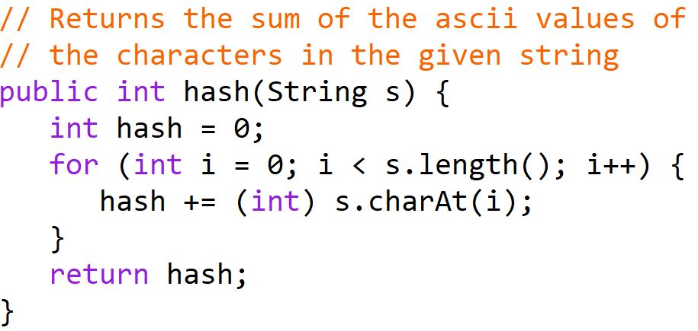
What Makes a Hash Function Good?
To avoid collisions, different elements should hash to different values
We want the elements to be evenly spread out
We want the hash function to appear random
Rank these Hash Functions!
Notes:
:55

Slide 9
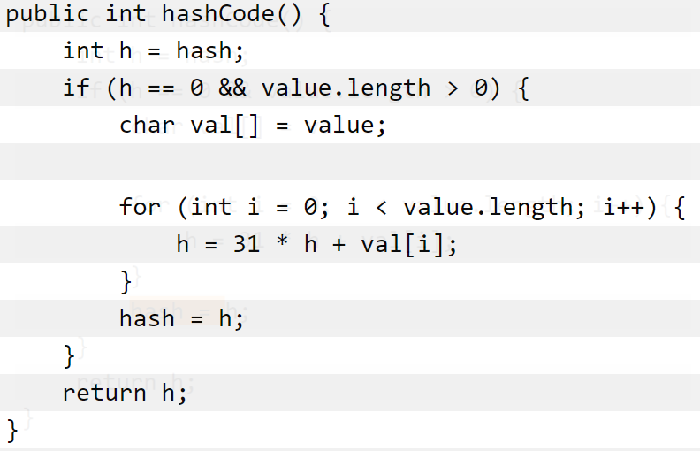
What Makes a Hash Function Good? Java’s String hashCode()
Notes:
:57
Skip through, don’t need to take many questions

Slide 10
What issues do we have?
Two elements might hash to the same spot!
This is called a collision
We can only have 10 elements!
Notes:
:58

Slide 11
Separate Chaining
Solve collisions and running out of space by storing a list at each index!
contains/add/remove must now traverse lists
index | 0 | 1 | 2 | 3 | 4 | 5 | 6 | 7 | 8 | 9
value
Morty
Rick
Jerry
Beth
Notes:
:15
Show code new code after this.
Only need 5 minutes.

Slide 12
Is this really O(1) though? How long do you expect the average chain to be if there are 30 elements in a hash table of size 10?
Load Factor : (# of elements in hash table) / (length of hash table)
As long as we limit the length of each chain to a constant number, it will be O(1)!

Slide 13
Rehashing
Load Factor : (# of elements in hash table) / (length of hash table)
The length of the average chain
Rehashing : Once the load factor becomes too high, we hash everything again into a bigger array
Usually rehash when load factor is around 0.75
Why can’t we copy into the new array?
This is Amortized O(1)

