Slide 6
Major themes
Abstraction
Leverage existing components without understanding details
Create components that can be used as black boxes
Design tradeoffs
Algorithm analysis - scalability and growth
Keeping code easy to read for maintainability
Recursion
Reason about problems in terms of self-similarity
Write very short code to achieve complex behaviors
Art – "A programmer who subconsciously views himself as an artist will enjoy what he does and will do it better." (Knuth)

Slide 7
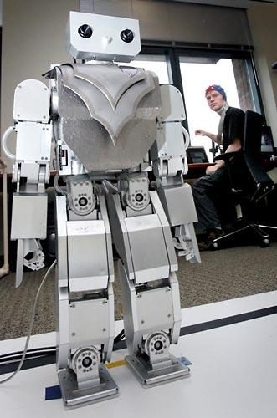
Beyond programming
Mind-controlled robots
http://www.youtube.com/watch?v=TQ7EOpPNQyw
Muscle-controlled interfaces
http://www.youtube.com/watch?v=pktVSTwC8qo
3D models from pictures
http://www.youtube.com/watch?v=25Yifq70elY
Face aging
http://www.youtube.com/watch?v=fLQtssJDMMc
Animation
http://www.youtube.com/watch?v=b4kkPlLdMvI
Security
http://www.pbs.org/wgbh/nova/tech/tadayoshi-kohno.html

Slide 8
What project?
Little text-processing applications
identify lines above 100
remove line-breaks
Add a GUI to the random sentence generator
Automate chemistry, physics, calculus problems, etc
Find quotes by keyword in books
What are you currently doing that a computer could do?

Slide 9
What language?
Expanding your Java knowledge with a project is valuable
Pick a project, see what language is most appropriate
iOS: Swift
Android: Java
Client-side web: Javascript
Beautiful visuals: Processing
Quick data processing: Python
Embedded systems: C/C++
Learn a new paradigm
Functional languages: Racket, Haskell (now, Java 8, too!)

Slide 10
Leveraging existing code
Processing language
http://nlp.stanford.edu/software/
Building games
http://lwjgl.org/
http://jbox2d.org/ (with physics!)
Processing biological data
http://biojava.org/wiki/Main_Page
Accessing Facebook data
http://restfb.com/
Making music
http://www.jfugue.org/

Slide 11
Courses?
CSE non-majors
CSE 154: Web Programming
CSE 373: Data Structures and Algorithms
CSE 374: Programming Concepts and Tools (C/C++, Linux, ...)
CSE 131: Digital Photography
CSE 460: Animation Capstone (open to all majors)
CSE majors
CSE 311: (Mathematical) Foundations of Computing
CSE 332: Data Abstractions (Data Structures and Algorithms)
CSE 331: Software Design and Implementation
CSE 341: Programming Languages
CSE 344: Intro to Data Management (and databases)
CSE 351: Hardware/Software Interface
INFO, AMATH, DXARTS, ...

Slide 12
Weekly meetings
Change – technologies for low-income regions
http://change.washington.edu/
Dub – human-computer interaction and design
http://dub.washington.edu/

Slide 13
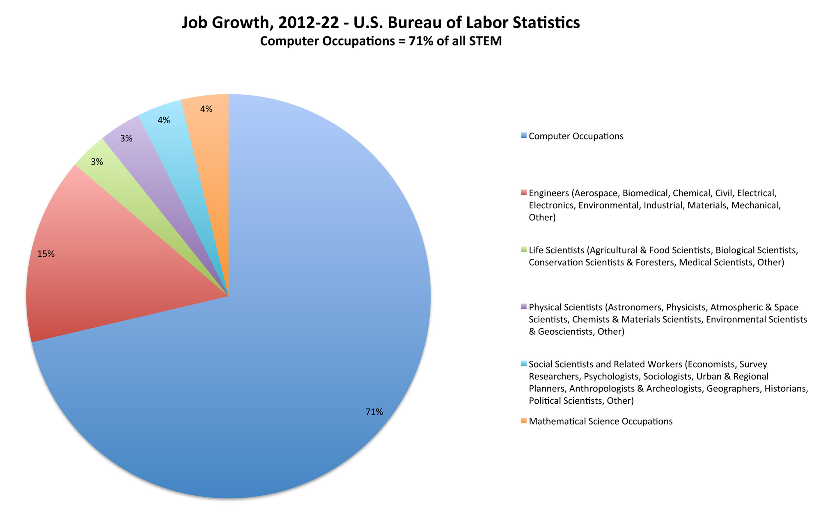

Slide 14
Roles in Industry
Software Developer/Software Engineer
Builds and designs software
Includes designing and engineering architecture of a software system as well as programming
Product Manager (PM)
Designs and makes decisions regarding the overall product
May write specifications for software developers
Works with people across disciplines at the company
May or may not program
Role can be different at different companies
Test/QA
Write and design tests of the product

Slide 15
Internships
Various career fairs around campus.
Start looking early!
For those just starting out
Microsoft Explorer Program - https://careers.microsoft.com/students/explore
Google Engineering Practicum - https://www.google.com/about/careers/search#!t=jo&jid=120165001&

Slide 16
What Do I Do?
When I’m not teaching, I work at Sift Science, a startup in San Francisco, as a Software Developer
Sift Science uses large scale machine learning to help online businesses detect fraud
Small company (~50). Work closely with people in different disciplines across the company
Full-stack, primarily focusing on front-end development
Frontend uses React, Facebook’s javascript framework
Backend uses Java!

