Slide 1
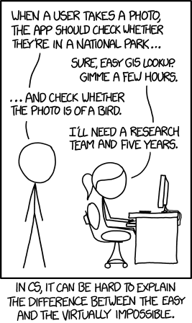
CSE 143
Goodbye, world!

Slide 2
Major themes
Abstraction
Leverage existing components without understanding details
Create components that can be used as black boxes
Algorithm analysis
Scalability and growth
Tradeoffs between implementations
Recursion
Reason about problems in terms of self-similarity
Write very short code to achieve complex behaviors
Beauty

Slide 3
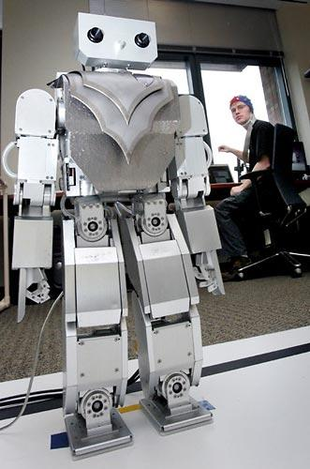
Beyond programming
Mind-controlled robots
http://www.youtube.com/watch?v=TQ7EOpPNQyw
Muscle-controlled interfaces
http://www.youtube.com/watch?v=pktVSTwC8qo
3D models from pictures
http://www.youtube.com/watch?v=25Yifq70elY
Face aging
http://www.youtube.com/watch?v=fLQtssJDMMc
Animation
http://www.youtube.com/watch?v=b4kkPlLdMvI
Security
http://www.pbs.org/wgbh/nova/tech/tadayoshi-kohno.html

Slide 4
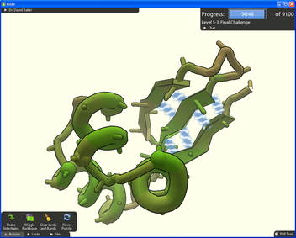
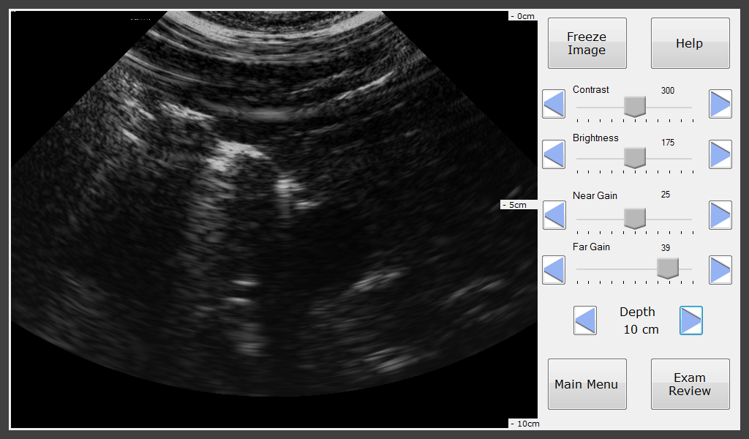
Computing for good
Foldit
Open Data Kit
Mobile Midwives’ Ultrasound
MobileASL
Tactile Graphics

Slide 5
Courses?
CSE non-majors
CSE 154: Web Programming
CSE 373: Data Structures and Algorithms
CSE 374: Programming Concepts and Tools (C/C++, Linux, ...)
CSE 131: Digital Photography
CSE 460: Animation Capstone (open to all majors)
INFO, AMATH, DXARTS, ...
CSE majors
CSE 311: (Mathematical) Foundations of Computing
CSE 332: Data Abstractions (Data Structures and Algorithms)
CSE 331: Software Design and Implementation
CSE 341: Programming Languages
CSE 344: Intro to Data Management (and databases)
CSE 351: Hardware/Software Interface

Slide 6
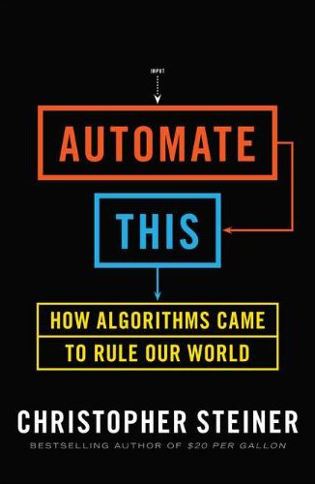
Explore Big Ideas
Historical context
Key algorithms
Privacy
Automate all the things

Slide 7
Do a project!
Little text-processing applications
identify lines above 100
remove line-breaks
Add a GUI to the random sentence generator
Automate chemistry, physics, calculus problems, etc
Find quotes by keyword in books
What are you currently doing that a computer could do?

Slide 8
Other languages?
Expanding your Java knowledge with a project is valuable
Pick a project, see what language is most appropriate
iOS: Objective-C or Swift
Android: Java
Client-side web: Javascript
Beautiful visuals: Processing
Quick data processing: Python
Embedded systems: C/C++
Learn a new paradigm
Functional languages: Racket, Haskell

Slide 9
Leveraging existing code
Accessing Facebook data
http://restfb.com/
Processing language
http://nlp.stanford.edu/software/
Building games with physics
http://jbox2d.org/
Processing biological data
http://biojava.org/wiki/Main_Page

Slide 10
Weekly meetings
Change – technologies for low-income regions
http://change.washington.edu/
Dub – human-computer interaction and design
http://dub.washington.edu/

