Slide 1
Goodbye, world!
I'll give you time to fill out evals at the end.
Please wait until I'm out of the room!

Slide 2
Major themes
Abstraction
Leverage existing components without understanding details
Create components that can be used as black boxes
Recursion
Reason about problems in terms of self-similarity
Write very short code to achieve complex behaviors
Algorithm analysis
Scalability and growth
Tradeoffs between implementations
Beauty

Slide 3
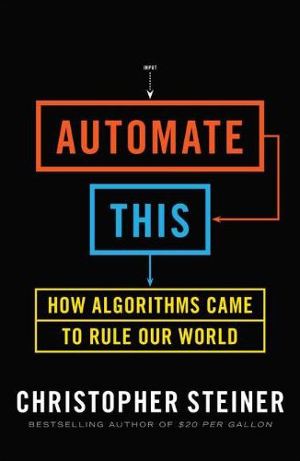
Automate all the things
Wall Street: high frequency trading
Music: identifying hits
Medicine: smart diagnostics
Marketing: using the right message
Law: summarize evidence
Foreign policy: predict events
Sports: identifying superstars

Slide 4
Leveraging existing code
Accessing Facebook data
http://restfb.com/
Processing language
http://nlp.stanford.edu/software/
Building games with physics
http://jbox2d.org/
Processing biological data
http://biojava.org/wiki/Main_Page

Slide 5
Using the restFB API
Add the restfb jar to your build path
In Eclipse, right click on your project > properties
In Java Build Path, Add JARs...
Get an access token from the Facebook Graph API Explorer

Slide 6
Other languages?
Expanding your Java knowledge with a project is valuable
Pick a project, see what language is most appropriate
iOS: Objective-C
Android: Java
Client-side web: Javascript
Beautiful visuals: Processing
Quick data processing: Python
Embedded systems: C/C++
Learn a new paradigm
Functional languages: Racket, Haskell

Slide 7
What project?
Little text-processing applications
identify lines above 100
remove line-breaks
Add a GUI to the random sentence generator
Automate chemistry, physics, calculus problems, etc
Find quotes by keyword in books
What are you currently doing that a computer could do?

Slide 8
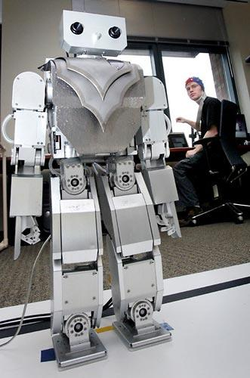
Beyond programming
Mind-controlled robots
http://www.youtube.com/watch?v=TQ7EOpPNQyw
Muscle-controlled interfaces
http://www.youtube.com/watch?v=pktVSTwC8qo
3D models from pictures
http://www.youtube.com/watch?v=25Yifq70elY
Face aging
http://www.youtube.com/watch?v=fLQtssJDMMc
Animation
http://www.youtube.com/watch?v=b4kkPlLdMvI
Security
http://www.pbs.org/wgbh/nova/tech/tadayoshi-kohno.html

Slide 9
Weekly meetings
Change – technologies for low-income regions
http://change.washington.edu/
Dub – human-computer interaction and design
http://dub.washington.edu/

Slide 10
Explore Big Ideas
Historical context
Key algorithms
Privacy

Slide 11
Courses?
CSE non-majors
CSE 154: Web Programming
CSE 373: Data Structures and Algorithms
CSE 374: Programming Concepts and Tools (C/C++, Linux, ...)
CSE 131: Digital Photography
CSE 460: Animation Capstone (open to all majors)
INFO, AMATH, DXARTS, ...
CSE majors
CSE 311: (Mathematical) Foundations of Computing
CSE 332: Data Abstractions (Data Structures and Algorithms)
CSE 331: Software Design and Implementation
CSE 341: Programming Languages
CSE 344: Intro to Data Management (and databases)
CSE 351: Hardware/Software Interface

