Slide 1
Goodbye, world!
I'll give you time to fill out evals at the end – please wait until I'm out of the room!

Slide 2
Major themes
Abstraction
Leverage existing components without understanding their details
Create components that can be used as black boxes
Recursion
Reason about problems in terms of self-similarity
Write very short code to achieve complex behaviors
Algorithm analysis
Scalability and growth
Tradeoffs between implementations
Beauty

Slide 3
Leveraging existing code
Accessing Facebook data
http://restfb.com/
Processing language
http://nlp.stanford.edu/software/
Building games with physics
http://jbox2d.org/
Processing biological data
http://biojava.org/wiki/Main_Page

Slide 4
Using the restFB API
Add the restfb jar to your build path
In Eclipse, right click on your project > properties
In Java Build Path, Add JARs...
Create Facebook app (https://developers.facebook.com/apps)
In your browser, request the pages described here to obtain an access token

Slide 5
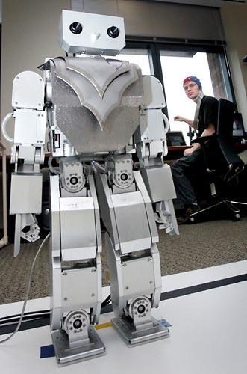
More to CS than programming
Mind-controlled robots
http://www.youtube.com/watch?v=TQ7EOpPNQyw
Muscle-controlled interfaces
http://www.youtube.com/watch?v=pktVSTwC8qo
3D models from pictures
http://www.youtube.com/watch?v=25Yifq70elY
Animation
http://www.youtube.com/watch?v=b4kkPlLdMvI

Slide 6
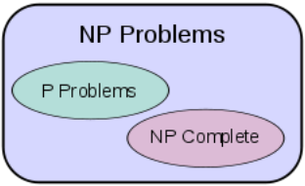
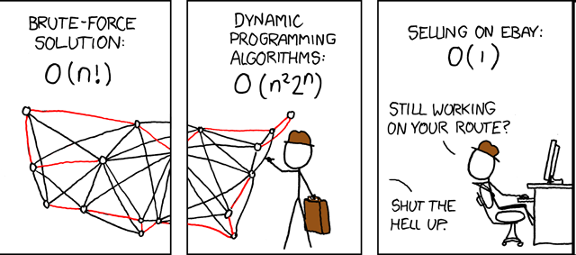
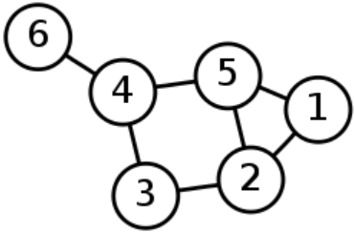
Theory of computation
languages, grammars, and automata
computational complexity and intractability
Big-Oh
polynomial vs. exponential time
P = NP?
graph theory
?

Slide 7
What's next?
CSE non-majors
CSE 373: Data Structures and Algorithms
CSE 374: Programming Concepts and Tools (C/C++, Linux, ...)
CSE 190M: Web Programming
CSE 131: Digital Photography
CSE 460: Animation Capstone (open to all majors)
INFO, AMATH, DXARTS, ...
CSE majors
CSE 332: Data Abstractions (Data Structures and Algorithms)
CSE 311: (Mathematical) Foundations of Computing
CSE 331: Software Design and Implementation
CSE 341: Programming Languages
CSE 344: Intro to Data Management (and databases)
CSE 351: Hardware/Software Interface

