Slide 1
computeSquares
Method Breakdown
(for loops)

Slide 2
For Loop
for (initialization; test; update) { statements; }
Initialization: declare and initialize a loop variable
Test: an expression that will be evaluated to determine whether to continue the loop or end it
Update: update the loop variable to make progress toward the test failing
These 3 components determine exactly how many times the for loop will run
Statements in the body of the loop will be executed each time the test evaluates to true

Slide 3
Method Description
Write a method called computeSquares to produce the following text:
1 squared = 1
2 squared = 4
3 squared = 9
4 squared = 16
5 squared = 25
6 squared = 36
Algorithm: (step by step procedure)
for the numbers 1, 2, 3, 4, 5, 6:
Print the number and it’s squared value on a single line of console output in the specified format
What we need:
for loop with a variable going from 1 to 6 by +1
println, String literal, loop variable, expressions

Slide 4
public static void computeSquares() { for (int number = 1; number <= 6; number++) { System.out.println(number + " squared = " + (number * number)); }
}
Output:
Scope of computeSquares

Slide 5
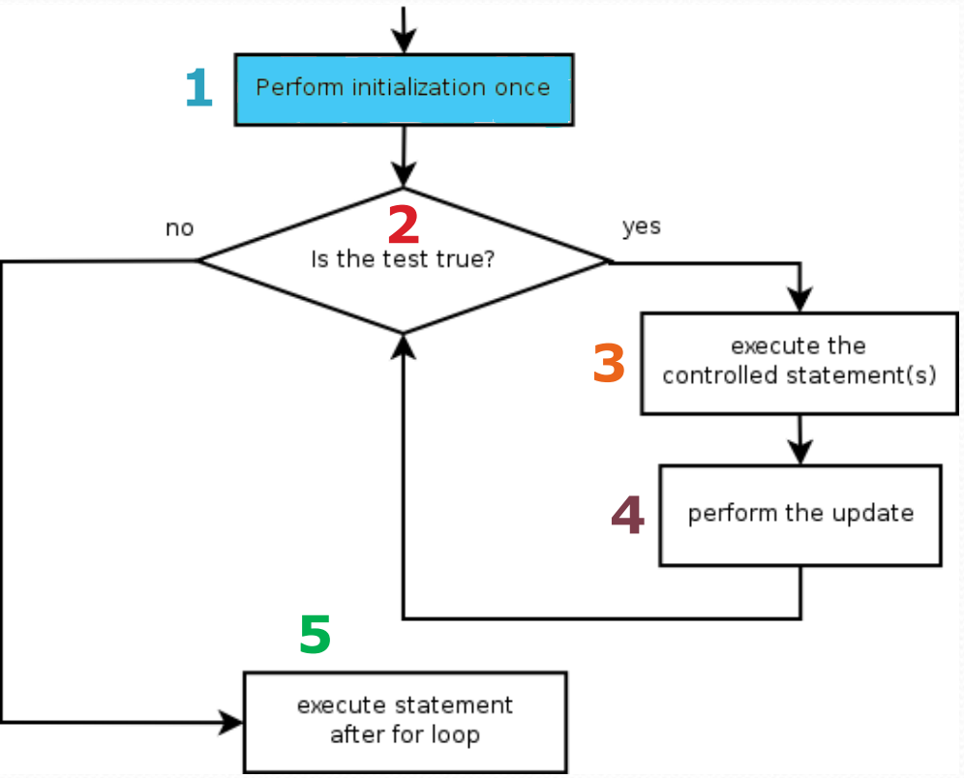
public static void computeSquares() { for (int number = 1; number <= 6; number++) { System.out.println(number + " squared = " + (number * number)); }
}
Scope of computeSquares
Output:

Slide 6
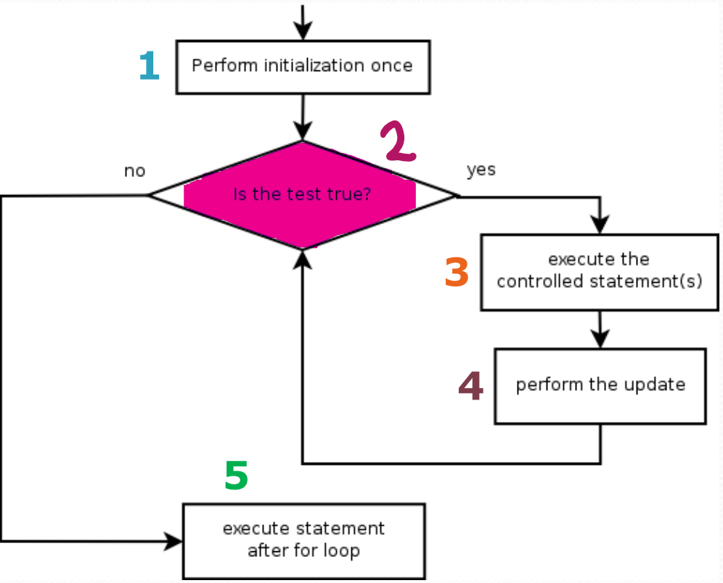
public static void computeSquares() { for (int number = 1; number <= 6; number++) { System.out.println(number + " squared = " + (number * number)); }
}
Scope of computeSquares
number | 1
Output:

Slide 7
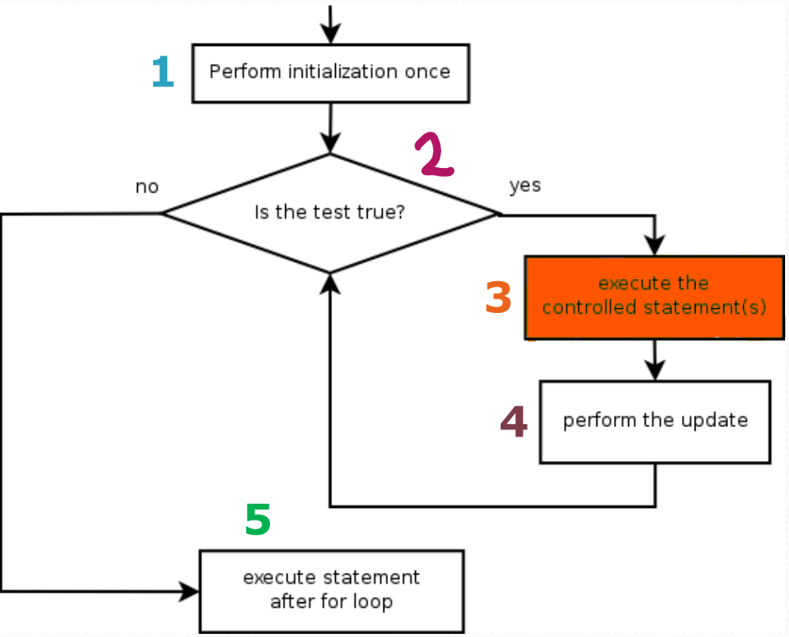
public static void computeSquares() { for (int number = 1; number <= 6; number++) { System.out.println(number + " squared = " + (number * number)); }
}
Scope of computeSquares
number | 1
Output:

Slide 8
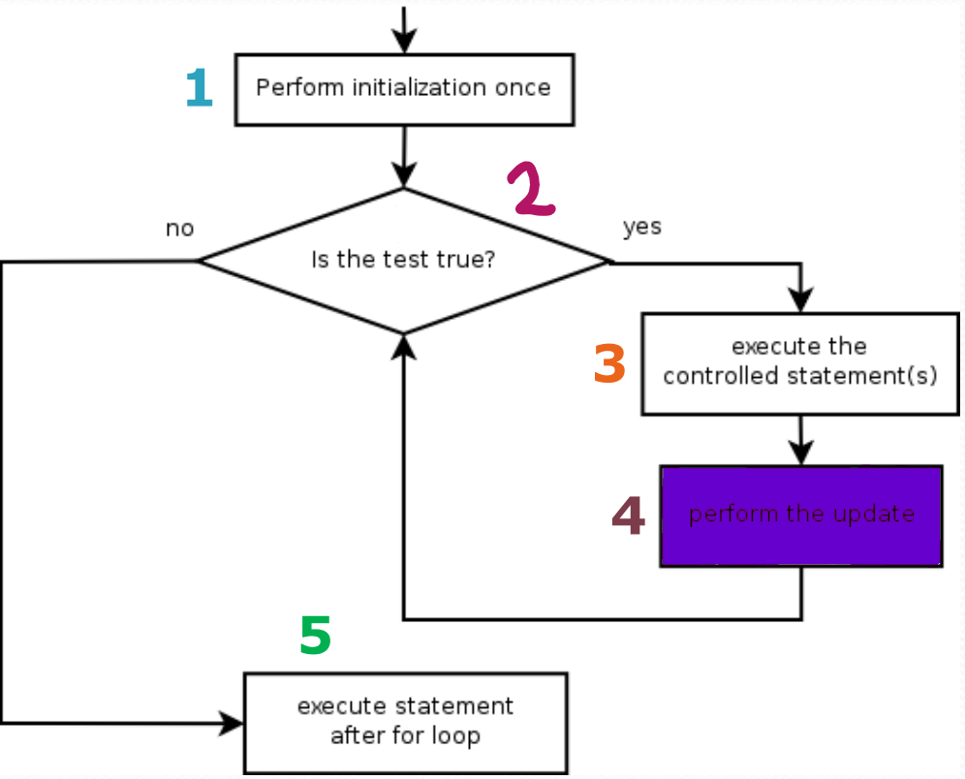
public static void computeSquares() { for (int number = 1; number <= 6; number++) { System.out.println(number + " squared = " + (number * number)); }
}
Scope of computeSquares
number | 1
Output:
1 squared = 1

Slide 9
public static void computeSquares() { for (int number = 1; number <= 6; number++) { System.out.println(number + " squared = " + (number * number)); }
}
Scope of computeSquares
number | 2
Output:
1 squared = 1

Slide 10
public static void computeSquares() { for (int number = 1; number <= 6; number++) { System.out.println(number + " squared = " + (number * number)); }
}
Scope of computeSquares
number | 2
Output:
1 squared = 1

Slide 11
public static void computeSquares() { for (int number = 1; number <= 6; number++) { System.out.println(number + " squared = " + (number * number)); }
}
Scope of computeSquares
number | 2
Output:
1 squared = 1
2 squared = 4

Slide 12
public static void computeSquares() { for (int number = 1; number <= 6; number++) { System.out.println(number + " squared = " + (number * number)); }
}
Scope of computeSquares
number | 3
Output:
1 squared = 1
2 squared = 4

Slide 13
public static void computeSquares() { for (int number = 1; number <= 6; number++) { System.out.println(number + " squared = " + (number * number)); }
}
Scope of computeSquares
number | 3
Output:
1 squared = 1
2 squared = 4

Slide 14
public static void computeSquares() { for (int number = 1; number <= 6; number++) { System.out.println(number + " squared = " + (number * number)); }
}
Scope of computeSquares
number | 3
Output:
1 squared = 1
2 squared = 4
3 squared = 9

Slide 15
public static void computeSquares() { for (int number = 1; number <= 6; number++) { System.out.println(number + " squared = " + (number * number)); }
}
Scope of computeSquares
number | 4
Output:
1 squared = 1
2 squared = 4
3 squared = 9

Slide 16
public static void computeSquares() { for (int number = 1; number <= 6; number++) { System.out.println(number + " squared = " + (number * number)); }
}
Scope of computeSquares
number | 4
Output:
1 squared = 1
2 squared = 4
3 squared = 9

Slide 17
public static void computeSquares() { for (int number = 1; number <= 6; number++) { System.out.println(number + " squared = " + (number * number)); }
}
Scope of computeSquares
number | 4
Output:
1 squared = 1
2 squared = 4
3 squared = 9
4 squared = 16

Slide 18
public static void computeSquares() { for (int number = 1; number <= 6; number++) { System.out.println(number + " squared = " + (number * number)); }
}
Scope of computeSquares
number | 5
Output:
1 squared = 1
2 squared = 4
3 squared = 9
4 squared = 16

Slide 19
public static void computeSquares() { for (int number = 1; number <= 6; number++) { System.out.println(number + " squared = " + (number * number)); }
}
Scope of computeSquares
number | 5
Output:
1 squared = 1
2 squared = 4
3 squared = 9
4 squared = 16

Slide 20
public static void computeSquares() { for (int number = 1; number <= 6; number++) { System.out.println(number + " squared = " + (number * number)); }
}
Scope of computeSquares
number | 5
Output:
1 squared = 1
2 squared = 4
3 squared = 9
4 squared = 16
5 squared = 25

Slide 21
public static void computeSquares() { for (int number = 1; number <= 6; number++) { System.out.println(number + " squared = " + (number * number)); }
}
Scope of computeSquares
number | 6
Output:
1 squared = 1
2 squared = 4
3 squared = 9
4 squared = 16
5 squared = 25

Slide 22
public static void computeSquares() { for (int number = 1; number <= 6; number++) { System.out.println(number + " squared = " + (number * number)); }
}
Scope of computeSquares
number | 6
Output:
1 squared = 1
2 squared = 4
3 squared = 9
4 squared = 16
5 squared = 25

Slide 23
public static void computeSquares() { for (int number = 1; number <= 6; number++) { System.out.println(number + " squared = " + (number * number)); }
}
Scope of computeSquares
number | 6
Output:
1 squared = 1
2 squared = 4
3 squared = 9
4 squared = 16
5 squared = 25
6 squared = 36

Slide 24
public static void computeSquares() { for (int number = 1; number <= 6; number++) { System.out.println(number + " squared = " + (number * number)); }
}
Scope of computeSquares
number | 7
Output:
1 squared = 1
2 squared = 4
3 squared = 9
4 squared = 16
5 squared = 25
6 squared = 36

Slide 25
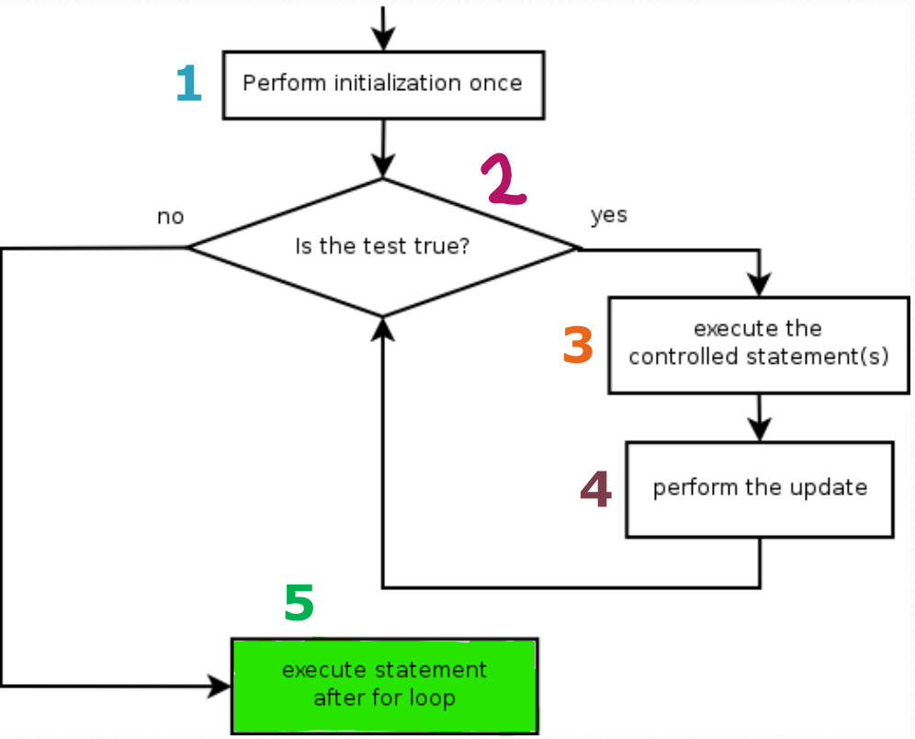
public static void computeSquares() { for (int number = 1; number <= 6; number++) { System.out.println(number + " squared = " + (number * number)); }
}
Scope of computeSquares
Output:
1 squared = 1
2 squared = 4
3 squared = 9
4 squared = 16
5 squared = 25
6 squared = 36

