Slide 1
Elementary statistics
Michael Ernst
CSE 140
University of Washington

Slide 2
A dice-rolling game
Two players each roll a die
The higher roll wins
Goal: roll as high as you can!
Repeat the game 6 times
Notes:
Have one student roll the die, and the other report the outcome
Mike rolls 5, 6, 6, 5, 6, 6

Slide 3
Hypotheses regarding the outcome
Luck
Fraud
loaded die
inaccurate reporting
How likely is luck?
How do we decide?

Slide 4
Questions that statistics can answer
I am flipping a coin. Is it fair? How confident am I in my answer?
I have two bags of beans, each containing some black and some white beans. I have a handful of beans. Which bag did the handful come from?
I have a handful of beans, and a single bag. Did the handful come from that bag?
Does this drug improve patient outcomes?
Which website design yields greater revenue?
Which baseball player should my team draft?
What premium should an insurer charge?
Which chemical process leads to the best-tasting beer?
Notes:
“Student” was William Gosset, a chemist working for the Guinness brewery in Dublin

Slide 5
What can happen when you roll a die?
What is the likelihood of each?

Slide 6
A dice-rolling experiment
Game: Roll one die, get paid accordingly:
Player self-reports the die roll and takes the money
no verification of the actual roll
From “Lies in disguise: An experimental study on cheating”
by Urs Fischbacher and Franziska Heusi
Roll | 1 | 2 | 3 | 4 | 5 | 6
Payoff | 1 CHF | 2 CHF | 3 CHF | 4 CHF | 5 CHF | 0 CHF

Slide 7
What can happen when you roll two dice?
How likely are you to roll 11 or higher?
This probability is known as the “p value”.
2
3
4
5
6
7
8
9
10
11
12

Slide 8
How to compute p values
Via a statistical formula
Requires you to make assumptions and know which formula to use
Computationally (simulation)
Run many experiments
Count the fraction with a better result
Requires a metric/measurement for “better”
Requires you to be able to run the experiments
We will use this approach exclusively

Slide 9
Interpreting p values
p value of 5% or less = statistically significant
This is a convention; there is nothing magical about 5%
Two types of errors may occur in statistical tests:
false positive (or false alarm or Type I error): no real effect, but report an effect (through good/bad luck or coincidence)
If no real effect, a false positive occurs about 1 time in 20
If there is a real effect, a false positive occurs less often
false negative (or miss or Type II error): real effect, but report no effect (through good/bad luck or coincidence)
The smaller the effect, the more likely a false negative is
How many die rolls to detect a die that is only slightly loaded?
The larger the sample, the less the likelihood of a false positive or negative

Slide 10
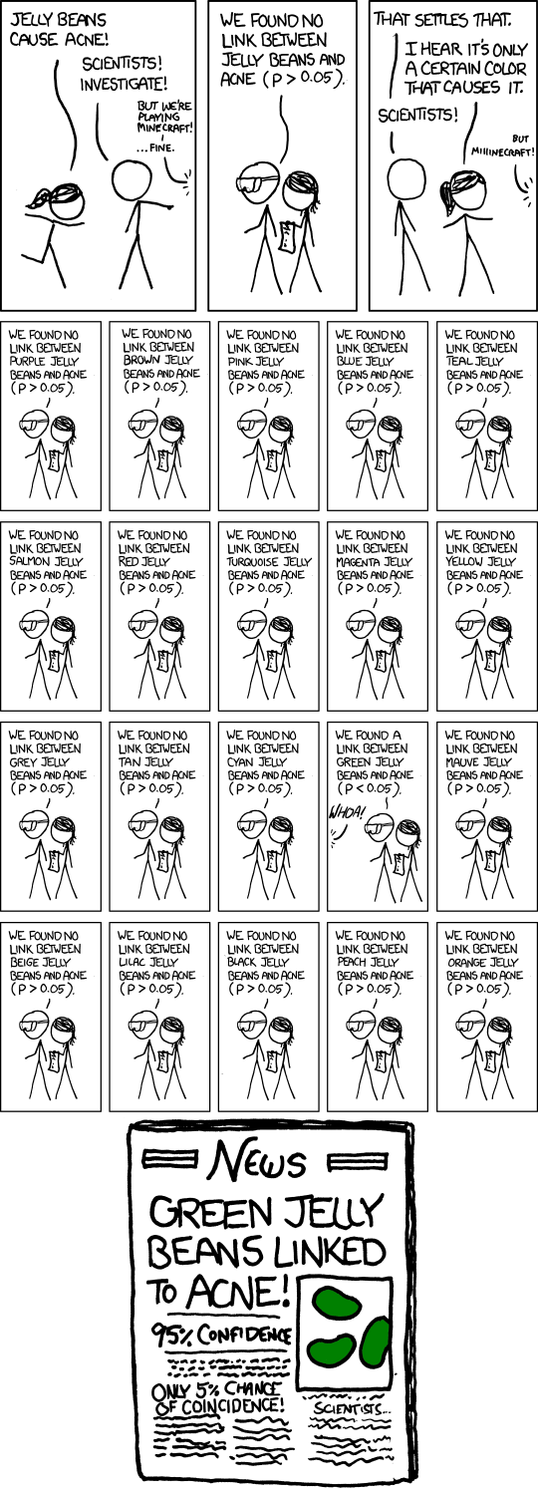
A false positive
http://xkcd.com/882/

Slide 11
http://xkcd.com/882/
http://xkcd.com/882/

Slide 12
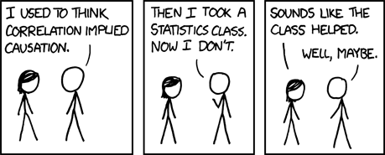
Correlation ≠ causation
Ice cream sales and murder rates are correlated
http://xkcd.com/552/

Slide 13
Statistical significance ≠ practical importance

Slide 14
Summary of statistical methodology
Decide on a metric (bigger value = better)
Observe what you see in the real world
Hypothesize that what you saw is normal/typical
This is the “null hypothesis”
Simulate the real world many times
How different is what you observed from the simulations?
What percent of the simulation values are the real world values bigger than?
If the percentage is 95% or more, reject the null hypothesis

Slide 15
Analogy between hypothesis testing and mathematical proofs
“The underlying logic [of hypothesis testing] is similar to a proof by contradiction. To prove a mathematical statement, A, you assume temporarily that A is false. If that assumption leads to a contradiction, you conclude that A must actually be true.”
From the book Think Statistics by Allen Downey

Slide 16
A common error
Observe what you see in the real world
Decide on a metric (bigger value = better)
This is backwards
For any observation, there is something unique about it.
Example: Roll dice, then be amazed because what are the odds you would get exactly that combination of rolls?

Slide 17
Don’t trust your intuition
People have very bad statistical intuition
It’s much better to follow the methodology and do the experiments

