Slide 1
Introduction to Data Programming
Michael Ernst and Bill Howe
Summer 2012

Slide 2
What this course is
An introduction to core programming concepts with an emphasis on real data manipulation tasks from science, engineering, and business.

Slide 3
What this course is not
A “skills course” in Python
…though you will become proficient in the basics of the Python programming language
…and you will gain experience with some important Python libraries
A data analysis / “data science” / data visualization course
There will be very little statistics knowledge assumed or taught
A “project” course
the assignments are “real,” but are intended to teach specific programming concepts
A “big data” course
Datasets will all fit comfortably in memory
No parallel programming

Slide 4
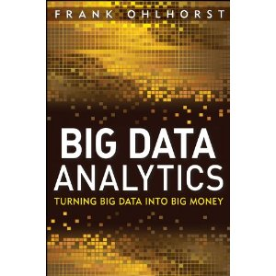
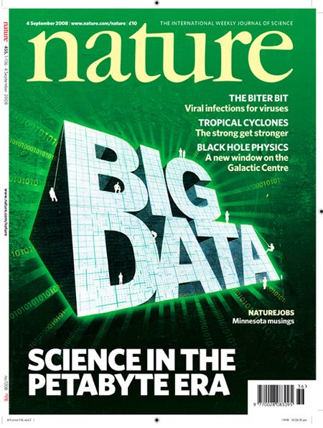
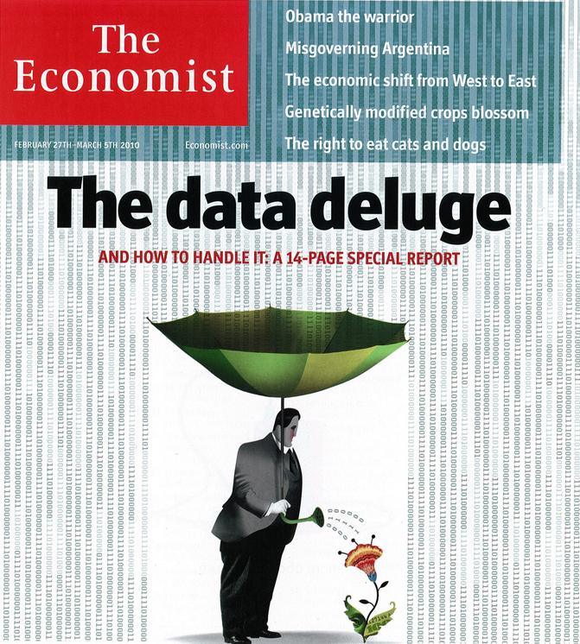
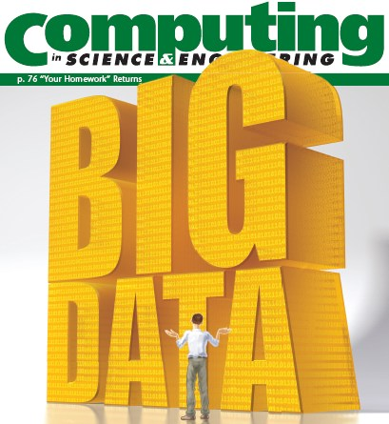
“It’s a great time to be a data geek.”
-- Roger Barga, Microsoft Research
“The greatest minds of my generation are trying
to figure out how to make people click on ads”
-- Jeff Hammerbacher, co-founder, Cloudera

Slide 5
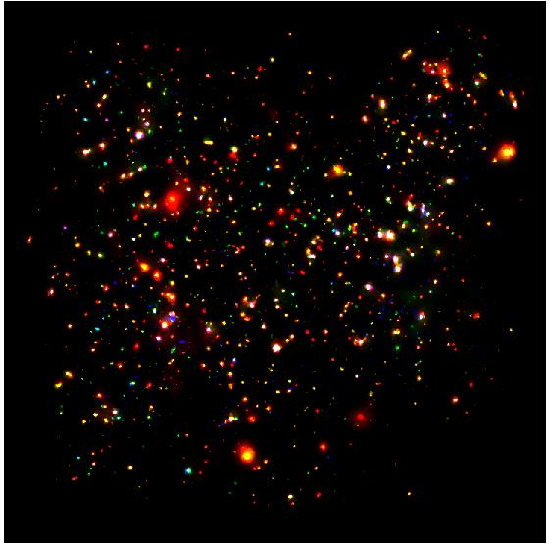
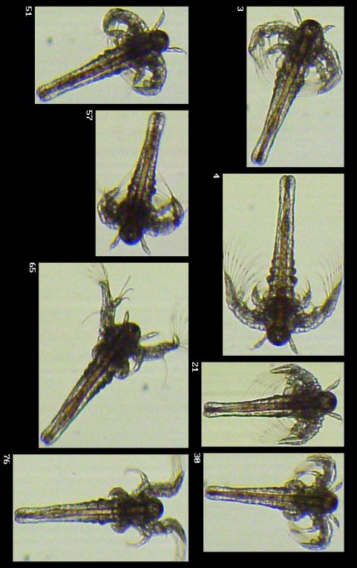
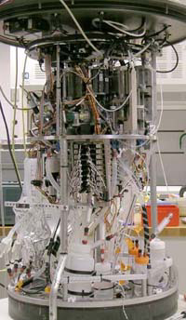
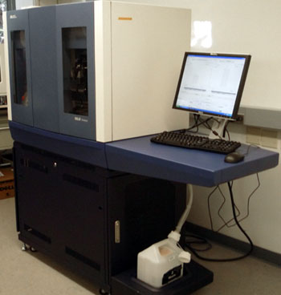
All of science is reducing to computational data manipulation
Old model: “Query the world” (Data acquisition coupled to a specific hypothesis)
New model: “Download the world” (Data acquisition supports many hypotheses)
Astronomy: High-resolution, high-frequency sky surveys (SDSS, LSST, PanSTARRS)
Biology: lab automation, high-throughput sequencing,
Oceanography: high-resolution models, cheap sensors, satellites
40TB / 2 nights
~1TB / day
100s of devices
Notes:
Drowning in data; starving for information
We’re at war with these engineering companies. FlowCAM is bragging about the amount of data they can spray out of their device. How to use this enormous data stream to answer scientific questions is someone else’s problem.
“Typical large pharmas today are generating 20 terabytes of data daily. That’s probably going up to 100 terabytes per day in the next year or so.”
“tens of terabytes of data per day” -- genome center at Washignton University
Increase data collection exponentially with flowcam

Slide 6
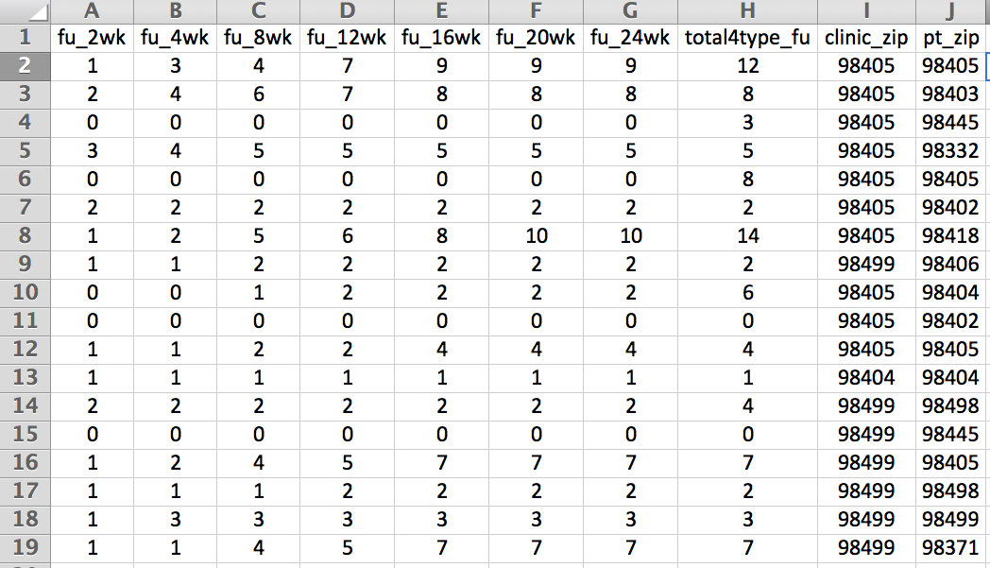
Example: Assessing Treatment Efficacy
number of follow ups within 16 weeks after treatment enrollment.
Zip code of clinic
Zip code of patient
Question: Does the distance between the patient’s home and clinic influence the number of follow ups, and therefore treatment efficacy?

Slide 7
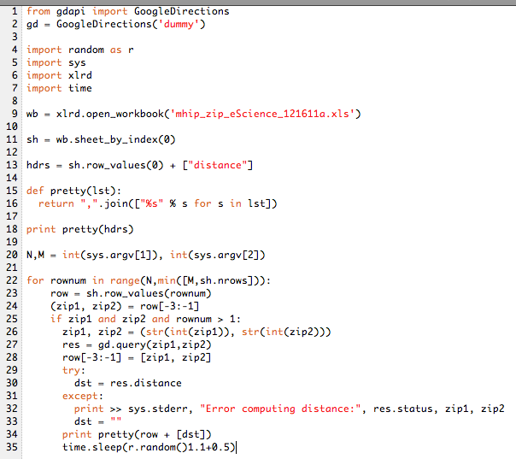
A library for interfacing with Google Maps API progtrammatically
A library for working with Excel spreadsheets
for each row,
clean up the data
compute the distance via Google
print out a new row with dist.
36 lines of code!

Slide 8
Demo: Twitter Sentiment Analysis
Do people have a favorable opinion of your product or company? Can we quantify this?
A very simple model: Words and phrases can be assigned a positive/negative valence.
Add up the valences of all the words in the tweet.
Get the current sentiment for a search term
Plot the sentiment of all tweets for a given period.

Slide 9
Demo: Twitter message length distribution
Plot the message length vs. time

Slide 10
Demo: Twitter Top K
Count the number of unique values for
words
user mentions
hashtags
places (of the user)
Plot the top k values

Slide 11
Demo: Twitter Tagcloud
Given the histogram of words, visualize the top 100 or so by mapping count to font size.

Slide 12
Other Possible Twitter Exercises
Map of geocoordinates showing location
Continuously updating plots

Slide 13
Learning Objectives (1)
Computational problem-solving
Writing a program will become your “go-to” solution for data analysis tasks
Basic Python proficiency
Including experience with relevant libraries for data manipulation, scientific computing, and visualization.
Experience working real datasets
astronomy, biology, linguistics, oceanography, open government, social networks, and more.
You will see that these are easy to process with a program, and that doing so yields insight.

Slide 14
Learning Objectives (2)
By the end of the quarter, students will be able to take a data source and a problem description and independently write a complete, useful program to solve the problem. Students will learn problem-solving and produce end-to-end solutions.
All assignments will use real data, at realistic scale and complexity.
Students will learn enough programming concepts to permit them to continue to more advanced computer science classes such as CSE 143, if desired. However, students will be independent enough not to need that for simple day-to-day data analysis and manipulation.

Slide 15
Book
Think Python: How to Think Like a Computer Scientist
Freely available online:
http://www.greenteapress.com/thinkpython/

Slide 16
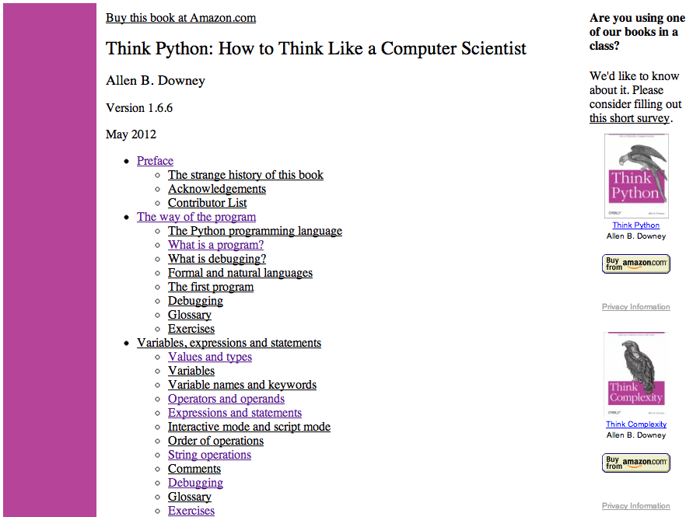

Slide 17
Assessment
Assignments 60%
Exams 30%
Participation 10%

Slide 18
Late policy
Each student is permitted 4 late days to use during the quarter.
Each late day permits you to submit an assignment up to 24 hours late.
You may use up to 2 late days per assignment.
Each late day is atomic; for example, you cannot use 8 hours of a single late day on each of three assignments.

Slide 19
Homework 1

