Slide 1

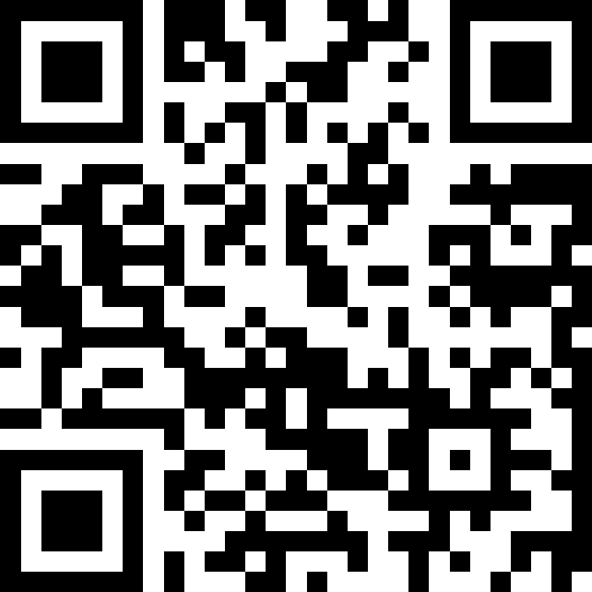
Welcome & Syllabus
BEFORE WE START
Talk to your neighbors:
Introduce yourself to your neighbor! What is your name? Major? What have you been up to the past week?
Instructor:
Brett Wortzman
TAs:
Arohan | Jonah | Kavya | Eeshani | Trien
Ashar | Brice | Misha | Aidan | Evan
Sean | Chris | Kieran | Cora | Rena
Chloe | Elden | Sahana | Dixon | Katharine
Jenny | Ishita | Anirudh | Nhan | Anya
Nate | Kuhu | Crystal
Now playing: 🎶 CSE 123 26wi Lecture Tunes 🎶

Slide 2
Lecture Outline
Introductions
About this Course
Course Components & Tools
Making the Most of this Class
Assignments and Grading

Slide 3

Hi, I’m Brett! (he/him)
Associate Teaching Professor
Frequent intro CS instructor
Lead designer/developer of new 12X curriculum
Also interested in CS education/pedagogy
Previously:
trained CS teachers (and still!)
developed CS curriculum
taught high school CS
worked as a software engineering
Non-CS hobbies: board games/RPGs, officiating football, announcing robotics competitions
Notes:
Brett

Slide 4

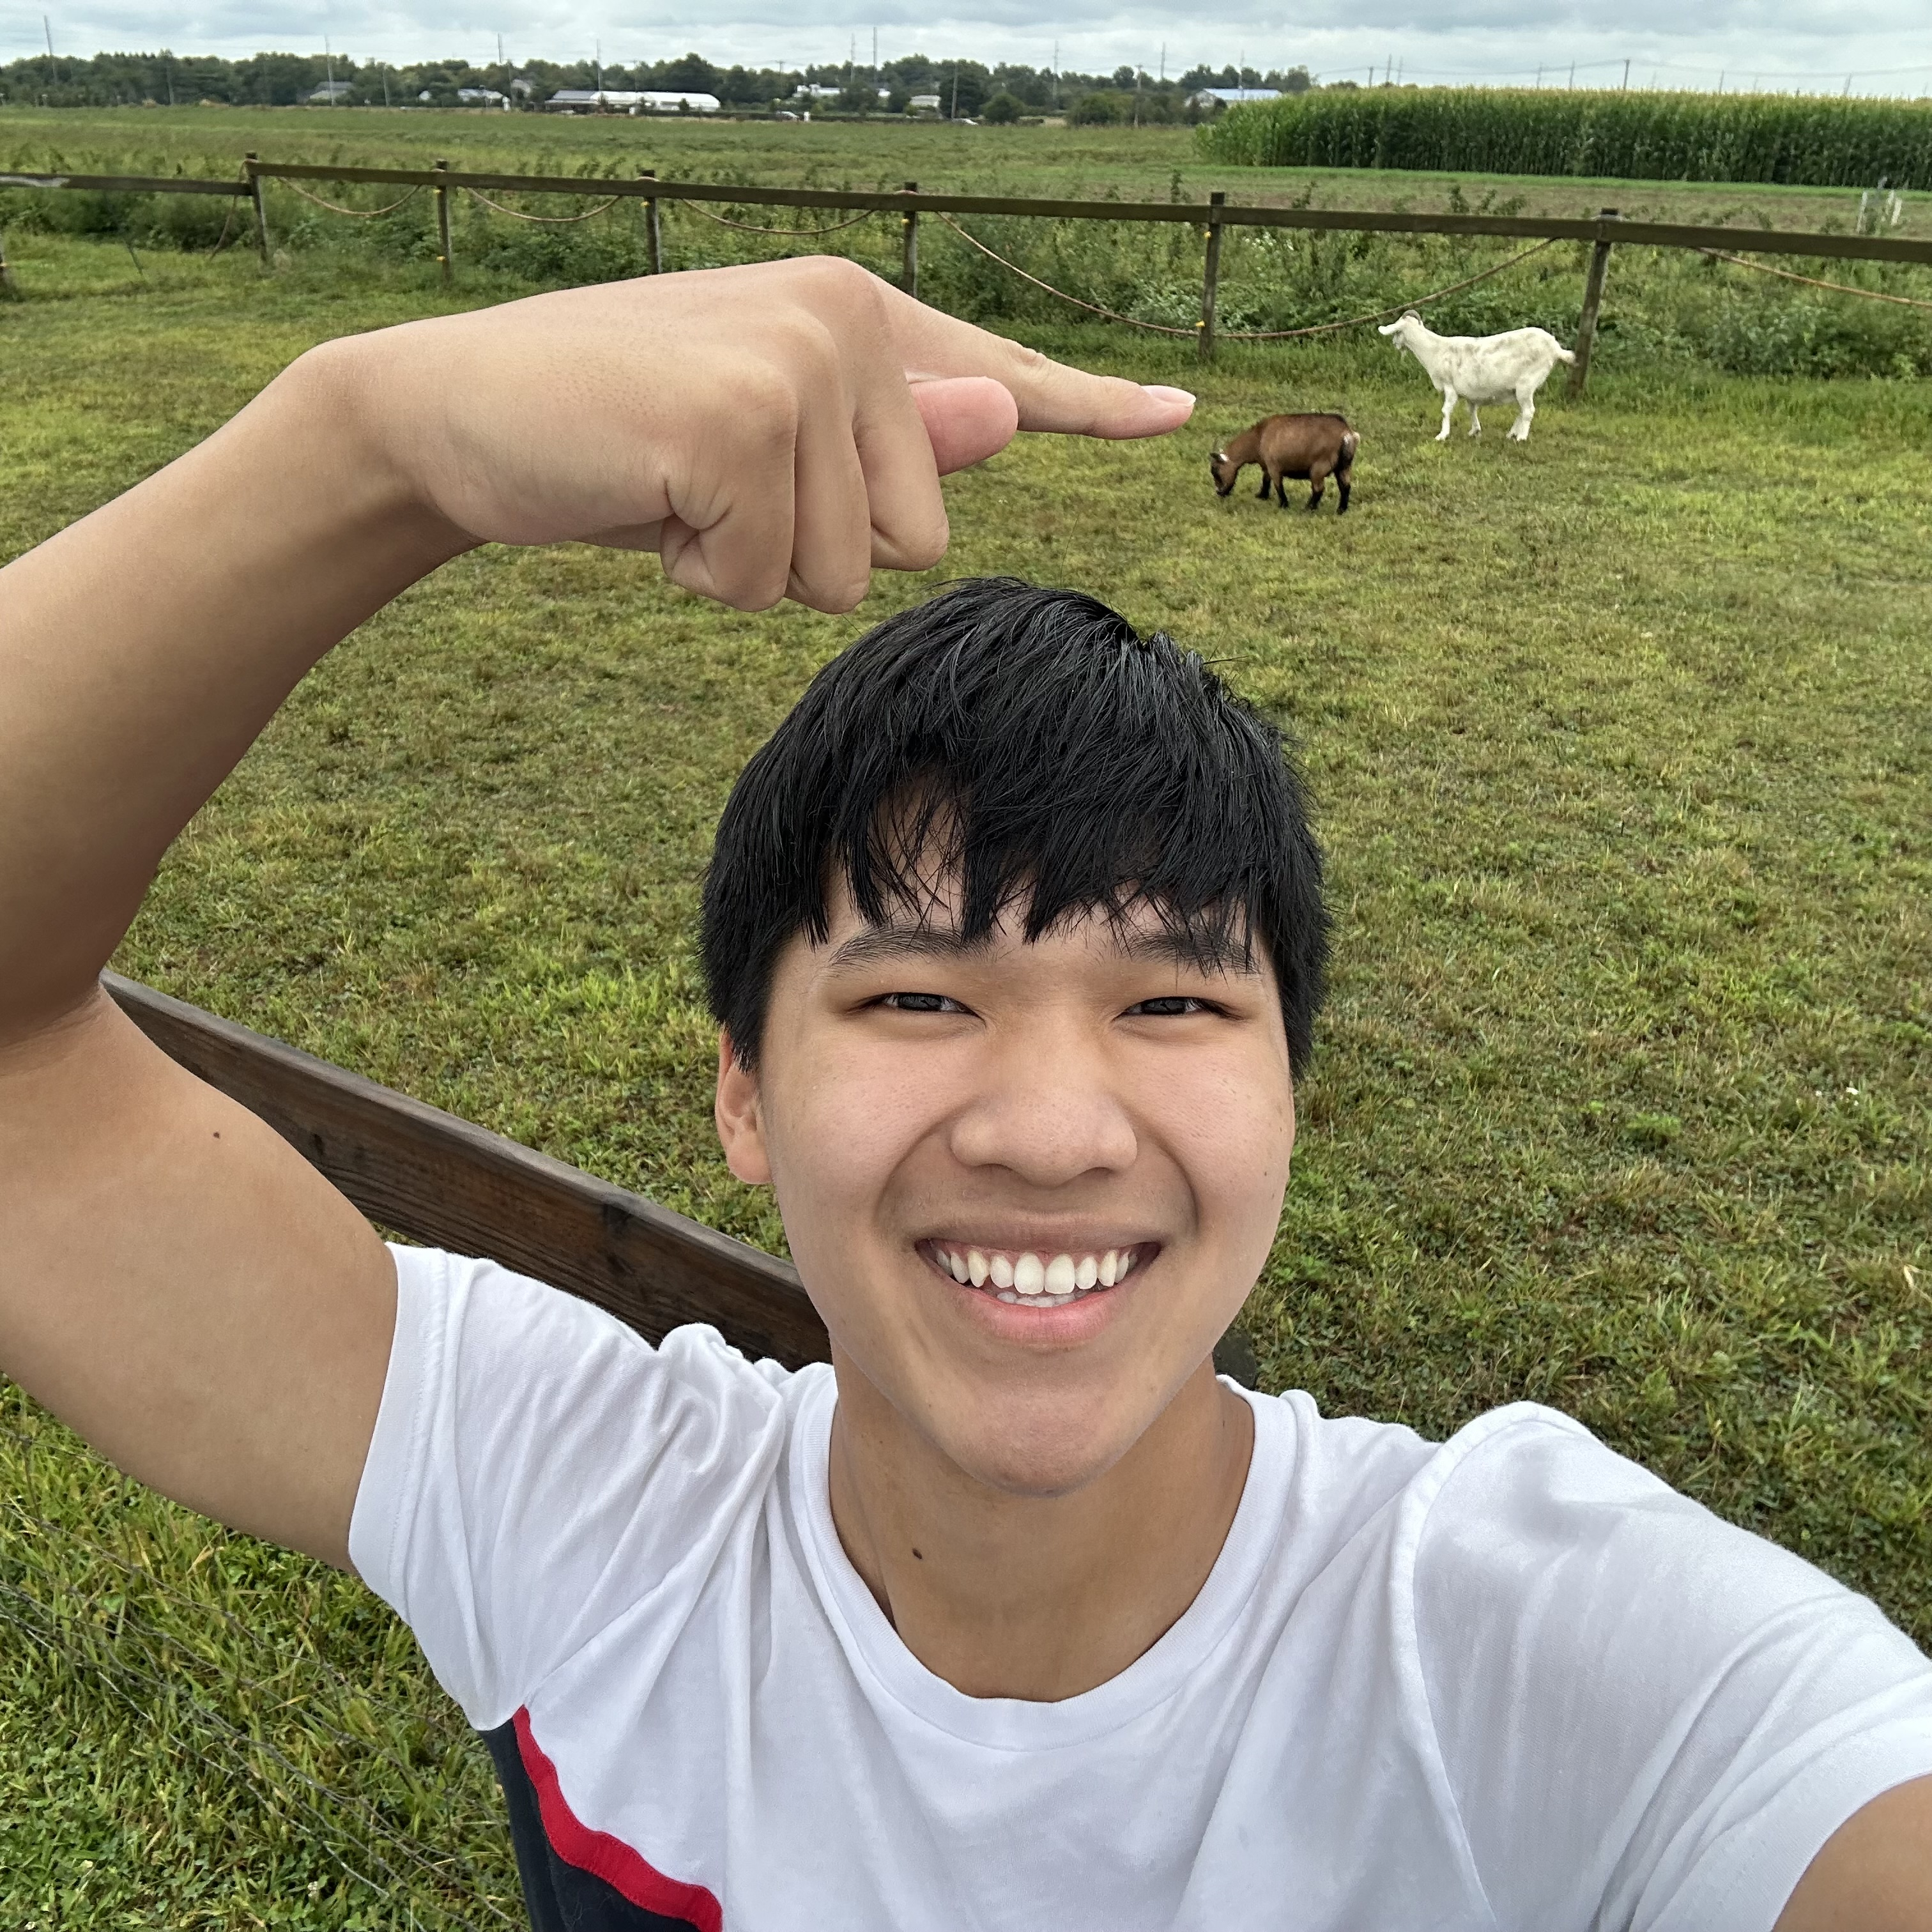

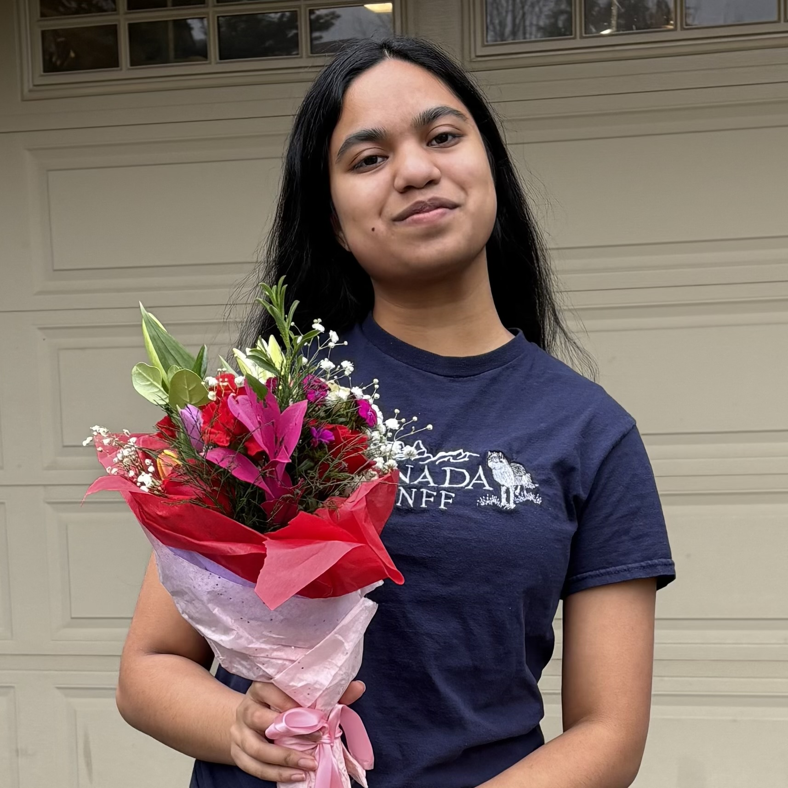


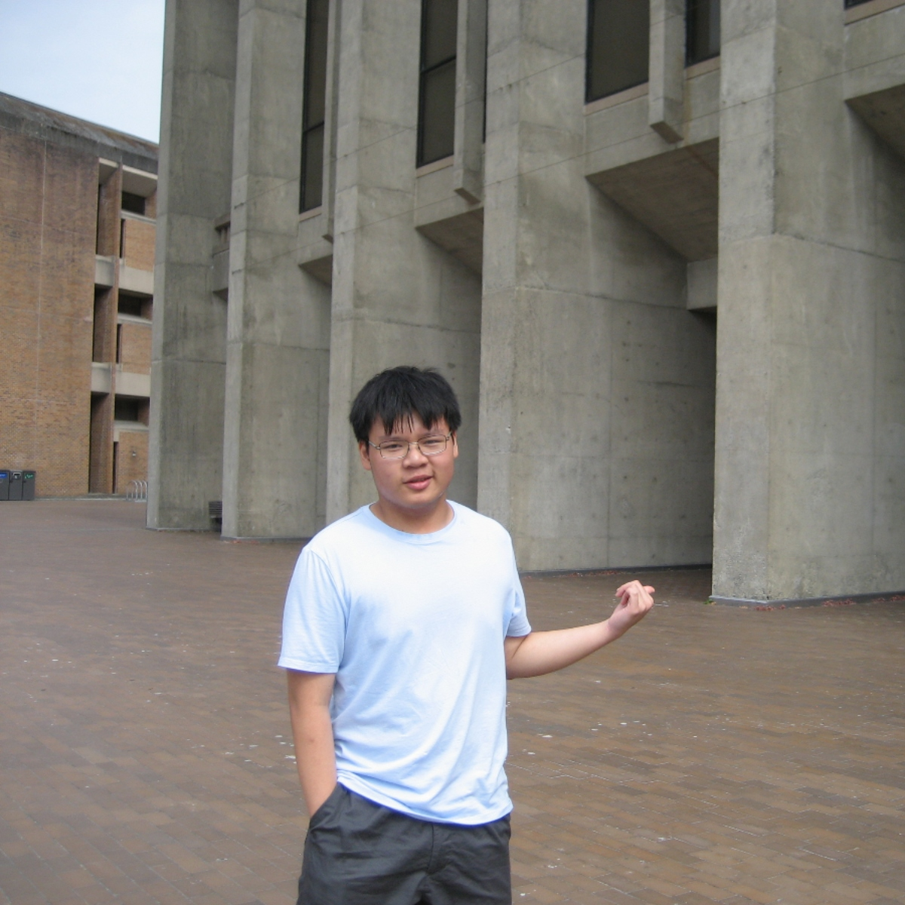
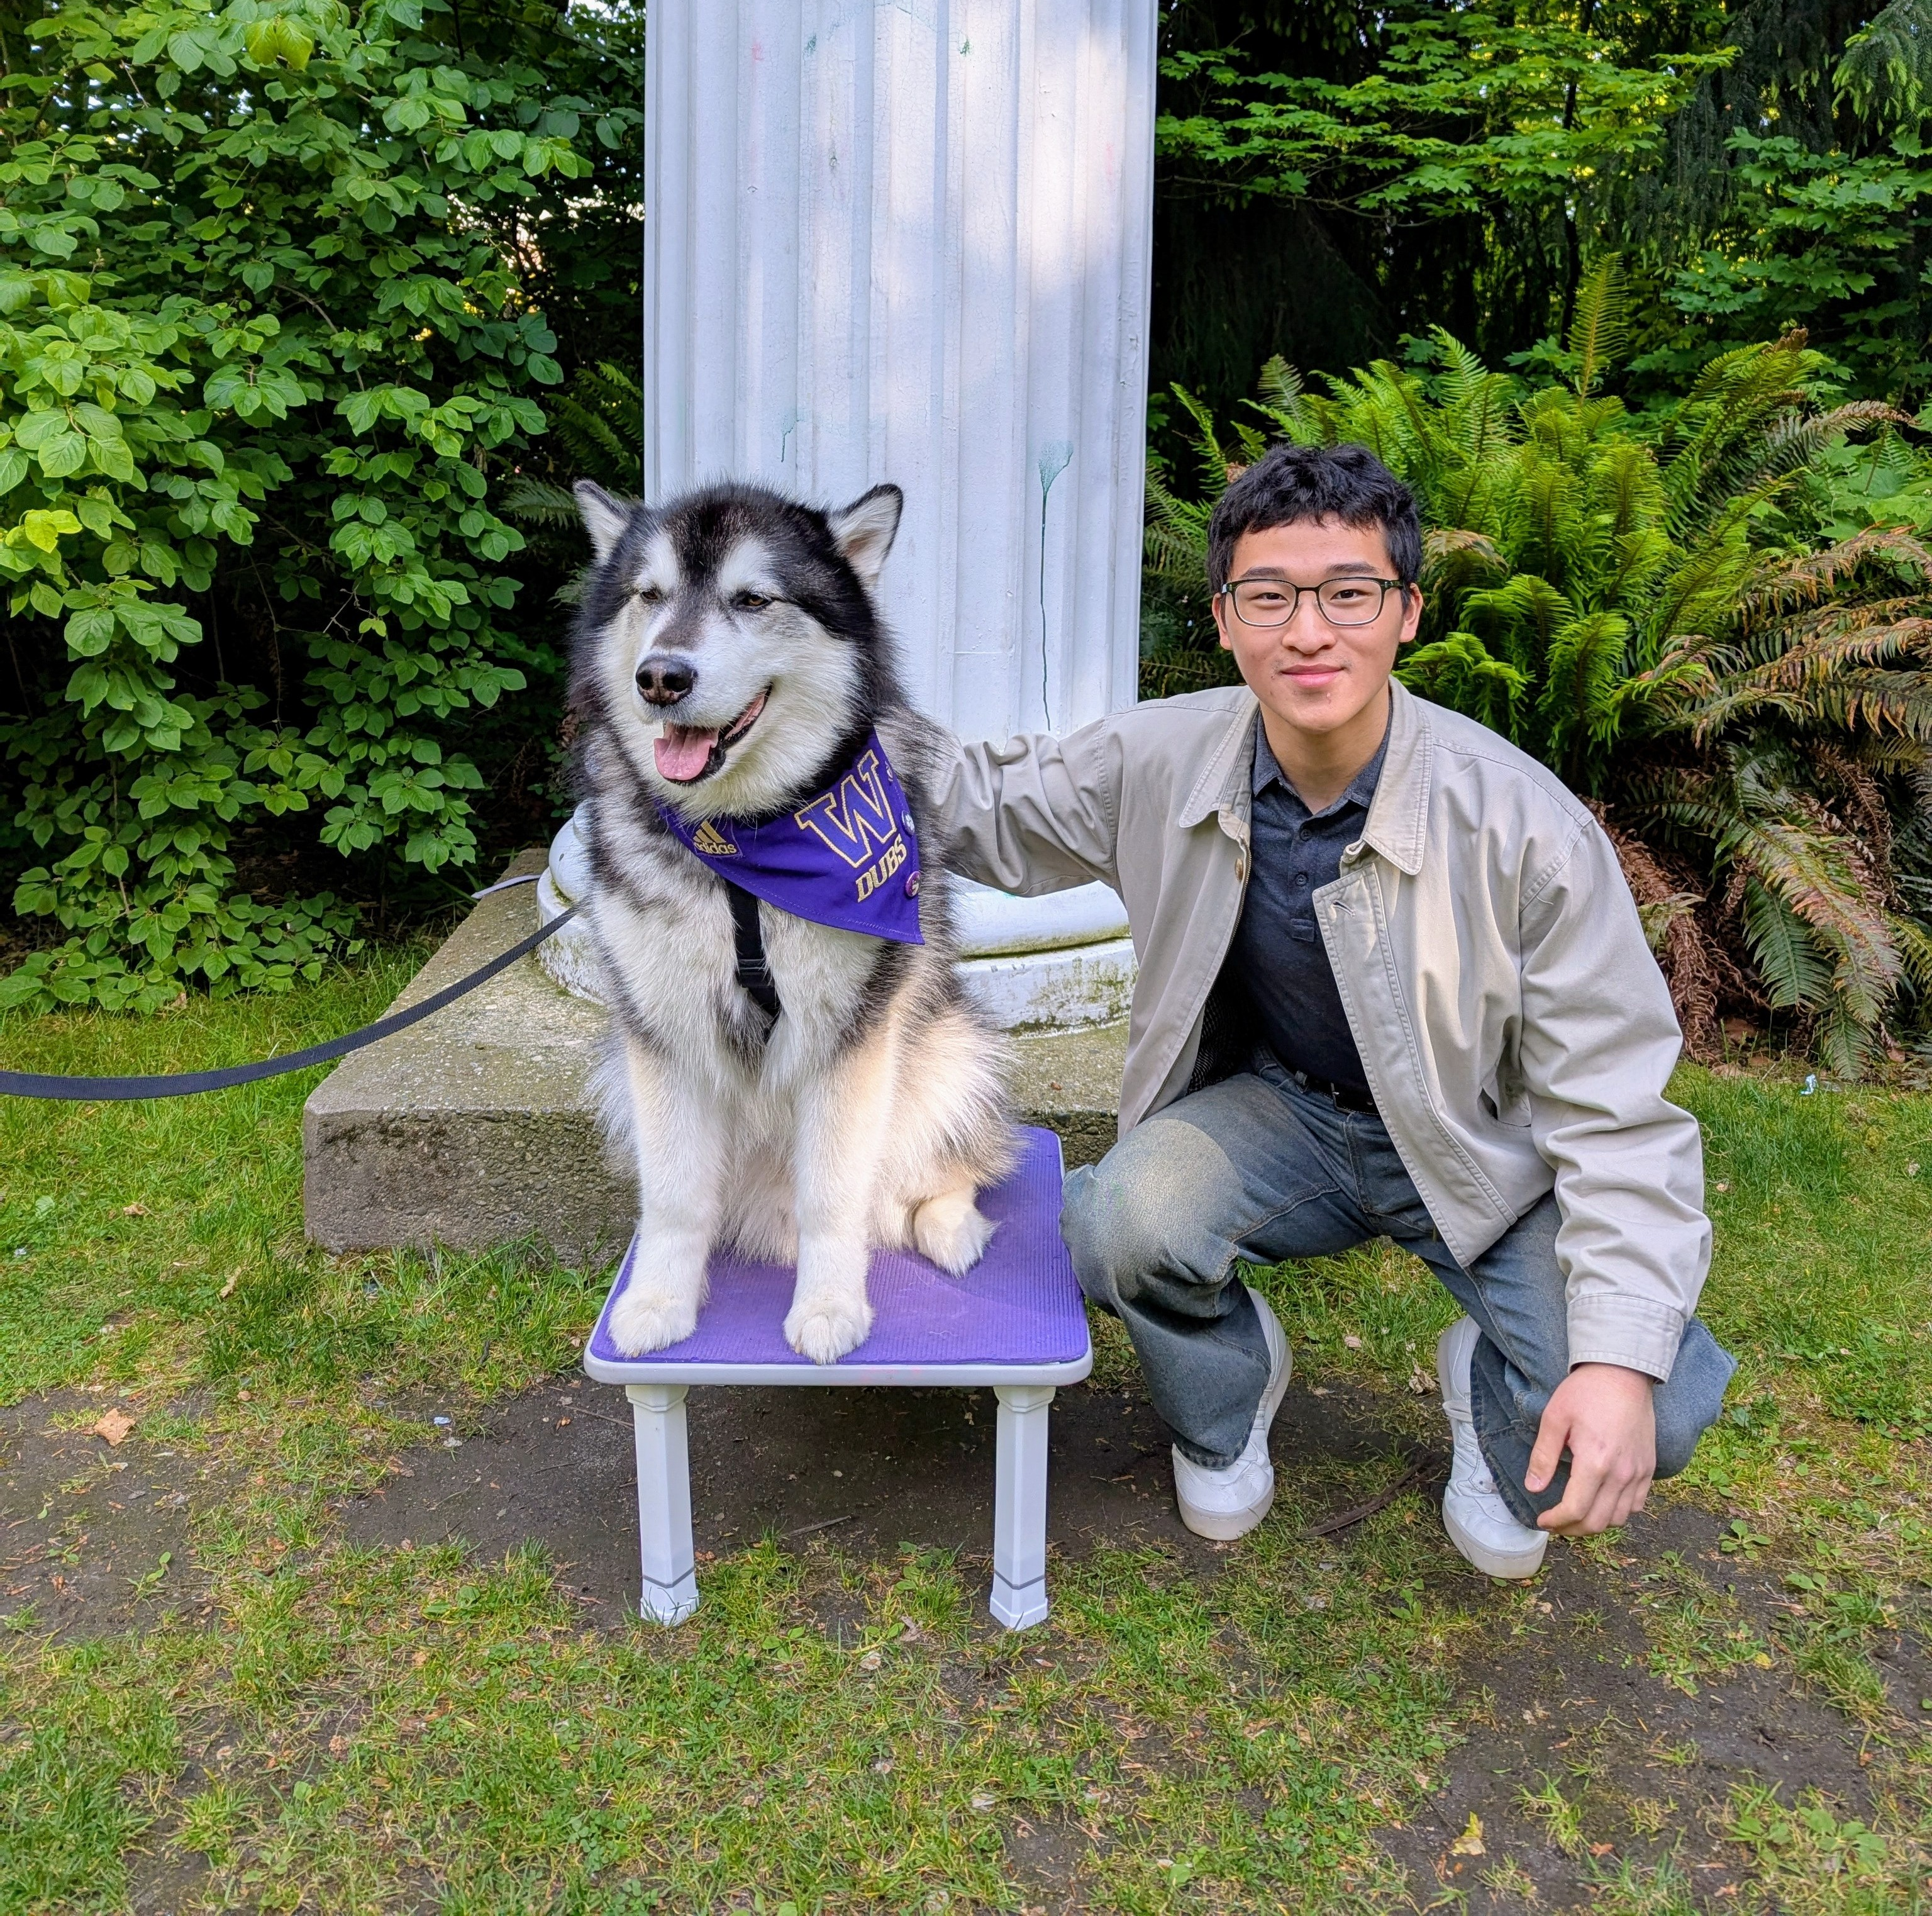



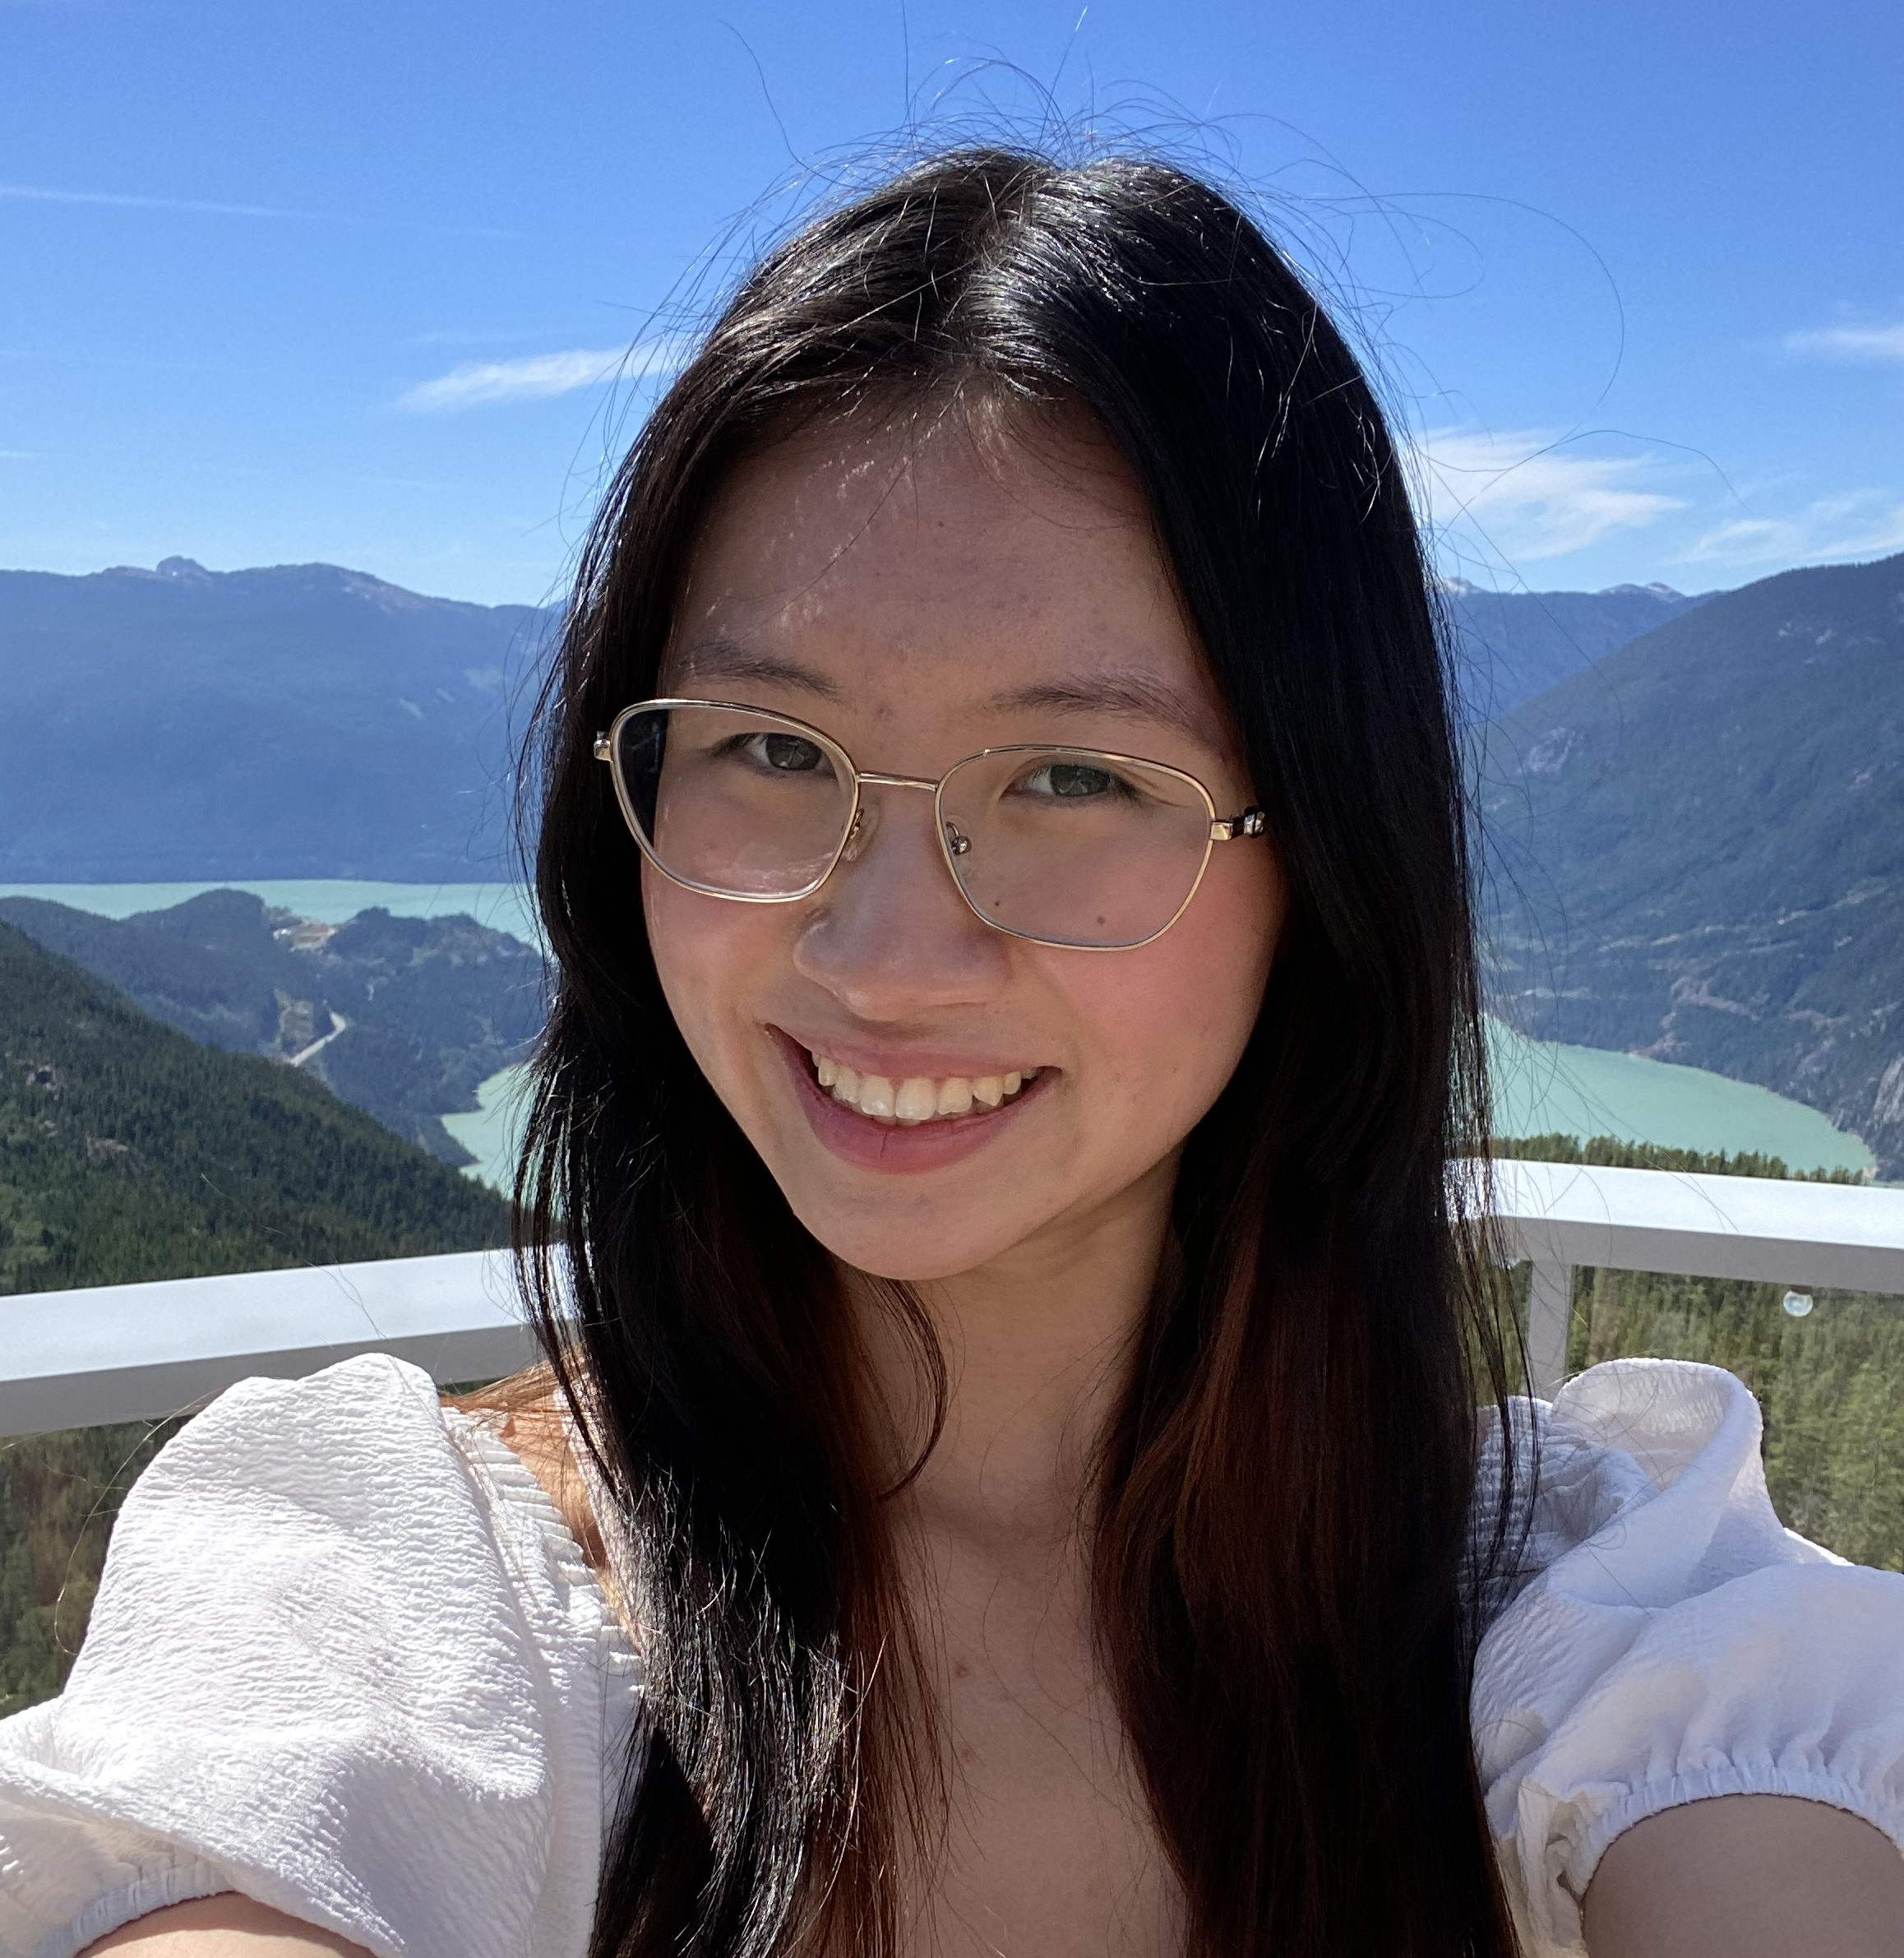
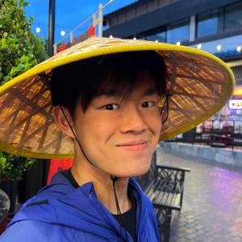



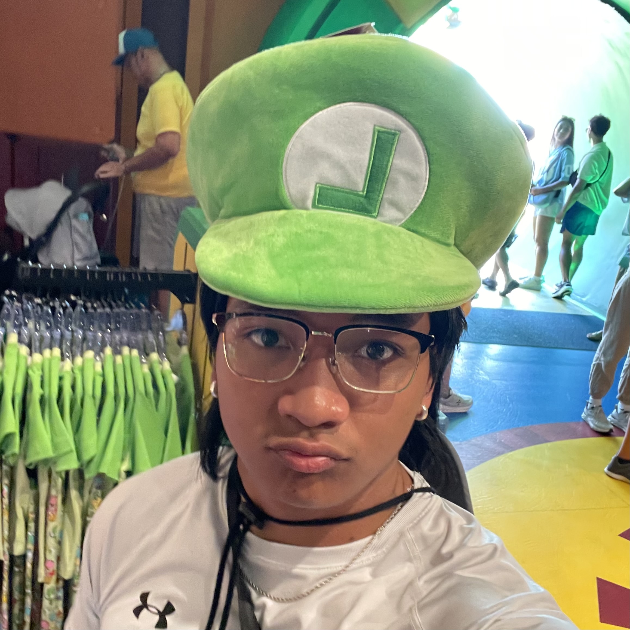



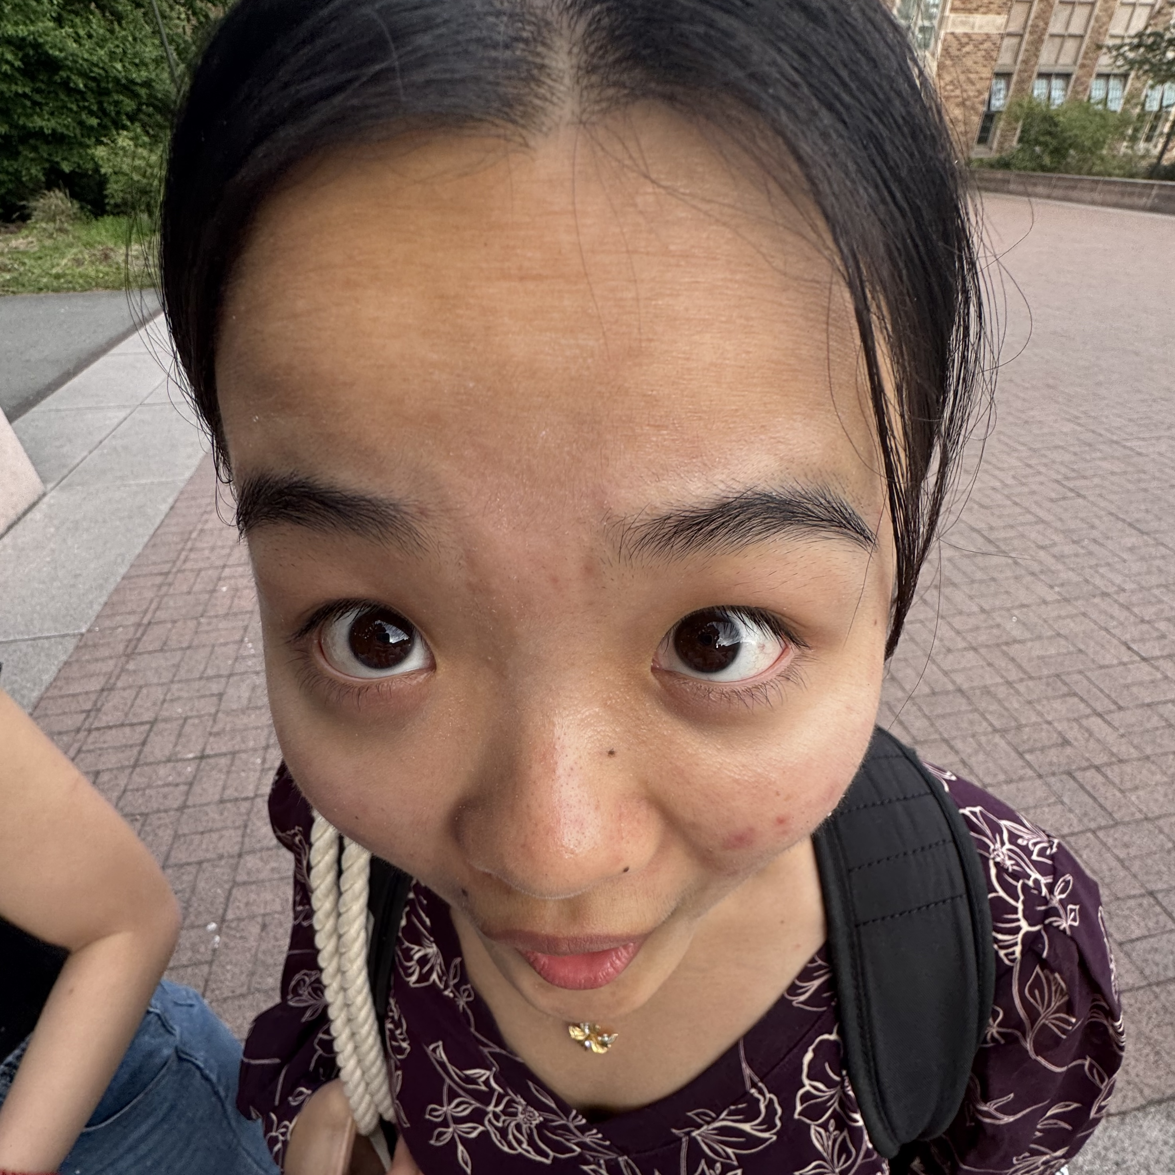




Meet your 28 fabulous TAs!
Notes:
Brett

Slide 5
What is this Class?
CSE 121 – Computer Programming I
CSE 122 – Computer Programming II
Data types (int, String, boolean)
Methods / Functions
Parameters, Returns
Control structures
Loops, Conditionals
Arrays & 2D arrays
Computational Thinking (language agnostic)
Functional Decomposition
File I/O
Using data structures
List, Stacks / Queues, Sets, Maps
Object Oriented Programming
Interfaces
CSE 123 – Computer Programming III
Advanced Object Oriented Programming
Comparable, Inheritance/Polymorphism, Abstract Classes
Implementing data structures
ArrayLists, LinkedLists, Trees
Recursion
Critical analysis of design

Slide 6
Why 123?
To solve more complex problems by leveraging more complex programming structures / patterns
To better rationalize specific design decisions
How to “best” structure programs
Which data structures are “most” appropriate to use
To understand and critically analyze intersections between Computer Science and society
Search engines, algorithmic art, machine learning, etc.
Developing informed opinions on current issues
Be a better programmer
Be a better person

Slide 7
Prerequisite Knowledge
Comfort with control structures
loops, conditionals, methods/functions
Experience with using basic data structures
arrays, lists, sets, maps
Experience with console and file input/output
Exposure to simple object-oriented programming
classes, interfaces
Programming experience in Java
Or willingness to pick up on your own

Slide 8

Course Expectations
What are you hoping to get out of taking CSE 123?
sli.do #cse123

Slide 9
Programming Skill
Fluency with the relevant language and tools
consists of many conceptually simple facts
e.g. syntax (of a for loop, method, ...) , how to run a program
eventually becomes second nature
Mental model of how programs execute
consists of a few deep concepts
e.g. what is a variable? a loop? a method? a reference?
develop the skill of tracing the current state of a program
Key course takeaway!

Slide 10
Lecture Outline
Introductions
About this Course
Course Components & Tools
Making the Most of this Class
Assignments and Grading

Slide 11
Course Components
LECTURES
x20
PROGRAMMING ASSIGNMENTS
x4
CREATIVE PROJECTS
x4
We’re here!
Introduce concepts, practice ideas, discuss applications.
Pre-class materials to prepare for class each day. Due before class.
Structured assignments
Programming in Java
Applying & implementing course concepts
More open-ended assignments
Explore new ideas and applications
SECTIONS
x16
QUIZZES
x3
EXAM
x1
Held in person
More practice, reviews, applications
TA advice, how to be an effective student
Preparation for quizzes / exams
Exit ticket done at end of section
Taken in quiz section
45 minutes on paper
Culminating exam
Tue, March 17th
12:30 – 2:20 PM
Graded Assignments
Meetings
Notes:
James

Slide 12
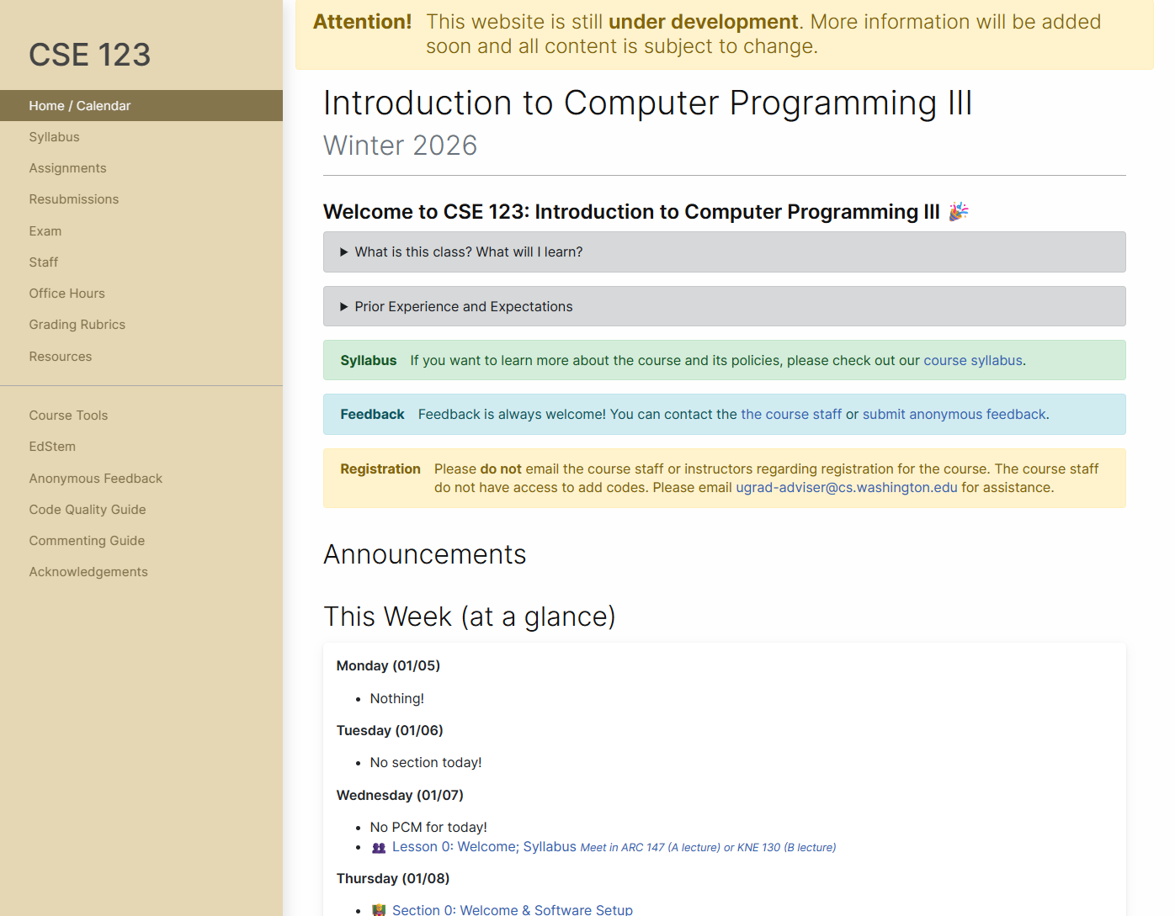
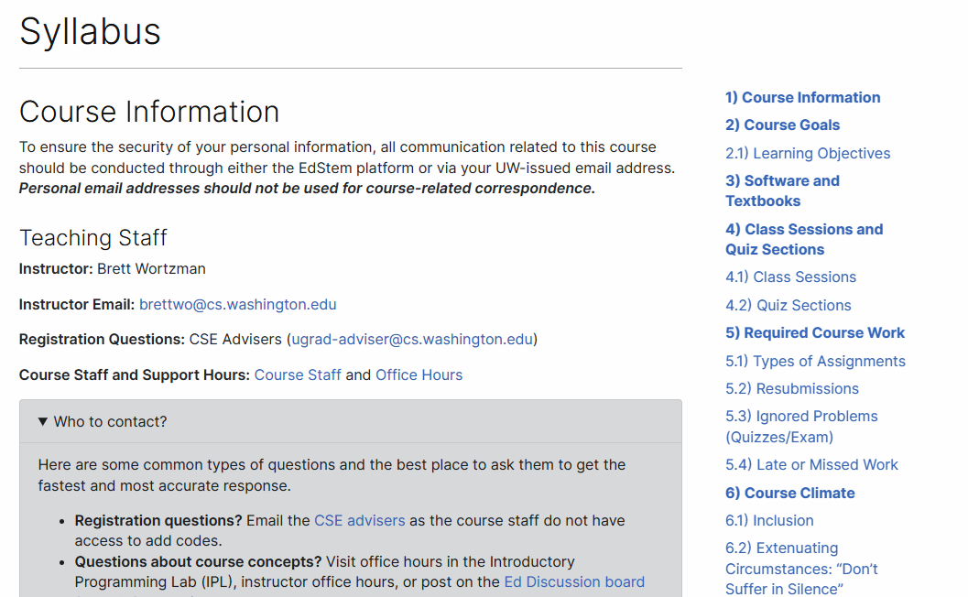
Course Website
cs.uw.edu/123
Review the syllabus!
Contains most course info – check frequently!
Announcements, Calendar, Lecture Slides, Office Hours schedule, Staff Bios, Important Links

Slide 13





Other Course Tools
My Digital Hand
Queueing in office hours
VSCode
Develop offline
Visual debugger
Ed
Community & Information
Discussion Board (please ask & answer!; anonymous option)
Announcements
Pre-Class Materials / Section Handouts
Assignments
Online IDE
Submit assignments
View Feedback
Gradescope
Quiz and final exam grades
Sli.do
In-class activities (ungraded)

Slide 14
Lecture Outline
Introductions
About this Course
Course Components & Tools
Making the Most of this Class
Assignments and Grading

Slide 15
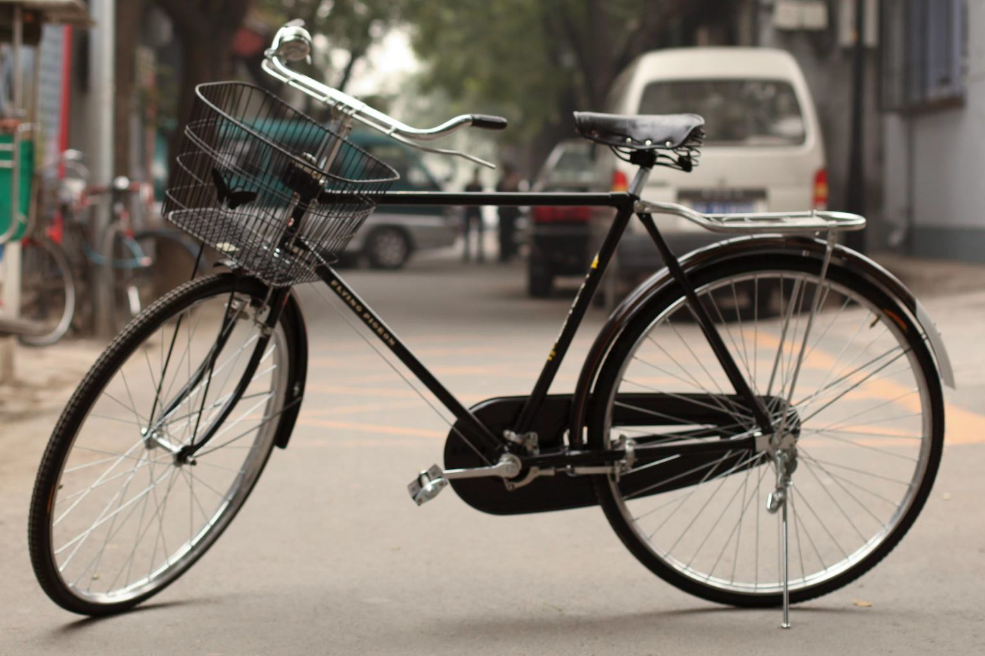
How did you learn how to ride a bike?
Notes:
Brett

Slide 16

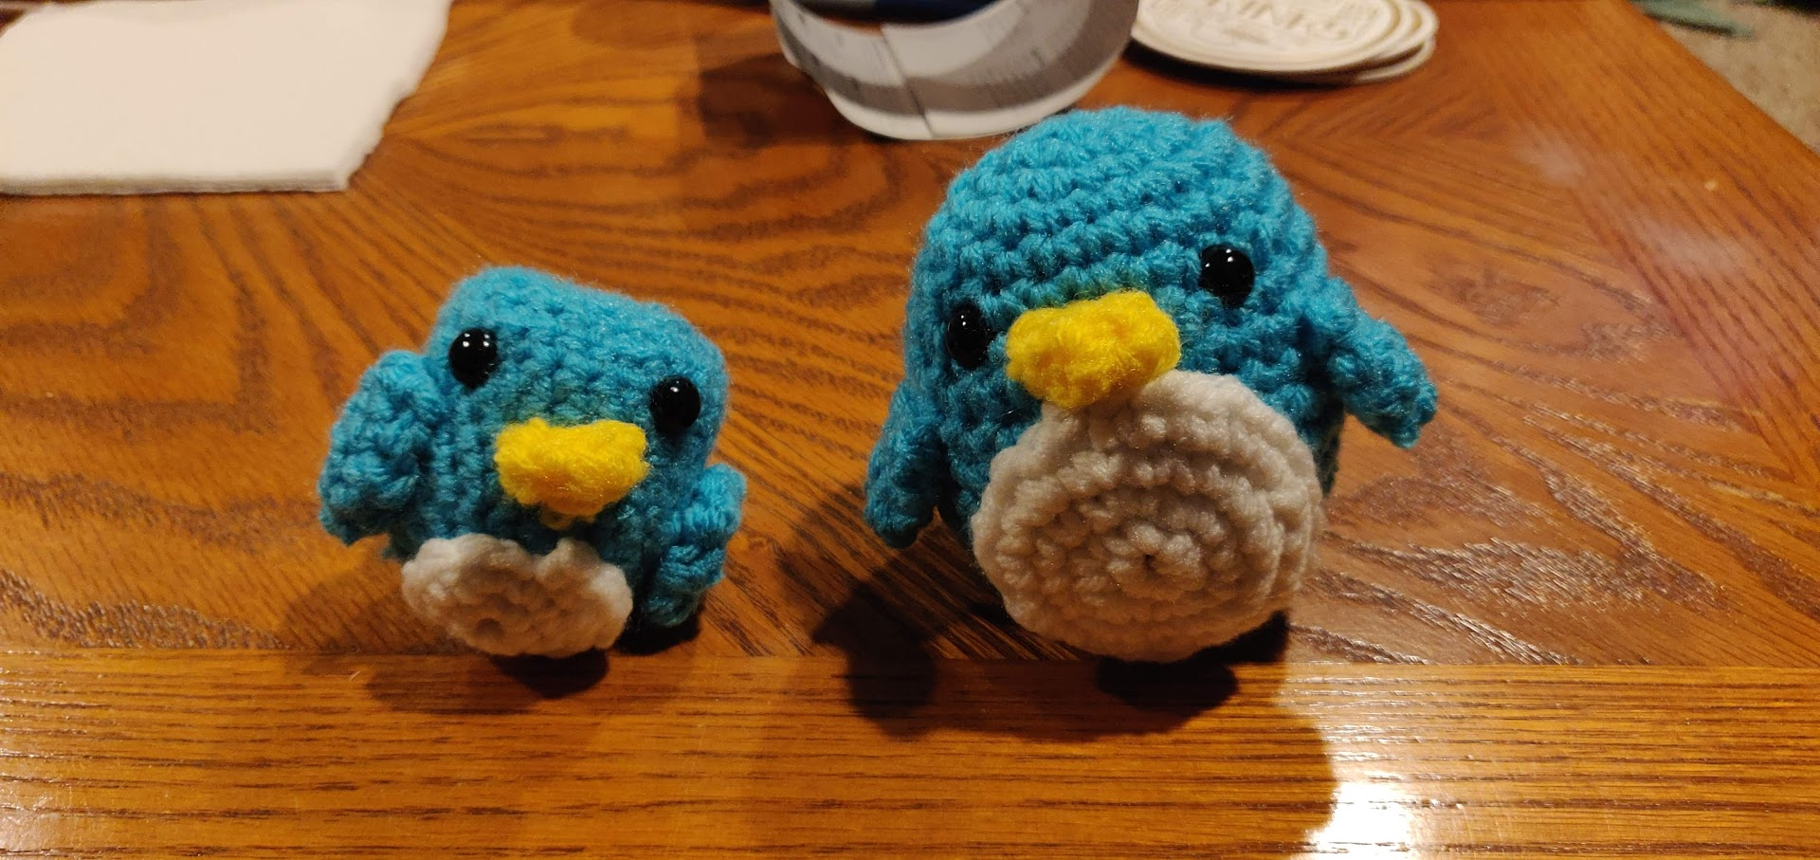
Digression: My Pandemic Hobby
Amigurumi: Japanese art of creating crocheted or knitted stuffed toys
Notes:
Brett
THIS was my first penguin.
I did everything “right”: followed instructions, looked for resources, paid attention. But I still made mistakes.
We don’t learn by watching, listening, or reading; we learn by DOING! And we almost always make mistakes along the way. Don’t expect to just show up to class, watch and listen, and get things exactly right the first time. Plan to engage, practice, and make mistakes.

Slide 17

How Learning Works
Learning requires active participation in the process. It’s not as simple as sitting and listening to someone talk at you.
Requires deliberate practice in learning by doing
Benefits from collaborative learning
Hybrid classroom model
Asks you to do some preparation before class in the form of readings and practice problems.
Should take ~30 minutes outside of class per lesson
Class will start with brief recap, then pick up where the reading and practice problems leave off.
Attendance isn’t graded, but showing up and trying is the first step in succeeding in the class!
Pre-class materials are ungraded, but…
It’s okay if you find them challenging! That means you are learning!

Slide 18
Learning Pattern
Pre-class Work
Your first introduction to a topic
Interactive components
In-class lessons
Recap of pre-class work
Further instruction from where it left off
Interactive components
Section
Review, restate, rephrase content
Very interactive
Homework
Learn by applying
Help when you need it!
Quizzes/Final Exam
Show us what you’ve learned
Instruction
Practice
Instruction
Practice
Instruction
Practice
Practice/Assessment
Instruction
Assessment

Slide 19
Learning in CSE 123: Live Support Systems
Programming is hard! We want to give you collaborative support!
Introductory Programming Lab (TA Office Hours) – starting Week 2
> 40 hours/week (and highly rated in the class!)
Face-to-face help from TAs on any course questions
Instructor Office Hours
Great for things from lecture, personal questions, or just saying hi
Notes:
Brett

Slide 20
Learning in CSE 123: Async Support Systems
Ed Board
Best for content and logistics questions – 445 of you >> 29 of us!!
Encourage public posts, except for things about your graded work
Answer other students’ questions – great way to learn!
Email
Best for personal circumstances and/or private questions
If unsure, always feel free to email Brett
May politely ask you to post on Ed instead!
For emails, please use your UW email (protecting student privacy!)
Notes:
Brett

Slide 21
Think-Pair-Share: Inclusive Environments
CSE 123 will have many think-pair-share activities. Let’s practice! Today’s think:
What was an experience you had that made you feel welcome or included in a learning environment?
Think on your own, in silence for about ~ 30 seconds
Pair with your neighbor about it (and introduce yourself!!)
Share in sli.do and in class (I’ll take a few volunteers from both)
Notes:
James

Slide 22
Think-Pair-Share: Exclusive Environments
CSE 123 will have many think-pair-share activities. Let’s practice! Today’s think:
What was an experience you had that made you feel unwelcome or excluded in a learning environment?
Think on your own, in silence for about ~ 30 seconds
Pair with your neighbor about it (and introduce yourself!!)
Share in sli.do and in class (I’ll take a few volunteers from both)
Notes:
James

Slide 23
Lecture Outline
Introductions
About this Course
Course Components & Tools
Making the Most of this Class
Assignments and Grading

Slide 24
Assignments and Grading
Our goal in the course is for you to gain proficiency the concepts and skills we teach
We assess your proficiency by asking you to apply the concepts and skills on tasks or problems
By necessity, we are assessing your work as a proxy for your proficiency

Slide 25
Assignments
Your learning in this course will be assessed in four ways:
Programming Assignments (~biweekly, 4 total)
Structured programming assignments to assess your proficiency of programming concepts
Creative Projects (~biweekly, 4 total)
Smaller, more open-ended assignments to give you space to explore
Quizzes (3 total, in section)
Series of problems covering all material up to that point
Final Exam (Tuesday, March 17, 12:30-2:20)
Final, culminating assessment of all your skills and knowledge

Slide 26
Resubmission and Ignored Quiz Problems
Learning takes time, and doesn’t always happen on the first try
One previous Programming Assignment or Creative Project can be resubmitted each week
Must be accompanied by a write-up describing changes (via Google Form)
Grade on resubmission will replace original grade
An assignment can be resubmitted in the 3 cycles after feedback has been published
Tip: Resubmit as early as possible!
We will ignore your two lowest quiz/exam problem grades
No special action required– we’ll do this automatically
See the syllabus for more details

Slide 27
Grading
Grades should reflect your proficiency in the course objectives
All assignments will be graded E (Excellent), S (Satisfactory), or N (Not yet)
Under certain circumstances, a grade of U (Unassessable) may be assigned
Final grades will be assigned based on the amount of work at each level
See the syllabus for more details

Slide 28
Collaboration Policy
When we assess your work in this class, we need to know that it’s yours.
Unless otherwise specified, all graded work must be completed individually and without touching AI tools.
Some specific rules to highlight:
do not share your own solution code or view solution code from any source – including but not limited to other students, tutors, or the internet
do not use AI tools (e.g. ChatGPT) to create graded work
See the syllabus for more details (this is very important to understand).

Slide 29
AI and CSE 123: Our Philosophy
Computing applications enabled by artificial intelligence (AI) are increasingly common and more widely used for a variety of tasks.
It is becoming more difficult to teach an introductory computing course without acknowledging the existence of AI tools.
But as relatively new programmers, you still need to learn and practice effectively using core programming ‘building blocks’.
Notes:
James

Slide 30
CSE 123 AI Policy
No part of any graded work may touch an AI tool.
You may not copy and paste any work generated by AI into any graded submission, nor may you copy and paste any work from or for a graded assignment into an AI tool. All other uses of AI on graded work must be cited.
cs.uw.edu/123/syllabus/#using-ai-in-cse-123
Notes:
James

Slide 31
CSE 123 AI Policy
No part of any graded work may touch an AI tool.
You may not copy and paste any work generated by AI into any graded submission, nor may you copy and paste any work from or for a graded assignment into an AI tool. All other uses of AI on graded work must be cited.
ALLOWED
PROHIBITED
Asking AI to explain an error message
Asking AI to explain the functionality of non-graded code snippets
Asking AI to suggest additional information or resources
Generating code, comments, reflections
Using AI to ‘solve’ an assignment
Using AI to write, modify, or extend reflections, code, comments, etc.
cs.uw.edu/123/syllabus/#using-ai-in-cse-123
Notes:
James

Slide 32
Coming up…
🧑‍🏫 Go to your first quiz section and meet your TAs tomorrow!
Make sure to double check MyUW for the location.
💻 Complete Pre-Class Work 1 before class on Friday!
It will be posted and linked from the course calendar later today.
❓ Complete the Introductory Survey
This helps us gather data about the students taking our classes and their backgrounds, to inform future offerings.

