Slide 1

Linked Nodes w/Loops
BEFORE WE START
What’s the last TV show you finished?
Respond on sli.do!

Slide 2
Lecture Outline
Announcements
ListNode practice
Iterating over ListNodes

Slide 3
Announcements
Resubmission Cycle 0 open, closes today
  Normally resubmissions will be open Mon – Fri each week
Creative Project 1 due Wednesday, January 28 at 11:59pm!
Quiz 0 next week (Tuesday, January 27)
  See Quiz Logistics Ed announcement
  Practice Quizzes posted, solutions posted tomorrow

Slide 4
Lecture Outline
Announcements
ListNode practice
Iterating over ListNodes

Slide 5
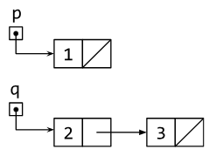
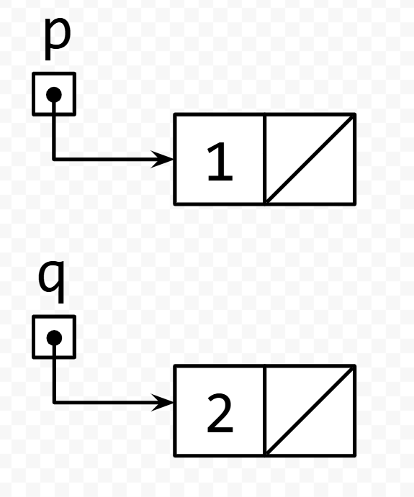
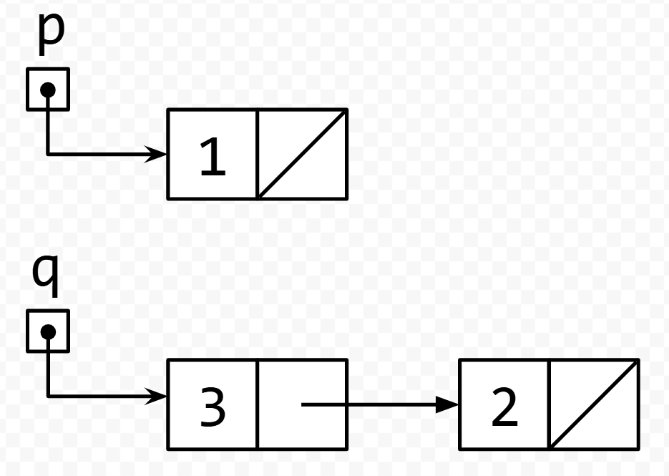
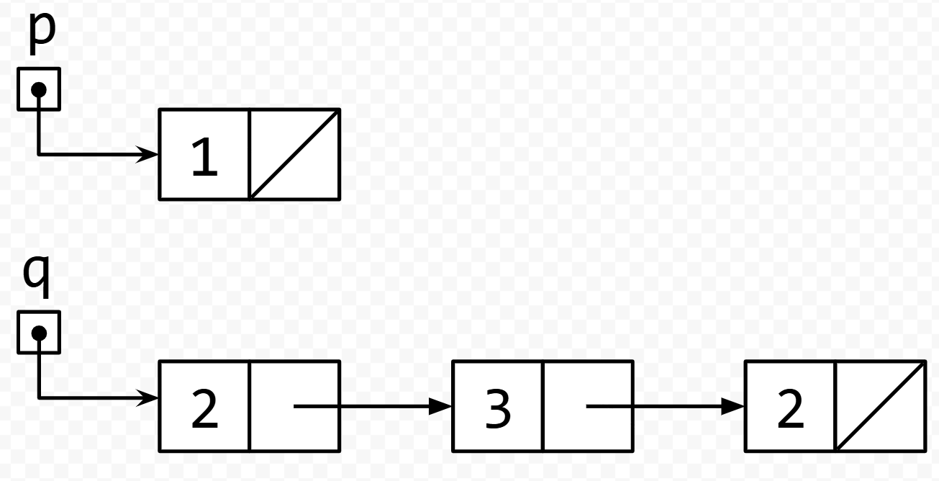
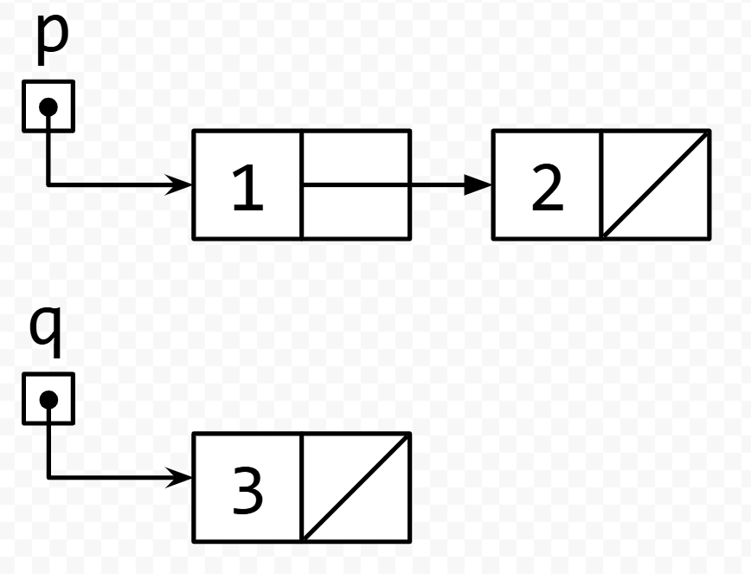
What is the result of running the code on the list shown in the picture?
A. B.
C. D.
q.next.next = q;
q = q.next;
q.next.next = null;

Slide 6
What is the result of running the code on the list shown in the picture?
A. B.
C. D.
q.next.next = q;
q = q.next;
q.next.next = null;

Slide 7
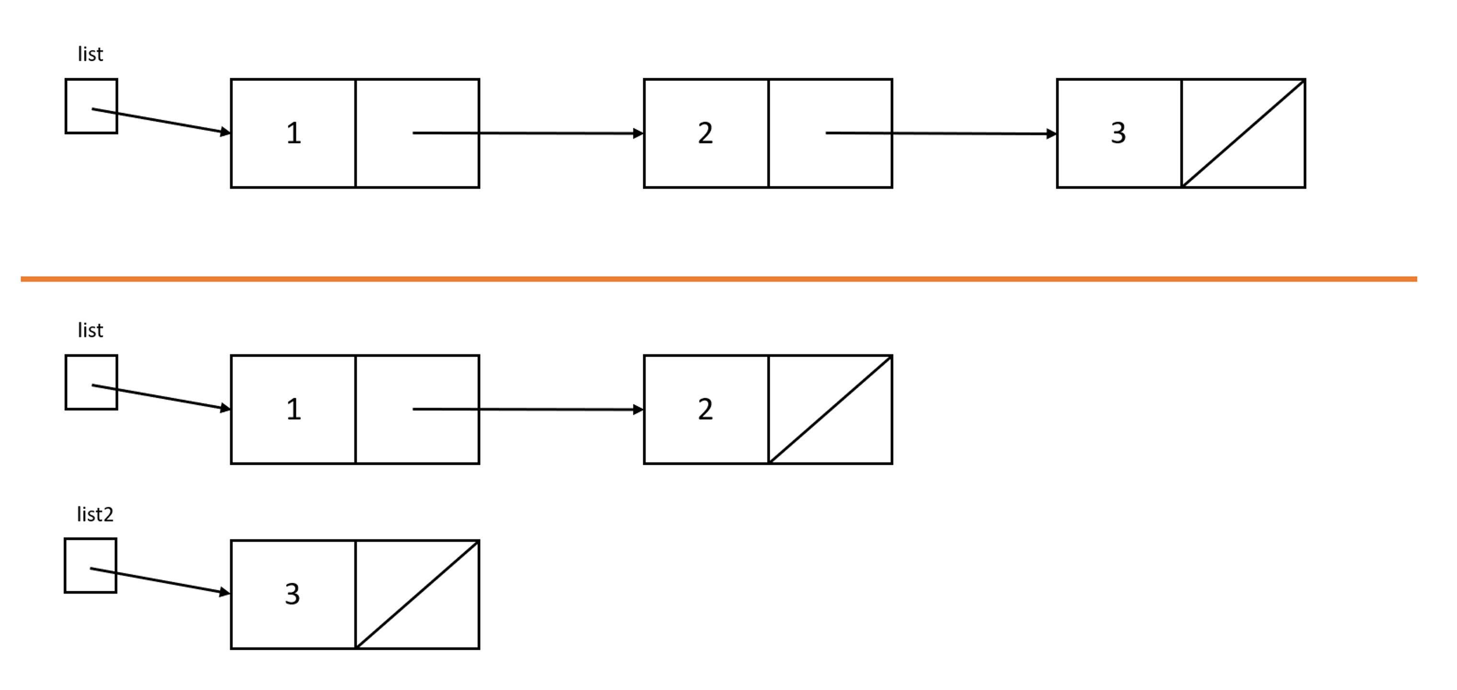
Which code will turn the top picture into the bottom picture?
A. ListNode list2 = list.next.next;
B. list.next.next = null;
ListNode list2 = list.next.next;
C. ListNode list2 = list.next.next;
list.next.next = null;
D. ListNode list2 = list.next;
list.next = null;

Slide 8
Which code will turn the top picture into the bottom picture?
A. ListNode list2 = list.next.next;
B. list.next.next = null;
ListNode list2 = list.next.next;
C. ListNode list2 = list.next.next;
list.next.next = null;
D. ListNode list2 = list.next;
list.next = null;

Slide 9
Lecture Outline
Announcements
ListNode practice
Iterating over ListNodes

Slide 10
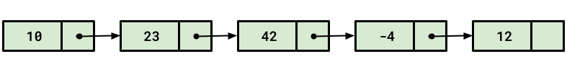
ListNode chains
Recall the ListNode class:
public class ListNode {
public int data;
public ListNode next;
}
How would we find the fourth value in a chain?
node.next.next.next.data
node

Slide 11
ListNode chains
Recall the ListNode class:
public class ListNode {
public int data;
public ListNode next;
}
How would we find the 100th value in a chain?
node.next.next.next.next.next.next.next....
node

Slide 12
Iterating over ListNodes
General pattern iteration code will follow:
ListNode curr = front;
while (curr != null) {
// Do something
curr = curr.next;
}

