Slide 1

Polymorphism; Abstract Classes
BEFORE WE START
Coffee or tea? Or something else?
Respond on sli.do!

Slide 2
Announcements
Creative Project 0 due tonight, Wednesday, January 14 at 11:59pm!
See generic Creative Project rubric posted on website
Programming Assignment 0 will be released tomorrow, Thursday, January 15 and is due Wednesday, January 21
Focused on inheritance and abstract classes
Recruiting students for a research study about the self-placement
See Ed post #68 for details

Slide 3
Lecture Outline
Polymorphism
Compiler vs. Runtime Errors
Abstract Classes

Slide 4
Polymorphism
DeclaredType x = new ActualType()
All methods in DeclaredType can be called on x
We’ve seen this with interfaces (List<String> vs. ArrayList<String>)
Can also be to inheritance relationships
Important: The ActualType determines what method is actually called!
Animal[] arr = {new Animal(), new Dog(), new Husky()};
for (Animal a : arr) {
a.speak();
}

Slide 5
Polymorphism
Animal[] arr = {new Animal(), new Dog(), new Husky()};
for (Animal a : arr) {
a.speak();
}
DeclaredType x = new ActualType()
Important: The ActualType determines what method is actually called!

Slide 6
Declared Type and Actual Type
DeclaredType varName = new ActualType(…);
ActualType must be a subclass of (or same as) DeclaredType
Animal rufus = new Dog("Rufus");
Dog rufus = new Dog(”Rufus");
Declared Type: Animal
Actual Type: Dog
Can call methods that makes sense for EVERY Animal
If Dog overrides a method, uses the Dog version
Declared Type: Dog
Actual Type: Dog
Can call methods that makes sense for EVERY Dog
If Dog overrides a method, uses the Dog version

Slide 7
Polymorphism
Typical Problem
Animal[] arr = {new Animal(), new Dog(), new Husky()};
for (Animal a : arr) {
a.speak();
}
Suppose Animal, Dog, and Husky all implement speak.
Which version gets called on each iteration of the loop?

Slide 8
Overrides and Method Calls
Solution Technique
Animal dubs = new Husky();
dubs.speak();
When running:
Use the most specific version of the method call starting from the actual type.
Start from the actual type, then go “up” to super classes until you find the method. Run that first-discovered version.
Animal
extends
“is a”
Running:
Look this way for speak
Use the first implementation found
Dog
extends
“is a”
In this example:
If the Husky class overrides speak, then we’ll use the implementation in Husky. If not, we’ll look in Dog and use that one if found. If not, then we’ll look in Animal.
Actual Type
Husky

Slide 9
Lecture Outline
Polymorphism
Compiler vs. Runtime Errors
Abstract Classes

Slide 10
Compiler vs. Runtime Errors
DeclaredType x = new ActualType()
At compile time, Java only knows DeclaredType
Compiler error: trying to call a method that isn’t present
Animal a = new Dog();
a.bark(); // No bark() -> CE
Can cast to change the DeclaredType of an object Dog d = (Dog) a;
d.bark(); // No more CE
Runtime error: attempting cast to type that is not a superclass of actual type
Animal a = new Fish(); Dog d = (Dog) a; // Can’t cast -> RE
d.bark();
- Order matters! Compilation before runtime

Slide 11
Compiling Method Calls
Animal rufus = new Dog();
rufus.bark();
When compiling:
Can we guarantee that the method exists for the declared type?
Does the declared type or one of its super classes contain a method of that name?
If not… Compile Error!
Object
Compiling:
Look this way for bark
extends
“is a”
Animal
Declared Type
extends
“is a”
extends
“is a”
In this example:
When compiling, neither Animal nor Object have a bark method, so we have a compile error!
Dog
Fish

Slide 12
Running Method Calls
Animal rufus = new Dog();
rufus.feed();
When running:
Use the most specific version of the method call starting from the actual type.
Start from the actual type, then go “up” to super classes until you find the method. Run that first-discovered version.
Object
extends
“is a”
Running:
Look this way for feed
Use the first implementation found
Animal
extends
“is a”
extends
“is a”
In this example:
If the Dog class overrides feed, then we’ll use the implementation in Dog. Otherwise we’ll use the one in Animal
Actual Type
Dog
Fish

Slide 13
Casts and Method Calls
When compiling:
Can we guarantee that the method exists for the Cast-to type?
Does the Cast-to type or one of its super classes contain a method of that name?
If not… Compile Error!
When Running:
Check that the Cast-to Type is either the Actual Type, or one of its super classes
Animal rufus = new Dog();
Dog d = (Dog) rufus;
d.bark();
Object
Compiling:
From cast-to type
Look this way
for bark
Running:
From actual type
Look this way
for cast-to type
Animal
Cast-to Type
Dog
Fish
Actual Type
This example has no error

Slide 14
Casts and Method Calls
When compiling:
Can we guarantee that the method exists for the Cast-to type?
Does the Cast-to type or one of its super classes contain a method of that name?
If not… Compile Error!
When Running:
Check that the Cast-to Type is either the Actual Type, or one of its super classes
Animal rufus = new Fish();
Dog d = (Dog) rufus;
d.bark();
Object
Compiling:
From cast-to type
Look this way
for bark
Running:
From actual type
Look this way
for cast-to type
Animal
Cast-to Type
Dog
Fish
Actual Type
This example has a runtime error

Slide 15
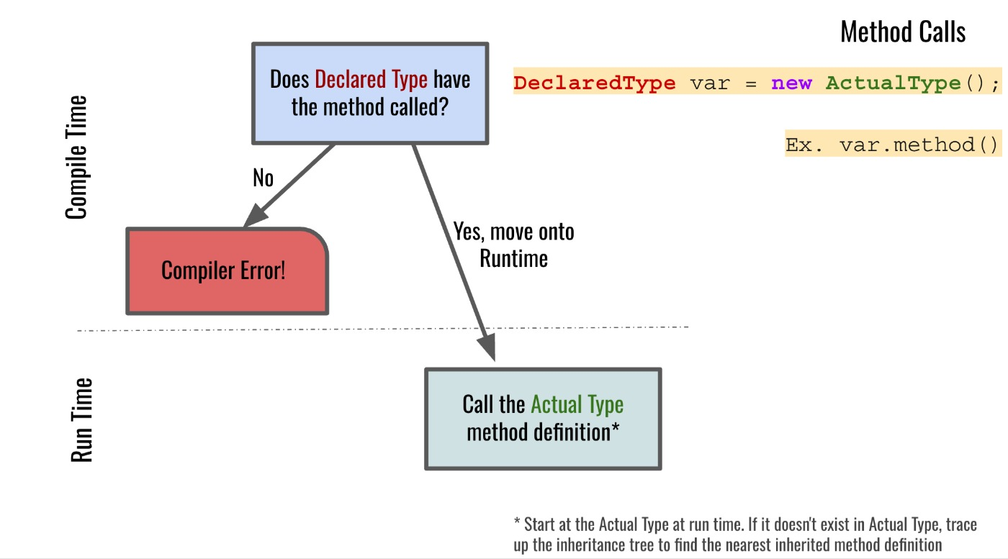
Compiler vs. Runtime Errors: Method Calls

Slide 16
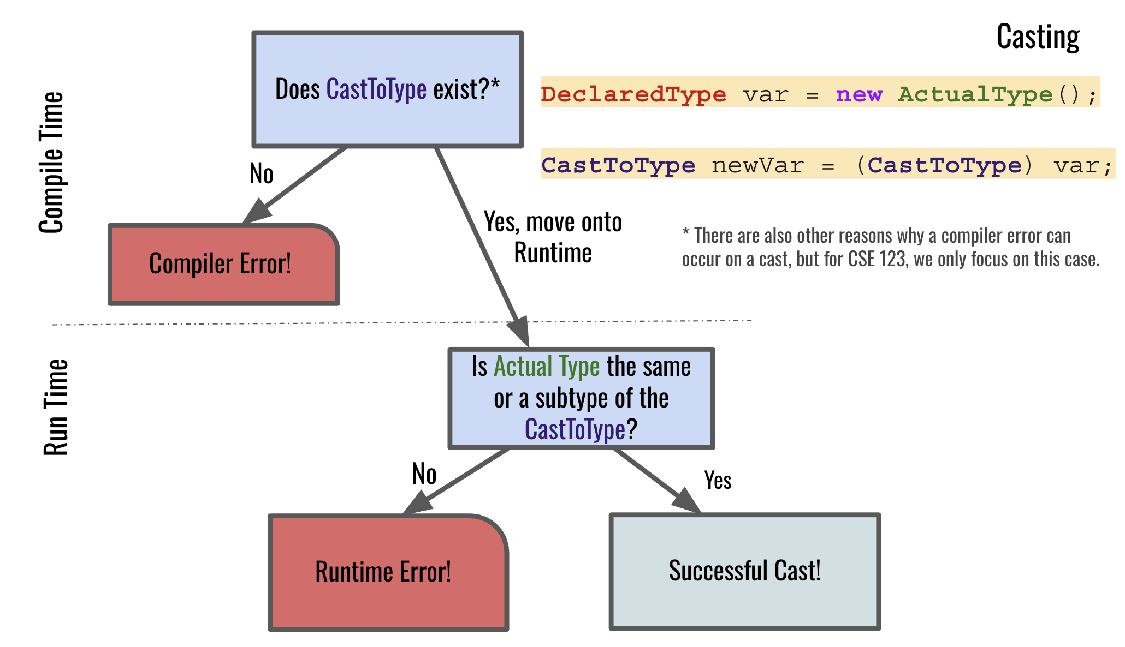
Compiler vs. Runtime Errors: Casting

Slide 17

What is the result of the following code?
Compiler Error
Runtime Error
No error– runs to completion
Teacher socrates = new Teacher("Socrates", 2400);
System.out.println(socrates.getEmployeeName());
System.out.println(socrates.getYearsExperience());

Slide 18
What is the result of the following code?
Compiler Error
Runtime Error
No error– runs to completion
Teacher socrates = new Teacher("Socrates", 2400);
System.out.println(socrates.getEmployeeName());
System.out.println(socrates.getYearsExperience());

Slide 19
What is the result of the following code?
Compiler Error
Runtime Error
No error– runs to completion
Employee anthony = new Chef("Anthony Bourdain");
System.out.println(anthony.getEmployeeName());
anthony.cookFood("shrimp");

Slide 20
What is the result of the following code?
Compiler Error
Runtime Error
No error– runs to completion
Employee anthony = new Chef("Anthony Bourdain");
System.out.println(anthony.getEmployeeName());
anthony.cookFood("shrimp");

Slide 21
What is the result of the following code?
Compiler Error
Runtime Error
No error– runs to completion
Employee anthony = new Chef("Anthony Bourdain");
System.out.println(anthony.getEmployeeName());
Chef c = (Chef) anthony;
c.cookFood("shrimp");

Slide 22
What is the result of the following code?
Compiler Error
Runtime Error
No error– runs to completion
Employee anthony = new Chef("Anthony Bourdain");
System.out.println(anthony.getEmployeeName());
Chef c = (Chef) anthony;
c.cookFood("shrimp");

Slide 23
What is the result of the following code?
Compiler Error
Runtime Error
No error– runs to completion
Employee anthony = new Chef("Anthony Bourdain");
System.out.println(anthony.getEmployeeName());
Teacher t = (Teacher) anthony;
t.getYearsExperience();

Slide 24
What is the result of the following code?
Compiler Error
Runtime Error
No error– runs to completion
Employee anthony = new Chef("Anthony Bourdain");
System.out.println(anthony.getEmployeeName());
Teacher t = (Teacher) anthony;
t.getYearsExperience();

Slide 25
Lecture Outline
Polymorphism
Compiler vs. Runtime Errors
Abstract Classes

Slide 26
Abstract Classes
Interfaces
Abstract Classes
Classes
Mixture of Interfaces and Classes
Interface similarities:
- Can contain (abstract) method declarations
- Can’t be instantiated
Class similarities:
- Can contain method implementations
- Can have fields
- Can have constructors
Is there identical / nearly similar behavior between classes that shouldn’t inherit from one another?

Slide 27
Advanced OOP Summary
Abstract
Allow us to define differing levels of abstraction
Interfaces = high-level specification
What behavior should this type of class have
Abstract classes = shared behavior + high-level specification
Classes = individual behavior implementation
Inheritance allows us to share code via “is-a” relationships
Reduce redundancy / repeated code & enable polymorphism
Still might not be the “best” decision!
Interfaces extend other interfaces
(abstract) classes extend other (abstract) classes
Interfaces
Abstract Classes
Classes
Concrete
You’re now capable of designing some pretty complex systems!

Slide 28
Design in the “real world”
In this course, we’ll always give you expected behavior of the classes you write
Often not the case when programming for real
Clients don’t really know what they want (but programmers don’t either)
My advice:
Clarify assumptions before making them (do I really want this functionality?)
There’s no one right answer
Weigh the options, make a decision, and provide explanation
Iterative development: make mistakes and learn from them
Be receptive to feedback and be willing to change your mind

Slide 29
Interface versus Implementation
Interface: what something should do
Implementation: how something is done
These are different!
Big theme of CSE 123: choose between different implementations of same interface

