Slide 1

Binary Trees: Modification
BEFORE WE START
Red button or blue button?
Instructor:
Trien Vuong
TAs:
Cora
Jonah
Maitreyi
Nhan
Nichole
Shiven
Music : CSE 123 26su Lecture Tunes
Notes:
Slido event: https://app.sli.do/event/hFhCL8KzS3p3MmXDKbCLUy
Or
Slido.com and event code cse123

Slide 2
Announcements
Creative Project 1 due tonight at 11:59pm
Creative Assignment 2 out tomorrow
Quiz 2 next Tuesday (8/04)
  Practice quizzes will be released after lecture today!
Programming Assignment 1 and Resub 2 feedback out today
Quiz 1 feedback out soon

Slide 3
Review: Binary Trees
A Binary Tree is either:
1
null
Tree
Tree
Empty tree
Node w/ two subtrees
This is a recursive definition!
A tree is either empty or a node with two more trees!

Slide 4
Review: Binary Tree Programming
Programs look very similar to Recursive LinkedList!
Guaranteed base case: empty tree
  Simplest possible input, should immediately know the return
Guaranteed public / private pair
  Need to know which subtree you’re currently processing
If modifying, we use x = change(x)
  Don’t stop early, return updated subtree (IntTreeNode)

Slide 5
Review: Binary Tree Traversals
3 different primary traversals
  All concerned with when you process your current root
Pre-order traversal:
  Process root, left subtree, right subtree
In-order traversal
  Process left subtree, root, right subtree
Post-order traversal:
  Process left subtree, right subtree, root
Sometimes different traversals yield different results

Slide 6
Modifying Binary Trees
Like linked lists, cannot modify nodes
  Because data field is final (there are good reasons for this)
Will need to create and insert new nodes
Use x = change(x), usually 3 times
  overall root (in public method)
  left subtree
  right subtree
Order might matter!
  Does operation on root depend on children?

Slide 7
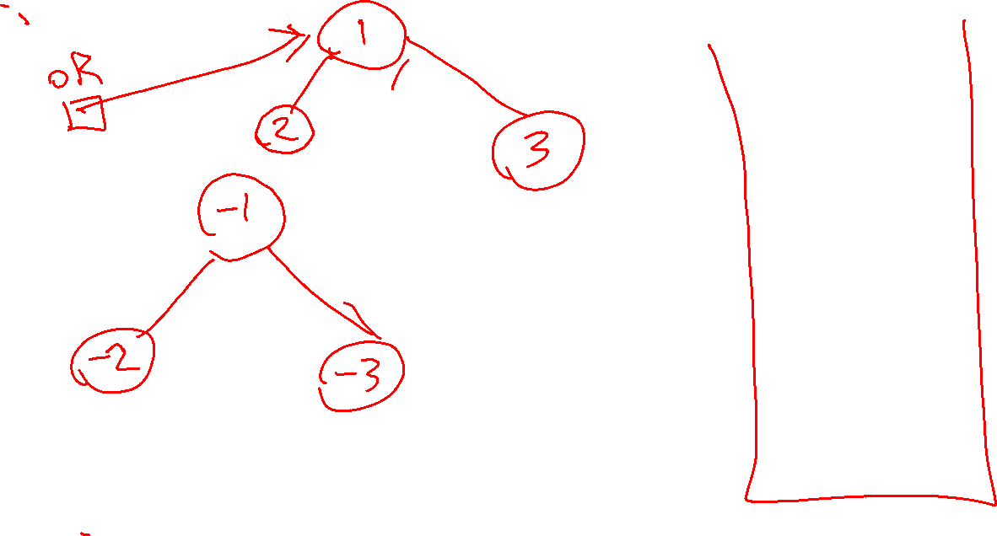
Doodling

