Slide 1

Recursive Programming
BEFORE WE START
What is your perfect temperature?
Respond on sli.do!
Instructor:
Trien Vuong
TAs:
Cora
Jonah
Maitreyi
Nhan
Nichole
Shiven
Music : CSE 123 26su Lecture Tunes
Notes:
Slido event https://app.sli.do/event/3JU2wS7VcYeUwLJoiPdW5j
Or
Slido.com and event code cse123

Slide 2
Announcements
Yay Quiz 1 is done!
  Again, grades before Quiz 2 but we have makeups to take of
Programming Assignment 1 due tonight (7/22) at 11:59 pm
Creative Project 1 released tomorrow due next Wednesday (7/29)
  Focused on recursion!
  Experimenting with giving y’all the choice between two assignments
Resubmission Cycle 2 cycle out due Friday (7/24) at 11:59pm
  P1 is not eligible. Only P0 and C0

Slide 3





Recursive Methods [Review]
2 components of every recursive method:
Recursive case
  Decompose problem into subproblem
  Make the actual recursive call
  Combine results meaningfully
Base case
  Simplest version of the problem
  No subproblems to break into
  Return known answer
If decomposing moves you closer to the base, no infinite recursion!

Slide 4
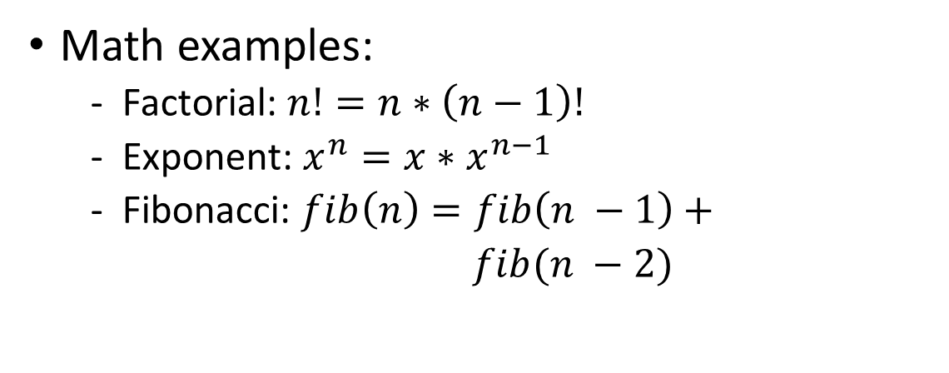
Why Recursion?
Generally, anything you can write iteratively you can write recursively
  So why write anything recursively?
Recursion is particularly useful when dealing with something that’s recursively defined
Math examples:
  Factorial: $n!=n∗\left(n−1\right)!$
  Exponent: $x^{n}=x∗x^{n−1}$
  Fibonacci: $fib\left(n\right)=fib\left(n −1\right)+$
  $fib(n −2)$
Non-math examples?
  ListNodes (int data, ListNode next)
  Other ideas?

Slide 5
Public / Private Pairs
Used when we need additional information between recursive calls
Private helper method hides additional info
  Clients shouldn’t have to worry about it
All public method does is kick-start the private one
  What’s the correct starting value(s) for additional param(s)?
Question to ask: “Do I need to keep track of any additional information?”

Slide 6


Files
We’ll say that computer files fall into one of the following categories:
Standard file (.txt, .csv, .java)
f.isDirectory() -> false
Directory w/ subfiles
f.isDirectory() -> true
File[] subFiles = f.listFiles()
This is a recursive definition! A File is either normal, or a directory with a File[] of subFiles

