Slide 1
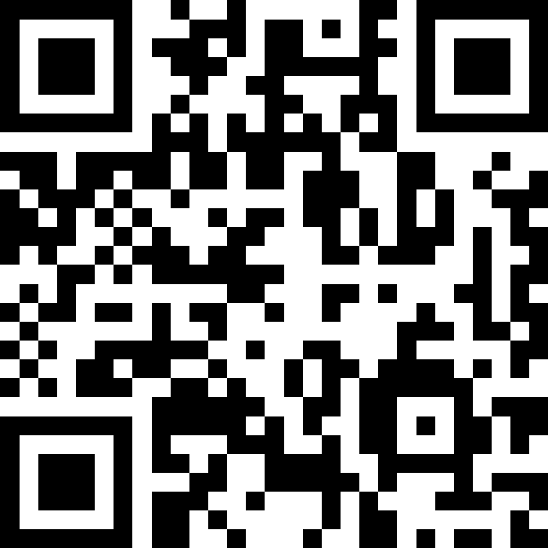
Recursion
BEFORE WE START
What is your favorite season/weather?
Respond on sli.do!
Instructor:
Trien Vuong
TAs:
Cora
Jonah
Maitreyi
Nhan
Nichole
Shiven
Music : CSE 123 26su Lecture Tunes
Notes:
Slido event https://app.sli.do/event/7y5b1VruodvCJx36tVVo5j
Or
Slido.com and event code cse123

Slide 2
Lecture Outline: Announcements
Announcements
Method Calls Review
Recursion Review
Recursive Tracing Practice

Slide 3
Announcements
Quiz 1 Tuesday (July 21)!
  Topics: Linked Lists, Runtime analysis
  Topics not on Quiz 1: Recursion
Resubmission Period 1 closes today @ 11:59pm
Trien’s office hours cancelled today!

Slide 4
Lecture Outline: Method Calls Review
Announcements
Method Calls Review
Recursion Review
Recursive Tracing Practice

Slide 5
Method Calls
Regardless how you use them, methods work the same way!
  Pause execution, finish method, return where you left off
How does Java keep track of the prior method?
  Sort of like the "history" of the method calls it has paused… (LIFO)
  Something called the Call Stack

Slide 6
Call Stack: Step 1
Call Stack
top
main()
Console:
bottom
public static void main(String[] args) {
mystery1();
mystery2();
}
public static void mystery1() {
System.out.println(“One”);
}
public static void mystery2() {
System.out.println(“Two”);
mystery3();
}
public static void mystery3() {
System.out.println(“Three”);
}

Slide 7
Call Stack: Step 2
Call Stack
top
main()
Console:
bottom
public static void main(String[] args) {
mystery1();
mystery2();
}
public static void mystery1() {
System.out.println(“One”);
}
public static void mystery2() {
System.out.println(“Two”);
mystery3();
}
public static void mystery3() {
System.out.println(“Three”);
}

Slide 8
Call Stack: Step 3
Call Stack
top
mystery1()
main()
Console:
bottom
public static void main(String[] args) {
mystery1();
mystery2();
}
public static void mystery1() {
System.out.println(“One”);
}
public static void mystery2() {
System.out.println(“Two”);
mystery3();
}
public static void mystery3() {
System.out.println(“Three”);
}

Slide 9
Call Stack: Step 4
Call Stack
top
mystery1()
main()
Console:
One
bottom
public static void main(String[] args) {
mystery1();
mystery2();
}
public static void mystery1() {
System.out.println(“One”);
}
public static void mystery2() {
System.out.println(“Two”);
mystery3();
}
public static void mystery3() {
System.out.println(“Three”);
}

Slide 10
Call Stack: Step 5
Call Stack
top
main()
Console:
One
bottom
public static void main(String[] args) {
mystery1();
mystery2();
}
public static void mystery1() {
System.out.println(“One”);
}
public static void mystery2() {
System.out.println(“Two”);
mystery3();
}
public static void mystery3() {
System.out.println(“Three”);
}

Slide 11
Call Stack: Step 6
Call Stack
top
main()
Console:
One
bottom
public static void main(String[] args) {
mystery1();
mystery2();
}
public static void mystery1() {
System.out.println(“One”);
}
public static void mystery2() {
System.out.println(“Two”);
mystery3();
}
public static void mystery3() {
System.out.println(“Three”);
}

Slide 12
Call Stack: Step 7
Call Stack
top
mystery2()
main()
Console:
One
bottom
public static void main(String[] args) {
mystery1();
mystery2();
}
public static void mystery1() {
System.out.println(“One”);
}
public static void mystery2() {
System.out.println(“Two”);
mystery3();
}
public static void mystery3() {
System.out.println(“Three”);
}

Slide 13
Call Stack: Step 8
Call Stack
top
mystery2()
main()
Console:
One
Two
bottom
public static void main(String[] args) {
mystery1();
mystery2();
}
public static void mystery1() {
System.out.println(“One”);
}
public static void mystery2() {
System.out.println(“Two”);
mystery3();
}
public static void mystery3() {
System.out.println(“Three”);
}

Slide 14
Call Stack: Step 9
Call Stack
top
mystery2()
main()
Console:
One
Two
bottom
public static void main(String[] args) {
mystery1();
mystery2();
}
public static void mystery1() {
System.out.println(“One”);
}
public static void mystery2() {
System.out.println(“Two”);
mystery3();
}
public static void mystery3() {
System.out.println(“Three”);
}

Slide 15
Call Stack: Step 10
Call Stack
top
mystery3()
mystery2()
main()
Console:
One
Two
bottom
public static void main(String[] args) {
mystery1();
mystery2();
}
public static void mystery1() {
System.out.println(“One”);
}
public static void mystery2() {
System.out.println(“Two”);
mystery3();
}
public static void mystery3() {
System.out.println(“Three”);
}

Slide 16
Call Stack: Step 11
Call Stack
top
mystery3()
mystery2()
main()
Console:
One
Two
Three
bottom
public static void main(String[] args) {
mystery1();
mystery2();
}
public static void mystery1() {
System.out.println(“One”);
}
public static void mystery2() {
System.out.println(“Two”);
mystery3();
}
public static void mystery3() {
System.out.println(“Three”);
}

Slide 17
Call Stack: Step 12
Call Stack
top
mystery2()
main()
Console:
One
Two
Three
bottom
public static void main(String[] args) {
mystery1();
mystery2();
}
public static void mystery1() {
System.out.println(“One”);
}
public static void mystery2() {
System.out.println(“Two”);
mystery3();
}
public static void mystery3() {
System.out.println(“Three”);
}

Slide 18
Call Stack: Step 13
Call Stack
top
main()
Console:
One
Two
Three
bottom
public static void main(String[] args) {
mystery1();
mystery2();
}
public static void mystery1() {
System.out.println(“One”);
}
public static void mystery2() {
System.out.println(“Two”);
mystery3();
}
public static void mystery3() {
System.out.println(“Three”);
}

Slide 19
Call Stack: Step 14
Call Stack
top
Console:
One
Two
Three
bottom
public static void main(String[] args) {
mystery1();
mystery2();
}
public static void mystery1() {
System.out.println(“One”);
}
public static void mystery2() {
System.out.println(“Two”);
mystery3();
}
public static void mystery3() {
System.out.println(“Three”);
}

Slide 20
Lecture Outline: Recursion Review
Announcements
Method Calls Review
Recursion Review
Recursive Tracing Practice

Slide 21
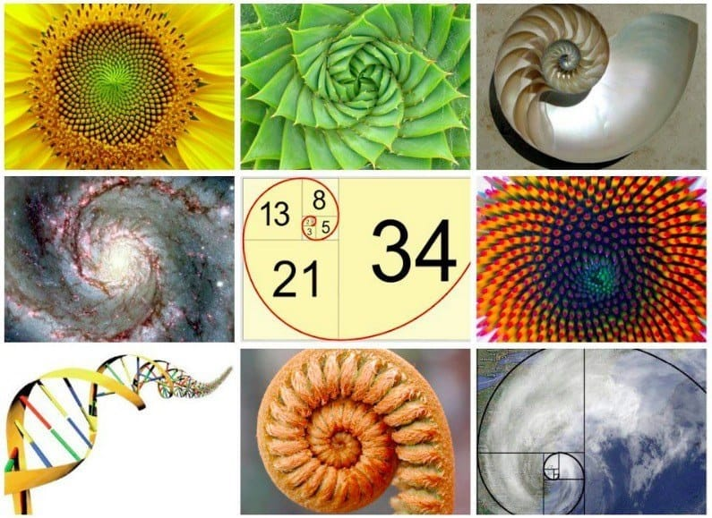

Recursion (1)
“The repeated application of a recursive procedure or definition”
- Oxford Languages
Real-world definition: defining a problem in terms of itself
  Case in point: above definition
  Further natural examples:

Slide 22

Recursion (2)
“The repeated application of a recursive procedure or definition”
- Oxford Languages
Real-world definition: defining a problem in terms of itself
  Case in point: above definition
  Further natural examples:

Slide 23
Recursion (3)
“The repeated application of a recursive procedure or definition”
- Oxford Languages
Real-world definition: defining a problem in terms of itself
  Case in point: above definition
Computer science definition: when a method calls itself
  “Alternative” to iteration (can combine for powerful results)

Slide 24
Recursion (4)
“The repeated application of a recursive procedure or definition”
- Oxford Languages
Why do we care?
  It's a fundamental Computer Science topic
  Some things are easier to describe with recursion than with loops
  There are some problems that lend themselves more easily to a recursive solution than an iterative (loop-y) solution
    Though all problems that can be solved with recursion can be solved with loops, and vice versa

Slide 25

Method Calls
Regardless how you use them, methods work the same way!
  Pause execution, finish method, return where you left off
How does Java keep track of the prior method (LIFO)?
  Something called the Call Stack
🤔 Wouldn’t that just lead to an infinite loop?
recursion()
recursion()
recursion()
Call Stack
recursion()
recursion()
top
...
recursion()
public static void recursion() {
System.out.println(“Woah”);
recursion();
}
recursion()
recursion()
recursion()
recursion()
StackOverflowException!
recursion()
main()
bottom

Slide 26
Method Calls: Avoiding Infinite Recursion
Regardless how you use them, methods work the same way!
  Pause execution, finish method, return where you left off
How does Java keep track of the prior method (LIFO)?
  Something called the Call Stack
🤔 Wouldn’t that just lead to an infinite loop?
  Yes! We get something called a StackOverflowException
How do we avoid infinite recursion?

Slide 27





Recursive Methods
2 components of every recursive method:
Recursive case
  Decompose problem into subproblem
  Make the actual recursive call
  Combine results meaningfully
Base case
  Simplest version of the problem
  No subproblems to break into
  Return known answer

Slide 28
Recursive Methods: Decomposition
2 components of every recursive method:
Recursive case
  Decompose problem into subproblem
  Make the actual recursive call
  Combine results meaningfully
Base case
  Simplest version of the problem
  No subproblems to break into
  Return known answer
If decomposing moves you closer to the base, no infinite recursion!

Slide 29
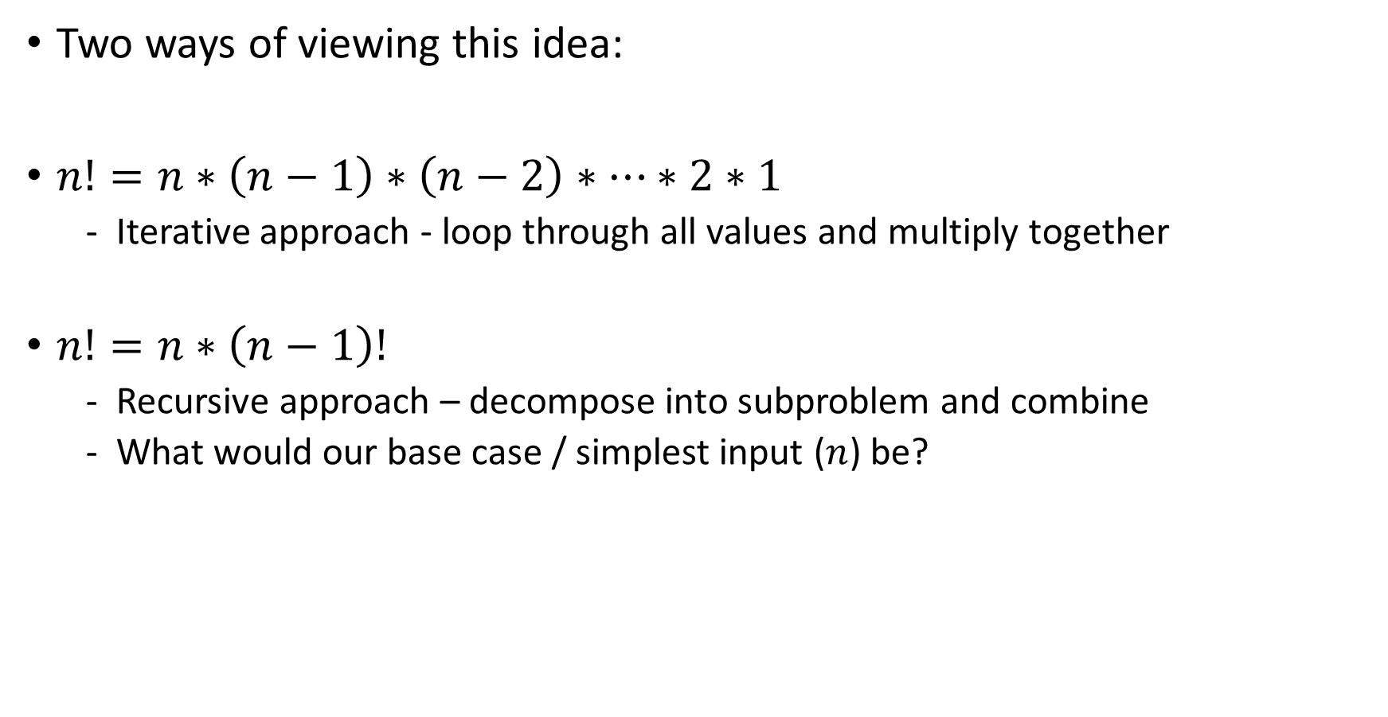
Math Examples
n! or factorial(n) = product of all positive integers <= n
Two ways of viewing this idea:
$n!=n∗\left(n−1\right)∗\left(n−2\right)∗…∗2∗1$
  Iterative approach - loop through all values and multiply together
$n!=n∗\left(n−1\right)!$
  Recursive approach – decompose into subproblem and combine
  What would our base case / simplest input ($n$) be?

Slide 30






Math Examples: Hitting the Base Case
n! / factorial(n) = product of all positive integers <= n
Reminder, recursive approach: $n!=n∗\left(n−1\right)!$
  Let’s trace through with a simple example
$$4!=4∗3!$$
$$3!=3∗2!$$
$$2!=2∗1!$$
$$1!=1∗0!$$
$$0!=1$$

Slide 31
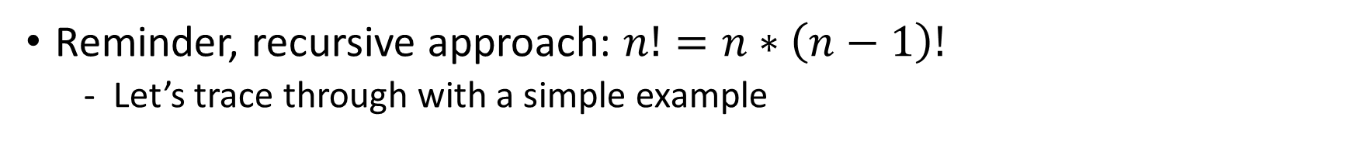
Math Examples: Popping off callstack 1
n! / factorial(n) = product of all positive integers <= n
Reminder, recursive approach: $n!=n∗\left(n−1\right)!$
  Let’s trace through with a simple example
$$4!=4∗3!$$
$$3!=3∗2!$$
$$2!=2∗1!$$
$$1!=1∗0!$$
$$0!=1$$

Slide 32

Math Examples: Popping off callstack 2
n! / factorial(n) = product of all positive integers <= n
Reminder, recursive approach: $n!=n∗\left(n−1\right)!$
  Let’s trace through with a simple example
$$4!=4∗3!$$
$$3!=3∗2!$$
$$2!=2∗1!$$
$$1!=1∗1$$

Slide 33

Math Examples: Popping off callstack 3
n! / factorial(n) = product of all positive integers <= n
Reminder, recursive approach: $n!=n∗\left(n−1\right)!$
  Let’s trace through with a simple example
$$4!=4∗3!$$
$$3!=3∗2!$$
$$2!=2∗1!$$
$$1!=1$$

Slide 34

Math Examples: Popping off callstack 4
n! / factorial(n) = product of all positive integers <= n
Reminder, recursive approach: $n!=n∗\left(n−1\right)!$
  Let’s trace through with a simple example
$$4!=4∗3!$$
$$3!=3∗2!$$
$$2!=2∗1$$

Slide 35

Math Examples: Popping off callstack 5
n! / factorial(n) = product of all positive integers <= n
Reminder, recursive approach: $n!=n∗\left(n−1\right)!$
  Let’s trace through with a simple example
$$4!=4∗3!$$
$$3!=3∗2!$$
$$2!=2$$

Slide 36

Math Examples: Popping off callstack 6
n! / factorial(n) = product of all positive integers <= n
Reminder, recursive approach: $n!=n∗\left(n−1\right)!$
  Let’s trace through with a simple example
$$4!=4∗3!$$
$$3!=3∗2$$

Slide 37

Math Examples: Popping off callstack 7
n! / factorial(n) = product of all positive integers <= n
Reminder, recursive approach: $n!=n∗\left(n−1\right)!$
  Let’s trace through with a simple example
$$4!=4∗3!$$
$$3!=6$$

Slide 38

Math Examples: Popping off callstack 8
n! / factorial(n) = product of all positive integers <= n
Reminder, recursive approach: $n!=n∗\left(n−1\right)!$
  Let’s trace through with a simple example
$$4!=4∗6$$

Slide 39

Math Examples: Popping off callstack 9
n! / factorial(n) = product of all positive integers <= n
Reminder, recursive approach: $n!=n∗\left(n−1\right)!$
  Let’s trace through with a simple example
$$4!=24$$

Slide 40
Lecture Outline: Recursive Tracing Practice
Announcements
Method Calls Review
Recursion Review
Recursive Tracing Practice

