Slide 1

LinkedIntList
BEFORE WE START
What is your favorite way to eat a potato? 🥔
Respond on sli.do!
Instructor:
Trien Vuong
TAs:
Cora
Jonah
Maitreyi
Nhan
Nichole
Shiven
Music : CSE 123 26su Lecture Tunes
Notes:
Slido event link: https://app.sli.do/event/kcpDE9Zw4WuMr5fcf6Jgdy
Or
Slido.com and event code cse123

Slide 2
Lecture Outline: Announcements
Announcements
Revisiting the PCM (Modifying Links)
LinkedIntList

Slide 3
Announcements
Resubmission Cycle 0 open, closes today
Programming Assignment 1 released
  Due Wednesday at 11:59 PM on July 22nd.

Slide 4
Lecture Outline: Revisiting the PCM (Modifying Links)
Announcements
Revisiting the PCM (Modifying Links)
LinkedIntList

Slide 5
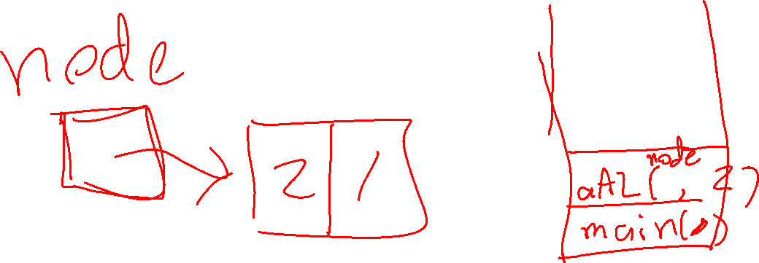
Doodling

Slide 6
Revisiting insertAfterLast
front
1
3
4
node

Slide 7
Lecture Outline: LinkedIntList
Announcements
Revisiting the PCM (Modifying Links)
LinkedIntList

Slide 8
Reminder: Implementing Data Structures
No different from designing any other class!
  Specified behavior (Recall the IntList interface):
  Choose appropriate fields based on behavior
Just requires some thinking outside the box
Method | Description
add(int value) | Adds the given value to the end of the list
add(int index, int value) | Adds the given value at the given index
remove(int value) | Removes the given value if it exists
remove(int index) | Removes the value at the given index
get(int index) | Returns the value at the given index
set(int index, int value) | Updates the value at the given index to the one given
size() | Returns the number of elements in the list

Slide 9
LinkedIntList (1)
Goal: leverage non-contiguous memory usage
  How? LinkedNodes!
What field(s) do we need to keep track of?
  ListNode front; // First node in the chain
front
data
next
1
2
3
4
node

Slide 10
LinkedIntList (2)
Now that we have a LinkedIntList class, will a client ever need to interact with a ListNode?
  No! Not something they should have to worry about
How can we abstract ListNodes away from them?
  Leaving them in a public file is pretty obvious…
We can make ListNode a private inner class inside LinkedIntList!
  We can still access it (just like private fields)
  Clients don't need to worry about its existence!

Slide 11
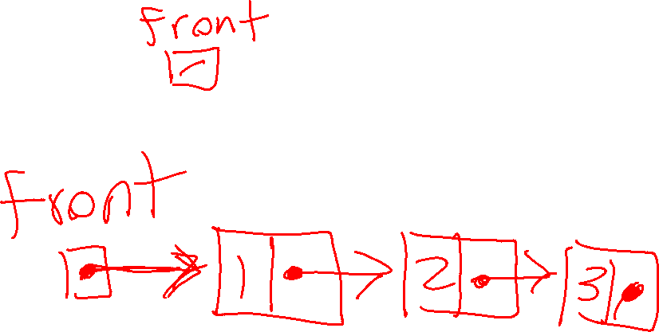

Common Cases to Consider for LinkedNodes
Front of list
Middle (general)
Empty list
End of list

Slide 12
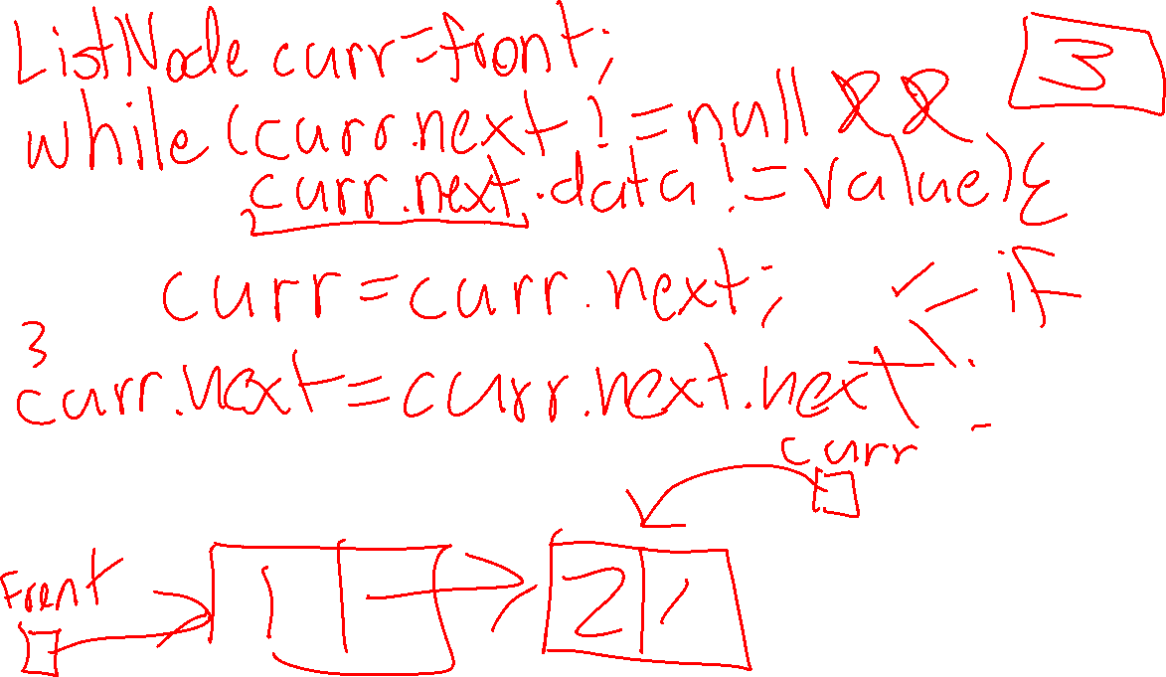

Slide 13
Reminder: Iterating over ListNodes
General pattern iteration code will follow:
ListNode curr = front;
while (curr != null) {
// Do something
curr = curr.next;
}
Why do we need a ListNode curr?

Slide 14
Why curr? printList(front) (1)
public static void main(String[] args) {
ListNode front = new ListNode(1, new ListNode(2, new ListNode(3)));
}
main()
public static void printList(ListNode front) {
while (front != null) {
System.out.print(front.data + " ");
front = front.next;
}
System.out.println();
}
front
printList()
front
1
2
3

Slide 15
Why curr? printList(front) (2)
public static void main(String[] args) {
ListNode front = new ListNode(1, new ListNode(2, new ListNode(3)));
}
main()
public static void printList(ListNode front) {
while (front != null) {
System.out.print(front.data + " ");
front = front.next;
}
System.out.println();
}
front
printList()
front
1
2
3

Slide 16
Why curr? printList(front) (3)
public static void main(String[] args) {
ListNode front = new ListNode(1, new ListNode(2, new ListNode(3)));
}
main()
public static void printList(ListNode front) {
while (front != null) {
System.out.print(front.data + " ");
front = front.next;
}
System.out.println();
}
front
printList()
front
1
2
3

Slide 17
Why curr? printList(front) (4)
public static void main(String[] args) {
ListNode front = new ListNode(1, new ListNode(2, new ListNode(3)));
}
main()
public static void printList(ListNode front) {
while (front != null) {
System.out.print(front.data + " ");
front = front.next;
}
System.out.println();
}
front
printList()
front
1
2
3

Slide 18
Why curr? LinkedIntList (1)
public class LinkedIntList {
private ListNode front;
public void printList() {
while (front != null) {
System.out.print(front.data + " ");
front = front.next;
}
}
}
LinkedIntList
front
1
2
3

Slide 19
Why curr? LinkedIntList (2)
public class LinkedIntList {
private ListNode front;
public void printList() {
while (front != null) {
System.out.print(front.data + " ");
front = front.next;
}
}
}
LinkedIntList
front
1
2
3

Slide 20
Why curr? LinkedIntList (3)
public class LinkedIntList {
private ListNode front;
public void printList() {
while (front != null) {
System.out.print(front.data + " ");
front = front.next;
}
}
}
LinkedIntList
front
2
3

Slide 21
Why curr? LinkedIntList (4)
public class LinkedIntList {
private ListNode front;
public void printList() {
while (front != null) {
System.out.print(front.data + " ");
front = front.next;
}
}
}
LinkedIntList
front
3
Modifying front now modifies the list!

Slide 22
Considering LinkedIntList printList()
LinkedIntList
front
1
2
3
curr

Slide 23
remove(value) v1
LinkedIntList
front
1
3
4
curr
if (curr.data == value) {
// remove curr from the list...
}

Slide 24
remove(value) v2
LinkedIntList
front
1
3
4
curr
if (curr.next.data == value) {
// remove curr from the list...
}

Slide 25
Modifying LinkedLists
Remember: using a curr variable to iterate over nodes
Does changing curr actually update our chain?
  What will? Changing curr.next, changing front
  Need to stop one early to make changes
Often a number of (edge) cases to watch out for:
  M(iddle) – Modifying node in the middle of the list (general)
  F(ront) – Modifying the first node
  E(mpty) – What if the list is empty?
  E(nd) – Rare, do we need to do something with the end of the list?

