Slide 1

Linked Nodes w/Loops
BEFORE WE START
What’s the last TV show or movie you finished?
Respond on sli.do!
Instructor:
Trien Vuong
TAs:
Cora
Jonah
Maitreyi
Nhan
Nichole
Shiven
Music : CSE 123 26su Lecture Tunes
Notes:
Slido event: https://app.sli.do/event/pU9bmxxvnpKCJJtLLcb5Hj
Or
Slido.com with event code cse123

Slide 2
Lecture Outline: Announcements
Announcements
Iterating over ListNodes

Slide 3
Announcements
Great job on Quiz 0!
  Expect grades before Quiz 1, but we need to wrap up makeup quizzes first
Programming Assignment 0 feedback will be released later today!
Resubmission Cycle 0 opens today, closes this Friday, July 10
  Normally resubmissions will be open Mon – Fri each week
Creative Project 0 due tonight, July 8 at 11:59pm!
Programming Assignment 1 releases tomorrow
  One of the trickier assignments in the course
  2 weeks to complete this one! Feel free to take a breather if necessary but get started sooner than later.

Slide 4
Lecture Outline: ListNode practice
Announcements
ListNode practice
Iterating over ListNodes

Slide 5
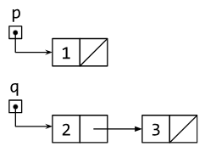
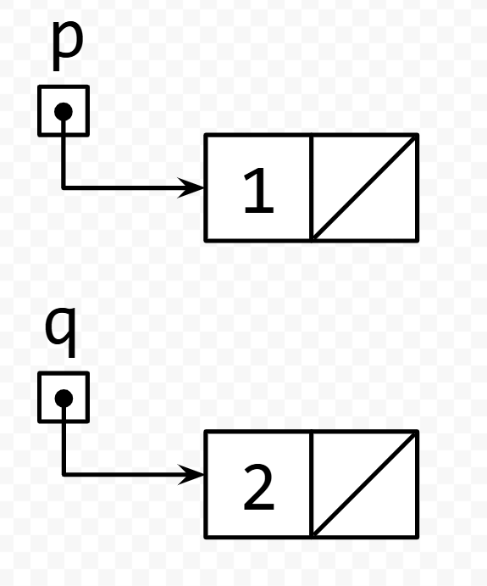
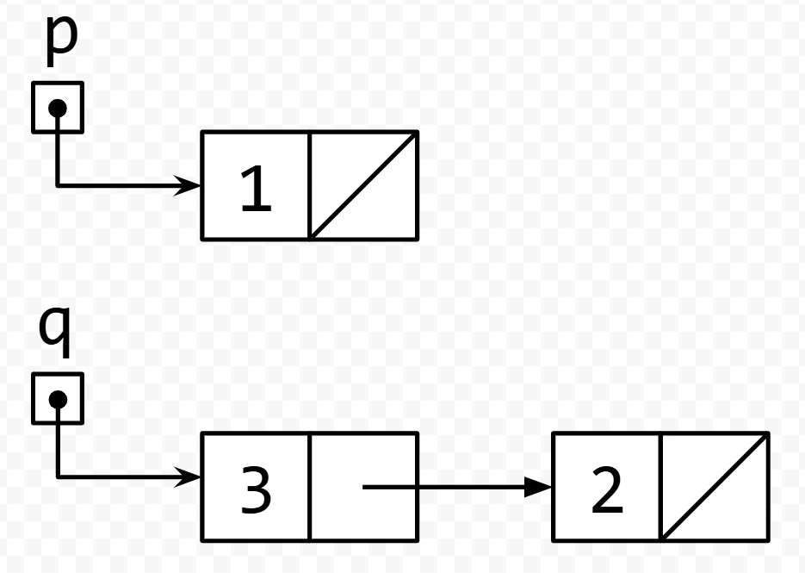
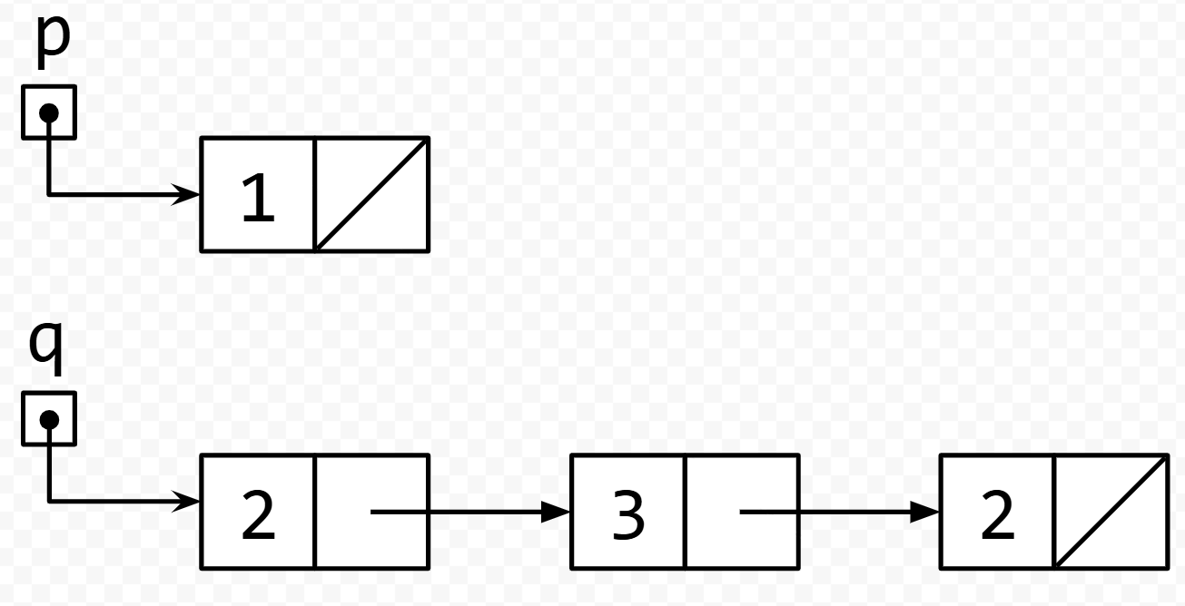
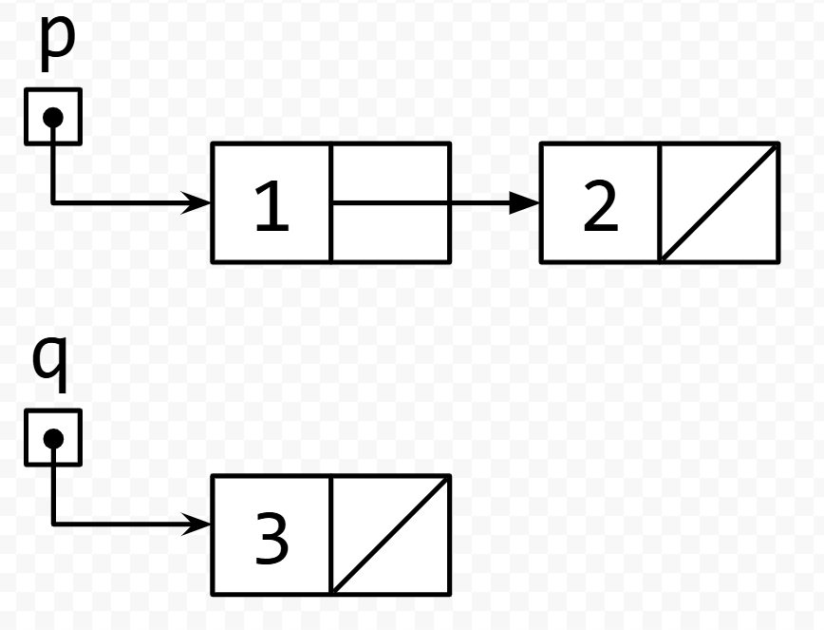
Think Pair Share: run code on example lists: Think
What is the result of running the code on the list shown in the picture?
A. B.
C. D.
q.next.next = q;
q = q.next;
q.next.next = null;
Notes:
Slido event: https://app.sli.do/event/pU9bmxxvnpKCJJtLLcb5Hj
Or
Slido.com with event code cse123

Slide 6
Think Pair Share: run code on example lists: Pair
What is the result of running the code on the list shown in the picture?
A. B.
C. D.
q.next.next = q;
q = q.next;
q.next.next = null;
Notes:
Slido event: https://app.sli.do/event/pU9bmxxvnpKCJJtLLcb5Hj
Or
Slido.com with event code cse123

Slide 7
TPS: run code on example lists
q.next.next = q;
q = q.next;
q.next.next = null;

Slide 8
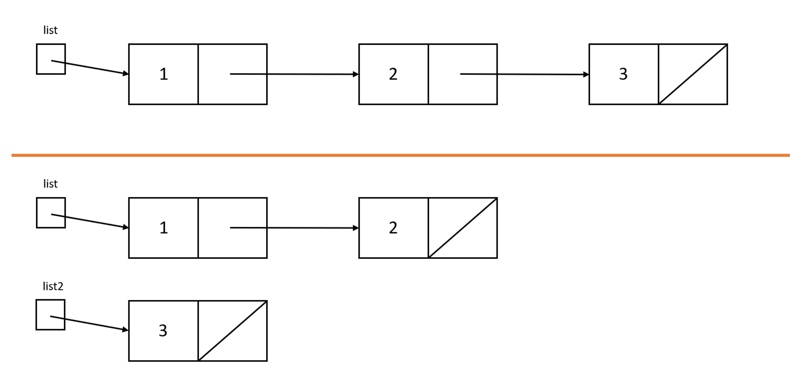
Think Pair Share: from top pic to bottom pic: Think
Which code will turn the top picture into the bottom picture?
A. ListNode list2 = list.next.next;
B. list.next.next = null;
ListNode list2 = list.next.next;
C. ListNode list2 = list.next.next;
list.next.next = null;
D. ListNode list2 = list.next;
list.next = null;
Notes:
top picture: variable list holding a reference to a node containing 1 and a next field pointing to another node containing 2 and a next field pointing to another node which contains 3 and a null next field
bottom picture: variable list holding a reference to a node containing 1 and a next field pointing to another node containing 2 and a null net field; then a separate variable list2 holding a reference to a node containing 3 and a null next field
Slido event: https://app.sli.do/event/pU9bmxxvnpKCJJtLLcb5Hj
Or
Slido.com with event code cse123

Slide 9
Think Pair Share: from top pic to bottom pic: Pair
Which code will turn the top picture into the bottom picture?
A. ListNode list2 = list.next.next;
B. list.next.next = null;
ListNode list2 = list.next.next;
C. ListNode list2 = list.next.next;
list.next.next = null;
D. ListNode list2 = list.next;
list.next = null;
Notes:
top picture: variable list holding a reference to a node containing 1 and a next field pointing to another node containing 2 and a next field pointing to another node which contains 3 and a null next field
bottom picture: variable list holding a reference to a node containing 1 and a next field pointing to another node containing 2 and a null net field; then a separate variable list2 holding a reference to a node containing 3 and a null next field
Slido event: https://app.sli.do/event/pU9bmxxvnpKCJJtLLcb5Hj
Or
Slido.com with event code cse123

Slide 10
TPS: from top pic to bottom pic

Slide 11
Lecture Outline: Iterating over ListNodes
Announcements
Iterating over ListNodes

Slide 12
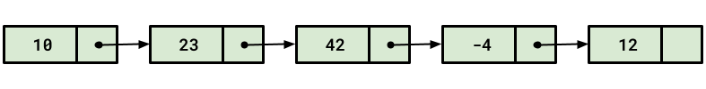
ListNode chains
Recall the ListNode class:
public class ListNode {
public int data;
public ListNode next;
}
How would we find the fourth value in a chain?
node.next.next.next.data
node

Slide 13
Longer ListNode chains
Recall the ListNode class:
public class ListNode {
public int data;
public ListNode next;
}
How would we find the 100th value in a chain?
node.next.next.next.next.next.next.next....
node

Slide 14
Iterating over ListNodes
General pattern iteration code will follow:
ListNode curr = front;
while (curr != null) {
// Do something
curr = curr.next;
}

