Slide 1

Inheritance
BEFORE WE START
What is your favorite summer activity?
Respond on sli.do!
Instructor:
Trien Vuong
TAs:
Cora
Jonah
Maitreyi
Nhan
Nichole
Shiven
Music : CSE 123 26su Lecture Tunes
Notes:
Slide event: https://app.sli.do/event/6cfM4EaxaJaE9CyvTBz8Gy or
Slido.com and event code cse123

Slide 2
Announcements
Quiz 2 is done!
  Grades out before the final exam
Programming Assignment 2 out tomorrow
Creative Project 2 due tonight at 11:59 PM
Resubmission Cycle 4 is out, due Friday (8/7) at 11:59 PM
Make sure to check section participation and reach out to your Tas if you see anything off!

Slide 3
Lecture Outline: Inheritance
Inheritance

Slide 4
Which of the following are true? (Select all that apply.): Think
Which of the following are true? (Select all that apply.)
If ClassA extends ClassB, then ClassA is the superclass
Classes can extend multiple classes (e.g. "ClassA extends ClassB, ClassC")
Java will prevent you from writing "ClassA extends ClassB" unless ClassA "is-a" ClassB
You can call a method from the superclass on an instance of the subclass
Notes:
Slido event: hhttps://app.sli.do/event/6cfM4EaxaJaE9CyvTBz8Gy

Slide 5
Which of the following are true? (Select all that apply.): Pair
Which of the following are true? (Select all that apply.)
If ClassA extends ClassB, then ClassA is the superclass
Classes can extend multiple classes (e.g. "ClassA extends ClassB, ClassC")
Java will prevent you from writing "ClassA extends ClassB" unless ClassA "is-a" ClassB
You can call a method from the superclass on an instance of the subclass
Notes:
Slido event: https://app.sli.do/event/6cfM4EaxaJaE9CyvTBz8Gy

Slide 6
Inheritance
Connect together a “subclass” and “superclass”
  Borrow / “inherit” code to reduce redundancy
  super() keyword can be used just like this() (in a constructor)
Syntax: public class Subclass extends Superclass
Should Represent “is-a” relationships
  public class Chef extends Employee
  public class Server extends Employee
In Java, all objects implicitly inherit from the Object class
  toString(), equals(Object), etc.

Slide 7





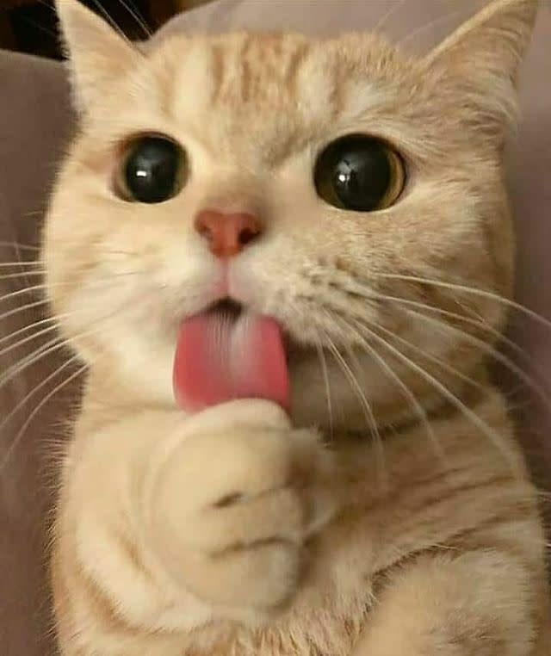

Is-a Relationships
Animal
Fish
Bird
Mammal
Reptile
Amphibian
Dog
Cat
Notes:
Animal: no super classes
Fish: extends Animal
Bird: extends Animal
Mammal: extends Animal
Reptile: extends Animal
Amphibian: extends Animal
Arrows going off screen for classes that extend Fish, Bird, Reptile, and Amphibian
Dog: extends Mammal
Cat: extends Mammal
Dog has 4 subclasses of different pictures of dogs
Cat has 4 subclasses of different pictures of cats

Slide 8
The “is-a” Rule of Thumb
class A should only extend class B if an A “is-a” B in the real world
Java will not force you to follow this rule! That’s your job!

Slide 9
Inheritance Design: Typical Problem
We give you:
Description of several classes, methods, and their behavior
Your job:
Design an inheritance hierarchy that
    minimizes redundancy
    follows best practices (“is-a” test)

Slide 10
Inheritance Design: Solution Technique
Use the “is-a” test to decide which classes should extend each other
Keep an eye out for redundant code and consider whether you can reduce it even further using inheritance
  Sometimes you can’t, and that’s ok!
  The “is-a” test is more important than getting rid of all redundancy
Often more than one reasonable answer!

Slide 11
What inheritance hierarchy did you come up with?

