Slide 1

Comparable; Binary Search Trees
BEFORE WE START
Do you collect anything? What?
Respond on sli.do!
Instructor:
Trien Vuong
TAs:
Cora
Jonah
Maitreyi
Nhan
Nichole
Shiven
Music : CSE 123 26su Lecture Tunes
Notes:
Slido event: https://app.sli.do/event/hkpBuTjvT2V6FogiMPPsJH
Or
Slido.com and event code cse123

Slide 2
Lecture Outline: Announcements
Announcements
Comparable
Binary Search Review
Binary (Search) Trees Review
More runtime!

Slide 3
Announcements
Creative Project 2 due Wednesday (8/01) at 11:59pm
Resubmission Cycle 3 due tonight at 11:59pm
  C0, P1 eligible

Slide 4
Lecture Outline: Comparable
Announcements
Comparable
Binary Search Review
Binary (Search) Trees Review
More runtime!

Slide 5
Comparable
Comparable<E> is an interface that allows implementers to define an ordering between two objects
  Used by TreeSet, TreeMap, Collections.sort, etc.
One required method:
  public int compareTo(E other);
Returned integer falls into 1 of 3 categories
  < 0: this is “less than” other
  = 0: this is “equal to” other
  > 0: this is “greater than” other
a.compareTo(b);
this
other

Slide 6
Lecture Outline: Binary Search Review
Announcements
Comparable
Binary Search Review
Binary (Search) Trees Review
More runtime!

Slide 7
contains() on Collections
contains() checks if an element is in a collection.
How fast is contains() on an ArrayList? LinkedList? IntTree?
Is it possible to be faster?

Slide 8
Looking through a dictionary
How would you find your favorite word in the dictionary?
  Look at every page?
  That would take O(n) time where n is the size of the dictionary.
Can you find a word more quickly?

Slide 9
Looking through a dictionary pseudocode
Assuming a sorted order of elements to search through list
Suppose you're looking for a specific element target
Return the index of the given target, or -1 if it's not in the list
begin with the dictionary, from the first to last word,
looking for target
search(dictionary, left, right, target):
if there are no more words to look through
give up
else
pick a midpoint between left and right
pick the word at that midpoint
if target is that word
found it!
else if target comes before that word
search(dictionary, left, midpoint-1, target)
else (target comes after that word)
search(dictionary, midpoint+1, right, target)

Slide 10
Binary Search
begin with search(list, 0, list.size() – 1, target)
search(list, left, right, target):
if (left > right):
return -1
else:
mid = (left + right) / 2
if (target == list[mid]):
return mid;
else if (target < list[mid]):
return search(list, left, mid – 1, target)
else
return search(list, mid + 1, right, target)
Assuming a sorted order of elements to search through list
Suppose you're looking for a specific element target
Return the index of the given target, or -1 if it's not in the list
How would we add an element to the array
while retaining our ability to do binary search?
How fast is this add operation?
-5 | 4 | 18 | 23 | 30 | 49 | 55 | 108 | 184

Slide 11
Lecture Outline: Binary (Search) Trees Review
Announcements
Comparable
Binary Search Review
Binary (Search) Trees Review
More runtime!

Slide 12
Binary Trees [Review]
We’ll say that any Binary Tree falls into one of the following categories:
1
null
Tree
Tree
Empty tree
root == null
Node w/ two subtrees
root != null
root.left / root.right = Tree
This is a recursive definition! A tree is either empty or a node with two more trees!

Slide 13
Binary Search Trees (BSTs)
We’ll say that any Binary Search Tree falls into the following categories:
For BSTs in this class, we'll make the simplifying assumption of no duplicates
x
null
> x
< x
BST
BST
Empty BST
root == null
Node w/ two subBSTs
root != null
root.left / root.right = Tree
max(root.left) < x && min(root.right) > x
Note that not all Binary Trees are Binary Search Trees

Slide 14
Why BSTs?
Our IntTree implementation to contains(int value)
Which direction(s) do we travel if root.data != value?
  Both left and right
In a Binary Search Tree, should we check both sides?
  Remember, additional constraint: max(root.left) < root.data &&
  min(root.right) > root.data
private boolean contains(int value, IntTreeNode root) {
if (root == null) {
return false;
} else {
return root.data == value ||
contains(value, root.left) ||
contains(value, root.right);
}
}

Slide 15
Lecture Outline: More runtime!
Announcements
Binary Search Review
Binary (Search) Trees Review
More runtime!

Slide 16
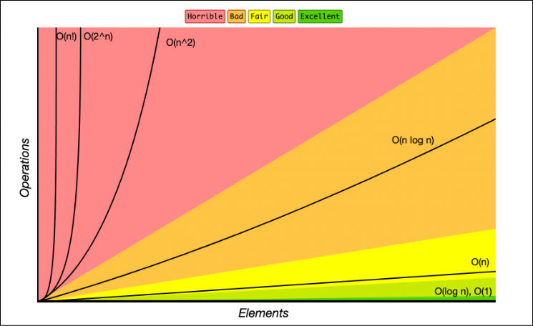
BSTs & Runtime (1)
Contains operation on a balanced BST runs in O(log(n))
  Leverages removing half of the values at each step
  New runtime class unlocked!

Slide 17
Example Tree: contains for balanced BST
4
2
6
1
3
5
7

Slide 18
BSTs & Runtime (2)
Contains operation on a balanced BST runs in O(log(N))
  Leverages removing half of the values at each step
  New runtime class unlocked!
Comparison between data structures:
Operation | ArrayIntList | LinkedIntList | IntSearchTree
contains(x) | O(N) | O(N) | O(log(N)) ?

Slide 19
BSTs & Runtime (3)
Contains operation on a balanced BST runs in O(log(N))
  Leverages removing half of the values at each step
  New runtime class unlocked!
Comparison between data structures:
Operation | ArrayIntList | LinkedIntList | IntSearchTree
contains(x) | O(N) | O(N) | O(N)
O(log(N)) runtime is only guaranteed for BALANCED BSTs. If your tree isn’t balanced, we see O(N) runtime!

Slide 20
BSTs In Java
Self-balancing BST implementations (AVL / Red-black) exist
  AVL better at contains, Red-black better at adding / removing
Both the TreeMap / TreeSet implementations use self-balancing BSTs
  Determines said ordering via the Comparable interface / compareTo method
  Printing out shows natural ordering – inorder traversal
Complete table comparing data structures:
Operation | ArrayList | LinkedList | TreeSet
contains(x) | O(N) | O(N) | O(log(N))
add(x) | O(1*) | O(1) | O(log(N)*)
remove(x) | O(N) | O(N) | O(log(N)*)
*It’s slightly more complicated but we’ll leave that for a higher level course

