Slide 1

Recursive Programming
BEFORE WE START
What is your perfect temperature?
Respond on sli.do!
Instructor:
Miya Natsuhara
Arohan
Sreshta
Rushil
Sean B
Chloe
Jenny
Nate
Saachi
Hawa
Maggie
Sean E
Shiven
Vrinda
Gavin
Shreya
Jonah
Renee
Chris
Ishita
Kuhu
Kavya
Misha
Yuntong
Amiya
Sahana
Anirudh
Rohan
Crystal
Eeshani
Prakshi
Aidan
Cora
Nhan
Anya
Anisha
Trien
Neal
Evan
Rena
TAs:
Music : 🌻 CSE 123 26sp Lecture Tunes 🌻
Notes:
Slido event https://app.sli.do/event/c4A2yNaM7NHybRUhaiskme
Or
Slido.com and event code cse123

Slide 2
Announcements
Resubmission Period 2 due tonight (5/1) at 11:59pm
Last opportunity for C0
Quiz 1 Tuesday (5/5) in your registered section
Programming Assignment 1 is due Wednesday (5/6) at 11:59pm

Slide 3





Recursive Methods [Review]
2 components of every recursive method:
Recursive case
Decompose problem into subproblem
Make the actual recursive call
Combine results meaningfully
Base case
Simplest version of the problem
No subproblems to break into
Return known answer
If decomposing moves you closer to the base, no infinite recursion!

Slide 4
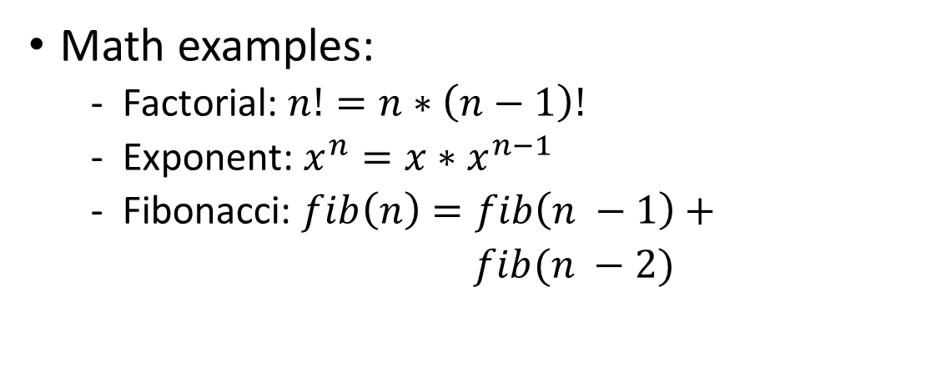
Why Recursion?
Generally, anything you can write iteratively you can write recursively
So why write anything recursively?
Recursion is particularly useful when dealing with something that’s recursively defined
Math examples:
Factorial: $n!=n∗\left(n−1\right)!$
Exponent: $x^{n}=x∗x^{n−1}$
Fibonacci: $fib\left(n\right)=fib\left(n −1\right)+$
$fib(n −2)$
Non-math examples?
ListNodes (int data, ListNode next)
Other ideas?

Slide 5
Public / Private Pairs
Used when we need additional information between recursive calls
Private helper method hides additional info
Clients shouldn’t have to worry about it
All public method does is kick-start the private one
What’s the correct starting value(s) for additional param(s)?
Question to ask: “Do I need to keep track of any additional information?”

Slide 6


Files
We’ll say that computer files fall into one of the following categories:
Standard file (.txt, .csv, .java)
f.isDirectory() -> false
Directory w/ subfiles
f.isDirectory() -> true
File[] subFiles = f.listFiles()
This is a recursive definition! A File is either normal, or a directory with a File[] of subFiles

