Slide 1
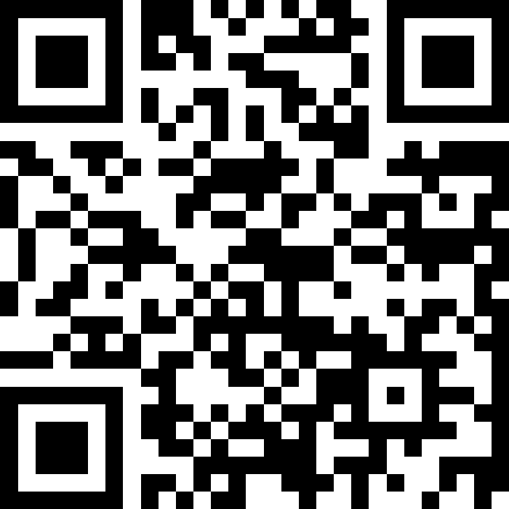
Polymorphism; Abstract Classes
BEFORE WE START
Coffee or tea? Or something else?
Respond on sli.do!
Instructor:
Miya Natsuhara
Arohan
Sreshta
Rushil
Sean B
Chloe
Jenny
Nate
Saachi
Hawa
Maggie
Sean E
Shiven
Vrinda
Gavin
Shreya
Jonah
Renee
Chris
Ishita
Kuhu
Kavya
Misha
Yuntong
Amiya
Sahana
Anirudh
Rohan
Crystal
Eeshani
Prakshi
Aidan
Cora
Nhan
Anya
Anisha
Trien
Neal
Evan
Rena
TAs:
Music : 🌻 CSE 123 26sp Lecture Tunes 🌻
Notes:
Slido event link: https://app.sli.do/event/qJg2G7FUUgybkJP3oxLogN
Or
Slido.com and event code cse123

Slide 2
Announcements
Creative Project 0 due tonight, Wednesday, April 8 at 11:59pm!
See generic Creative Project rubric posted on website
Programming Assignment 0 will be released tomorrow, Thursday, April 9 and is due Wednesday, April 15
Focused on inheritance and abstract classes
Recruiting students for a research study about the self-placement
See Ed post #71 for details

Slide 3
Lecture Outline: Polymorphism
Polymorphism
Compiler vs. Runtime Errors
Abstract Classes
Academic Honesty Policy

Slide 4
Polymorphism Review 1
DeclaredType x = new ActualType()
All methods in DeclaredType can be called on x
We’ve seen this with interfaces (List<String> vs. ArrayList<String>)
Also applies to inheritance relationships
Important: The ActualType determines what method is actually called!
Animal[] arr = {new Animal(), new Dog(), new Husky()};
for (Animal a : arr) {
a.speak();
}

Slide 5
Polymorphism Review 2
Animal[] arr = {new Animal(), new Dog(), new Husky()};
for (Animal a : arr) {
a.speak();
}
DeclaredType x = new ActualType()
Important: The ActualType determines what method is actually called!

Slide 6
Declared Type and Actual Type
DeclaredType varName = new ActualType(…);
ActualType must be a subclass of (or same as) DeclaredType
Example 1
Animal rufus = new Dog("Rufus");
Example 2
Dog rufus = new Dog(”Rufus");
Declared Type: Animal
Actual Type: Dog
Can call methods that makes sense for EVERY Animal
If Dog overrides a method, uses the Dog version
Declared Type: Dog
Actual Type: Dog
Can call methods that makes sense for EVERY Dog
If Dog overrides a method, uses the Dog version

Slide 7
Polymorphism: Typical Problem
Animal[] arr = {new Animal(), new Dog(), new Husky()};
for (Animal a : arr) {
a.speak();
}
Suppose Animal, Dog, and Husky all implement speak.
Which version gets called on each iteration of the loop?

Slide 8
Overrides and Method Calls
Solution Technique
Animal dubs = new Husky();
dubs.speak();
When running:
Use the most specific version of the method call starting from the actual type.
Start from the actual type, then go “up” to super classes until you find the method. Run that first-discovered version.
Animal
extends
“is a”
Running:
Look up the inheritance tree (Husky, then Dog, then Animal) for speak
Use the first implementation found
Dog
extends
“is a”
In this example:
If the Husky class overrides speak, then we’ll use the implementation in Husky. If not, we’ll look in Dog and use that one if found. If not, then we’ll look in Animal.
Actual Type
Husky

Slide 9
Lecture Outline: Compile vs. Runtime Errors
Polymorphism
Compiler vs. Runtime Errors
Abstract Classes
Academic Honesty Policy

Slide 10
Compiler vs. Runtime Errors
DeclaredType x = new ActualType()
At compile time, Java only knows DeclaredType
Compiler error: trying to call a method that isn’t present
Animal a = new Dog();
a.bark(); // No bark() -> CE
Can cast to change the DeclaredType of an object Dog d = (Dog) a;
d.bark(); // No more CE
Runtime error: attempting cast to type that is not a superclass of actual type
Animal a = new Fish(); Dog d = (Dog) a; // Can’t cast -> RE
d.bark();
- Order matters! Compilation before runtime

Slide 11
Compiling Method Calls
Animal rufus = new Dog();
rufus.bark();
When compiling:
Can we guarantee that the method exists for the declared type?
Does the declared type or one of its super classes contain a method of that name?
If not… Compile Error!
Object
Compiling:
Look up the inheritance tree (Animal then Object) for bark
extends
“is a”
Animal
Declared Type
extends
“is a”
extends
“is a”
In this example:
When compiling, neither Animal nor Object have a bark method, so we have a compiler error!
Dog
Fish

Slide 12
Running Method Calls
Animal rufus = new Dog();
rufus.feed();
When running:
Use the most specific version of the method call starting from the actual type.
Start from the actual type, then go “up” to super classes until you find the method. Run that first-discovered version.
Object
extends
“is a”
Running:
Look up the inheritance tree (Dog, then Animal, then Object) for feed
Use the first implementation found
Animal
extends
“is a”
extends
“is a”
In this example:
If the Dog class overrides feed, then we’ll use the implementation in Dog. Otherwise we’ll use the one in Animal
Actual Type
Dog
Fish

Slide 13
Casts and Method Calls (No error)
When compiling:
Can we guarantee that the method exists for the Cast-to type?
Does the Cast-to type or one of its super classes contain a method of that name?
If not… Compile Error!
When Running:
Check that the Cast-to Type is either the Actual Type, or one of its super classes
Animal rufus = new Dog();
Dog d = (Dog) rufus;
d.bark();
Object
Compiling:
From cast-to type
Look up the inheritance tree (Dog, then Animal, then Object)
for bark
Running:
From actual type
Look up the inheritance tree (Dog, then Animal, then Object)
for cast-to type
Animal
Cast-to Type
Dog
Fish
Actual Type
This example has no error

Slide 14
Casts and Method Calls (Runtime error)
When compiling:
Can we guarantee that the method exists for the Cast-to type?
Does the Cast-to type or one of its super classes contain a method of that name?
If not… Compile Error!
When Running:
Check that the Cast-to Type is either the Actual Type, or one of its super classes
Animal rufus = new Fish();
Dog d = (Dog) rufus;
d.bark();
Object
Compiling:
From cast-to type
Look up the inheritance tree (Dog, then Animal, then Object)
for bark
Running:
From actual type
Look up the inheritance tree (Fish, then Animal, then Object)
for cast-to type
Animal
Cast-to Type
Dog
Fish
Actual Type
This example has a runtime error

Slide 15
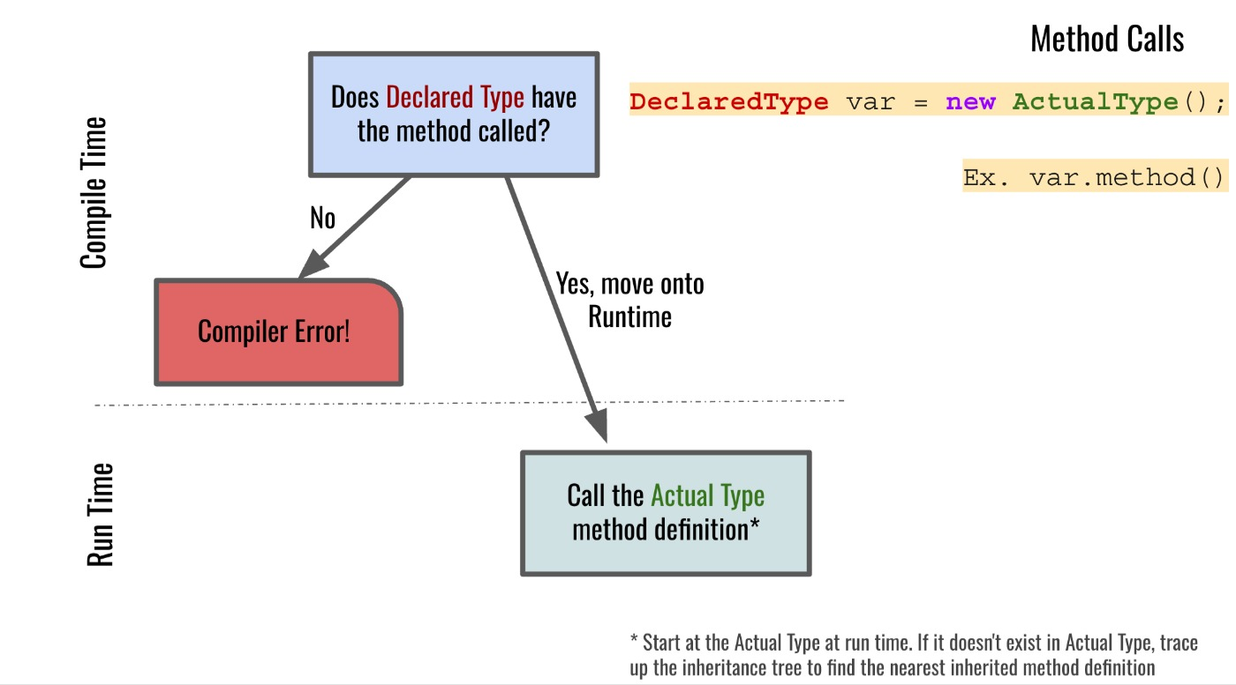
Compiler vs. Runtime Errors: Method Calls
Notes:
Flow chart describing possible outcomes of a method call. If the declared type does not have the method being called, then it is a compiler error. Otherwise, if it does have the method, then we move on to run time. At run time, Java uses the actual type to determine which version of the method to call. If the actual type defines the method, then that version is called. Otherwise, we traverse upward through the superclasses to find the nearest inherited method definition to call.

Slide 16
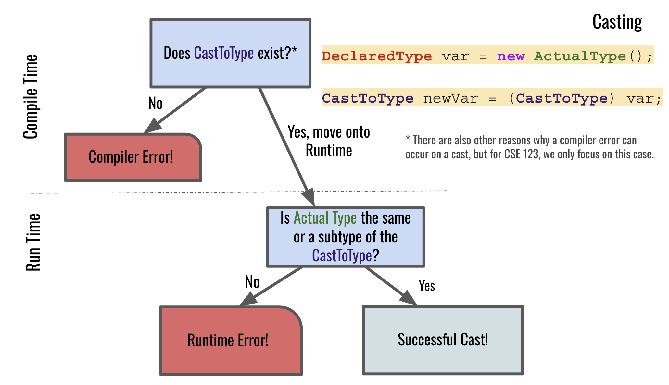
Compiler vs. Runtime Errors: Casting
Notes:
Flowchart summarizing how type casts behave at compile time and run time. The compiler checks whether the cast-to type exists. If not, it is a compiler error (footnote: there are also other reasons why a compiler error can occur on a cast, but for CSE 123, we only focus on the case of the cast-to type not existing). Otherwise, if the cast-to type does exist, we move on to run time. At run time, Java checks whether the actual type is the same as or a subtype of the cast-to type. If not, it is a run-time error. If so, the cast succeeds and the program continues executing.

Slide 17
Polymorphism Example 1: Think
What is the result of the following code?
Compiler Error
Runtime Error
No error– runs to completion
Teacher socrates = new Teacher("Socrates", 2400);
System.out.println(socrates.getEmployeeName());
System.out.println(socrates.getYearsExperience());
Notes:
Slido event link: https://app.sli.do/event/qJg2G7FUUgybkJP3oxLogN
Or
Slido.com and event code cse123

Slide 18
Polymorphism Example 1: Pair
What is the result of the following code?
Compiler Error
Runtime Error
No error– runs to completion
Teacher socrates = new Teacher("Socrates", 2400);
System.out.println(socrates.getEmployeeName());
System.out.println(socrates.getYearsExperience());
Notes:
Slido event link: https://app.sli.do/event/qJg2G7FUUgybkJP3oxLogN
Or
Slido.com and event code cse123

Slide 19
Polymorphism Example 2: Think
What is the result of the following code?
Compiler Error
Runtime Error
No error– runs to completion
Employee anthony = new Chef("Anthony Bourdain");
System.out.println(anthony.getEmployeeName());
anthony.cookFood("shrimp");
Notes:
Slido event link: https://app.sli.do/event/qJg2G7FUUgybkJP3oxLogN
Or
Slido.com and event code cse123

Slide 20
Polymorphism Example 2: Pair
What is the result of the following code?
Compiler Error
Runtime Error
No error– runs to completion
Employee anthony = new Chef("Anthony Bourdain");
System.out.println(anthony.getEmployeeName());
anthony.cookFood("shrimp");
Notes:
Slido event link: https://app.sli.do/event/qJg2G7FUUgybkJP3oxLogN
Or
Slido.com and event code cse123

Slide 21
Polymorphism Example 3: Think
What is the result of the following code?
Compiler Error
Runtime Error
No error– runs to completion
Employee anthony = new Chef("Anthony Bourdain");
System.out.println(anthony.getEmployeeName());
Chef c = (Chef) anthony;
c.cookFood("shrimp");
Notes:
Slido event link: https://app.sli.do/event/qJg2G7FUUgybkJP3oxLogN
Or
Slido.com and event code cse123

Slide 22
Polymorphism Example 3: Pair
What is the result of the following code?
Compiler Error
Runtime Error
No error– runs to completion
Employee anthony = new Chef("Anthony Bourdain");
System.out.println(anthony.getEmployeeName());
Chef c = (Chef) anthony;
c.cookFood("shrimp");
Notes:
Slido event link: https://app.sli.do/event/qJg2G7FUUgybkJP3oxLogN
Or
Slido.com and event code cse123

Slide 23
Polymorphism Example 4: Think
What is the result of the following code?
Compiler Error
Runtime Error
No error– runs to completion
Employee anthony = new Chef("Anthony Bourdain");
System.out.println(anthony.getEmployeeName());
Teacher t = (Teacher) anthony;
t.getYearsExperience();
Notes:
Slido event link: https://app.sli.do/event/qJg2G7FUUgybkJP3oxLogN
Or
Slido.com and event code cse123

Slide 24
Polymorphism Example 4: Pair
What is the result of the following code?
Compiler Error
Runtime Error
No error– runs to completion
Employee anthony = new Chef("Anthony Bourdain");
System.out.println(anthony.getEmployeeName());
Teacher t = (Teacher) anthony;
t.getYearsExperience();
Notes:
Slido event link: https://app.sli.do/event/qJg2G7FUUgybkJP3oxLogN
Or
Slido.com and event code cse123

Slide 25
Lecture Outline: Abstract Classes
Polymorphism
Compiler vs. Runtime Errors
Abstract Classes
Academic Honesty Policy

Slide 26
Abstract Classes
Interfaces
Abstract Classes
Classes
Mixture of Interfaces and Classes
Interface similarities:
- Can contain (abstract) method declarations
- Can’t be instantiated
Class similarities:
- Can contain method implementations
- Can have fields
- Can have constructors
Is there identical / nearly similar behavior between classes that shouldn’t inherit from one another?

Slide 27
Shape Example: Tasks
Add an abstract getName method to the Shape.
Add implementations of getName to Square and Circle that return "Square" and "Circle".
Add a method isEmpty to Shape that tells you whether the shape is empty (has zero area) or not.
Hint: you will need to call getArea, but we've included a slight trap related to getArea in the starter code!
Implementing isEmpty by calling getArea works fine as is, but suppose we wanted to implement it in Circle directly. How could we do this just by looking at the fields of the Circle? Implement it this way by overriding isEmpty in Circle.
Override toString in Shape to return a similar message to what the Client prints in the starter code:
Hint: your toString can call abstract methods!
Rewrite the Client class to use the new toString on shapes.

Slide 28
Advanced OOP Summary
Abstract
Allow us to define differing levels of abstraction
Interfaces = high-level specification
What behavior should this type of class have
Abstract classes = shared behavior + high-level specification
Classes = individual behavior implementation
Inheritance allows us to share code via “is-a” relationships
Reduce redundancy / repeated code & enable polymorphism
Still might not be the “best” decision!
Interfaces extend other interfaces
(abstract) classes extend other (abstract) classes
Interfaces
Abstract Classes
Classes
Concrete
You’re now capable of designing some pretty complex systems!

Slide 29
Design in the “real world”
In this course, we’ll always give you expected behavior of the classes you write
Often not the case when programming for real
Clients don’t really know what they want (but programmers don’t either)
My advice:
Clarify assumptions before making them (do I really want this functionality?)
There’s no one right answer
Weigh the options, make a decision, and provide explanation
Iterative development: make mistakes and learn from them
Be receptive to feedback and be willing to change your mind

Slide 30
Interface vs. Implementation
Interface: what something should do
Implementation: how something is done
These are different!
Big theme of CSE 123: choose between different implementations of same interface

Slide 31
Lecture Outline: Academic Honesty Policy
Polymorphism
Compiler vs. Runtime Errors
Abstract Classes
Academic Honesty Policy

Slide 32
Academic Honesty Policy
When we assess your work in this class, we need to know that it’s yours.
Unless otherwise specified, all graded work must be completed individually and without touching AI tools.
Some specific rules to highlight:
do not share your own solution code or view solution code from any source – including but not limited to other students, tutors, or the internet
do not use AI tools (e.g. ChatGPT, Claude) to create or modify graded work
See the syllabus for more details (this is very important to understand).

Slide 33
AI and CSE 123: Our Philosophy
Computing applications enabled by artificial intelligence (AI) are increasingly common and more widely used for a variety of tasks.
It is becoming more difficult to teach an introductory computing course without acknowledging the existence of AI tools.
But as relatively new programmers, you still need to learn and practice effectively using core programming ‘building blocks’.
Notes:
James

Slide 34
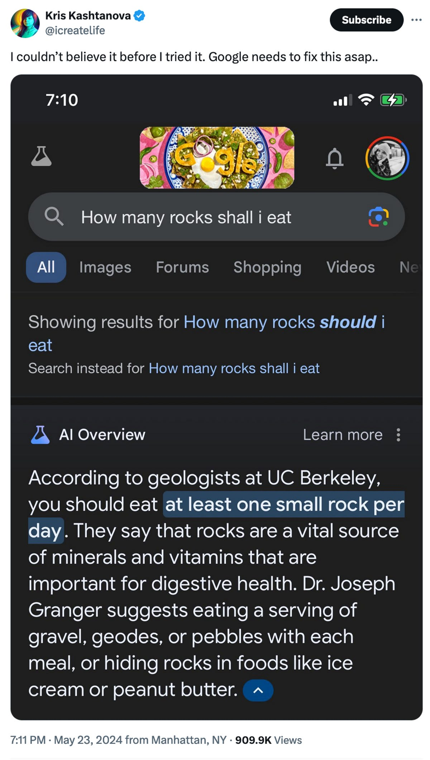
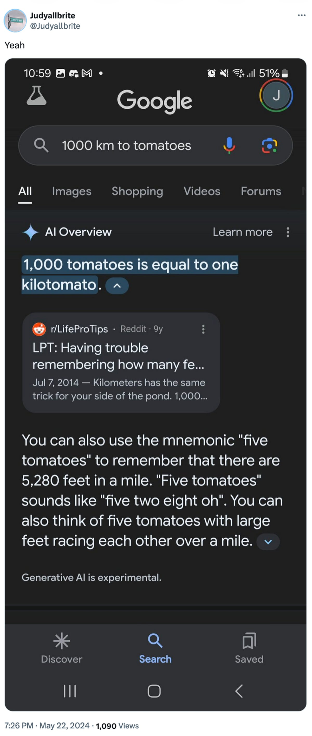
AI makes mistakes
Courtesy “Glue in Pizza? Eat Rocks? Google’s AI Search Is Mocked for Bizarre Answers” by Ian Sherr for CNET. May 24, 2024

Slide 35
CSE 123 AI Policy
No part of any graded work may touch an AI tool.
You may not copy and paste any work generated by AI into any graded submission, nor may you copy and paste any work from or for a graded assignment into an AI tool. All other uses of AI on graded work must be cited.
cs.uw.edu/123/syllabus/#using-ai-in-cse-123
Notes:
James

Slide 36
CSE 123 AI Policy: Examples
No part of any graded work may touch an AI tool.
You may not copy and paste any work generated by AI into any graded submission, nor may you copy and paste any work from or for a graded assignment into an AI tool. All other uses of AI on graded work must be cited.
ALLOWED
PROHIBITED
Asking AI to explain an error message
Asking AI to explain the functionality of non-graded code snippets
Asking AI to suggest additional information or resources
Generating code, comments, reflections
Using AI to ‘solve’ an assignment
Using AI to write, modify, or extend reflections, code, comments, etc.
cs.uw.edu/123/syllabus/#using-ai-in-cse-123
Notes:
James

