Slide 1
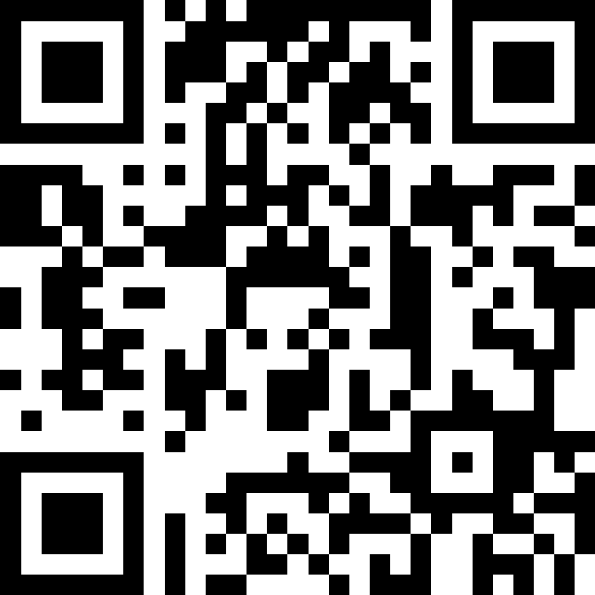
Victory Lap &
Next Steps
BEFORE WE START
What was your favorite thing you learned about this quarter? Why?
Respond on sli.do!
Instructor:
Miya Natsuhara
Arohan
Sreshta
Rushil
Sean B
Chloe
Jenny
Nate
Saachi
Hawa
Maggie
Sean E
Shiven
Vrinda
Gavin
Shreya
Jonah
Renee
Chris
Ishita
Kuhu
Kavya
Misha
Yuntong
Amiya
Sahana
Anirudh
Rohan
Crystal
Eeshani
Prakshi
Aidan
Cora
Nhan
Anya
Anisha
Trien
Neal
Evan
Rena
TAs:
Music : 🌻 CSE 123 26sp Lecture Tunes 🌻
Notes:
Slido event: https://app.sli.do/event/o8Mrk2DkftppBrpfxCZAxj
Or
Slido.com and event code cse123

Slide 2
Announcements
C3 due tonight (6/5) at 11:59pm
R7/R-Gumball due Sunday (6/7) at 11:59pm
  R7 open to C3 if you need two extra days instead of another resub
  R-Gumball open to all assignments w/ feedback released
IPL closes end of day today (6/5)
  Not open this weekend or next week
  Message board will remain available
Final Exam Thursday (6/11) @ 12:30pm-2:20pm in KNE 210/220
  Seating chart now posted on the course website!
  Typical rules for quizzes, note sheet (8.5” x 11” double-sided, typed or handwritten)
Please fill out course evaluation by Sunday night!
  Currently at about 12.5%
TA-led review session Tuesday 6/9 4:30pm-7:00pm in JHN 102
Gumball & friends visit on Monday, 6/8 1:00pm – 2:30pm around Drumheller Fountain!

Slide 3
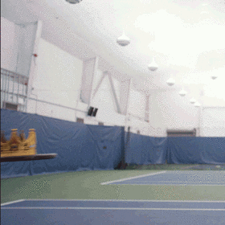






You Made It!

Slide 4
[Recap] Why 123?
To solve more complex problems by leveraging more complex programming structures / patterns
To better rationalize specific design decisions
  How to “best” structure classes to reduce redundancy
  Which ADT implementations are “most” appropriate to use
To understand and critically analyze intersections between Computer Science and society
  Search engines, algorithmic art, machine learning, etc.
  Developing informed opinions on current issues
Be a better programmer
Be a better person

Slide 5
[Recap] Topics Covered
Advanced Object-Oriented Programming (OOP)
  Inheritance, Polymorphism, Abstract classes
Implementing Abstract Data Types (ADTs)
  ArrayIntList (int[] elementData, int size)
  LinkedIntList (ListNode front)
  Java’s ArrayList & LinkedList (int size, ListNode back)
Runtime (Complexity & Big O notation)
Recursion
  Recursive definitions (n! = n * (n – 1)!)
  (Implicit) Base and Recursive cases
  Public / private pairs
  LinkedLists w/ recursion (x = change(x))
Binary Trees
  Binary Search Trees (BST) & Runtime
Exhaustive Search / Recursive Backtracking
  Dead ends / Choose, explore Un-choose
Machine Learning & Hashing
You’ve learned A LOT!!!
(hopefully)
Assessable content

Slide 6
Future Courses
Also: bringing computational thinking to other fields!
CSE Majors
Non-CSE Majors
Tons of options for everyone!
  Self study always valid too!
Course | Overview
CSE 311 | Mathematical foundations
CSE 351 | Low-level computer organization/abstraction
CSE 331 | Software design/implementation
CSE 340 | Interaction Programming
CSE 341 | Programming languages
CSE 344 | Data Management (databases)
Course | Overview
CSE 154 | Intro to web programming
CSE 163 | Intermediate programming, data analysis
CSE 180 | Introduction to data science
CSE 373 | Data structures and algorithms
CSE 374 | Low-level programming and tools
CSE 412 | Data Visualization
CSE 416 | Intro. to Machine Learning
https://www.cs.washington.edu/academics/ugrad/current-students
https://www.cs.washington.edu/academics/ugrad/nonmajor-options/nonmajor-courses

Slide 7
Applications of CS
or “What can I do with what I learned?”
Detect and prevent toxicity online
Digitize basketball players
Help DHH people identify sounds
Figure out how to best distribute relief funds
Recognize disinformation online
Make movies
Improve digital collaboration
Fix Olympic badminton
And so much more!

Slide 8
Future Projects
At this point, you know 90% of the fundamentals you need to accomplish practically any project
  Hurdle will typically be learning the syntax of a new language, using GitHub, importing external libraries, etc.
Some ideas:
  Make a Minecraft mod! (Java) [link]
  Make a Discord bot! (Python) [link]
  Make personal website! (HTML, CSS, Javascript) [link]
  Convert a project from this course into a more user-friendly application
    C1, make a Graphical User Interface (GUI) [link]
    P3, refine the Email class until you get an accuracy you’re happy with
  Really, anything you want!!!*
*Warning: it’s often hard to tell what computers can do easily and what they struggle with…

Slide 9
Frequently Asked Questions
How can I get better at programming?
  Practice!
How can I learn to X?
  Search online, read books, look at examples
  Start with something that already works (try github), then make changes!
What should I work on next?
  Anything you can think of! (See previous slide for some ideas)
Should I learn another language? Which one?
  Depends on what you want to do!
    Python: Data Science & Machine Learning
    JavaScript: Web Dev
    C / C++: Systems Programming
What’s the best programming language?
  😠 (take CSE 341/CSE 413)

Slide 10
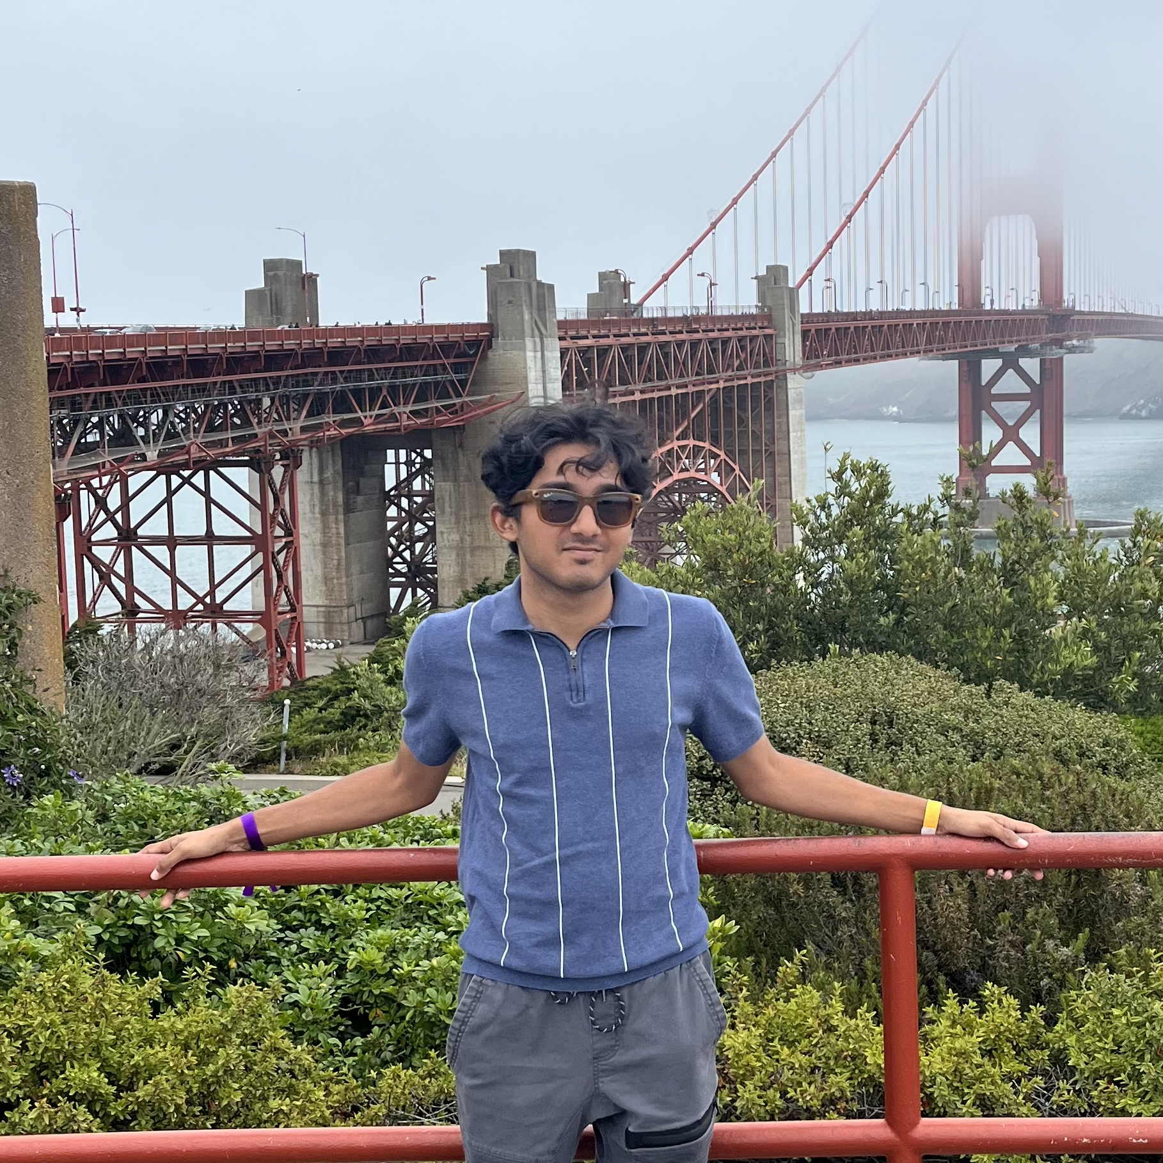
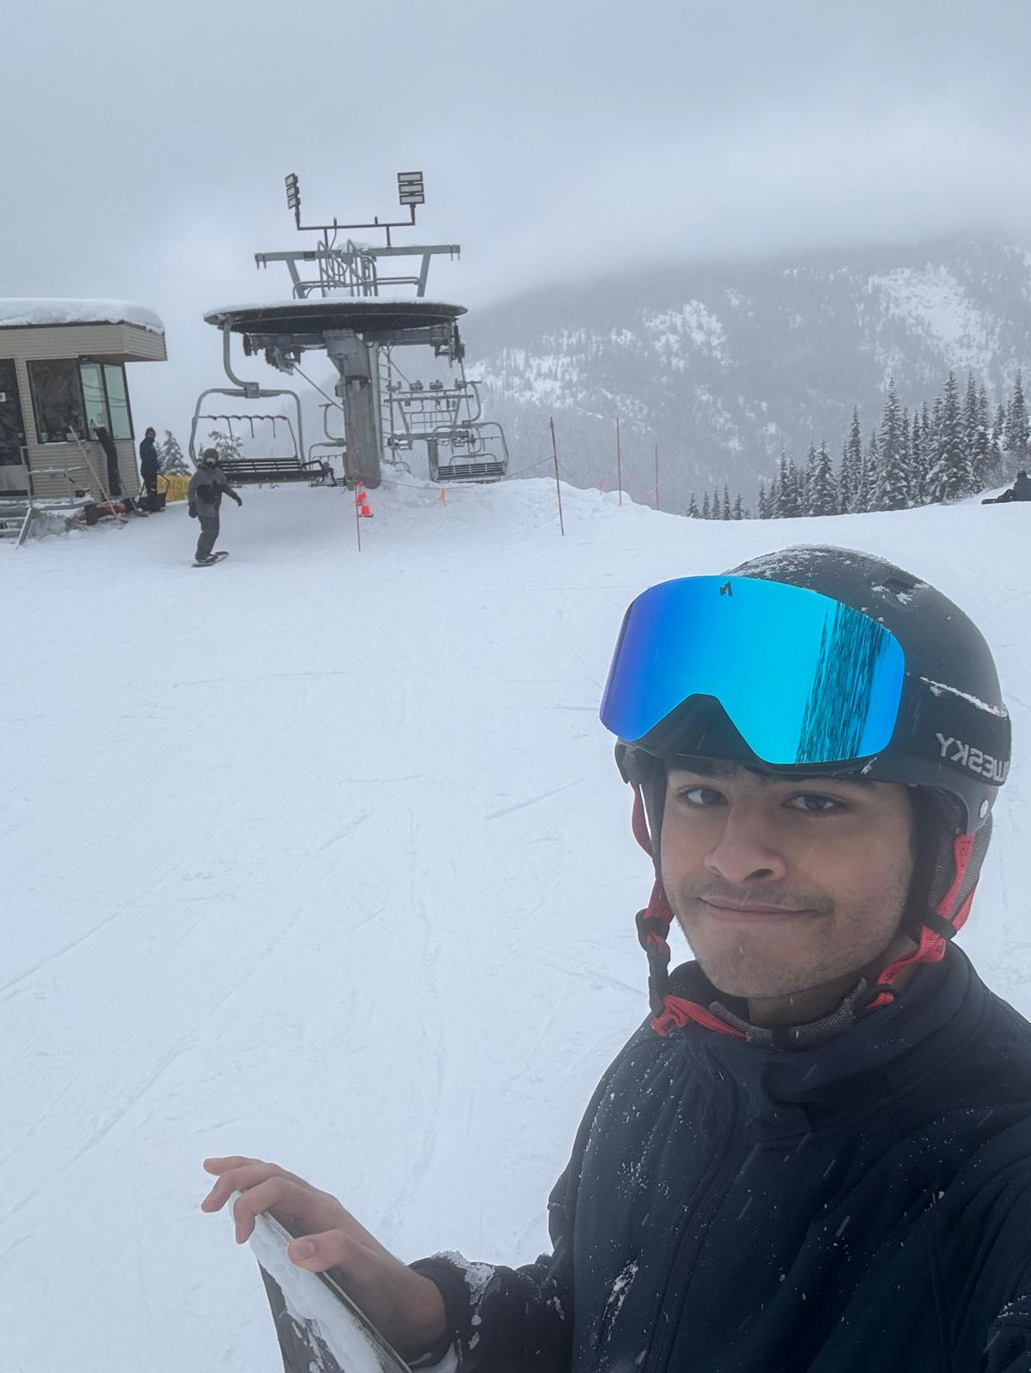
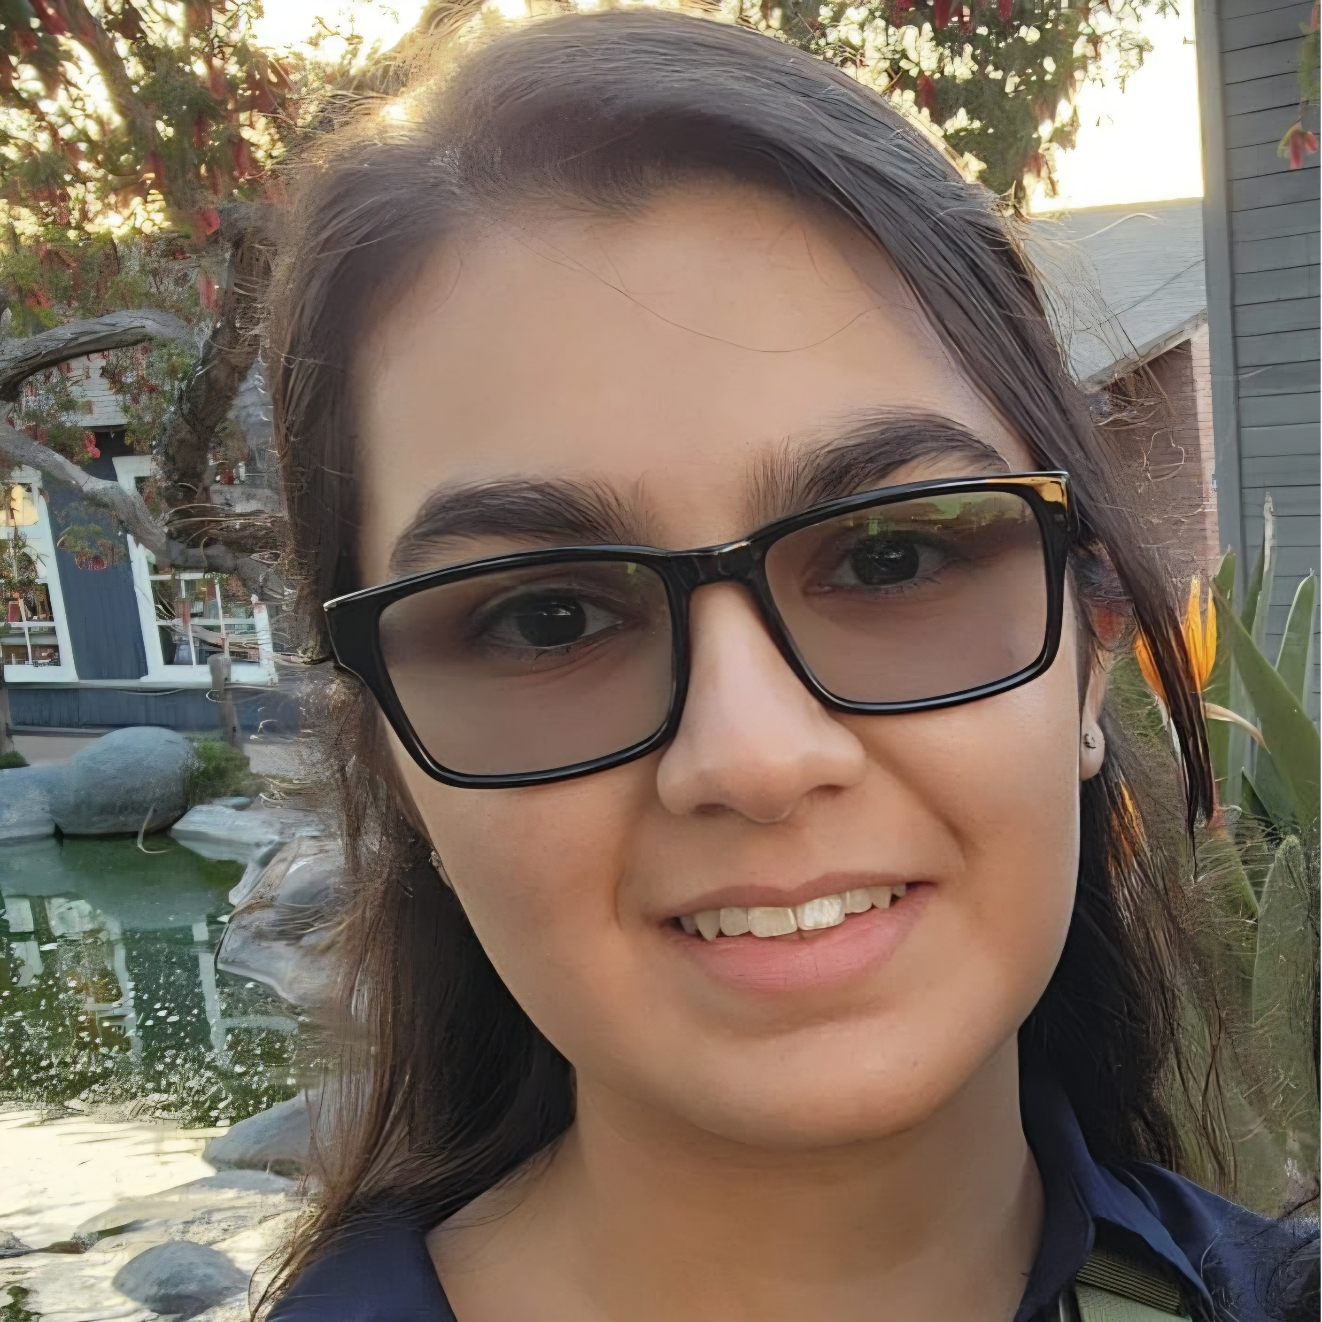
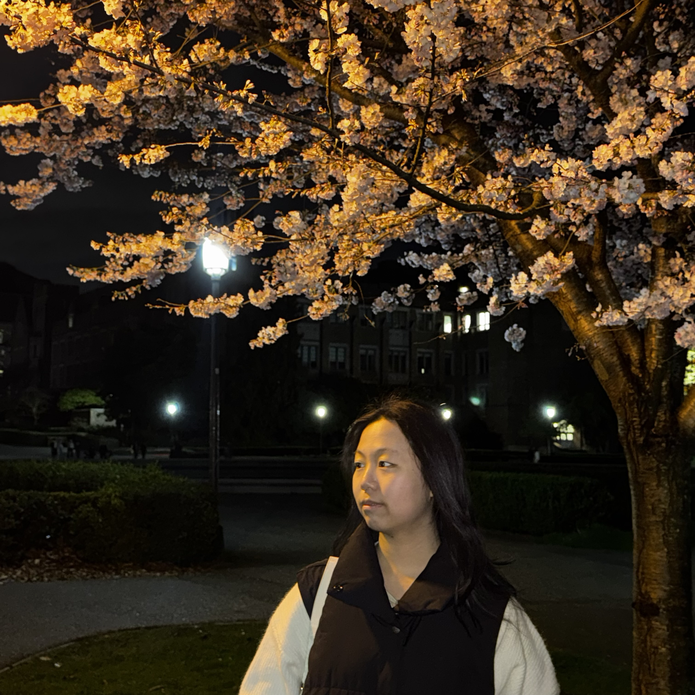
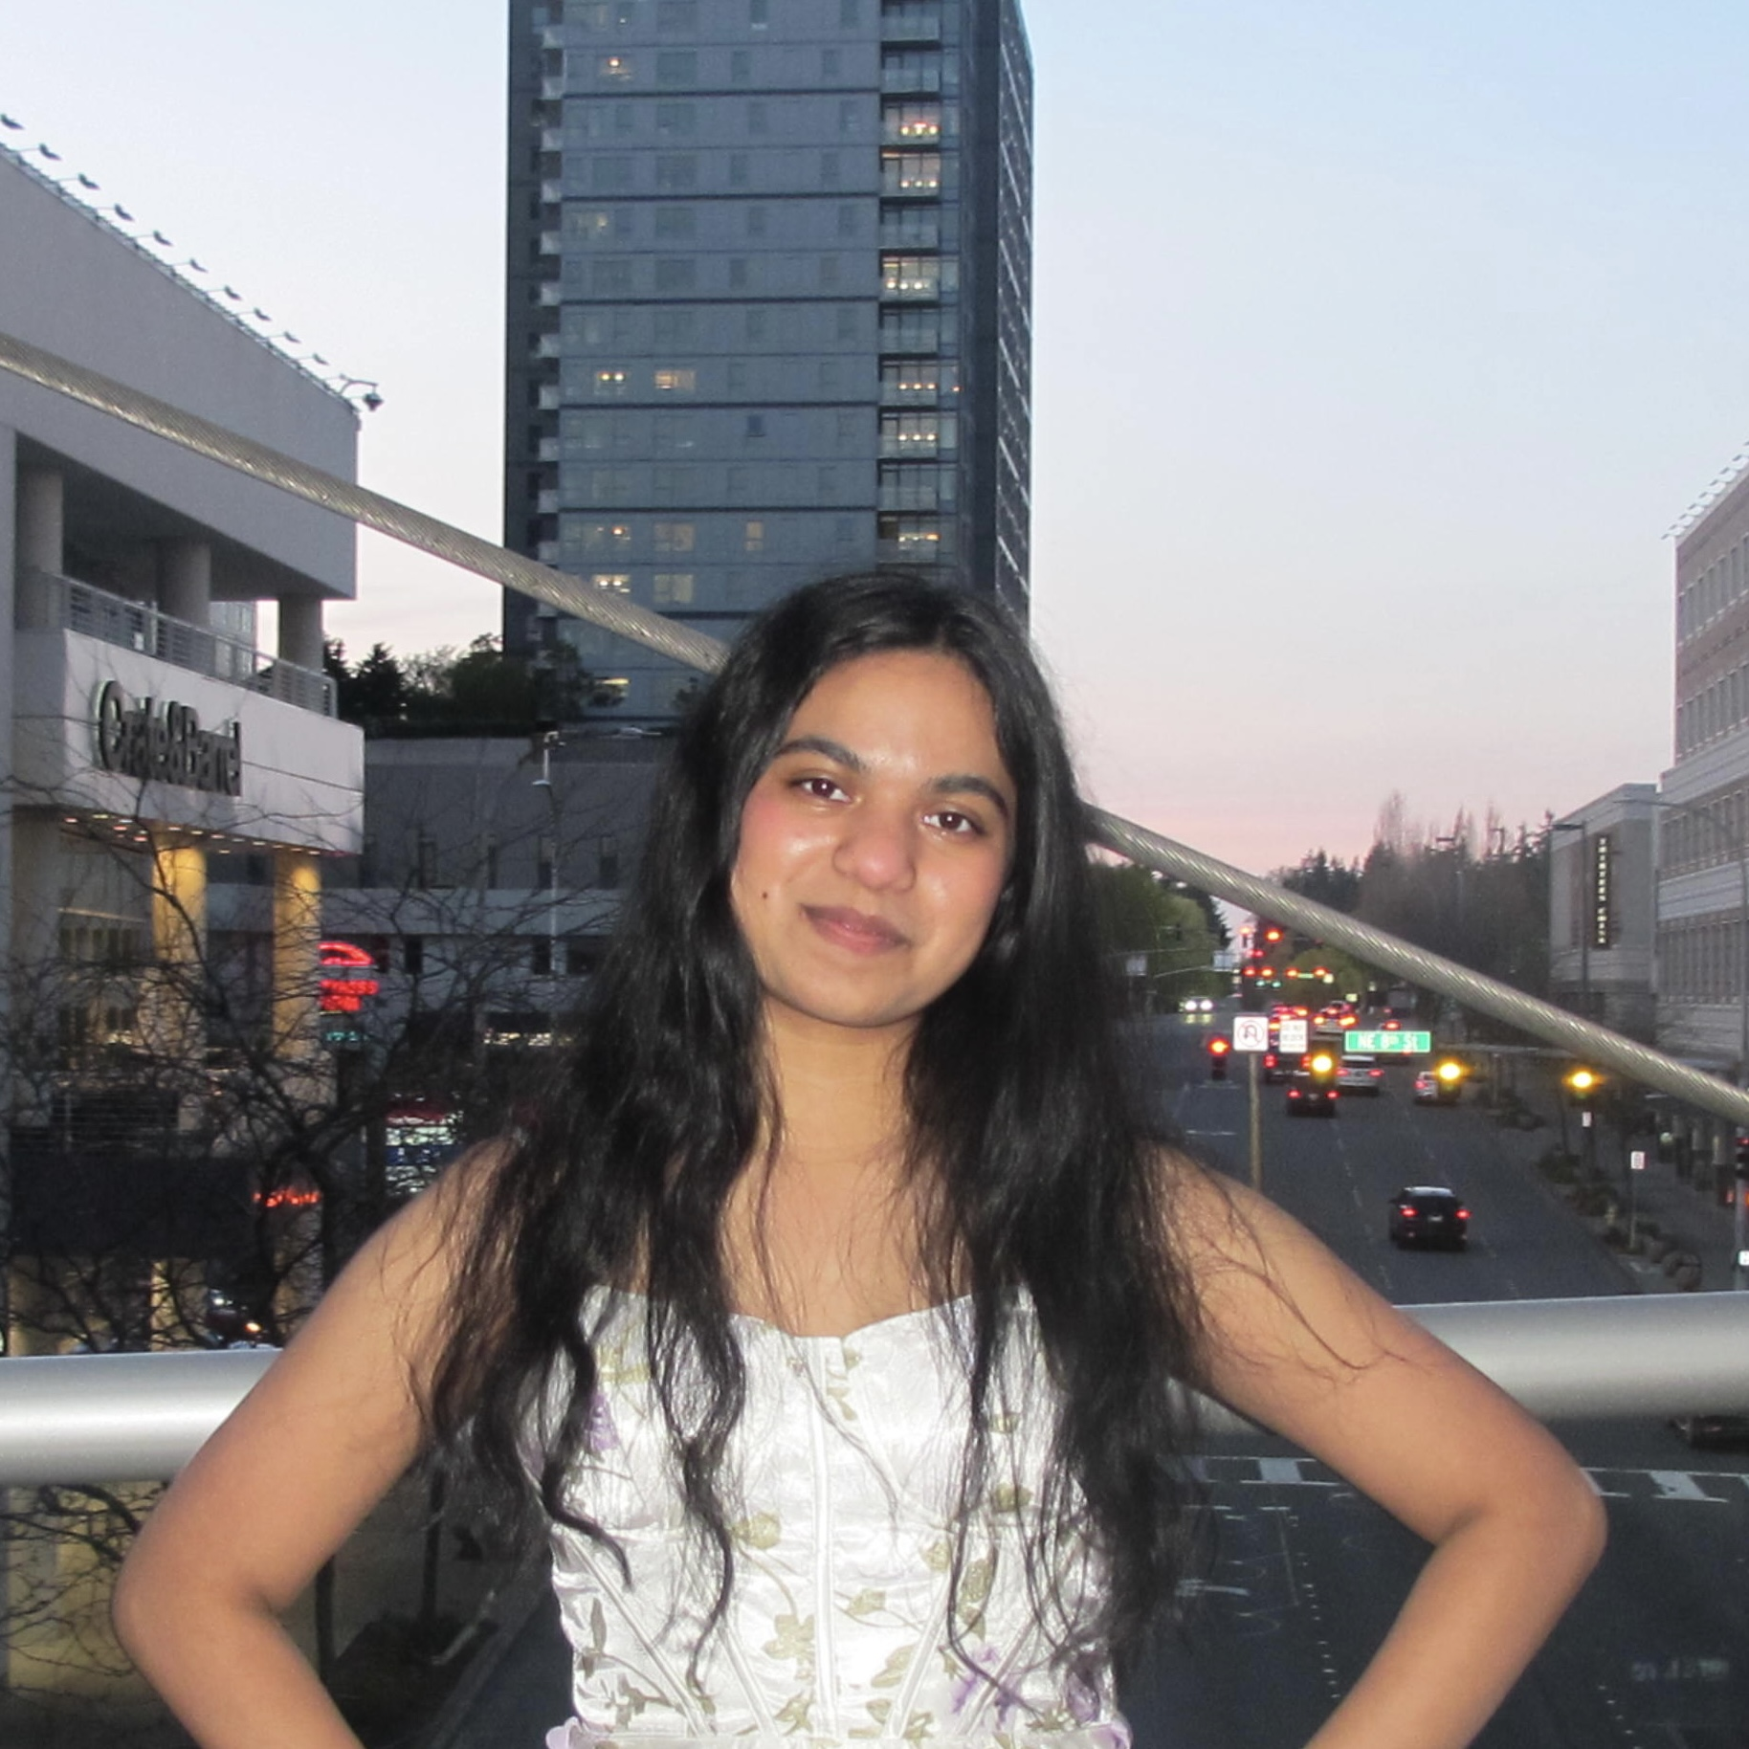
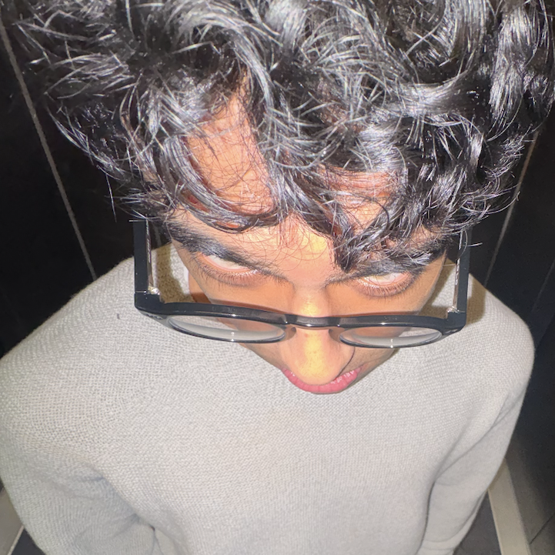
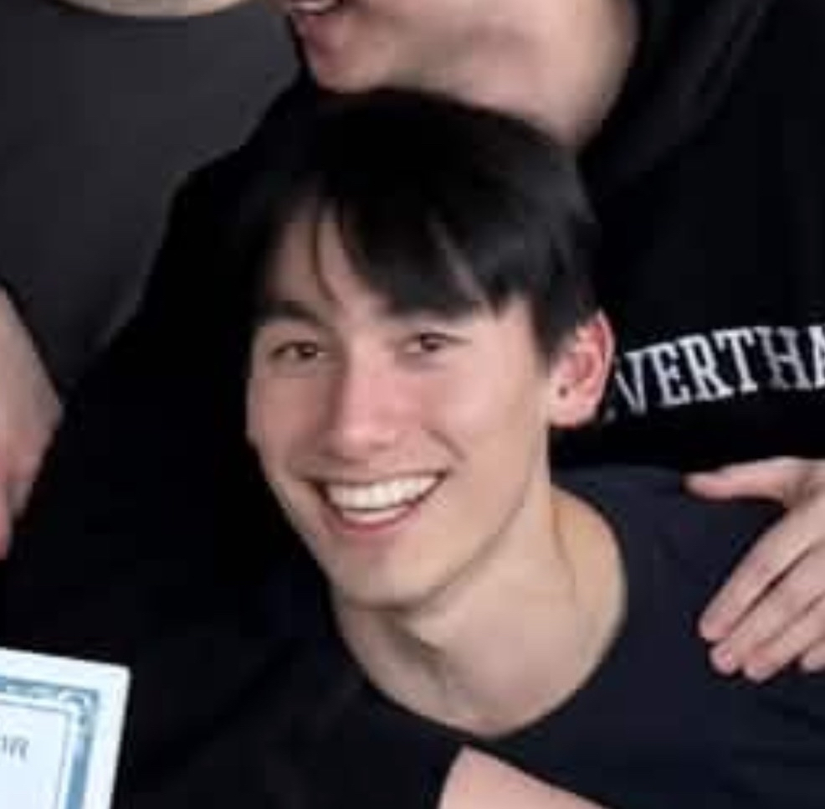

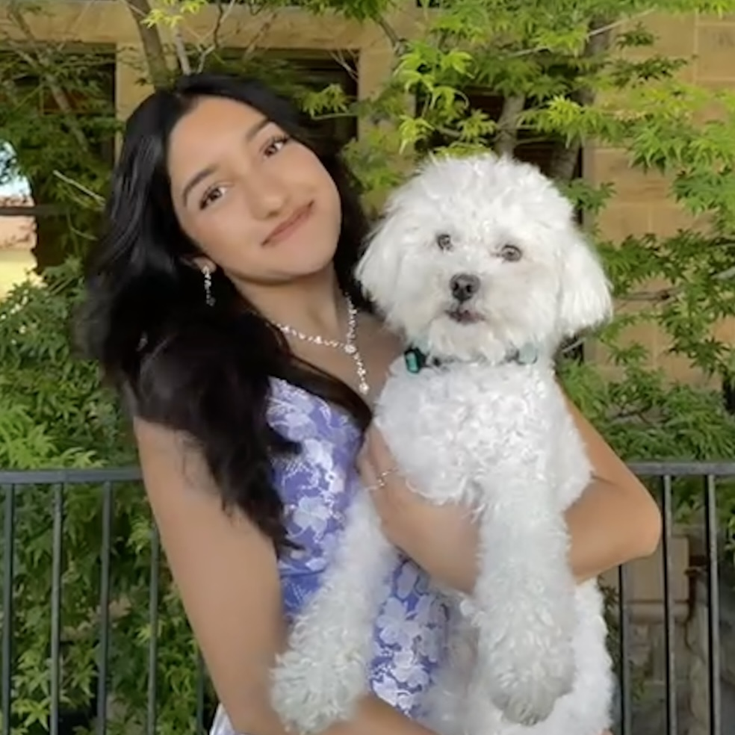
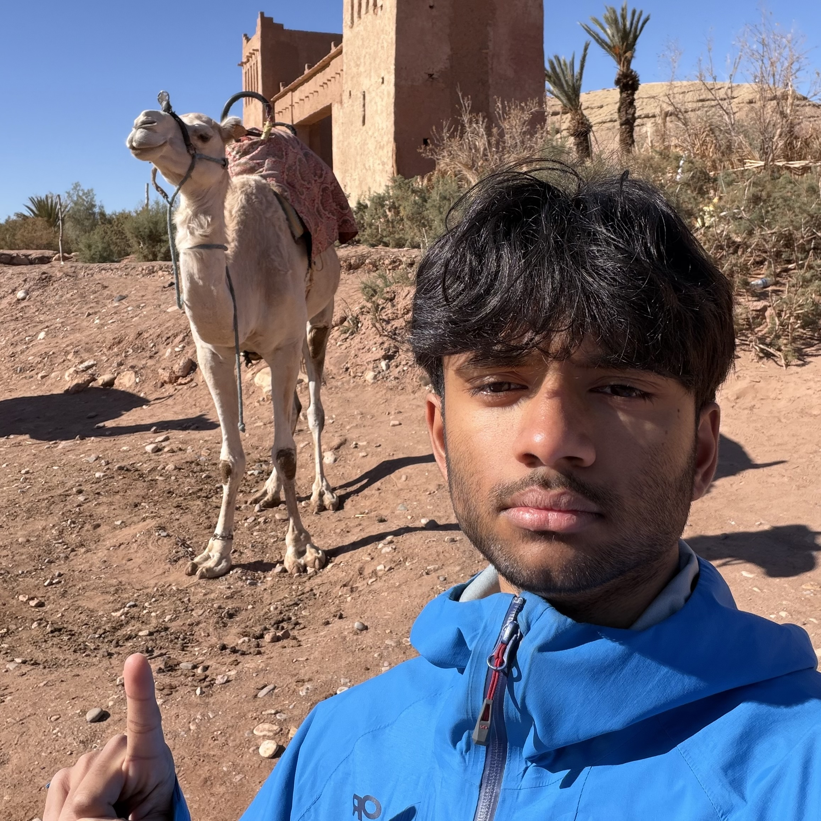
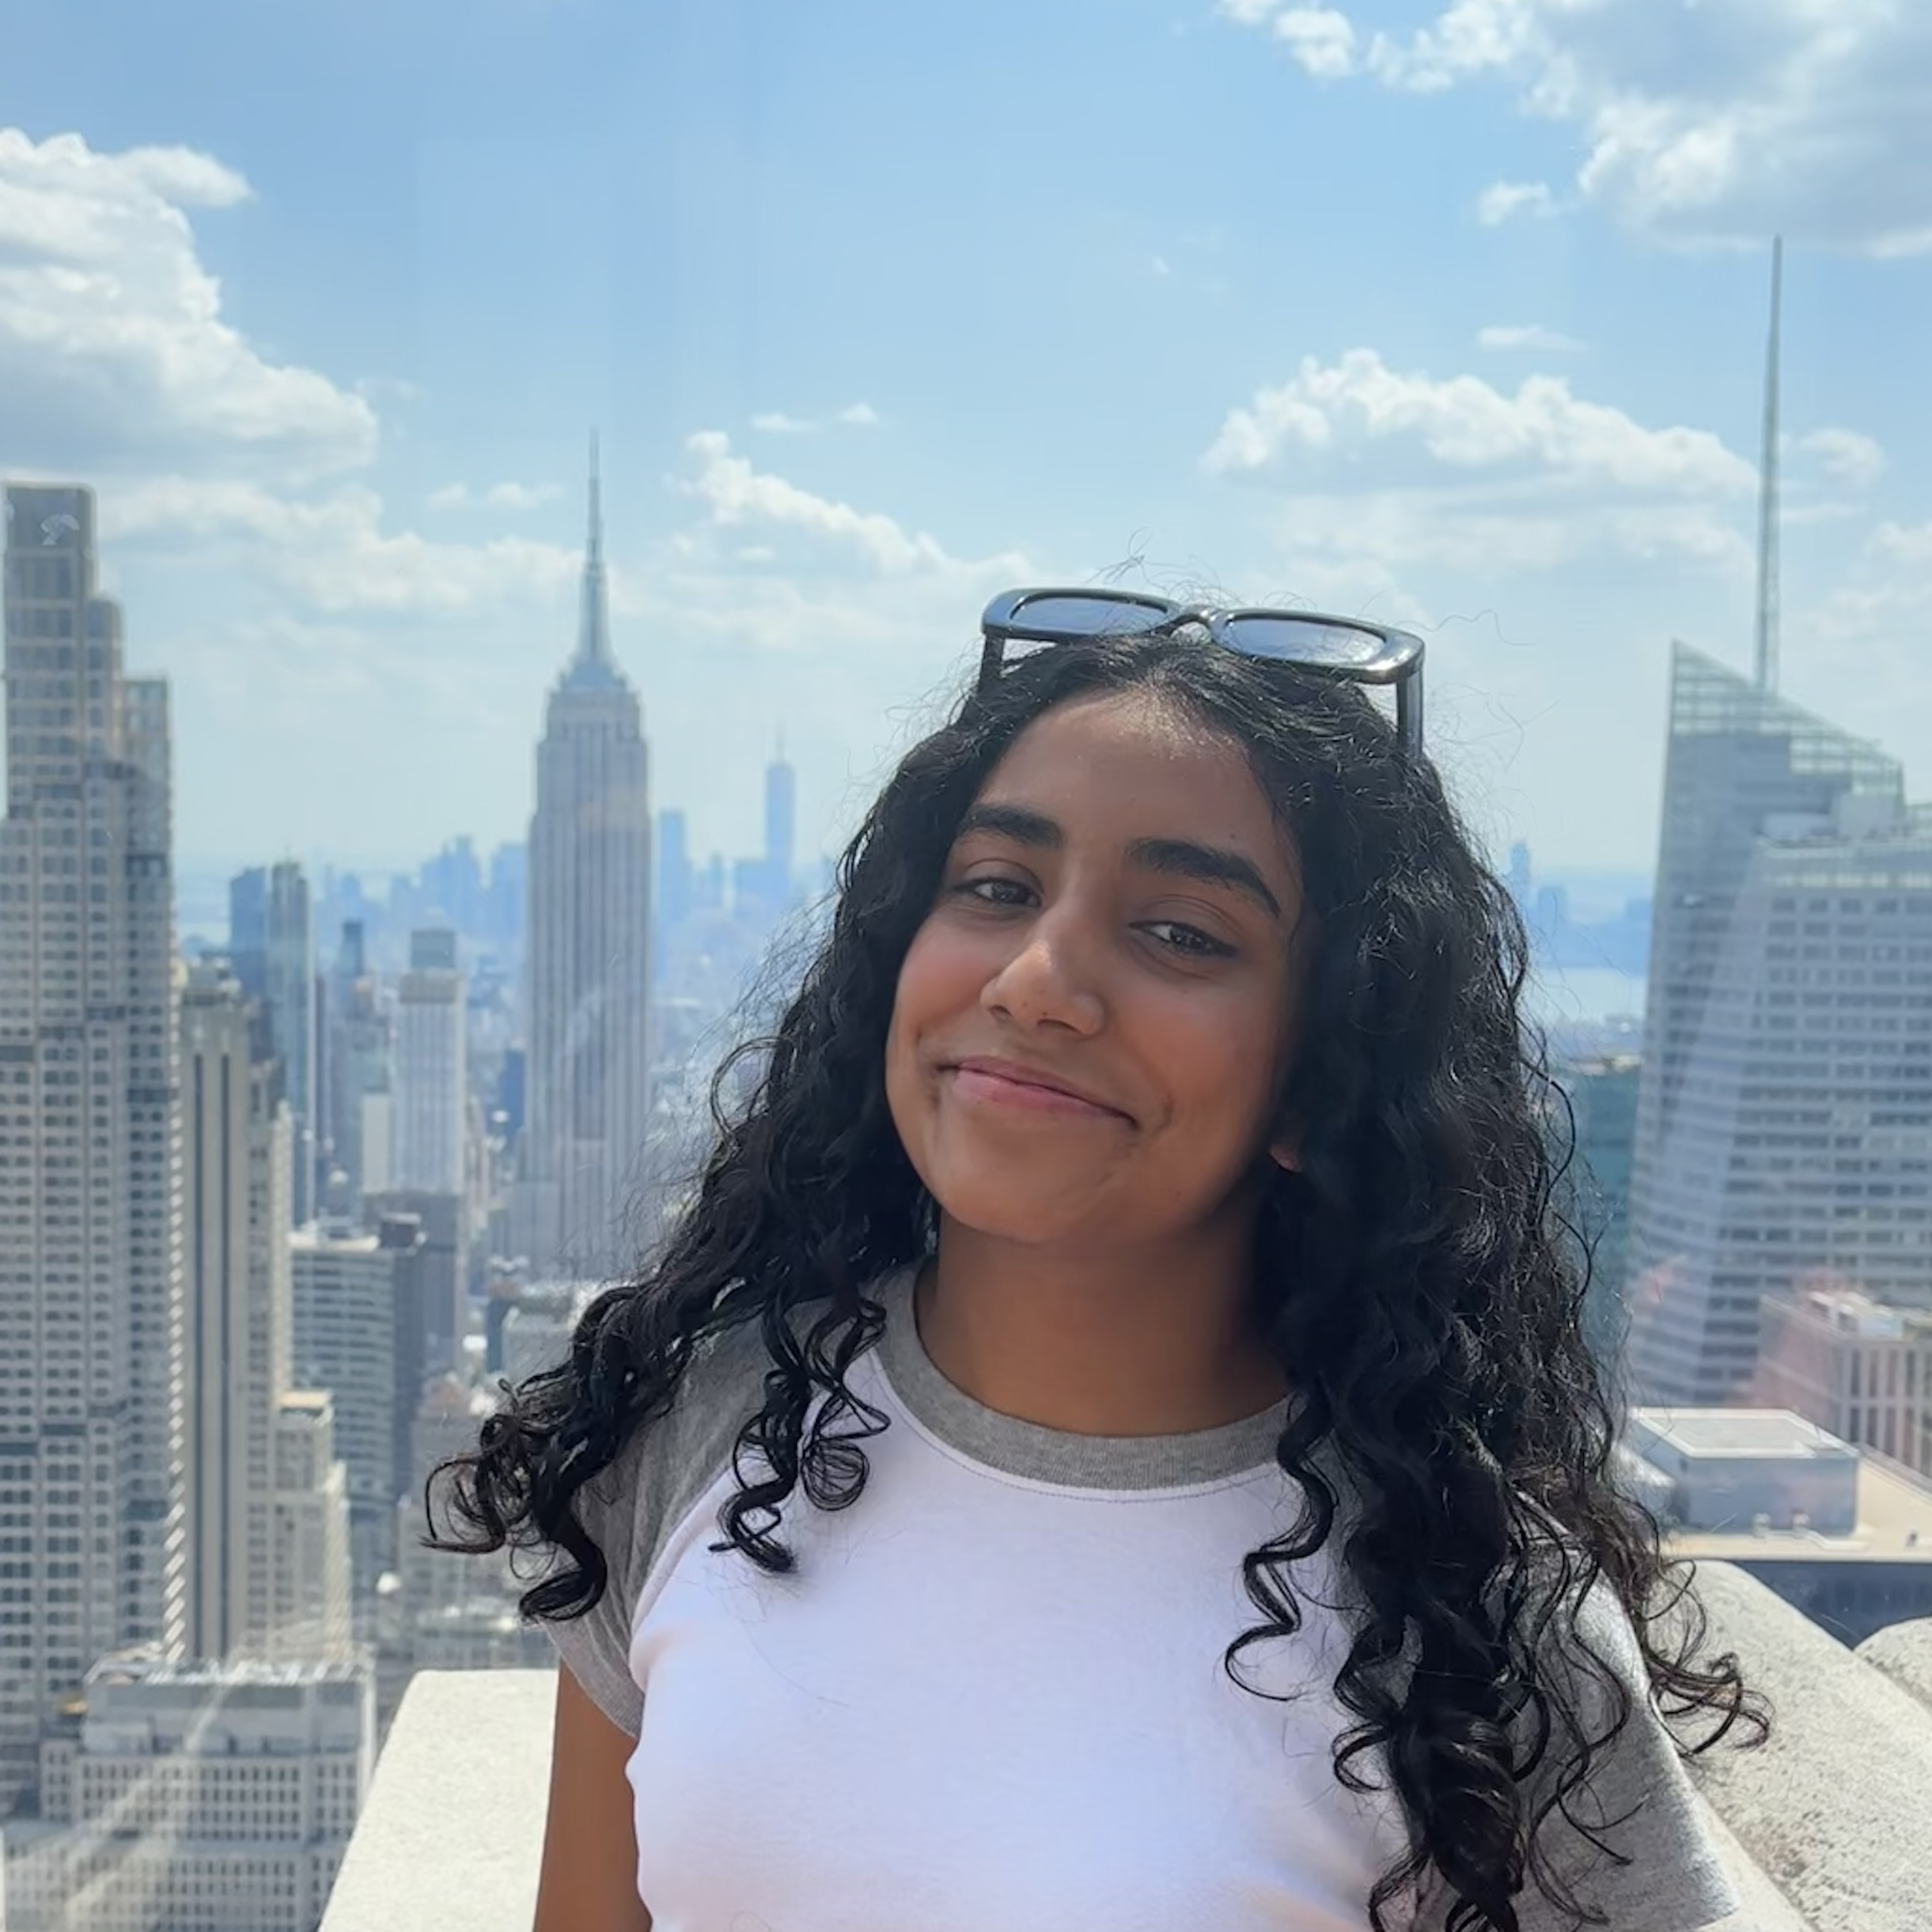
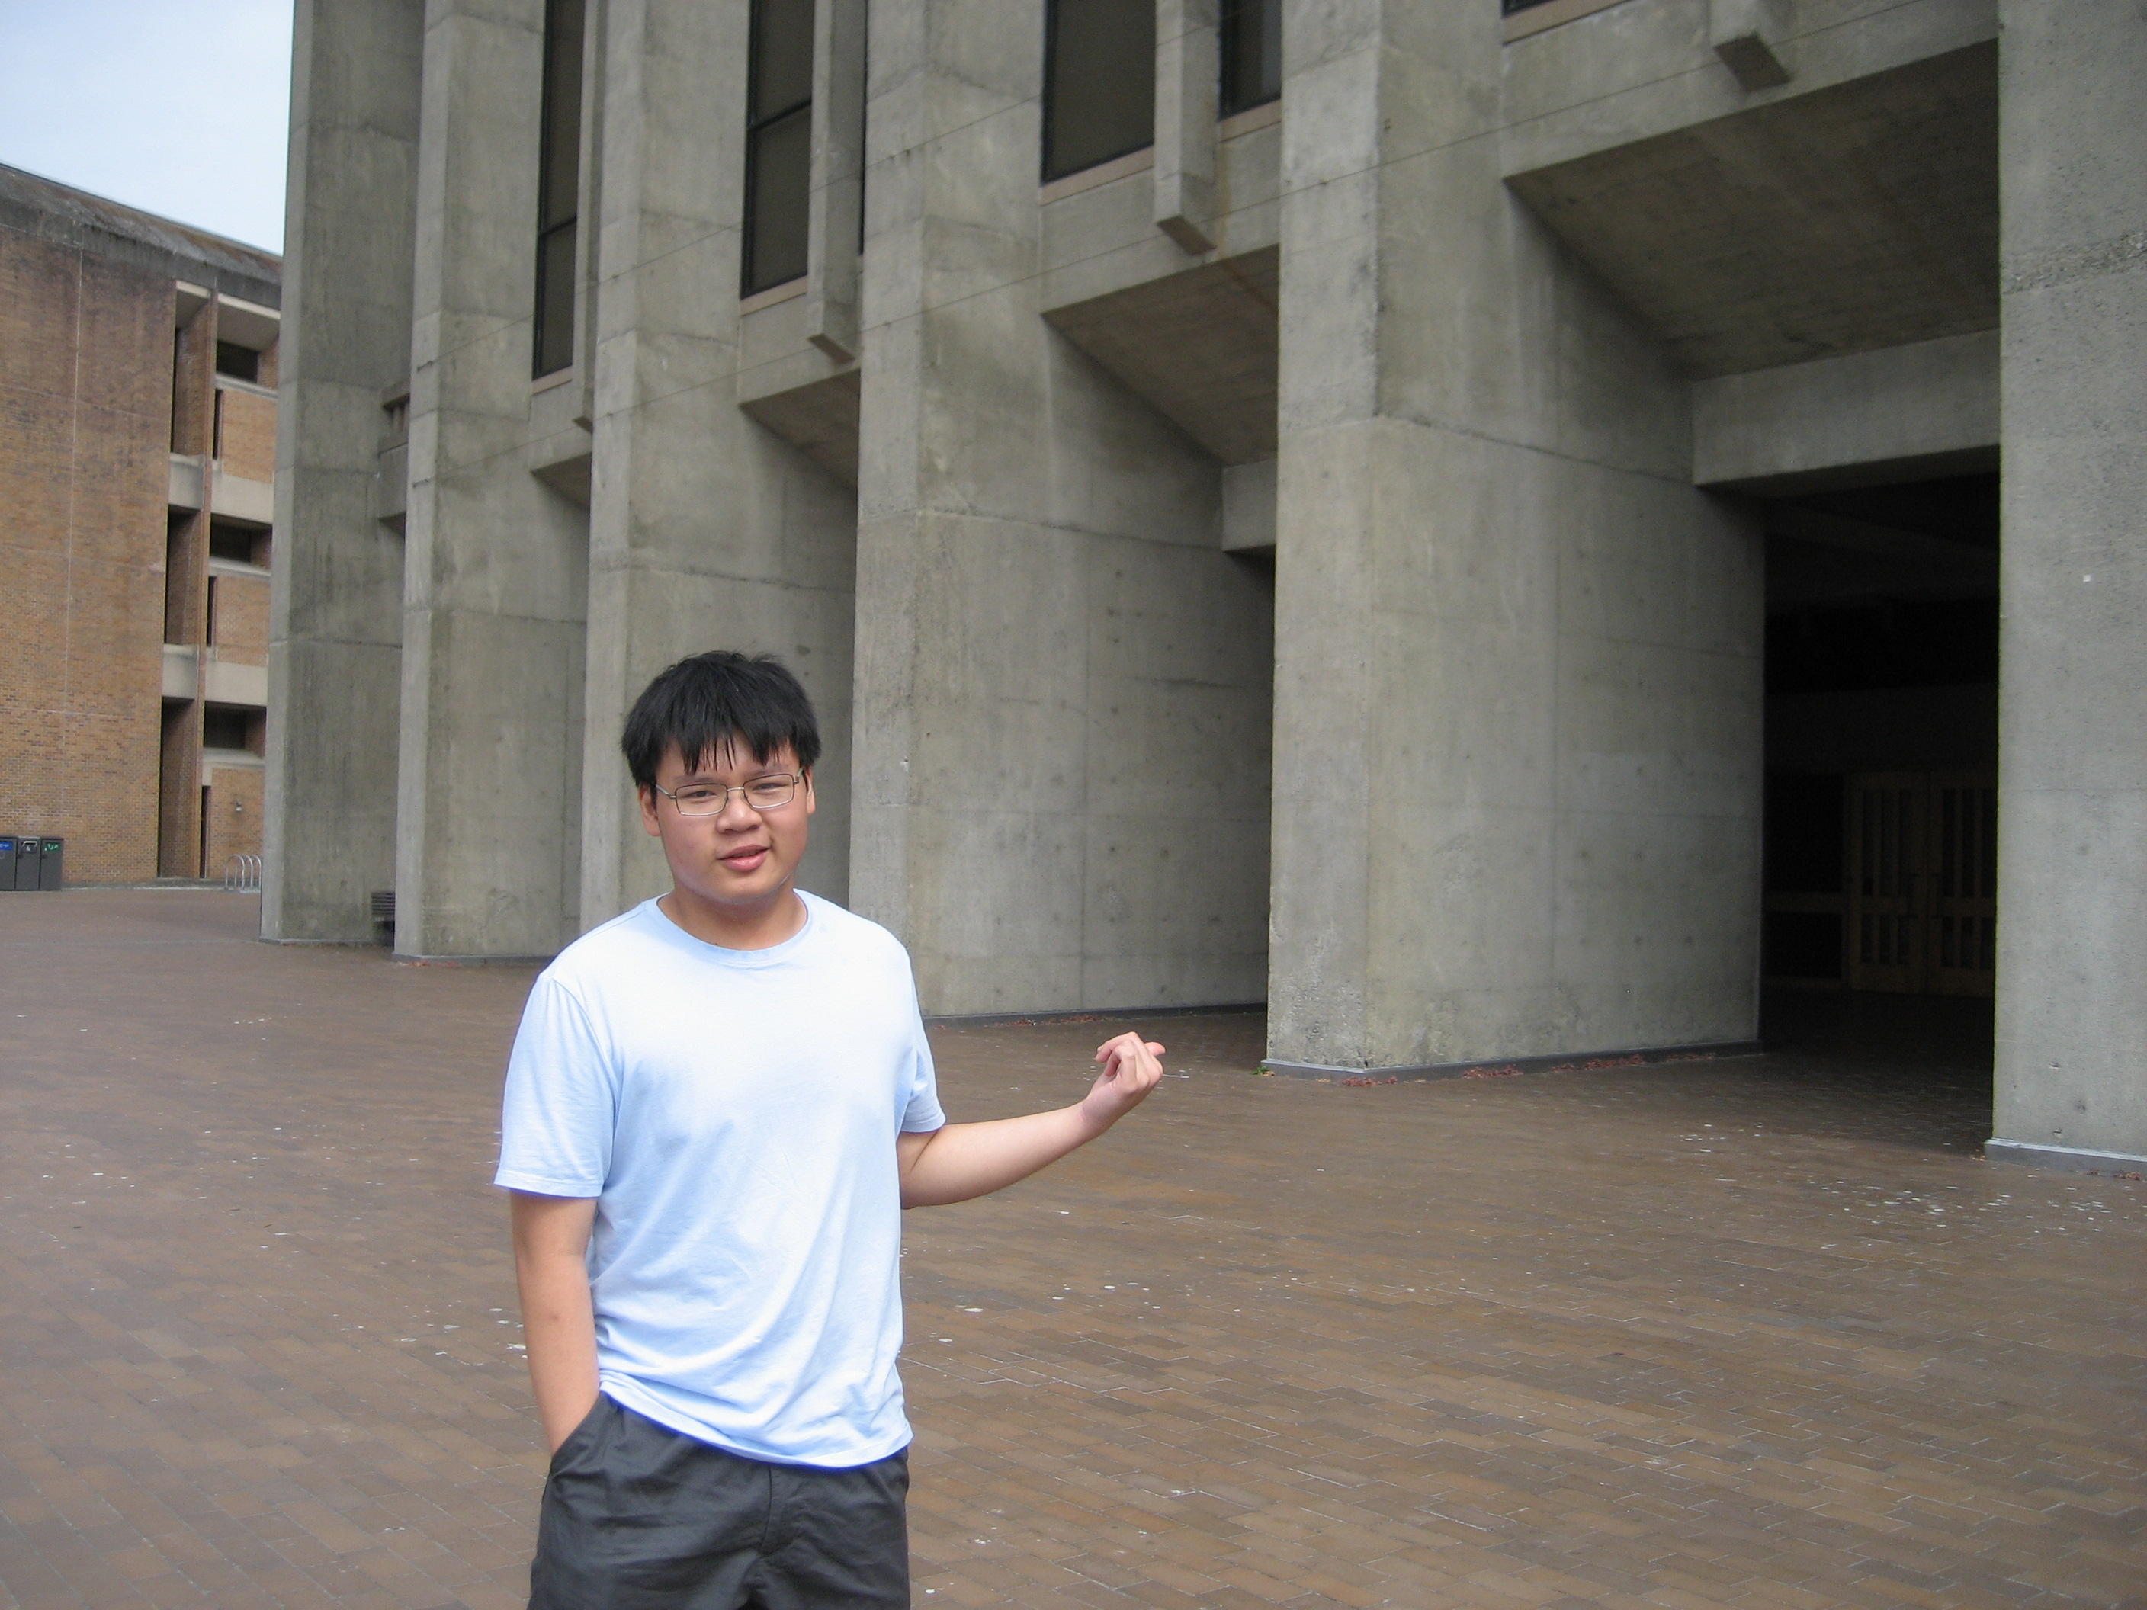
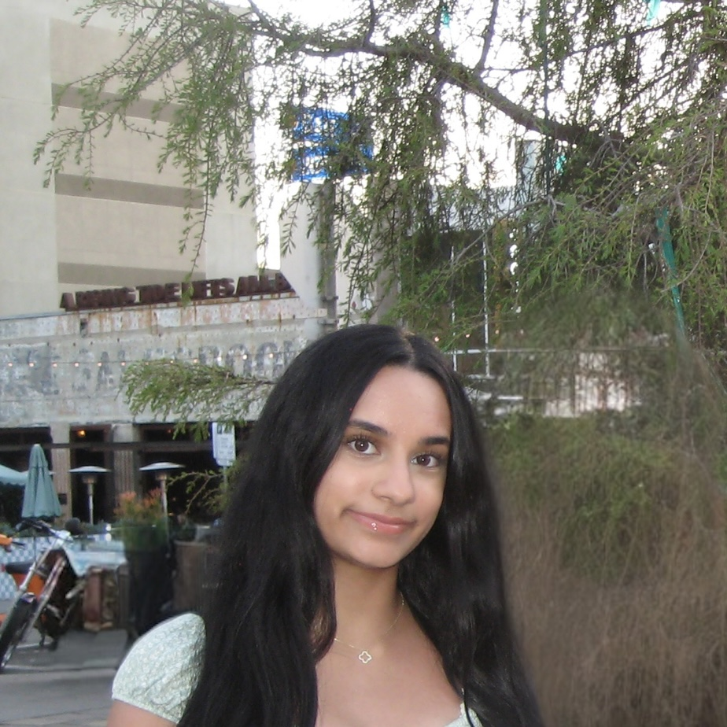
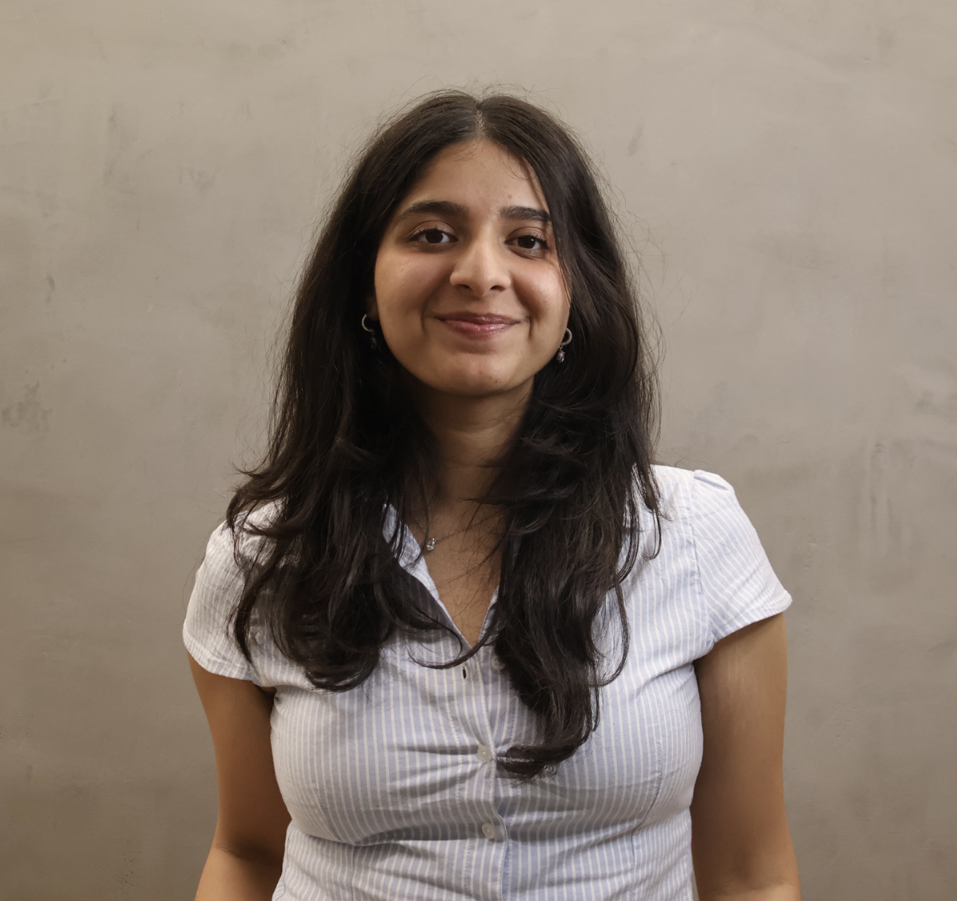
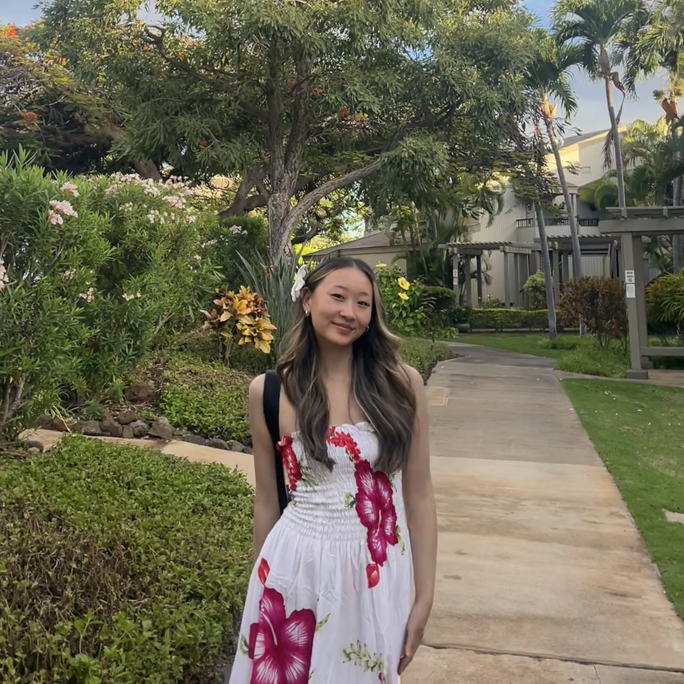
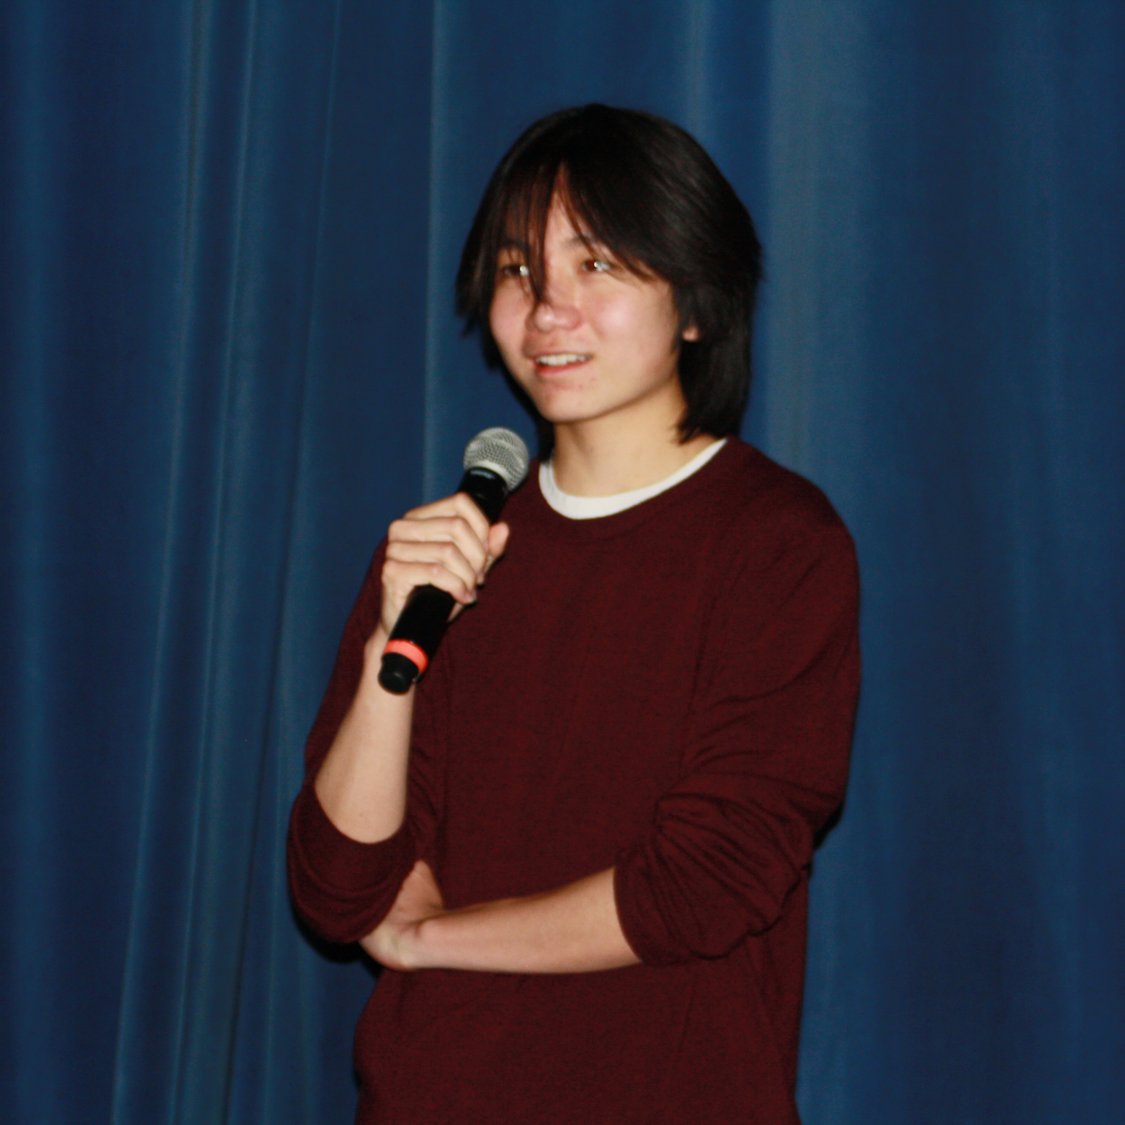
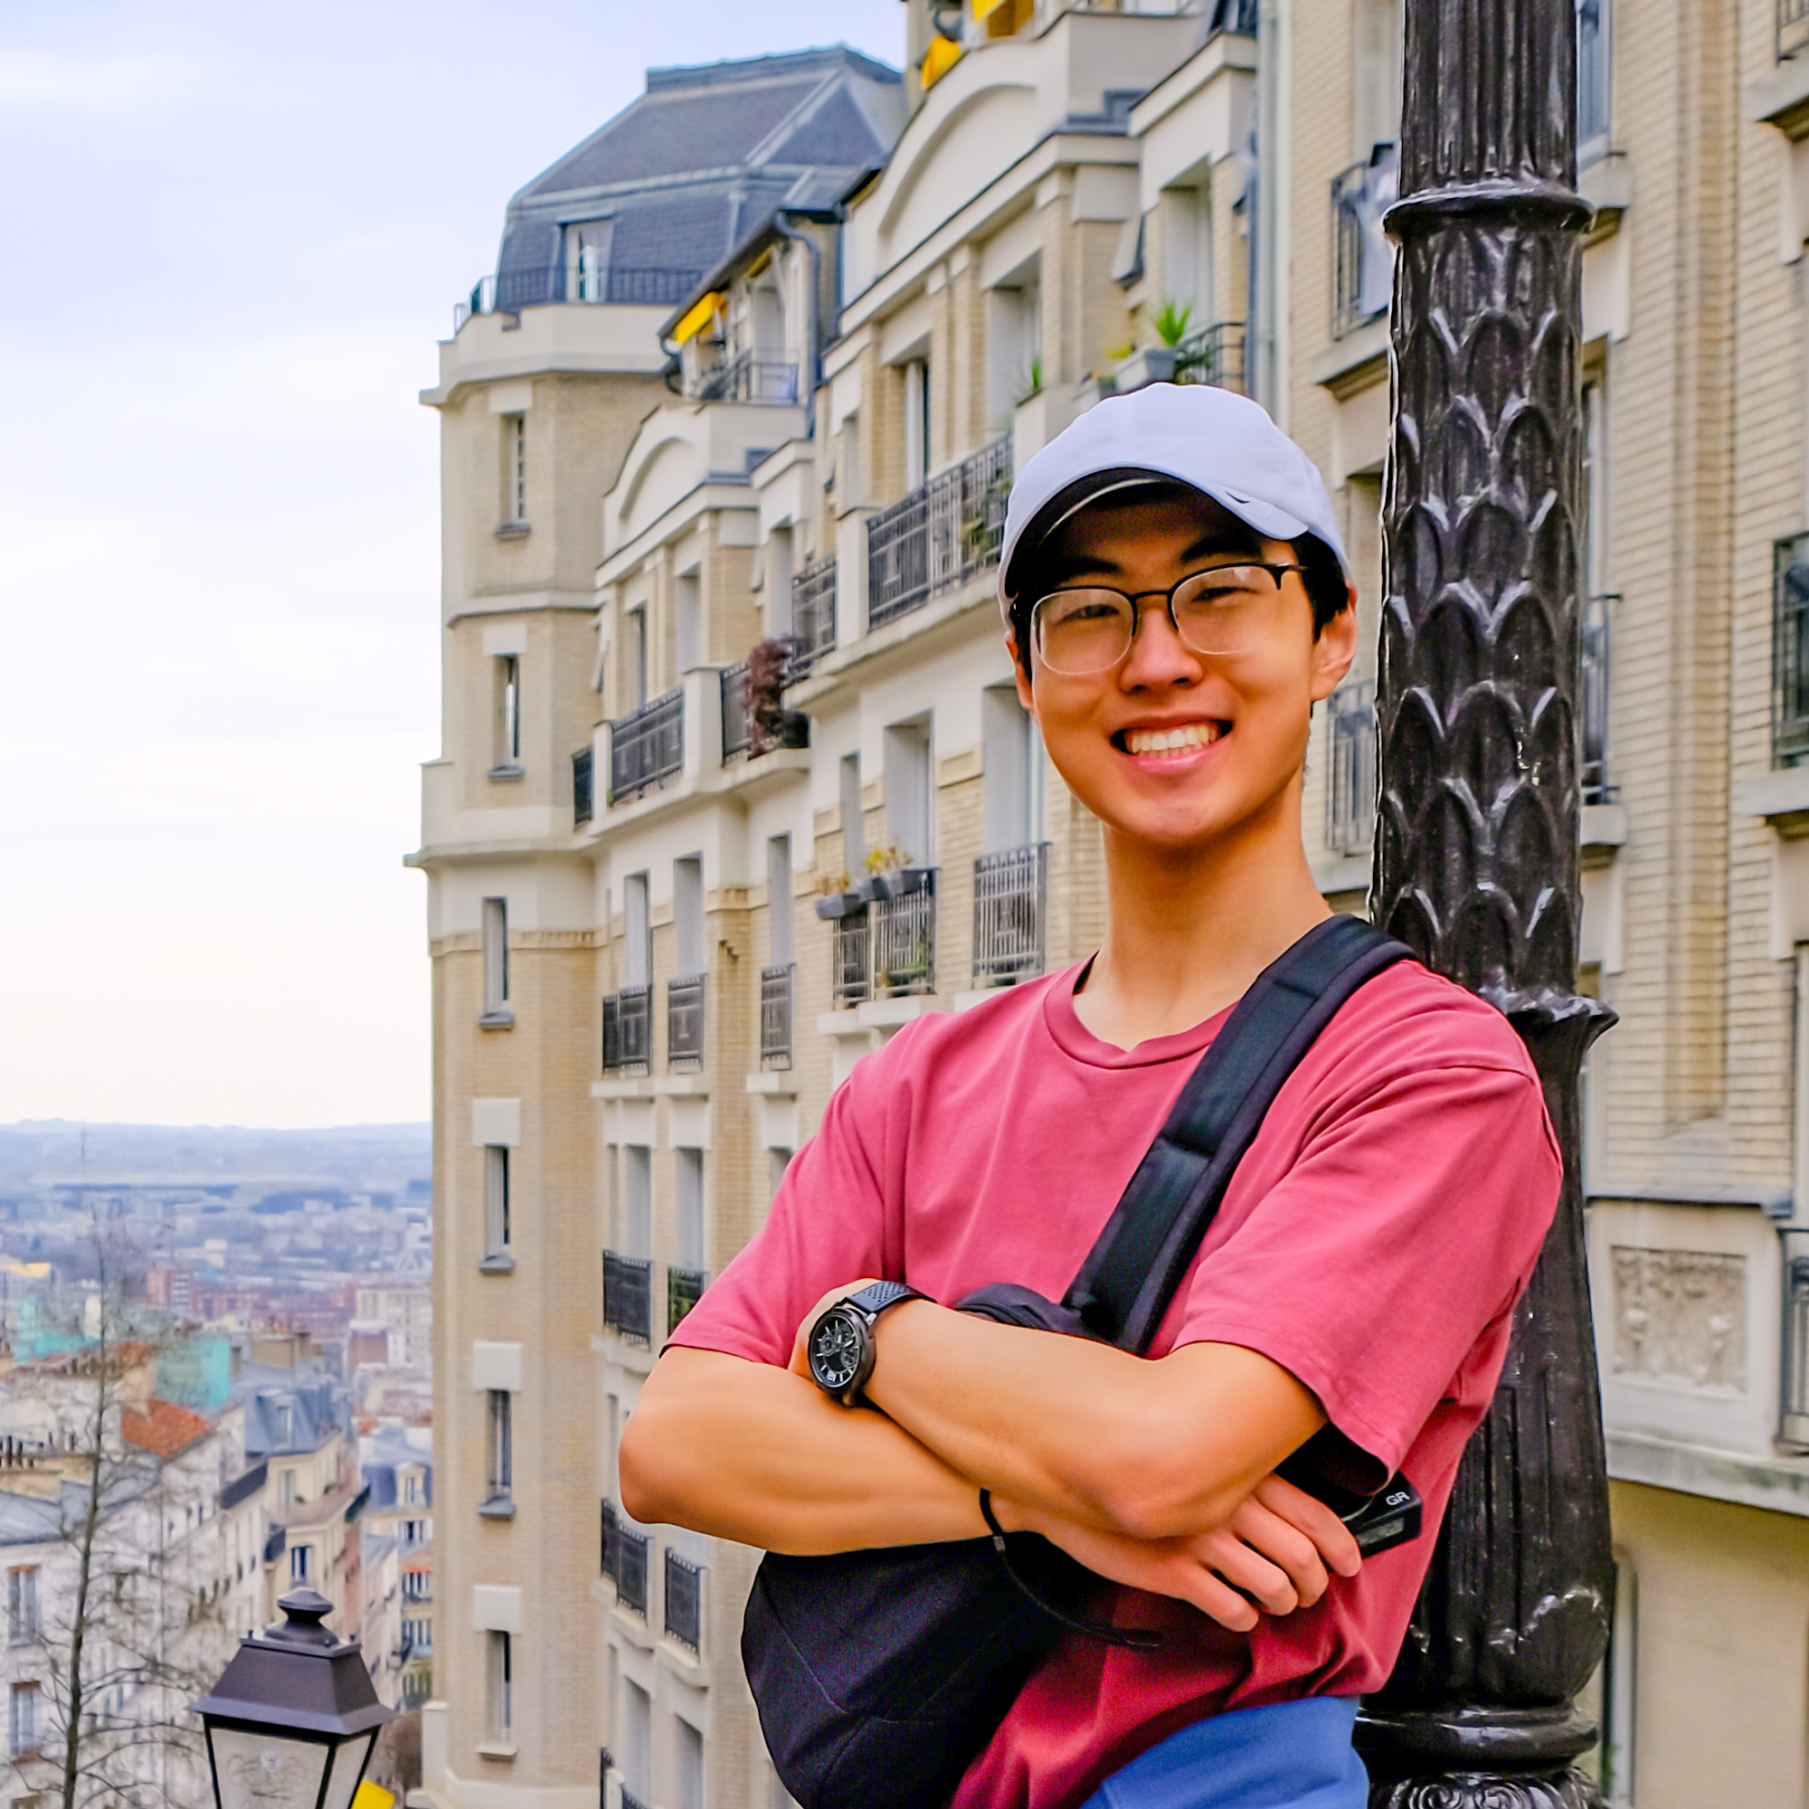
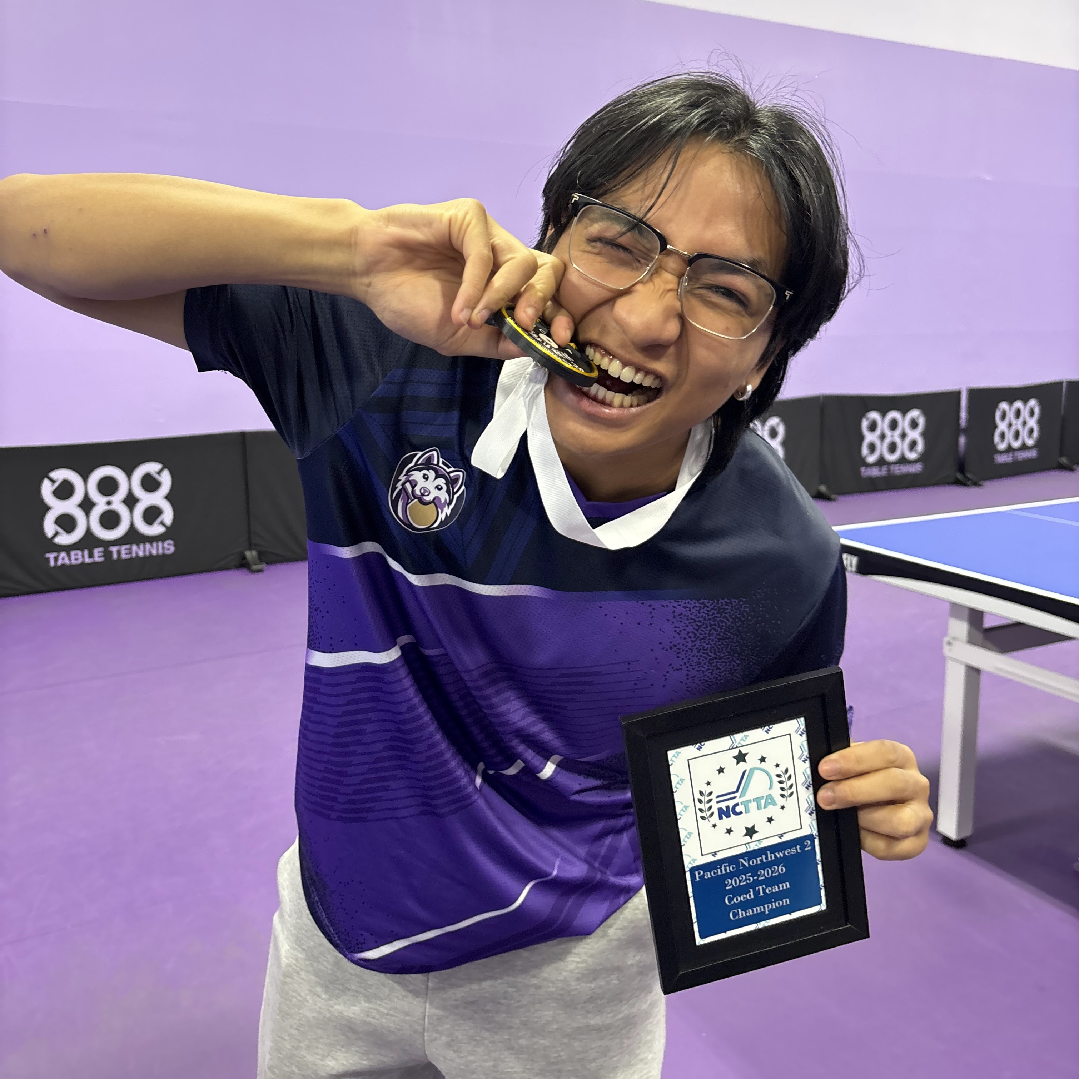

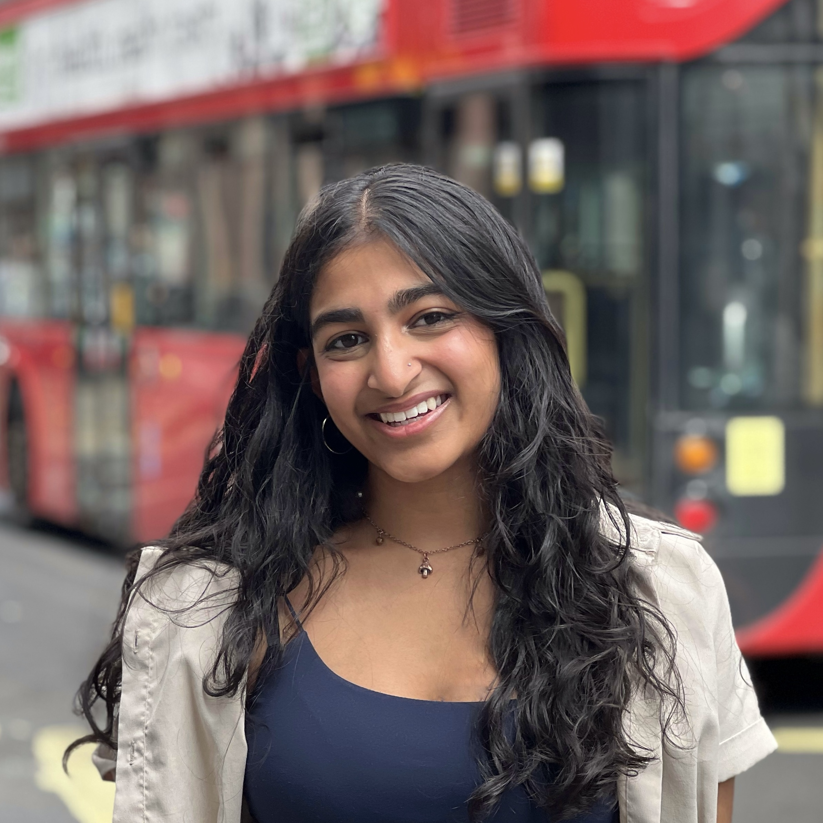
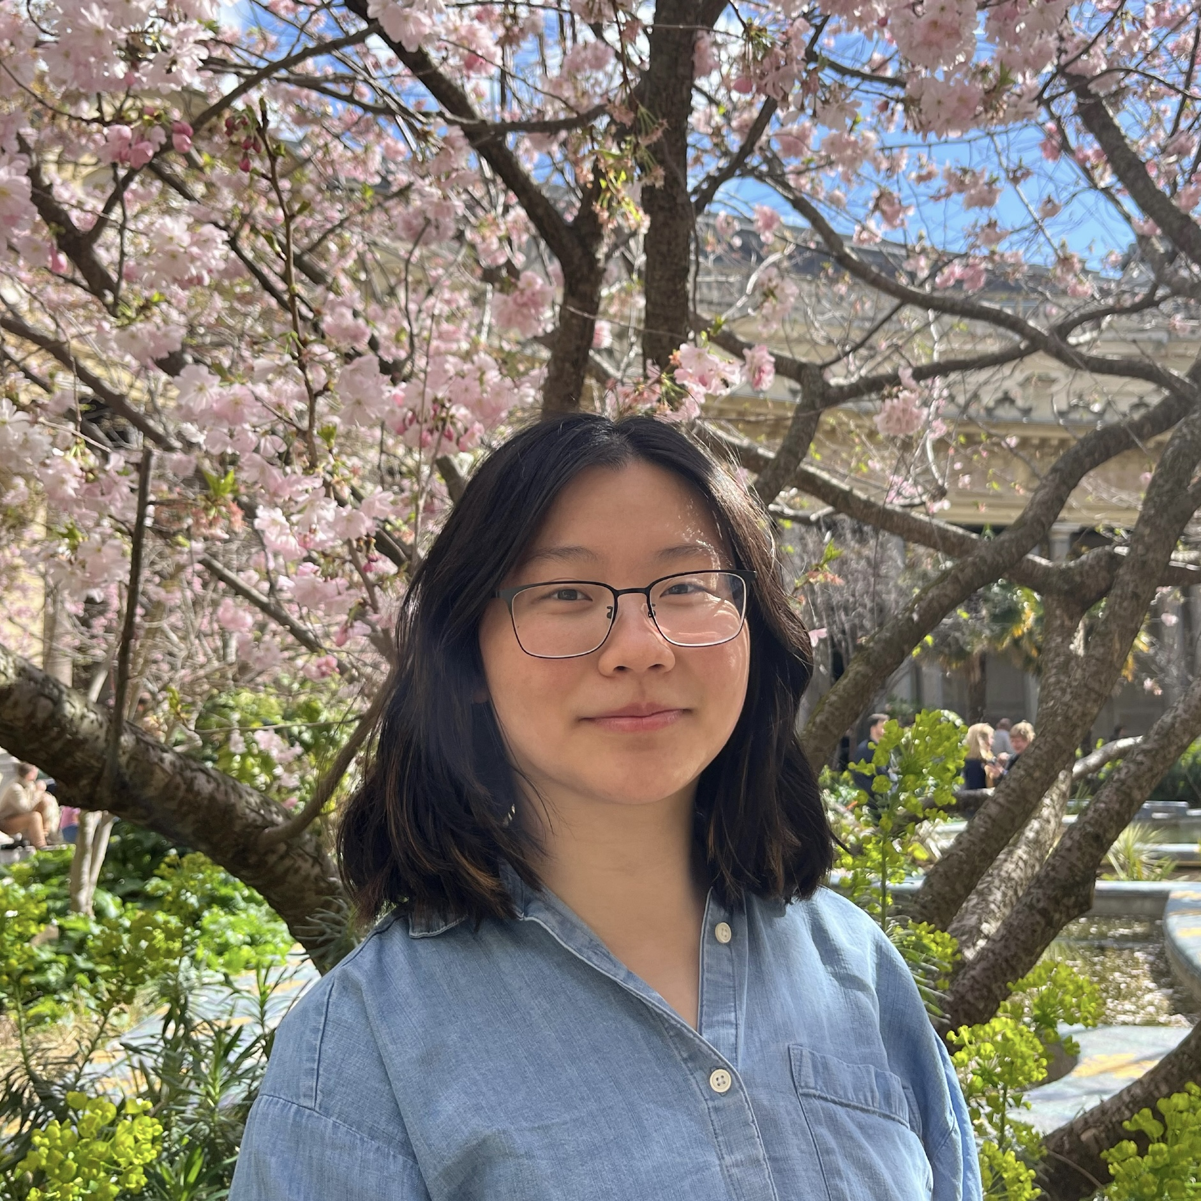
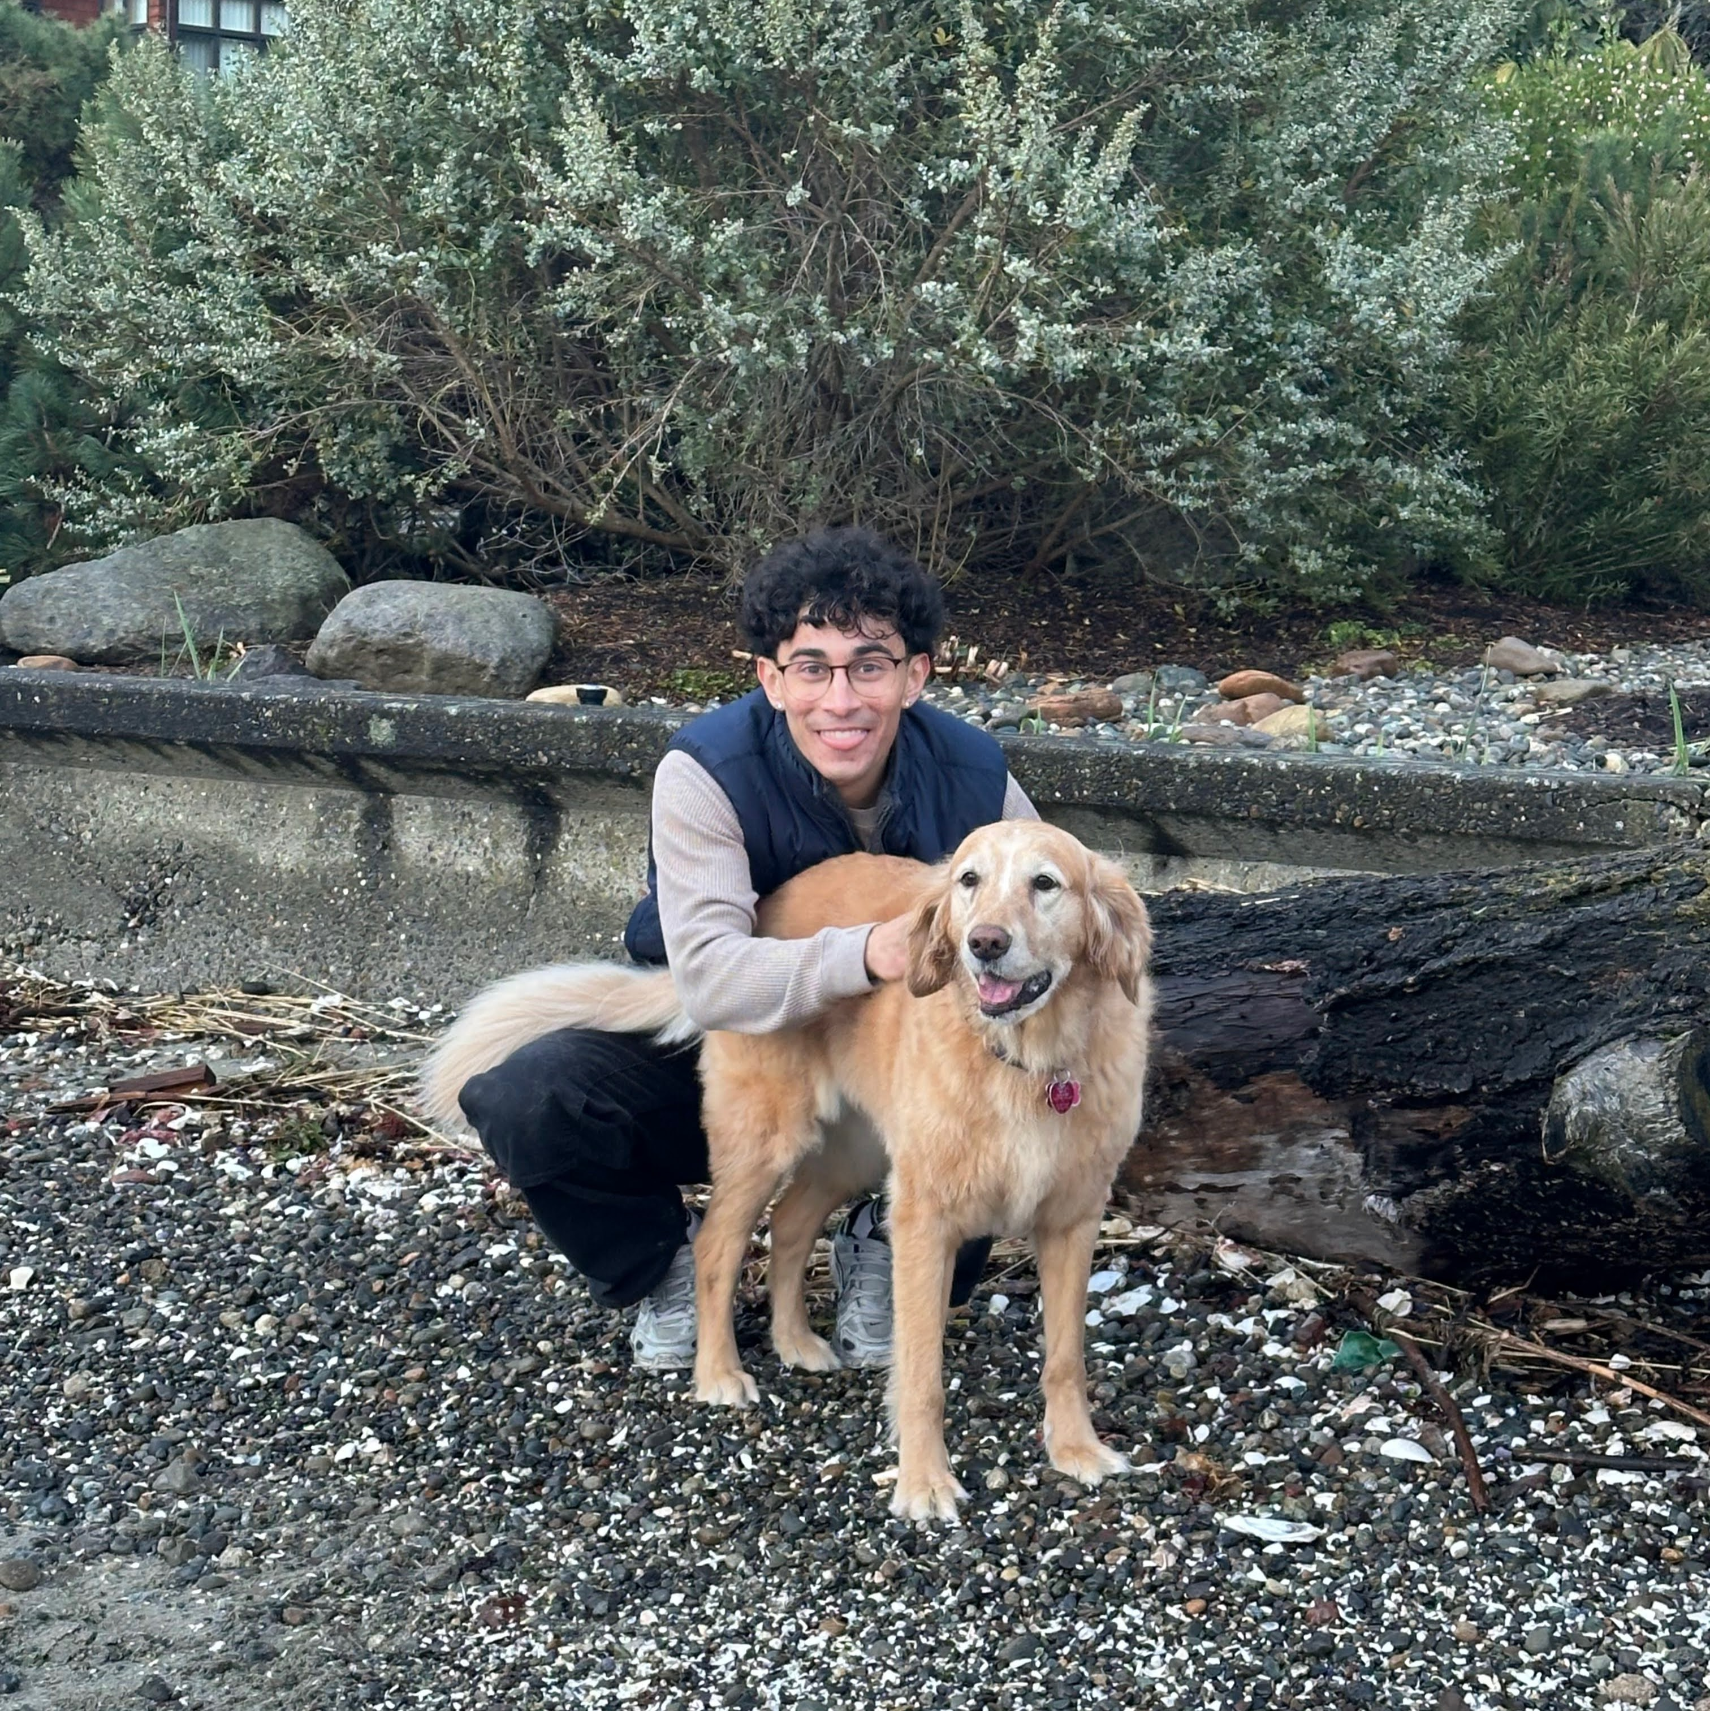
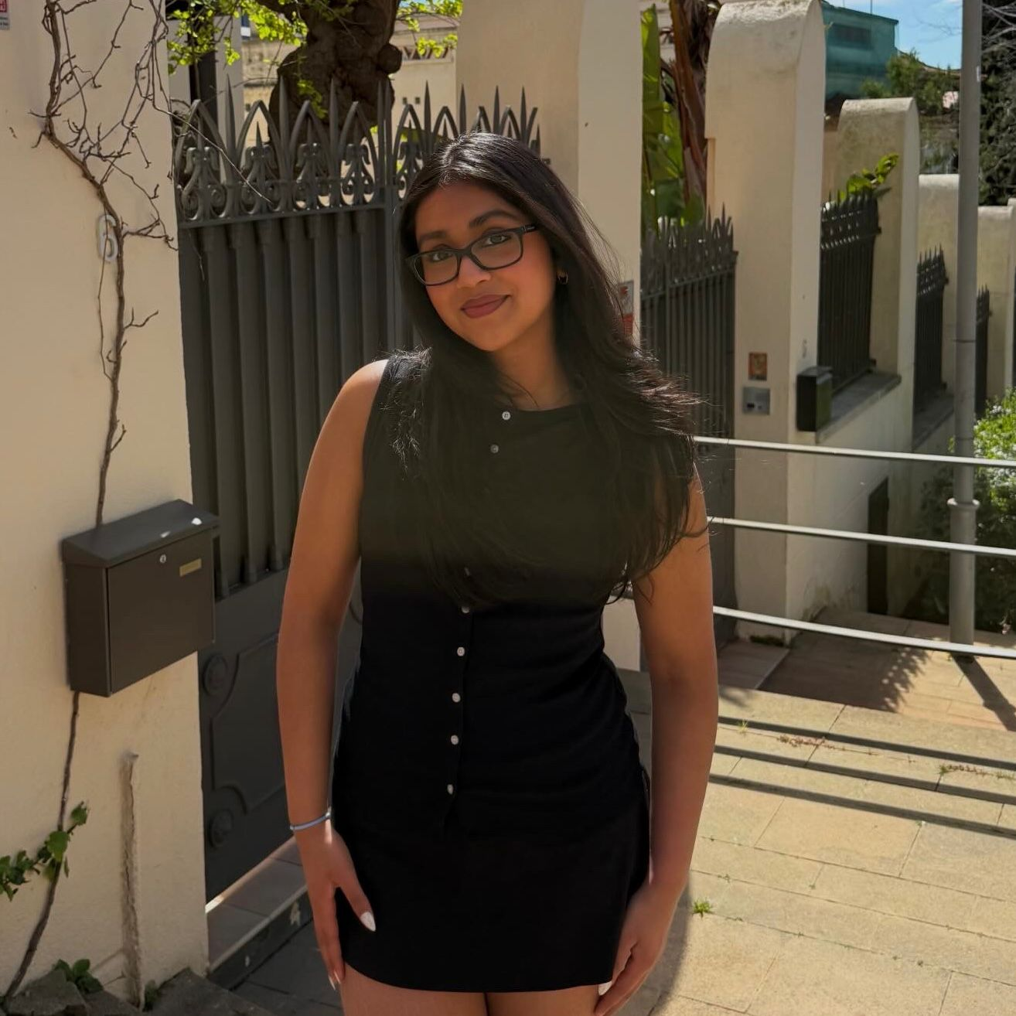
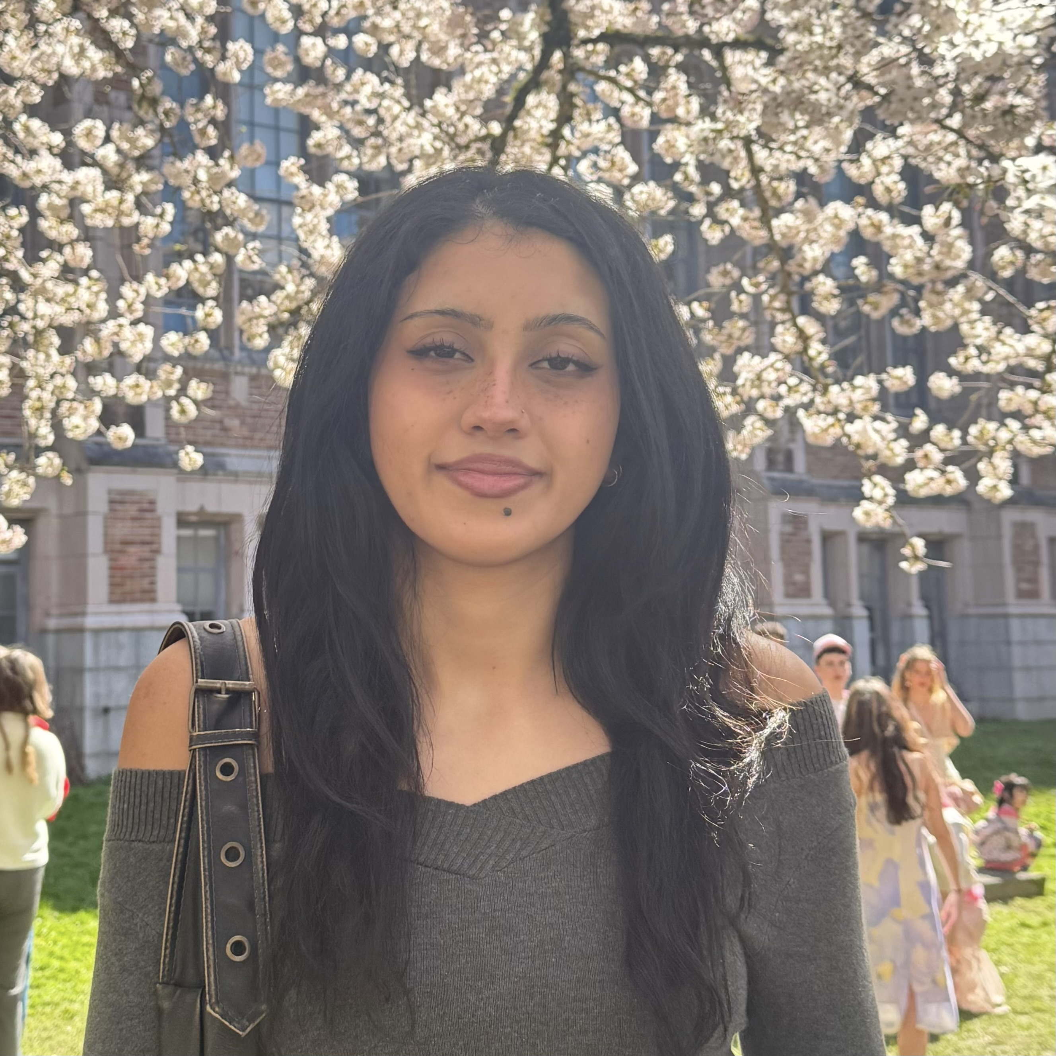
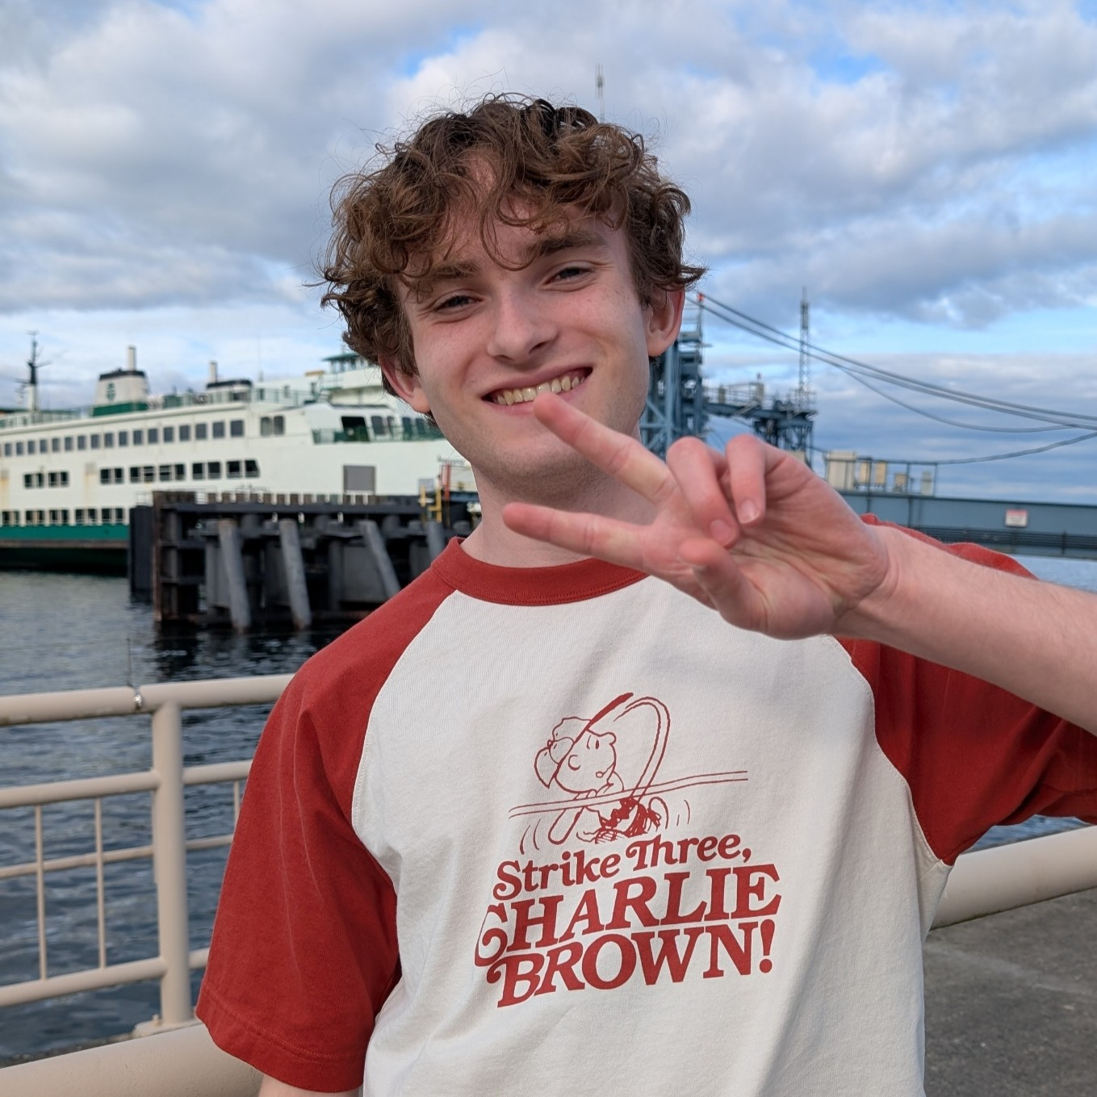
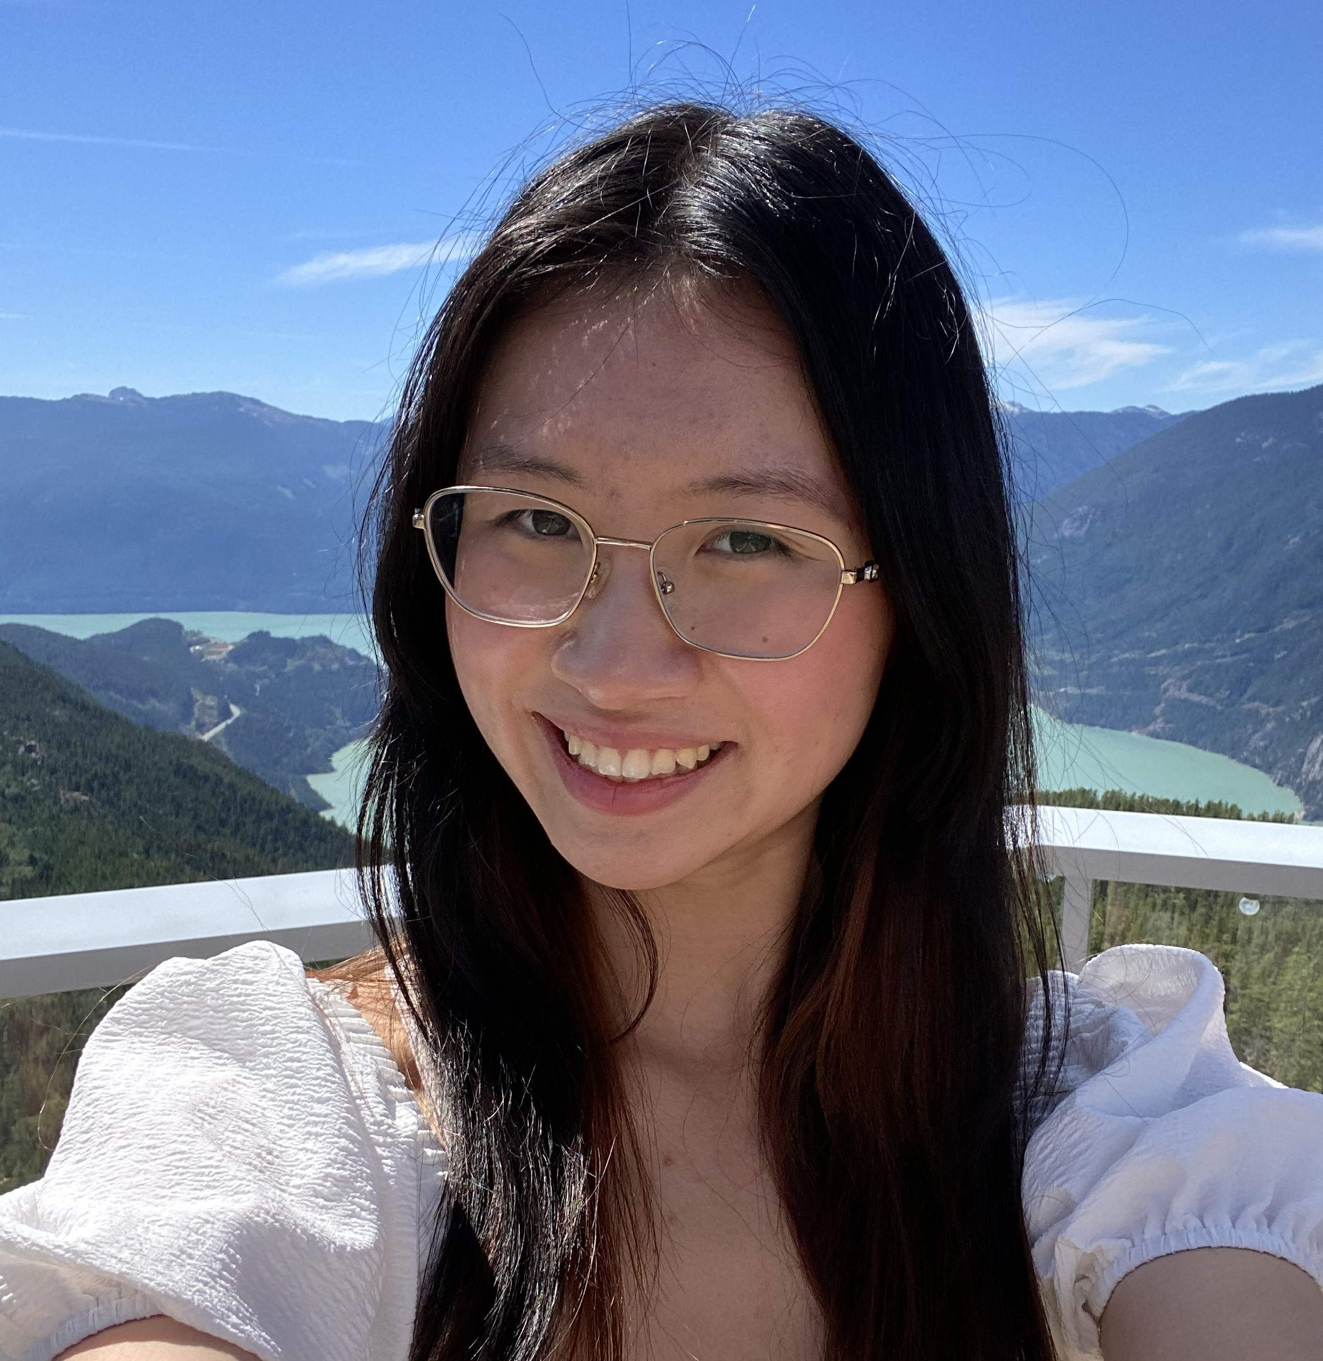
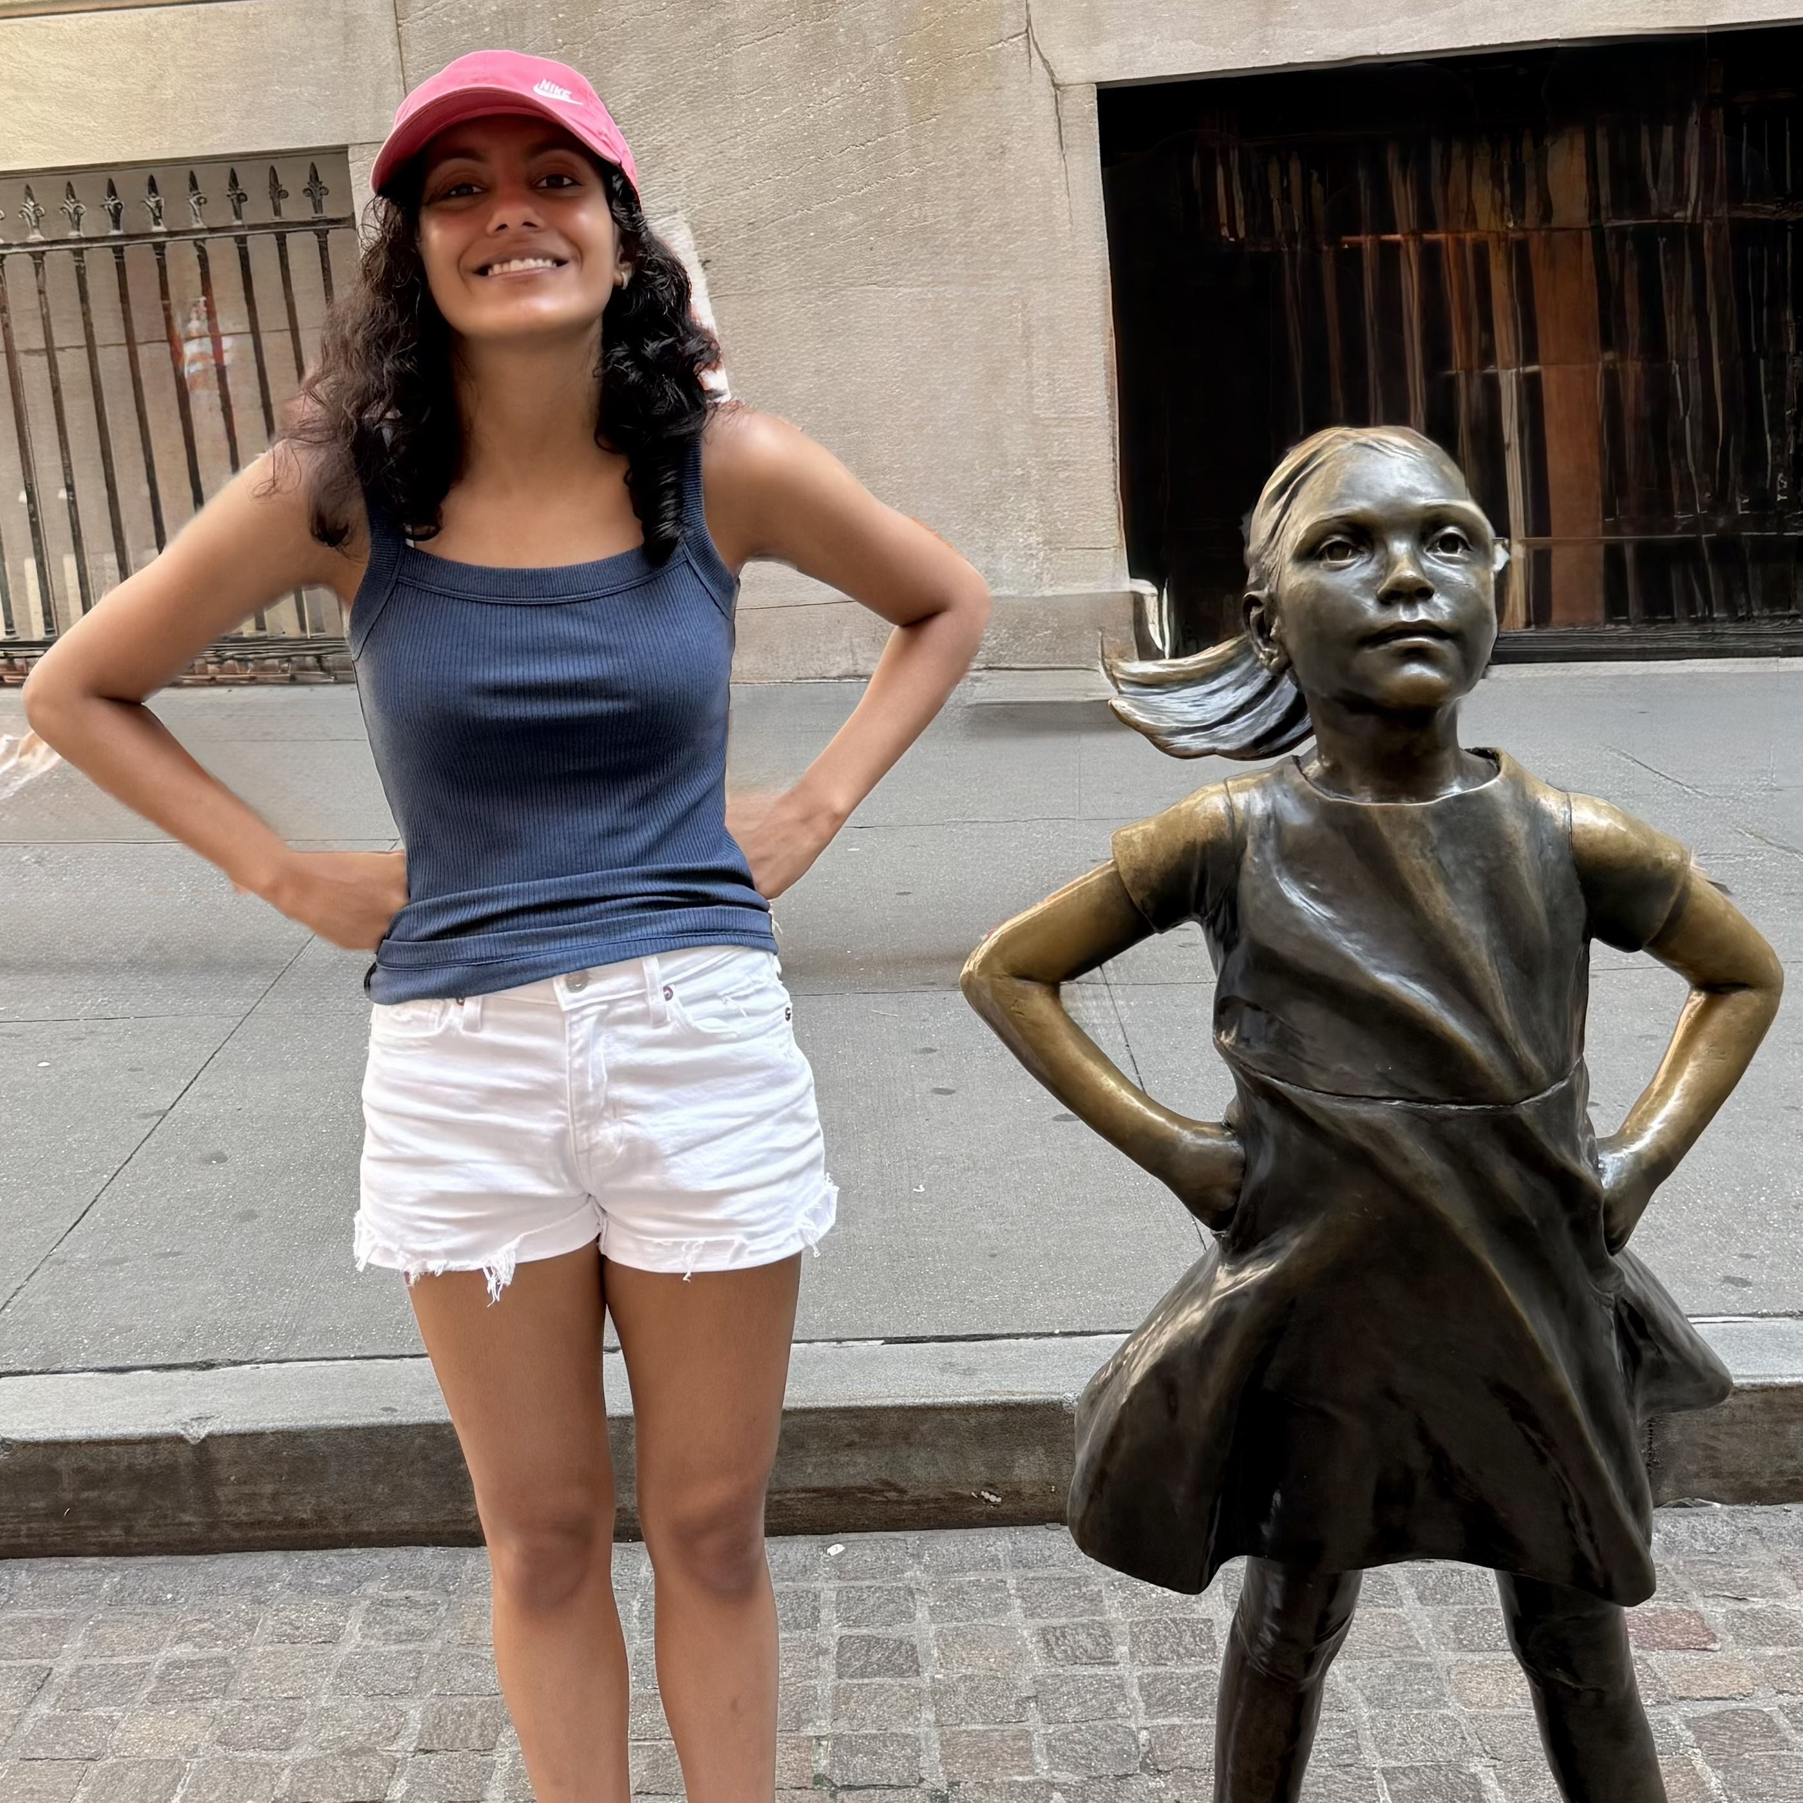
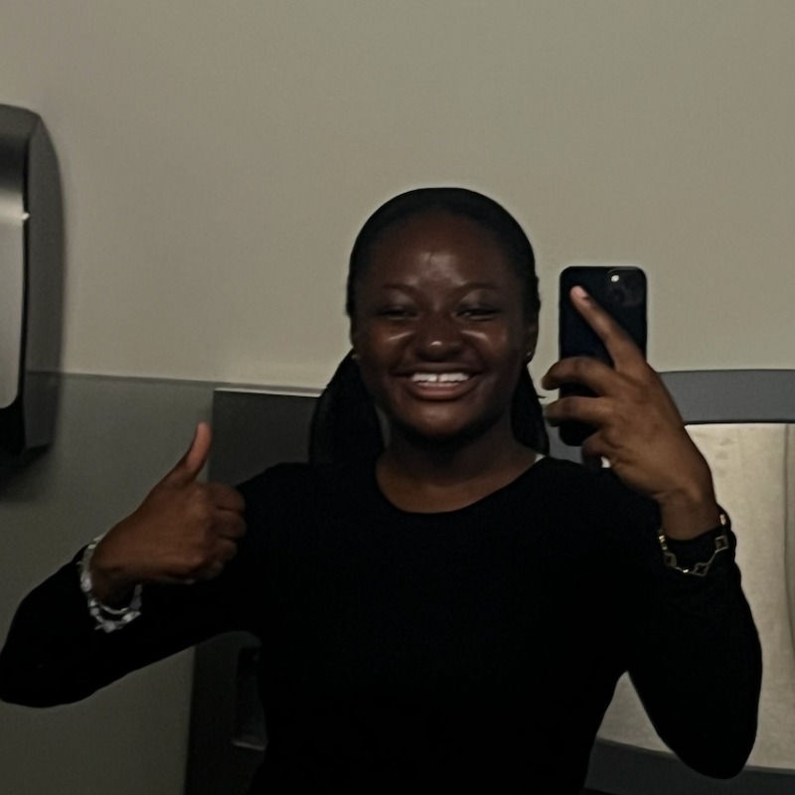
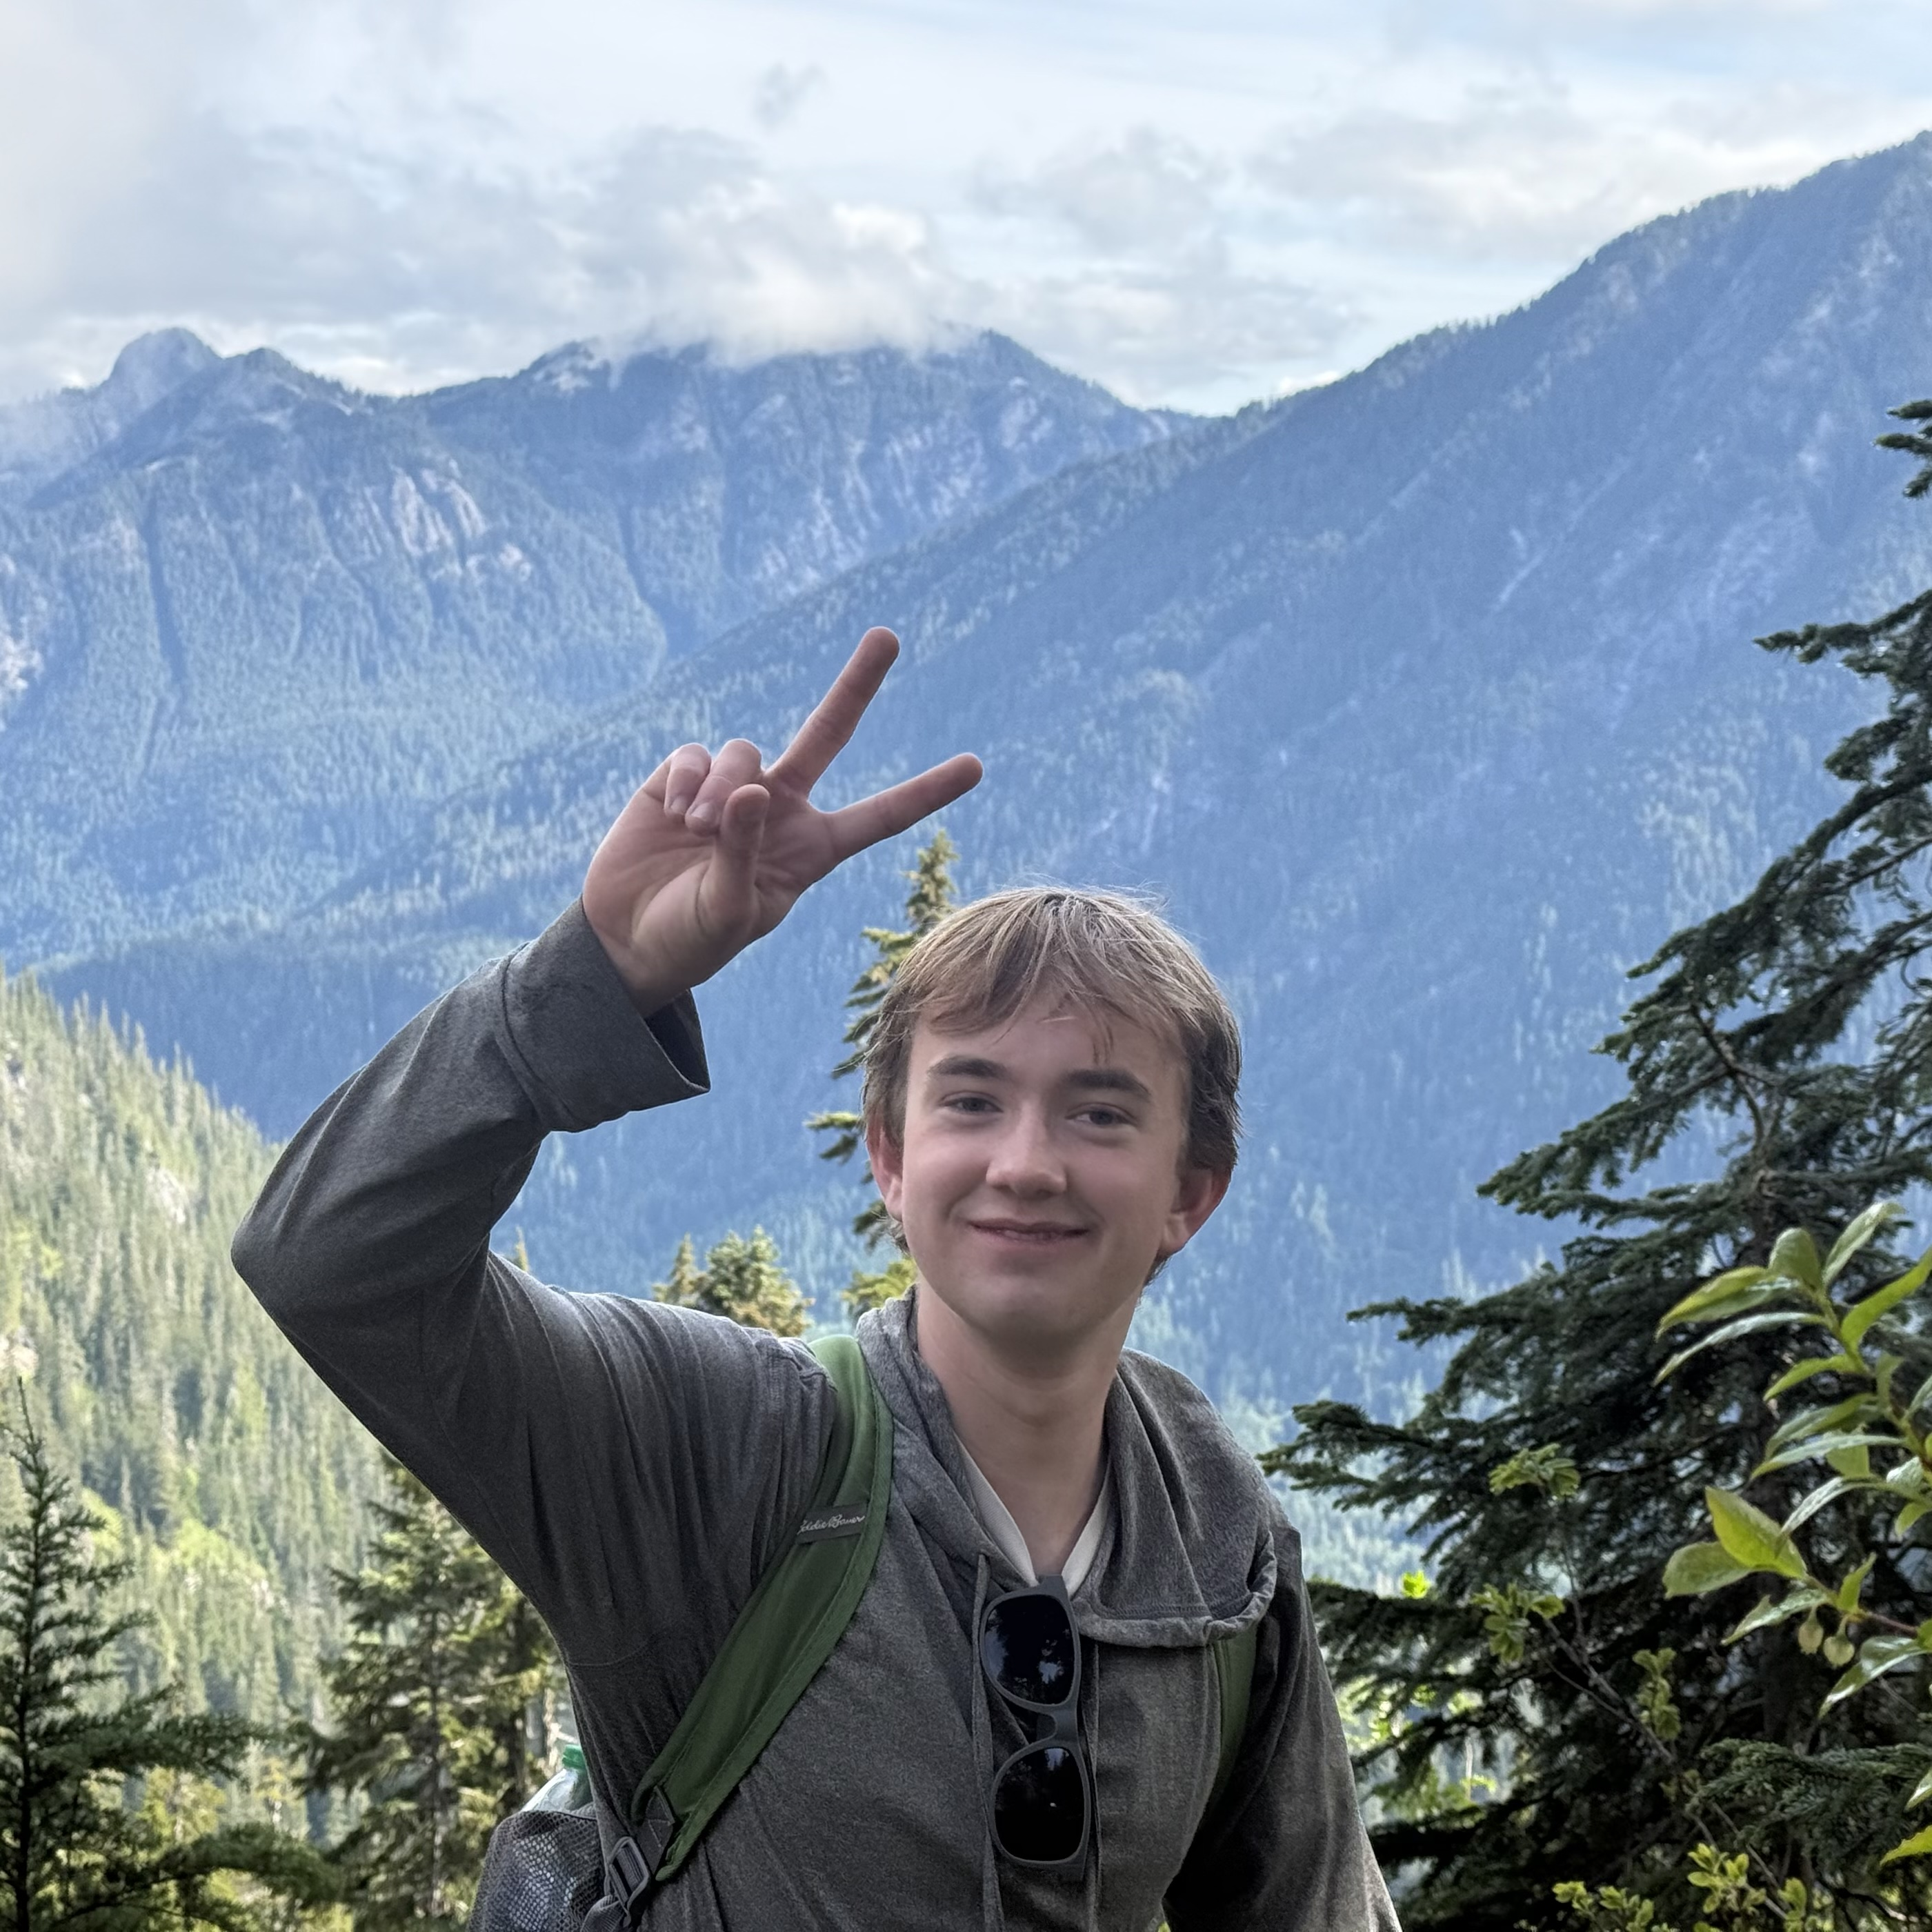
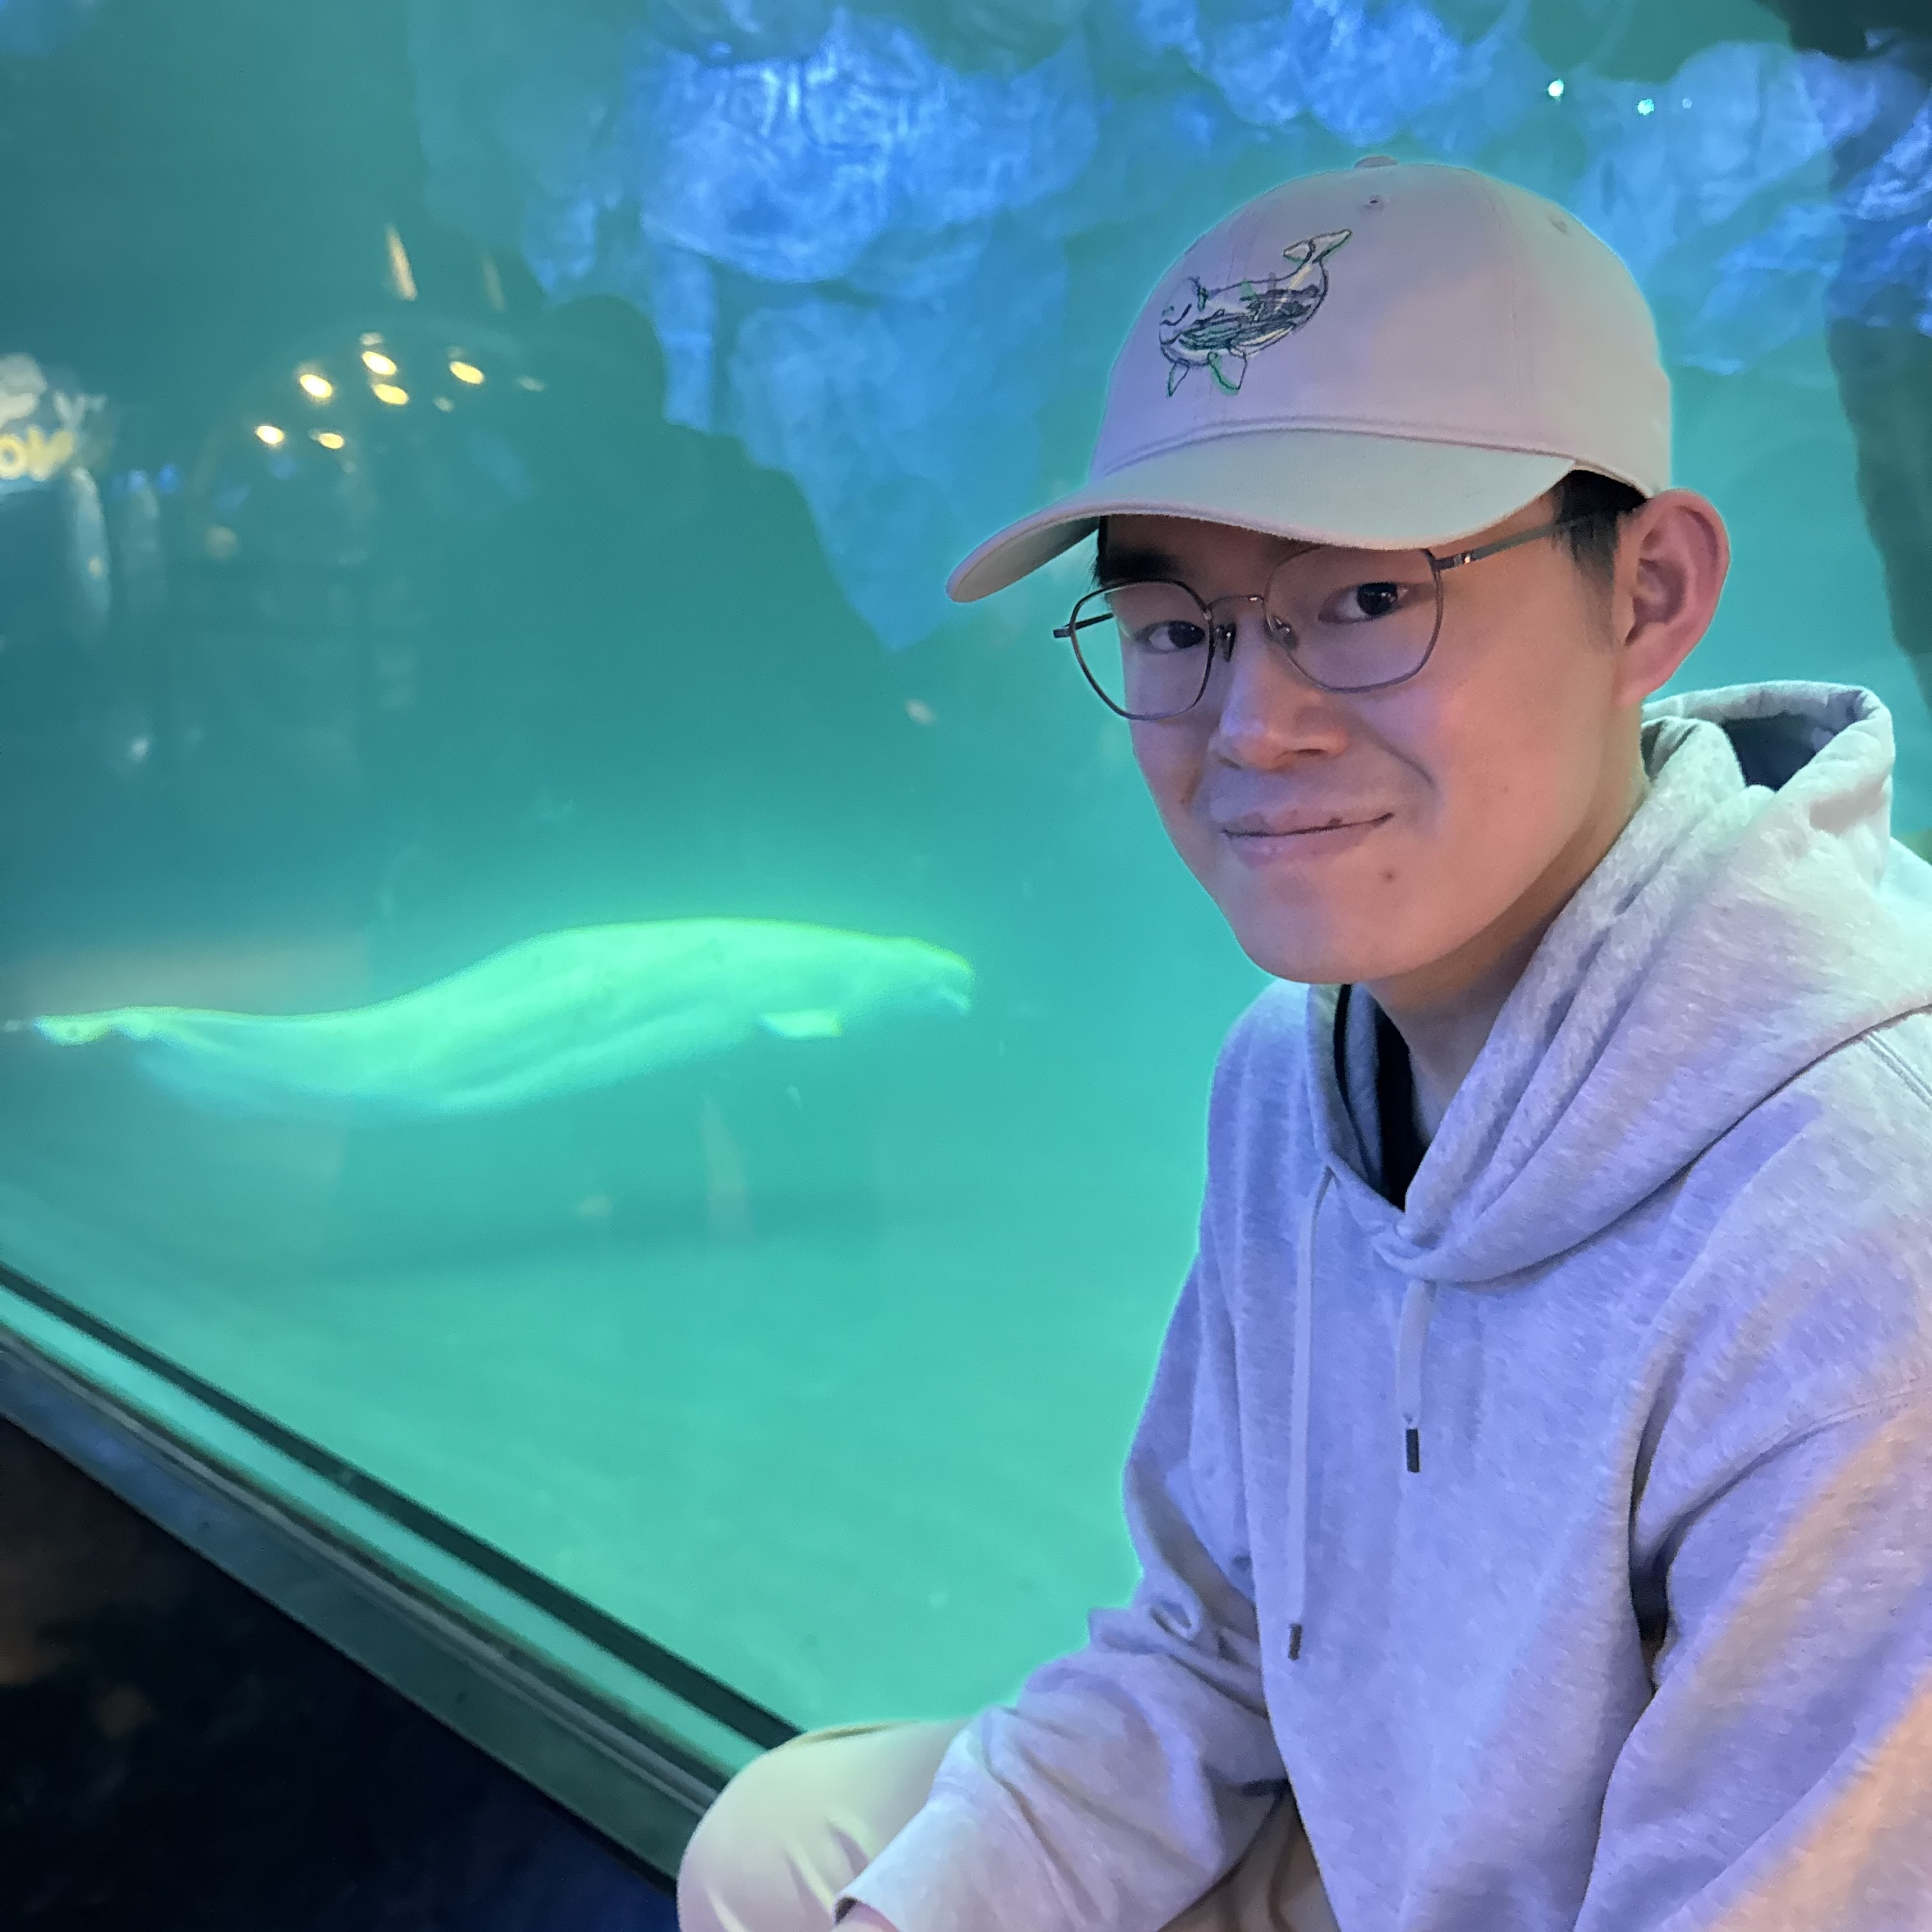
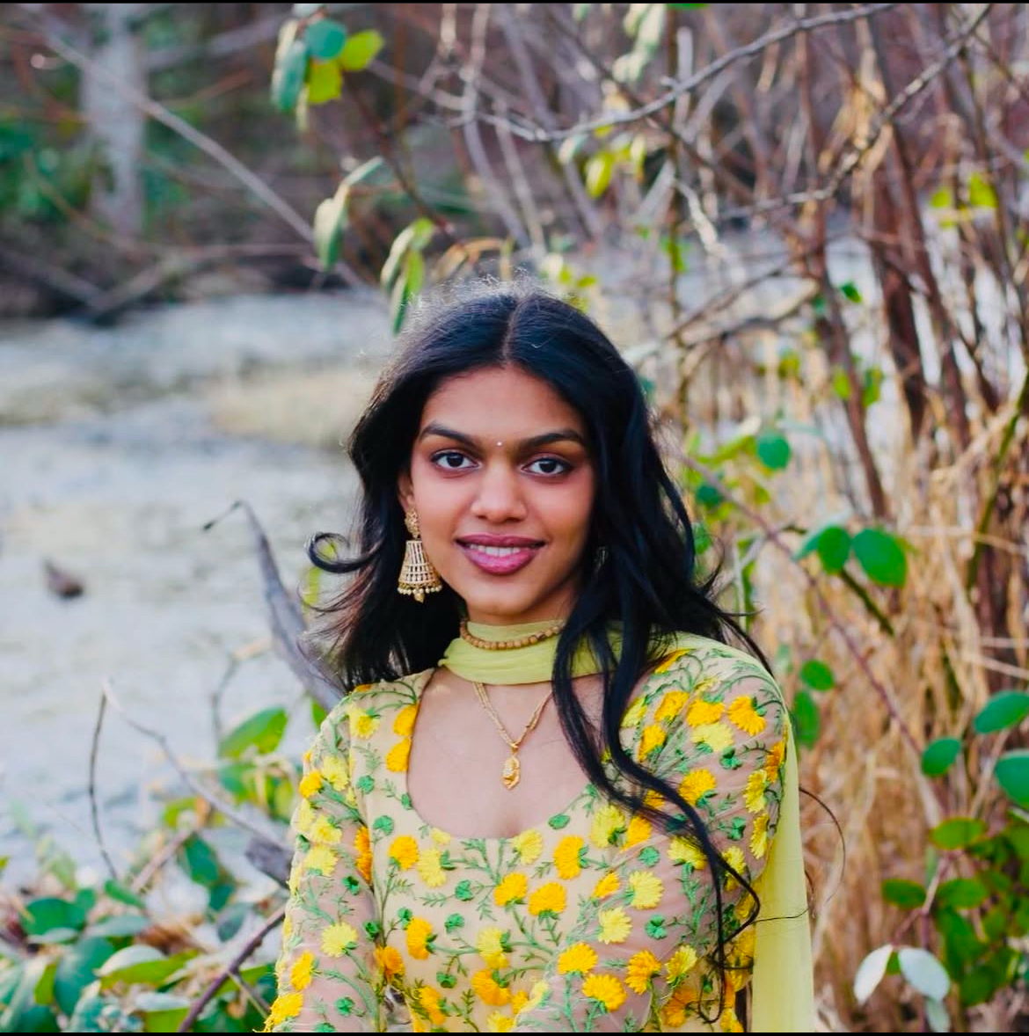
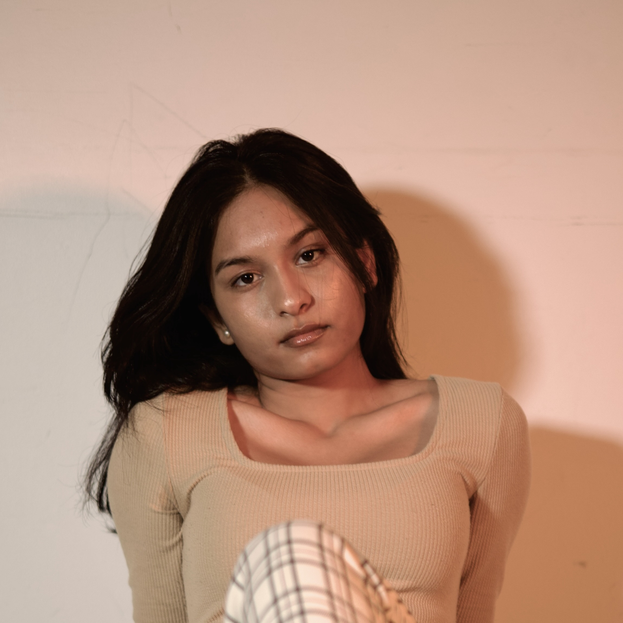

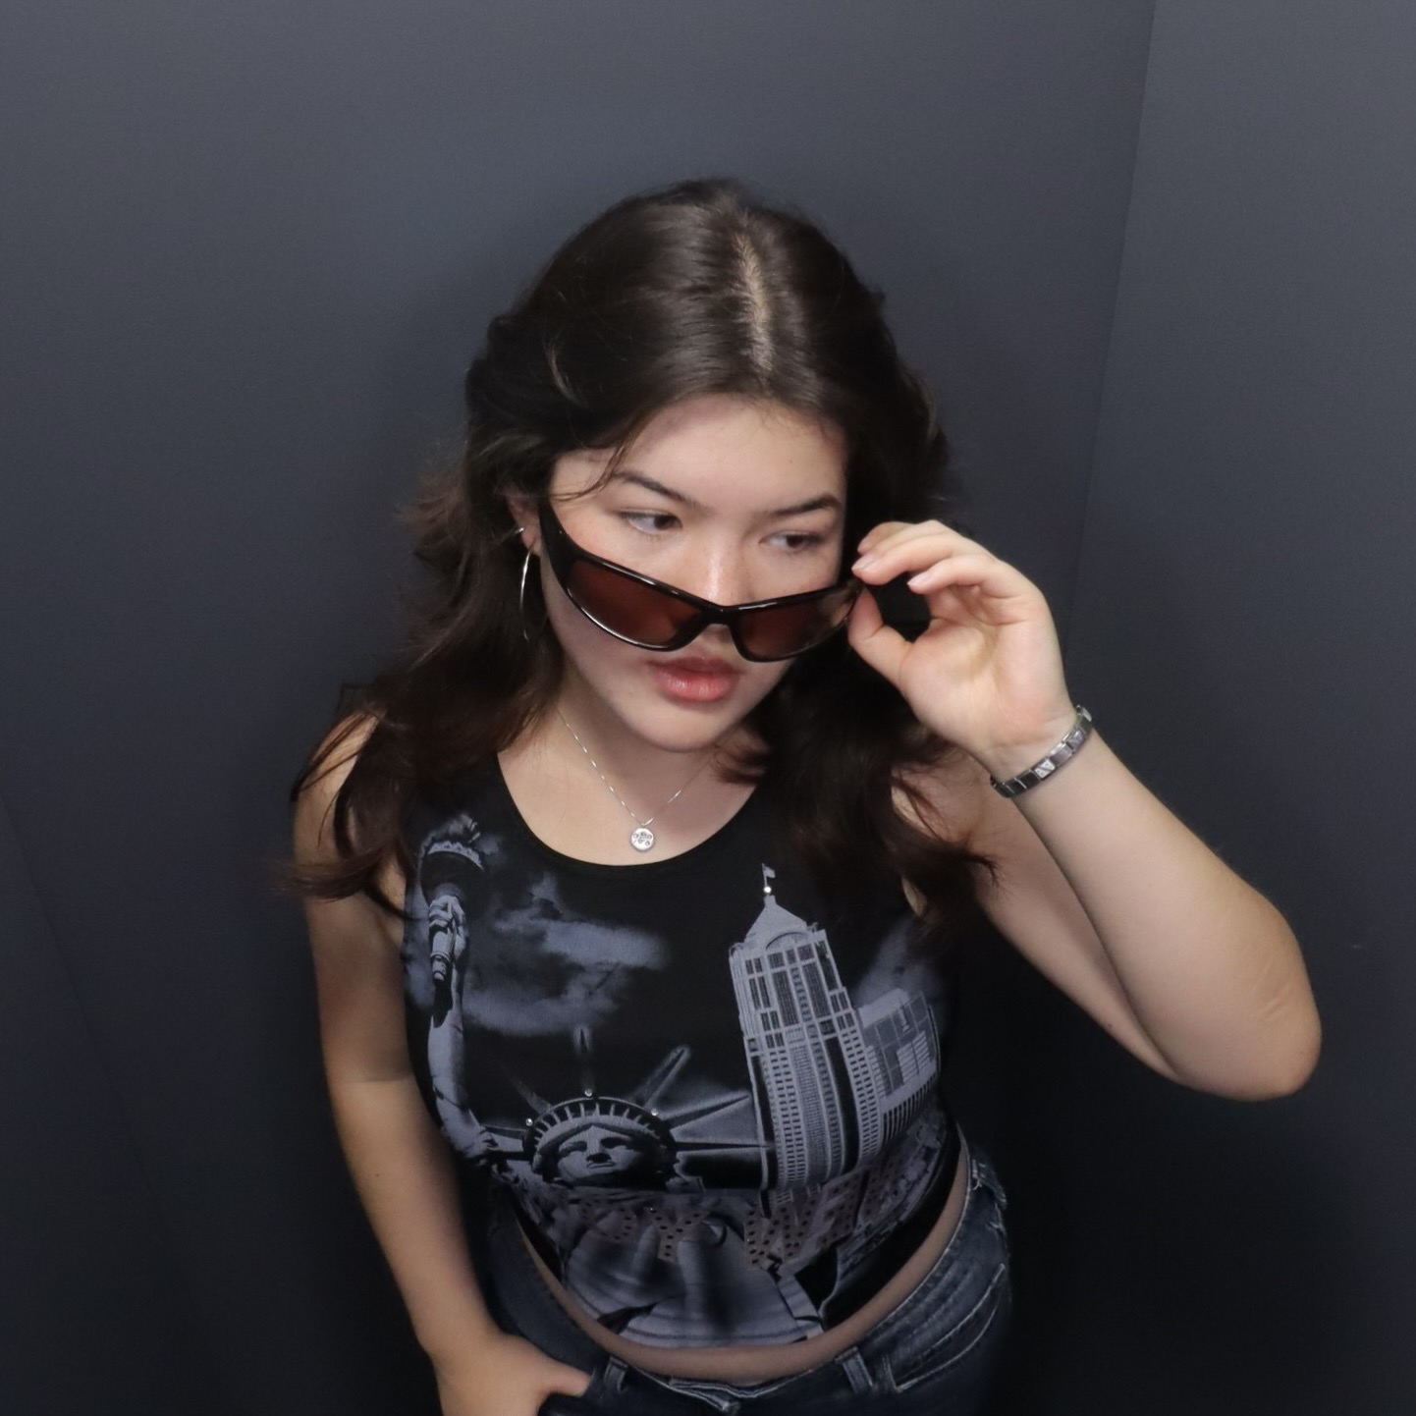

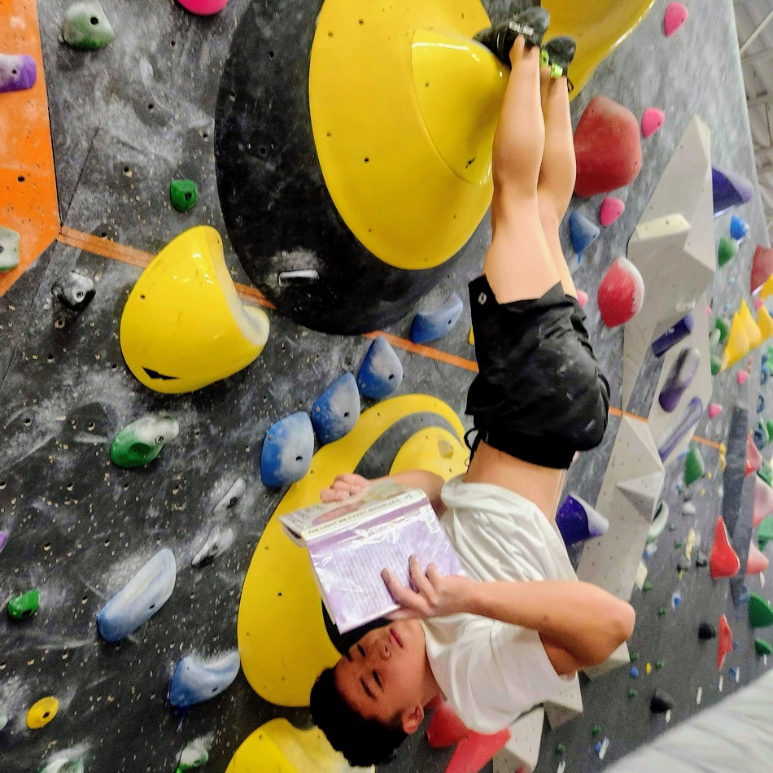
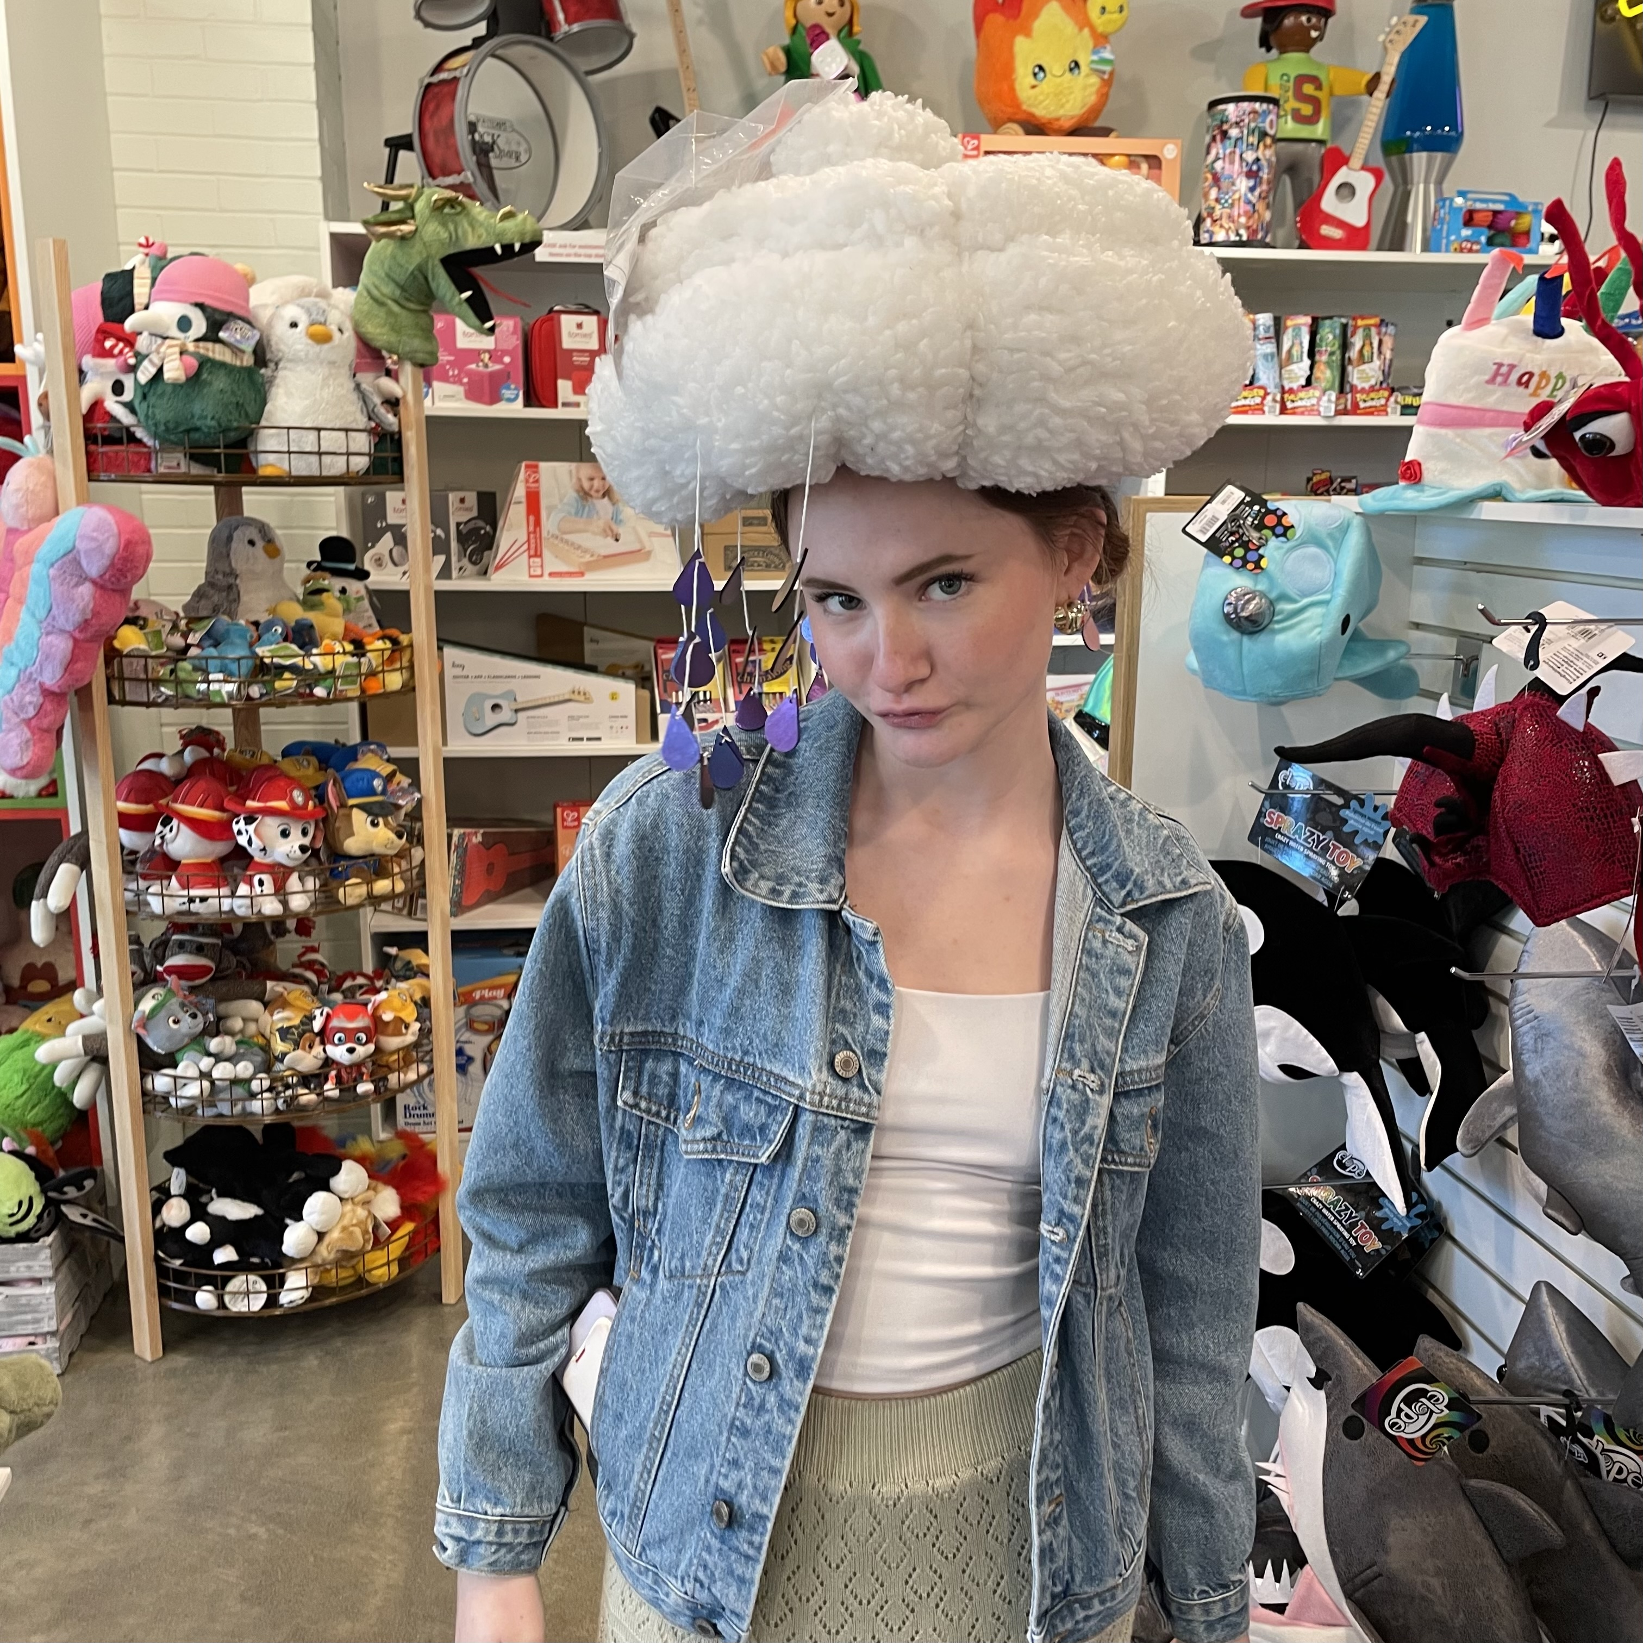
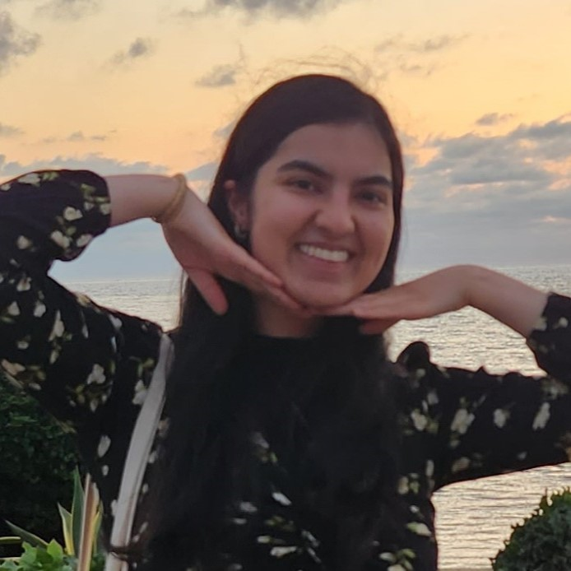
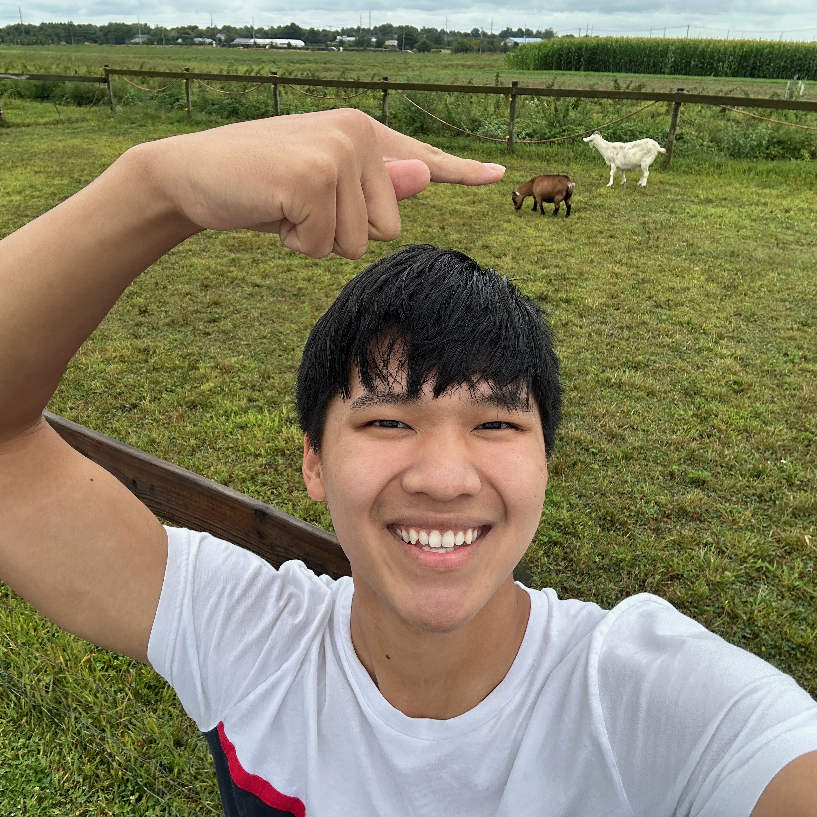
Thank your TAs!
Notes:
Brett

Slide 11
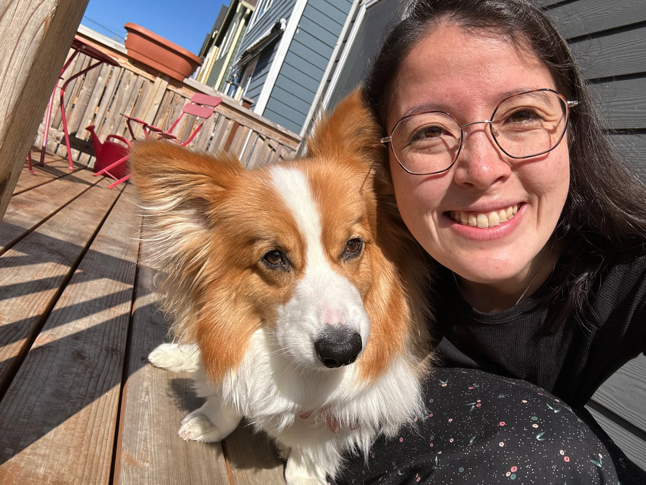
Thank You!
Thank you for participating, asking questions, engaging with course materials & resources!
  And thank you for the feedback if you filled out the course evaluation :)
Thank your amazing TAs!
Any final questions before we wrap?

