Slide 1
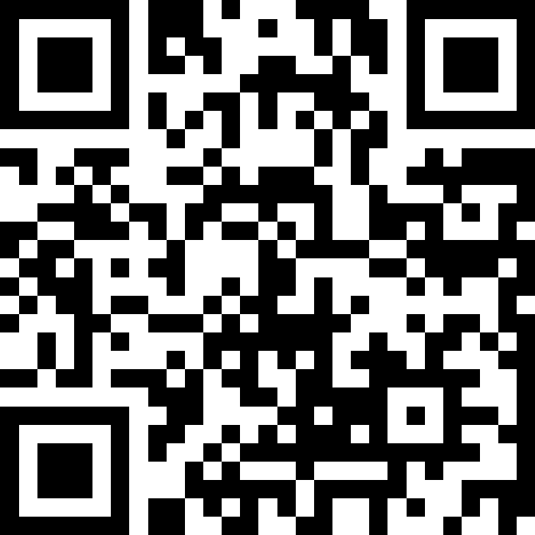
Machine Learning
BEFORE WE START
What is your favorite beverage?
Respond on sli.do!
Instructor:
Miya Natsuhara
Arohan
Sreshta
Rushil
Sean B
Chloe
Jenny
Nate
Saachi
Hawa
Maggie
Sean E
Shiven
Vrinda
Gavin
Shreya
Jonah
Renee
Chris
Ishita
Kuhu
Kavya
Misha
Yuntong
Amiya
Sahana
Anirudh
Rohan
Crystal
Eeshani
Prakshi
Aidan
Cora
Nhan
Anya
Anisha
Trien
Neal
Evan
Rena
TAs:
Music : 🌻 CSE 123 26sp Lecture Tunes 🌻
Notes:
Slido event: https://app.sli.do/event/qMWvNjpjho4uZTeNfvZBoM
Or
Slido.com and event code cse123

Slide 2
Announcements
Programming Assignment 3 out, due next Friday! (May 29)
Resubmission 5 closes tonight
Eligible assignments: P1, C2
Monday (May 25) is a university holiday, so campus is closed
No Miya office hours
IPL is closed
Ed message board will still be available, but may have slower response times
Quiz 2 next Tuesday (May 26)
Check your section participation in Gradescope!
If something looks incorrect, reach out to your section TA

Slide 3
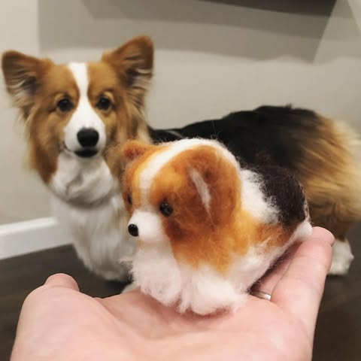
Feedback & Closing the Loop: The Good
Quiz sections, the IPL, and your TAs!
Project-based assignments
Lectures, interactive activities, and live coding
Resubmissions
PCMs

Slide 4

Feedback & Closing the Loop: Suggestions
Suggestions that we’re already working on:
PCM walkthrough videos
Adjustments to the course calendar (resub period, assignment spacing)
Resources for quizzes
Other suggestions…
Both faster and slower pacing?

Slide 5

Feedback & Closing the Loop: Reminders
Minimum grade guarantees
Minimum Grade Guarantee Calculator
General Grading rubrics on the course website
Building of knowledge + skill
PCM: introduction
Lecture: reinforcement + initial guided practice
Section: practice with minimal guidance
Assessments: learn by applying!

Slide 6
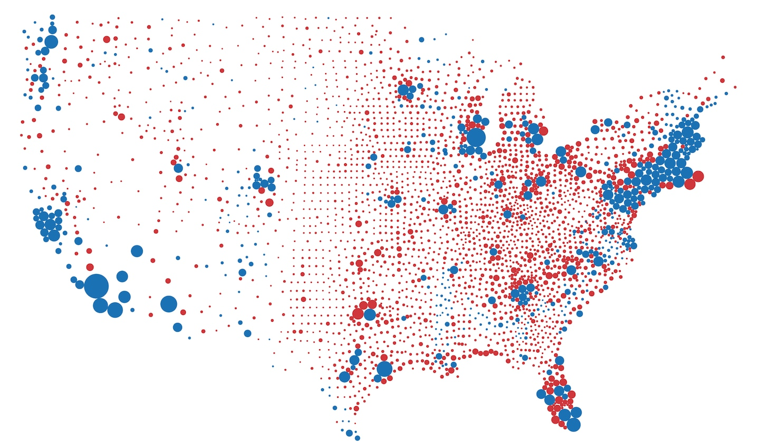

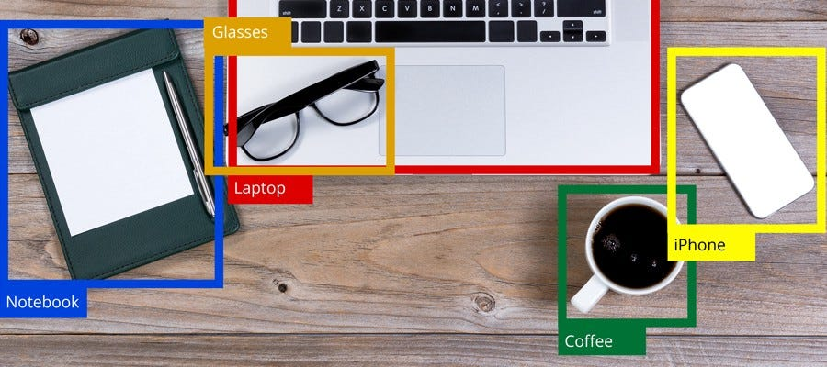

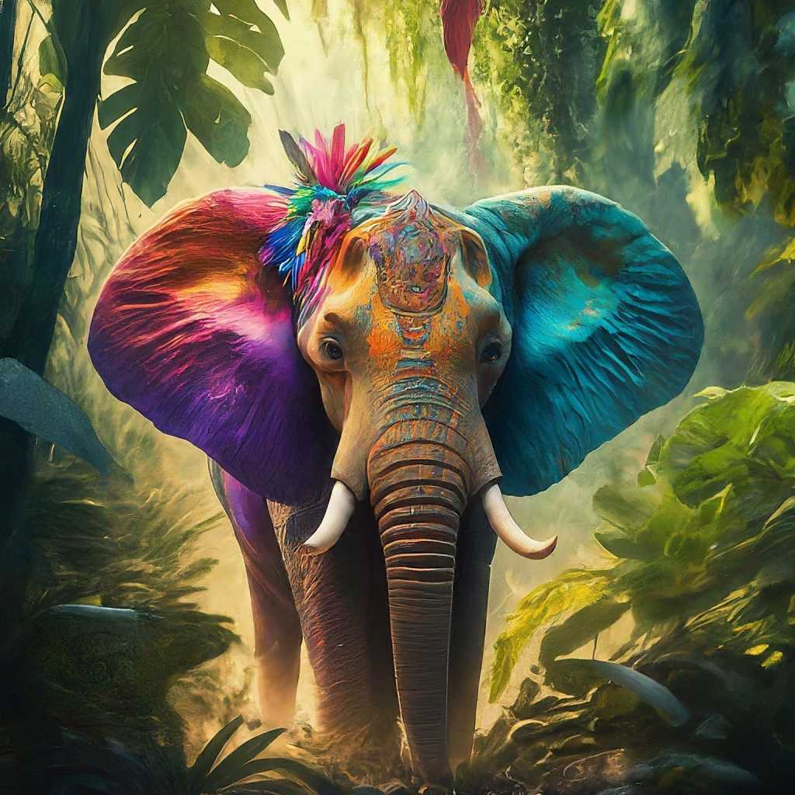
Applications of ML
Opinion Polls
How does a population feel about an issue?
Content Recommendation
Can we predict how much someone will like a movie based on past ratings?
Object Recognition
Identify {Car, Road, Plane, Bird, Person} within an image?
Text Generation
Can computers generate text written like a human?
Image Generation
Can computers generate images from a prompt
Estimation
Prediction
Generation

Slide 7
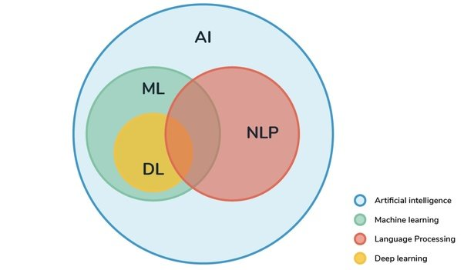
What is Machine Learning (ML)? Related fields
Subset of Computer Science concerned with “learning” data trends
(Today’s lecture will not be tested on quizzes/exams.)
MATH!!!

Slide 8
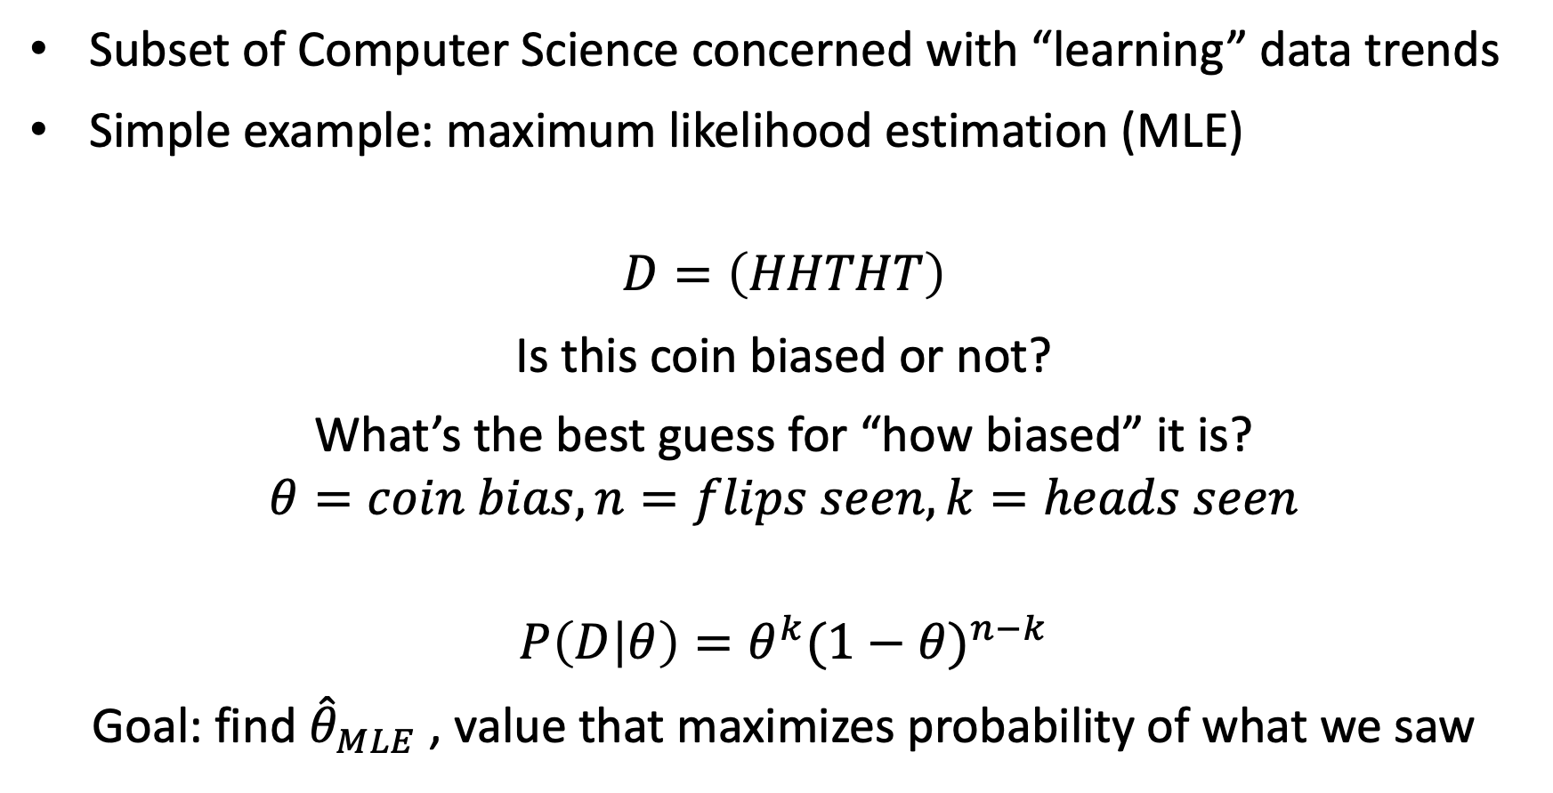
What is Machine Learning (ML)? Math premise
Subset of Computer Science concerned with “learning” data trends
Simple example: maximum likelihood estimation (MLE)
$$D=\left(HHTHT\right)$$
Is this coin biased or not?
What’s the best guess for “how biased” it is?
$$θ=coin bias, n=flips seen, k=heads seen$$
$$P\left(D | θ\right)=θ^{k}{(1−θ)}^{n−k}$$
Goal: find ${\hat{θ}}_{MLE}$ , value that maximizes probability of what we saw

Slide 9

Maximum Likelihood Estimation: Step 1
$$P\left(D | θ\right)=θ^{k}{(1−θ)}^{n−k}$$
$${\hat{θ}}_{MLE}={argmax}_{θ} P(D|θ)$$
$$\frac{∂}{∂θ}\left(θ^{k}{(1−θ)}^{n−k}\right)=0$$
$$kθ^{k−1}{(1−θ)}^{n−k} − \left(n−k\right)θ^{k}{\left(1−θ\right)}^{n−k−1}=0$$

Slide 10

Maximum Likelihood Estimation: Step 2
$$kθ^{k−1}{(1−θ)}^{n−k}= \left(n−k\right)θ^{k}{\left(1−θ\right)}^{n−k−1}$$
$$k(1−θ)= \left(n−k\right)θ$$
$$k=nθ$$
$${\hat{θ}}_{MLE}=k/n$$
Takeaway: There are formal, mathematical ways to verify intuition!
+ We can perform this process with more complicated distributions!

Slide 11
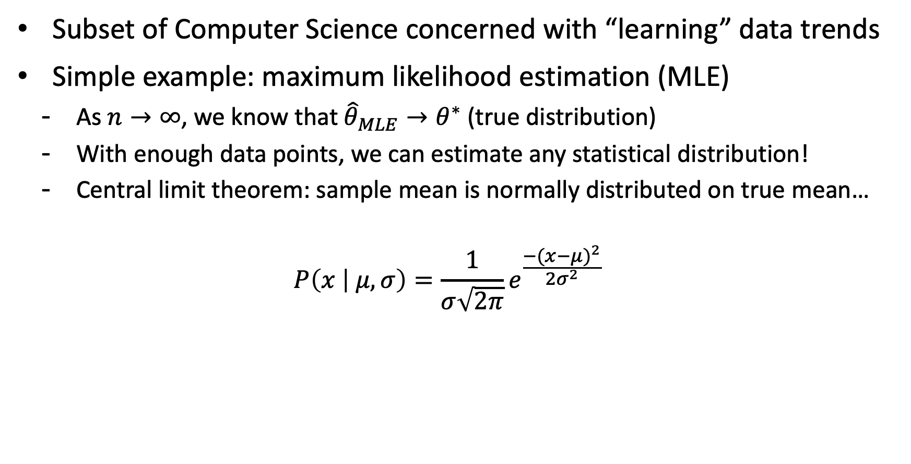
What is Machine Learning (ML)? Math conclusions
Subset of Computer Science concerned with “learning” data trends
Simple example: maximum likelihood estimation (MLE)
As $n→∞$, we know that ${\hat{θ}}_{MLE}→θ^{∗}$ (true distribution)
With enough data points, we can estimate any statistical distribution!
Central limit theorem: sample mean is normally distributed on true mean…
$$P\left(x | μ,σ\right)=\frac{1}{σ\sqrt{2π}}e^{\frac{{−(x−μ)}^{2}}{2σ^{2}}}$$

Slide 12
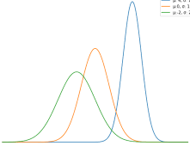
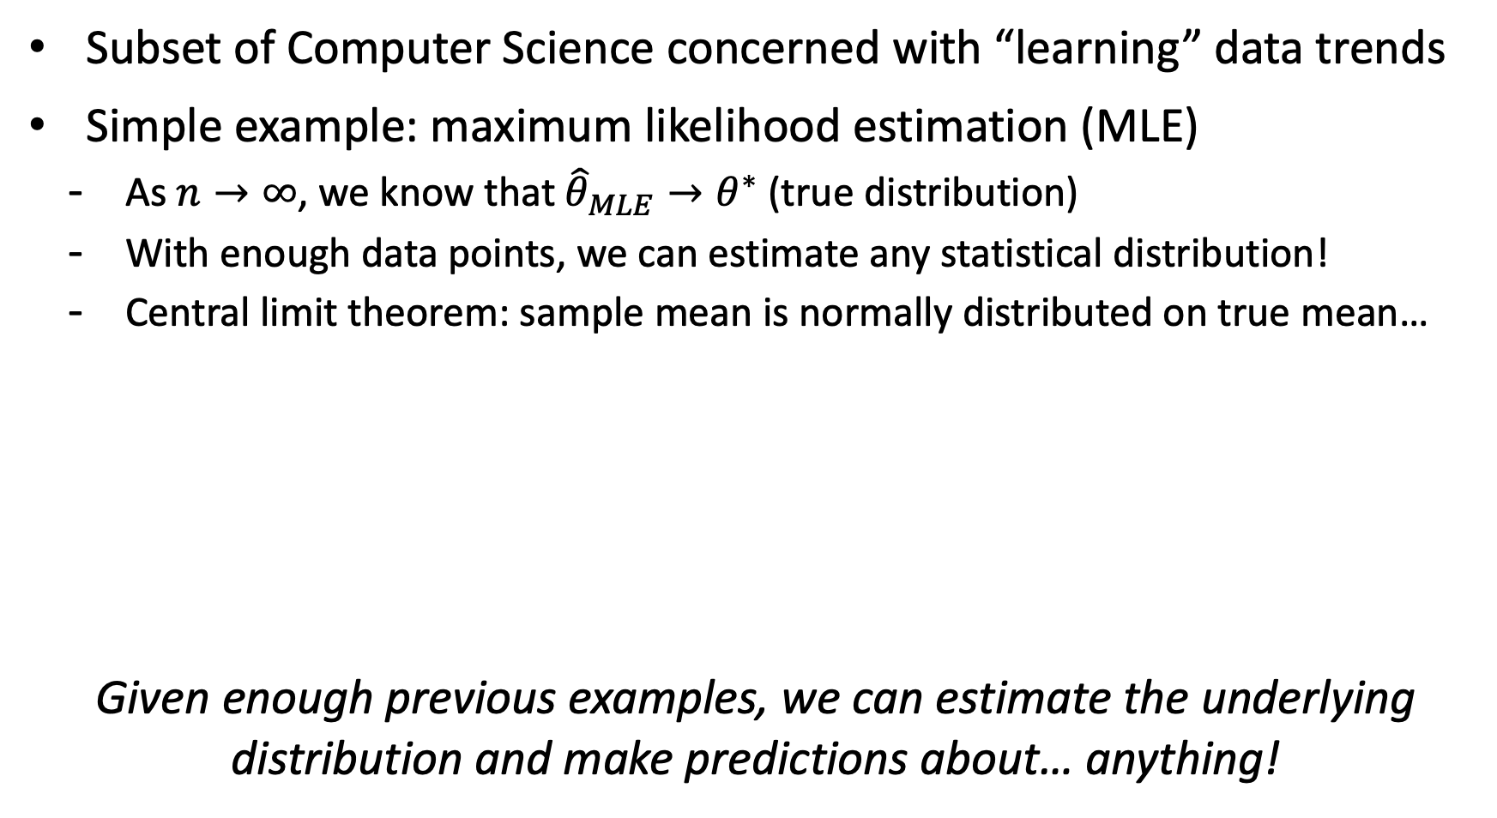
What is Machine Learning (ML)? Making predictions
Subset of Computer Science concerned with “learning” data trends
Simple example: maximum likelihood estimation (MLE)
As $n→∞$, we know that ${\hat{θ}}_{MLE}→θ^{∗}$ (true distribution)
With enough data points, we can estimate any statistical distribution!
Central limit theorem: sample mean is normally distributed on true mean…
Given enough previous examples, we can estimate the underlying distribution and make predictions about… anything!

Slide 13





ML Pipeline
Generally, building an ML model involves the following steps:
Notice that you can step backwards!
ML in particular is an applied science, it’s all an experiment!
Data Collection / Sanitization
Featurization
Model Training / Tuning
Evaluation
Deployment

Slide 14

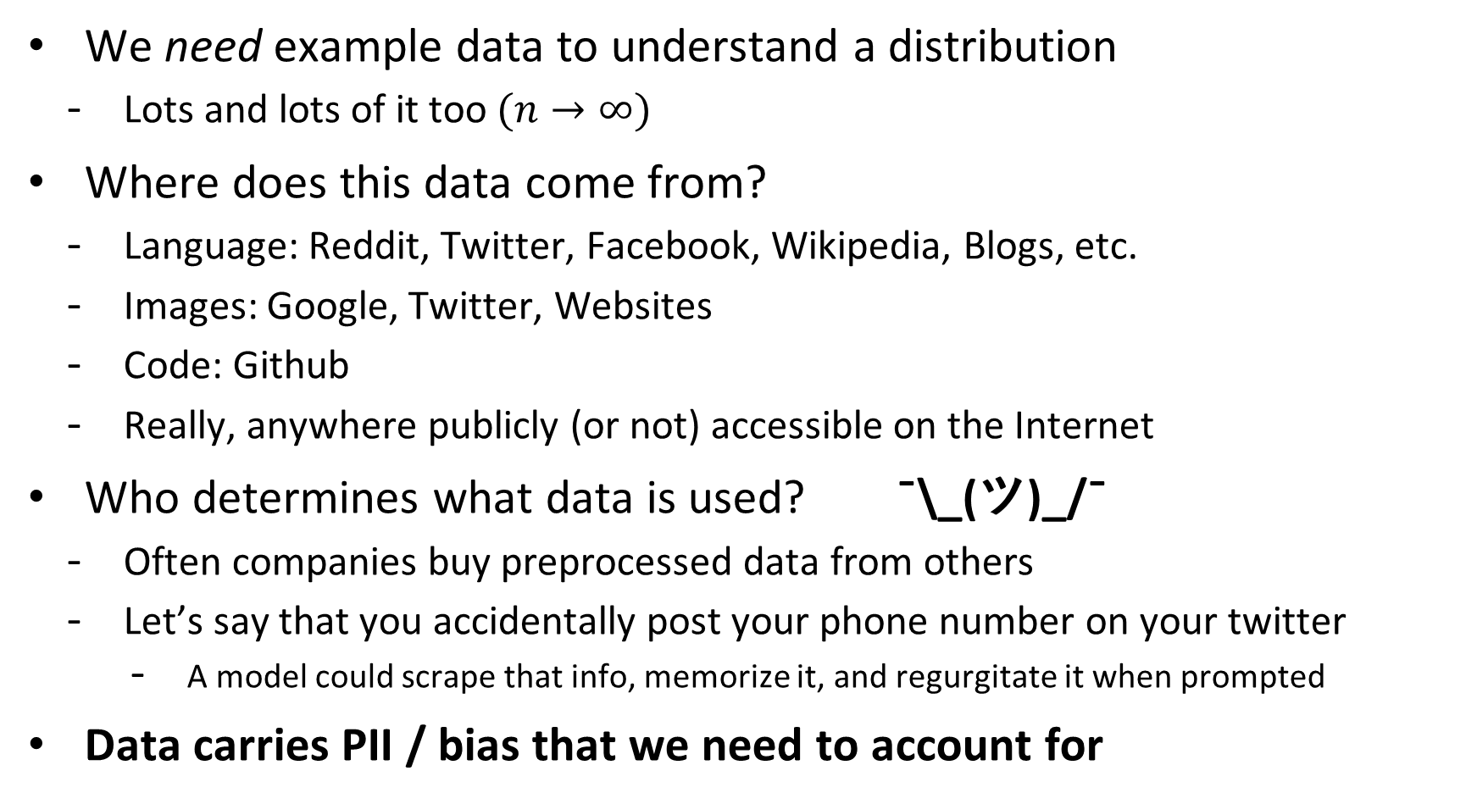
1. Data Collection
We need example data to understand a distribution
Lots and lots of it too $(n→∞)$
Where does this data come from?
Language: Reddit, Twitter, Facebook, Wikipedia, Blogs, etc.
Images: Google, Twitter, Websites
Code: Github
Really, anywhere publicly (or not) accessible on the Internet
Who determines what data is used? ¯\_(ツ)_/¯
Often companies buy preprocessed data from others
Let’s say that you accidentally post your phone number on your twitter
A model could scrape that info, memorize it, and regurgitate it when prompted
Data carries PII / bias that we need to account for

Slide 15
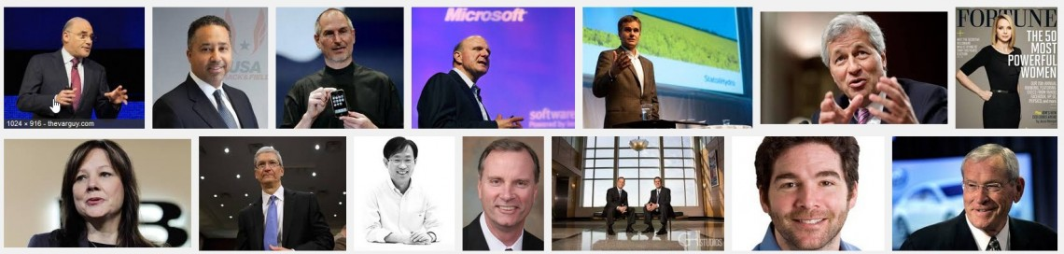
Data Bias: CEO in 2015
Image results for searching the term “CEO” on Google (2015)
Notice anything about the results?
https://www.washington.edu/news/2015/04/09/whos-a-ceo-google-image-results-can-shift-gender-biases/

Slide 16
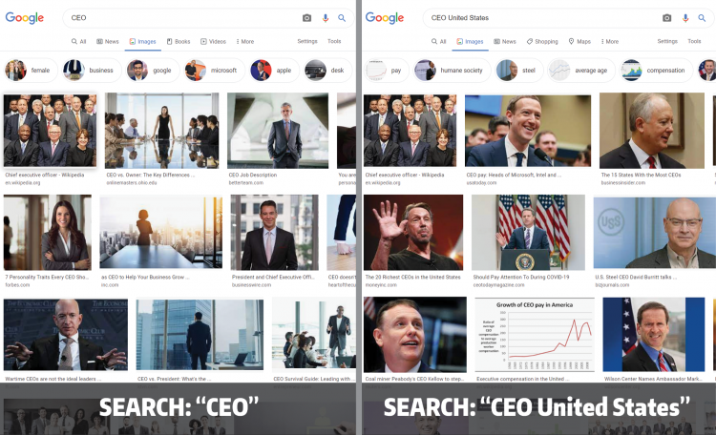
Data Bias: CEO and CEO United States in 2022
Fix: Image results for searching “CEO” and “CEO United States” (2022)
https://www.washington.edu/news/2022/02/16/googles-ceo-image-search-gender-bias-hasnt-really-been-fixed

Slide 17
Data Sanitization
Data carries PII / bias that we need to account for
We don’t want our model to memorize a phone number
Let’s just remove all phone numbers from our inputs!
Is this an effective solution?
Sanitization can be ethically gray – does it disproportionately affect subpopulations?
Correlated features
Our models are only as strong as the data they’re built upon. Garbage in, garbage out.

Slide 18
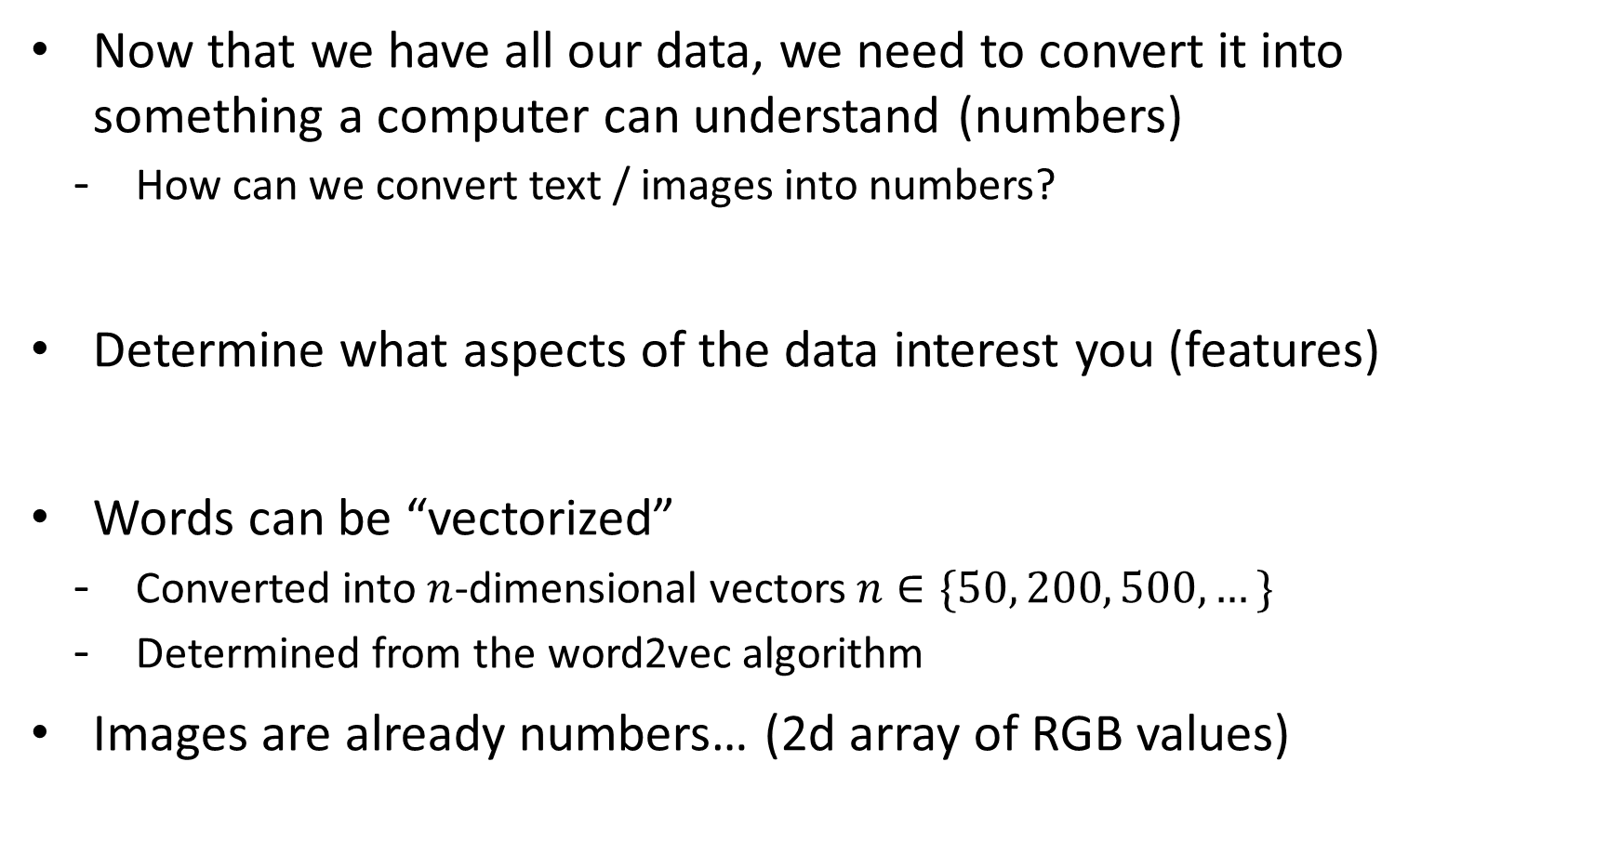
2. Featurization
Now that we have all our data, we need to convert it into something a computer can understand (numbers)
How can we convert text / images into numbers?
Determine what aspects of the data interest you (features)
Words can be “vectorized”
Converted into $n$-dimensional vectors $n∈\{50, 200, 500,…\}$
Determined from the word2vec algorithm
Images are already numbers… (2d array of RGB values)

Slide 19
Word Embeddings
We call these word vectors “embeddings” and they’re pretty interesting to mess around with
Can perform mathematical operations on them
Find the nearest vectors to any given word (synonyms)
Compute comparisons (dog is to puppy as cat is to ___)
Take the difference between puppy and dog (age vector) and add it to cat
Find the nearest vectors to the result and you’ll likely see “kitten”
These operations can further reveal bias
man is to doctor as woman is to ______
Any model trained from biased data points will estimate a biased distribution

Slide 20
3. Model Training
Pick some way of using data to estimate
Lots of different flavors of this
Regression (linear, logistic)
Neural Networks (CNNs, RNNs, Transformer, etc.)
Nearest neighbors
Decision trees
Provide additional computation (memory / GPUs / time) until desired result is achieved
It’s all one big experiment – try options until something sticks.
This should feel somewhat concerning…

Slide 21
4. Evaluation
Does your model actually work?
Typically we split our initial dataset into 3 different subsets:
Train (provided to the model during training)
Validation (used after a model has trained to compare to previous iterations)
Test (used once a model has been chosen to see how it performs)
Determine whether or not your model is over / underfitting
Most ML applications go no further than this step
No attempt to determine why a particular model is working well

Slide 22
5. Deployment
Put your model out into the real world and see what happens
Does it perform the job as expected? Should further work be put into development?
At this point, often the next iteration of refinement takes place
GPT 2.0 -> 3.0 -> 3.5 -> 4.0
Options include:
Collect more data, use more compute, discover better tuning, discover better model
Often, not much effort is put into understanding negative impacts
Case in point: ChatGPT and the education system

Slide 23
ML Pipeline: Iteration and Refinement
That’s it – in essence, that’s how every ML model is created
Does this knowledge change your perspective on ML / AI?
Data Collection / Sanitization
Featurization
Model Training / Tuning
Evaluation
Deployment

Slide 24
Cornbear’s Classifier
Programming assignment will involve part 3 of this pipeline
You’ll implement a decision tree capable of classifying text
Data Collection / Sanitization
Featurization
Model Training / Tuning
Evaluation
Deployment

Slide 25
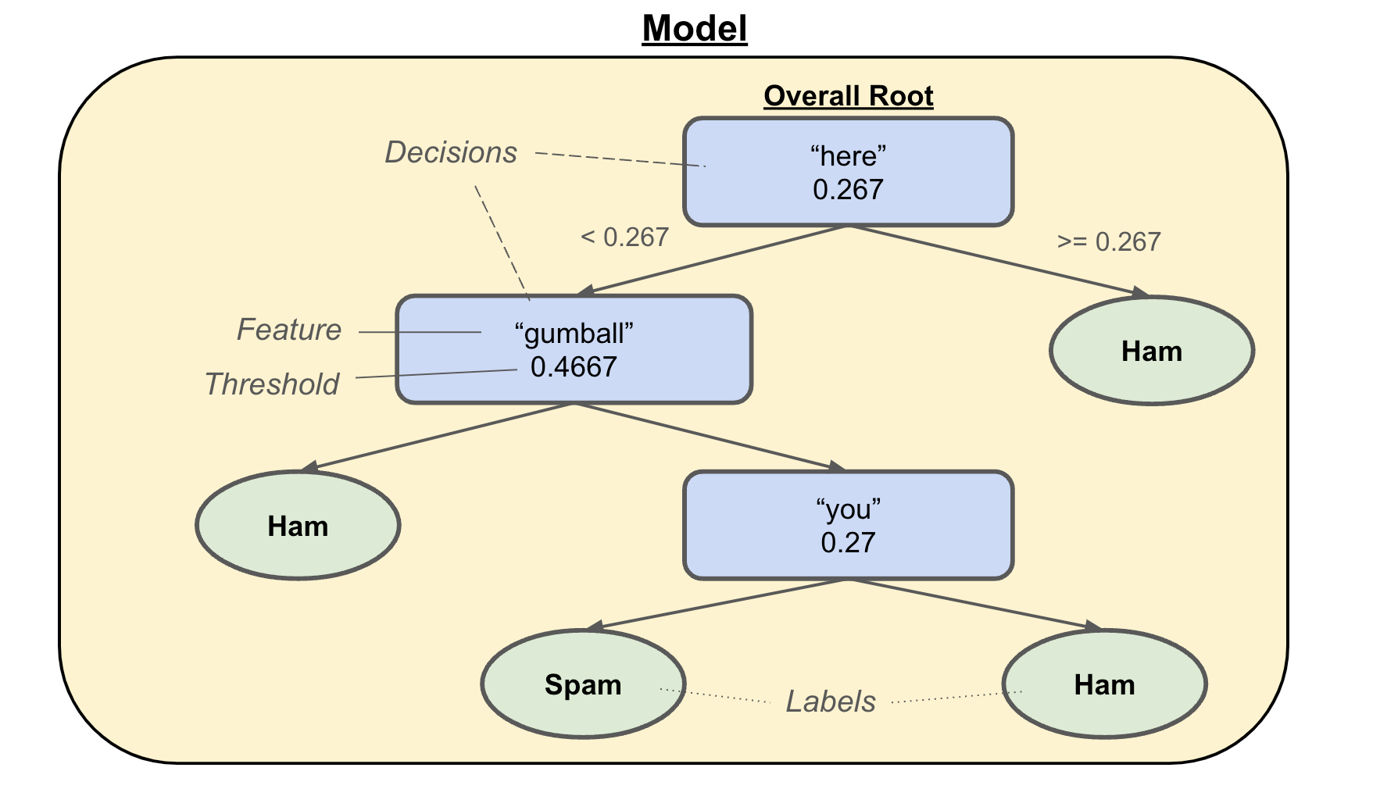
Decision Trees
Tree structure where each intermediary node contains a feature / threshold pair (decision) and leaf nodes are labels

Slide 26
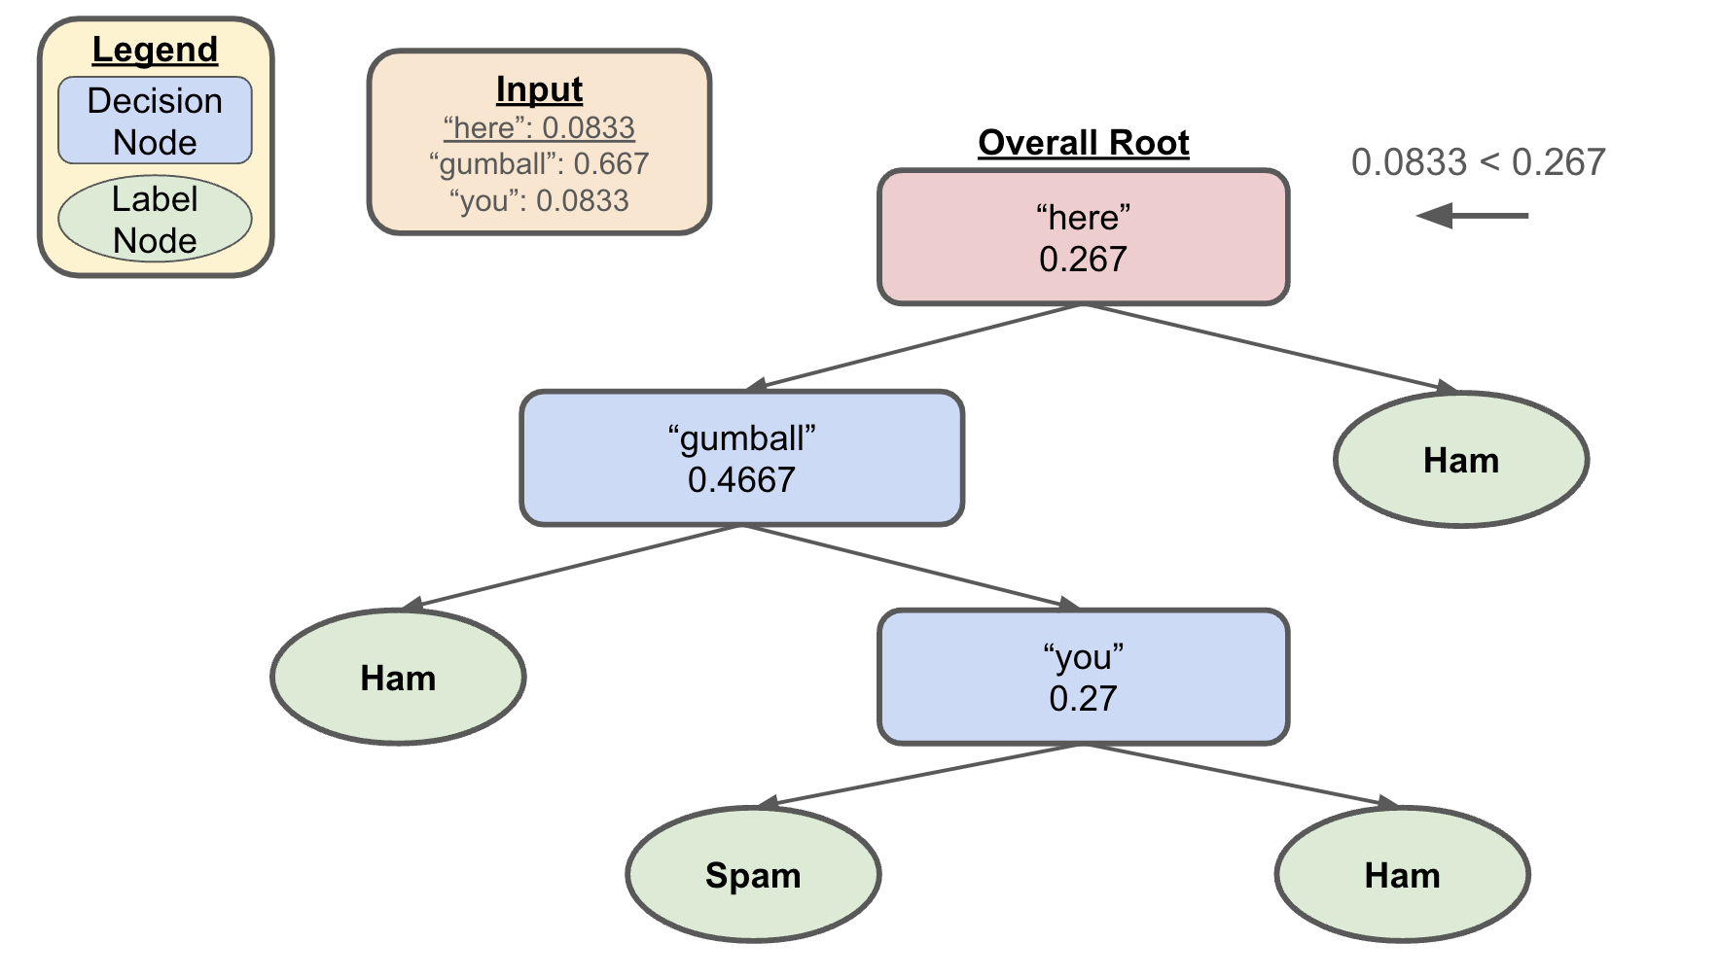
Decision Trees Example: Step 1
Let’s say we wanted to classify the following
here gumball gumball gumball gumball you silly gumball gumball gumball gumball doggo

Slide 27
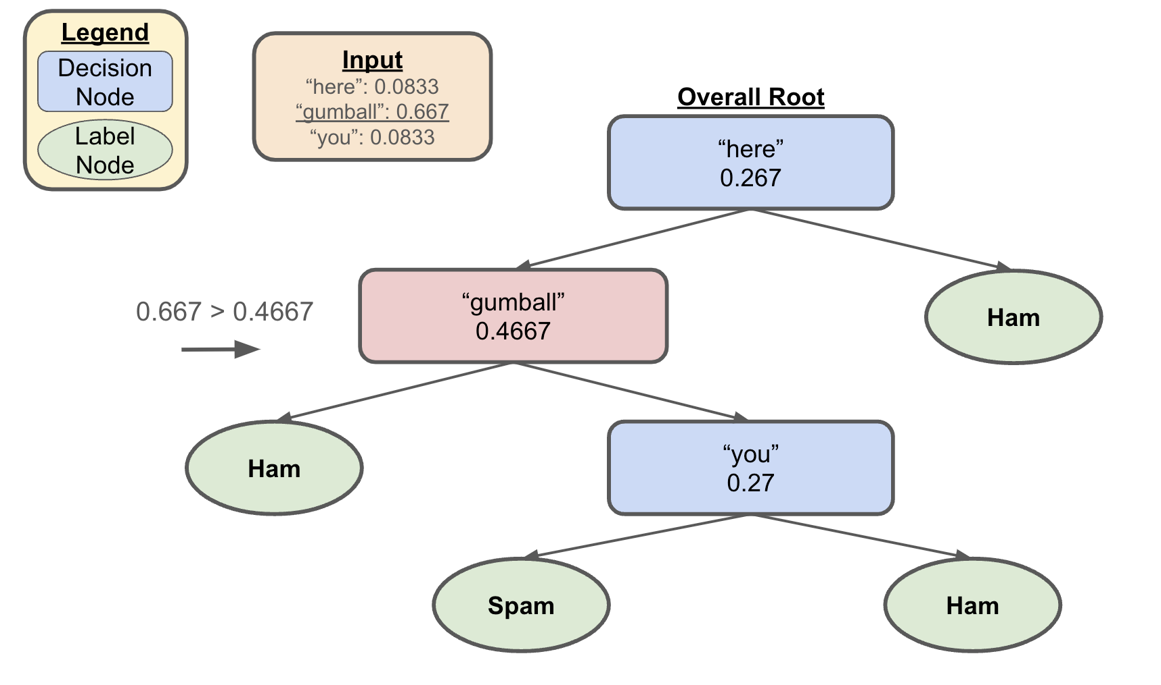
Decision Trees Example: Step 2
Let’s say we wanted to classify the following
here gumball gumball gumball gumball you silly gumball gumball gumball gumball doggo

Slide 28
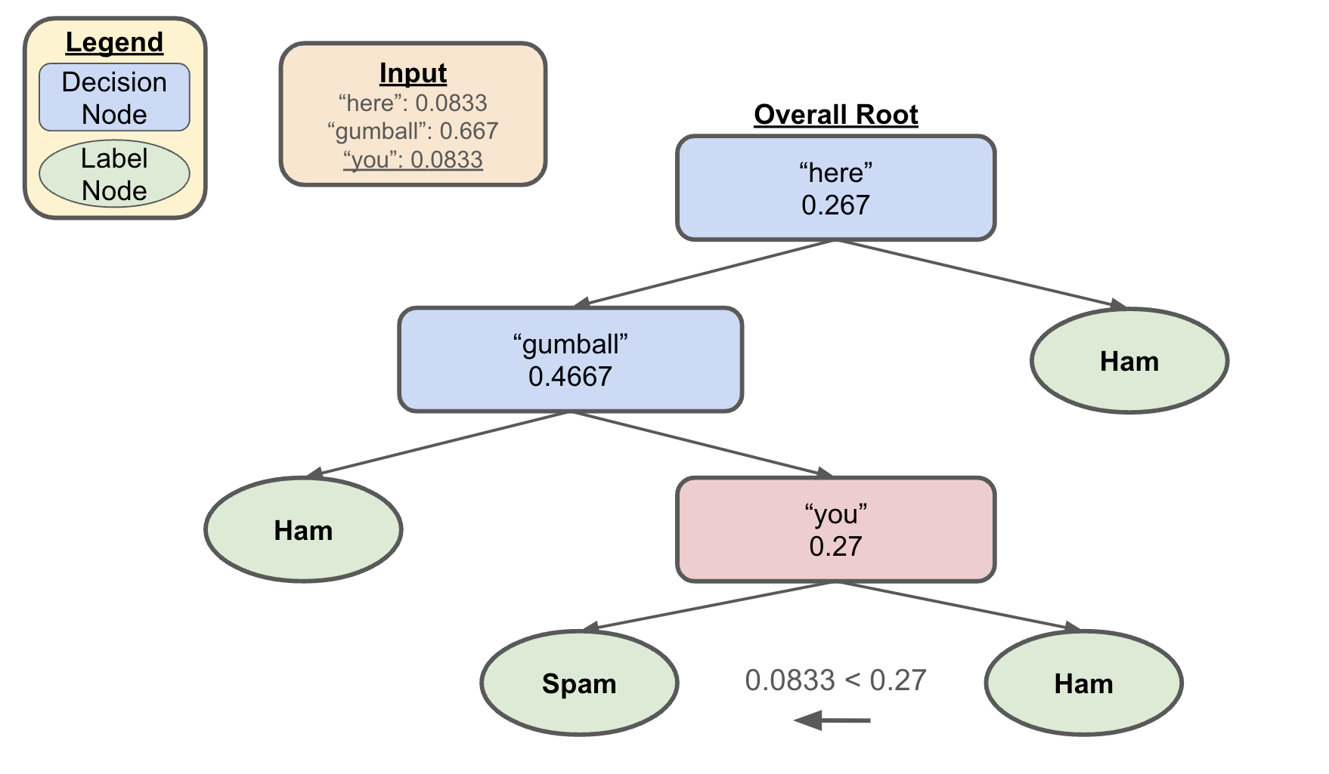
Decision Trees Example: Step 3
Let’s say we wanted to classify the following
here gumball gumball gumball gumball you silly gumball gumball gumball gumball doggo

Slide 29
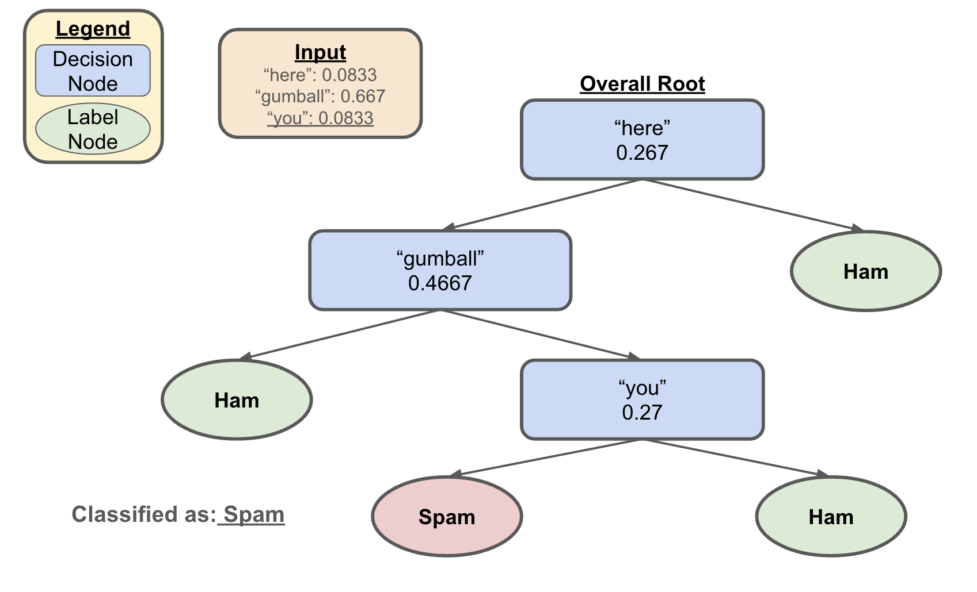
Decision Trees Example: Step 4
Let’s say we wanted to classify the following
here gumball gumball gumball gumball you silly gumball gumball gumball gumball doggo

Slide 30
Questions to Consider
Are ML models capable of “learning”?
i.e. is it possible to “learn” just by observing / memorizing?
Does ChatGPT actually “understand” language?
If all output from ML models is based on previous examples, who gets credit / takes responsibility for generation?
Think AI art and your C2 / P2 reflection responses
What harm could come from deploying ML models we don’t fully understand?
If society itself is biased, how much should we worry about the bias present in data / ML models?
To what extent should concern about bias hinder further advancements?

