Slide 1
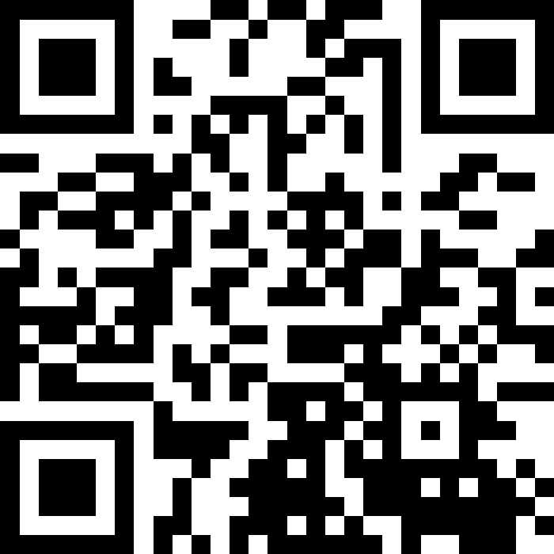
Comparable;
Inheritance
BEFORE WE START
What is your favorite spring activity?
Respond on sli.do!
Instructor:
Miya Natsuhara
Arohan
Sreshta
Rushil
Sean B
Chloe
Jenny
Nate
Saachi
Hawa
Maggie
Sean E
Shiven
Vrinda
Gavin
Shreya
Jonah
Renee
Chris
Ishita
Kuhu
Kavya
Misha
Yuntong
Amiya
Sahana
Anirudh
Rohan
Crystal
Eeshani
Prakshi
Aidan
Cora
Nhan
Anya
Anisha
Trien
Neal
Evan
Rena
TAs:
Music : 🌻 CSE 123 26sp Lecture Tunes 🌻
Notes:
Slide event: https://app.sli.do/event/taUFF6ZBLn61opjEJWJGAh or
Slido.com and event code cse123

Slide 2
Coming up…
❓ Complete the Introductory Survey
  This helps us gather data about the students taking our classes and their backgrounds, to inform future offerings.
💻 The IPL opens Monday, April 6th
  Schedule posted soon
🔎 Creative Project 0: Search Engine out later today!
  Due Wednesday, April 8th, 11:59pm

Slide 3
Lecture Outline: Comparable
Comparable
Inheritance
Assignments and Grading

Slide 4
Comparable
Comparable<E> is an interface that allows implementers to define an ordering between two objects
  Used by TreeSet, TreeMap, Collections.sort, etc.
One required method:
  public int compareTo(E other);
Returned integer falls into 1 of 3 categories
  < 0: this is “less than” other
  = 0: this is “equal to” other
  > 0: this is “greater than” other
a.compareTo(b);
this
other

Slide 5
Subtraction Trick
compareTo implementation when comparing two integers (a) ascending:
This is just subtraction!
What if we wanted to sort descending?
Warning: this only works for integers! Doubles have issues with truncation.
if (this.a < other.a) -> negative number
else if (this.a > other.a) -> positive number
else -> 0
this.a – other.a
other.a – this.a

Slide 6
equals should be consistent with compareTo!
The equals() method returns true if the given parameter is considered equal to this object, and false otherwise.
  Used by lots of library methods! e.g. contains, remove for specific elements, etc.
Let’s do it!
Each class implicitly extends Object, so they inherit an equals method, but it checks for reference equality. (Thanks?)
If you want equals to check for value equality, you need to write this method yourself.

Slide 7
Lecture Outline: Inheritance
Comparable
Inheritance
Assignments and Grading

Slide 8
Which of the following are true? (Select all that apply.): Think
Which of the following are true? (Select all that apply.)
If ClassA extends ClassB, then ClassA is the superclass
Classes can extend multiple classes (e.g. "ClassA extends ClassB, ClassC")
Java will prevent you from writing "ClassA extends ClassB" unless ClassA "is-a" ClassB
You can call a method from the superclass on an instance of the subclass
Notes:
Slido event: https://app.sli.do/event/taUFF6ZBLn61opjEJWJGAh

Slide 9
Which of the following are true? (Select all that apply.): Pair
Which of the following are true? (Select all that apply.)
If ClassA extends ClassB, then ClassA is the superclass
Classes can extend multiple classes (e.g. "ClassA extends ClassB, ClassC")
Java will prevent you from writing "ClassA extends ClassB" unless ClassA "is-a" ClassB
You can call a method from the superclass on an instance of the subclass
Notes:
Slido event: https://app.sli.do/event/taUFF6ZBLn61opjEJWJGAh

Slide 10
Inheritance
Connect together a “subclass” and “superclass”
  Borrow / “inherit” code to reduce redundancy
  super() keyword can be used just like this() (in a constructor)
Syntax: public class Subclass extends Superclass
Should Represent “is-a” relationships
  public class Chef extends Employee
  public class Server extends Employee
In Java, all objects implicitly inherit from the Object class
  toString(), equals(Object), etc.

Slide 11

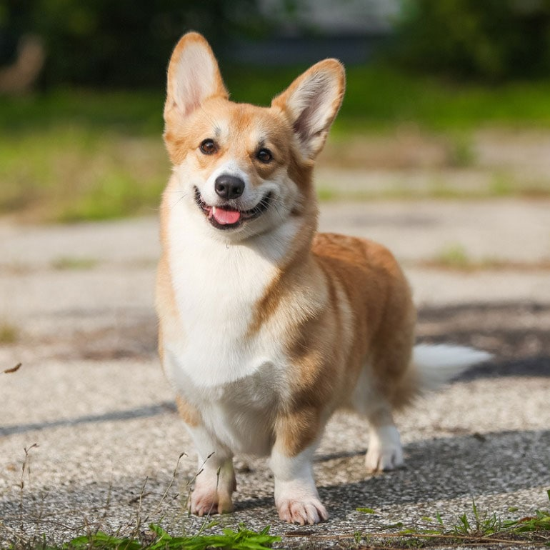



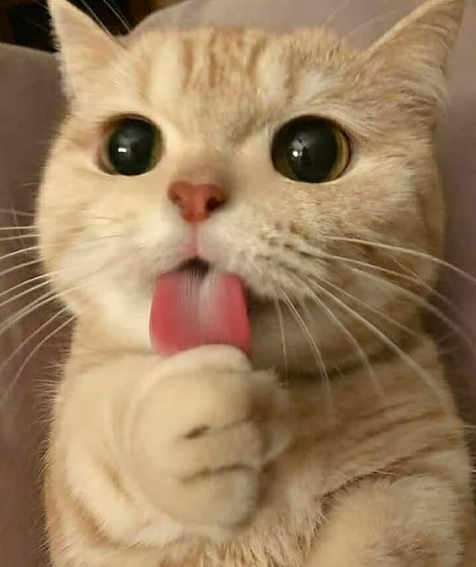

Is-a Relationships
Animal
Fish
Bird
Mammal
Reptile
Amphibian
Dog
Cat
Notes:
Animal: no super classes
Fish: extends Animal
Bird: extends Animal
Mammal: extends Animal
Reptile: extends Animal
Amphibian: extends Animal
Arrows going off screen for classes that extend Fish, Bird, Reptile, and Amphibian
Dog: extends Mammal
Cat: extends Mammal
Dog has 4 subclasses of different pictures of dogs
Cat has 4 subclasses of different pictures of cats

Slide 12
The “is-a” Rule of Thumb
class A should only extend class B if an A “is-a” B in the real world
Java will not force you to follow this rule! That’s your job!

Slide 13
Inheritance Design: Typical Problem
We give you:
Description of several classes, methods, and their behavior
Your job:
Design an inheritance hierarchy that
    minimizes redundancy
    follows best practices (“is-a” test)

Slide 14
Inheritance Design: Solution Technique
Use the “is-a” test to decide which classes should extend each other
Keep an eye out for redundant code and consider whether you can reduce it even further using inheritance
  Sometimes you can’t, and that’s ok!
  The “is-a” test is more important than getting rid of all redundancy
Often more than one reasonable answer!

Slide 15
What inheritance hierarchy did you come up with?

Slide 16
Lecture Outline: Assignments and Grading
Comparable
Inheritance
Assignments and Grading

Slide 17
Assignments and Grading
Our goal in the course is for you to gain proficiency the concepts and skills we teach
We assess your proficiency by asking you to apply the concepts and skills on tasks or problems
By necessity, we are assessing your work as a proxy for your proficiency

Slide 18
Assignments
Your learning in this course will be assessed in four ways:
  Programming Assignments (~biweekly, 4 total)
    Structured programming assignments to assess your proficiency of programming concepts
  Creative Projects (~biweekly, 4 total)
    Smaller, more open-ended assignments to give you space to explore
  Quizzes (3 total, in section)
    Series of problems covering all material up to that point
  Final Exam (Tuesday, March 17, 12:30-2:20)
    Final, culminating assessment of all your skills and knowledge

Slide 19
Grading
Grades should reflect your proficiency in the course objectives
All assignments will be graded E (Excellent), S (Satisfactory), or N (Not yet)
  Under certain circumstances, a grade of U (Unassessable) may be assigned
Final grades will be assigned based on the amount of work at each level
See the syllabus for more details

Slide 20
Resubmission and Ignored Quiz Problems
Learning takes time, and doesn’t always happen on the first try
One previous Programming Assignment or Creative Project can be resubmitted each week
  Must be accompanied by a write-up describing changes (via Google Form)
  Grade on resubmission will replace original grade
  An assignment can be resubmitted in the 3 cycles after feedback has been published
  Tip: Resubmit as early as possible!
We will ignore your two lowest quiz/exam problem grades
  No special action required– we’ll do this automatically
See the syllabus for more details

Slide 21
Academic Honesty Policy
When we assess your work in this class, we need to know that it’s yours.
Unless otherwise specified, all graded work must be completed individually and without touching AI tools.
Some specific rules to highlight:
  do not share your own solution code or view solution code from any source – including but not limited to other students, tutors, or the internet
  do not use AI tools (e.g. ChatGPT, Claude) to create or modify graded work
See the syllabus for more details (this is very important to understand).

Slide 22
AI and CSE 123: Our Philosophy
Computing applications enabled by artificial intelligence (AI) are increasingly common and more widely used for a variety of tasks.
It is becoming more difficult to teach an introductory computing course without acknowledging the existence of AI tools.
But as relatively new programmers, you still need to learn and practice effectively using core programming ‘building blocks’.
Notes:
James

Slide 23
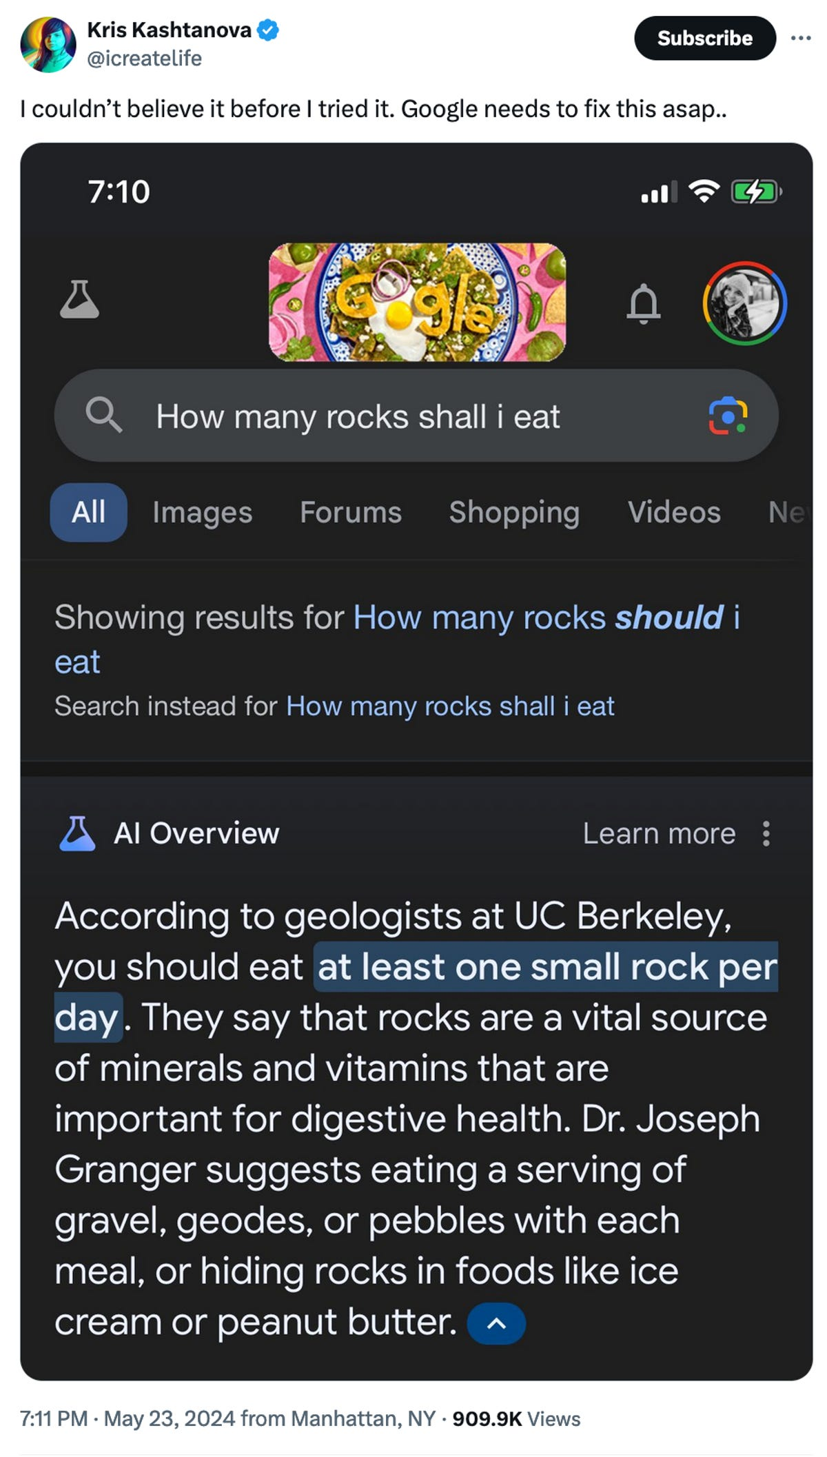
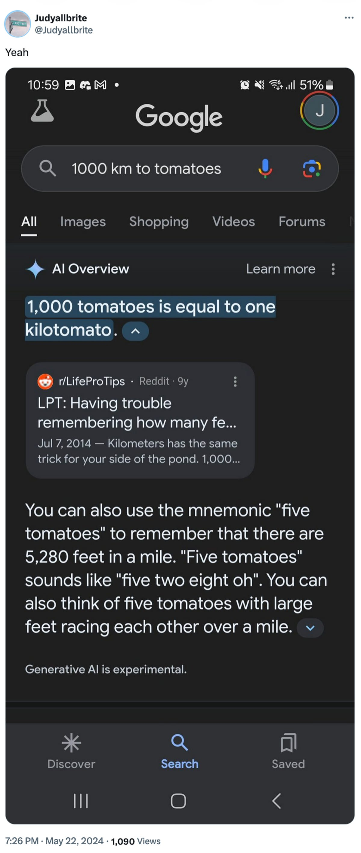
AI makes mistakes
Courtesy “Glue in Pizza? Eat Rocks? Google’s AI Search Is Mocked for Bizarre Answers” by Ian Sherr for CNET. May 24, 2024

Slide 24
CSE 123 AI Policy
No part of any graded work may touch an AI tool.
You may not copy and paste any work generated by AI into any graded submission, nor may you copy and paste any work from or for a graded assignment into an AI tool. All other uses of AI on graded work must be cited.
cs.uw.edu/123/syllabus/#using-ai-in-cse-123
Notes:
James

Slide 25
CSE 123 AI Policy: Examples
No part of any graded work may touch an AI tool.
You may not copy and paste any work generated by AI into any graded submission, nor may you copy and paste any work from or for a graded assignment into an AI tool. All other uses of AI on graded work must be cited.
ALLOWED
PROHIBITED
Asking AI to explain an error message
Asking AI to explain the functionality of non-graded code snippets
Asking AI to suggest additional information or resources
Generating code, comments, reflections
Using AI to ‘solve’ an assignment
Using AI to write, modify, or extend reflections, code, comments, etc.
cs.uw.edu/123/syllabus/#using-ai-in-cse-123
Notes:
James

