Slide 1

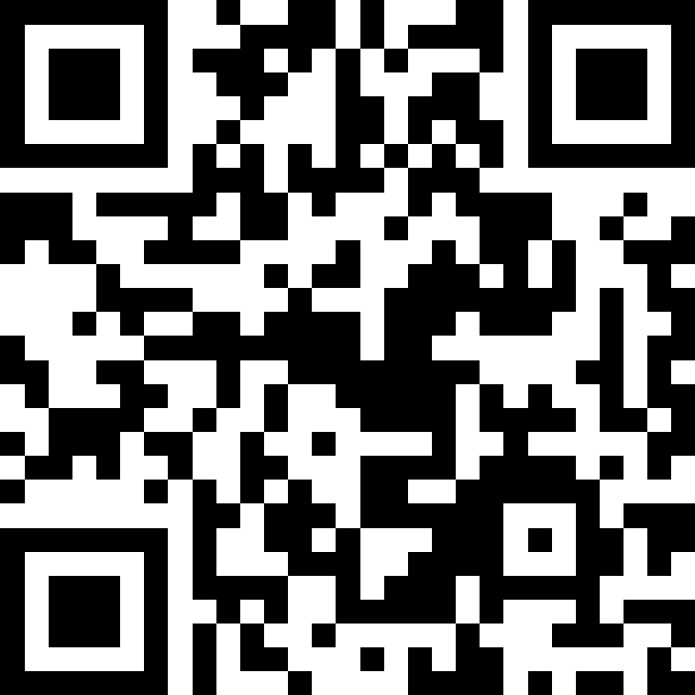
Welcome
& Syllabus
BEFORE WE START
Talk to your neighbors:
Introduce yourself to your neighbor!
What is your name? Major? What have you been up to the past week?
Instructor:
Miya Natsuhara
Arohan
Sreshta
Rushil
Sean B
Chloe
Jenny
Nate
Saachi
Hawa
Maggie
Sean E
Shiven
Vrinda
Gavin
Shreya
Jonah
Renee
Chris
Ishita
Kuhu
Kavya
Misha
Yuntong
Amiya
Sahana
Anirudh
Rohan
Crystal
Eeshani
Prakshi
Aidan
Cora
Nhan
Anya
Anisha
Trien
Neal
Evan
Rena
TAs:
Now playing: 🌻 CSE 123 26sp Lecture Tunes 🌻
Notes:
Slido event: https://app.sli.do/event/ahia5ii71Q41CMLcphxgiS

Slide 2
Lecture Outline: Introductions
Introductions
About this Course
  Course Components & Tools
  Making the Most of this Class
Assignments and Grading

Slide 3
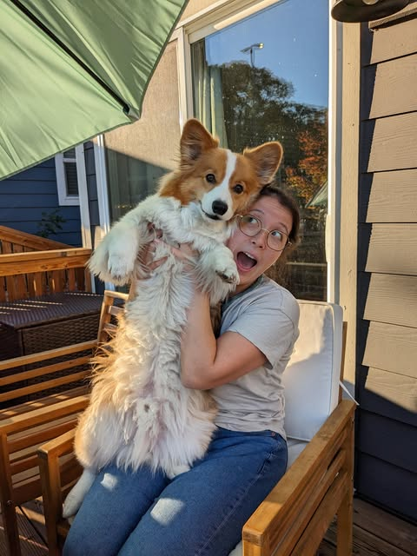
Hi, I’m Miya! (she/her)
Assistant Teaching Professor
Frequent intro CS instructor
Works in areas of CS Education, Accessibility
Previously:
  Grew up in Washington state
  An undergrad and grad student at UW (Math, Computer Science, American Sign Language)
  A software engineer at Microsoft on the Visual C++ Libraries Team
  Now in 3rd year as Allen School faculty
Non-CS hobbies: knitting, baking, playing with my very cute corgi

Slide 4

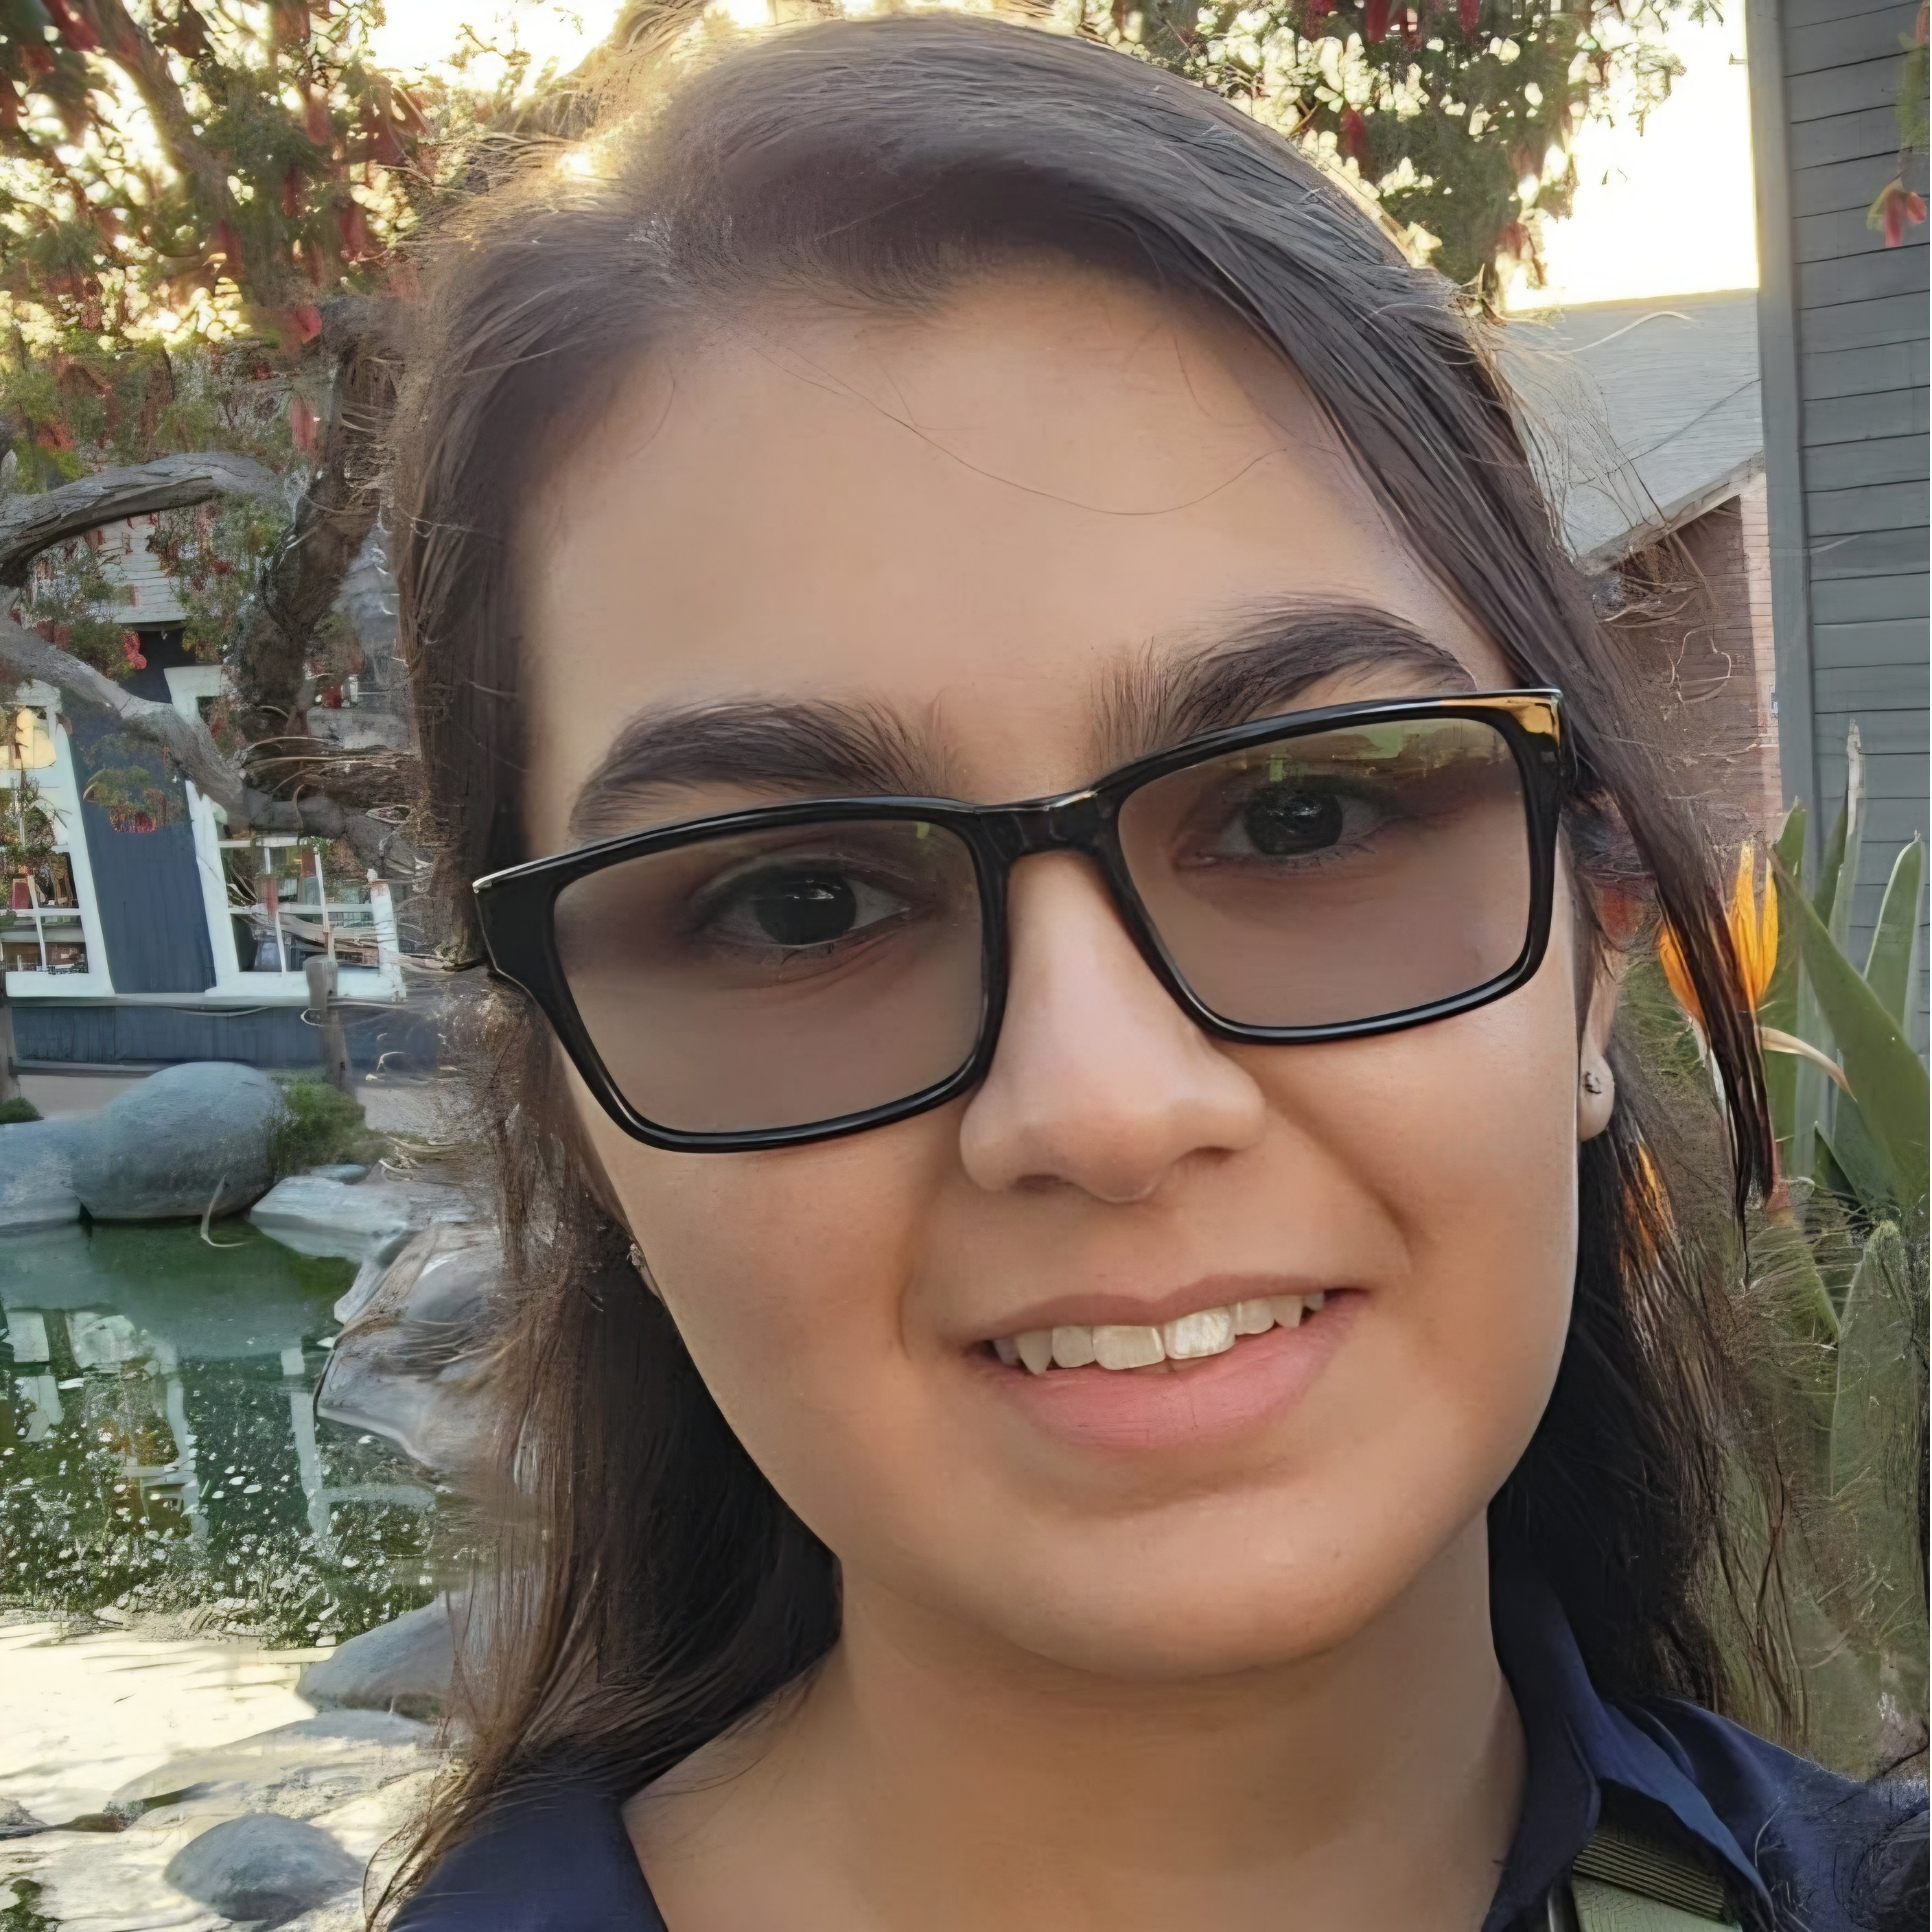


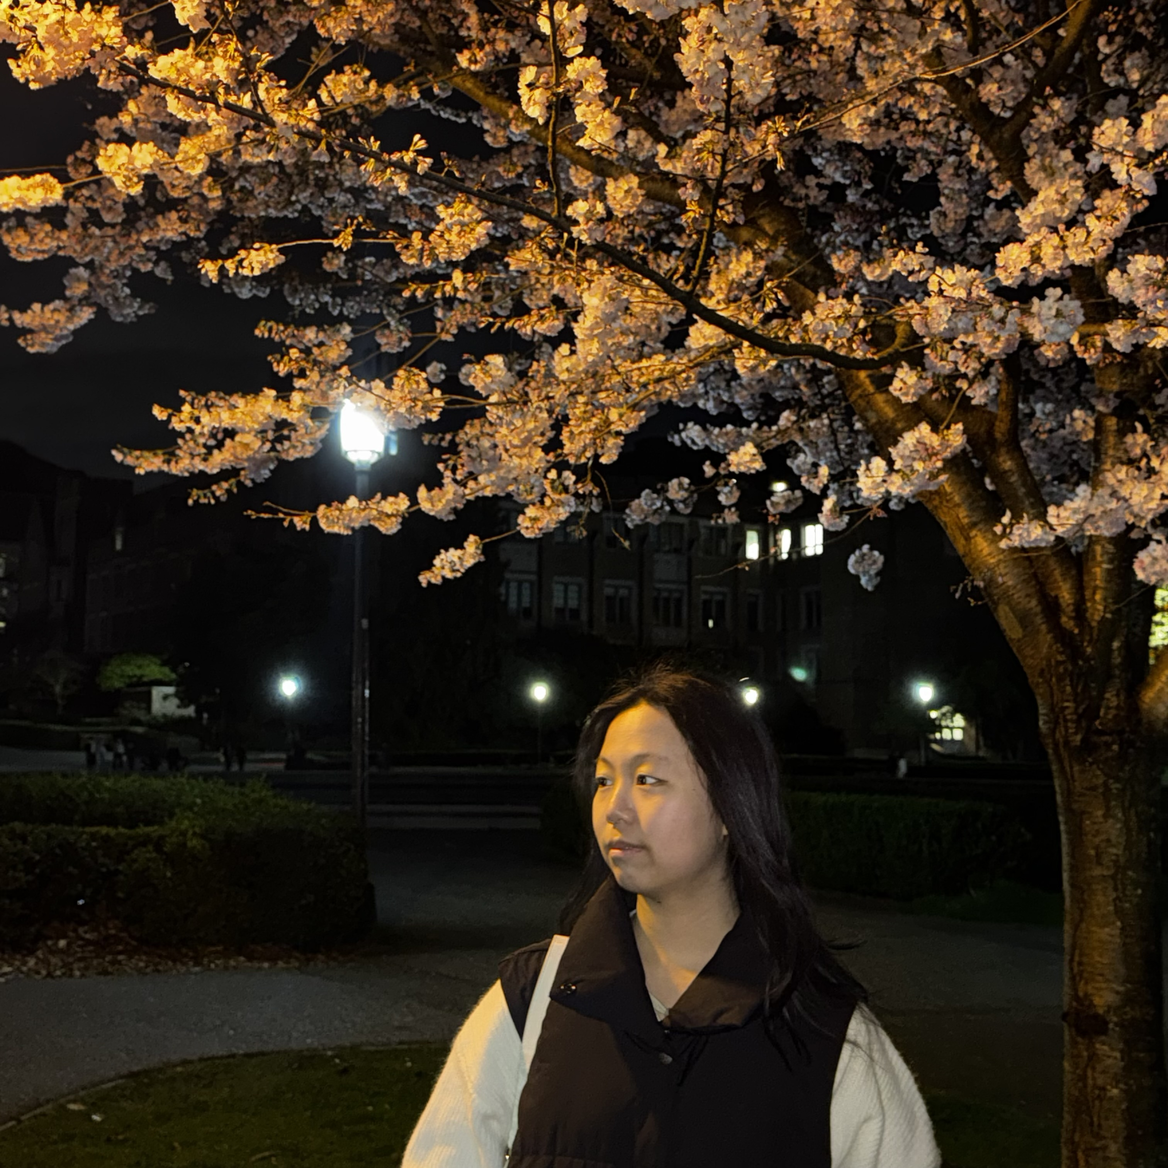
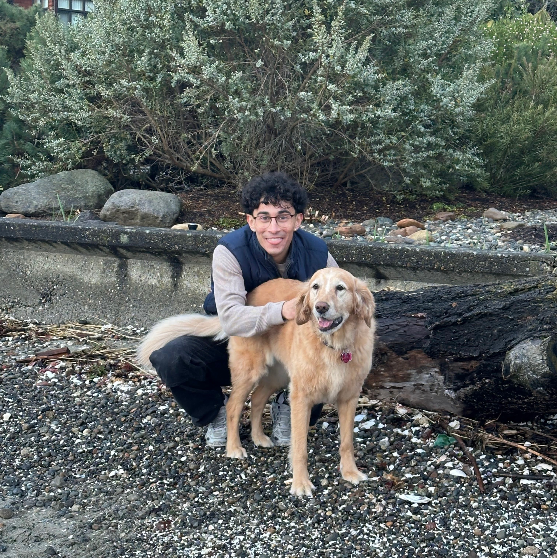
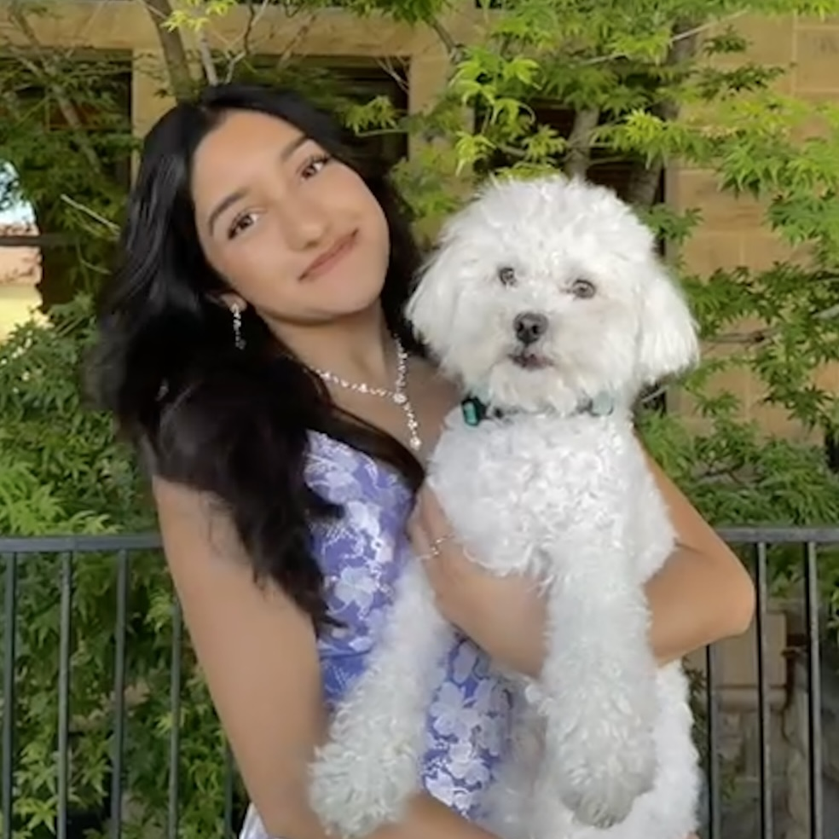

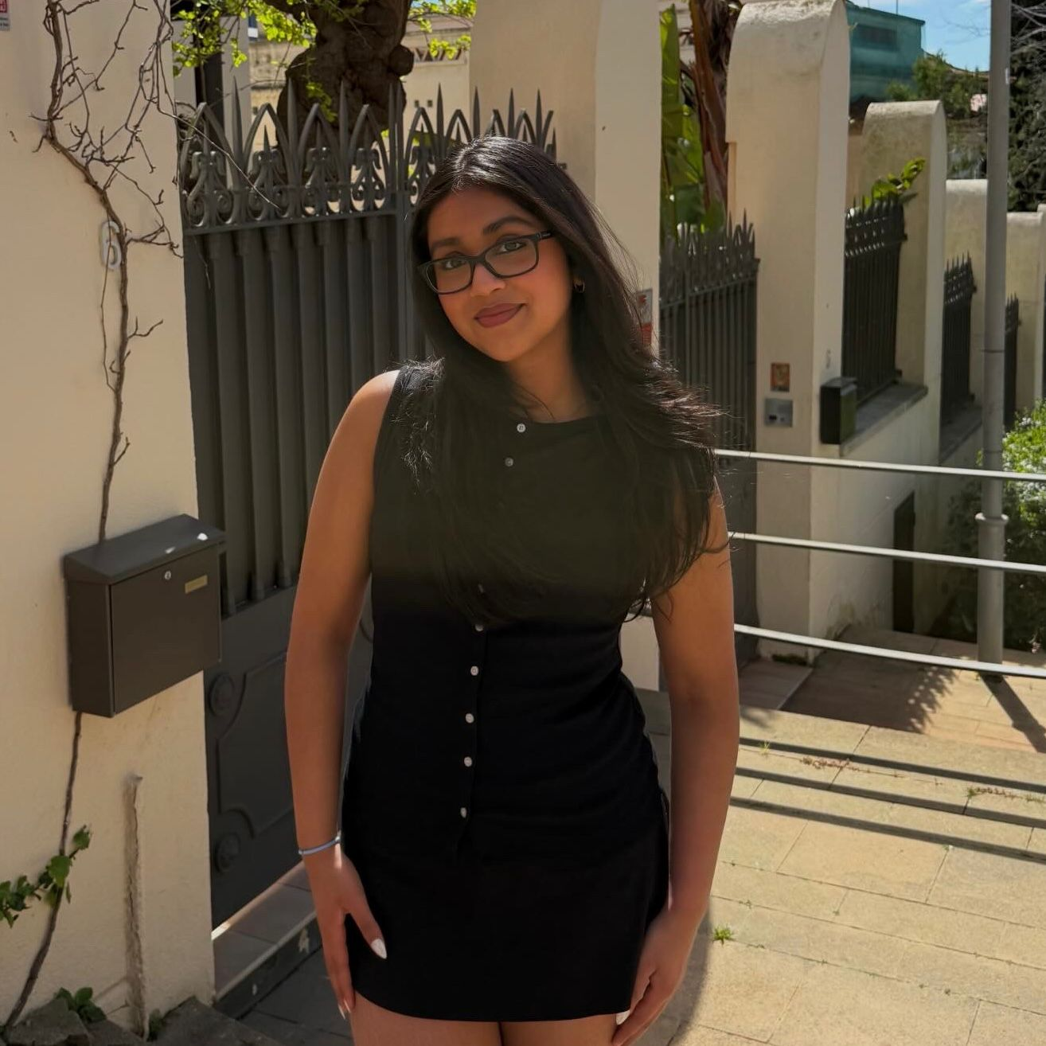


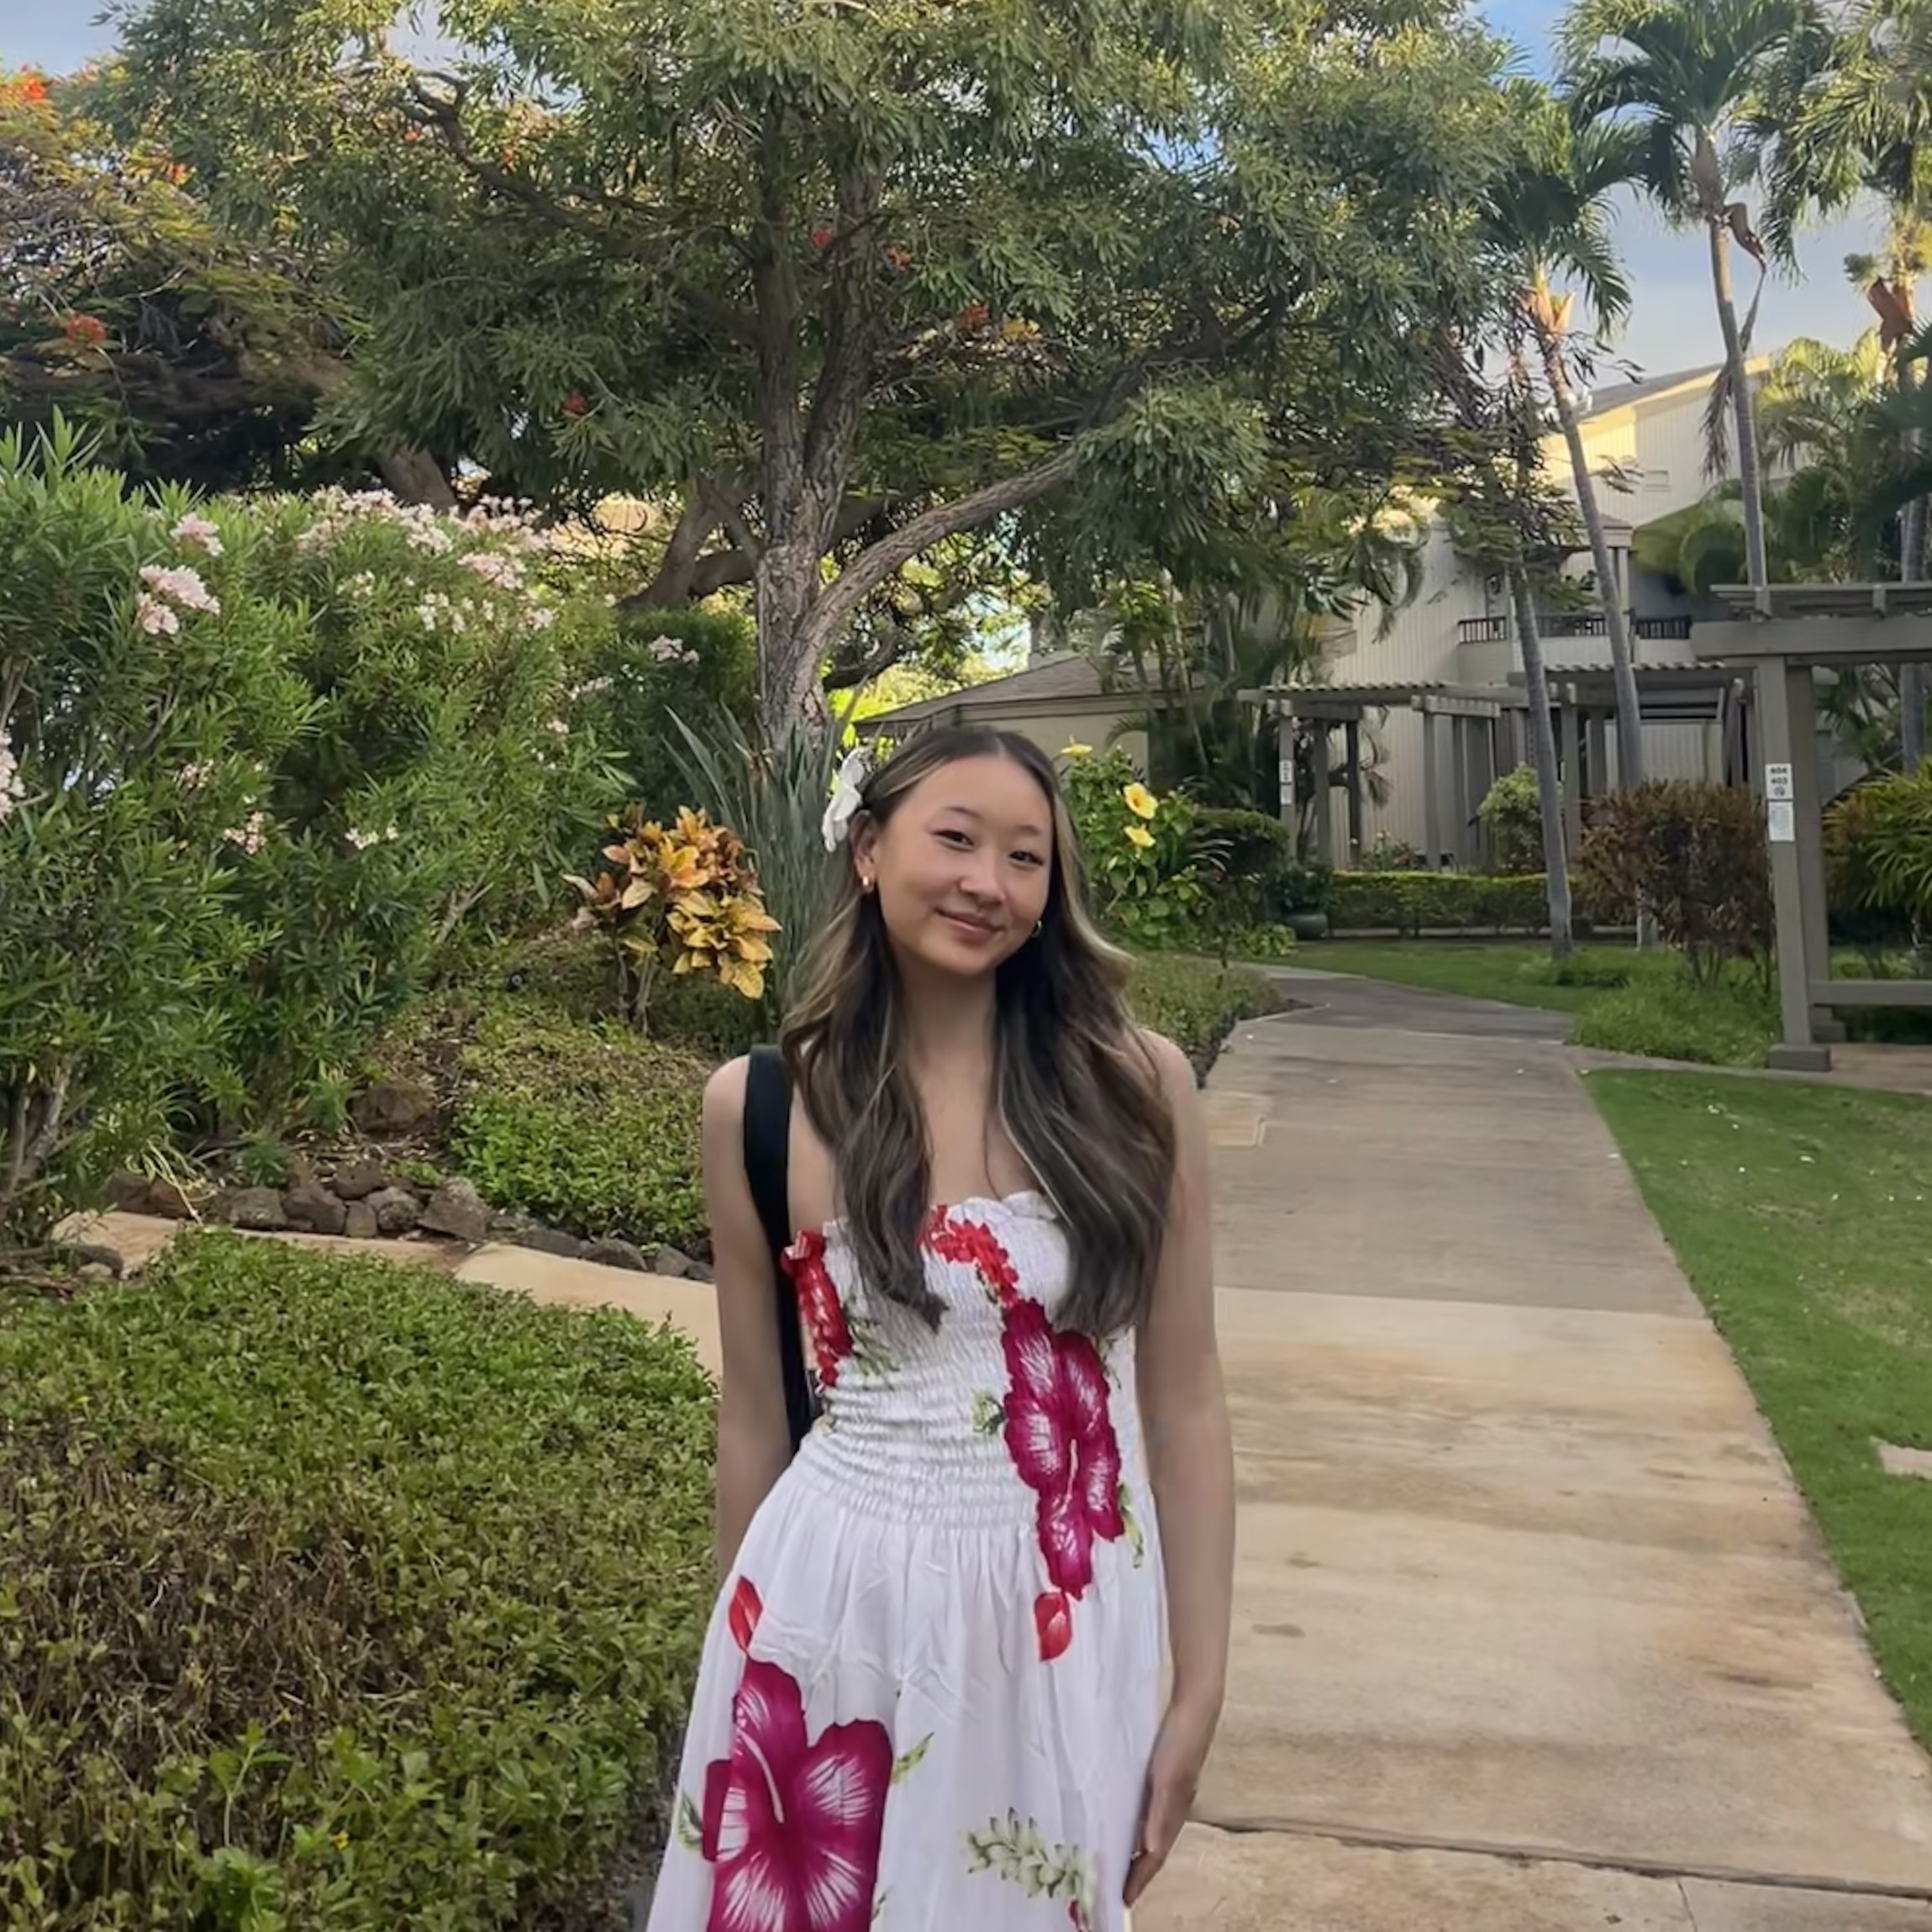


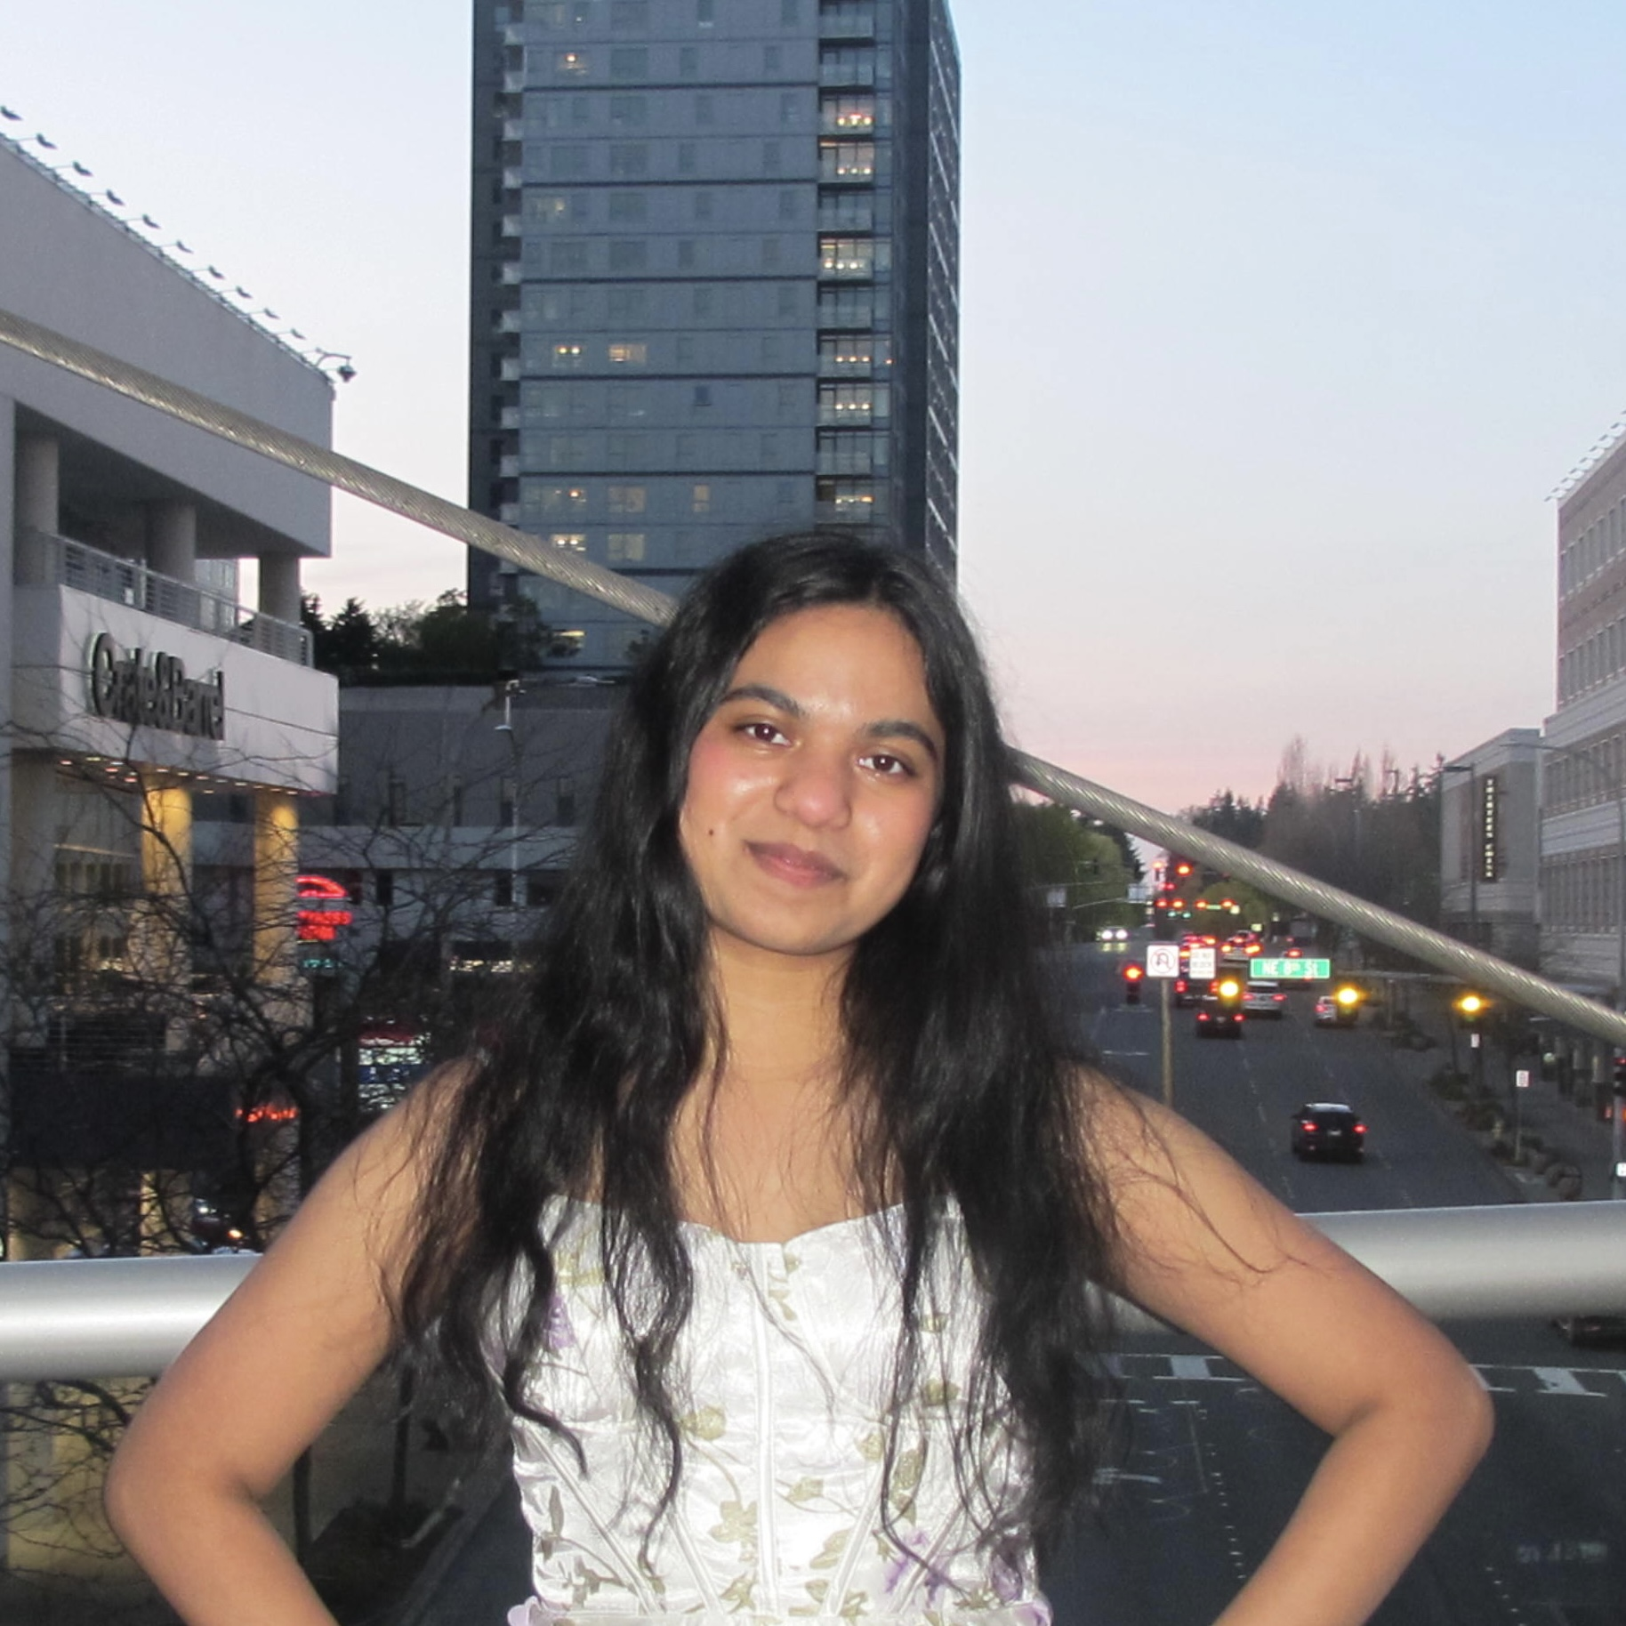

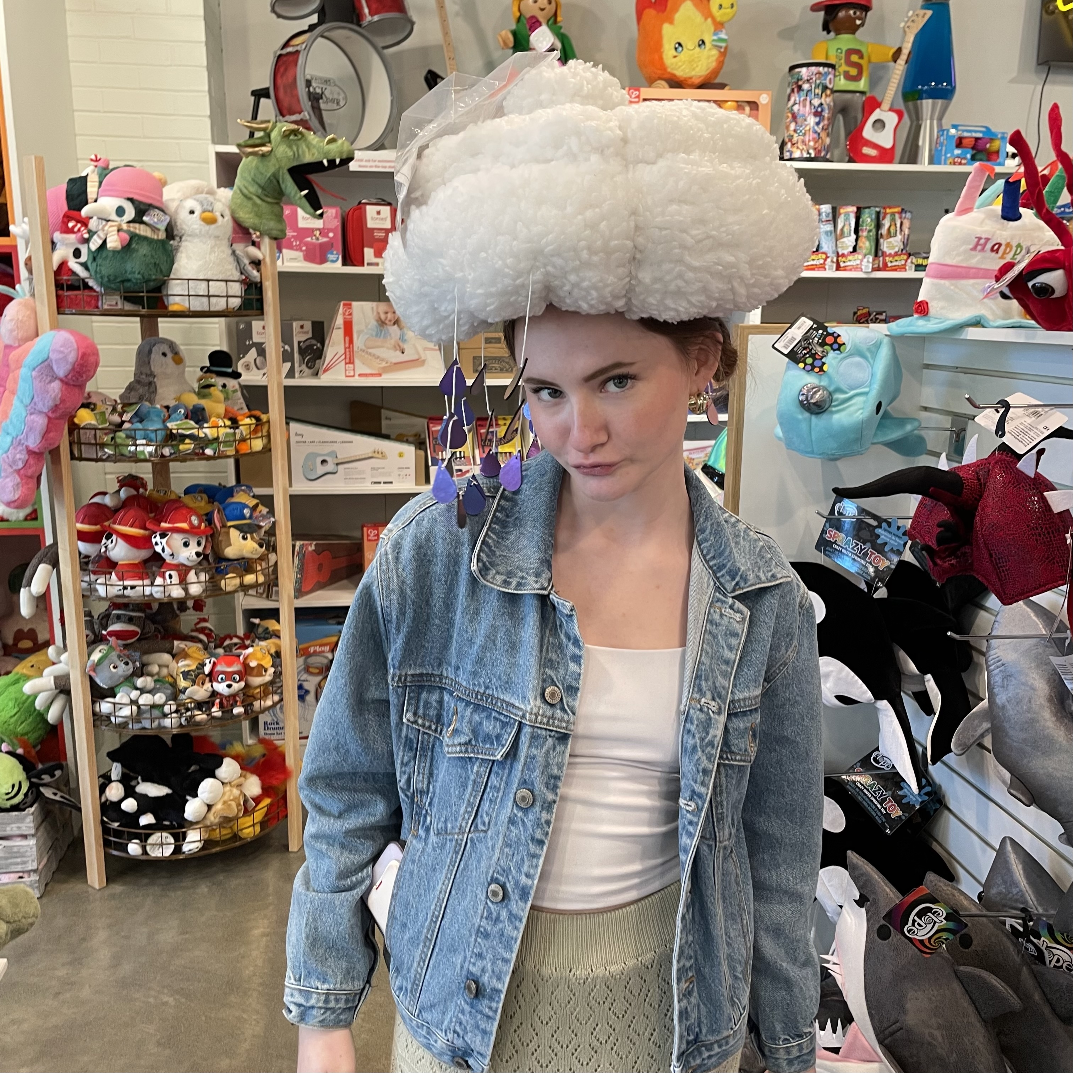



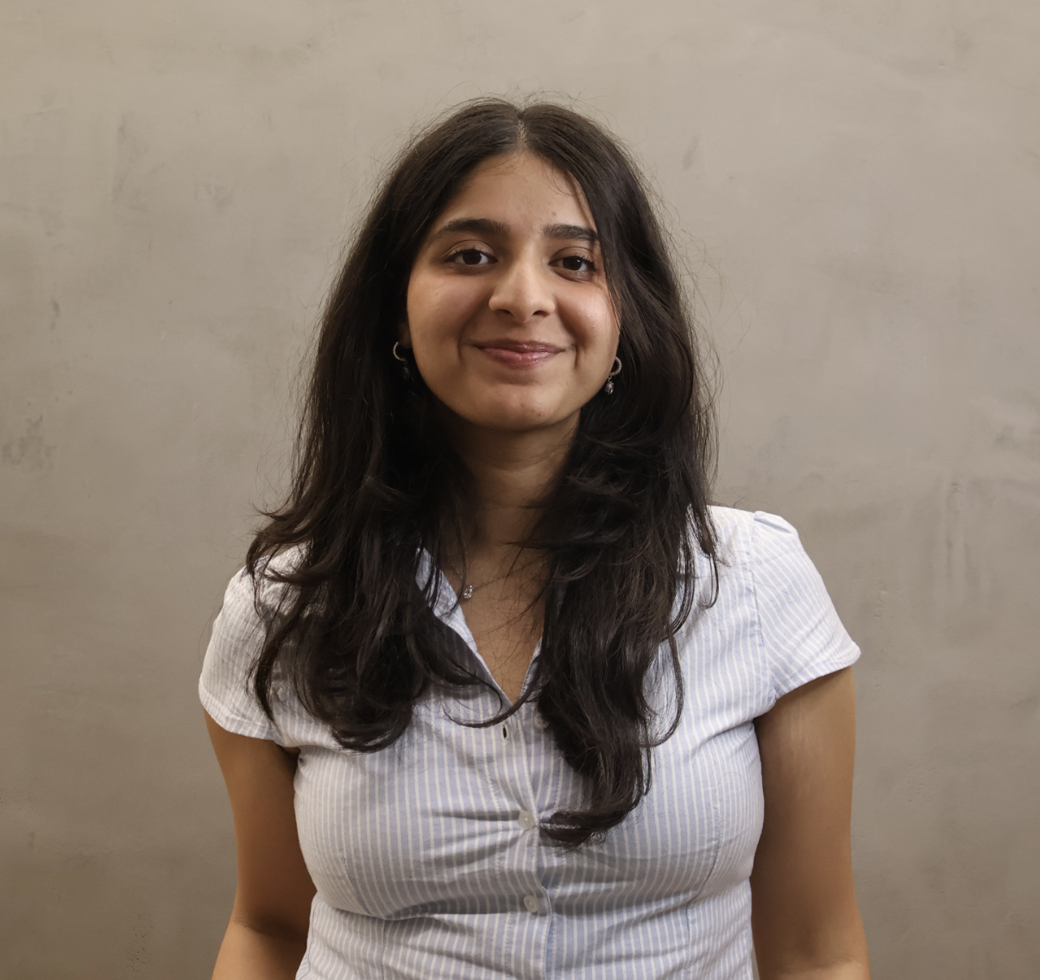
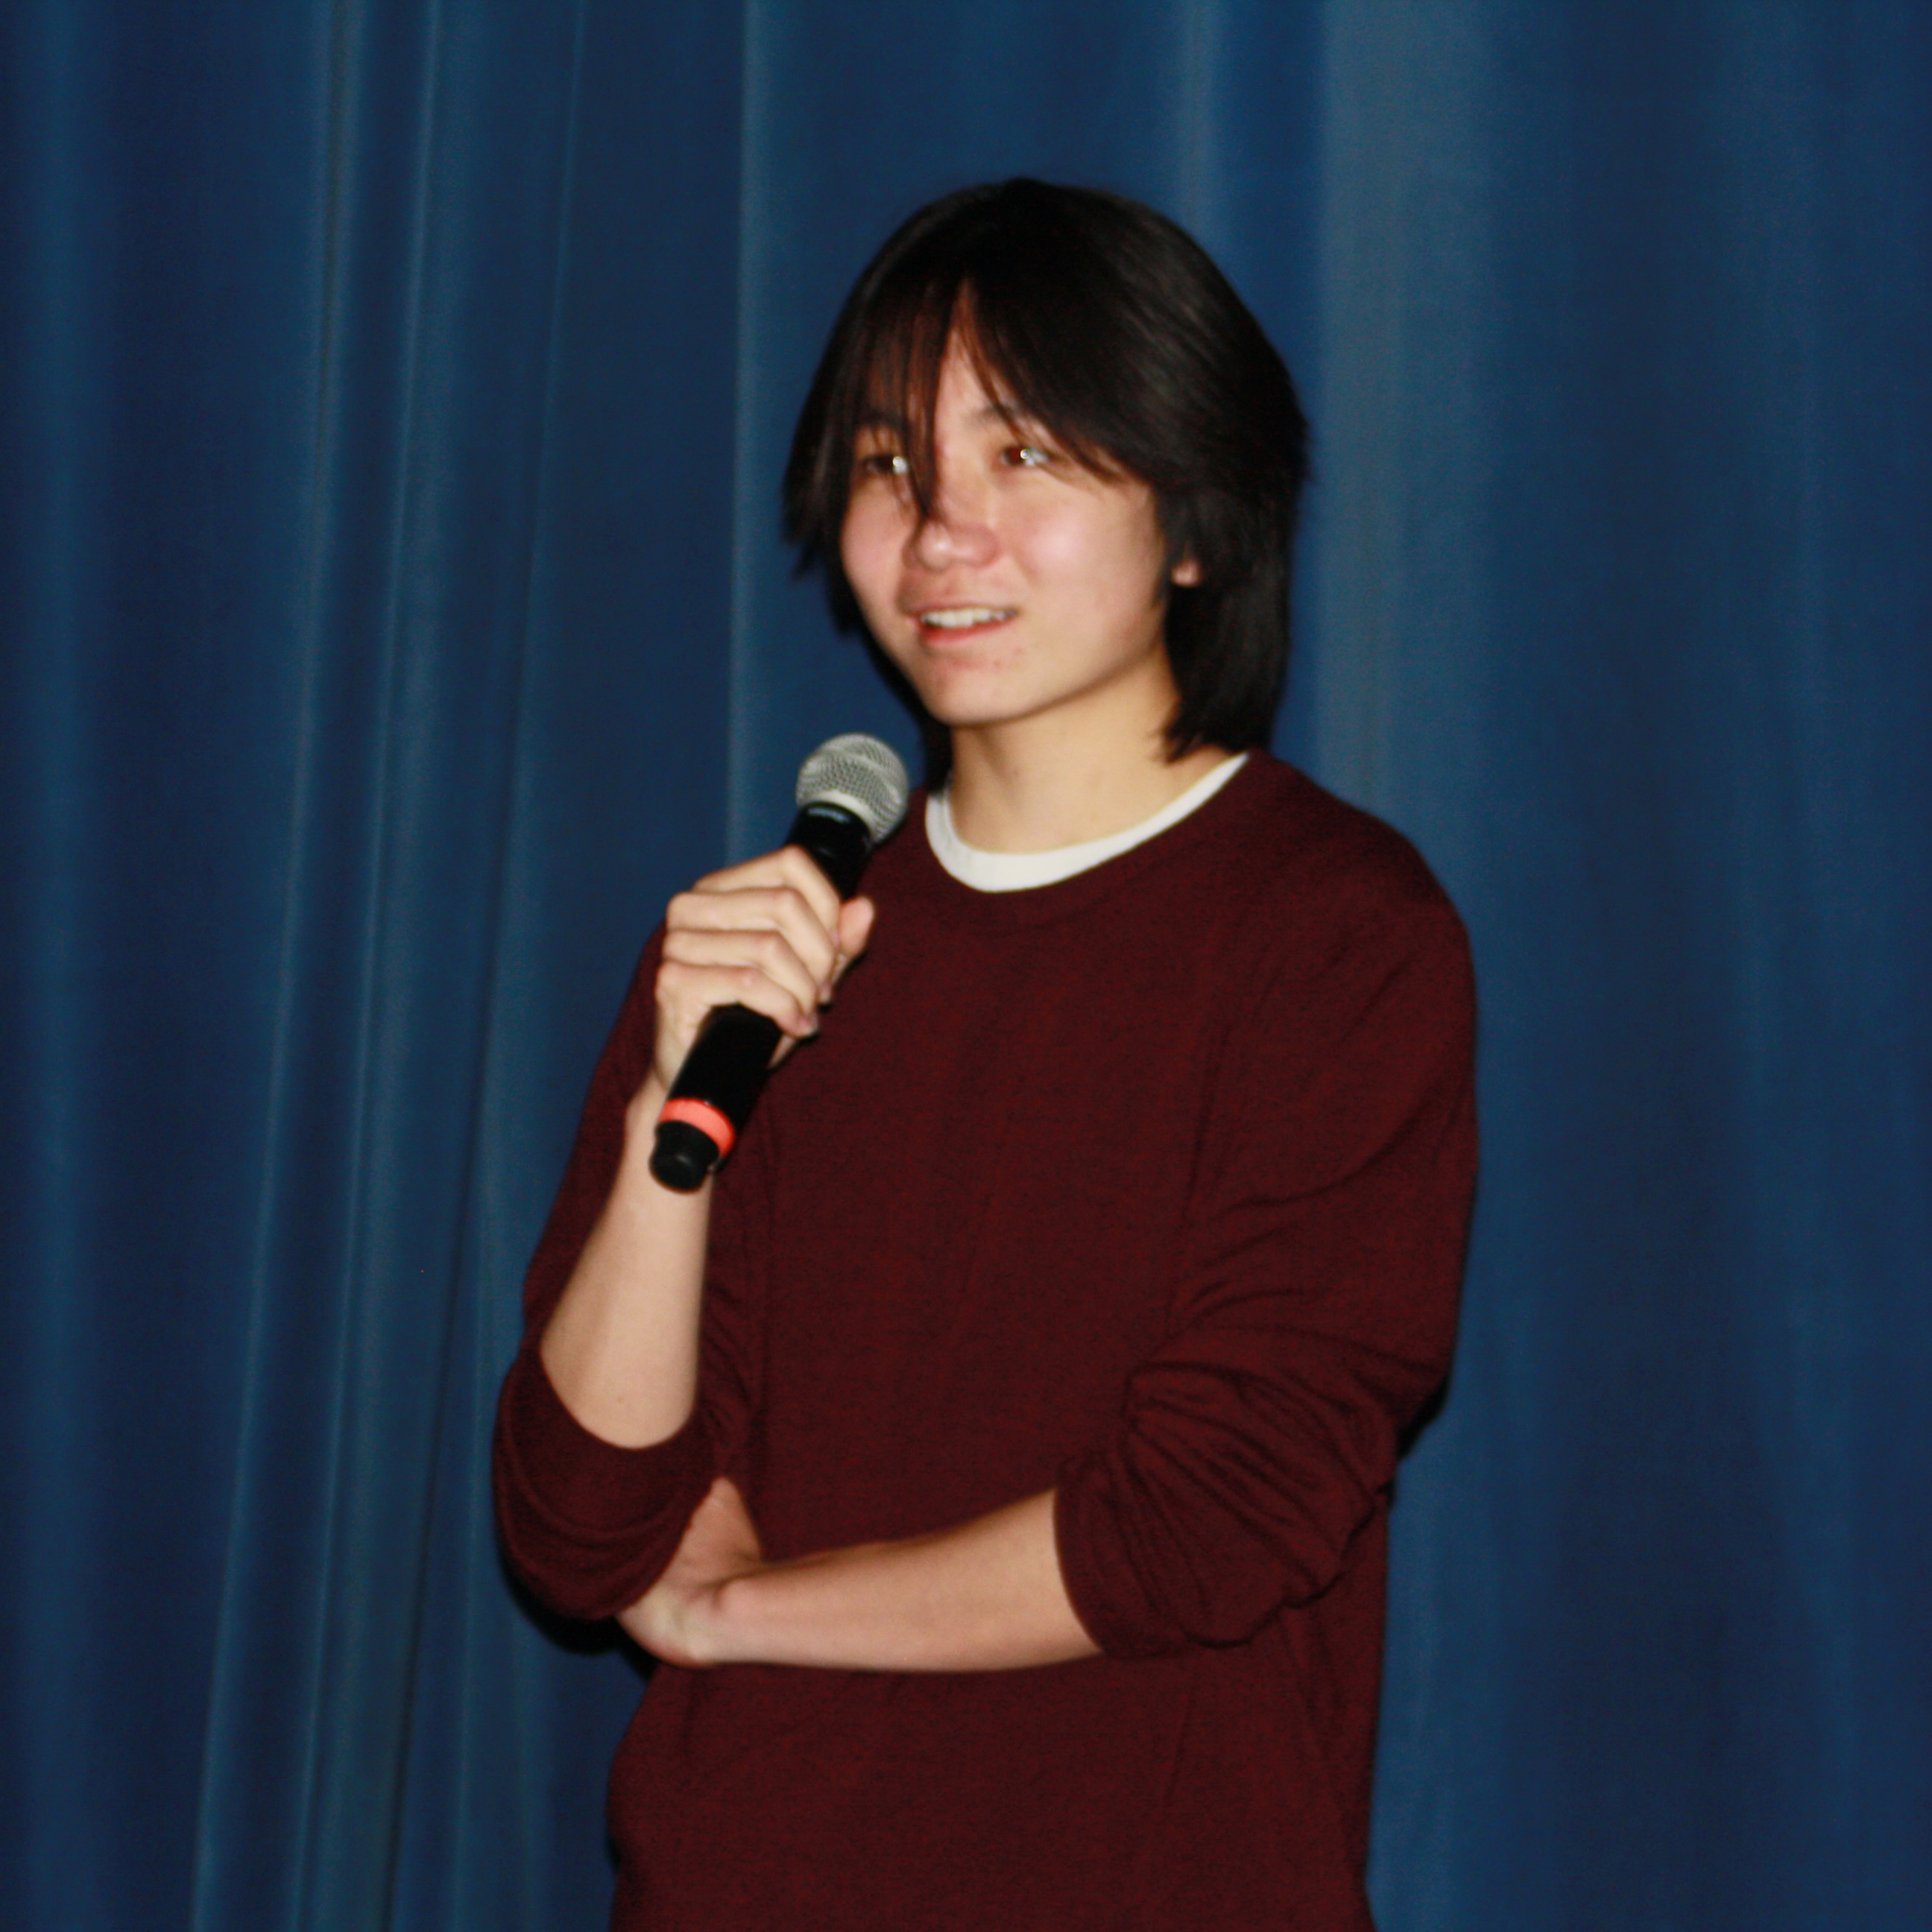



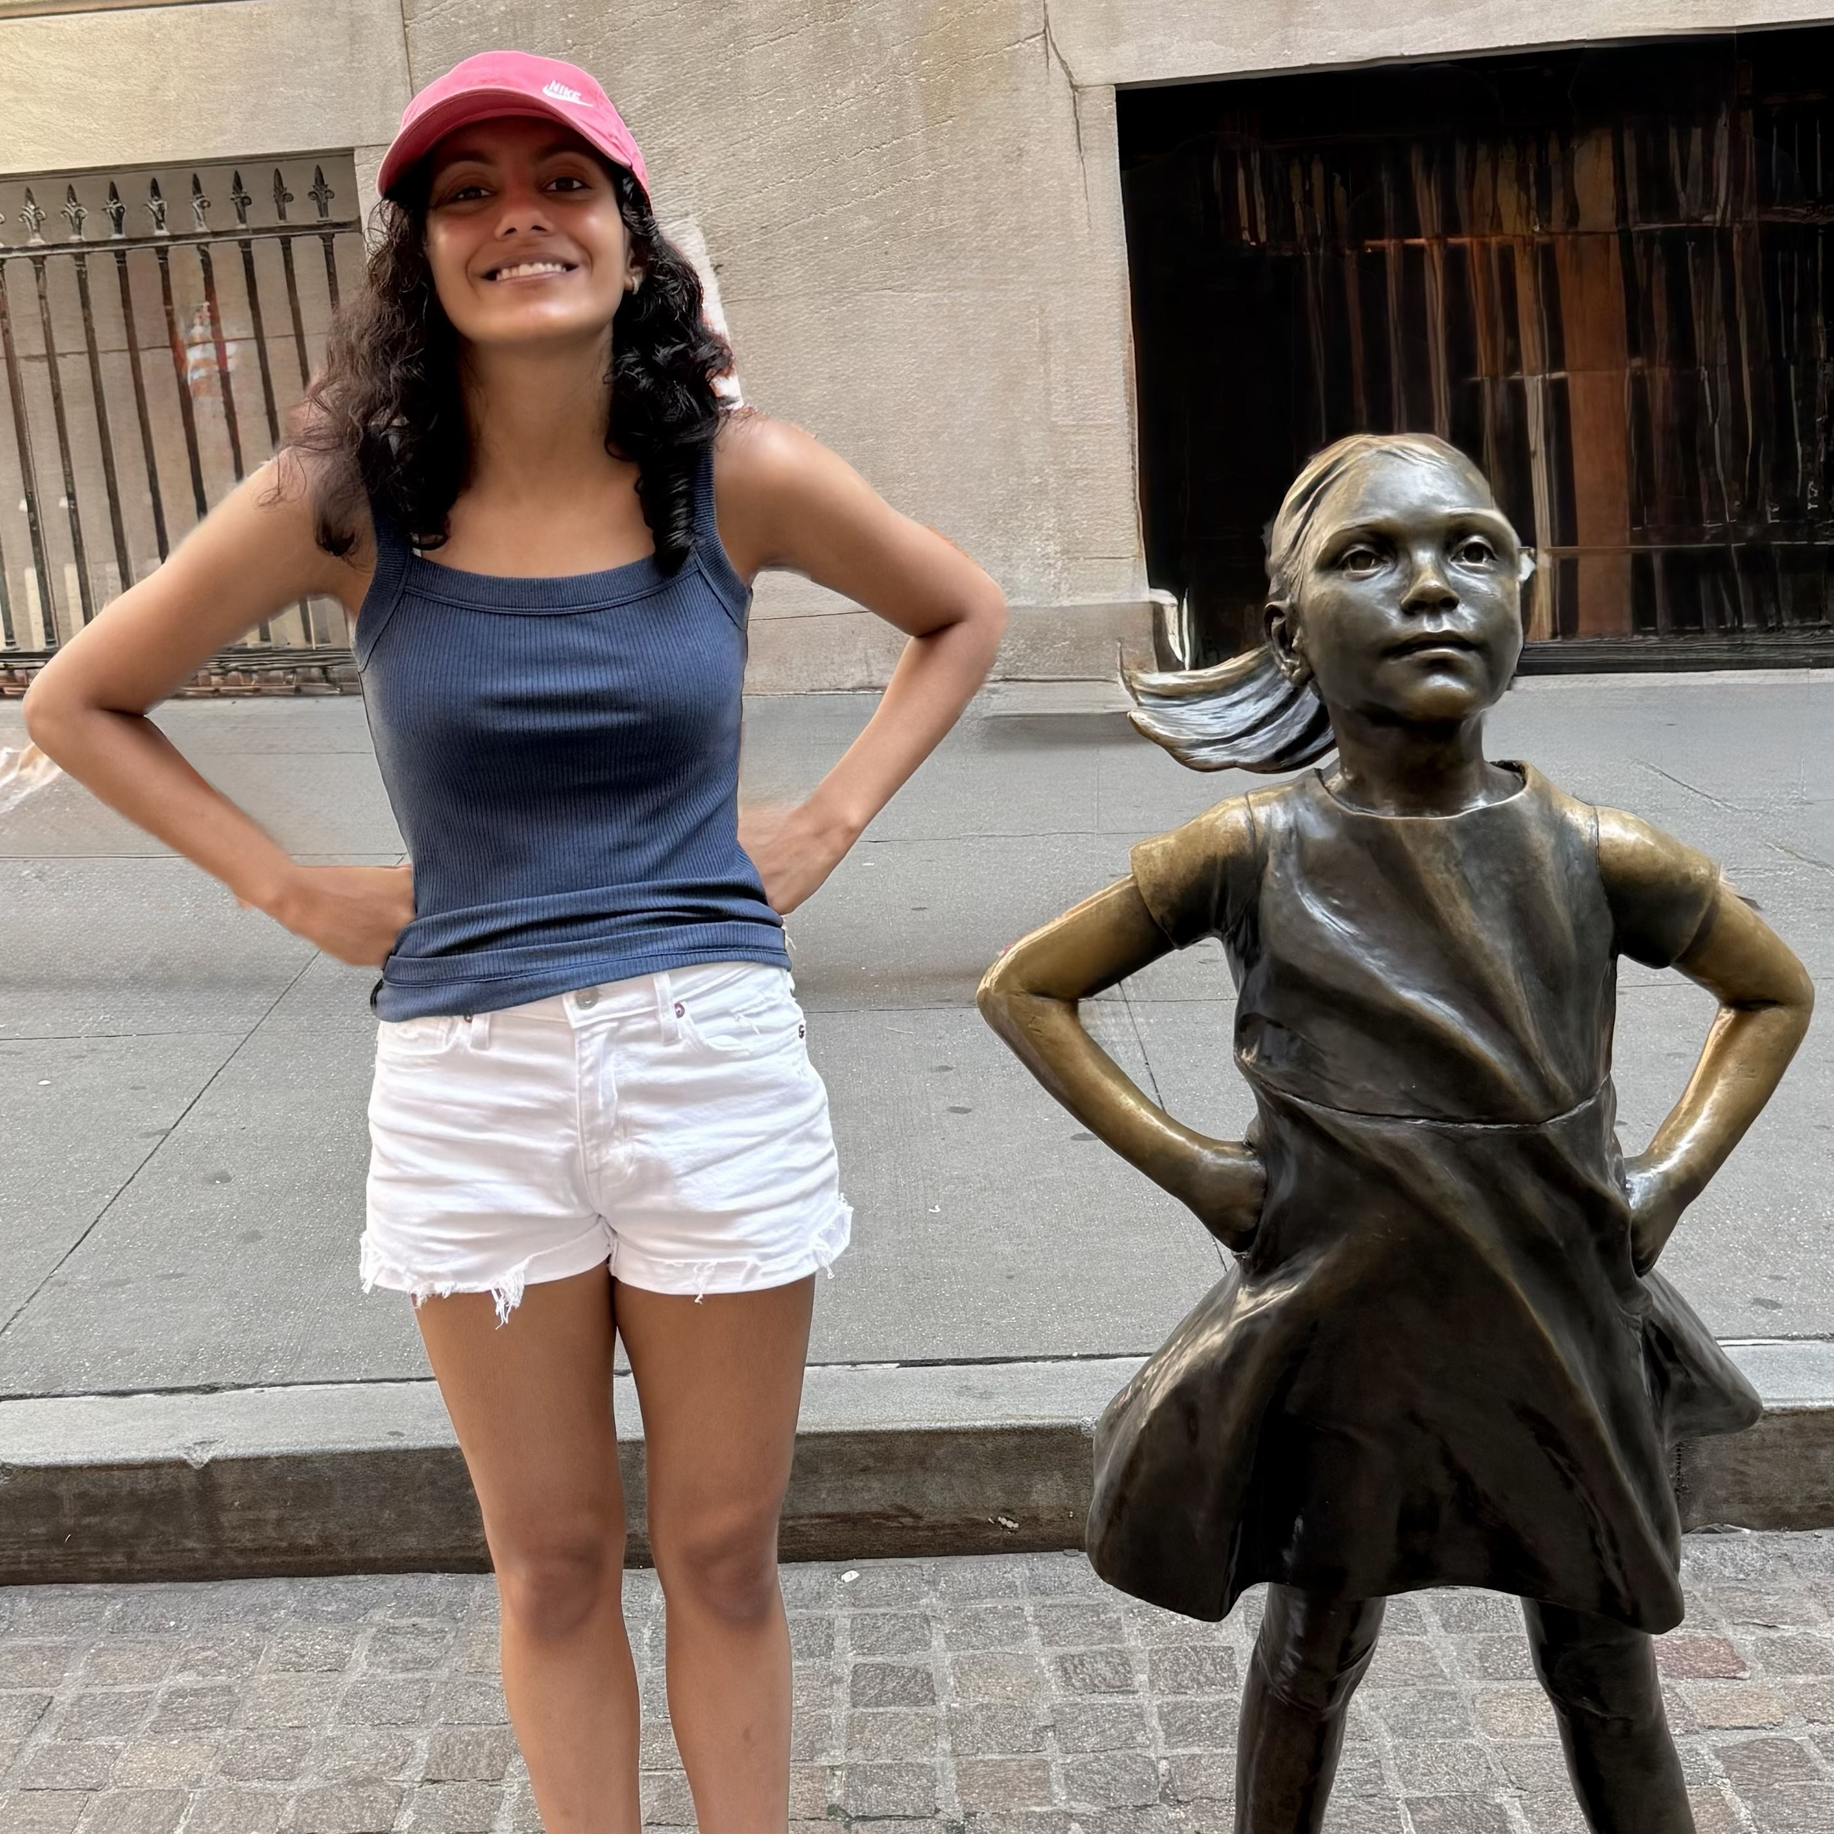









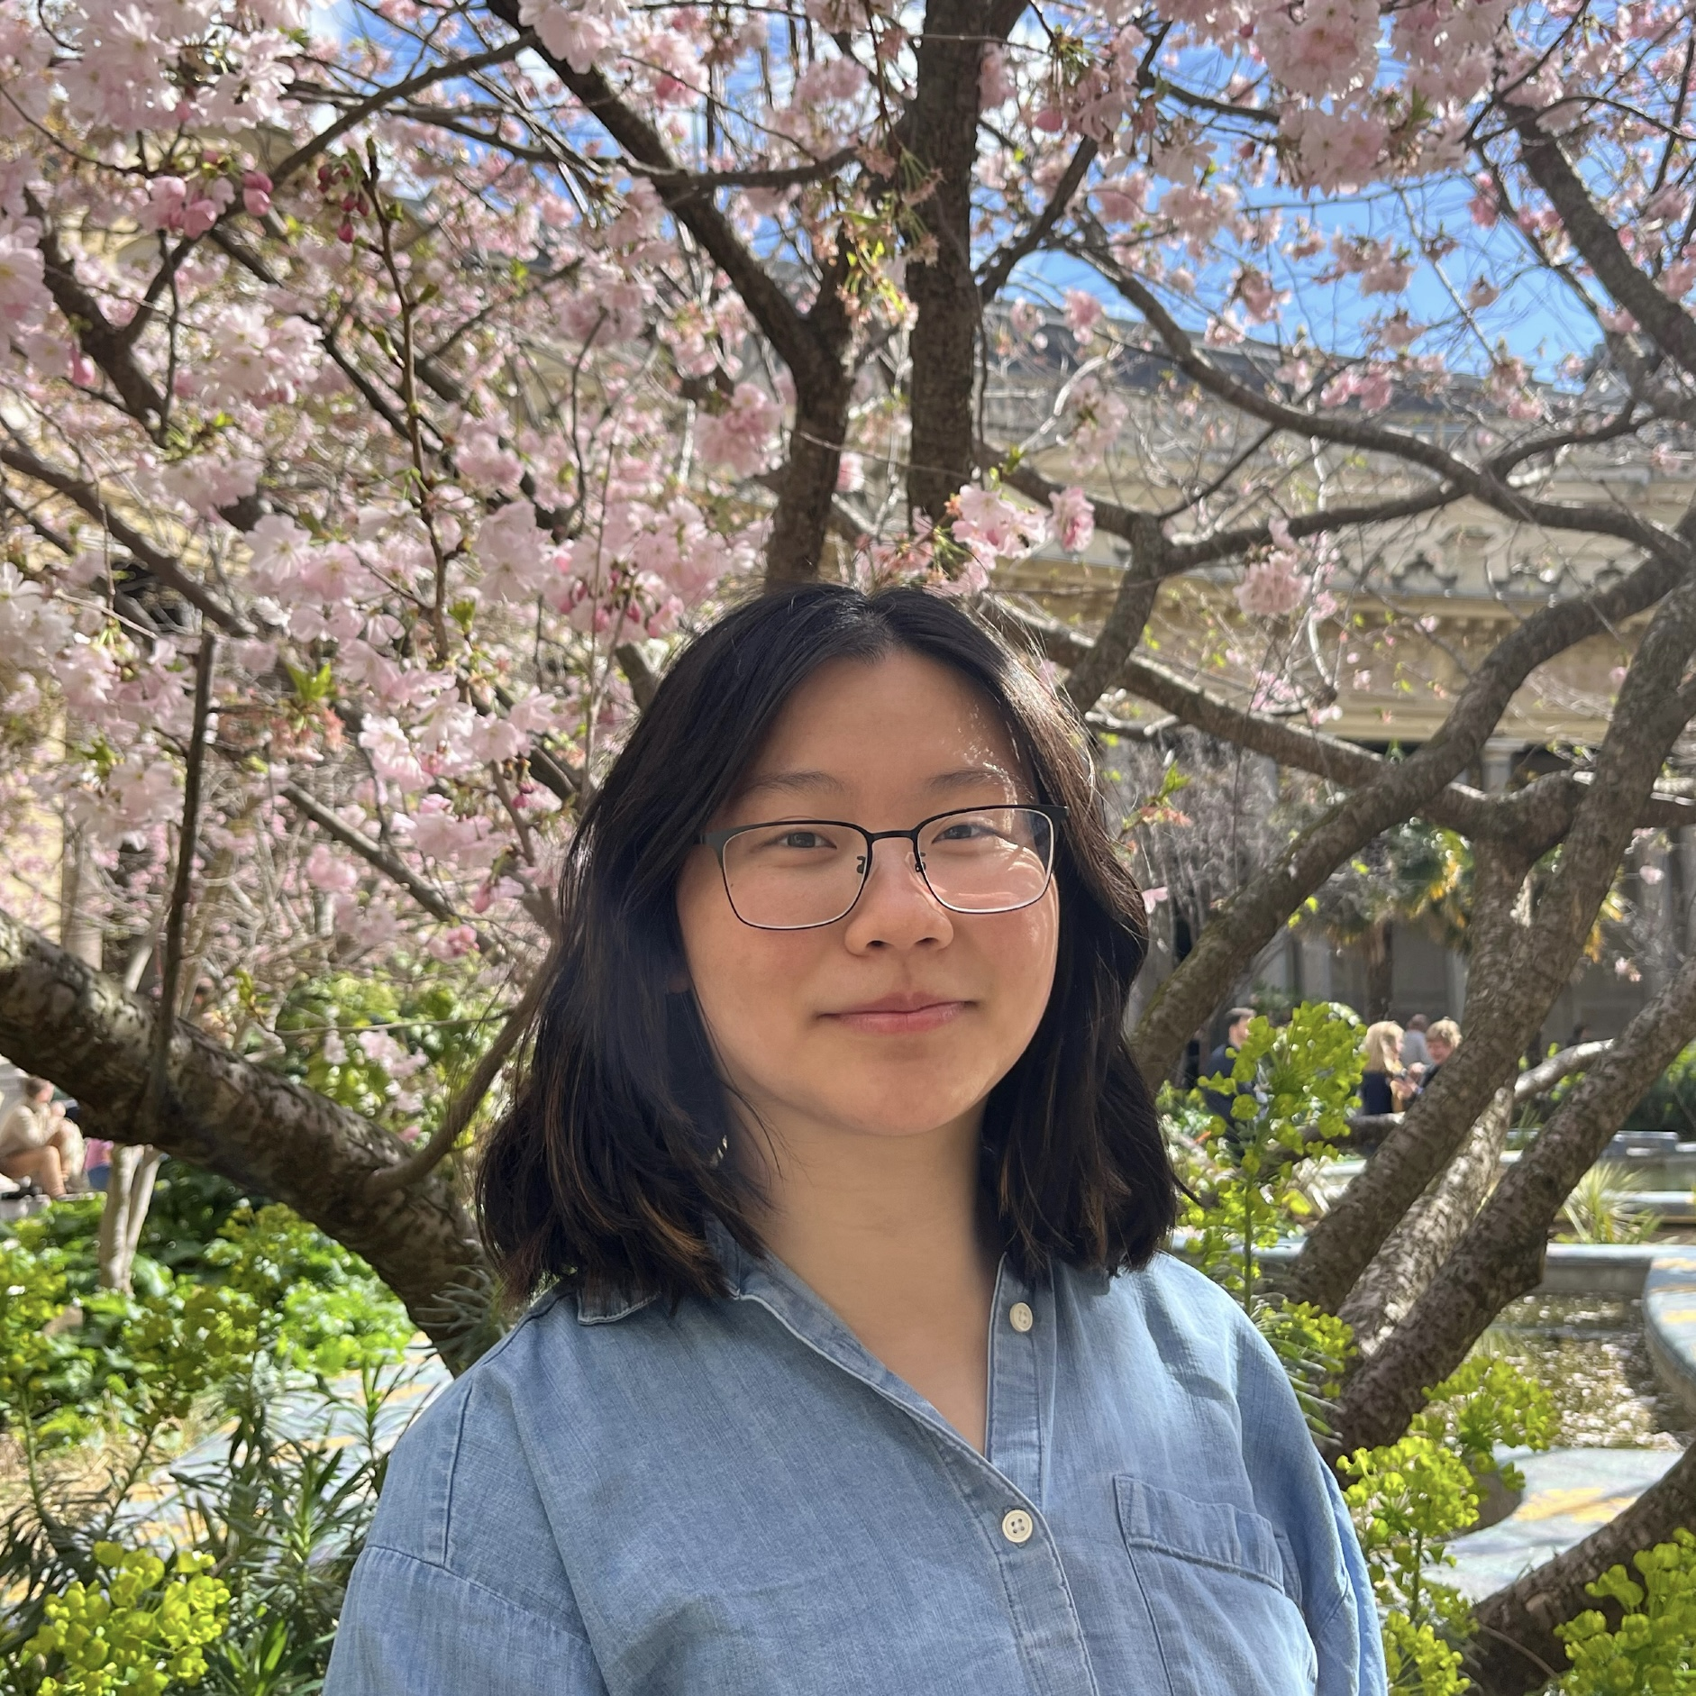
Meet your 39 fabulous TAs!

Slide 5
Lecture Outline: About this Course
Introductions
About this Course
  Course Components & Tools
  Making the Most of this Class
Assignments and Grading

Slide 6
What is this Class?
CSE 121 – Computer Programming I
CSE 122 – Computer Programming II
  Data types (int, String, boolean)
  Methods / Functions
    Parameters, Returns
  Control structures
    Loops, Conditionals
  Arrays & 2D arrays
  Computational Thinking
  (language agnostic)
  Functional Decomposition
  File I/O
  Using data structures
    List, Stacks / Queues, Sets, Maps
  Object Oriented Programming
    Interfaces
CSE 123 – Computer Programming III
  Advanced Object Oriented Programming
    Comparable, Inheritance/Polymorphism, Abstract Classes
  Implementing data structures
    ArrayLists, LinkedLists, Trees
  Recursion
  Critical analysis of design

Slide 7
Why 123?
To solve more complex problems by leveraging more complex programming structures / patterns
To better rationalize specific design decisions
  How to “best” structure programs
  Which data structures are “most” appropriate to use
To understand and critically analyze intersections between Computer Science and society
  Search engines, algorithmic art, machine learning, etc.
  Developing informed opinions on current issues
Be a better programmer
Be a better person

Slide 8
Prerequisite Knowledge
Comfort with control structures
  loops, conditionals, methods/functions
Experience with using basic data structures
  arrays, lists, sets, maps
Experience with console and file input/output
Exposure to simple object-oriented programming
  classes, interfaces
Programming experience in Java
  Or willingness to pick up on your own

Slide 9
Course Expectations
What are you hoping to get out of taking CSE 123?
sli.do #cse123
Notes:
Slido event: https://app.sli.do/event/ahia5ii71Q41CMLcphxgiS

Slide 10
Programming Skill
Fluency with the relevant language and tools
  consists of many conceptually simple facts
    e.g. syntax (of a for loop, method, ...) , how to run a program
  eventually becomes second nature
Mental model of how programs execute
  consists of a few deep concepts
    e.g. what is a variable? a loop? a method? a reference?
  develop the skill of tracing the current state of a program
Key course takeaway!

Slide 11
Lecture Outline: Course Components & Tools
Introductions
About this Course
  Course Components & Tools
  Making the Most of this Class
Assignments and Grading

Slide 12
Course Components
LECTURES
x20
PROGRAMMING ASSIGNMENTS
x4
CREATIVE PROJECTS
x4
We’re here!
Introduce concepts, practice
ideas, discuss applications.
Pre-class materials to prepare for
class each day. Due before class.
Structured assignments
Programming in Java
Applying & implementing course concepts
More open-ended assignments
Explore new ideas and applications
SECTIONS
x16
QUIZZES
x3
EXAM
x1
Held in person
More practice, reviews, applications
TA advice, how to be an effective student
Preparation for quizzes / exams
Taken in quiz section
45 minutes on paper
Culminating exam
Thurs, June 11th
12:30 – 2:20 PM
Graded Assignments
Meetings

Slide 13
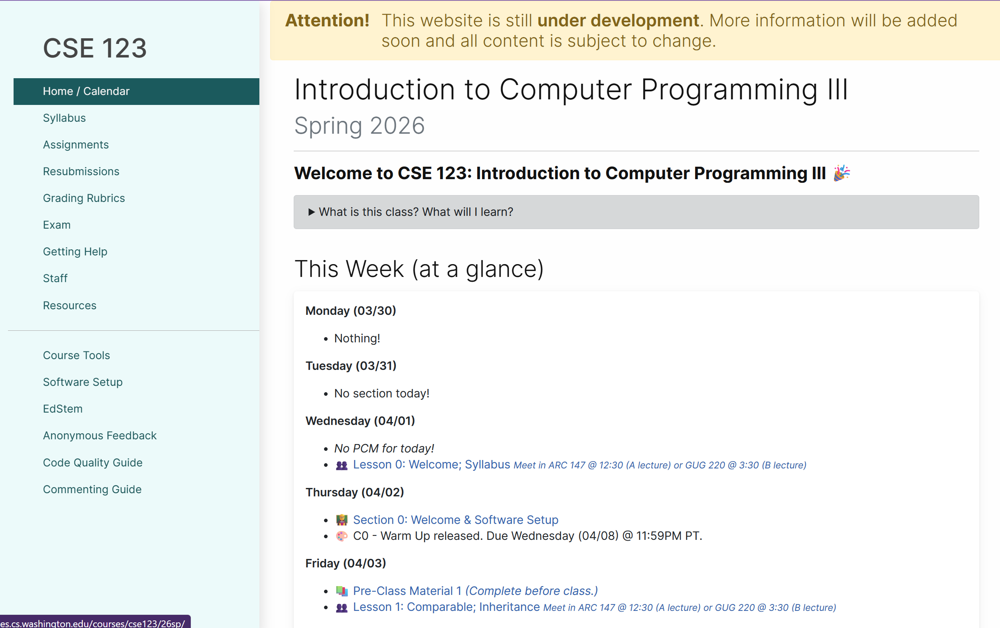
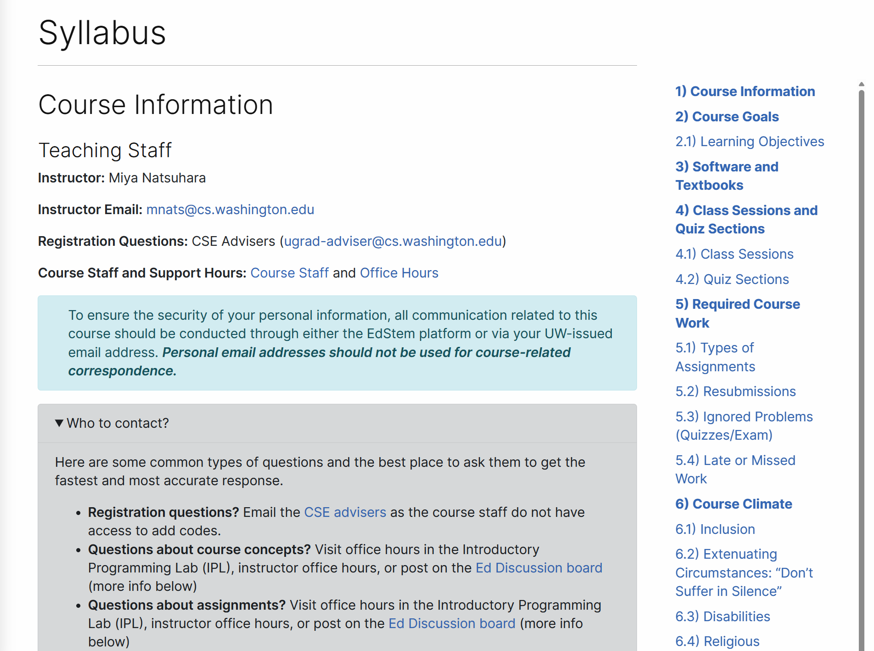
Course Website
cs.uw.edu/123
Review the syllabus!
Contains most course info – check frequently!
Announcements, Calendar, Lecture Slides, Office Hours schedule,
Staff Bios, Important Links

Slide 14





Other Course Tools
My Digital Hand
Queueing in office hours
VSCode
Develop offline
Visual debugger
Ed
Community & Information
  Discussion Board
  (please ask & answer!; anonymous option)
  Announcements
Pre-Class Materials / Section Handouts
Assignments
  Online IDE
  Submit assignments
  View Feedback
Gradescope
Quiz and final exam grades
Sli.do
In-class activities
(ungraded)

Slide 15
Lecture Outline: Making the Most of this Class
Introductions
About this Course
  Course Components & Tools
  Making the Most of this Class
Assignments and Grading

Slide 16

How did you learn how to ride a bike?

Slide 17

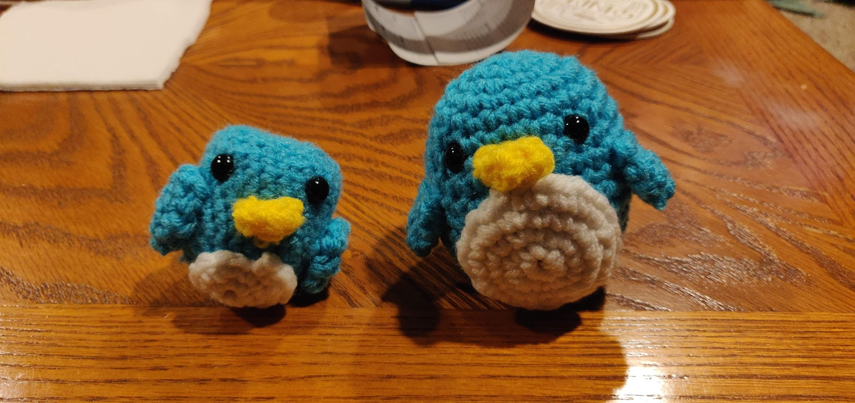
Digression: A Pandemic Hobby
Amigurumi: Japanese art of creating crocheted or knitted stuffed toys

Slide 18

How Learning Works
Learning requires active participation in the process. It’s not as simple as sitting and listening to someone talk at you.
  Requires deliberate practice in learning by doing
  Benefits from collaborative learning
Hybrid classroom model
  Asks you to do some preparation before class in the form
  of readings and practice problems.
    Should take ~30 minutes outside of class per lesson
  Class will start with brief recap, then pick up
  where the reading and practice problems leave off.
  Attendance isn’t graded, but showing up and trying
  is the first step in succeeding in the class!
Pre-class materials are ungraded, but…
  It’s okay if you find them challenging! That means
  you are learning!

Slide 19
Learning Pattern
Pre-class Work
  Your first introduction to a topic
  Interactive components
In-class lessons
  Recap of pre-class work
  Further instruction from where it left off
  Interactive components
Section
  Review, restate, rephrase content
  Very interactive
Homework
  Learn by applying
  Help when you need it!
Quizzes/Final Exam
  Show us what you’ve learned
Instruction
Practice
Instruction
Practice
Instruction
Practice
Practice/Assessment
Instruction
Assessment

Slide 20
Learning in CSE 123: Live Support Systems
Programming is hard! We want to give you collaborative support!
Introductory Programming Lab (TA Office Hours) – starting Week 2
> 40 hours/week (and highly rated in the class!)
Face-to-face help from TAs on any course questions
Instructor Office Hours
Great for things from lecture, personal questions, or just saying hi

Slide 21
Learning in CSE 123: Async Support Systems
Ed Board
Best for content and logistics questions – 395 of you >> 40 of us!!
Encourage public posts, except for things about your graded work
Answer other students’ questions – great way to learn!
Email
Best for personal circumstances and/or private questions
If unsure, always feel free to email Miya
  May politely ask you to post on Ed instead!
For emails, please use your UW email (protecting student privacy!)

Slide 22
The World Around Us
College is challenging and CSE 123 isn’t your only class.
Life is unpredictable and things happen.
We can’t leave the impacts of the world around us at the classroom door.
OUR POLICIES
SUPPORT
Our course policies are designed for flexibility:
  Resubmissions
  Dropping quiz/exam problems
  Asynchronous help
  Lecture recordings
We’re here to support you as a student and as a person.
Please reach out if you’re struggling or have circumstances that require extra support.

Slide 23
Think-Pair-Share: Inclusive Environments
CSE 123 will have many think-pair-share activities. Let’s practice! Today’s think:
What was an experience you had that made you feel welcome or included in a learning environment?
Think on your own, in silence for about ~ 30 seconds
Pair with your neighbor about it (and introduce yourself!!)
Share in sli.do and in class (I’ll take a few volunteers from both)
Notes:
Slido event: https://app.sli.do/event/ahia5ii71Q41CMLcphxgiS

Slide 24
Think-Pair-Share: Exclusive Environments
CSE 123 will have many think-pair-share activities. Let’s practice! Today’s think:
What was an experience you had that made you feel unwelcome or excluded in a learning environment?
Think on your own, in silence for about ~ 30 seconds
Pair with your neighbor about it (and introduce yourself!!)
Share in sli.do and in class (I’ll take a few volunteers from both)
Notes:
Slido event: https://app.sli.do/event/ahia5ii71Q41CMLcphxgiS

Slide 25
Lecture Outline: Assignments and Grading
Introductions
About this Course
  Course Components & Tools
  Making the Most of this Class
Assignments and Grading

Slide 26
Assignments and Grading
Our goal in the course is for you to gain proficiency the concepts and skills we teach
We assess your proficiency by asking you to apply the concepts and skills on tasks or problems
By necessity, we are assessing your work as a proxy for your proficiency

Slide 27
Assignments
Your learning in this course will be assessed in four ways:
  Programming Assignments (~biweekly, 4 total)
    Structured programming assignments to assess your proficiency of programming concepts
  Creative Projects (~biweekly, 4 total)
    Smaller, more open-ended assignments to give you space to explore
  Quizzes (3 total, in section)
    Series of problems covering all material up to that point
  Final Exam (Tuesday, March 17, 12:30-2:20)
    Final, culminating assessment of all your skills and knowledge

Slide 28
Resubmission and Ignored Quiz Problems
Learning takes time, and doesn’t always happen on the first try
One previous Programming Assignment or Creative Project can be resubmitted each week
  Must be accompanied by a write-up describing changes (via Google Form)
  Grade on resubmission will replace original grade
  An assignment can be resubmitted in the 3 cycles after feedback has been published
  Tip: Resubmit as early as possible!
We will ignore your two lowest quiz/exam problem grades
  No special action required– we’ll do this automatically
See the syllabus for more details

Slide 29
Grading
Grades should reflect your proficiency in the course objectives
All assignments will be graded E (Excellent), S (Satisfactory), or N (Not yet)
  Under certain circumstances, a grade of U (Unassessable) may be assigned
Final grades will be assigned based on the amount of work at each level
See the syllabus for more details

Slide 30
Collaboration Policy
When we assess your work in this class, we need to know that it’s yours.
Unless otherwise specified, all graded work must be completed individually and without touching AI tools.
Some specific rules to highlight:
  do not share your own solution code or view solution code from any source – including but not limited to other students, tutors, or the internet
  do not use AI tools (e.g. ChatGPT) to create graded work
See the syllabus for more details (this is very important to understand).

Slide 31
AI and CSE 123: Our Philosophy
Computing applications enabled by artificial intelligence (AI) are increasingly common and more widely used for a variety of tasks.
It is becoming more difficult to teach an introductory computing course without acknowledging the existence of AI tools.
But as relatively new programmers, you still need to learn and practice effectively using core programming ‘building blocks’.

Slide 32
CSE 123 AI Policy
No part of any graded work may touch an AI tool.
You may not copy and paste any work generated by AI into any graded submission, nor may you copy and paste any work from or for a graded assignment into an AI tool. All other uses of AI on graded work must be cited.
cs.uw.edu/123/syllabus/#using-ai-in-cse-123

Slide 33
CSE 123 AI Policy Examples
No part of any graded work may touch an AI tool.
You may not copy and paste any work generated by AI into any graded submission, nor may you copy and paste any work from or for a graded assignment into an AI tool. All other uses of AI on graded work must be cited.
ALLOWED
PROHIBITED
Asking AI to explain an error message
Asking AI to explain the functionality of non-graded code snippets
Asking AI to suggest additional information or resources
Generating code, comments, reflections
Using AI to ‘solve’ an assignment
Using AI to write, modify, or extend reflections, code, comments, etc.
cs.uw.edu/123/syllabus/#using-ai-in-cse-123

Slide 34
Coming up…
🧑‍🏫 Go to your first quiz section and meet your TAs tomorrow!
  Make sure to double check MyUW for the location.
💻 Complete Pre-Class Work 1 before class on Friday!
  It will be posted and linked from the course calendar later today.
❓ Complete the Introductory Survey
  This helps us gather data about the students taking our classes and their backgrounds, to inform future offerings.

