Slide 1

Recursive Programming
BEFORE WE START
What is your favorite flower?
Respond on sli.do!
Instructor:
Nathan Brunelle
TAs:
Cora | Chris | Crystal | Anya | Evan
Jonah | Nhan | Saachi | Ishita | Sahana
Chloe | Shiven | Nate | Renee | Yuntong
Amiya | Shashmit | Akshaya | Vihan | Shreedhaarini
Roshan | Adiyan | Nancy | Rachel | Ananya
Ryuta | Mimi | Isaac | Megan
Notes:
Slido event https://app.sli.do/event/jABx64miC7k9Tid2tFLE6u
Or
Slido.com and event code cse123

Slide 2
Announcements
Tomorrow (10/29) is the last date for CQ0
  Email me ASAP if you do not currently have a time slot booked
Paper Quiz 0 on Tuesday 11/3
  Practice paper quiz is available in Ed Resources
Programming Project 1 due Wednesday 11/4
Computer Quiz 1 begins 11/5

Slide 3





Recursive Methods [Review]
2 components of every recursive method:
Recursive case
  Decompose problem into subproblem
  Make the actual recursive call
  Combine results meaningfully
Base case
  Simplest version of the problem
  No subproblems to break into
  Return known answer
If decomposing moves you closer to the base, no infinite recursion!

Slide 4
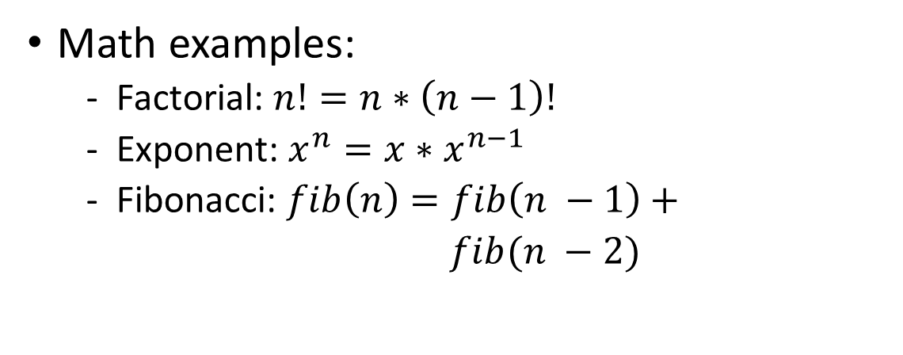
Why Recursion?
Generally, anything you can write iteratively you can write recursively
  So why write anything recursively?
Recursion is particularly useful when dealing with something that’s recursively defined
Math examples:
  Factorial: $n!=n∗\left(n−1\right)!$
  Exponent: $x^{n}=x∗x^{n−1}$
  Fibonacci: $fib\left(n\right)=fib\left(n −1\right)+$
  $fib(n −2)$
Non-math examples?
  ListNodes (int data, ListNode next)
  Other ideas?

Slide 5
Public / Private Pairs
Used when we need additional information between recursive calls
Private helper method hides additional info
  Clients shouldn’t have to worry about it
All public method does is kick-start the private one
  What’s the correct starting value(s) for additional param(s)?
Question to ask: “Do I need to keep track of any additional information?”

Slide 6


Files
We’ll say that computer files fall into one of the following categories:
Standard file (.txt, .csv, .java)
f.isDirectory() -> false
Directory w/ subfiles
f.isDirectory() -> true
File[] subFiles = f.listFiles()
This is a recursive definition! A File is either normal, or a directory with a File[] of subFiles

