Slide 1

Linked Nodes w/Loops
BEFORE WE START
What’s the last TV show or movie you finished?
Respond on sli.do!
Instructor:
Nathan Brunelle
TAs:
Cora | Chris | Crystal | Anya | Evan
Jonah | Nhan | Saachi | Ishita | Sahana
Chloe | Shiven | Nate | Renee | Yuntong
Amiya | Shashmit | Akshaya | Vihan | Shreedhaarini
Roshan | Adiyan | Nancy | Rachel | Ananya
Ryuta | Mimi | Isaac | Megan
Notes:
Slido event: https://app.sli.do/event/dWEW6XzFpXq37KFkbTkUcQ
Or
Slido.com with event code cse123

Slide 2
Lecture Outline: Announcements
Announcements
ListNode practice
Iterating over ListNodes

Slide 3
Announcements
P0 due Wednesday 10/21 at 11:59pm
CQ0 can be scheduled 10/22-10/29
  Book a time on Canvas
  See Ed announcement for details
Commentpalooza

Slide 4
Lecture Outline: ListNode practice
Announcements
ListNode practice
Iterating over ListNodes

Slide 5
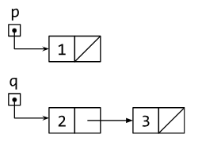
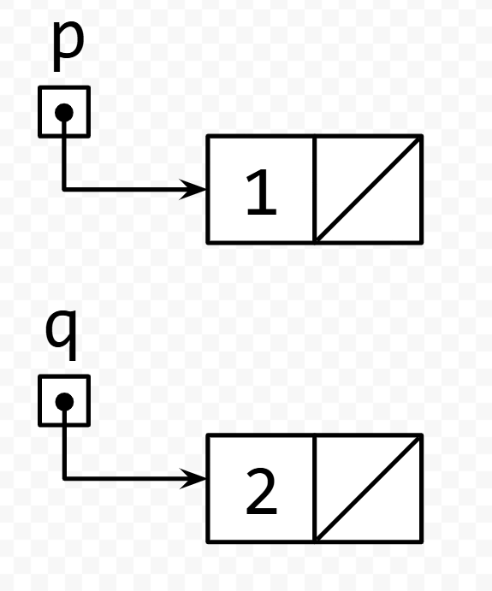
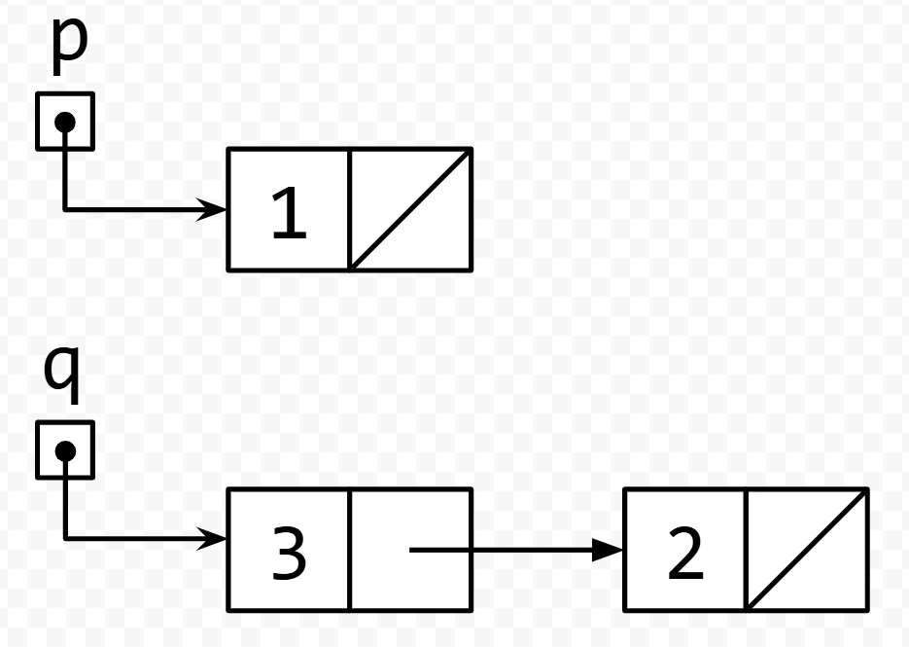
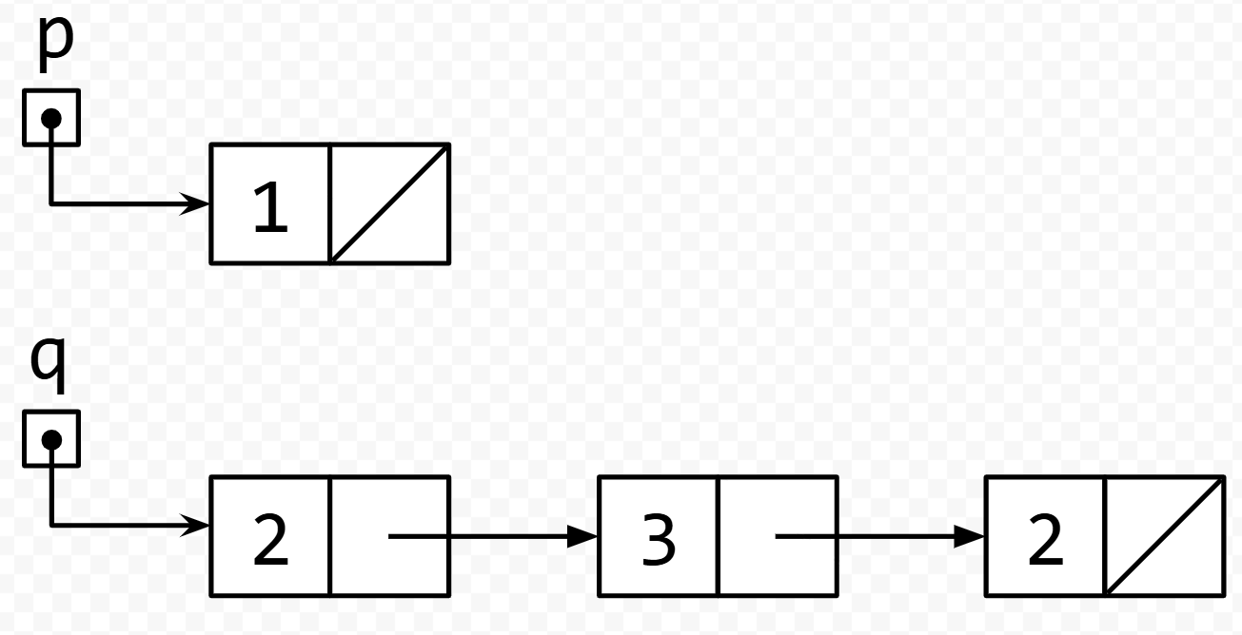
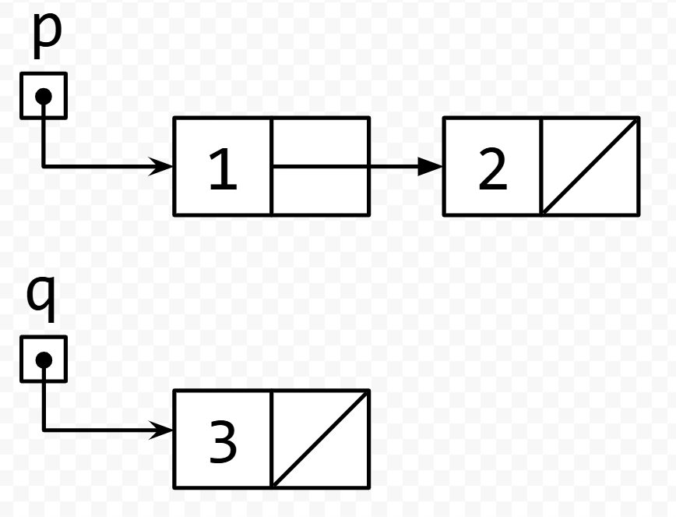
Think Pair Share: run code on example lists: Think
What is the result of running the code on the list shown in the picture?
A. B.
C. D.
q.next.next = q;
q = q.next;
q.next.next = null;
Notes:
Slido event: https://app.sli.do/event/dWEW6XzFpXq37KFkbTkUcQ
Or
Slido.com with event code cse123

Slide 6
Think Pair Share: run code on example lists: Pair
What is the result of running the code on the list shown in the picture?
A. B.
C. D.
q.next.next = q;
q = q.next;
q.next.next = null;
Notes:
Slido event: https://app.sli.do/event/dWEW6XzFpXq37KFkbTkUcQ
Or
Slido.com with event code cse123

Slide 7
TPS: run code on example lists
q.next.next = q;
q = q.next;
q.next.next = null;

Slide 8
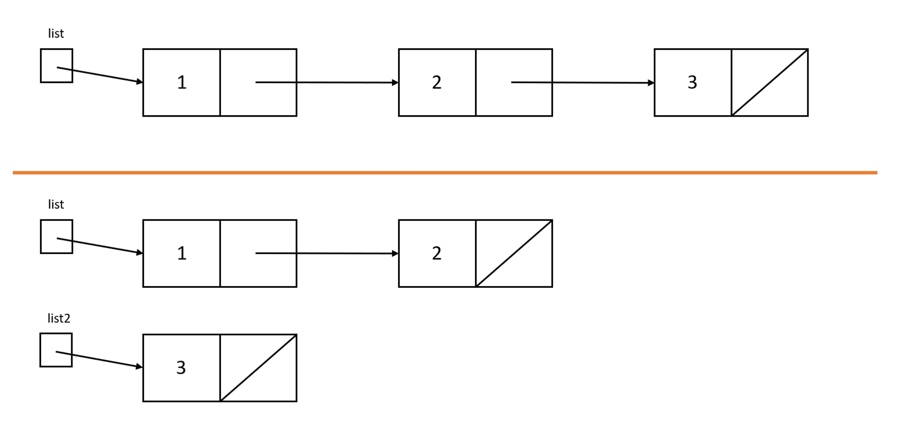
Think Pair Share: from top pic to bottom pic: Think
Which code will turn the top picture into the bottom picture?
A. ListNode list2 = list.next.next;
B. list.next.next = null;
ListNode list2 = list.next.next;
C. ListNode list2 = list.next.next;
list.next.next = null;
D. ListNode list2 = list.next;
list.next = null;
Notes:
top picture: variable list holding a reference to a node containing 1 and a next field pointing to another node containing 2 and a next field pointing to another node which contains 3 and a null next field
bottom picture: variable list holding a reference to a node containing 1 and a next field pointing to another node containing 2 and a null net field; then a separate variable list2 holding a reference to a node containing 3 and a null next field
Slido event: https://app.sli.do/event/dWEW6XzFpXq37KFkbTkUcQ
Or
Slido.com with event code cse123

Slide 9
Think Pair Share: from top pic to bottom pic: Pair
Which code will turn the top picture into the bottom picture?
A. ListNode list2 = list.next.next;
B. list.next.next = null;
ListNode list2 = list.next.next;
C. ListNode list2 = list.next.next;
list.next.next = null;
D. ListNode list2 = list.next;
list.next = null;
Notes:
top picture: variable list holding a reference to a node containing 1 and a next field pointing to another node containing 2 and a next field pointing to another node which contains 3 and a null next field
bottom picture: variable list holding a reference to a node containing 1 and a next field pointing to another node containing 2 and a null net field; then a separate variable list2 holding a reference to a node containing 3 and a null next field
Slido event: https://app.sli.do/event/dWEW6XzFpXq37KFkbTkUcQ
Or
Slido.com with event code cse123

Slide 10
TPS: from top pic to bottom pic

Slide 11
Lecture Outline: Iterating over ListNodes
Announcements
ListNode practice
Iterating over ListNodes

Slide 12
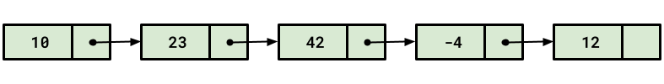
ListNode chains
Recall the ListNode class:
public class ListNode {
public int data;
public ListNode next;
}
How would we find the fourth value in a chain?
node.next.next.next.data
node

Slide 13
Longer ListNode chains
Recall the ListNode class:
public class ListNode {
public int data;
public ListNode next;
}
How would we find the 100th value in a chain?
node.next.next.next.next.next.next.next....
node

Slide 14
Iterating over ListNodes
General pattern iteration code will follow:
ListNode curr = front;
while (curr != null) {
// Do something
curr = curr.next;
}

