Slide 1
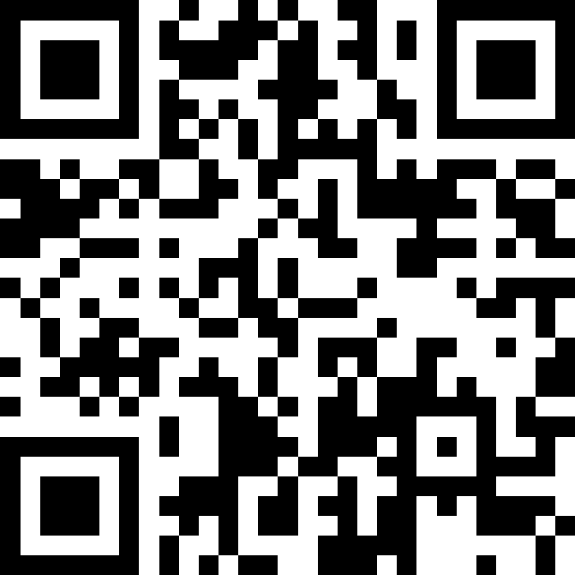

Welcome
& Syllabus
BEFORE WE START
Talk to your neighbors:
Introduce yourself to your neighbor!
What is your name? Major? What have you been up to the past week?
Instructor:
Nathan Brunelle
TAs:
Cora | Chris | Crystal | Anya | Evan
Jonah | Nhan | Saachi | Ishita | Sahana
Chloe | Shiven | Nate | Renee | Yuntong
Amiya | Shashmit | Akshaya | Vihan | Shreedhaarini
Roshan | Adiyan | Nancy | Rachel | Ananya
Ryuta | Mimi | Isaac | Megan
Notes:
Slido event: https://app.sli.do/event/h1h54ptZxfCMf5m8QF6Gpx

Slide 2
Lecture Outline: Introductions
Introductions
About this Course
  Course Components & Tools
  Making the Most of this Class
Assignments and Grading

Slide 3
Course Staff
Instructor: Nathan Brunelle
  Feel free to call me any combination of
  (“”, “Mr.”, “Dr.”, “Prof.”) + (“Nathan”, “Nate”, “Brunelle”)
  E.g. “Nathan”, “Prof. Nate”, and “Brunelle” all work!
Teaching Assistants: 29 Fantatsic Tas!
  Available in section, office hours, and discussion board
  Invaluable source of information and help in this course

Slide 4
Lecture Outline: About this Course
Introductions
About this Course
  Course Components & Tools
  Making the Most of this Class
Assignments and Grading

Slide 5
What is this Class?
CSE 121 – Computer Programming I
CSE 122 – Computer Programming II
  Data types (int, String, boolean)
  Methods / Functions
    Parameters, Returns
  Control structures
    Loops, Conditionals
  Arrays & 2D arrays
  Computational Thinking
  (language agnostic)
  Functional Decomposition
  File I/O
  Using data structures
    List, Stacks / Queues, Sets, Maps
  Object Oriented Programming
    Interfaces
CSE 123 – Computer Programming III
  Advanced Object Oriented Programming
    Comparable, Inheritance/Polymorphism, Abstract Classes
  Implementing data structures
    ArrayLists, LinkedLists, Trees
  Recursion
  Critical analysis of design

Slide 6
Why 123?
To solve more complex problems by leveraging more complex programming structures / patterns
To better rationalize specific design decisions
  How to “best” structure programs
  Which data structures are “most” appropriate to use
To understand and critically analyze intersections between Computer Science and society
  Search engines, algorithmic art, machine learning, etc.
  Developing informed opinions on current issues
Be a better programmer
Be a better person

Slide 7
Prerequisite Knowledge
Comfort with control structures
  loops, conditionals, methods/functions
Experience with using basic data structures
  arrays, lists, sets, maps
Experience with console and file input/output
Exposure to simple object-oriented programming
  classes, interfaces
Programming experience in Java
  Or willingness to pick up on your own

Slide 8
Course Expectations
What are you hoping to get out of taking CSE 123?
sli.do #cse123
Notes:
Slido event: https://app.sli.do/event/h1h54ptZxfCMf5m8QF6Gpx

Slide 9
Programming Skill
Fluency with the relevant language and tools
  consists of many conceptually simple facts
    e.g. syntax (of a for loop, method, ...) , how to run a program
  eventually becomes second nature
Mental model of how programs execute
  consists of a few deep concepts
    e.g. what is a variable? a loop? a method? a reference?
  develop the skill of tracing the current state of a program
Key course takeaway!

Slide 10
Lecture Outline: Course Components & Tools
Introductions
About this Course
  Course Components & Tools
  Making the Most of this Class
Assignments and Grading

Slide 11
Course Components (New in Autumn ’26)
LECTURES
x19
PROGRAMMING PROJECTS
x4
COMPUTER QUIZZES
x4
We’re here!
Introduce concepts, practice
ideas, discuss applications.
Pre-class materials to prepare for
class each day. Due before class.
Structured assignments
Programming in Java
Applying & implementing course concepts
One per project
Add functionality to, change behavior of, your project code
45 minutes scheduled out of class
PAPER QUIZZES
x4
PARTICIPATION
x36
SECTIONS
x17
3 taken in quiz section
1 taken on final exam day
45 minutes on paper
Complete Pre-class materials before class
Attend and engage in section
Held in person
More practice, reviews, applications
TA advice, how to be an effective student
Preparation for quizzes
RETAKE + RESUBMISSION
1 programming project + computer quiz pair (keep the last)
1 Problem per paper quiz on the final (keep the best)
Graded Assignments
Meetings

Slide 12
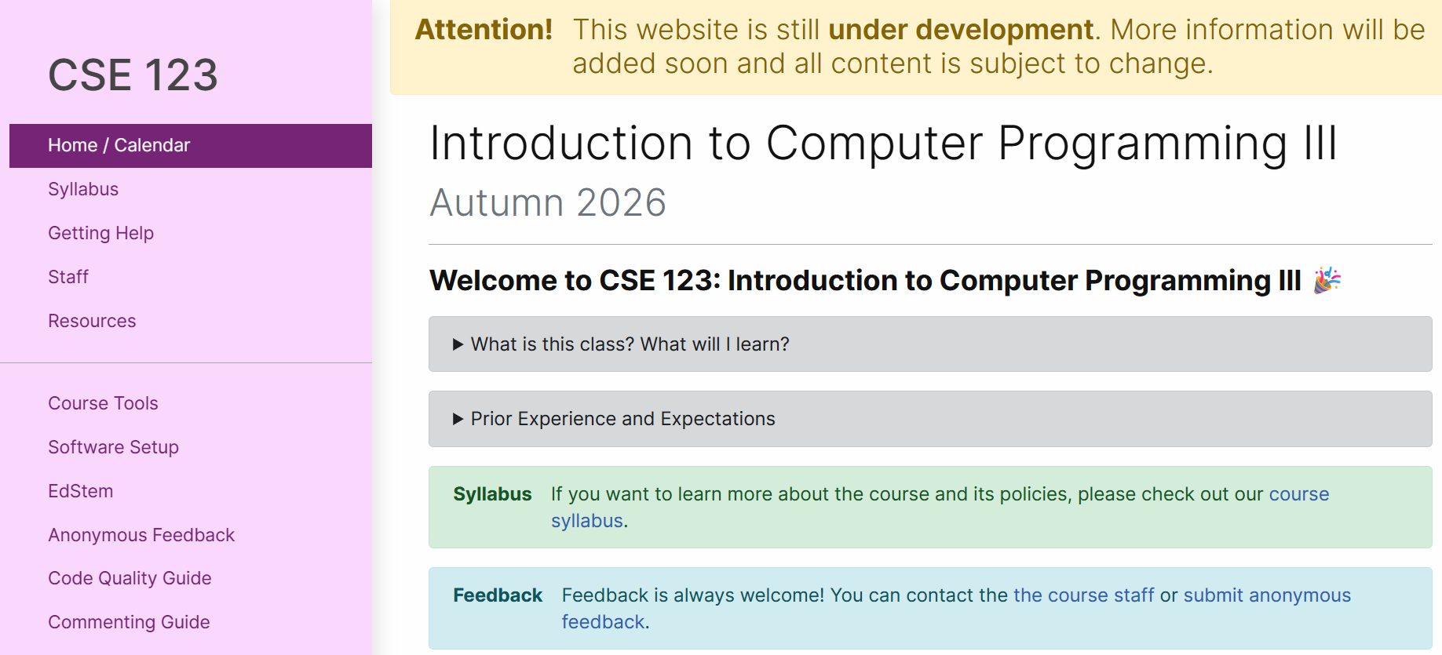
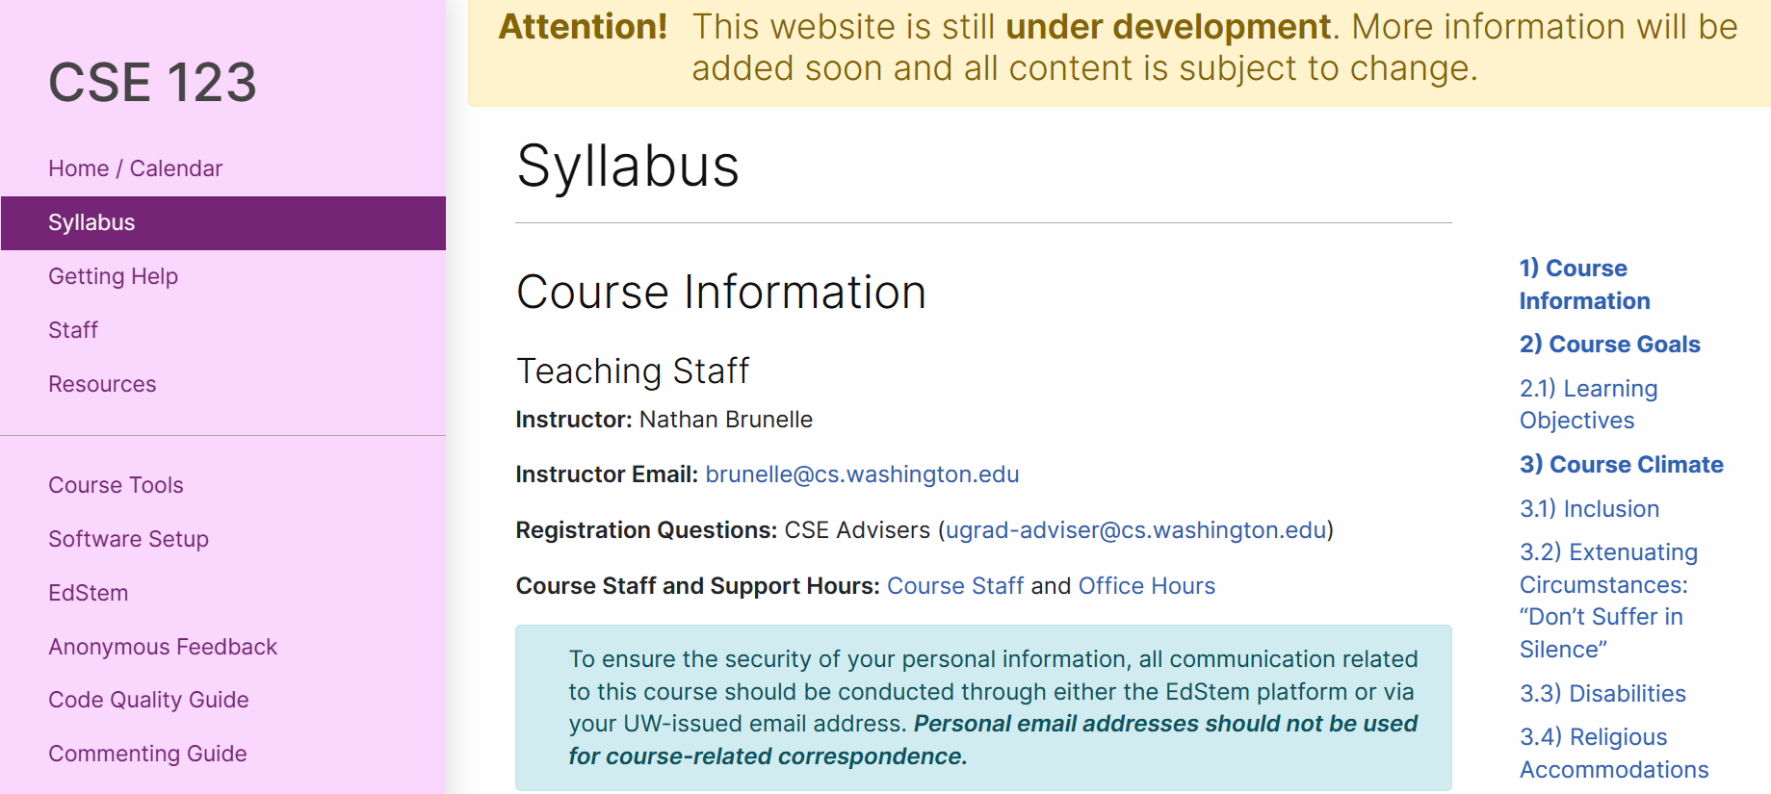
Course Website
cs.uw.edu/123
Review the syllabus!
Contains most course info – check frequently!
Announcements, Calendar, Lecture Slides, Office Hours schedule,
Staff Bios, Important Links

Slide 13





Other Course Tools
My Digital Hand
Queueing in office hours
VSCode
Develop offline
Visual debugger
Ed
Community & Information
  Discussion Board
  (please ask & answer!; anonymous option)
  Announcements
Pre-Class Materials / Section Handouts
Computer Quizzes
Assignments
  Online IDE
  Submit assignments
  View Feedback
Gradescope
Paper Quiz grades
Sli.do
In-class activities
(ungraded)

Slide 14
Lecture Outline: Making the Most of this Class
Introductions
About this Course
  Course Components & Tools
  Making the Most of this Class
Assignments and Grading

Slide 15

How Learning Works
Learning requires active participation in the process. It’s not as simple as sitting and listening to someone talk at you.
  Requires deliberate practice in learning by doing
  Benefits from collaborative learning
Hybrid classroom model
  Asks you to do some preparation before class in the form
  of readings and practice problems.
    Should take ~30 minutes outside of class per lesson
  Class will start with brief recap, then pick up
  where the reading and practice problems leave off.
  Attendance isn’t graded, but showing up and trying
  is the first step in succeeding in the class!
For participation credit you only need to attempt the pre-class materials, but…
  It’s okay if you find them challenging! That means
  you are learning!

Slide 16
Learning Pattern
Pre-class Work
  Your first introduction to a topic
  Interactive components
In-class lessons
  Recap of pre-class work
  Further instruction from where it left off
  Interactive components
Section
  Review, restate, rephrase content
  Very interactive
Homework
  Learn by applying
  Help when you need it!
Quizzes
  Show us what you’ve learned
Instruction
Practice
Instruction
Practice
Instruction
Practice
Practice/Assessment
Instruction
Assessment

Slide 17
Learning in CSE 123: Live Support Systems
Programming is hard! We want to give you collaborative support!
Introductory Programming Lab (TA Office Hours) – starting Week 2
> 20 hours/week (and highly rated in the class!)
Face-to-face help from TAs on any course questions
Instructor Office Hours
Great for things from lecture, personal questions, or just saying hi

Slide 18
Learning in CSE 123: Async Support Systems
Ed Board
Best for content and logistics questions – 500 of you >> 30 of us!!
Encourage public posts, except for things about your graded work
Answer other students’ questions – great way to learn!
Email
Best for personal circumstances and/or private questions
If unsure, always feel free to email Trien
  May politely ask you to post on Ed instead!
For emails, please use your UW email (protecting student privacy!)

Slide 19
The World Around Us
College is challenging and CSE 123 isn’t your only class.
Life is unpredictable and things happen.
We can’t leave the impacts of the world around us at the classroom door.
OUR POLICIES
SUPPORT
Our course policies are designed for flexibility:
  Resubmissions/Retakes
  Asynchronous help
  Lecture recordings
We’re here to support you as a student and as a person.
Please reach out if you’re struggling or have circumstances that require extra support.

Slide 20
Lecture Outline: Assignments and Grading
Introductions
About this Course
  Course Components & Tools
  Making the Most of this Class
Assignments and Grading

Slide 21
Assignments and Grading
Our goal in the course is for you to gain proficiency the concepts and skills we teach
You gain proficiency by applying the concepts and skills on tasks or problems
We assess your proficiency on quizzes (paper and computer)

Slide 22
Assignments
Your learning in this course will be assessed in four ways:
  Programming Project (~biweekly, 4 total)
    Structured programming assignments to assess your proficiency of programming concepts
  Computer Quizzes (1 per Programming Assignment)
    Questions largely derived from the corresponding Programming Assignment
  Paper Quizzes (4 total, 3 in section, 1 on the Final Exam)
    Series of problems covering all material up to that point

Slide 23
Resubmissions and Retakes
Learning takes time, and doesn’t always happen on the first try
One previous Programming Project + Computer Quiz pair can be resubmitted + retaken
  To resubmit code you must retake the quiz. You may retake the quiz with the same code
  Grade on resubmission will replace original grade
  All retakes happen in the last week of classes through final exams
We will ignore your two lowest quiz/exam problem grades
  No special action required– we’ll do this automatically
See the syllabus for more details

Slide 24
Grading
Grades should reflect your proficiency in the course objectives
All assignments will be graded E (Excellent), S (Satisfactory), or N (Not yet)
  Under certain circumstances, a grade of U (Unassessable) may be assigned
Final grades will be assigned based on the amount of work at each level
See the syllabus for more details

Slide 25
Collaboration Policy
We encourage you to collaborate (with each other or with AI tools) on programming projects
You may not collaborate (with classmates or AI) on Quizzes
Some rules/guidelines to highlight:
  Computer quizzes heavily derive from the projects, so understanding your project code is key to success on the quiz
  You must cite all of your collaborators (classmates or AI)
  Do not discuss quizzes until after grades are released
See the syllabus for more details (this is very important to understand).

Slide 26
AI and CSE 123: Our Philosophy
Computing applications enabled by artificial intelligence (AI) are increasingly common and more widely used for a variety of tasks.
It is becoming more difficult to teach an introductory computing course without acknowledging the existence of AI tools.
But as relatively new programmers, you still need to learn and practice effectively using core programming ‘building blocks’.

Slide 27
Coming up…
🧑‍🏫 Go to your first quiz section and meet your TAs tomorrow!
  Make sure to double check MyUW for the location.
💻 Complete Pre-Class Work 1 before class on Friday!
  It will be posted and linked from the course calendar later today.
❓ Complete the Introductory Survey
  This helps us gather data about the students taking our classes and their backgrounds, to inform future offerings.

