Slide 1
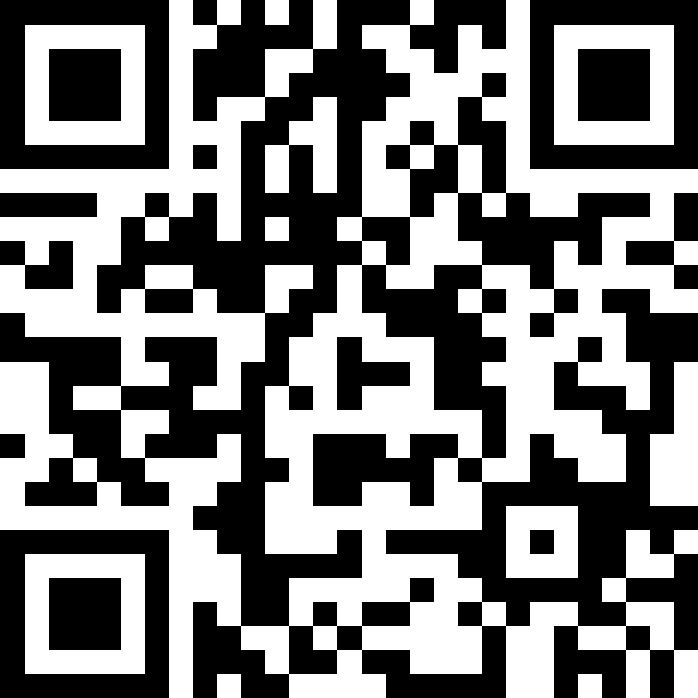
Abstract Classes
BEFORE WE START
Talk to your neighbors:
Coffee or tea? Or something else?
Instructors:
Brett Wortzman
Miya Natsuhara
Arohan | Neha | Rushil | Johnathan | Nicholas
Sean | Hayden | Srihari | Benoit | Isayiah
Audrey | Chris | Andras | Jessica | Kavya
Cynthia | Shreya | Kieran | Rohan | Eeshani
Amy | Packard | Cora | Dixon | Nichole
Trien | Lawrence | Liza | Helena
Music: CSE 123 25wi Lecture Tunes

Slide 2
Announcements
Review sessions held on Monday Jan 13
Recordings are linked from the course calendar
Creative Project 0 due tonight, Wed Jan 15 at 11:59pm!
See generic Creative Project rubric posted on website
Programming Assignment 0 will be released tomorrow, Thurs Jan 16
Focused on inheritance and abstract classes
NOTE: Monday, Jan 20 is a university holiday (MLK Jr. day) so campus will be closed
Instructor office hours will be cancelled
IPL will be closed
Message board will still be available, but response time may vary

Slide 3
Lecture Outline
Polymorphism Review
Declared vs. Actual Type
Compiler vs. Runtime Errors
Abstract Classes Review
Pre/Post conditions and commenting

Slide 4
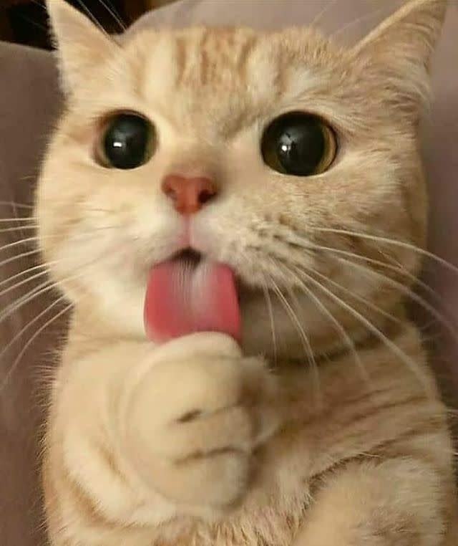
Review: Is-a Relationships
Animal
Fish
Birds
Mammal
Reptile
Amphibian
Dog
Cat

Slide 5
Review: Polymorphism
DeclaredType x = new ActualType()
All methods in DeclaredType can be called on x
We’ve seen this with interfaces (List<String> vs. ArrayList<String>)
Can also be to inheritance relationships
Animal[] arr = {new Dog(), new Cat(), new Bear()};
for (Animal a : arr) {
a.feed();
}

Slide 6
Compiler vs. Runtime Errors
DeclaredType x = new ActualType()
At compile time, Java only knows DeclaredType
Compiler error (CE): trying to call a method that isn’t present
Animal a = new Dog();
a.bark(); // No bark() -> CE
Can cast to change the DeclaredType of an object
((Dog) a).bark(); // No more CE
Runtime error (RE): attempting to cast to an invalid DeclaredType*
Animal a = new Fish();
((Dog) a).bark(); // Can’t cast -> RE
- Order matters! Compilation before runtime

Slide 7
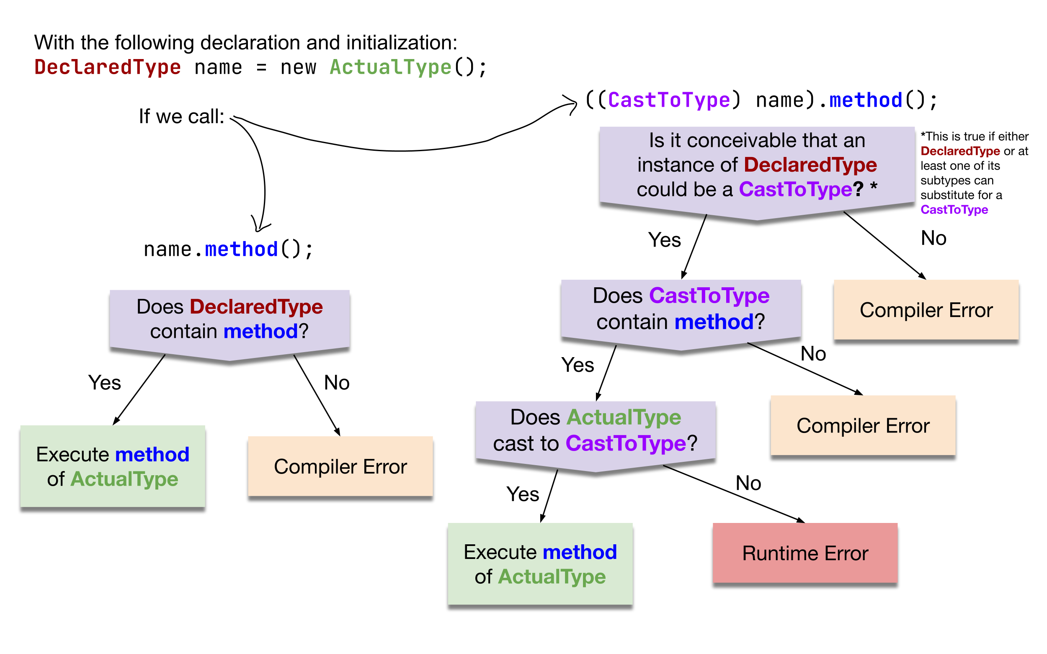
Compiler vs. Runtime Errors

Slide 8
What results from the following code being executed? (1)
Compiler Error
Runtime Error
Compiles and runs without error
Animal gumball = new Dog();
gumball.bark();

Slide 9
What results from the following code being executed? (1)
Compiler Error
Runtime Error
Compiles and runs without error
Animal gumball = new Dog();
gumball.bark();

Slide 10
What results from the following code being executed? (2)
Compiler Error
Runtime Error
Compiles and runs without error
Animal gumball = new Dog();
((Dog) gumball).bark();

Slide 11
What results from the following code being executed? (2)
Compiler Error
Runtime Error
Compiles and runs without error
Animal gumball = new Dog();
((Dog) gumball).bark();

Slide 12
What results from the following code being executed? (3)
Compiler Error
Runtime Error
Compiles and runs without error
Animal gumball = new Dog();
((String) gumball).meow();

Slide 13
What results from the following code being executed? (3)
Compiler Error
Runtime Error
Compiles and runs without error
Animal gumball = new Dog();
((String) gumball).meow();

Slide 14
What results from the following code being executed? (4)
Compiler Error
Runtime Error
Compiles and runs without error
Animal gumball = new Dog();
((Reptile) gumball).slither();

Slide 15
What results from the following code being executed? (4)
Compiler Error
Runtime Error
Compiles and runs without error
Animal gumball = new Dog();
((Reptile) gumball).slither();

Slide 16
Lecture Outline
Polymorphism Review
Declared vs. Actual Type
Compiler vs. Runtime Errors
Abstract Classes Review
Pre/Post conditions and commenting

Slide 17
Abstract Classes
Interfaces
Abstract Classes
Classes
Mixture of Interfaces and Classes
Interface similarities:
- Can contain (abstract) method declarations
- Can’t be instantiated
Class similarities:
- Can contain method implementations
- Can have fields
Is there identical / nearly similar behavior between classes that shouldn’t inherit from one another?

Slide 18
Shape / Square / Circle Example
The starter code contains Shape, Square, and Circle classes similar to the pre-class work, as well as a Client that prints out a couple of shapes.
Add an abstract getName method to the Shape.
Add implementations of getName to Square and Circle that return "Square" and "Circle".
Add a method isEmpty to Shape that tells you whether the shape is empty (has zero area) or not.
Hint: you will need to call getArea, but it may not immediately work…
Implementing isEmpty by calling getArea works fine as is, but suppose we wanted to implement it in Circle directly. How could we do this just by looking at the fields of the Circle? Implement it this way by overriding isEmpty in Circle.
Override toString in Shape to return a similar message to what the Client prints in the starter code:
Hint: your toString can call abstract methods!
Rewrite the Client class to use the new toString on shapes.

Slide 19
Advanced OOP Summary
Abstract
Allow us to define differing levels of abstraction
Interfaces = high-level specification
What behavior should this type of class have
Abstract classes = shared behavior + high-level specification
Classes = individual behavior implementation
Inheritance allows us to share code via “is-a” relationships
Reduce redundancy / repeated code & enable polymorphism
Still might not be the “best” decision!
Interfaces extend other interfaces
(abstract) classes extend other (abstract) classes
Interfaces
Abstract Classes
Classes
Concrete
You’re now capable of designing some pretty complex systems!

Slide 20
Design in the “real world”
In this course, we’ll always give you expected behavior of the classes you write
Often not the case when programming for real
Clients don’t really know what they want (but programmers don’t either)
My advice:
Clarify assumptions before making them (do I really want this functionality?)
There’s no one right answer
Weigh the options, make a decision, and provide explanation
Iterative development: make mistakes and learn from them
Be receptive to feedback and be willing to change your mind

Slide 21
Interface versus Implementation
Interface: what something should do
Implementation: how something is done
These are different!
Big theme of CSE 123: choose between different implementations of same interface

