Slide 1
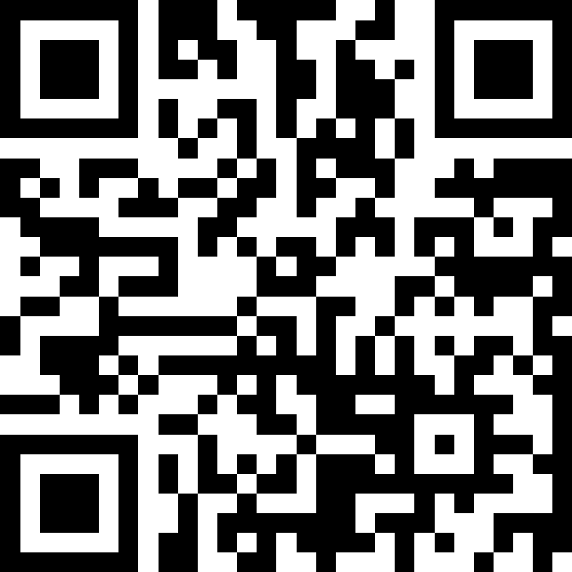
Inheritance; Polymorphism; Comparable
BEFORE WE START
Talk to your neighbors:
Plans for the weekend?
Instructors:
Brett Wortzman
Miya Natsuhara
TAs:
Arohan | Neha | Rushil | Johnathan | Nicholas
Sean | Hayden | Srihari | Benoit | Isayiah
Audrey | Chris | Andras | Jessica | Kavya
Cynthia | Shreya | Kieran | Rohan | Eeshani
Amy | Packard | Cora | Dixon | Nichole
Trien | Lawrence | Liza | Helena
Music: CSE 123 25wi Lecture Tunes

Slide 2
Coming up…
❓ Complete the Introductory Survey
This helps us gather data about the students taking our classes and their backgrounds, to inform future offerings.
🙋 Consider attending the Review Session on Monday, Jan 13
12:30pm – 1:20pm in ARC 147 ; 2:30pm – 3:20pm in GUG 220
Optional, hopefully recorded (waiting for confirmation)
💻 The IPL opens Monday, January 13
Schedule posted soon
🔎 Creative Project 0: Search Engine out now
Due Wednesday, January 15, 11:59pm

Slide 3
Collaboration Policy
When we assess your work in this class, we need to know that it’s yours.
Unless otherwise specified, all graded work must be completed individually.
Some specific rules to highlight:
do not share your own solution code or view solution code from any source – including but not limited to other students, tutors, or the internet
do not use AI tools (e.g. ChatGPT) on graded work in any capacity
See the syllabus for more details (this is very important to understand).

Slide 4
Lecture Outline
Inheritance
Comparable
Polymorphism
Declared vs. Actual Type
Compiler vs. Runtime Errors

Slide 5
Inheritance
Connect together a “subclass” and “superclass”
Borrow / “inherit” code to reduce redundancy
super() keyword can be used just like this()
Syntax: public class Subclass extends Superclass
Should Represent “is-a” relationships
public class Chef extends Employee
public class Server extends Employee
In Java, all objects implicitly inherit from the Object class
toString(), equals(Object), etc.

Slide 6
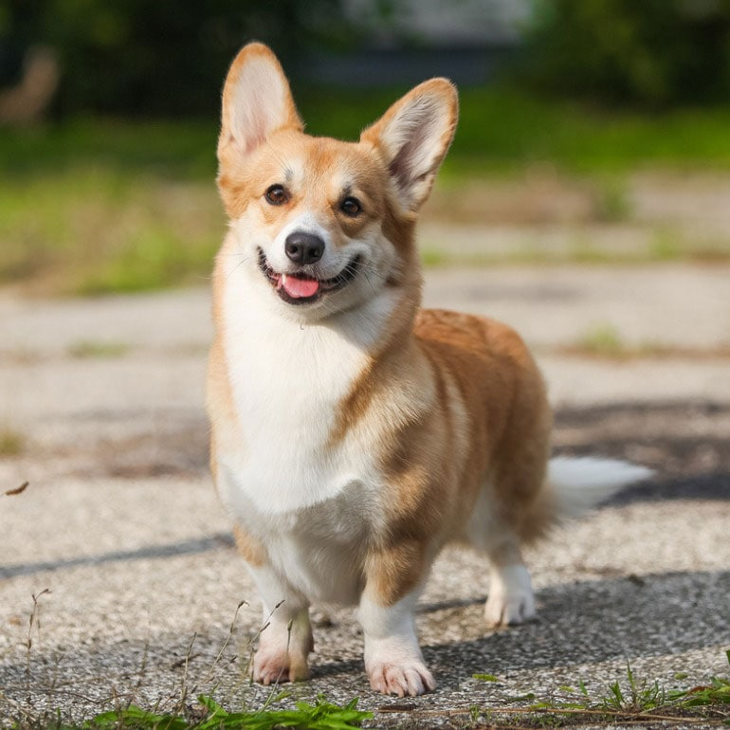
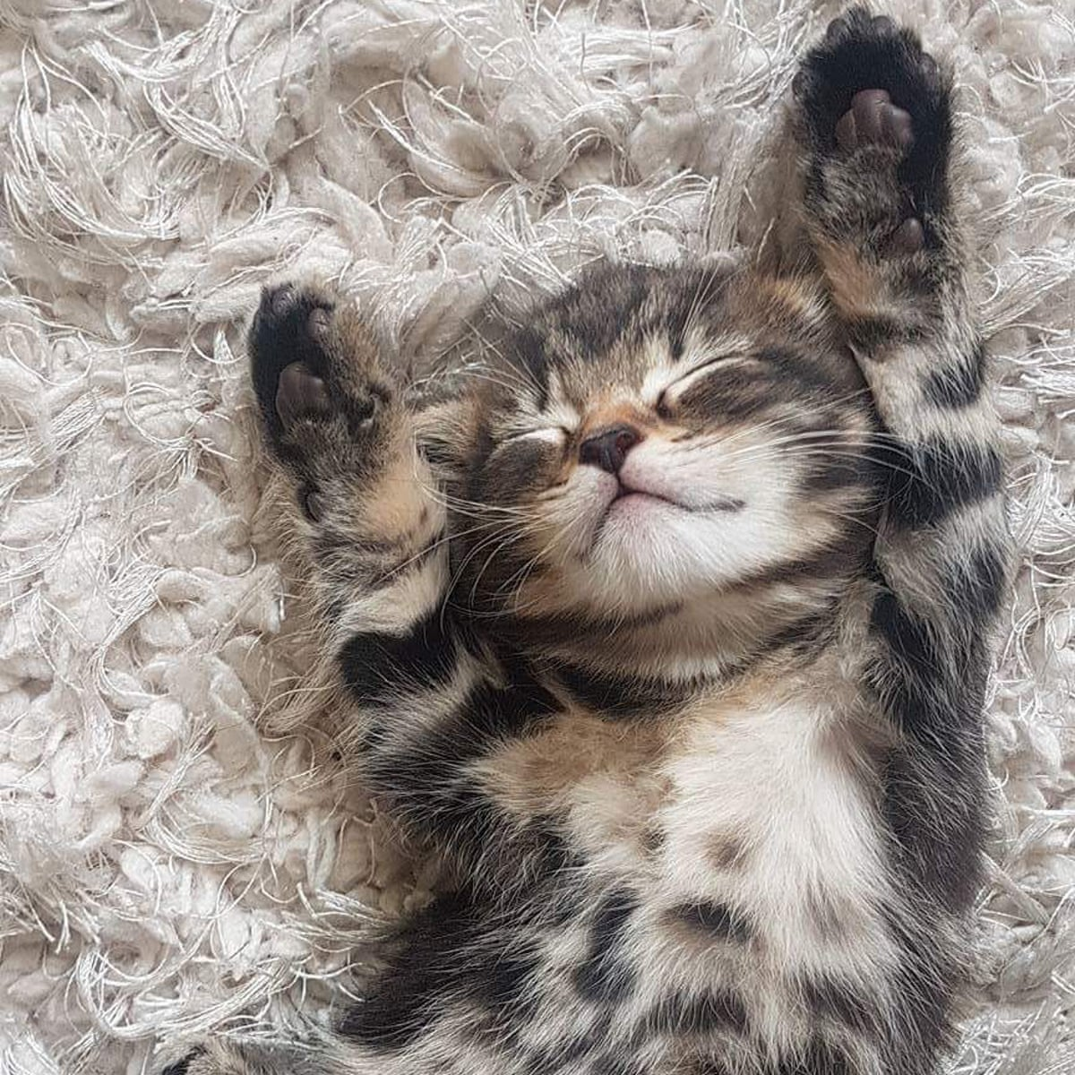
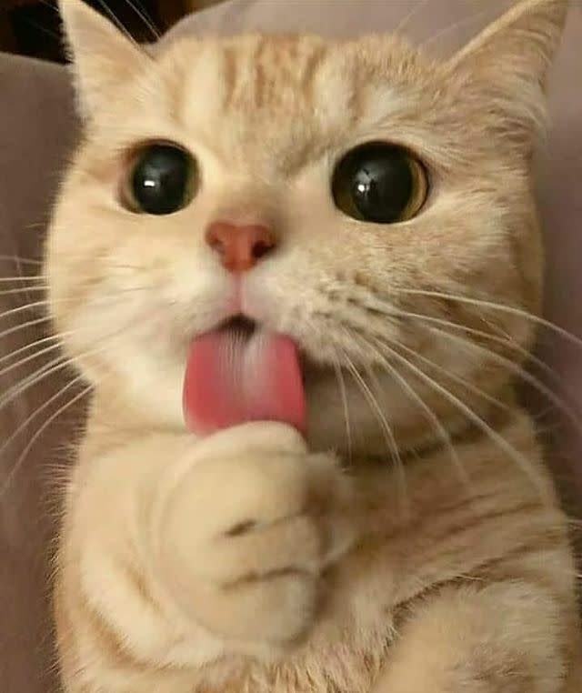
Is-a Relationships
Animal
Fish
Birds
Mammal
Reptile
Amphibian
Dog
Cat

Slide 7
PCM Review
sli.do #cse123

Slide 8
Lecture Outline
Inheritance
Comparable
Polymorphism
Declared vs. Actual Type
Compiler vs. Runtime Errors

Slide 9
Comparable
Comparable<E> is an interface that allows implementers to define an ordering between two objects
Used by TreeSet, TreeMap, Collections.sort, etc.
One required method:
public int compareTo (E other);
Returned integer falls into 1 of 3 categories
< 0: this is “less than” other
= 0: this is “equal to” other
> 0: this is “greater than” other
a.compareTo(b);
this
other

Slide 10
Subtraction Trick
compareTo implementation when comparing two integers (a) ascending:
This is just subtraction!
What if we wanted to sort descending?
Warning: this only works for integers! Doubles have issues with truncation.
if (this.a < other.a) -> negative number
else if (this.a > other.a) -> positive number
else -> 0
this.a – other.a
other.a – this.a

Slide 11
Lecture Outline
Inheritance
Comparable
Polymorphism
Declared vs. Actual Type
Compiler vs. Runtime Errors

Slide 12
Polymorphism
DeclaredType x = new ActualType()
All methods in DeclaredType can be called on x
We’ve seen this with interfaces (List<String> vs. ArrayList<String>)
Can also be to inheritance relationships
Animal[] arr = {new Dog(), new Cat(), new Bear()};
for (Animal a : arr) {
a.feed();
}

Slide 13
Compiler vs. Runtime Errors
DeclaredType x = new ActualType()
At compile time, Java only knows DeclaredType
Compiler error: trying to call a method that isn’t present
Animal a = new Dog();
a.bark(); // No bark() -> CE
Can cast to change the DeclaredType of an object
((Dog) a).bark(); // No more CE
Runtime error: attempting to cast to an invalid DeclaredType*
Animal a = new Fish();
((Dog) a).bark(); // Can’t cast -> RE
- Order matters! Compilation before runtime

Slide 14
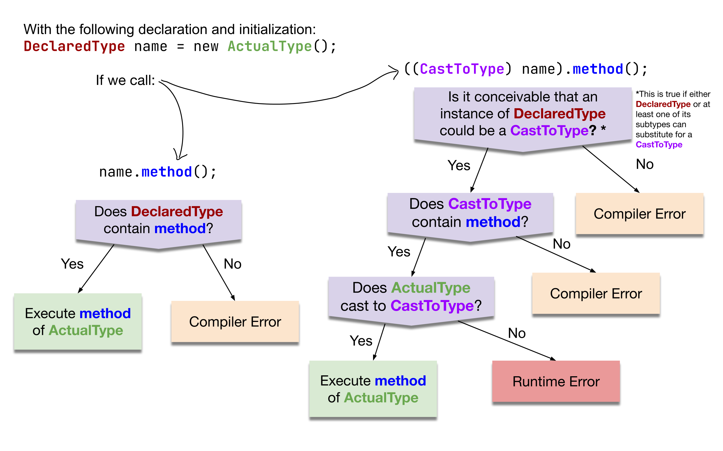
Compiler vs. Runtime Errors

