Slide 1
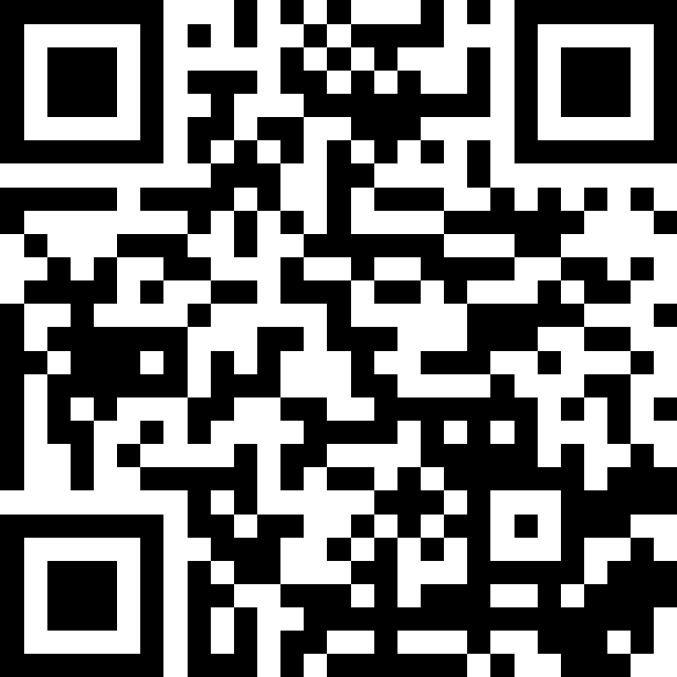
Welcome & Syllabus
BEFORE WE START
Talk to your neighbors:
Introduce yourself to your neighbor! What is your name? Major? What have you been up to the past week?
Instructors:
Brett Wortzman
Miya Natsuhara
TAs:
Arohan | Neha | Rushil | Johnathan | Nicholas
Sean | Hayden | Srihari | Benoit | Isayiah
Audrey | Chris | Andras | Jessica | Kavya
Cynthia | Shreya | Kieran | Rohan | Eeshani
Amy | Packard | Cora | Dixon | Nichole
Trien | Lawrence | Liza | Helena
Music: CSE 123 25wi Lecture Tunes

Slide 2
Lecture Outline
Introductions
About this Course
Course Components & Tools
Making the Most of this Class
Assignments and Grading

Slide 3
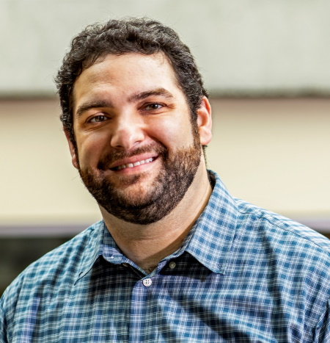
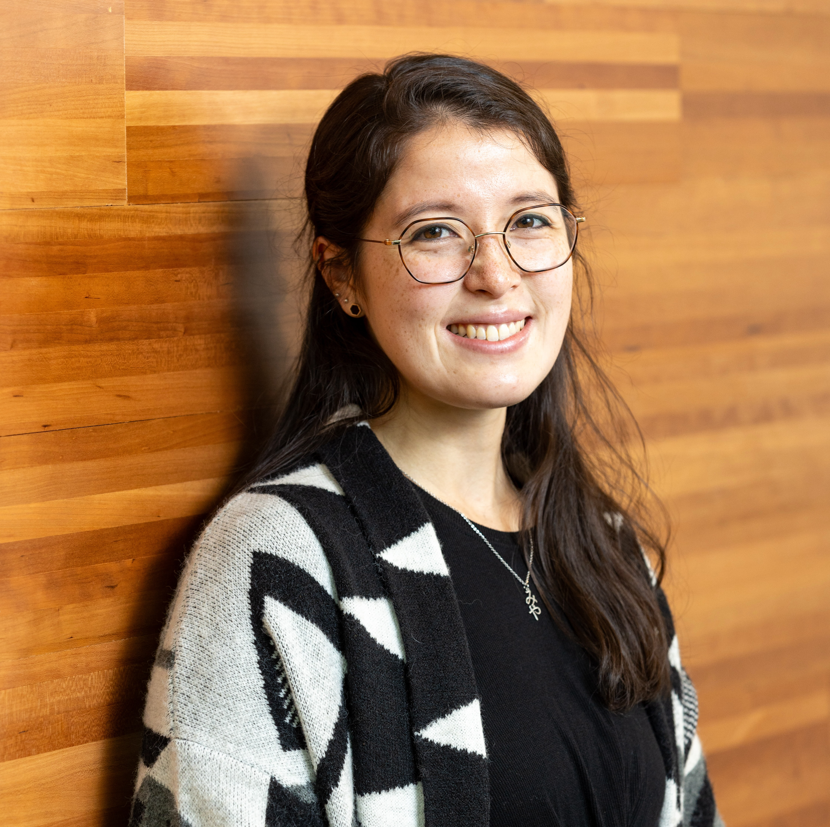
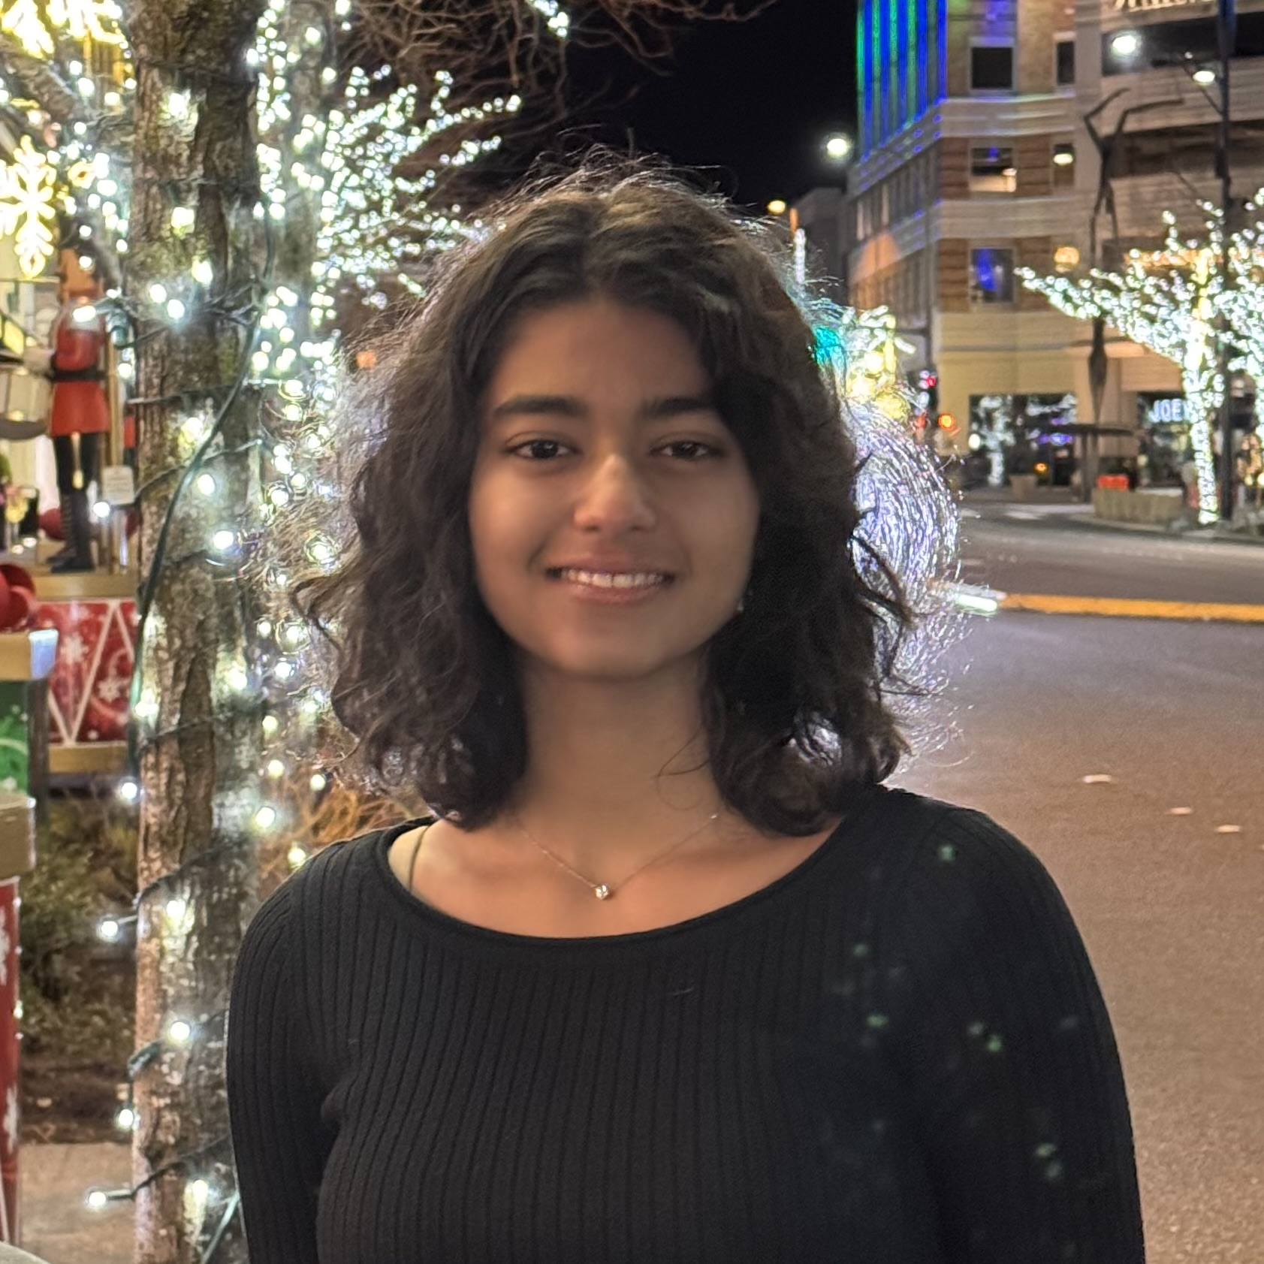
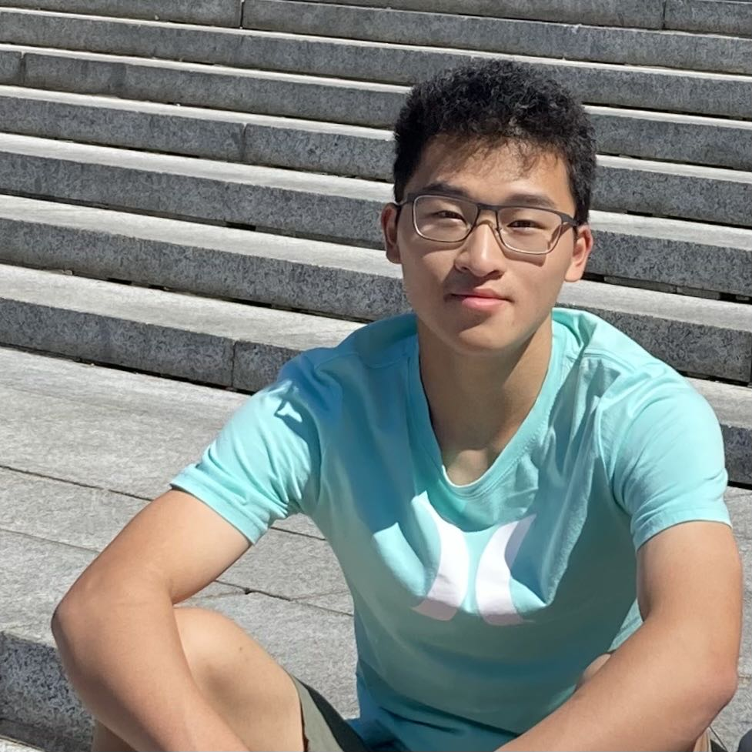
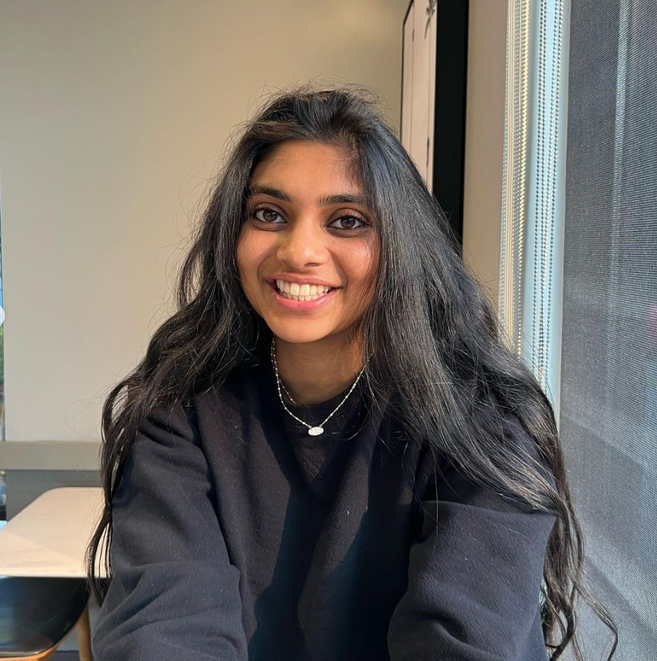
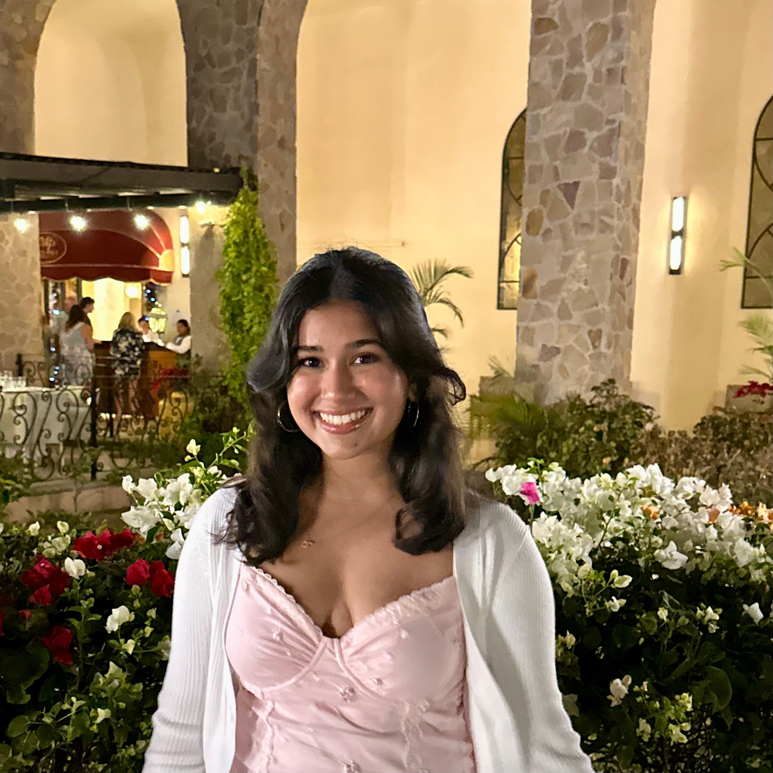
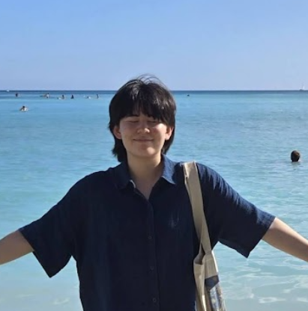
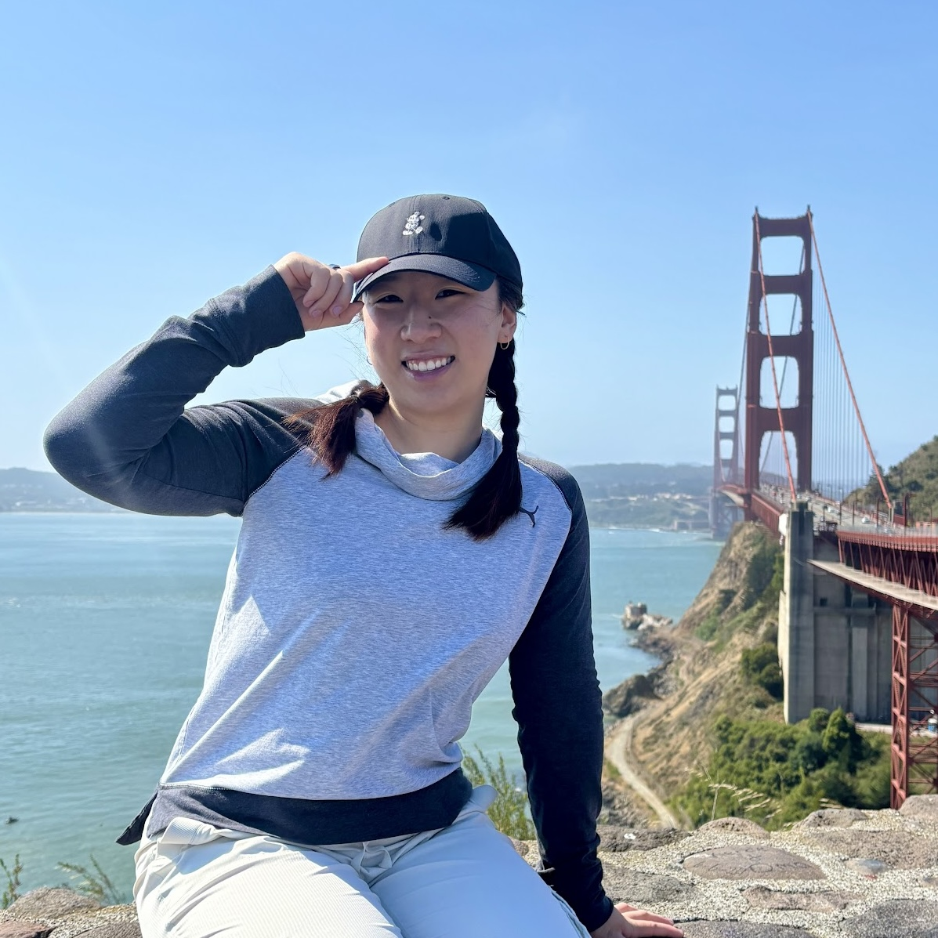
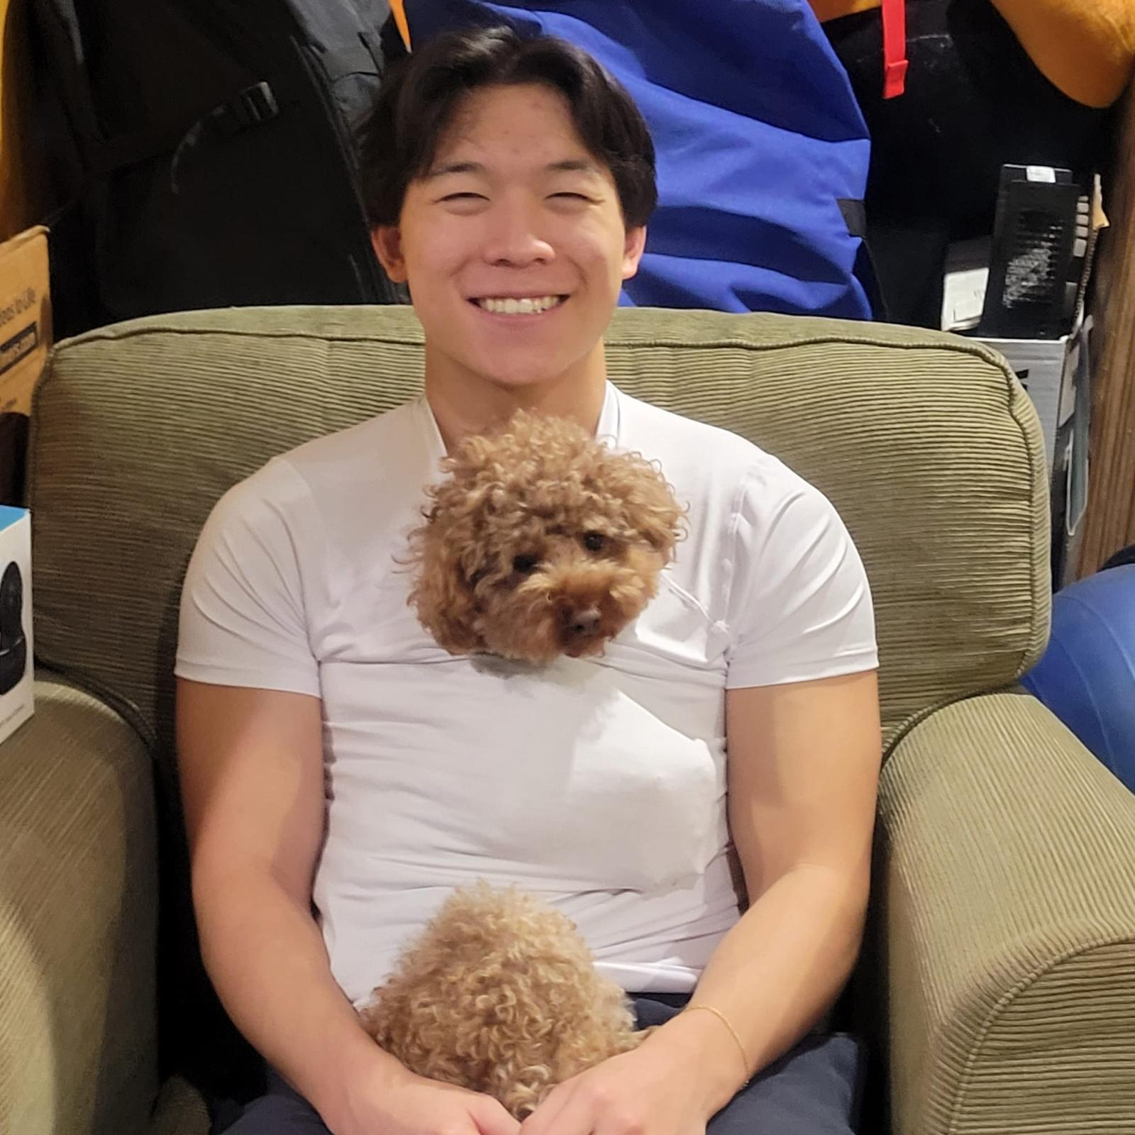
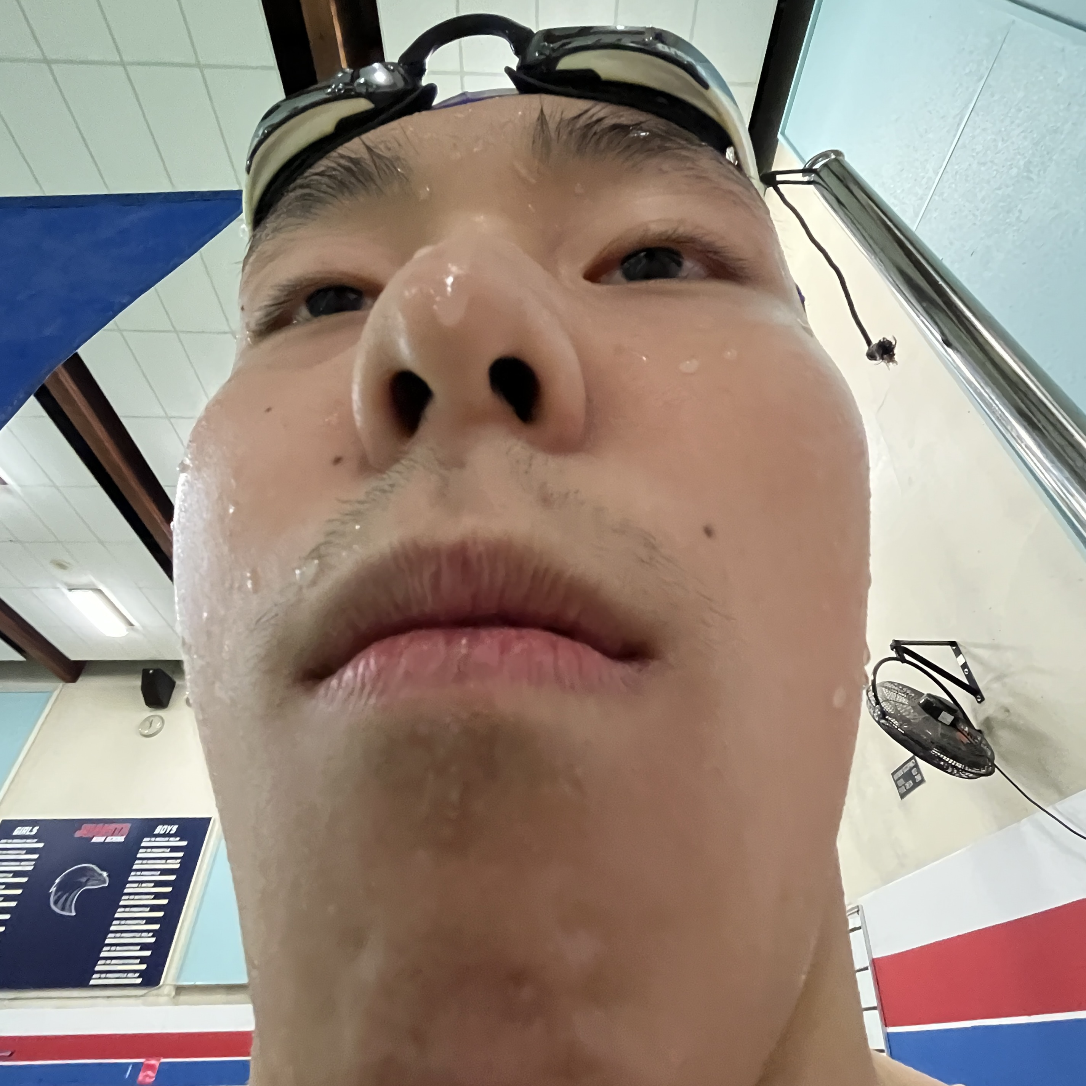
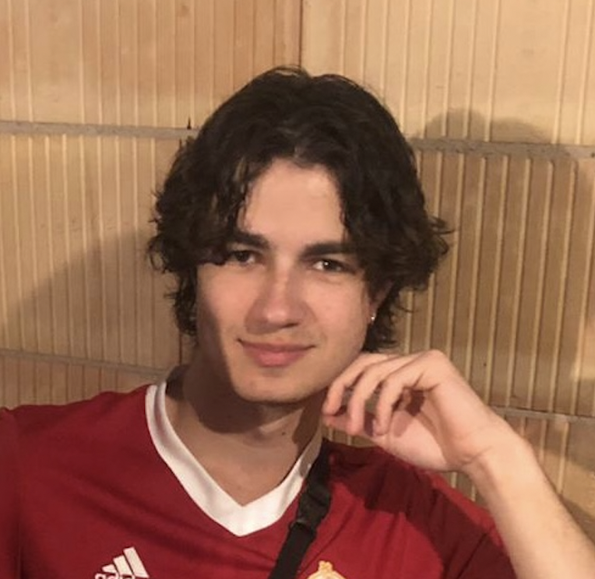
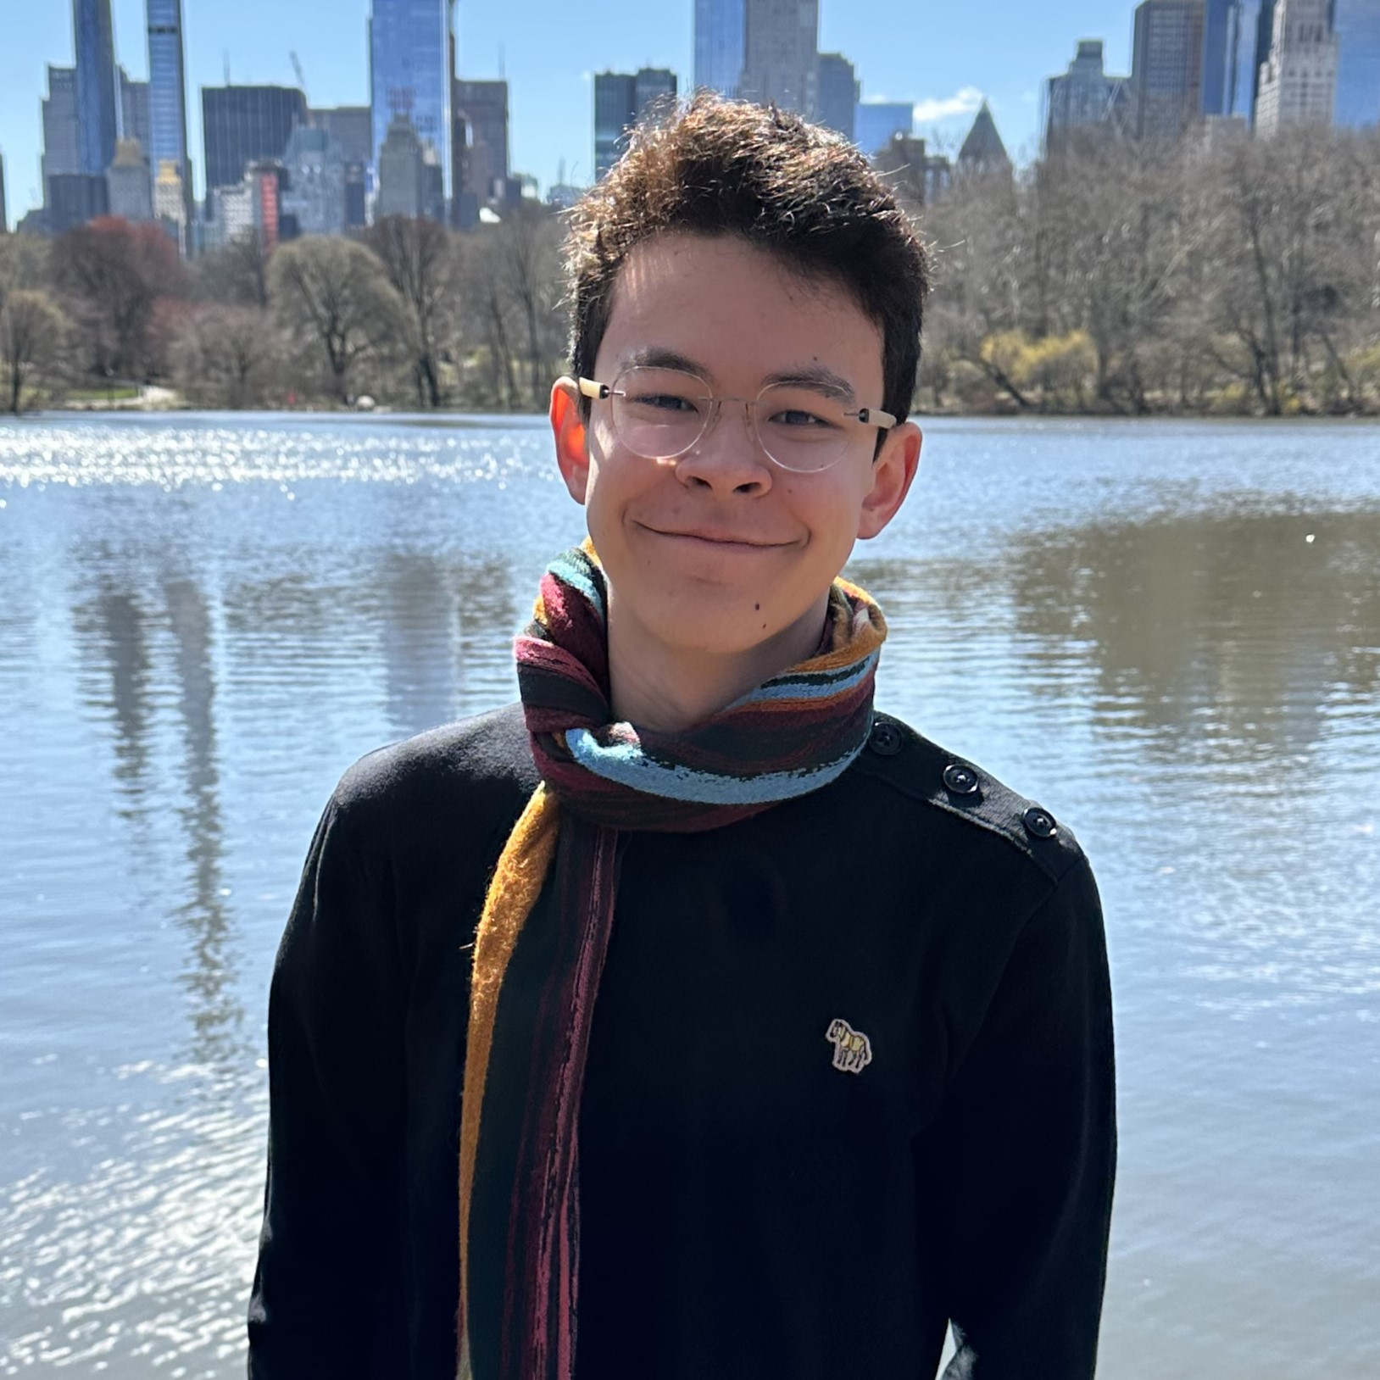
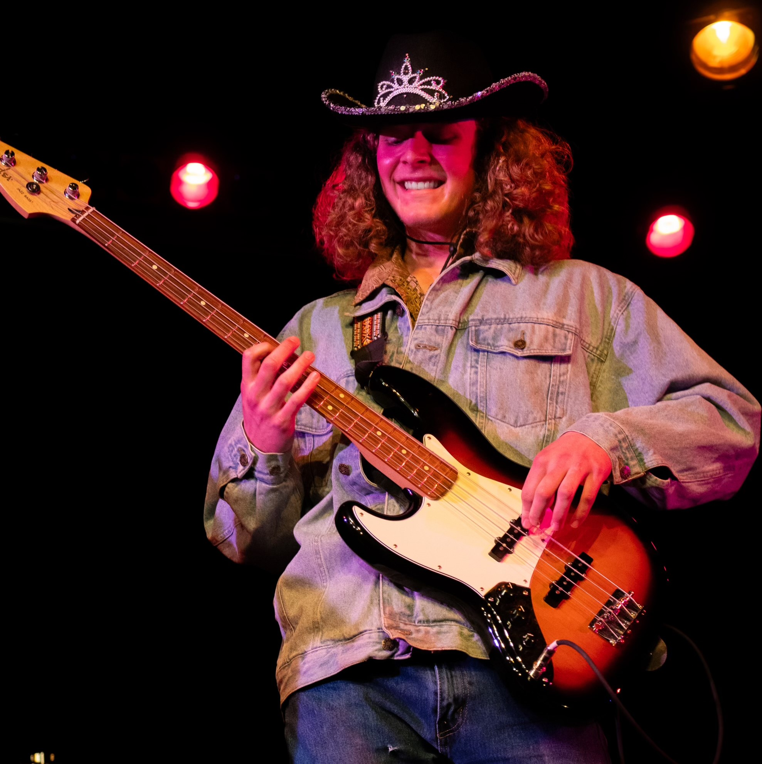
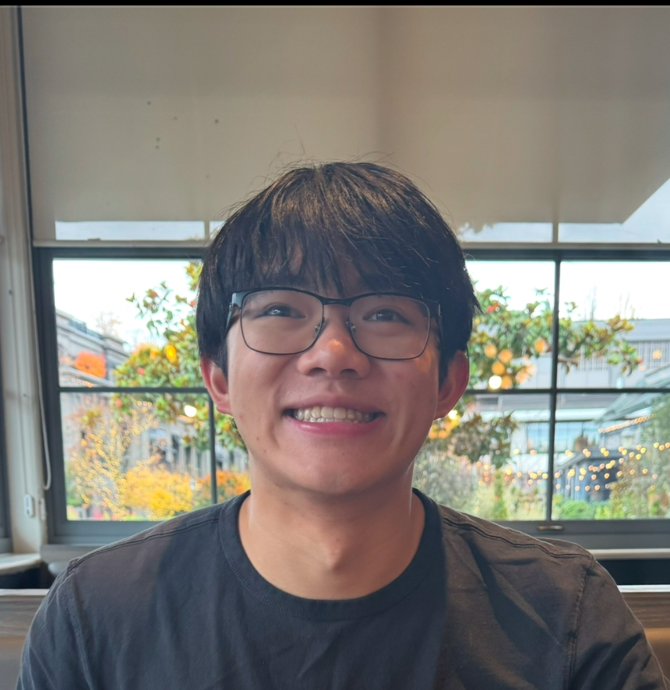
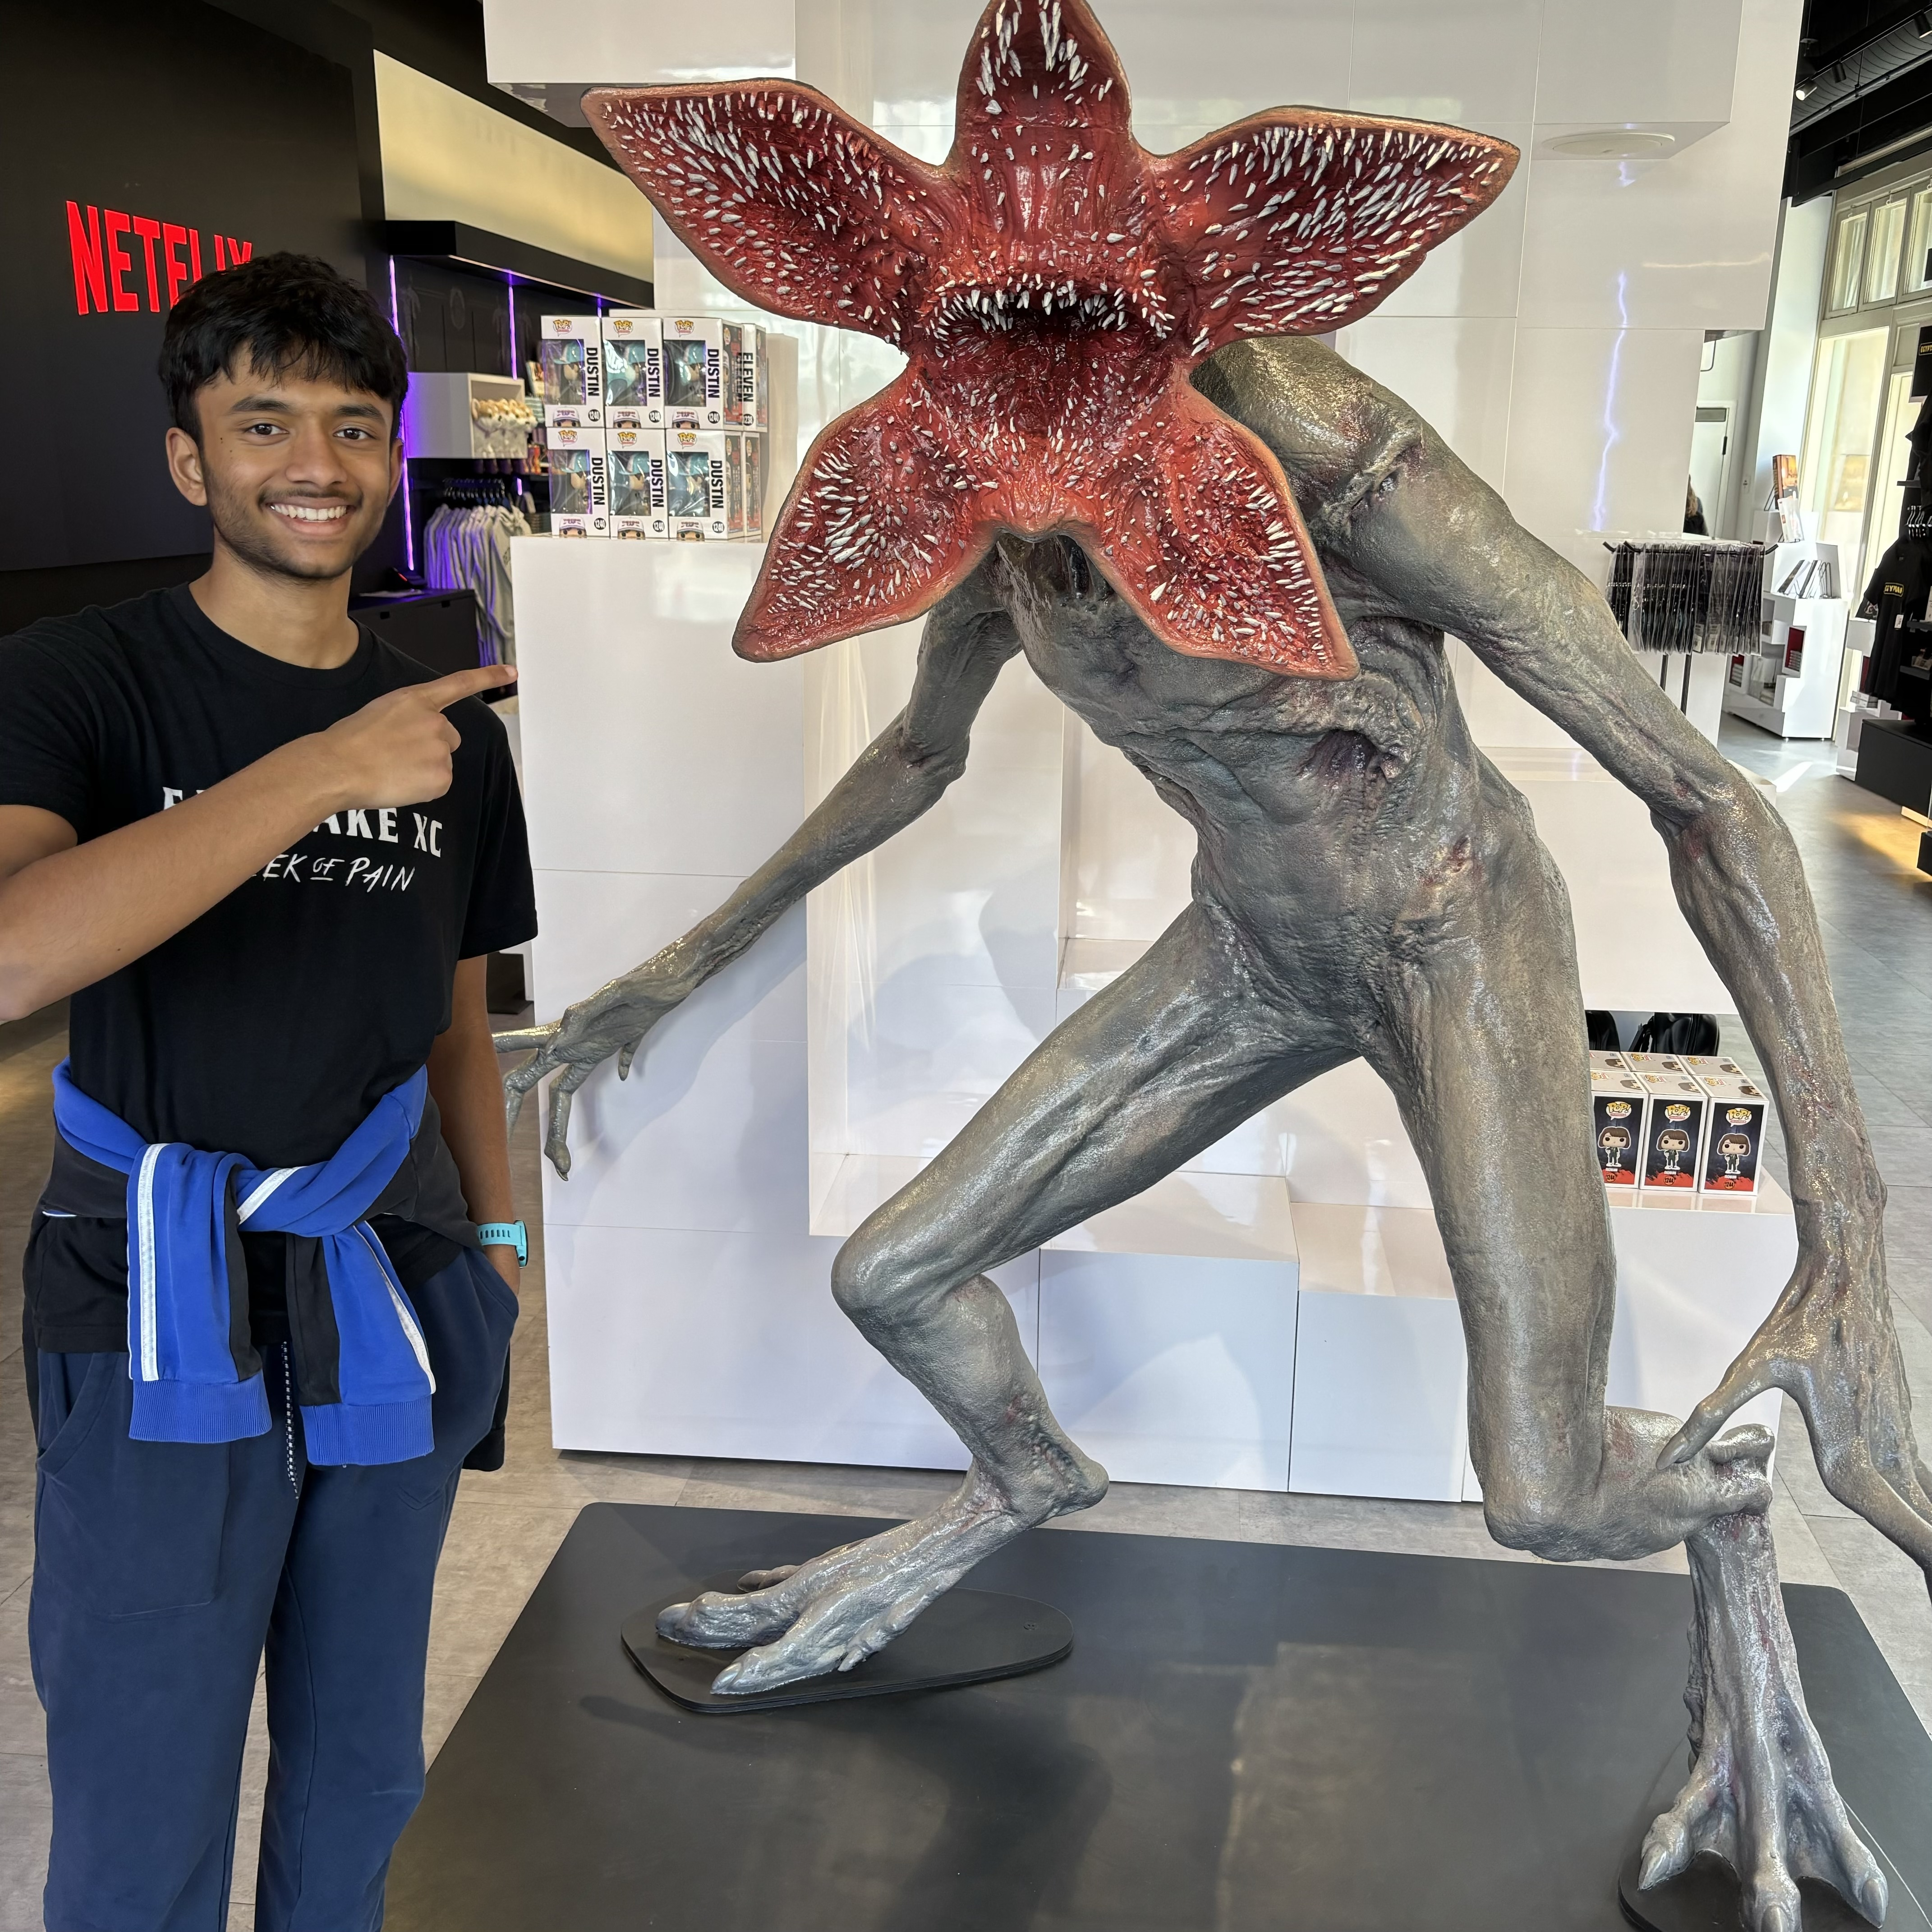
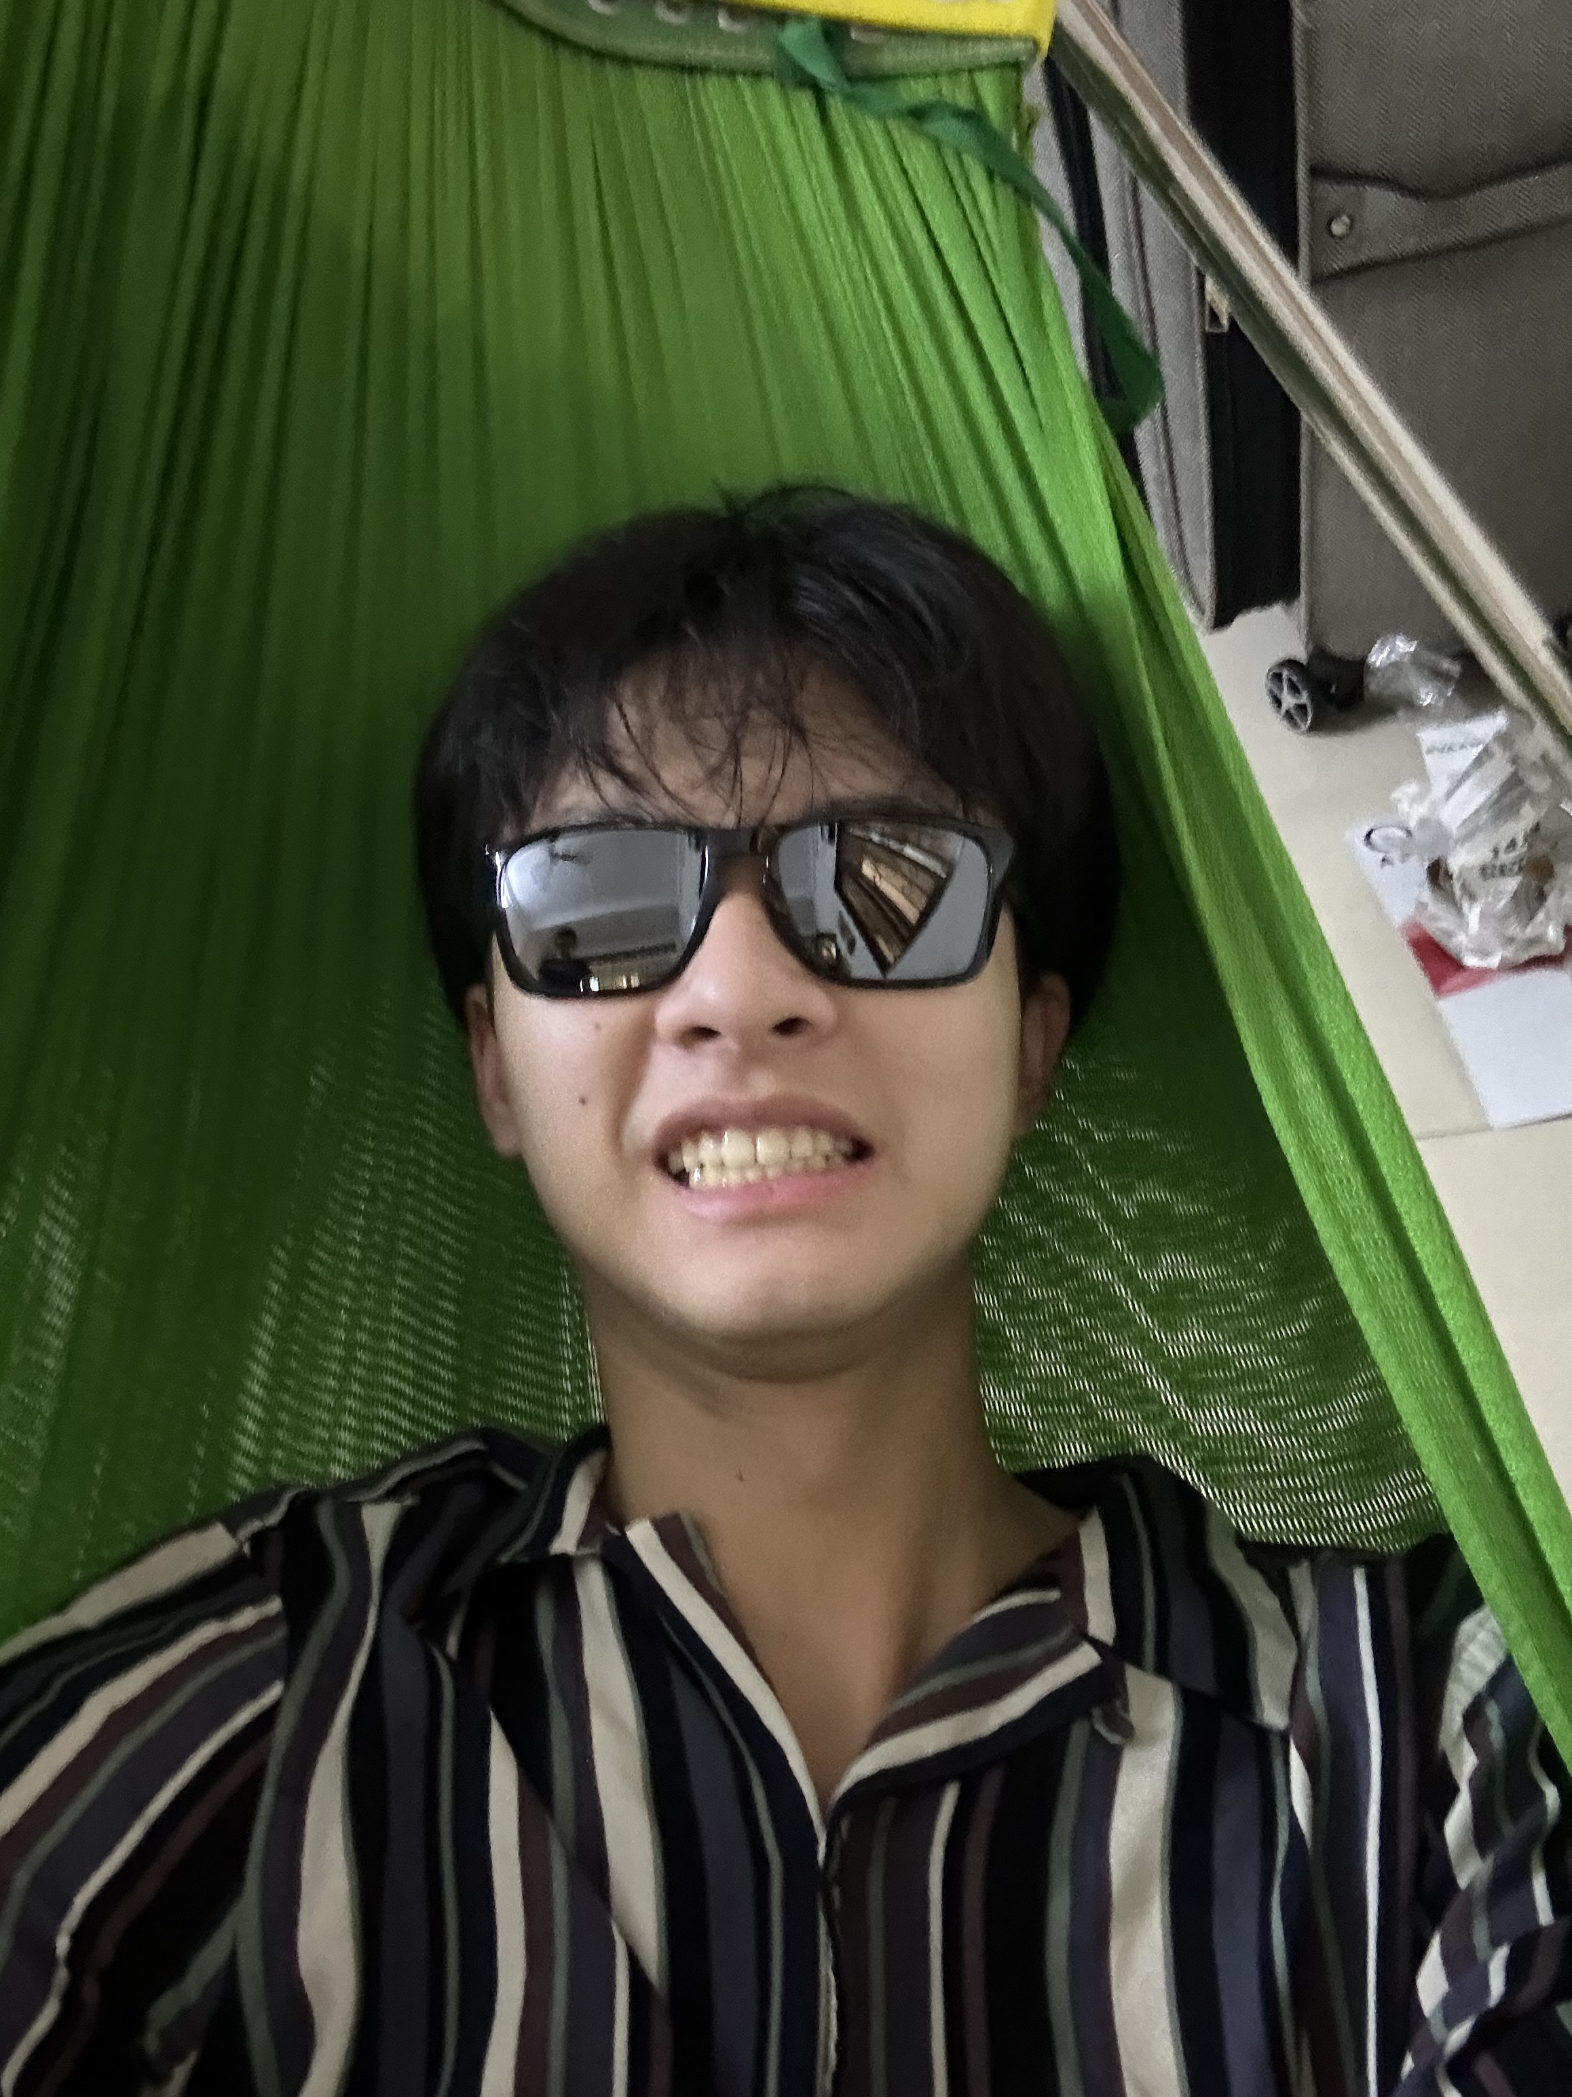
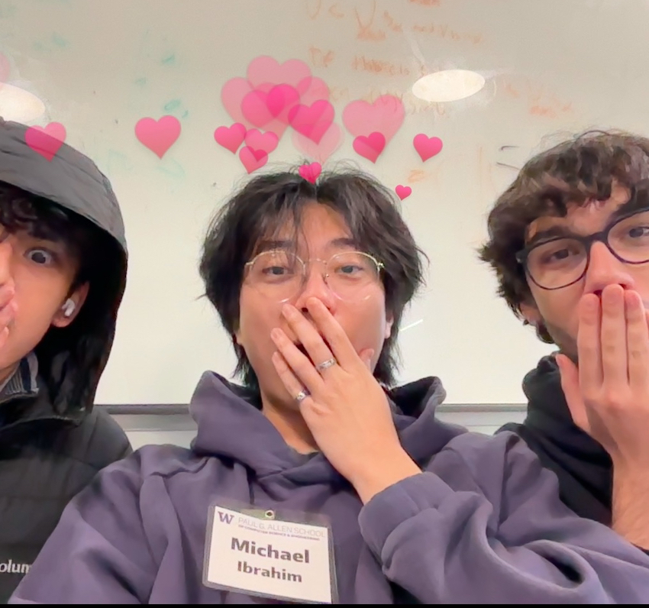
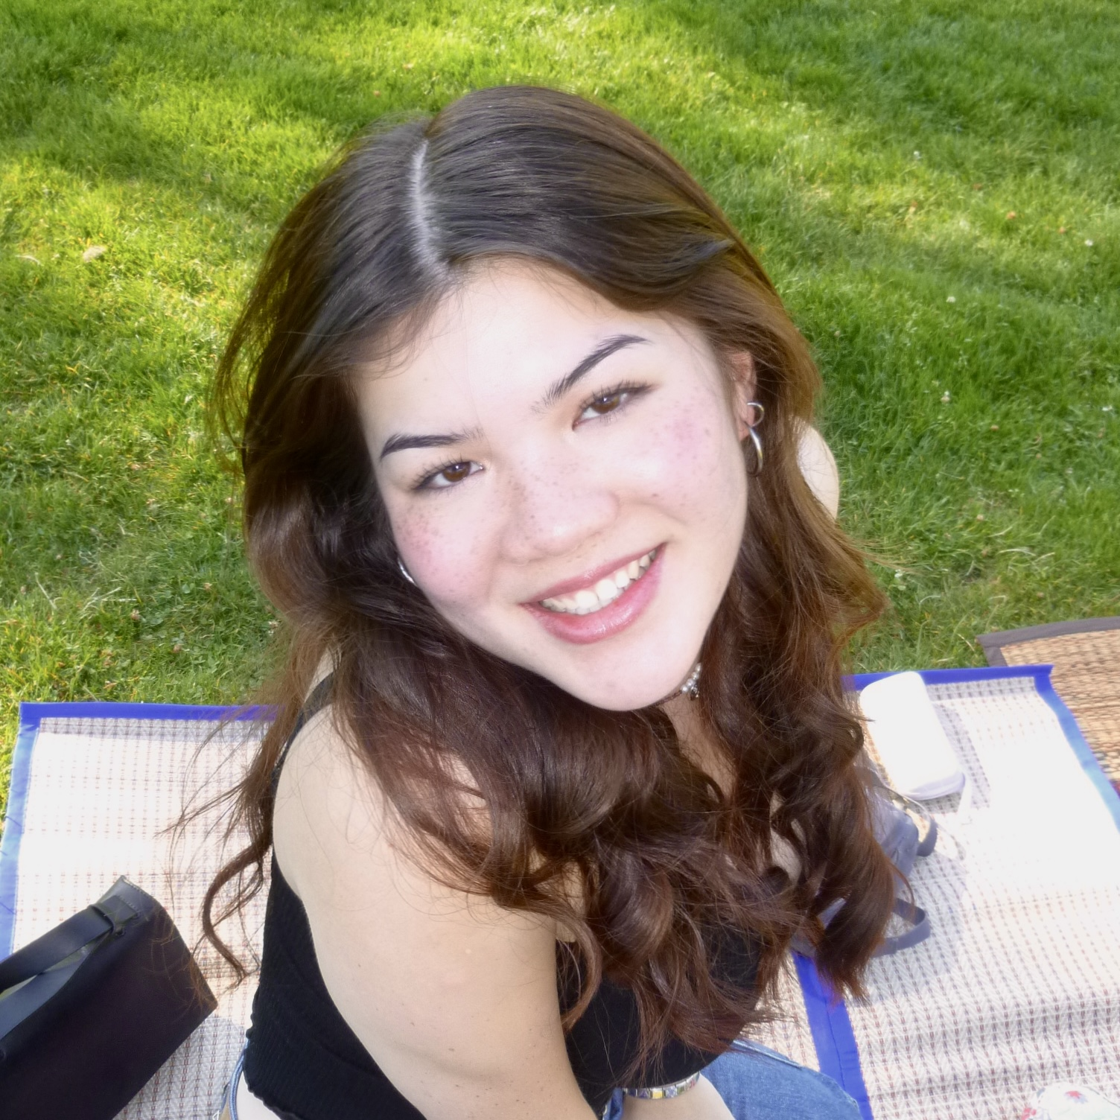
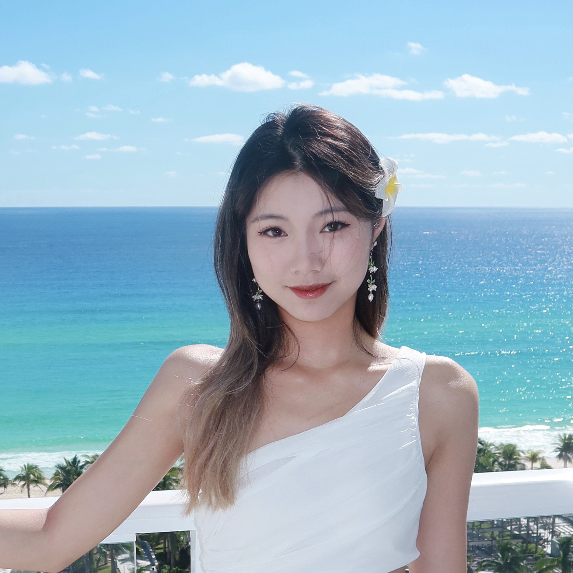
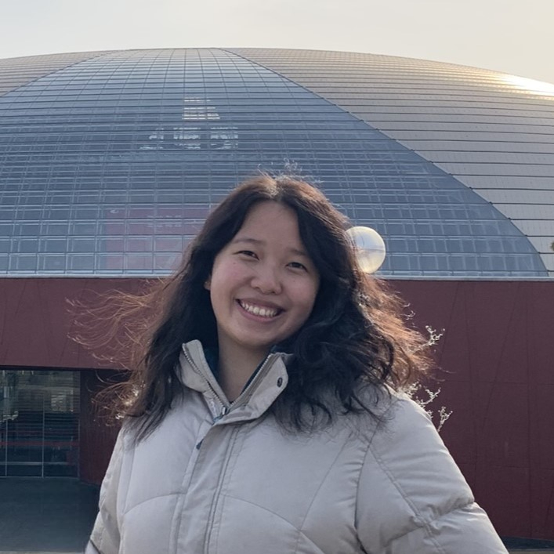
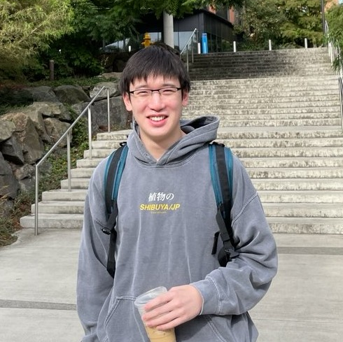
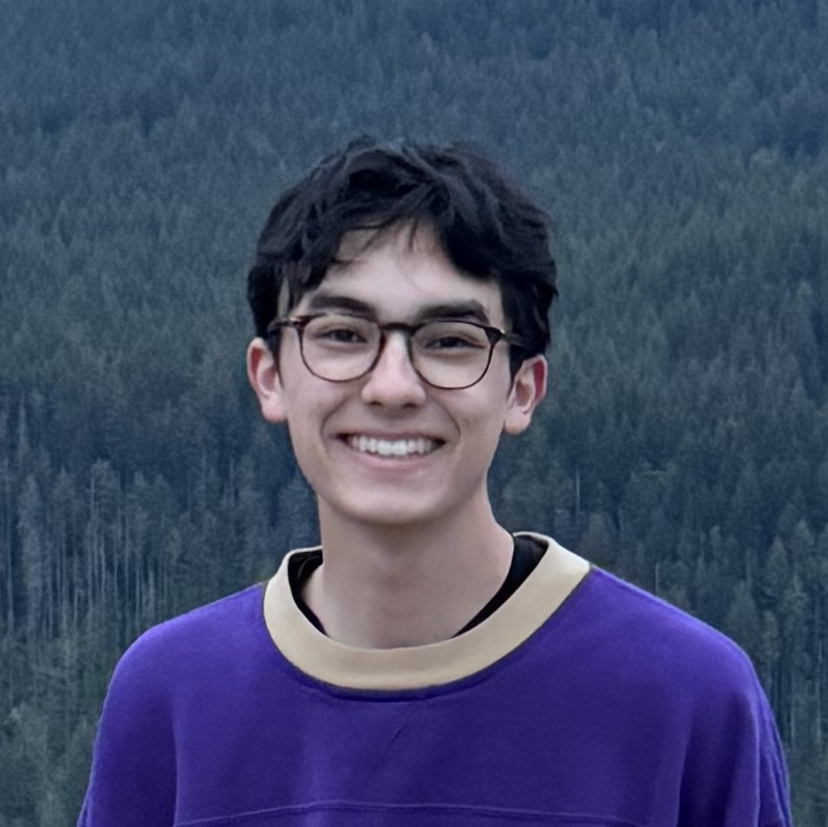
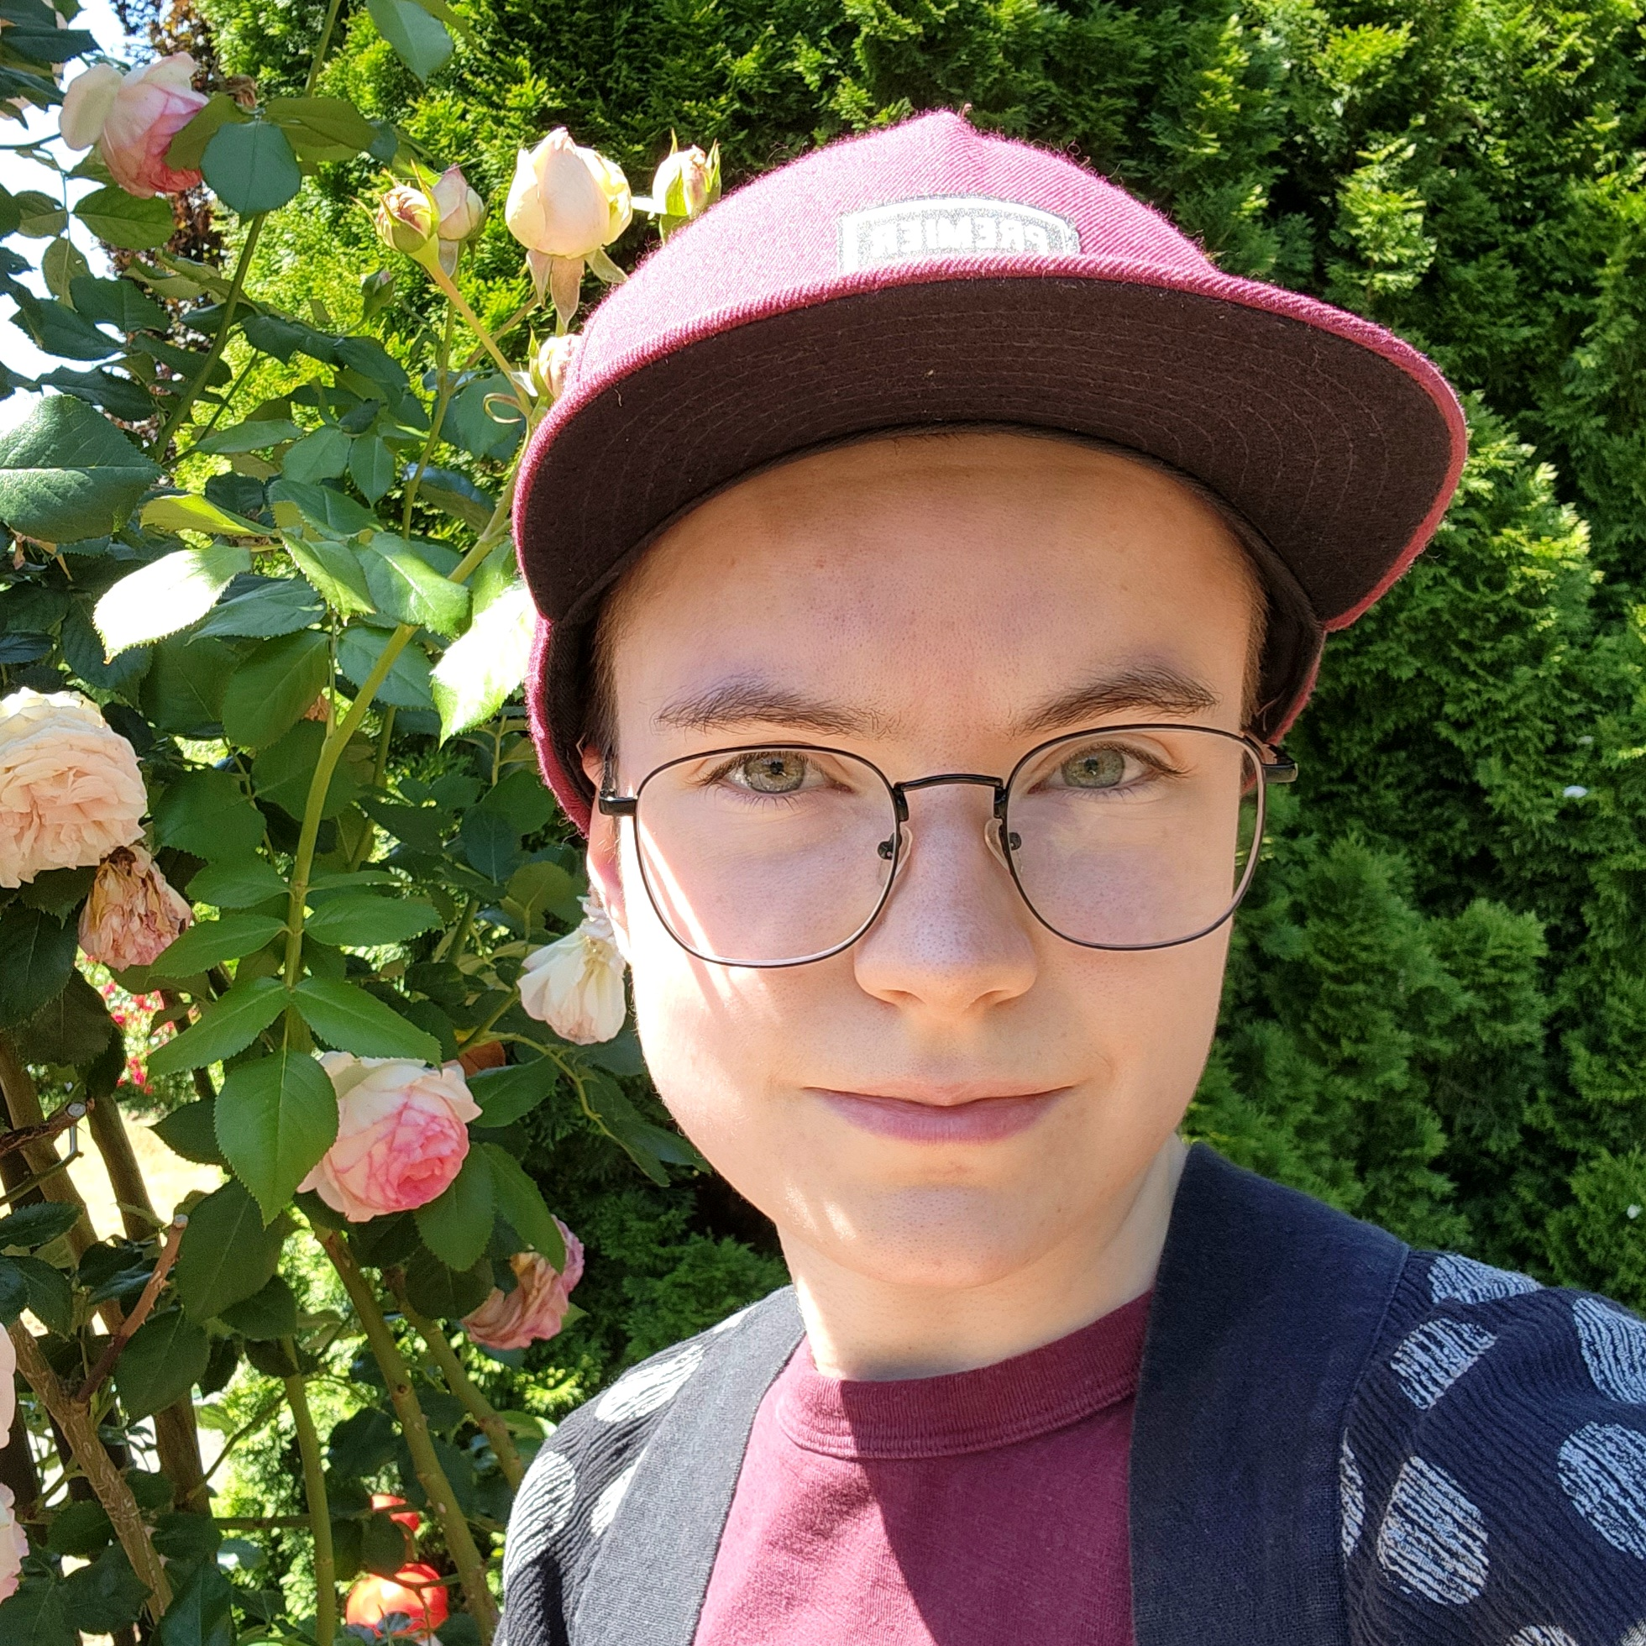
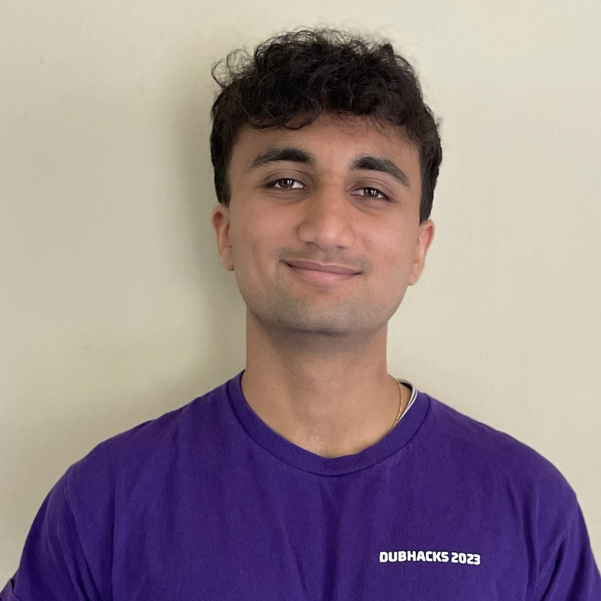
Course Staff
Instructors: Brett Wortzman Miya Natsuhara
Teaching Assistants: 29 Fantastic TAs!
Available in section, office hours, and discussion board
Invaluable source of information & help in this course
We’re excited to get to know you!
Our goal is to help you succeed ☺

Slide 4
What is this Class?
CSE 121 – Computer Programming I
CSE 122 – Computer Programming II
Data types (int, String, boolean)
Methods / Functions
Parameters, Returns
Control structures
Loops, Conditionals
Arrays & 2D arrays
Computational Thinking (language agnostic)
Functional Decomposition
File I/O
Using data structures
List, Stacks / Queues, Sets, Maps
Object Oriented Programming
Interfaces
CSE 123 – Computer Programming III
Advanced Object Oriented Programming
Comparable, Inheritance/Polymorphism, Abstract Classes
Implementing data structures
ArrayLists, LinkedLists, Trees
Recursion
Critical analysis of design

Slide 5
Why 123?
To solve more complex problems by leveraging more complex programming structures / patterns
To better rationalize specific design decisions
How to “best” structure programs
Which data structures are “most” appropriate to use
To understand and critically analyze intersections between Computer Science and society
Search engines, algorithmic art, machine learning, etc.
Developing informed opinions on current issues
Be a better programmer
Be a better person

Slide 6
Prerequisite Knowledge
Comfort with control structures
loops, conditionals, methods/functions
Experience with using basic data structures
arrays, lists, sets, maps
Experience with console and file input/output
Exposure to simple object-oriented programming
classes, interfaces
Programming experience in Java
Or willingness to pick up on your own

Slide 7
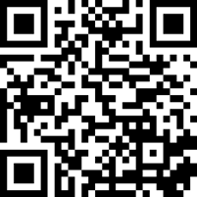
What do you want to get out of this course?
sli.do #cse123

Slide 8
Lecture Outline
Introductions
About this Course
Course Components & Tools
Making the Most of this Class
Assignments and Grading

Slide 9
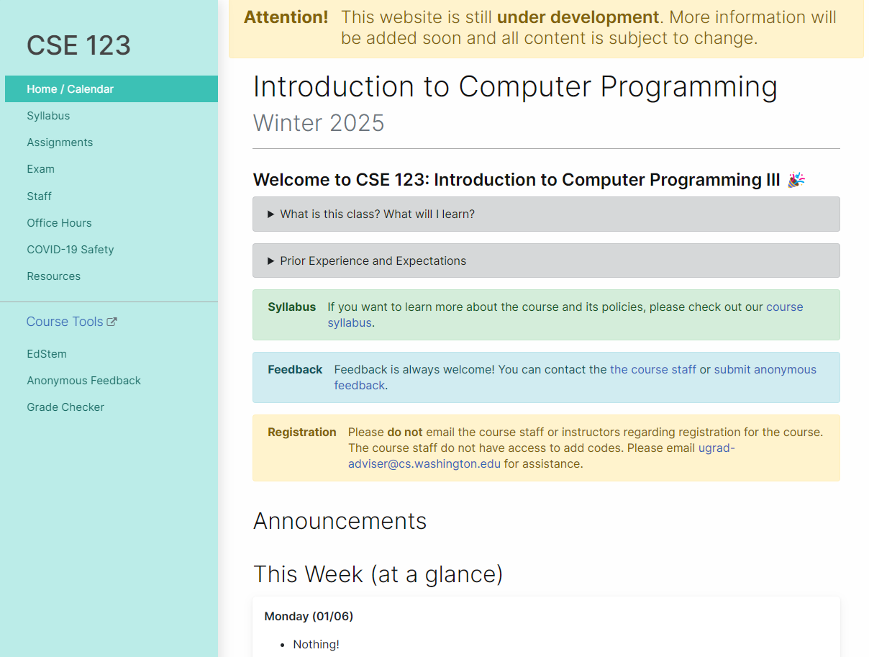
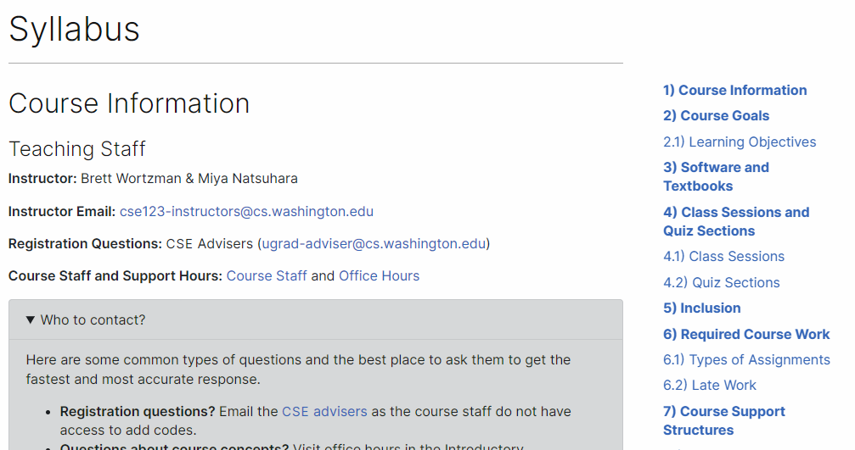
Course Website
cs.uw.edu/123
Review the syllabus!
Contains most course info – check frequently!
Announcements, Calendar, Lecture Slides, Office Hours schedule, Staff Bios, Important Links

Slide 10
Creating an inclusive environment
Video
This is a more professional environment than hanging out with friends
Think about the impact your words can have.
Collaboration, Support, and Empathy
Check your own biases and communicate thoughtfully
Challenge unacceptable behaviors

Slide 11
Other Course Tools
My Digital Hand
Queueing in office hours
VSCode
Develop offline
Visual debugger
Ed
Community & Information
Discussion Board (please ask & answer!; anonymous option)
Announcements
Pre-Class Materials / Section Handouts
Assignments
Online IDE
Submit assignments
View Feedback
Canvas
Lecture recordings
Sli.do
In-class activities (ungraded)
No account needed

Slide 12
Lecture Outline
Introductions
About this Course
Course Components & Tools
Making the Most of this Class
Assignments and Grading

Slide 13
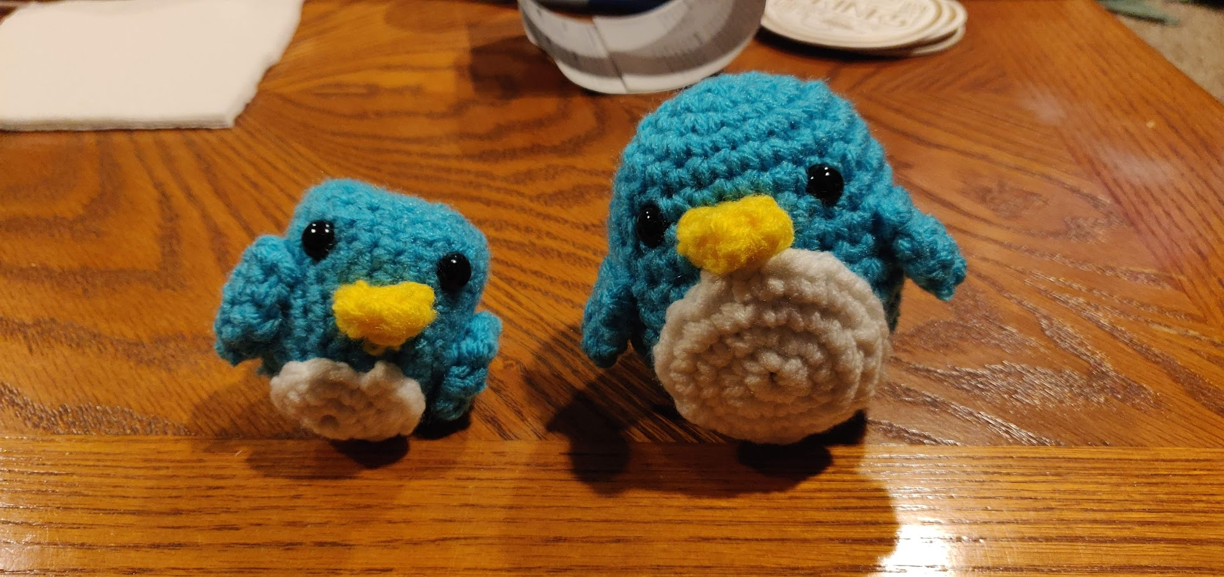
Digression: Brett’s Pandemic Hobby
Amigurumi: Japanese art of creating crocheted or knitted stuffed toys
Notes:
Brett
THIS was my first penguin.
I did everything “right”: followed instructions, looked for resources, paid attention. But I still made mistakes.
We don’t learn by watching, listening, or reading; we learn by DOING! And we almost always make mistakes along the way. Don’t expect to just show up to class, watch and listen, and get things exactly right the first time. Plan to engage, practice, and make mistakes.

Slide 14
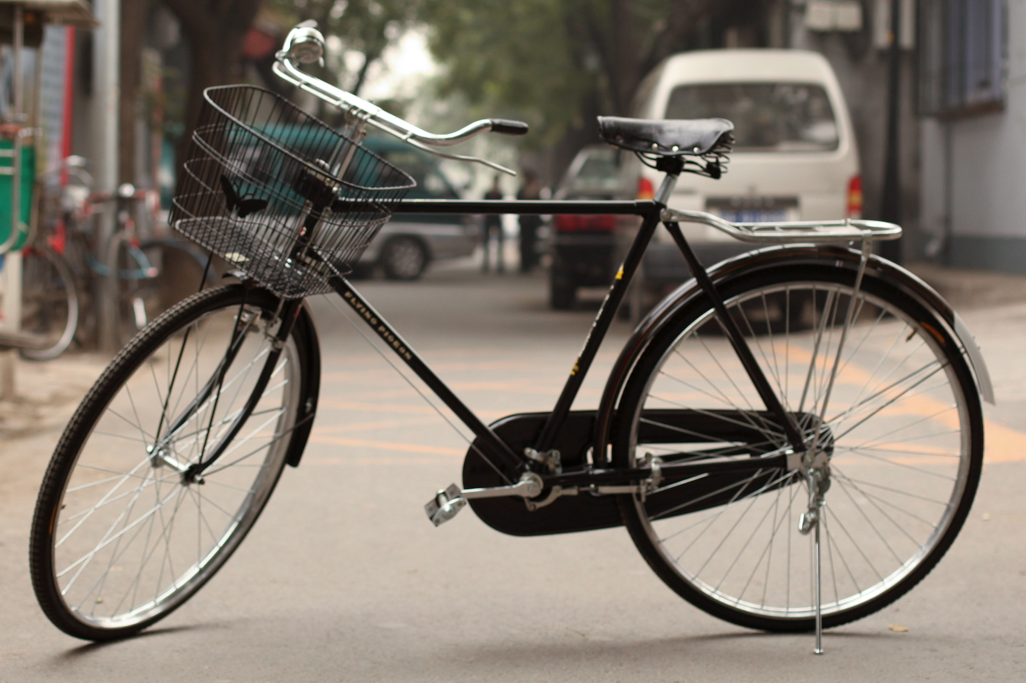
How Learning Works
Learning requires active participation in the process. It’s not as simple as sitting and listening to someone talk at you.
Requires deliberate practice in learning by doing
Benefits from collaborative learning
Hybrid classroom model
Asks you to do some preparation before class in the form of readings and practice problems.
Should take ~30 minutes outside of class per lesson
Class will start with brief recap, then pick up where the reading and practice problems leave off.
Attendance isn’t graded, but showing up and trying is the first step in succeeding in the class!
Pre-class materials are ungraded, but…
It’s okay if you find them challenging! That means you are learning!

Slide 15
Getting Help
Discussion Board
Feel free to make a public or private post on Ed
We encourage you to answer other peoples’ questions! A great way to learn
Introductory Programming Lab (Office Hours)
TAs can help you face to face in office hours, and look at your code
You can go to the IPL with any course questions, not just assignments
Section
Work through related problems, get to know your TA who is here to support you
Your Peers
We encourage you to form study groups! Discord or Ed are great places to do that
Email
We prefer that all content and logistic questions go on the Ed discussion board (even if you make them private). Many more students than staff!
For serious personal circumstances, you can email Miya/Brett directly. It never hurts to email us, but if it’s a common logistic question, we may politely ask you to post on the discussion board instead.

Slide 16
Lecture Outline
Introductions
About this Course
Course Components & Tools
Making the Most of this Class
Assignments and Grading

Slide 17
Assignments and Grading
Our goal in the course is for you to gain proficiency the concepts and skills we teach
We assess your proficiency by asking you to apply the concepts and skills on tasks or problems
By necessity, we are assessing your work as a proxy for your proficiency

Slide 18
Assignments
Your learning in this course will be assessed in four ways:
Programming Assignments (~biweekly, 4 total)
Structured programming assignments to assess your proficiency of programming concepts
Creative Projects (~biweekly, 4 total)
Smaller, more open-ended assignments to give you space to explore
Quizzes (3 total, in section)
Series of problems covering all material up to that point
Final Exam (Tuesday, March 18)
Final, culminating assessment of all your skills and knowledge

Slide 19
Resubmission and Ignored Quiz Problems
Learning takes time, and doesn’t always happen on the first try
One previous Programming Assignment or Creative Project can be resubmitted each week
Must be accompanied by a write-up describing changes (via Google Form)
Grade on resubmission will replace original grade
An assignment can be resubmitted in the 3 cycles after feedback has been published
Tip: Resubmit as early as possible!
We will ignore your two lowest quiz problem grades
No special action required– we’ll do this automatically
See the syllabus for more details

Slide 20
Grading
Grades should reflect your proficiency in the course objectives
All assignments will be graded E (Excellent), S (Satisfactory), or N (Not yet)
Under certain circumstances, a grade of U (Unassessable) may be assigned
Final grades will be assigned based on the amount of work at each level
See the syllabus for more details

Slide 21
Collaboration Policy
When we assess your work in this class, we need to know that it’s yours.
Unless otherwise specified, all graded work must be completed individually.
Some specific rules to highlight:
do not share your own solution code or view solution code from any source – including but not limited to other students, tutors, or the internet
do not use AI tools (e.g. ChatGPT) on graded work in any capacity
See the syllabus for more details (this is very important to understand).

Slide 22
Coming up…
🧑‍🏫 Go to your first quiz section and meet your TAs tomorrow!
Make sure to double check MyUW for the location.
💻 Complete Pre-Class Work 1 before class on Friday!
It will be posted and linked from the course calendar later today.
❓ Complete the Introductory Survey
This helps us gather data about the students taking our classes and their backgrounds, to inform future offerings.
🙋 Consider attending the Review Session on Monday, Jan 13
12:30pm – 1:20pm in ARC 147 ; 2:30pm – 3:20pm in GUG 220
Optional, hopefully recorded (waiting for confirmation)

